Slide 1
SPECIAL TOPIC - divine names, Week 10
Ghaffar vs Tawwab - and why 110:3 names the Returner
Two intensive Names, two different acts - covering vs returning
Both Ghaffar and Tawwab are intensive Divine Names. Are they synonyms? And why does 110:3, after the command 'seek forgiveness' (istaghfir), name God Tawwab - not the more 'natural' Ghaffar? We record the Name each is PAIRED with and the roots in its ayah.
Counts and pairings recompute from Book6; Ghaffar pairs with the Mighty, Tawwab with the Merciful.

Slide 2
The question, and the method
The claim to test
Are Ghaffar and Tawwab synonyms - and why does Sura al-Nasr (110:3) name the Returner?
The method
- collect every occurrence of each Name; record its paired Name and ayah-roots
- distinguish ghafr (to cover - unilateral) from tawb (to turn/return - bilateral)
- read 110:3 in its own context (victory, people entering in crowds)

Slide 3
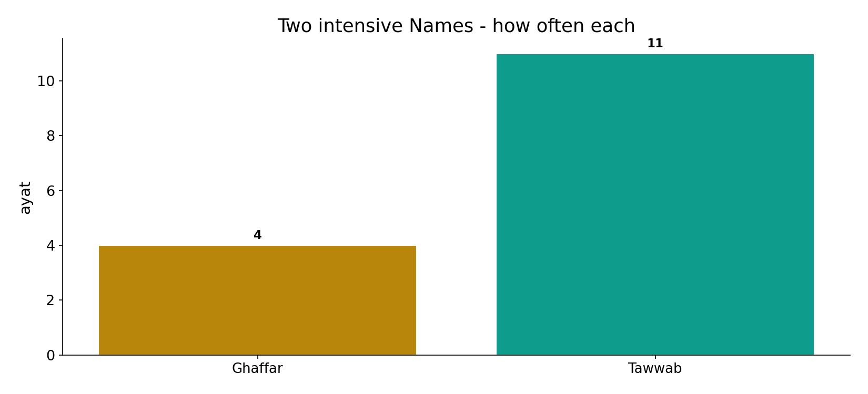
Two intensive Names
In the data - Ghaffar (4) and Tawwab (11) are both rare intensives, but they keep different company.

Slide 4
Ghaffar - covering, with might
the text's own words (address - snippet - gloss):
39:5 أَلَا هُوَ الْعَزِيزُ الْغَفَّارُ - GHAFFĀR pairs with might: al-ʿAzīz
20:82 وَإِنِّي لَغَفَّارٌ لِّمَن تَابَ وَآمَنَ وَعَمِلَ - GHAFFĀR for the one who turns (tāba)
71:10 رَبَّكُمْ إِنَّهُ كانَ غَفَّارًا - istighfār → He is Ghaffār

Slide 5
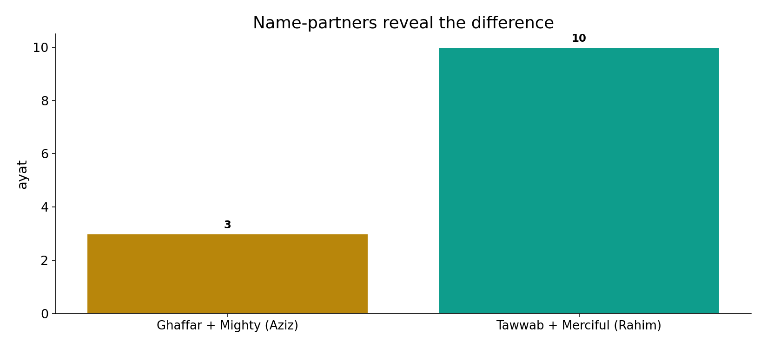
Their partners differ
In the data - Ghaffar pairs with the Mighty (Aziz, 3); Tawwab pairs with the Merciful (Rahim, 10). Might vs mercy.

Slide 6
What the data shows
Ghaffar - covers, with might
4 occurrences; pairs with the Mighty (Aziz, 3). About erasing SIN - a sovereign concealing faults.
Tawwab - returns, with mercy
pairs with the Merciful (Rahim, 10). Bilateral: 'He turned to them so they would turn' (9:118) - a relationship restored.
Why Tawwab in 110:3
al-Nasr is about RETURN, not sin - the scene calls for the God who receives the turning, not merely one who conceals faults.

Slide 7
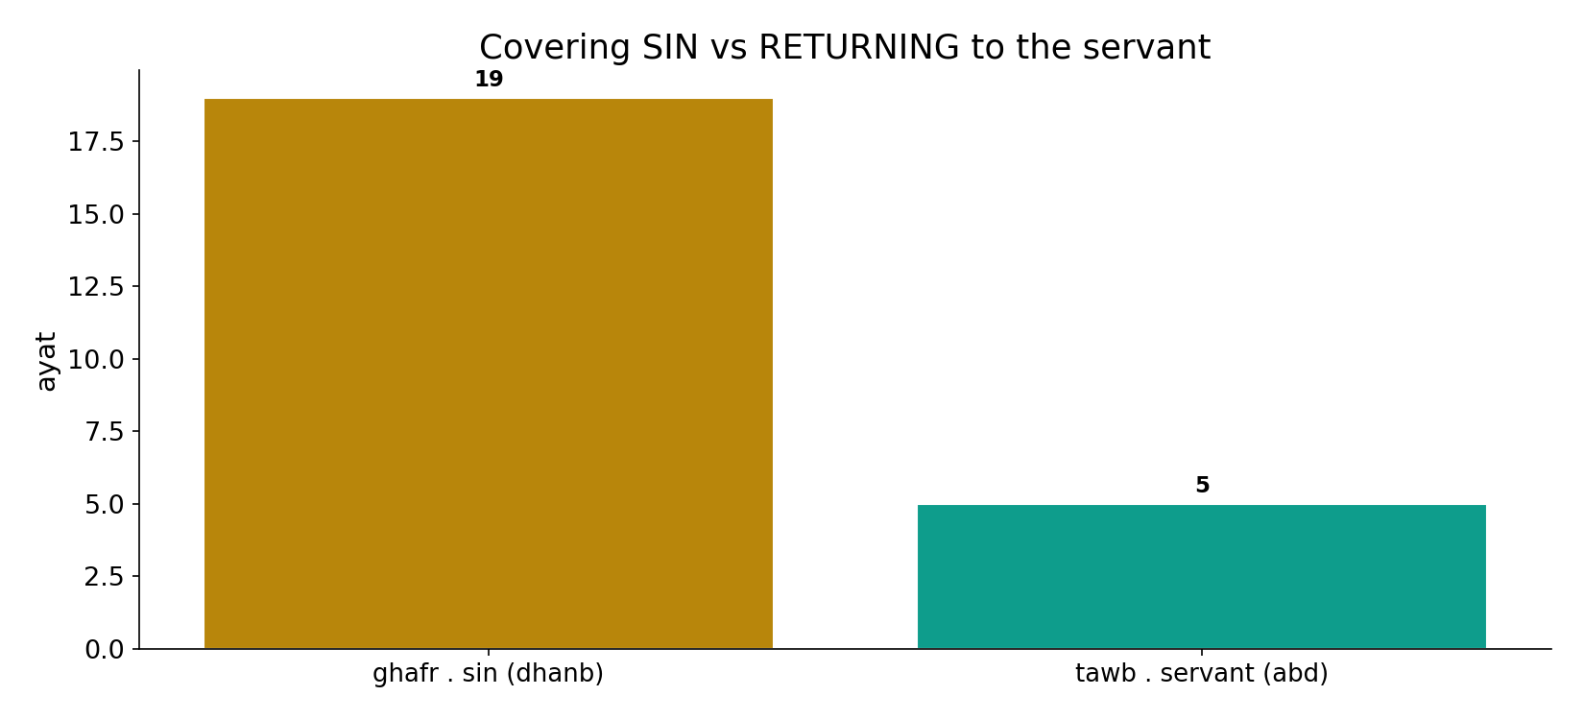
Covering sin vs returning to the servant
In the data - the covering-root sits with SIN (dhanb, 19); the turning-root sits with the SERVANT (abd, 5): erasing a fault vs restoring a bond.

Slide 8
Tawwab - returning, with mercy; and 110:3
the text's own words (address - snippet - gloss):
2:37 عَلَيْهِ إِنَّهُ هُوَ التَّوَّابُ الرَّحِيمُ - TAWWĀB pairs with mercy: al-Raḥīm
9:118 إِلاَّ إِلَيْهِ ثُمَّ تَابَ عَلَيْهِمْ لِيَتُوبُواْ إِنَّ اللّهَ - He turned to them so they would turn
110:3 وَاسْتَغْفِرْهُ إِنَّهُ كانَ تَوَّابًا - …seek His forgiveness; He is ever-Returning

Slide 9
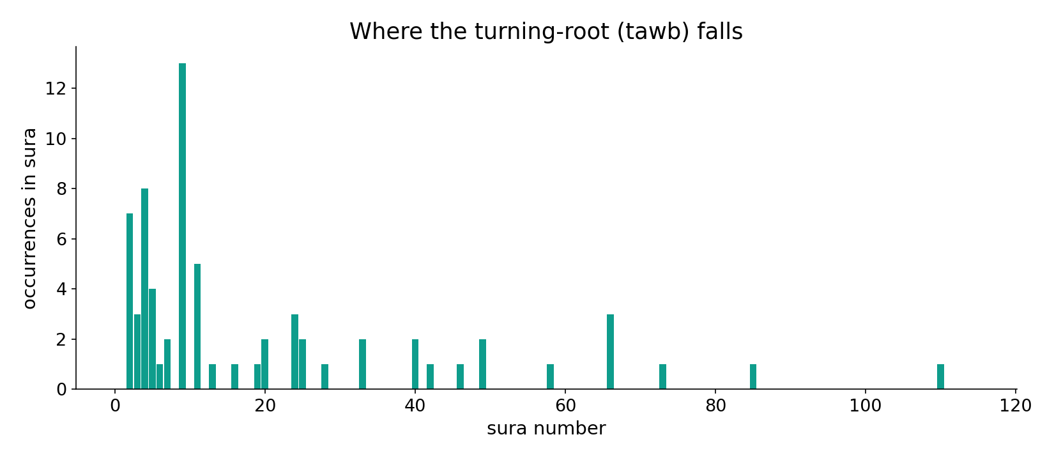
The turning-root across the corpus
In the data - the turning-root (tawb) clusters in the repentance and relationship passages - 'He turned to them so they would turn' (9:118).

Slide 10
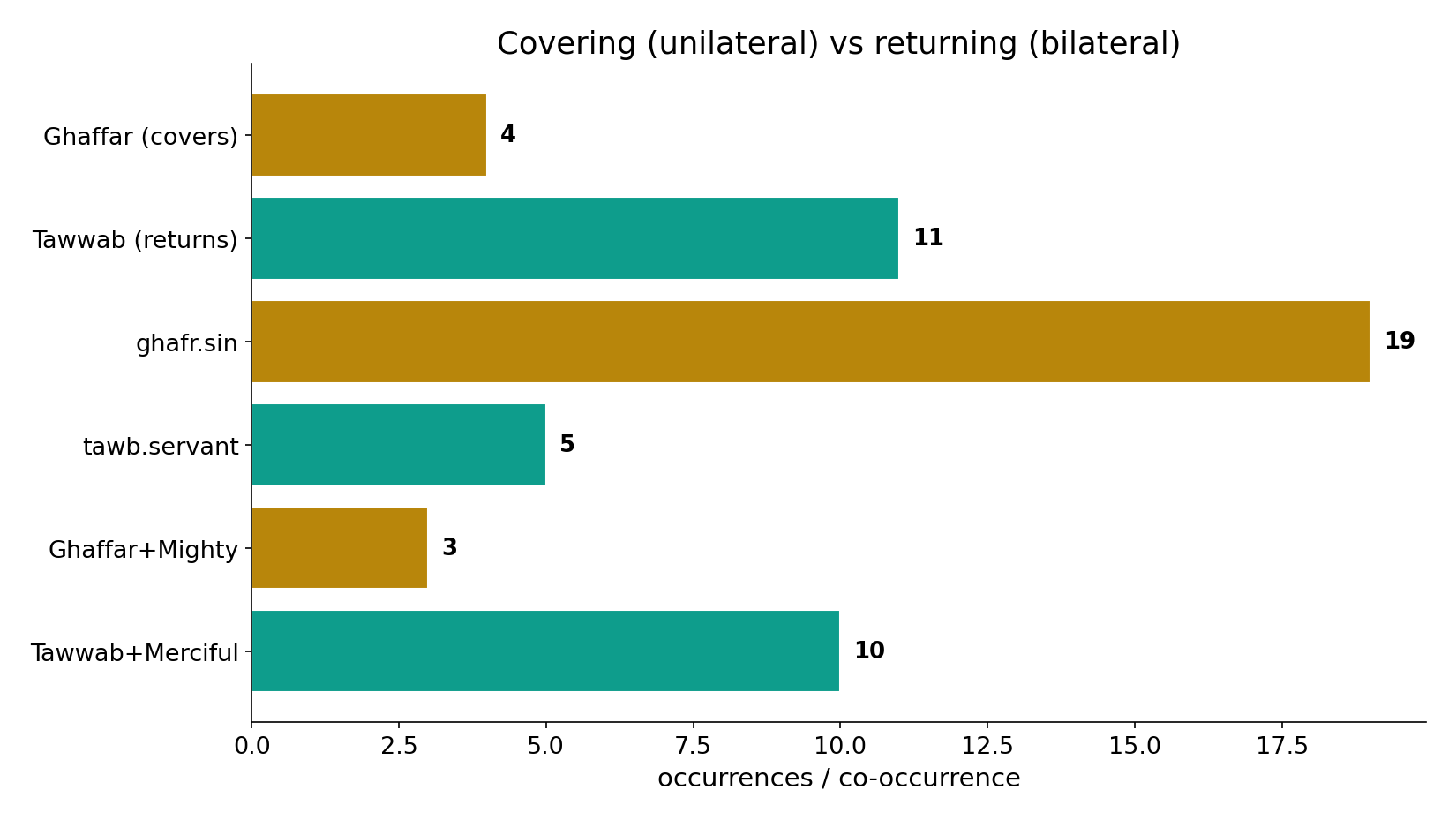
Unilateral vs bilateral
In the data - Ghaffar covers (a sovereign concealing faults, with Might 3); Tawwab returns (a bond restored, with Mercy 10). The Names are not synonyms.

Slide 11
The latent nuance of 110:3
The command uses istaghfir (seek COVERING, from ghafr); the Name given is Tawwab (the ever-RETURNING). The verse pairs a request for covering with a God who turns BACK to you - more than a cover, a restored bond. Why not Ghaffar? Sura al-Nasr is not about sin - it is about RETURN: victory won, the mission's end, people entering the religion 'in crowds.' The scene calls for the God who receives the turning.
Ghaffar pairs with might, Tawwab with mercy - computed company, not assumption.

Slide 12
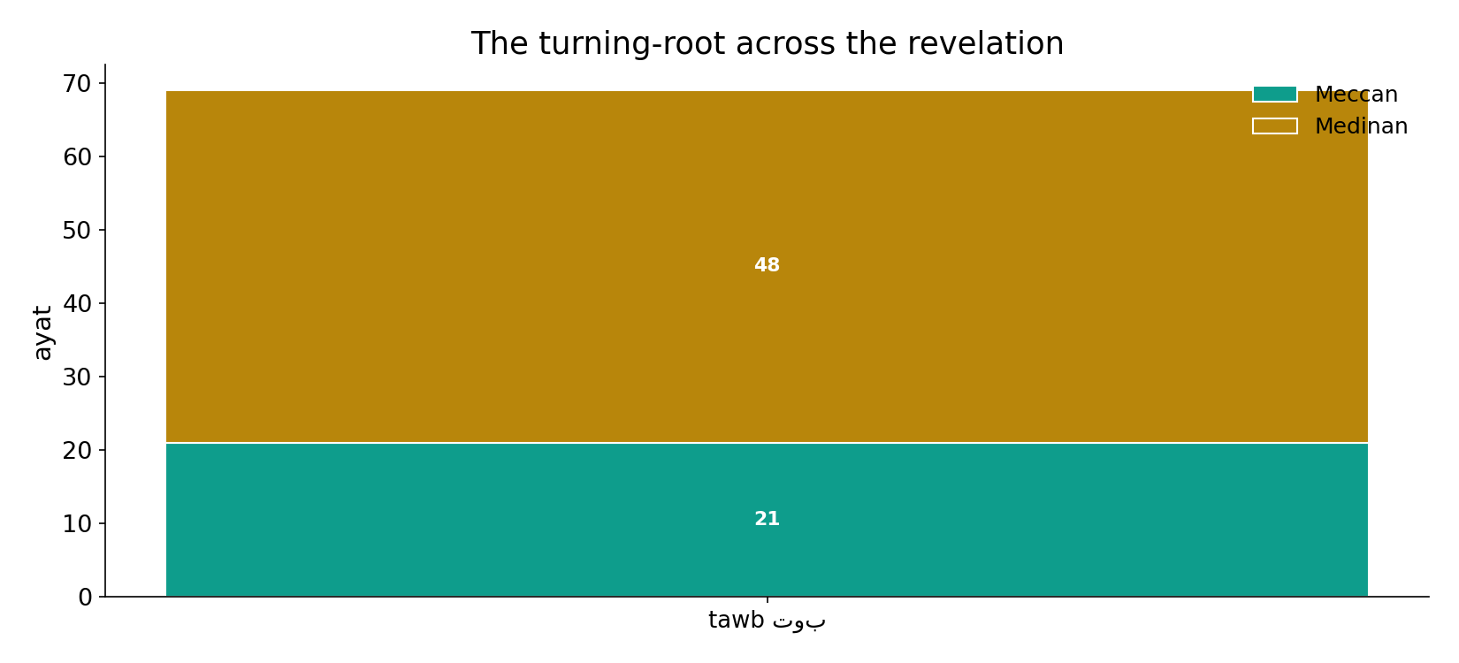
Across the revelation
In the data - the turning-root runs throughout, naming the mutual turning of servant and Lord.

Slide 13
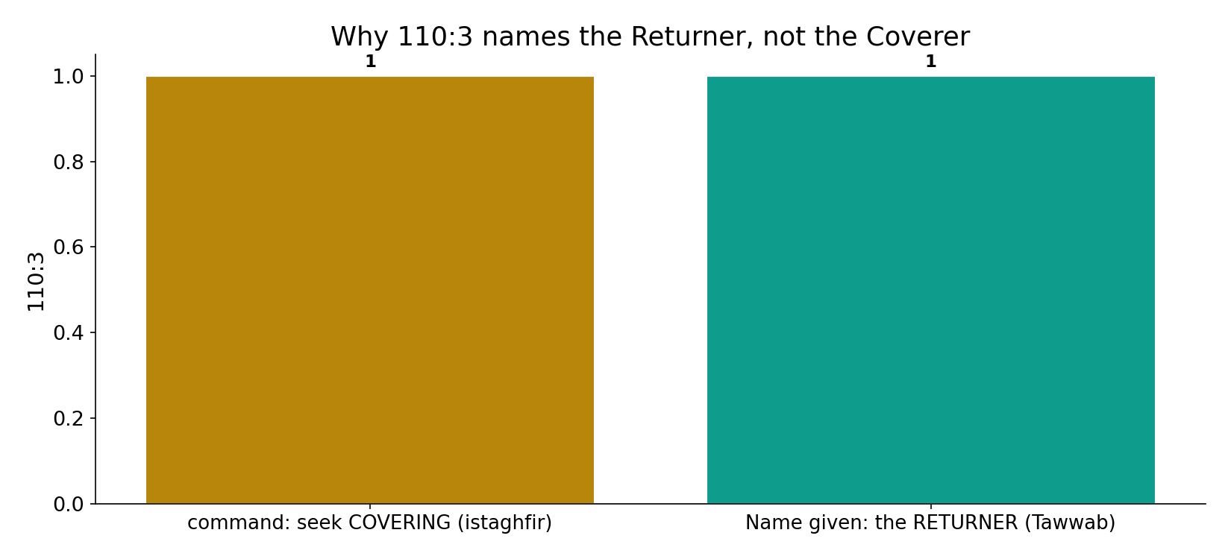
Why 110:3 names the Returner
In the data - 110:3 commands seeking COVERING (istaghfir) yet names God the RETURNER (Tawwab): Sura al-Nasr is about RETURN - victory won, people entering 'in crowds' - not about sin.

Slide 14
Cover vs return
Ghaffar
covers a fault - with Might
Tawwab
returns to you - with Mercy
110:3
al-Nasr = return, so the Returner
Not synonyms
Ghaffar conceals the fault; Tawwab restores the bond - and al-Nasr's scene calls for the Returner.

Slide 15
Honest limits and critique
A reading of placement
this is a reading of collocation and context, not a proof; Tawwab also rhymes the sura's cadence - a formal echo, not the cause.
But the company is computed
Ghaffar+Mighty (3) vs Tawwab+Merciful (10) is computed from Book6, not assumed - the might/mercy contrast is real.

Slide 16
Reading this honestly - the audit
✓ Names counted
Ghaffar 4, Tawwab 11.
✓ Partners computed
Ghaffar+Mighty 3, Tawwab+Merciful 10.
✓ Roots computed
ghafr+sin 19, tawb+servant 5.
~ 110:3 is a reading
of placement and collocation, not a proof.
✗ Not a proof
counts/co-occurrence locate the text's data; the equity verdict is interpretive.
✗ No raw mixing
forms/senses separated before counting (course rule).

Slide 17
How this was computed (reproducible)
Book6
the two intensive Names; partners & roots
measure
frequency, paired Name, ayah-roots
figures
frequency bars, partner bars, root bars, sura map
count
chart
Fully reproducible
Every figure recomputes from Book6.xlsx via the shared wk.py kernel (fixed seed). Roots are normalized (Persian/Arabic letter variants folded) so counts are stable; surface forms are used wherever a concept must be kept apart from its root family (per the course's sense-verification rule).

Slide 18
Appendix - input snippets (Book6, vocalized)
verbatim snippets with addresses:
39:5 أَلَا هُوَ الْعَزِيزُ الْغَفَّارُ - GHAFFĀR pairs with might: al-ʿAzīz
20:82 وَإِنِّي لَغَفَّارٌ لِّمَن تَابَ وَآمَنَ وَعَمِلَ - GHAFFĀR for the one who turns (tāba)
71:10 رَبَّكُمْ إِنَّهُ كانَ غَفَّارًا - istighfār → He is Ghaffār

Slide 19
Takeaway
Covering vs returning - and why al-Nasr chose the Returner
Ghaffar (covers, with Might 3) and Tawwab (returns, with Mercy 10) are not synonyms.
110:3 commands seeking covering yet names the Returner - because al-Nasr is about RETURN (victory, the mission's end), not sin.
A reading of placement and computed company - not a proof. Presented from the text.

Slide 20
Quick reference
The numbers
Ghaffar 4 (+Mighty 3) - Tawwab 11 (+Merciful 10); ghafr+sin 19, tawb+servant 5.
The shape
Ghaffar = covering (unilateral, with might); Tawwab = returning (bilateral, with mercy); 110:3 names the Returner because al-Nasr is about return.

