Slide 1
SPECIAL TOPIC - forms & meaning, Week 10
Ghafr - what kind of 'forgiveness'?
A word that means COVERING - twinned with mercy, opening onto more
The forgiveness-root is read variously as 'forgive', 'cover/conceal', even 'promote in status.' Which does the corpus carry? We tally every surface form, separate the Divine-Name intensives from the verbs, and test what the root shares its ayah with - sin? mercy? garden?
Counts and co-occurrences recompute from Book6 and reproduce exactly; the concrete root-sense is a helmet that COVERS the head.

Slide 2
The question, and the method
The claim to test
Is the forgiveness-root primarily 'covering a fault', 'status promotion', or something else?
The method
- tally every surface form; separate the Names from the verbs
- test what the root co-occurs with - sin, mercy, garden
- locate the meaning empirically, anchored by the concrete root-sense (to cover)

Slide 3
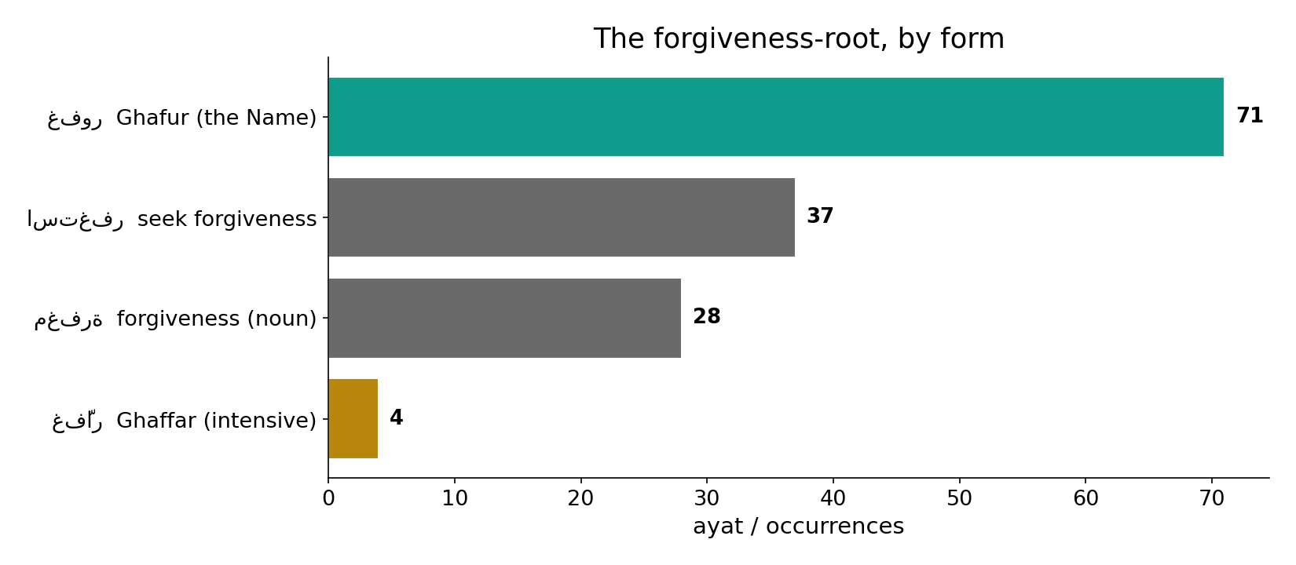
The root, by form
In the data - the dominant form is the Name Ghafur (71); seek-forgiveness (37) and the noun (28) follow; the intensive Ghaffar is rare (4).

Slide 4
Covering a sin
the text's own words (address - snippet - gloss):
3:135 فَاسْتَغْفَرُواْ لِذُنُوبِهِمْ وَمَن يَغْفِرُ الذُّنُوبَ إِلاَّ اللّهُ وَلَمْ - who forgives sins but God
71:10 رَبَّكُمْ إِنَّهُ كانَ غَفَّارًا - seek forgiveness — He is Ghaffār

Slide 5
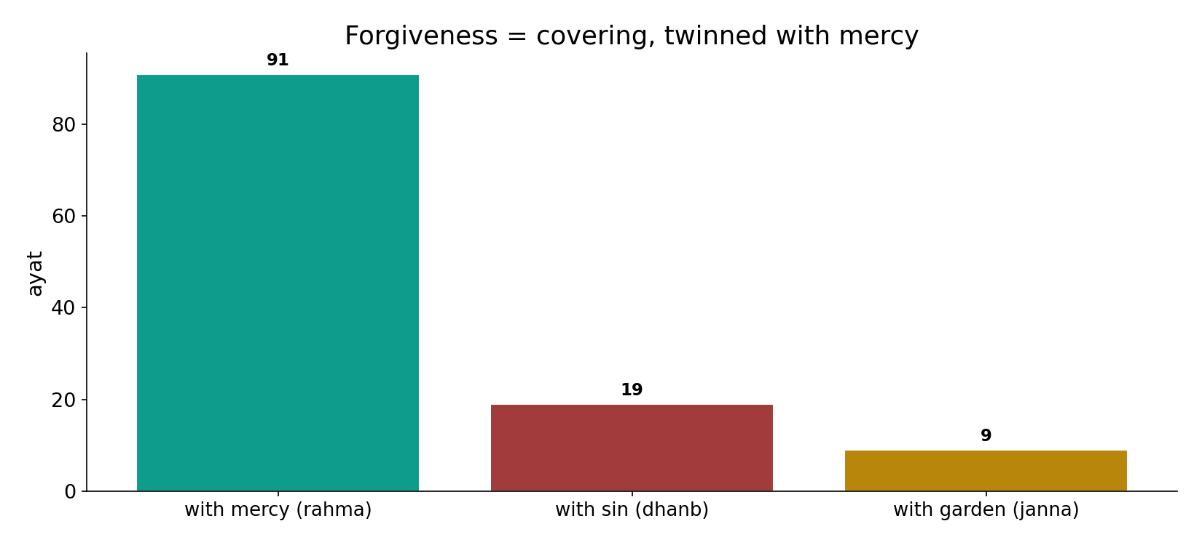
Covering, twinned with mercy
In the data - the root is named on SIN (dhanb, 19) and almost always twinned with MERCY (rahma, 91); it co-occurs with garden (9) downstream.

Slide 6
What the data shows
Forgiveness = COVERING
the root is named on sin (19); the concrete sense is a helmet (mighfar) that covers - to cover a fault.
Twinned with mercy
it is almost always paired with mercy (91); the dominant Name is Ghafur (71), the intensive Ghaffar rare (4).
Elevation follows
forgiveness -> garden (9) is downstream (3:133): the covered one is raised, but the WORD names the cover.

Slide 7
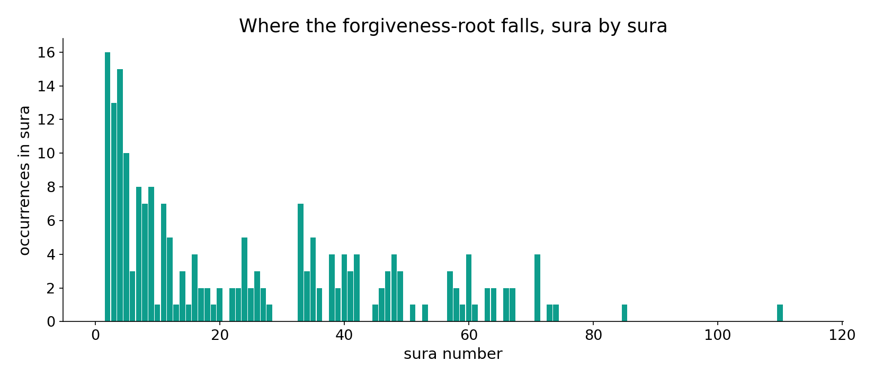
Across the corpus
In the data - the forgiveness-root is spread throughout, densest where mercy and repentance are the theme.

Slide 8
The dominant Name, and the rise to garden
the text's own words (address - snippet - gloss):
2:173 عَلَيْهِ إِنَّ اللّهَ غَفُورٌ رَّحِيمٌ - the dominant Name: Ghafūr Raḥīm
3:133 وَسَارِعُواْ إِلَى مَغْفِرَةٍ مِّن رَّبِّكُمْ وَجَنَّةٍ عَرْضُهَا - forgiveness AND a garden — the lift

Slide 9
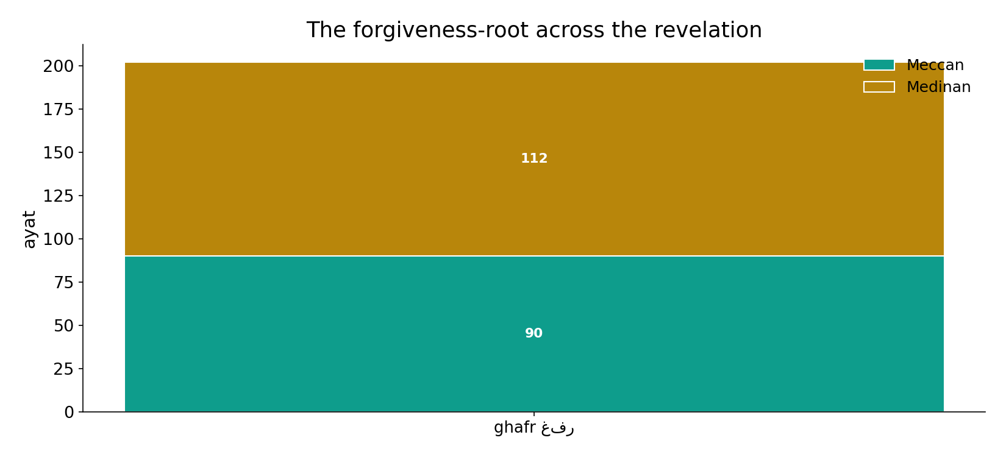
Across the revelation
In the data - the root runs the whole revelation; the 'covering' sense is steady throughout.

Slide 10
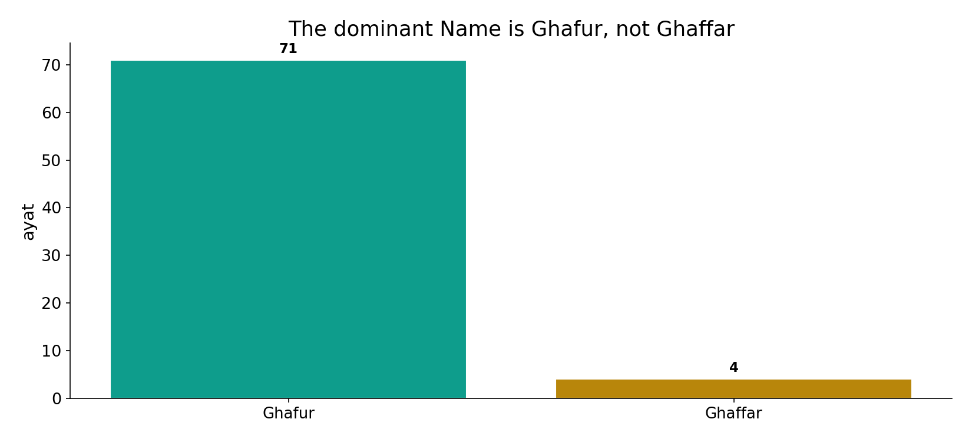
The dominant Name is Ghafur
In the data - the corpus prefers Ghafur (71) over the intensive Ghaffar (4): forgiveness framed as covering, not as rank.

Slide 11
A cover that opens onto more
Computed: the root is named on SIN (19) and almost always twinned with MERCY (91); the dominant Name is Ghafur (71). The primary sense is COVERING / erasing a fault - then, downstream, the covered one is raised to mercy and garden (3:133, 9 co-occurrences). The 'promotion' is real but consequential, not lexical: cover the fault, then elevate.
Reading the root as 'status promotion' imports the destination into the word; the data keeps them ordered.

Slide 12
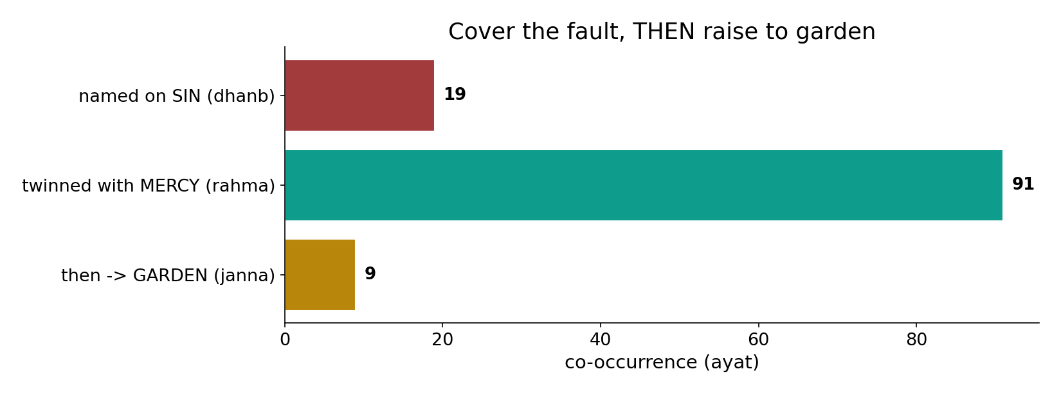
Cover the fault, then raise
In the data - the root is named on sin (19), twinned with mercy (91), and only downstream linked to garden (9): elevation FOLLOWS the covering.

Slide 13
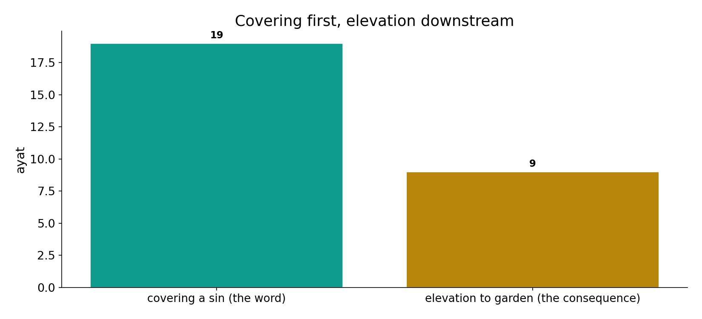
Covering first, elevation downstream
In the data - the word names the COVER (sin 19); the rise to garden (9) is the consequence, not the lexical meaning.

Slide 14
Cover, then raise
Named on sin
the fault to be covered
Twinned with mercy
the cover applied
-> garden
elevation, downstream
A cover that opens onto more
the word names the cover; the rise to garden is the consequence, not the meaning.

Slide 15
Honest limits and critique
'Status promotion' imports the destination
reading the root as 'promotion' folds the consequence (garden) into the word; the data keeps cover-then-elevate ordered.
Co-occurrence locates, doesn't fix
co-occurrence locates meaning but does not fix it; the concrete root-sense (helmet/cover) anchors the reading.

Slide 16
Reading this honestly - the audit
✓ Forms tallied
Ghafur 71, seek-forgiveness 37, noun 28, Ghaffar 4.
✓ Company computed
mercy 91, sin 19, garden 9.
✓ Order preserved
named on sin -> mercy -> garden.
~ Co-occurrence locates
it does not fix meaning alone.
✗ Not a proof
counts/co-occurrence locate roles; theology is not settled by counts.
✗ No raw mixing
forms/senses separated before counting (course rule).

Slide 17
How this was computed (reproducible)
Book6
forgiveness forms; co-occurring roots
measure
form tally, company (sin/mercy/garden)
figures
form bars, company bars, sura map
count
chart
Fully reproducible
Every figure recomputes from Book6.xlsx via the shared wk.py kernel (fixed seed). Roots are normalized (Persian/Arabic letter variants folded) so counts are stable; surface forms are used wherever a concept must be kept apart from its root family (per the course's sense-verification rule).

Slide 18
Appendix - input snippets (Book6, vocalized)
verbatim snippets with addresses:
3:135 فَاسْتَغْفَرُواْ لِذُنُوبِهِمْ وَمَن يَغْفِرُ الذُّنُوبَ إِلاَّ اللّهُ وَلَمْ - who forgives sins but God
71:10 رَبَّكُمْ إِنَّهُ كانَ غَفَّارًا - seek forgiveness — He is Ghaffār

Slide 19
Takeaway
A cover that opens onto more
The forgiveness-root means COVERING - named on sin (19), twinned with mercy (91); the dominant Name is Ghafur (71).
Elevation to garden (9) is downstream (3:133) - real, but consequential, not the word's lexical meaning.
'Status promotion' imports the destination; the data keeps cover-then-elevate ordered. Presented from the text.

Slide 20
Quick reference
The numbers
Ghafur 71 - seek-forgiveness 37 - noun 28 - Ghaffar 4; with mercy 91, sin 19, garden 9.
The shape
forgiveness = covering a fault, twinned with mercy; elevation to garden is downstream, not lexical.

