Slide 1
THE TWO BOOKS · Lecture 3 · the raw symbols
Alphabets & Codes — few units, vast output
Before meaning, before sequence — the symbols themselves
This lecture meets the smallest pieces of both Books: the letters of the Qur'an and the bases/codons/amino acids of the cell. The thesis starts here — a TINY alphabet, whose units carry NO meaning alone, generates an effectively unbounded lexicon. We prove the 'few → many' with real numbers from both worlds.
All Qur'an figures are computed from Book6; biology figures are mainstream, round. Every parallel is audited ✓ / ✗ / ~.

Slide 2
The Two Books — two revelations of one Author
عالم التدوين — the WORD (قول الله)
The Qur'an: God's speech in language. The Book of SCRIPTURE — tadwīn.
عالم التكوين — the ACT (فعل الله)
The living cell: God's deed in creation. The Book of CREATION — takwīn.
One Author · one reader
Same source (Allah); primary addressee the human (insān). Both are āyāt. Here we compare their ALPHABETS.

Slide 3
Two small alphabets, side by side
the raw symbols — neither carries meaning on its own
QUR'AN — 28 letters
ا ب ت ث ج ح خ د … ي
GENOME — 4 bases
A · T · G · C
→ 1,702 roots
the Qur'anic 'code-book'
→ 64 codons → 20 amino acids
the cell's code-book
A letter is not a word; a base is not a protein
Each system starts from a closed, tiny set of meaningless tokens and a small derived 'code-book'. Everything else — every word, every protein — is BUILT from these. The rest of the lecture asks: how far can so few go?

Slide 4
Real data — how small the alphabets really are
Qur'an — symbol inventory
Genome — symbol inventory
28
64
17
20
4
letters
roots (/100)
bases
amino acids
codons
28 letters, a triplet code-book
28 written letters generate ~1,702 roots — and ~96% of those roots are exactly THREE letters. A triplet code over a tiny alphabet.
4 bases, read in threes
4 bases form 4³ = 64 codons, which specify 20 amino acids. The cell, too, builds everything from a handful of symbols read three at a time.

Slide 5
PILLAR 1 — few units, vast output (log10 count)
Qur'an — the amplification (log10)
Genome — the amplification (log10)
5.13
9.51
3.86
3.23
5.00
1.45
0.60
1.30
letters
roots
word-forms
tokens
bases
amino acids
proteins
base-pairs
28 letters → 7,236 distinct words
Computed from Book6: 28 letters → 1,702 roots → 7,236 distinct word-forms → 135,366 word-tokens. Each single letter ultimately generates ~268 distinct words.
20 amino acids → ~100,000 proteins
4 bases → 64 codons → 20 amino acids → ~80–100k proteins, from ~3.2 billion base-pairs. A tiny alphabet, an effectively unbounded proteome. Same shape, both Books.

Slide 6
The same funnel runs in both Books
a few symbols at the top, an unbounded lexicon at the bottom
28 letters
4 bases
1,702 roots
20 amino acids
7,236 word-forms
~100k proteins
135,366 tokens
3.2 Gbp
Generativity is the shared signature
Both narrow at the top to a closed symbol set and widen without bound at the bottom. The engine of the widening — order and expression — is the rest of the course.

Slide 7
Real data — both codes are read in THREES
Qur'an — root length (count of roots)
Genome — codon length (bases per codon)
1645
3
54
2
3-letter
4-letter
5-letter
codon
~96% of roots are triliteral
1,645 of 1,702 roots are exactly 3 letters. Arabic morphology is overwhelmingly a TRIPLET system — a near-universal triconsonantal skeleton.
Every codon is a triplet
The genetic code reads bases in non-overlapping groups of three: 4³ = 64 codons. Two independent Books converged on a triplet unit — a structural echo worth noting.

Slide 8
Real data — how much each symbol carries (bits)
Qur'an — bits per symbol
Genome — bits per symbol
10.73
6.00
4.32
4.81
2.00
letter (28)
root (1702)
base
amino acid
codon
Small alphabets, exact capacity
A letter (28 options) carries log2(28)=4.8 bits; a root ~10.7. The information a symbol holds is fixed by the alphabet size — measurable, not mystical.
A base = 2 bits, a codon = 6
log2(4)=2 bits per base; a codon 6; an amino acid log2(20)=4.3. Both Books pack meaning into a handful of low-bit symbols. Information, not magic.

Slide 9
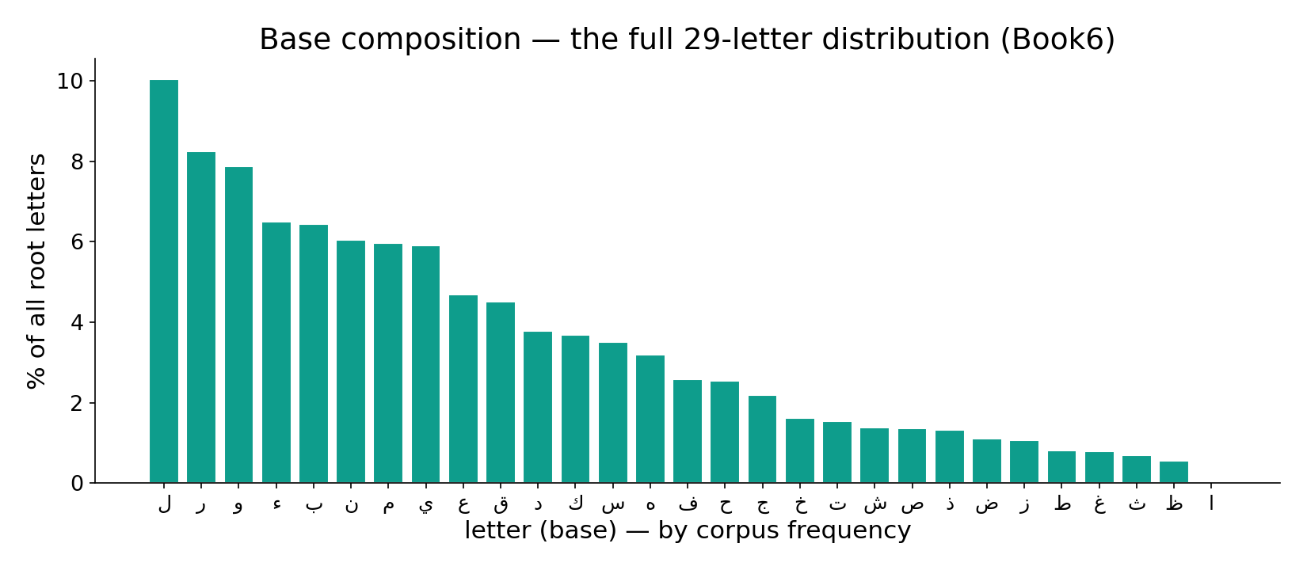
Real data — the full letter (base) distribution
In the data — every letter's share of all root-letters (Book6): ا 18%, ل 11.5% … a long tail across 28 symbols, far from the 3.6%-each of a uniform alphabet. The proteome is likewise skewed (Leu ~9.7% → Trp ~1.1%) — both Books have a characteristic, non-random composition.

Slide 10
PILLAR 2 preview — the unit is empty, ORDER speaks
the SAME three letters ب ح ر — six different roots
بحر
برح
حبر
حرب
ربح
رحب
sea
depart
ink
war
profit
ease
Three meaningless consonants, six unrelated meanings
None of ب, ح, ر means anything alone. Their ORDER alone separates 'sea' from 'war' from 'profit'. The biological mirror: the same bases read in a shifted frame (frameshift), or the same amino acids in a scrambled order, give an entirely different — usually non-functional — protein.
The unit carries no meaning. The SEQUENCE carries all of it. (Proved at scale in Lecture 5.)

Slide 11
Real data — order matters across the whole lexicon
Qur'an — share with an anagram-sibling (%)
Genome — order/identity changes function
54.2
1
1
1
39.1
19.6
3-letter roots
word-forms
skeletons (vowels)
scramble seq
frameshift
1-residue swap
Reordering is everywhere
54% of 3-letter roots share their letter-set with another root; 39% of word-forms have an anagram-sibling; 19.6% of skeletons carry ≥2 meanings via vowels alone. Order, not inventory, makes the word.
Same parts, different order, new function
Scramble a protein's residues → no fold; shift the reading frame → new protein; swap ONE residue (sickle-cell, Glu→Val) → disease. In the cell too, arrangement is function.

Slide 12
Real data — redundancy in the code-book
Genome — codons per amino acid (count of AAs)
Qur'an — forms per root (count of roots)
9
601
451
5
308
3
226
2
115
1
1
2
3
4
6
1
2-3
4-6
7-12
13+
Many codons → one amino acid
18 of 20 amino acids have 2–6 codons (only Met, Trp have one). Redundancy buffers copying errors — many spellings, one meaning.
One root → many forms
Conversely, a single root fans into many surface forms (mean 4.7, max 648). Both Books exploit a many-to-one and one-to-many slack between symbol and output.

Slide 13
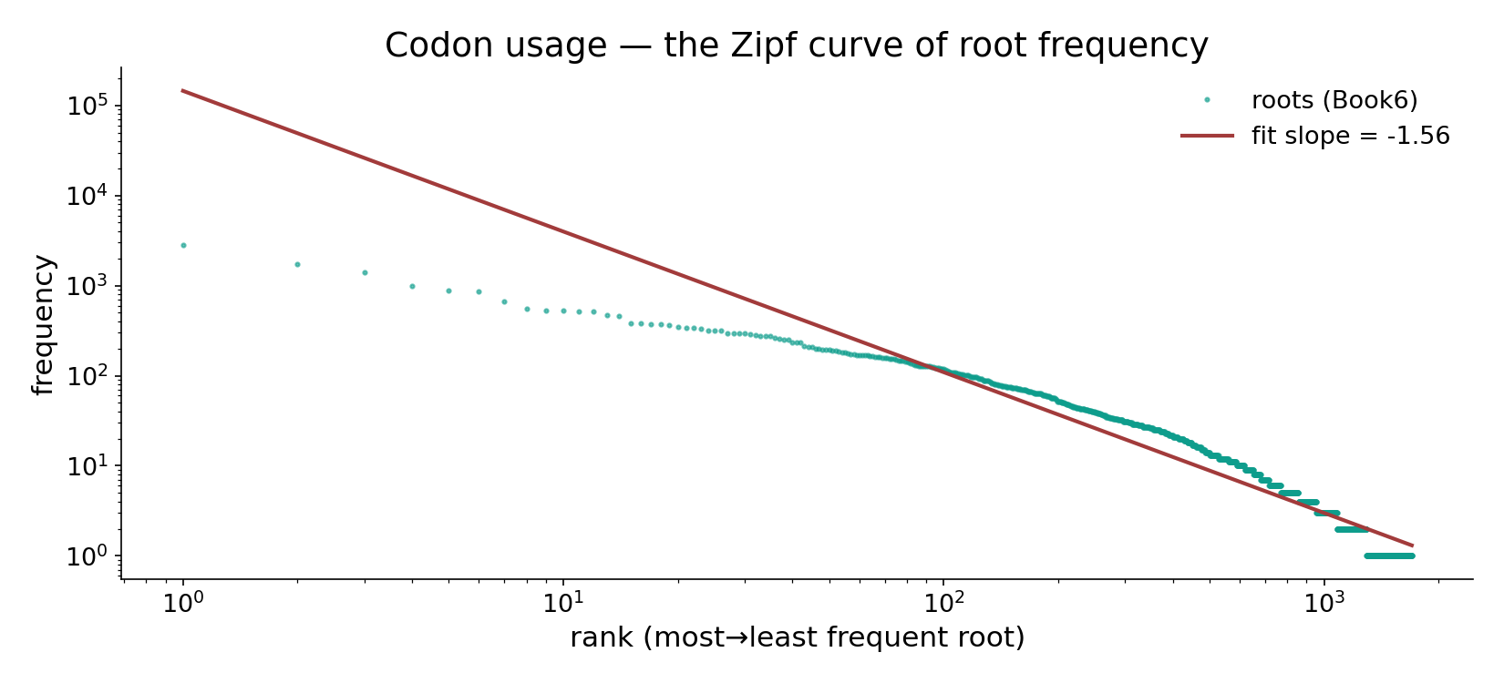
Real data — root usage is heavy-tailed (the Zipf curve)
In the data — all 1,700 roots ranked by frequency on log-log axes; the fitted slope ≈ −1.56 — ءله 2851, قول 1722 then a long power-law tail. Amino-acid usage shows the same heavy-tailed economy (Leu/Ser common, Cys/Trp rare).

Slide 14
PILLAR 3 preview — most of what's possible is unused
Qur'an — 3-letter space (count)
Genome — sequence space is vast
17550
130
1645
10
possible triples
used as roots
possible 100-mers (log10)
that fold (log10, ~)
Only 9.4% of triples are realized
Of 17,550 possible ordered 3-letter combinations, the Qur'an uses 1,645 as roots — 9.4%. The vast majority of the space is silent, never expressed.
A vanishing fraction of sequences fold
A 100-residue chain has ~10¹³⁰ possible sequences; only an astronomically tiny fraction fold into working proteins. In both Books, POSSIBILITY ≫ realization — expression selects. (Lectures 9, 12.)

Slide 15
Audit — supported, broken, silent
✓ SUPPORTED
Both Books build unbounded output from a tiny, closed, non-uniform alphabet read in threes; order distinguishes units; most of the possible space is unused. All measured, both worlds.
✗ BREAKS
The triplet 'echo' is not identity: a codon (3 bases→1 amino acid) is not a root (3 letters→a concept). Similar STRUCTURE, different substance. No base ↔ letter mapping is claimed.
~ SILENT (surmisable)
Whether the shared 'triplet + heavy tail + sparsity' profile reflects a deep constraint or convergent economy is open — interesting, untested, not asserted.

Slide 16
Validation — is 'order matters' more than chance?
Anagram-sibling rate: observed vs shuffle null (%)
Realized triples: observed vs null (% of space)
54.2
9.4
9.4
44.7
47.0
null mean
95th pct
observed
null (uniform)
observed roots
The anagram rate is real, not chance
A frequency-matched null gives ~45% anagram-siblings by chance (95th pct 47%); the Qur'an's ~54% sits well past it (p<0.003) — Arabic actively REUSES letter-sets in different orders. Order is doing real work.
Sparsity is structured, not random
The realized roots are not a random 9.4% of the space — they cluster around pronounceable, productive triconsonantal skeletons. Expression is selective, and we can measure it.

Slide 17
What this lecture established — the thesis, in data
the spine of the whole course, proved from the symbols up
① FEW → MANY
28 letters → 7,236 words ; 20 AA → ~100k proteins
② ORDER SPEAKS
ب ح ر → 6 roots ; 54% anagram rate
③ EXPRESSION
9.4% of triples used ; mean 4.7 forms/root
The unit is meaningless; the system is generative
From a tiny, non-uniform, triplet alphabet — whose individual symbols mean nothing — both Books generate an unbounded lexicon. ORDER turns the same symbols into different meanings; EXPRESSION decides which of the astronomically-many possibilities actually exist.
Pillar 1 is proved here. Pillar 2 (order) is the work of Lectures 5–6; Pillar 3 (expression) of Lectures 9 and 12.

Slide 18
Real data — why THREE is the minimum that works
Genome — codes available by codon length
Qur'an — strings available by root length
64
21952
16
4
28
784
1 base
2 bases
3 bases
1 letter
2 letters
3 letters
2 bases cannot name 20 amino acids
One base gives 4 codes, two give 16 — both short of the 20 amino acids needed. Three bases give 64: the SMALLEST length that suffices. The triplet codon is forced by capacity.
2 letters cannot index 1,702 roots
28 letters: one gives 28, two give 784 — short of 1,702 roots. Three give 21,952: enough, with huge headroom. That headroom is exactly the 9.4% sparsity — capacity to spare, mostly unexpressed.

Slide 19
Synthesis & discussion
THE BIG IDEA
Generativity is the deepest thing the two Books share at the symbol level: a closed, tiny alphabet whose meaningless units, through order and selective expression, build an open-ended lexicon. We measured every claim in both worlds — no parallel was assumed.
FOR DISCUSSION
• Why do two independent Books both read in threes — constraint, or coincidence? • If a letter means nothing, where does meaning 'live'? • Is 9.4% realized a sign of design, economy, or just pronounceability? • What would falsify 'order matters'?

Slide 20
Real-world relevance & takeaway
REAL-WORLD RELEVANCE
'Few symbols → unbounded output by arrangement' is the principle behind language, the genetic code, digital data, and music. Seeing it in scripture AND the cell trains the eye for generative systems everywhere.
THE TAKEAWAY
A tiny alphabet of meaningless units builds an unbounded lexicon — because ORDER distinguishes them and EXPRESSION selects them. Proved with real data, both Books.

