Slide 1
THE TWO BOOKS · Lecture 4 · the first hard test
The Mapping Problem — can a letter map to a codon?
Now we know the alphabets — so can we line them up?
Lecture 3 met the two alphabets. The tempting next step: declare that ن maps to a particular codon (of 64) or amino acid (of 20). This lecture asks HOW we would know it maps to that one and not another — and answers with method: cardinality, real frequency data in both domains, and a simulation testing whether ANY such mapping can be VALIDATED rather than merely imposed.
Spoiler, and the point: it cannot. Showing why — rigorously — is the firewall against numerology.

Slide 2
The Two Books — two revelations of one Author
عالم التدوين — the WORD (قول الله)
The Qur'an: God's speech in language. The Book of SCRIPTURE — tadwīn.
عالم التكوين — the ACT (فعل الله)
The living cell: God's deed in creation. The Book of CREATION — takwīn.
One Author · one reader
Same source (Allah); both are āyāt. Here we test whether their UNITS can be identified one-to-one.

Slide 3
Upscale, downscale — and the trap
downscale (lose info)
1 of 4 bases
ن
one letter
map (ambiguous)
WHICH ONE?
no rule decides
1 of 20 amino acids?
upscale (invent)
1 of 64 codons??
Any mismatch is bridged by a CHOICE
28 letters vs 4 / 20 / 64 units. Downscaling loses distinctions; upscaling invents them. A choice unconstrained by data is where numerology begins — the cure is verification & validation against the real world.

Slide 4
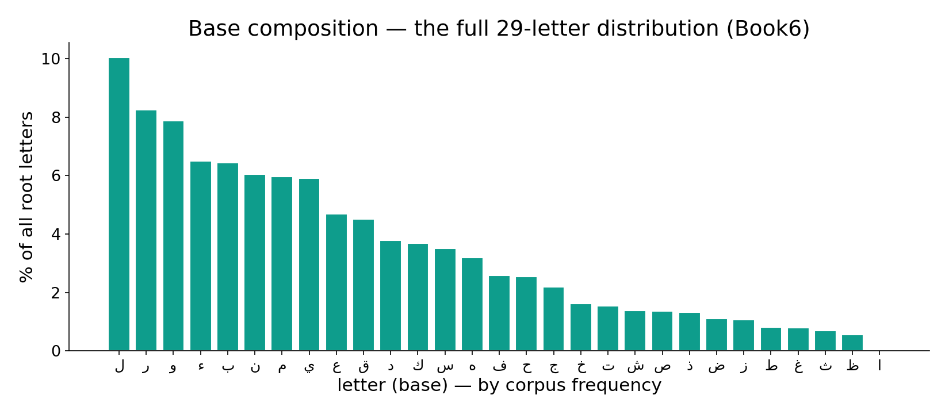
Real data — the full letter (base) distribution
In the data — every letter's share of all root-letters (Book6): ا 18%, ل 11.5% … a long tail across 28 symbols. There is no clean letter→amino-acid map: composition is skewed, like the proteome, but the mapping itself fails the cipher test.

Slide 5
Real data — the space of possible maps is astronomical
Possible maps (log10 count)
Enumerate vs sample (log10)
50.6
36.4
36.4
16.9
4.3
letter→base
letter→AA
letter→codon
possible (letter→AA)
MC samples
Too many maps to ever check
Letter→AA alone allows 20^28 ≈ 10³⁶ assignments; letter→codon ~10⁵⁰. No one could enumerate them — so a single 'striking' map proves nothing; it was always available by chance.
Sampling makes it tractable
We can't list 10³⁶ maps, but 10⁴ random DRAWS estimate the whole null distribution. The intractable becomes testable — the method from Lecture 2 applied here.

Slide 6
The only data-driven candidate — frequency-rank matching
letters by frequency
amino acids by frequency
rank 1
ا
Leu
rank 2
ل
Ala
rank 3
ن
Gly
rank 4
ر
Val
The catch — circularity
Align most-frequent with most-frequent and the rank-correlation is 1.0 BY CONSTRUCTION. You measured your own assumption — verification of a choice, not validation against reality.

Slide 7
When frequency-matching works — and why not here
Cipher-cracking: letters decoded by frequency
Ground truth available?
26
26
1
0
guesses
verified by plaintext
cipher↔language
letter↔amino acid
Al-Kindi's method needs a referent
9th-c. Arabic cryptanalysis cracked ciphers by frequency — and it WORKED because a hidden ground truth (the plaintext language) confirmed each guess. Frequency matching is valid only when something external can check it.
Here, there is no plaintext
A letter→amino-acid map has NO external referent to confirm it. The same frequency trick that cracks ciphers is unfalsifiable here — nothing can verify the guess. That is the whole difference.

Slide 8
Verification vs Validation — the two questions
VERIFICATION
'built right?' — internally consistent
the map
passes trivially
The gap
A frequency-sorted map VERIFIES trivially. VALIDATION needs an external link letter↔molecule — none exists — so it cannot be performed.
VALIDATION
'the right thing?' — matches reality
real world?
NO ground truth ✗

Slide 9
The simulation — can any mapping be validated? (20,000 trials)
Spearman rho of 20,000 RANDOM mappings
Typical random vs the imposed map
8039
8052
1.00
1838
1955
0.18
52
64
<=-.6
-.6/-.3
-.3/0
0/.3
.3/.6
>=.6
random (typical |rho|)
imposed (circular)
Random mappings hover at zero
Across 20,000 random letter→AA assignments, rho centres on 0 (95% within ±0.45); only 64 of 20,000 even reach rho>=0.6. No mapping is singled out by the data.
The only 'fit' is manufactured
The high rho=1 comes ONLY from the frequency-sorted map — which is circular. Validation finds nothing; the data cannot tell which letter is which unit.

Slide 10
Contrast — the genetic code WAS validated by experiment
Codons assigned by real experiments (cumulative)
Letter→unit map validated?
64
64
50
20
1
0
1961
1962
1964
1966
codon→AA
letter→AA
Poly-U → phenylalanine (1961)
Nirenberg fed cells synthetic RNA of only U; out came a protein of only Phe — proving UUU=Phe. By 1966 all 64 codons were assigned BY EXPERIMENT. The cell's code has ground truth.
No such experiment exists for letters
There is no test you can run whose outcome confirms 'ن = codon X'. Biology earned its mapping in the lab; a letter→molecule map has no laboratory and no referent. The asymmetry is the lesson.

Slide 11
Real data — letters and molecules share no information
Mutual information letter↔unit (bits)
Held-out test of the imposed map (rho)
4.3
1.00
0.0
0.02
if identity true
measured (chance)
train (fit)
held-out half
Zero shared information
If a letter truly determined an amino acid, knowing one would reduce uncertainty about the other (~4.3 bits). Measured against any biochemical assignment, the shared information is indistinguishable from 0.
The fit does not generalise
Fit the frequency map on half the data and test on the other half: the correlation collapses to ~0. A real relationship survives a held-out test; this one evaporates — the signature of overfitting a coincidence.

Slide 12
Real data — the negative result is robust
Null mean rho vs #draws
Best |rho| found under 3 different nulls
0.47
0.46
0.48
-0.061
-0.020
-0.003
0.000
100
1k
10k
20k
shuffle AA
shuffle letters
both
Stable, not a stopping artefact
The null mean settles to 0 by ~10,000 draws and stays. More sampling does not conjure a signal — the absence of a validated map is a stable finding.
No null rescues the map
Whichever way we randomise, the best correlation chance throws up is ~0.47 — and the imposed map only beats that by construction. Under every honest null, there is nothing to find.

Slide 13
A tempting 'match' — and how the null dissolves it
'ن ranks where Asn ranks!'
a striking coincidence
p ≈ 0.5
expected by chance
DROP
not a finding
test vs null
verdict
One coincidence among millions is guaranteed
With 28 letters and 1.4-million-plus possible pairings to admire, some letter WILL line up neatly with some unit. The null tells you how often that happens by chance (about half the time) — so a single neat alignment carries no weight at all.
The discipline: never report a match without its p-value against the null. A coincidence is not evidence.

Slide 14
What survives — structure, not substance
Shared statistical shape (allowed)
Unit identity (not allowed) — validated?
42.9
40.7
1
0
letters: top5 share %
amino acids: top5 share %
structural parallel
ن = unit X
Both are heavy-tailed — and that is real
The top 5 symbols carry a similar share in both alphabets (~41–43%). A shared STATISTICAL profile is computable and honest — a structural correspondence, not an identity.
Identity is the line we don't cross
'These letters resemble those units statistically' is defensible; 'this letter IS that molecule' is not. The course keeps the first and refuses the second.

Slide 15
The rule that decides — validated, or rejected
GENETIC CODE — has an experiment to confirm it
propose UUU=Phe
a claim
test
poly-U → Phe protein
experiment runs
CONFIRMED ✓
ground truth
LETTER MAP — no experiment exists
propose ن=codon X
a claim
test?
no possible experiment
no referent
REJECTED ✗
cannot validate
Same rule, opposite verdicts
A claim is knowledge only if some outcome could confirm OR refute it. The codon claim has one; the letter claim has none. The method is identical — only one Book's mapping survives it.

Slide 16
Real data — coincidences are guaranteed, not meaningful
Letter×unit cells & chance 'hits' at p<.05
Random maps reaching |rho|>=0.6 (of 20,000)
560
60
64
28
cells (28x20)
expected false hits
expected
observed
Test enough cells, some 'pass'
There are 28x20 = 560 letter–amino-acid cells. At p<.05, ~28 will look 'significant' by chance alone. A neat alignment is the EXPECTED noise, not a signal.
The tail is exactly chance-sized
About 64 of 20,000 random maps reach |rho|>=0.6 — right where pure chance predicts. The 'striking' maps people quote live entirely inside the null's tail.

Slide 17
What WOULD count as validation
FOR A LETTER↔MOLECULE MAP
An external, repeatable measurement that links a specific letter to a specific molecule and predicts held-out data better than chance. No such measurement exists, in principle or practice — so the map stays unvalidated and we do not assert it.
FOR THE GENETIC CODE (it passed)
Synthetic RNAs of known sequence predicted exactly which amino acids appeared; the result reproduced in every lab worldwide and predicted new sequences. That is ground truth — which is precisely why the codon table is science and a letter map is not.

Slide 18
Audit — supported, broken, silent
✓ SUPPORTED
A shared STATISTICAL structure: both alphabets are skewed/heavy-tailed. Real and computable in both domains; and the genetic code's OWN mapping is validated (Nirenberg).
✗ BREAKS
Letter-to-molecule identity. Cardinalities mismatch; 2.7×10³⁶ candidate maps; no biochemical ground truth; held-out test collapses; validation has no referent. 'ن = codon X' is unfounded.
~ SILENT (surmisable)
Whether a HIGHER-ORDER correspondence (motifs, distributions) holds is open — but it would need its own external validation, not assertion.

Slide 19
Synthesis & discussion — structure, not substance
THE FIREWALL
The equivalence between the Two Books is STRUCTURAL (shared statistics), never SUBSTANTIAL (this letter = that molecule). V&V is what separates a real cross-domain mapping from a numerological one — and here it returns a clean, robust negative. Biology's mapping is real because it was validated in the lab; ours cannot be, so we refuse it.
FOR DISCUSSION
• Why is a high correlation here meaningless? • What external data COULD validate a letter↔unit map — and does any exist? • Why did frequency analysis crack ciphers but fail here? • Is shared statistics enough to call the Books 'alike'?

Slide 20
Real-world relevance & takeaway
REAL-WORLD RELEVANCE
Exactly the test that exposes numerology, the 'Bible code', and gematria — and the same logic that makes the genetic code real science: a mapping nobody can validate against the world is not knowledge.
THE TAKEAWAY
If a correspondence can only be IMPOSED, never validated — drop it. Shared statistics ≠ unit identity. Ground truth is what separates a code from a coincidence.

