Slide 1
THE TWO BOOKS · Lecture 6 · the polymer level
Word & Peptide — sequence in the longer chain
Pillar 2, scaled up — from the triplet to the whole chain
A protein is a linear chain of amino acids from a ~20-unit alphabet; its 'primary structure' is just the SEQUENCE. A Qur'anic word is a linear chain of letters from a ~28-letter alphabet. Lecture 5 proved order matters in the triplet; here we read both as longer STRINGS — and the same string tools (alignment, edit distance, motifs) apply to each.
Still below full meaning; biology figures mainstream. Every parallel audited ✓ / ✗ / ~.

Slide 2
The Two Books — two revelations of one Author
عالم التدوين — the WORD (قول الله)
The Qur'an: God's speech in language. The Book of SCRIPTURE — tadwīn.
عالم التكوين — the ACT (فعل الله)
The living cell: God's deed in creation. The Book of CREATION — takwīn.
One Author · one reader
Same source (Allah); both are āyāt. Here we read both as linear CHAINS.

Slide 3
Two linear polymers
PROTEIN — a chain of amino acids (~20-letter alphabet)
L
A
G
V
E
S
K
D
Y
WORD — a chain of letters (~28-letter alphabet)
ا
ل
ح
م
د
ل
ل
ه
Both are strings
Read in ONE direction (N→C for proteins; right→left for Arabic), each is a sequence of units from a small alphabet. At this scale a word IS a string — and so is a peptide.

Slide 4
The data — composition is skewed in both
Letter frequency — Qur'an (% of letters)
Amino-acid frequency — proteins (%)
18.0
9.7
8.3
7.1
6.9
11.5
8.4
8.1
7.5
1.1
ا
ل
ن
م
و
Leu
Ala
Gly
Val
Trp
A few units dominate
Arabic letters are far from uniform: ا, ل, ن lead; others trail. A heavy-headed distribution over 28 letters.
So do amino acids
Proteins are biased too — Leu/Ala/Gly common, Trp rare (~1%). Both alphabets have a skewed, non-random composition that shapes every chain.

Slide 5
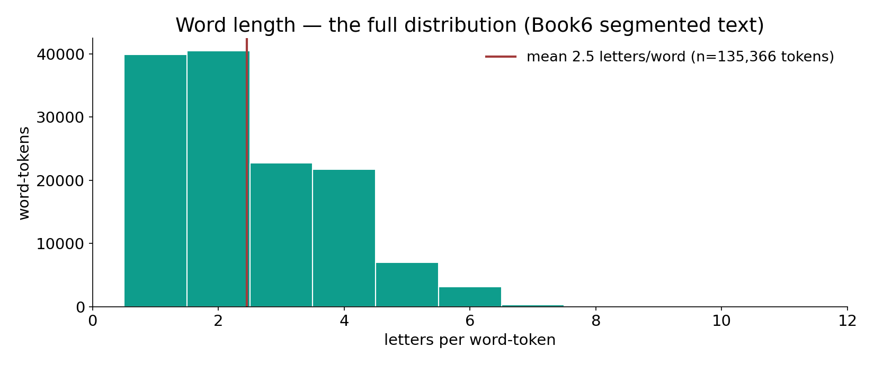
Real data — the full word-length distribution
In the data — letters per word-token across all 135,366 tokens (Book6 segmentation, mean 2.45): short function-words dominate, a tail of longer content-words — the same right-skewed length profile proteins show.

Slide 6
Order at the word scale — anagram words
Word-forms sharing a letter-set (%)
Protein: identical composition, different fold
60.9
2
39.1
1
unique letter-set
has anagram-sibling
composition
folds (order-dependent)
39% of words have an anagram-sibling
Computed across 7,236 word-forms: 39.1% share their exact multiset of letters with another distinct word. Even at the whole-word scale, ORDER — not the bag of letters — fixes the word.
Same residues, different protein
Two proteins can share amino-acid composition yet fold and function differently because their SEQUENCE differs. Composition is necessary, never sufficient — in both Books.

Slide 7
Sequence alignment — the same operation, both Books
align two strings; mark matches and mismatches
ك
ت
ب
2 of 3 positions match
a 'point' difference at position 2
ك
ذ
ب
Alignment is character-level, not semantic
Comparing two protein sequences (alignment / BLAST) finds matched and mismatched positions — exactly what the course's root-normalization does when it lines up two strings. No meaning is consulted; only characters and positions.
This is the engine under the whole course: match strings first, interpret later.

Slide 8
The data — identity and edit distance
Sequence identity needed to infer relatedness (%)
Edit distance — كتب to related strings
35
3
20
10
1
1
clearly related
twilight zone
unrelated
كذب
كتاب
قلب
Bioinformatics has a threshold
Two proteins above ~35% sequence identity are confidently homologous; ~20% is the 'twilight zone'. Relatedness is read off the STRING, quantitatively — the same logic the course uses on roots.
Edit distance counts the steps
كتب→كذب is one edit; كتب→كتاب is one insertion; كتب→قلب is three. Levenshtein distance measures string similarity for words exactly as for sequences — one shared toolkit.

Slide 9
Recurring sub-strings — motifs in both Books
Qur'an — a recurring formula (occurrences)
Protein — conserved sequence motifs (illustrative)
258
3
2
114
1
الذين آمنوا
بسم الله
zinc finger
kinase
signal peptide
Texts repeat sub-strings
Fixed formulae recur across the Qur'an — e.g. 'those who believe' appears hundreds of times. Recurring sub-sequences are a measurable feature of the string, found by the same scan that finds protein motifs. (Counts approximate.)
Proteins repeat motifs too
Short conserved motifs (a zinc finger, a kinase site, a signal peptide) recur across unrelated proteins and signal function. Motif discovery is one algorithm, two Books.

Slide 10
Local templates — awzan and secondary structure
a fixed TEMPLATE shapes the chain, both Books
ARABIC wazn: فَاعِل
template C-a-C-i-C → فاعل, كاتب, ناصر
PROTEIN: α-helix / β-sheet
local sequence → a repeating fold motif
A pattern imposed on a sequence
Arabic morphology pours a root into a fixed vowel-consonant TEMPLATE (wazn) — فاعل, مفعول, استفعال — generating a family of words with shared shape. A protein's local sequence likewise prefers a repeating secondary-structure template (helix, sheet).
In both, a small set of templates patterns the chain into recognizable, reusable shapes.

Slide 11
The data — a few templates, much of the output
Arabic — common patterns (share of forms, approx.)
Protein — secondary structure (% of residues)
55
45
34
22
21
15
8
فاعِل
مفعول
فعّال
other
helix
sheet
coil
A handful of awzan recur
A small inventory of patterns (فاعِل, مفعول, فعّال …) accounts for a large share of derived word-forms — templated reuse, like a design library. (Shares approximate.)
Two folds dominate the chain
Across proteins, ~34% of residues sit in α-helices and ~21% in β-sheets — two templates pattern most of the structure. Few templates, much of the output, both Books.

Slide 12
The data — not every position is equal
Arabic root — variability by position (distinct letters)
Protein motif — conservation by position (bits)
26
27
25
4.0
0.8
pos 1
pos 2
pos 3
core pos
variable pos
Positions carry different loads
Across roots, each slot draws on a different sub-set of letters with different spread — the positions are not interchangeable, echoing Lecture 5's positional bias.
Conserved vs free positions
In a protein motif, some positions are near-invariant (high information, ~4 bits) while others tolerate any residue (~0.8 bits). A sequence-logo measures exactly which positions matter — usable on Arabic patterns too.

Slide 13
Direction matters — and palindromes in both
a string read backwards is a different string
Arabic reads right → left
reverse a word → usually a non-word; some palindromes (e.g. رمر)
DNA reads 5' → 3'
reverse-complement; palindromic sites (e.g. GAATTC) cut by enzymes
Orientation is part of the information
A protein chain has a direction (N→C); DNA has a strand (5'→3'); Arabic is read right-to-left. Reversing a sequence generally destroys it — but special PALINDROMES read the same both ways, and in DNA these mark real functional sites (restriction enzymes, regulatory elements).
Direction and symmetry are measurable string properties — shared between text and sequence.

Slide 14
The data — a few strings dominate usage
Qur'an — most frequent words (token count)
Cell — protein abundance is heavy-tailed (log10 copies)
2763
2699
7
4
1185
1124
1010
2
من
الله
في
لا
ما
top
median
rare
Word usage is heavy-tailed
A few function words (من, الله, في …) dominate the token stream; thousands of words appear rarely — Zipf's law, the statistics of natural text.
So is protein abundance
A cell holds millions of copies of a few proteins and a handful of others — abundance spans ~10^7. Both Books deploy their strings with the same steep, heavy-tailed economy.

Slide 15
One toolkit — strings, both Books
the same algorithms read a word and a peptide
ALIGN
match positions
EDIT DIST.
count changes
MOTIF SCAN
find sub-strings
n-GRAM
local statistics
ENTROPY
info per position
SEARCH
find a query
Bioinformatics = computational linguistics, applied to molecules
Every method here — alignment, edit distance, motif discovery, n-gram models, entropy, search — was built for one kind of string and works on the other. The word and the peptide are the same KIND of object, so one toolbox serves both.

Slide 16
At every length — composition is not the message
Strings from one letter-multiset (4 letters)
Orderings of a chain (log10)
24
18.4
2.9
1
0.8
composition
orderings (4!)
3 units
6 units
20 units
More units, far more orderings
Four letters admit 24 orderings; six admit 720; twenty admit ~10^18. As chains lengthen, the order-space explodes — and only a vanishing fraction are real words or working proteins.
So sequence carries almost all the information
Composition fixes the parts; the astronomically larger choice of ORDER fixes the message. The longer the chain, the more decisively this is true — both Books.

Slide 17
Finding a string — search in both Books
Qur'an concordance — a query's hits
BLAST significance vs identity (-log10 E)
2699
20
114
103
2
الله
رحيم
صبر
40% identity
25% identity
Concordance = ranked string search
Querying a word returns every occurrence, ranked and located — a concordance. It is the textual twin of a database sequence search: same operation, different corpus.
BLAST scores a match against chance
A sequence search reports an E-value — how many matches this good you'd expect by chance in a database of this size. Strong identity (~40%) gives a tiny E (significant); weak identity fades into noise. Significance, again, is judged against a null.

Slide 18
Audit — supported, broken, silent
✓ SUPPORTED
Both are linear strings from a small alphabet, skewed composition, characteristic lengths, recurring motifs, templated patterns, and order-dominated information — all read by one string toolkit, no semantics.
✗ BREAKS
Proteins FOLD into 3-D shapes that give function; a written word does not physically fold. Scale and chemistry differ entirely. The match is the STRING, not the substance.
~ SILENT (surmisable)
Whether recitation's acoustic shape is the word's 'fold' is suggestive; the right 'alphabet' (28 letters? with/without vowels?) is a modeling choice.

Slide 19
Synthesis & discussion — and the next tier
THE STRING, THEN THE MEANING
At the character scale, a word and a peptide are the same kind of object: a string whose information lives in ORDER. The course's power comes from working here FIRST — matching, aligning, scanning strings — before any interpretation. Pillar 2 holds at every length.
NEXT TIER (Lecture 7)
Move up one level — root ↔ PROTEIN — and a semantic/functional dimension enters: a root carries a CONCEPT as a protein carries a FUNCTION via its fold. That lecture reads meaning; this one read only characters.

Slide 20
Real-world relevance & takeaway
REAL-WORLD RELEVANCE
String and sequence methods — alignment, BLAST, motif discovery, NLP — are one toolkit across texts and proteins alike; what you learn on one transfers to the other.
THE TAKEAWAY
At every length a word and a peptide are the same kind of object: a linear string whose meaning lives in ORDER, not composition. One toolkit reads both.

