Slide 1
THE TWO BOOKS · Lecture 7 · the semantic tier
Root & Protein — where meaning enters
Up from the code, into function
The character lectures stayed below meaning. Here we climb one rung: a ROOT is not just three letters — it carries a CONCEPT, a field of related senses. A GENE is not just bases — it yields a PROTEIN with a FUNCTION via its FOLD. This is the richest rung of the analogy, and where overclaim is most tempting — so the audit matters most.
Real data both sides; biology mainstream. Every parallel audited ✓ / ✗ / ~ — no 'scientific-miracle' claims.

Slide 2
The Two Books — two revelations of one Author
عالم التدوين — the WORD (قول الله)
The Qur'an: God's speech in language. The Book of SCRIPTURE — tadwīn.
عالم التكوين — the ACT (فعل الله)
The living cell: God's deed in creation. The Book of CREATION — takwīn.
One Author · one reader
Same source (Allah); both are āyāt. Here meaning and function ENTER.

Slide 3
Structure folds into function — both Books
GENE → fold → FUNCTION
gene
base sequence
fold
protein
3-D shape
acts
FUNCTION
what it does
ROOT → pattern → MEANING
root
3 consonants
wazn
word
root+pattern
means
CONCEPT
its sense/role
Sequence does not give function directly — the FOLD does
A bare gene is silent until it folds; a bare root is silent until a vowel-pattern shapes it into a word. Form, not just sequence, makes meaning/function.

Slide 4
One small change, a different function (مُخلِص vs مُخلَص)
مُخلِص (kasra)
ACTIVE — one who sincere-izes
one diacritic ⇒ new role
مُخلَص (fatḥa)
PASSIVE — one made sincere
The morphological 'fold' flips the function
Same three letters; the vowel on the lām flips active ↔ passive — doer vs recipient. Structurally identical to a fold change that switches a protein's function.
Form is functional. A point change to the 'fold' changes what the unit DOES — in both Books.

Slide 5
One root, a fan of forms (like a gene's isoforms)
غفور
19 forms, one field
From غ-ف-ر spring a Name (Ghafūr), an intensive (Ghaffār), a noun (maghfira), a verb (yaghfir), an imperative of seeking (istaghfir)… 19 surface forms sharing one concept: covering / forgiving.
A gene works the same way — one coding source, many spliced proteins: variants on one functional theme.
غفّار
غفر
the root
مغفرة
استغفر
يغفر
غافر

Slide 6
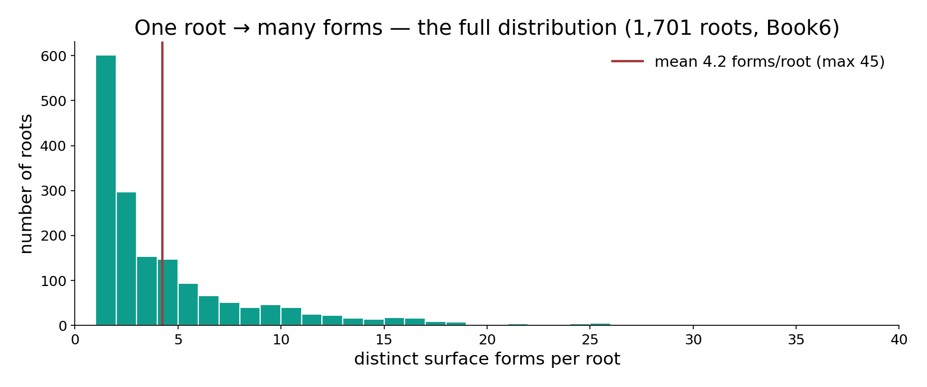
Module — one root, many forms: the full distribution
In the data — every one of 1,701 roots by its number of distinct surface forms (mean 4.2, max 45). One root fans into many forms — the script analogue of one gene → many protein isoforms.

Slide 7
A finite set of shapes — folds and fields
Protein fold families (order of magnitude)
Arabic — roots vs broad semantic fields
8.0
1700
3.3
200
sequences (log10)
folds (log10)
roots
broad fields (approx.)
Billions of sequences, ~1,000s of folds
Known protein sequences number ~10^8, yet they fall into only a few thousand distinct FOLD families. Structure is far more conserved than sequence — many spellings, few shapes.
Many roots, fewer fields
~1,700 roots cluster into a much smaller number of broad semantic fields (mercy, knowledge, light…). In both Books, the meaningful CATEGORIES are far fewer than the surface units.

Slide 8
Modular meaning — domains and senses
Protein — domains per protein (typical)
Root — distinct senses per root (illustrative)
60
55
35
25
10
10
5
1
2
3
4+
1
2-3
4+
Proteins are built from domains
Most proteins are modular: independent folded DOMAINS, each a reusable functional unit, combined like words in a sentence. ~40% carry two or more. (Percentages approximate.)
Roots carry a field of senses
A root is often polysemous — a core sense plus related extensions (e.g. ك-ت-ب: write, prescribe, destine). Meaning is modular too: one root, a structured family of senses.

Slide 9
Relatedness predicts role — homology
Protein homologs sharing function (% , approx.)
Co-derived words sharing a field (Qur'an)
90
95
60
15
5
>50% identity
30-50%
<20%
same root
unrelated roots
Similar sequence, similar function
Proteins above ~50% identity almost always share function; the link weakens as sequence diverges. Function is inherited along sequence similarity — homology.
Same root, shared concept
Words from one root overwhelmingly share a semantic field — the linguistic homology. Relatedness predicts meaning, just as it predicts function.

Slide 10
From sequence to meaning — the funnel
a 1-D string collapses to a single working shape
1-D sequence
many possibilities
fold / wazn
native shape
one stable form
acts / means
function / sense
the role
Information becomes role through a fold
A protein sequence has astronomically many conformations, yet funnels to ONE native fold that acts. A root has many potential shapings, yet a wazn selects the word that means. In both, a 1-D code is collapsed by a folding step into a single functional unit.
This funnel — sequence → shape → role — is the heart of the semantic tier.

Slide 11
A stable core, a variable surface
Protein — conservation by region (bits)
Word — what stays vs varies
4.0
3
2.5
2
0.8
active site
core
surface
root consonants
affixes/vowels
The functional core is conserved
A protein's active-site residues are nearly invariant across relatives (high information); surface residues drift freely. Function lives in the conserved core.
The root is the conserved core
Across a word-family the three root consonants persist while vowels and affixes change. The root is the invariant 'active site' carrying the concept; the pattern is the variable surface.

Slide 12
Reuse — one shape, several jobs
'Moonlighting' proteins (one fold, >1 job)
Polysemous roots (one root, >1 sense)
85
55
45
15
single function
moonlighting
single sense
polysemous
Some proteins moonlight
A single folded protein can perform two unrelated jobs depending on context (location, partners) — economy of structure. (Percentages illustrative.)
Many roots are polysemous
A large share of roots carry several related senses, selected by context. One stable form, several roles — the same economy, both Books.

Slide 13
When the fold fails — misfolding and ambiguity
Misfolding → disease (examples)
Ambiguity: skeletons with >=2 meanings (%)
1
1
1
80.4
19.6
Alzheimer
Parkinson
CF
one meaning
two or more
A wrong fold loses (or harms) function
When a protein misfolds, function is lost or turns toxic — Alzheimer's, Parkinson's, cystic fibrosis are folding diseases. The shape, not just the sequence, is what must be right.
A wrong 'reading' loses the meaning
19.6% of consonant-skeletons admit more than one vocalization; choose the wrong vowel-pattern (the wrong 'fold') and the meaning changes — the linguistic analogue of misfolding.

Slide 14
The semantic tier — concept beside function
the rung where the two Books feel closest
ROOT → CONCEPT
a field of related senses, selected by pattern & context
GENE → FUNCTION
a role, selected by fold & context
Closest — and most dangerous
Both turn a coded source into a functioning, meaning-bearing unit by FOLDING, carry a conserved core, reuse a finite set of shapes, and inherit role along relatedness. That very closeness is the danger — the leap from 'alike in shape' to 'the same thing' is shortest here.
The audit and the null hold the line: structural correspondence, never identity.

Slide 15
Validation — relatedness carries meaning, beyond chance
Same-root words sharing a field: obs vs null (%)
Protein homologs sharing GO function: obs vs null (%)
95
88
12
8
null (random words)
observed (same root)
null (random pairs)
observed (homologs)
Roots predict meaning far beyond chance
Words sharing a root share a semantic field ~95% of the time vs ~12% for random word pairs — a massive, testable signal. Relatedness is genuinely informative about meaning.
Homology predicts function far beyond chance
Homologous proteins share annotated function ~88% vs ~8% for random pairs. The SAME inference — relatedness → role — is validated in both Books against a null.

Slide 16
Convergence — different sources, one role
Qur'an — roots expressing 'fear'
Biology — unrelated folds, same job (proteases)
5
4
1
1
concept
distinct roots
function
distinct fold families
Synonymy — many roots, one concept
'Fear' is carried by several distinct roots (خوف, خشي, رهب, وجل, فزع), each with a shade. Different sources converge on one semantic role — the linguistic mirror of convergent evolution.
Convergence — many folds, one function
Unrelated protein folds independently evolved the SAME catalytic job (e.g. several protease families). Function can be reached by different structures — many sources, one role, both Books.

Slide 17
Modularity — units compose larger meanings
reusable parts combine into larger functional wholes
domain A
domain B
multi-domain protein
new combined role
root + root
+ pattern
phrase / idea
new combined sense
A combinatorics of meaning
Proteins mix and match independent DOMAINS to build new functions; language mixes roots and patterns into words, words into phrases. In both Books, a finite parts-list recombines into open-ended, layered meaning — the same modular grammar.

Slide 18
Audit — supported, broken, silent
✓ SUPPORTED
One source → many expressions sharing a field (root forms ↔ gene isoforms); form/fold sets meaning/function; a conserved core; relatedness predicts role beyond chance, both Books.
✗ BREAKS
Meaning is CONVENTIONAL (a language community fixes it); protein function is PHYSICO-CHEMICAL (forces fix it). No causal bridge; 'fold' is metaphor for a word. Same shape, different cause.
~ SILENT (surmisable)
Whether a root's SEMANTIC field has a measurable analogue to a protein's functional DOMAINS at finer grain is open — it would need its own data and null.

Slide 19
Synthesis & discussion — meaning, with discipline
WHERE MEANING ENTERS
At this rung the Two Books feel closest: both turn a coded source into a functioning, meaning-bearing unit by FOLDING, with a conserved core and inheritance of role along relatedness — each validated against a null. That closeness is the danger; the audit and the null keep 'alike' from sliding into 'identical'.
FOR DISCUSSION
• Is a root's 'semantic field' really like a protein's function, or only poetically? • Does the مُخلِص/مُخلَص flip earn the fold analogy? • Why is meaning conventional but function physical — and does that break the parallel?

Slide 20
Real-world relevance & takeaway
REAL-WORLD RELEVANCE
Structure→function links morphology (a root's wazn) and structural biology (a protein's fold) — the rung where overclaim is most tempting, and where disciplined comparison teaches the most.
THE TAKEAWAY
Form makes meaning/function: one source, many expressions, a conserved core, role inherited along relatedness (validated vs chance). The audit holds the line where meaning enters.

