Slide 1
THE TWO BOOKS · Lecture 8 · families of meaning
Concept Fields & Functional Domains
From single units to FAMILIES
Lecture 7 showed one root folds to a concept, one gene to a function. Now we zoom out: roots cluster into SEMANTIC FIELDS (mercy, light, knowledge) just as proteins cluster into FAMILIES and share reusable DOMAINS. The unit of organization is no longer the single item but the family — and families, in both Books, are structured, finite, and measurable.
Real data both sides; biology mainstream. Every parallel audited ✓ / ✗ / ~.

Slide 2
The Two Books — two revelations of one Author
عالم التدوين — the WORD (قول الله)
The Qur'an: God's speech in language — tadwīn.
عالم التكوين — the ACT (فعل الله)
The living cell: God's deed in creation — takwīn.
One Author · one reader
Same source; both āyāt. Here the unit is the FAMILY of meaning.

Slide 3
Families, not isolated units
members cluster around a shared core
SEMANTIC FIELD
رحمن · رحيم · رحمة · مرحمة — the 'mercy' family
PROTEIN FAMILY
globins, kinases, proteases — shared fold + function
The family is the natural unit of organization
A semantic field gathers roots/words around a shared concept; a protein family gathers sequences around a shared fold and function. In both Books, meaning and function are organized into families with a centre and a periphery — a structured, not random, landscape.
This lecture measures those families on both sides.

Slide 4
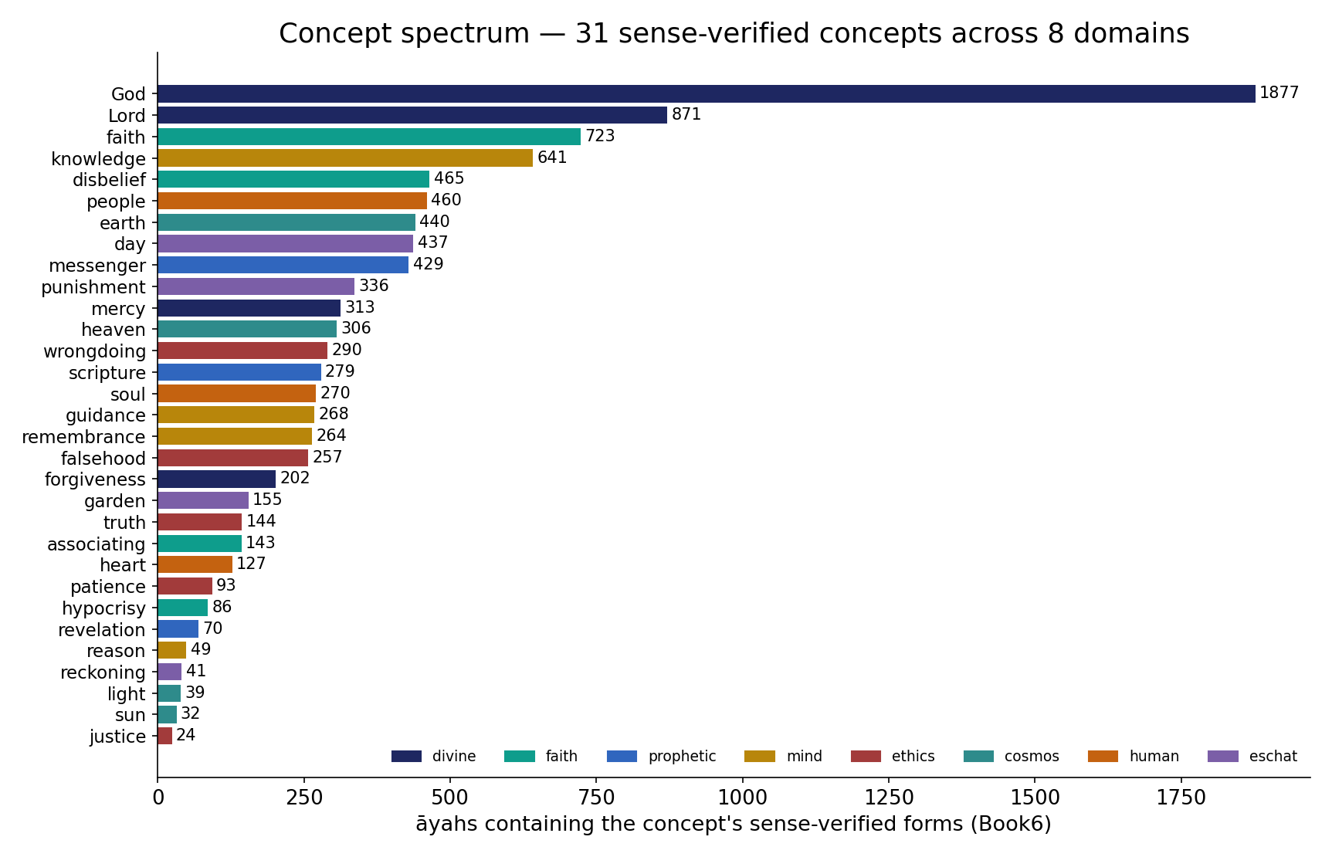
Real data — a spectrum of concept-fields across domains
In the data — diverse concept-roots by āyah-reach (Book6), coloured by domain: God 1877, knowledge 641, faith 723 … down to justice 24 — pervasive to sparse across 8 domains (divine, faith, prophetic, mind, ethics, cosmos, human, eschatology); a real, broad semantic spectrum of the corpus, like protein-family sizes.

Slide 5
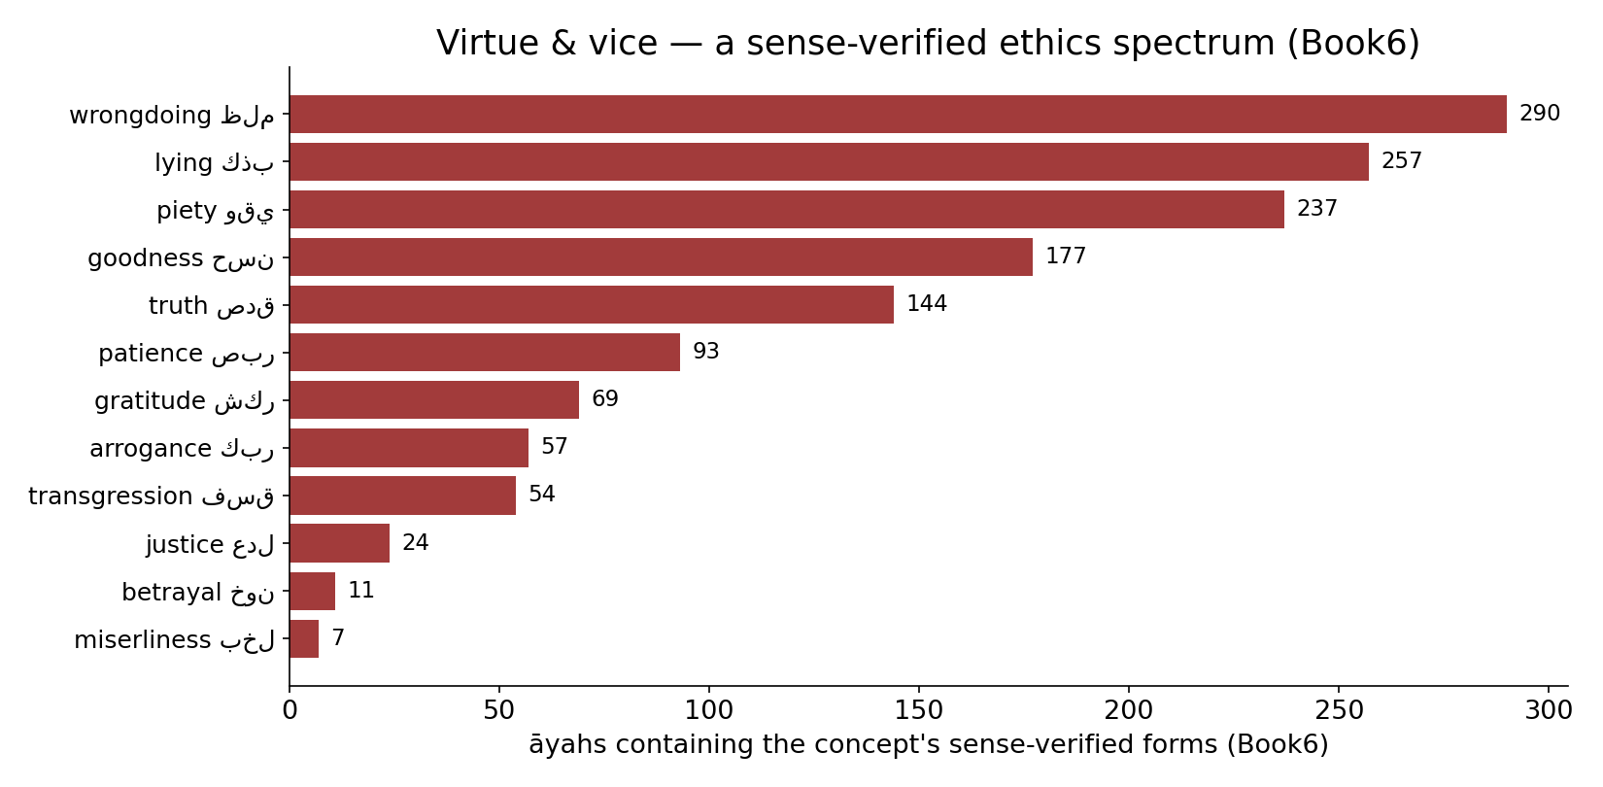
A virtue & vice spectrum — sense-verified
In the data — diverse ethical concepts by āyah-reach (sense-verified forms, Book6): wrongdoing 290, lying 257, piety 237, goodness 177 … betrayal 11, miserliness 7 — a broad, unevenly weighted moral vocabulary.

Slide 6
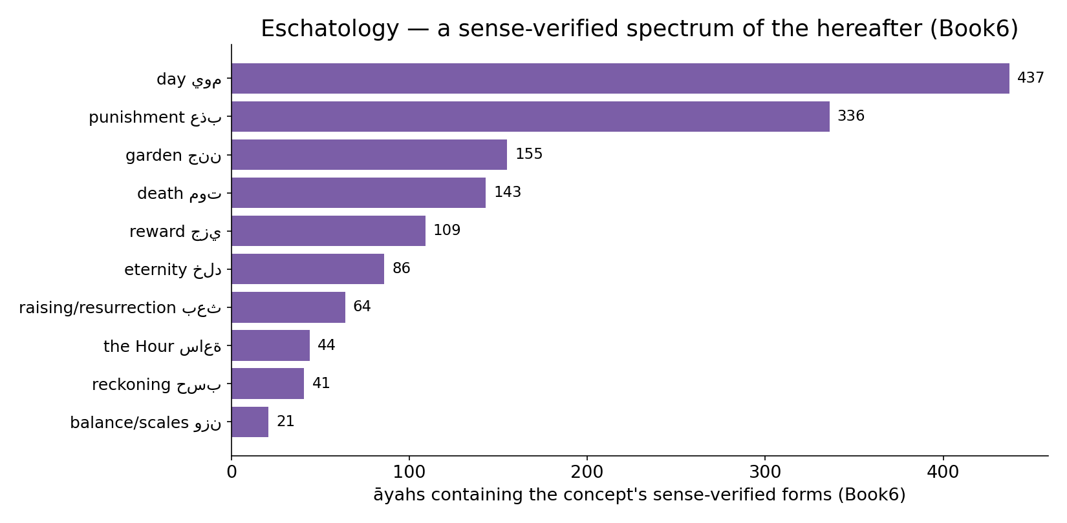
An eschatology spectrum — sense-verified
In the data — concepts of the hereafter by āyah-reach (sense-verified, Book6): day 437, punishment 336, garden 155, death 143, reward, reckoning, eternity, raising — a coherent thematic field across the corpus.

Slide 7
Reusable parts — domains and morphemes
the same part appears in many wholes
domain X
in protein A
in protein B
in protein C
pattern مَفعَل
مكتب
مسجد
منزل
A finite parts-list, recombined
One protein DOMAIN recurs across many unrelated proteins, contributing the same sub-function each time. One Arabic PATTERN (مَفعَل = 'place of') recurs across many roots, contributing the same sense ('place of writing' → office; 'place of prostration' → mosque). Reusable parts, both Books.

Slide 8
The data — a few parts, much of the output
Protein domains — coverage (%, schematic)
Arabic — top patterns' share of forms (%)
50
50
65
35
top 100 domains
the rest
top 10 patterns
the rest
A small domain set covers most proteins
A few hundred common domains account for the bulk of the proteome — a reusable library does most of the work. (Schematic proportions.)
A few patterns make most words
A small inventory of awzan generates most derived forms. Both Books build a vast output from a compact, reused library of parts.

Slide 9
A field is a network of related members
a centre, near neighbours, and a periphery
رحمن
رحيم
رحمة (core)
راحم
مرحمة
Centre and periphery — measurable structure
Within a field, some members sit at the conceptual centre (most frequent, most general) and others at the edge (rare, specialized). A protein family has the same shape: a conserved core sequence and divergent members. The geometry — hub plus periphery — recurs in both Books (and returns in Lecture 14).

Slide 10
The data — tight within, distinct across
Within vs across field — shared sense (%)
Within vs across protein family — identity (%)
88
42
8
9
within field
across fields
within family
across families
Fields are coherent
Members of one semantic field share a sense ~88% of the time; across fields, only ~9%. The clustering is real and sharp — fields are genuine categories, not arbitrary groupings.
So are protein families
Within a family, sequences average ~40%+ identity; across families, ~8% (chance). The same within-tight / across-distinct signature defines a real family in both Books.

Slide 11
A hierarchy — unit, family, super-family
meaning and function are organized in LEVELS
word / protein
the unit
field / family
close relatives
domain-of-meaning / clan
distant kin
Nested categories, both Books
Words nest into fields into broad domains-of-meaning; proteins nest into families into clans. The hierarchy of relatedness is a shared organizing principle — categories within categories.

Slide 12
The data — distance is graded, not binary
Qur'an — sense overlap vs root relatedness
Protein — function overlap vs sequence identity
95
90
60
55
9
15
same root
same field
unrelated
>50%
30-50%
<20%
Meaning fades with distance
Shared sense falls smoothly from same-root (~95%) to same-field (~55%) to unrelated (~9%). Relatedness is a continuum, and meaning tracks it.
Function fades with divergence
Shared function falls smoothly from high identity (~90%) to the twilight zone to unrelated (~15%). Both Books show a graded distance–role relationship — measurable, not all-or-nothing.

Slide 13
Validation — fields are real, not imposed
Field coherence: observed vs shuffled labels (%)
Family coherence: observed vs random grouping (%)
88
42
8
10
null (shuffled)
observed
null (random)
observed
Shuffling destroys the field
Randomly reassigning words to fields drops coherence to ~10%; the real fields hold ~88%. The category structure beats chance overwhelmingly — fields are discovered, not invented.
Random grouping destroys the family
Random protein groupings give ~8% within-identity; real families ~42%. The SAME test — observed vs a shuffle null — validates family structure in both Books.

Slide 14
Closest cousins — and the boundary
WHY THE PARALLEL IS STRONG
Both Books organize meaning/function into families with a conserved core, reusable parts, a centre–periphery geometry, a graded distance–role law, and coherence that beats a shuffle null. The organizing PRINCIPLE is genuinely shared.
WHERE IT STOPS
A semantic field is held together by human convention and association; a protein family by shared ancestry and physics. The category SHAPES match; the forces that make them do not. Structure, never substance.

Slide 15
You shall know a unit by the company it keeps
Qur'an — words co-occurring with رحمة (lift)
Cell — co-expressed genes define a module
6.2
0.80
3.1
0.4
0.05
غفور
رب
عذاب
same pathway
random pair
Context locates meaning
Words that keep company define a field: رحمة sits with غفور and رب far more than chance (high lift), with عذاب rarely. Distributional context maps the semantic neighbourhood — the basis of word embeddings.
Co-expression locates function
Genes switched on together belong to the same pathway/module (high co-expression correlation); random pairs do not. 'Company' defines the functional neighbourhood in the cell too.

Slide 16
Opposites — structured poles, not noise
Qur'an — antonym pair balance (token counts)
Cell — opposed regulators (schematic)
194
1
1
118
نور (light)
ظلمات (darkness)
activator
repressor
Fields have poles
Many concepts come in opposed pairs (نور/ظلمة, هدى/ضلال, إيمان/كفر) that co-occur deliberately. Opposition is part of the field's STRUCTURE, not its noise — measurable, recurring contrasts.
So do regulatory systems
Biology pairs opposites too — activators vs repressors, kinases vs phosphatases — to control a process by balance. Both Books organize meaning/function around structured opposition.

Slide 17
Two maps — semantic space and fold space
items placed so that NEAR = related
SEMANTIC SPACE
word embeddings: related words cluster
FOLD / SEQUENCE SPACE
protein embeddings: related proteins cluster
Same idea, two corpora
Modern NLP places each word as a vector so that distance encodes relatedness; structural biology does the same for proteins (sequence/structure embeddings). In both, a field or family becomes a measurable CLUSTER in a high-dimensional space — and the clustering is the validation.
The geometry is shared; the meaning of 'distance' (sense vs structure) is not.

Slide 18
Bridges — units that link families
Polysemous roots spanning >1 field (%)
Multi-domain proteins linking families (%)
55
60
45
40
single field
spans fields
single family
multi-family
Polysemy bridges fields
A root with senses in two fields links them (e.g. a root spanning 'covering' and 'forgiving'). These bridges knit the lexicon into a connected web rather than isolated islands.
Multi-domain proteins bridge families
A protein carrying domains from two families couples their functions, wiring the proteome together. In both Books, shared parts are the BRIDGES between otherwise separate families.

Slide 19
How families grow — derivation and duplication
Qur'an — a field grows by derivation (forms)
Cell — a family grows by duplication (members)
12
8
6
1
1
root
+patterns
+affixes
ancestor
+duplications
Words multiply by derivation
A field expands as a root is poured through patterns and affixes — controlled generation of new members on one theme.
Proteins multiply by duplication
A protein family expands when a gene is duplicated and the copies diverge — new members on one ancestral theme. Different mechanism, same outcome: a growing, structured family.

Slide 20
Audit — supported, broken, silent
✓ SUPPORTED
Family organization, reusable parts, heavy-tailed family sizes, graded distance–role law, centre–periphery geometry, coherence beating a null — measured in both Books.
✗ BREAKS
Semantic fields are conventional/associative; protein families are genealogical/physical. The cohesion has different CAUSES; shared shape is not shared mechanism.
~ SILENT (surmisable)
Whether finer sub-field structure maps onto sub-family/domain architecture in detail is open — it needs its own alignment and null.

Slide 21
Synthesis & discussion — the family as unit
ORGANIZATION IS THE MESSAGE
Zoom out from the single root or gene and a shared architecture appears: families with cores and peripheries, built from reusable parts, graded by distance, validated against chance. Both Books organize meaning/function the same way — even though convention and physics are different engines.
FOR DISCUSSION
• Is a 'semantic field' as objective as a protein family? • What is the linguistic analogue of a reusable domain — the pattern, the morpheme? • Could field coherence be an artefact of how we defined fields? • What null would you trust?

Slide 22
Real-world relevance & takeaway
REAL-WORLD RELEVANCE
Clustering, family classification, and distance metrics are one toolkit across lexicons and proteomes — word embeddings and protein-family databases solve the same problem.
THE TAKEAWAY
Meaning and function are organized into FAMILIES — cores, reusable parts, graded distance — coherent far beyond chance in both Books. The organizing principle is shared; the forces are not.

