Slide 1
THE TWO BOOKS · a Qur’an-and-science lecture
Istinsākh & the Genome
Book of CREATION
the genome
Book of SCRIPTURE
the record of deeds
āyāt (signs)
“…We were TRANSCRIBING (نستنسخ) what you used to do.” — 45:29
A labelled analogy, audited stage by stage: ✓ Supported · ✗ Breaks · ~ Silent-but-surmisable. No “scientific-miracle” claims.

Slide 2
The Two Books — two revelations of one Author
عالم التدوين — the WORD (قول الله)
The Qur’an: God’s speech, revealed in language. The composed Book — tadwīn, “what is set down.” The Book of SCRIPTURE.
عالم التكوين — the ACT (فعل الله)
The Universe: God’s deed, revealed in creation. The Book of CREATION — takwīn, “what is brought into being.”
One Author · one reader
Same SOURCE — Allah. Same primary ADDRESSEE — the human being (insān); the jinn too (a later lecture). Both are āyāt (signs); this series reads them side by side, never collapsed.

Slide 3
The question — a life recorded, to what end?
THE HOOK
The Qur’an: deeds are written down, by watchers, omitting nothing. Biology: cells continually TRANSCRIBE coded instructions, expressed later as traits.
One shape: copy now, express later, lose nothing. We test it honestly.
THE RULE
For every parallel: does the text SUPPORT it, BREAK it, or is it SILENT but surmisable? Never claim the Qur’an “contains” genetics.

Slide 4
The genome’s pipeline (central dogma)
BOOK OF CREATION — molecular biology
DNA
genome
transcription
mRNA
transcript
translation
protein
express
phenotype
trait
Read left to right
An inherited archive (DNA) is COPIED into a working message (transcription), the message is READ into a protein (translation), and proteins make the organism’s visible traits — the phenotype, expressed later, in context.
Three moves: copy → read → express. Information is preserved throughout.

Slide 5
The deeds pipeline (the Qur’an’s record)
BOOK OF SCRIPTURE — the record of deeds
deeds
free acts
istinsākh 45:29
record
الكتاب
read & weigh 17:14
reckoning
اقرأ كتابك
requital
outcome
hereafter
The same three moves
Free deeds are TRANSCRIBED into a record (نستنسخ, 45:29), the record is READ — “Read your record; you suffice as your own reckoner” (17:14) — and weighed on the just scales (21:47), and the consequence is EXPRESSED in the hereafter.
copy → read → express — stated in the text’s own words.

Slide 6
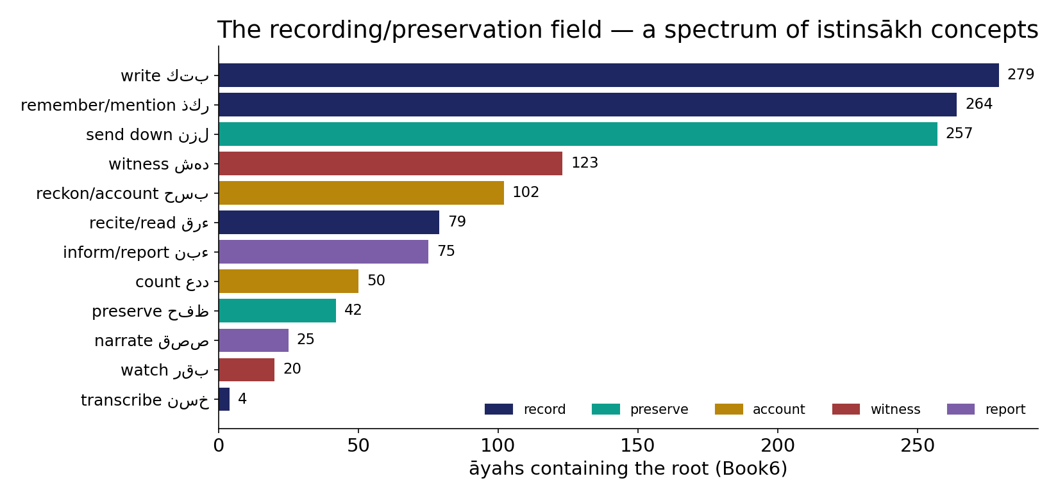
Real data — the recording / preservation field
In the data — a spectrum of istinsākh (transcription) concepts by āyah-reach: write كتب 279, remember ذكر 264, send-down نزل 257 … transcribe نسخ 4 — the Qur'an's own vocabulary of recording and preservation, computed from Book6.

Slide 7
The two pipelines, side by side
GENOME
DNA
genome
transcription
mRNA
transcript
translation
protein
express
phenotype
trait
✓
✓
✓
✓
DEEDS
deeds
free acts
istinsākh
record
الكتاب
read & weigh
reckoning
اقرأ كتابك
requital
outcome
hereafter
Same structure, stage for stage — copy → read → express, lose nothing. (Where it BREAKS comes next.)

Slide 8
What an analogy is — and the three verdicts
MAPS STRUCTURE, NOT IDENTITY
An analogy lines up the SHAPE of two systems to think with. It is not a claim of identity, shared mechanism, or prediction.
THREE VERDICTS (the Week-9 audit)
✓ SUPPORTED — the text states it.
✗ BREAKS — the text contradicts it.
~ SILENT — but surmisable from the text.

Slide 9
Where it BREAKS — fidelity
BIOLOGY
copying has ERRORS → repair fixes most
THE RECORD
bil-ḥaqq — ERROR-FREE
vs
✗ The parallel cracks here
Biology is accurate but imperfect — mutations happen, and cells run proofreading and repair. The Qur’anic record is described as flawless: “in truth,” “you are not wronged a single thread.”
Perfect fidelity vs an error-prone, self-correcting system. Honest verdict: BREAKS.

Slide 10
Molecular biology — by the numbers
Fidelity (1 error per 10^N — higher = better)
The genetic code is tiny
9.0
64
4.5
3.5
20
4
DNA copy
transcription
translation
bases
amino acids
codons
Finite fidelity — quantified
DNA copying is near-perfect — ~1 error per 10^9 bases (proofreading + repair); transcription/translation are looser (~1 per 10^4). The record’s claim is PERFECT (bil-ḥaqq) — off this chart. That is the fidelity break, in numbers.
A small code, vast output
4 bases → 64 triplet codons → 20 amino acids build ALL proteins; the Qur’an: ~28 letters → ~1700 roots. Small alphabets, unbounded output.

Slide 11
A one-way bias toward the good
الحسنات
good deeds
drive away (11:114)
السيئات
bad deeds
✗
no auto-reverse
✓ SUPPORTED — and directional
“The good deeds drive away the bad” (11:114); repentance converts bad into good (25:70). There is NO symmetric rule that bad erases good — the arrow points one way.
Biology echoes this only as ERROR-CORRECTION (DNA repair; error-correcting codes; smaller chips → more capacity). CAVEAT: do NOT read it as “evolution → perfection” — that overreach is excluded.

Slide 12
The transcript is editable — repentance
أم الكتاب
master archive (13:39)
the record
سيئات (draft)
repentance 25:70
rewritten
حسنات
The text OVER-answers biology
Biology’s pipeline is largely write-once. But the text is not silent: for the repentant, “God CONVERTS their evil deeds into good” (25:70); “He erases what He wills and confirms, and with Him is the Mother of the Record” (13:39).
Hope is built into the pipeline — the draft can be rewritten before the final read.

Slide 13
The scorecard — going back and forth
✓ SUPPORTED
Transcription (deeds→record) 45:29
Translation (record→verdict) 17:14
Phenotype (deferred outcome)
Nothing lost / fidelity 78:29
Weighed, not tallied 21:47
Editable by repentance 25:70
One-way bias toward good 11:114
✗ BREAKS
Error-free vs error-prone biology
Consequence NOT inherited 35:18
Free deeds AUTHOR the code
Expressed in ANOTHER realm
Moral, not blind expression
“Evolution→perfection” — overreach
~ SILENT (surmisable)
Mechanism of recording — unstated
HOW deeds are “weighed” — unstated
Descendants’ share by grace 52:21
umm al-kitāb as “master archive”

Slide 14
The data — nothing omitted
Qur'an — completeness terms (occurrences)
Cell — every division copies the whole genome (log10)
279
9.5
42
11
0.5
كتب
حفظ
احصى
bases copied
errors left
'It omits nothing'
The record is exhaustive — 'leaving out nothing small or great' (18:49); writing (كتب) 279, preserving (ḥifẓ) 42, enumerating (aḥṣā) 11. Completeness is a stated property.
Every cell, the whole archive
Each cell division copies all ~3.2 billion bases — the COMPLETE genome — into the daughter cell, with proofreading leaving ~1 error per 10^9. Exhaustive copying is a real biological fact too.

Slide 15
The data — a dedicated apparatus does the copying
Qur'an — recording agents/terms (occurrences)
Cell — machines of the central dogma (proofread?)
160
1
1
1
57
20
رقب (watcher)
شهد (witness)
عدد
polymerase
ribosome
repair
Recording is staffed, not casual
The text names dedicated agents — watchers (raqīb), witnesses (shahida ~160), noble scribes (kirāman kātibīn). Recording is performed by an apparatus, not left to chance.
So is transcription
The cell runs dedicated machines — RNA polymerase, the ribosome, and repair enzymes — each with proofreading. Both Books copy with purpose-built machinery, not by accident.

Slide 16
Copied now, expressed later — the timing
the record is written before its consequence appears
gene copied
at conception
developmental clock
trait expressed
years later
deed → record → reckoning
outcome deferred (hereafter)
Expression is deferred in both Books
A gene is copied at conception but many traits switch on much later, on a developmental schedule. A deed is recorded now but its consequence is expressed later, at the reckoning. In both, there is a gap — copy first, express on a timetable — and the gap is where REGULATION lives (Lecture 12).
Same structure: archive early, express on schedule, in context.

Slide 17
What this lecture does NOT claim
NOT A “SCIENTIFIC MIRACLE”
No verse is read as biology; no biology is offered as proof. iʿjāz-by-science is exactly the unsubstantiated move this course rejects.
WHAT IT IS
A structurally honest mental model — 7 parallels supported, 6 broken, 4 left silent but surmisable.

Slide 18
Synthesis & discussion — the Two Books
THE TWO BOOKS
The genome is a page of the Book of Creation; istinsākh (45:29) is from the Book of Scripture — both called āyāt. Read side by side (never collapsed), each lends the other a grammar of consequence: copy now, express later, lose nothing, bias toward the good.
FOR DISCUSSION
• Where do the Two Books agree, and break? • Is repentance an edit or a new transcript (25:70 / 13:39)? • Why a one-way arrow toward the good that biology mirrors only as repair? • What does reading creation as an āyah ask of a scientist?

Slide 19
Appendix — the verses (Book6, vocalized col 11)
هَذَا كِتَابُنَا يَنطِقُ عَلَيْكُم بِالْحَقِّ إِنَّا كُنَّا نَسْتَنسِخُ مَا
45:29 · TRANSCRIPTION & fidelity
فَمَن يَعْمَلْ مِثْقَالَ ذَرَّةٍ خَيْرًا يَرَهُ
99:7 · TRANSLATION / weighing
إِلَّا مَن تَابَ وَآمَنَ وَعَمِلَ عَمَلًا صَالِحًا فَأُوْلَئِك يُبَدِّلُ اللَّهُ
25:70 · EDITABLE & directional
وَكُلَّ شَيْءٍ أَحْصَيْنَاهُ كِتَابًا
78:29 · TRANSCRIPTION & fidelity
اقْرَأْ كتَابَك كفَى بِنَفْسِك الْيَوْمَ عَلَيْك حَسِيبًا
17:14 · TRANSLATION / weighing
يَمْحُو اللّهُ مَا يَشَاء وَيُثْبِتُ وَعِندَهُ أُمُّ الْكِتَابِ
13:39 · EDITABLE & directional
وَوُضِعَ الْكِتَابُ فَتَرَى الْمُجْرِمِينَ مُشْفِقِينَ مِمَّا فِيهِ وَيَقُولُونَ يَا وَيْلَتَنَا مَالِ
18:49 · TRANSCRIPTION & fidelity
وَنَضَعُ الْمَوَازِينَ الْقِسْطَ لِيَوْمِ الْقِيَامَةِ فَلَا تُظْلَمُ نَفْسٌ شَيْئًا
21:47 · TRANSLATION / weighing
وَأَقِمِ الصَّلاَةَ طَرَفَيِ النَّهَارِ وَزُلَفًا مِّنَ اللَّيْلِ إِنَّ الْحَسَنَاتِ
11:114 · EDITABLE & directional

Slide 20
Real-world relevance & takeaway
REAL-WORLD RELEVANCE
A vivid, accountable mental model for how a life is recorded and its consequence deferred — and a guard against “scientific-miracle” overreach.
THE TAKEAWAY
Deeds are transcribed now, expressed later, nothing lost — a labelled analogy, audited, never offered as proof.

