Slide 1
THE TWO BOOKS · Lecture 11 · keeping the copy true
Fidelity & Preservation
How a code is kept from drifting
Copying always risks error. The cell answers with PROOFREADING and REPAIR; the Qur'anic tradition answers with ḥifẓ — memorization and meticulous written transmission. This lecture measures the cell's fidelity in numbers, describes the text's preservation, and states honestly where they agree and where they part: an imperfect-but-self-correcting system versus a claim of perfect preservation.
Biology figures mainstream; preservation treated as transmission history + a textual claim. Every parallel audited ✓ / ✗ / ~ — no 'miracle' proof.

Slide 2
The Two Books — two revelations of one Author
عالم التدوين — the WORD (قول الله)
The Qur'an: God's speech in language — tadwīn.
عالم التكوين — the ACT (فعل الله)
The living cell: God's deed in creation — takwīn.
One Author · one reader
Same source; both āyāt. Here: how each KEEPS its text true.

Slide 3
Every copy risks an error
the universal problem of transmission
original
copy (error?)
copy
may drift
repeat
...
Without correction, copies decay
Any system that copies — DNA across cell divisions, a text across scribes and reciters — accumulates errors unless something CHECKS each copy. Fidelity is not automatic; it must be engineered. Both Books face the same problem; this lecture compares their answers.
The question is not 'is there error?' but 'how is it caught and corrected?'

Slide 4
The data — the cell's error rates, by stage
Fidelity (1 error per 10^N — higher = better)
Error reduction by each safeguard (fold)
9.0
3.0
7.0
2.5
2.0
4.5
3.5
DNA + repair
DNA polymerase alone
transcription
translation
base pairing
proofreading
mismatch repair
Near-perfect, but not perfect
DNA copying reaches ~1 error per 10^9 bases — but only AFTER layered correction. Raw polymerase is ~1 per 10^7; transcription/translation are far looser (~1 per 10^4). Fidelity is a stacked achievement.
Each safeguard multiplies accuracy
Base-pairing (~10^2), polymerase proofreading (~10^2-3), and mismatch repair (~10^2-3) compound to ~10^9. Remove any layer and errors surge — fidelity is built in stages. (Folds are log10 orders.)

Slide 5
The cell's defence — layered correction
three lines of defence, each catching what the last missed
base pairing
right partner only
proofreading
polymerase backs up
mismatch repair
fixes errors after
Redundant checking is the secret
No single mechanism is perfect; the genome stays faithful because INDEPENDENT checks are stacked, so an error must slip past all of them. The same logic preserves a text: independent reciters and written copies cross-check, so a slip in one is caught by the others.
Fidelity = redundancy + independent verification — in both Books.

Slide 6
The text's defence — ḥifẓ and writing
two independent channels, cross-checking
الحِفظ — memorization
oral channel: huffāẓ recite from memory
الكتابة — writing
written channel: copied manuscripts
Two channels, mutually correcting
The Qur'an is transmitted by TWO independent channels at once — an oral tradition of memorizers and a written manuscript tradition — each able to correct the other. A scribal slip is caught by reciters; a misremembering is caught by the text. This is precisely the cell's strategy of independent, redundant checks.
The claim of preservation rests on this dual, cross-verified transmission.

Slide 7
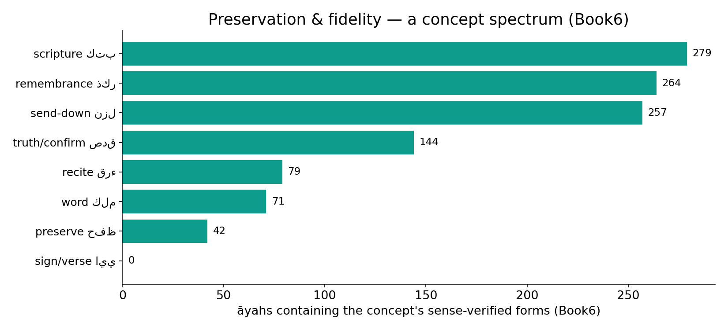
Real data — the preservation & fidelity field
In the data — the corpus vocabulary of preservation by reach (verified forms, Book6): scripture 279, remembrance 264, send-down 257, recite, preserve, sign, word — a recurring fidelity field, the analogue of error-correction machinery.

Slide 8
The data — more copies, lower error
Error surviving N independent checks (-log10)
Undetected slip vs # independent transmitters (-log10)
9
8
6
4
3
2
1 check
2 checks
3 checks
1
100
many
Independent checks multiply
If each check independently catches all but 1-in-10^3 errors, two checks leave 1-in-10^6, three 1-in-10^9 — exactly how the genome reaches its fidelity. Redundancy is multiplicative.
Independent transmitters do the same
An error must survive EVERY independent transmitter to go unnoticed; with many independent lines, the chance of undetected drift falls steeply. The mathematics of redundancy is shared by both Books.

Slide 9
Where they part — repaired vs preserved
BIOLOGY — imperfect, self-correcting
The genome is near-perfect but NOT error-free: mutations occur, slip past repair, and accumulate over generations — indeed that variation is the raw material of evolution. Fidelity is high, finite, and statistical.
THE TEXT — claimed perfect
The Qur'an is described as preserved without error (15:9; bil-ḥaqq). This is a stronger claim than any biological system meets — perfect, not merely high, fidelity. We mark this as the honest BREAK, not a match.

Slide 10
The gap, quantified
Claimed vs achieved fidelity (-log10 error)
Mutations fixed per genome per generation
18
1000
9
4
70
translation
DNA+repair
text (claimed)
arise
escape repair (fixed)
A real, measurable difference
Biology tops out near 1-in-10^9 (DNA); the text's claim is effectively errorless (off-chart). The bar marked 'text' is a CLAIM, not a measured rate — shown to make the contrast explicit, not to assert proof.
Biology keeps some change on purpose
~10^3 mutations arise per genome per generation; ~tens escape repair and are inherited. Biology does not WANT perfect fidelity — variation feeds adaptation. The text's preservation goal is the opposite.

Slide 11
The data — fidelity has a cost
Proofreading slows replication (relative)
Careful transmission takes effort
100
4
40
1
no proofread
with proofread
casual copy
verified (tajwīd/isnād)
Accuracy trades against speed
Proofreading and repair consume time and energy — a cell that checks copies replicates more slowly. High fidelity is paid for, not free. (Relative rates, schematic.)
So does verified transmission
Preserving a text precisely takes disciplined effort — careful recitation rules (tajwīd) and chains of verification (isnād). In both Books, fidelity costs resources; it is a priority, deliberately funded.

Slide 12
One mathematics — error-correcting codes
redundancy that not only DETECTS but CORRECTS
add redundancy
extra check bits / copies
detect error
a copy disagrees
correct
majority wins
The same idea runs from DNA to digital
Information theory shows how redundancy lets a message survive a noisy channel — used in DNA repair, in CDs and deep-space links, and, structurally, in a text carried by many independent witnesses. Store extra copies, compare, and let agreement correct disagreement.
Fidelity is an information-theoretic achievement, wherever it occurs.

Slide 13
Validation — redundancy provably lowers error
Observed error vs # repair layers (-log10)
Undetected error vs redundancy (model, -log10)
9
7
7
5
4
3
2
0
1
2
3
x1
x10
x100
Knock out repair, watch error rise
Cells with repair genes disabled show measurably higher mutation rates — a direct, experimental confirmation that the layered system is what delivers fidelity. The mechanism is testable, not assumed.
Redundancy's effect is calculable
The drop in undetected error with added independent copies follows a clean law — the same law whether the copies are repair enzymes or independent transmitters. Both Books obey the mathematics of redundancy.

Slide 14
The data — a specific check for each error type
Cell — dedicated repair pathways (count)
Text — kinds of slip and their check
2
2
1
1
1
1
1
mismatch
excision
double-strand
direct
mishearing
miswriting
skipping
Many error types, many fixes
The cell runs SPECIALIZED pathways — mismatch repair, base/nucleotide excision, double-strand-break repair, direct reversal — each tuned to a kind of damage. Fidelity is not one tool but a toolkit.
So does careful transmission
Different transmission errors have different checks: a mishearing is caught by the written text, a miswriting by reciters, a skipped line by counting verses. A specific safeguard per error type — the same design, both Books.

Slide 15
Two capabilities — detect, then correct
finding an error is not the same as fixing it
DETECT
a copy disagrees — error flagged
needs a reference
CORRECT
restore from the true copy
Correction needs a trusted reference
Detection only needs disagreement; CORRECTION needs to know which copy is right. The cell uses the intact strand as the template (the original is the reference); the tradition uses the cross-verified consensus (the agreed reading) as the reference. Both restore the error to the KNOWN-true version.
No reference, no correction — only a warning. The reference is the heart of fidelity.

Slide 16
The data — a reference to copy against
Cell — reference genome closes error (-log10)
Text — a standard reference (schematic)
9
7
3
1
no template
with template strand
pre-standard variants
standardized consensus
The intact strand is the reference
Repair works because DNA is double-stranded: the undamaged strand is a built-in REFERENCE to rebuild the damaged one. A reference copy turns mere detection into true correction (~10^3 → 10^9).
A standardized consensus is the reference
Early standardization (the ʿUthmānic codex) fixed a single reference text, against which all copies are checked — the textual analogue of a reference genome / consensus sequence. (Proportions schematic.)

Slide 17
The data — remove the checks, and it drifts
Errors accumulated over copies (no repair, rel.)
Surviving fidelity with vs without checks (-log10)
1000
9
2
100
10
10
100
1000 copies
with checks
without
Uncorrected error compounds
Without repair, errors accumulate linearly with the number of copies — a code left unchecked degrades steadily. This is exactly the fate the safeguards exist to prevent.
Checking is what holds the line
With the checks, fidelity stays near 10^9; without them it collapses toward 10^2. The DIFFERENCE the safeguards make is enormous and measurable — fidelity is an active achievement, in both Books.

Slide 18
Audit — supported, broken, silent
✓ SUPPORTED
Both keep a copy true by REDUNDANCY + independent cross-checking; both pay a cost for fidelity; both obey the mathematics of error-correcting codes. Structurally, the strategy is shared and testable.
✗ BREAKS
Biology is high-but-finite fidelity and KEEPS some error on purpose (variation feeds evolution); the text claims PERFECT, error-free preservation. Different goals, different guarantees — the honest break.
~ SILENT (surmisable)
How a theological 'guarding' (15:9) relates to physical mechanism is outside measurement; the parallel is in STRATEGY (redundancy), not in the source of the guarantee.

Slide 19
Synthesis & discussion — keeping the text true
THE SHARED STRATEGY
Faced with the same threat — copying error — both Books reach for the same engineering: stack independent, redundant checks so an error must beat them all. The cell does it with base-pairing, proofreading, and repair; the tradition does it with parallel oral and written transmission. The STRATEGY is shared and provably effective; the GUARANTEE (statistical vs claimed-perfect) is where they part.
FOR DISCUSSION
• Why does biology not 'want' perfect fidelity? • Is dual oral+written transmission really like proofreading + repair? • What would it take to TEST a preservation claim? • Where is the line between a mechanism and a claim?

Slide 20
Real-world relevance & takeaway
REAL-WORLD RELEVANCE
Error-correcting codes — the same redundancy-plus-verification — protect your files, space probes, and genomes alike; fidelity is a universal engineering problem with a universal answer.
THE TAKEAWAY
Fidelity = redundancy + independent cross-checking, paid for, and provably effective — shared by both Books. The honest difference: biology is high-but-finite (and keeps some error); the text claims perfect preservation.

