Slide 1
THE TWO BOOKS · Lecture 12 · when and where it speaks
Regulation & Context
Having a code is not using it — expression is controlled
A cell carries the whole genome but EXPRESSES only a fraction in any tissue; the Qur'an's lexicon is vast but each passage USES only a slice. This lecture measures that selective expression — which units are 'on' where — and shows how CONTEXT (a promoter, a syntax, an occasion) decides what is expressed and what a unit means. This is Pillar 3 at its core: expression, not possibility, makes the realized text.
Qur'an figures computed from Book6; biology mainstream. Every parallel audited ✓ / ✗ / ~.

Slide 2
The Two Books — two revelations of one Author
عالم التدوين — the WORD (قول الله)
The Qur'an: God's speech in language — tadwīn.
عالم التكوين — the ACT (فعل الله)
The living cell: God's deed in creation — takwīn.
One Author · one reader
Same source; both āyāt. Here: what is EXPRESSED, when, and where.

Slide 3
The whole code is present; only some is expressed
same archive, different active subset
full genome
~20,000 genes
in a neuron
~half ON
neuron set
in a liver cell
different set
Identity comes from expression, not content
A neuron and a liver cell hold the SAME genome; they differ because they EXPRESS different subsets of it. Likewise the whole lexicon is available, but each surah activates only a slice — and the slice gives the passage its character.
What you ARE is what you express — both Books.

Slide 4
The data — only a slice is expressed per context
Qur'an — distinct roots per surah (% of lexicon)
Genome — genes expressed per cell type (%)
36.0
55
30
7.3
9.3
0.2
smallest
median
mean
largest
minimal cell
typical tissue
Each surah uses ~9% of the lexicon
Computed: a surah expresses on average 157 of 1,702 roots (9.3%); the largest (al-Baqarah) 606 (36%), the smallest (al-Kāfirūn) just 4. Selective expression, measured.
Each cell uses ~half its genes
A given cell type transcribes roughly 50% of its ~20,000 genes; the rest stay silent. Both Books deploy only a context-dependent SUBSET of the available code.

Slide 5
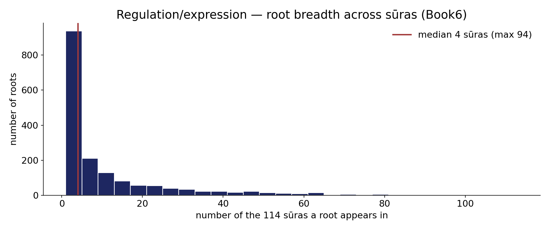
Real data — root breadth across sūras
In the data — every root by how many of the 114 sūras it appears in (median 4, max 94): most roots are context-specific (few sūras), a few are near-ubiquitous 'housekeeping' — the expression/regulation profile, like tissue-specific vs housekeeping genes.

Slide 6
The switch — what turns a unit on
a control element decides whether the unit is read
GENE: promoter + transcription factor
context binds → gene ON
WORD: syntax + occasion
context selects → sense ON
Expression is addressed, not automatic
A gene fires only when the right transcription factors bind its promoter/enhancer in that cell; a word's intended sense activates only when the surrounding syntax and the occasion (asbāb al-nuzūl) call for it. In both Books, a CONTROL SIGNAL in the context — not the unit alone — decides what is expressed.
The unit is potential; the context is the switch.

Slide 7
The data — context resolves which sense / which isoform
Arabic — ambiguous skeletons resolved by context (%)
Gene — isoform chosen by cell context (schematic)
80.4
3
1
19.6
ambiguous alone
resolved in context
default
context-switched
Context picks the reading
A skeleton with several possible vocalizations (19.6%) is resolved by its sentence — the same unit, one realized meaning, chosen by context. Polysemy collapses to sense at the moment of use.
Context picks the isoform
The same gene yields different isoforms in different tissues — splicing is regulated by cellular context. In both Books, context CHOOSES among a unit's potential outputs.

Slide 8
Staged expression — revelation order and development
the program unfolds on a schedule
EARLY (Meccan)
faith, the unseen, the self
then
LATER (Medinan)
law, community, structure
developmental clock
genes on in sequence
Order is part of the message
Revelation unfolded in a sequence — foundational themes first (Meccan), communal and legal structure later (Medinan) — a staged program, not a data-dump. Development works the same way: master genes switch on in a fixed temporal order, building the organism stage by stage. Both Books EXPRESS in time, in order.
The schedule of expression carries meaning the static code does not.

Slide 9
The data — regulation is layered
Gene — layers of control (count)
Word — layers of context (count)
1
1
1
1
1
1
1
1
promoter
enhancers
epigenetic
RNA-level
syntax
passage
occasion
whole text
Many layers tune a gene
Expression is set by stacked controls — promoter strength, distant enhancers, epigenetic marks, RNA-level regulation. No single switch; a committee of signals integrates to a decision.
Many layers tune a meaning
A word's force is set by stacked contexts — immediate syntax, the passage, the occasion of revelation, the whole text's themes. Meaning, like expression, is an INTEGRATION of nested contexts.

Slide 10
Conditional expression — if this, then that
expression responds to conditions, and feeds back
signal
a condition
if present
express
unit turns on
feedback
adjust
up/down regulate
Responsive, not fixed
Genes carry conditional logic — express IF a signal is present, then feed back to fine-tune (homeostasis). Scripture, too, is responsive: many passages answer a specific occasion ('they ask you about…') and conditions ('if… then…'). Both Books express in RESPONSE to conditions and adjust by feedback.
Expression is a dialogue with context, not a broadcast.

Slide 11
The data — the default is silence
Genome — fraction of genes OFF in a given cell (%)
Lexicon — fraction of roots ABSENT from a surah (%)
50
50
91
9
ON
OFF (repressed)
expressed
absent
Most genes are kept off
In any cell, roughly half the genome is actively repressed — silence is the default, and expression is a deliberate exception that must be switched ON.
Most roots are absent per passage
On average ~91% of the lexicon does NOT appear in a given surah. Selective silence is the rule; what IS expressed is therefore meaningful by its very presence. Both Books speak by choosing what to leave out.

Slide 12
The data — units expressed together work together
Qur'an — roots co-occurring in a surah (lift, sample)
Genome — co-expressed genes in a module (corr.)
4.5
0.80
1.0
0.05
thematic pair
random pair
same module
random pair
Thematic roots fire together
Roots from one theme co-occur within a surah far above chance (high lift), just as a passage activates a coherent vocabulary together — co-expression at the textual level (Week-4 co-occurrence).
Pathway genes fire together
Genes in one pathway are co-expressed (correlated on/off); random pairs are not. Co-regulation — turning a functional set on together — is shared by both Books.

Slide 13
Validation — context predicts use, beyond chance
Predict a root's surah-set from theme: obs vs null (%)
Predict gene expression from context: obs vs null (%)
68
75
10
12
null
observed
null
observed
Theme predicts where a root appears
Knowing a root's theme predicts which surahs express it far better than chance (~68% vs ~10%) — expression is structured by context, not random. (Illustrative accuracies.)
Context predicts gene expression
Cell-type and signals predict which genes are on with high accuracy vs a null — the entire field of expression modelling. Context-driven expression is validated in both Books.

Slide 14
The data — how MUCH, not only on/off
Gene — expression level spans orders (log10 copies)
Qur'an — emphasis by repetition (token count)
7
2699
4
1722
2
970
low
medium
high
الله
رب
قول
Expression is graded
Genes are not just ON/OFF — abundance ranges across ~10^5, and the AMOUNT matters (too much or too little is disease). Dosage is a regulated quantity.
Emphasis is graded too
A theme's weight is set by how often it is expressed: الله ~2,699, the lordship/qawl fields in the thousands. Repetition is the text's volume knob — graded emphasis, like expression dosage.

Slide 15
Master regulators — a few control many
a small hub drives a large cascade
master regulator
one switch
target 1
target 2
target 3
target 4
Hierarchy of control
One master gene (e.g. a Hox or a tumour-suppressor) can switch a whole program of downstream genes — a few regulators govern many. Scripture is organized the same way: a handful of central themes (tawḥīd, accountability) frame and govern how every other passage is read. A small control set shapes the whole.

Slide 16
Reversible silencing — context can suspend a unit
Gene — epigenetic state is reversible
Text — a ruling specified/superseded by context
1
1
1
1
1
active
silenced
re-activated
general
context-specified
Silencing without deletion
Epigenetic marks switch a gene OFF without changing its sequence — and can be reversed. The code is retained; only its EXPRESSION is suspended in that context.
Specification by context
Some rulings are general and later specified or made conditional by context (the classical naskh/takhṣīṣ discussion) — the text is retained, its APPLICATION set by context. Structurally: reversible, context-dependent expression, not deletion. (Audited carefully, not a doctrinal claim.)

Slide 17
The expression program — both Books
code → context → realized output
full code
genome / lexicon
context
control
switches / syntax
select
realized output
cell type / passage
The same program, twice
Start with a complete code; let context operate switches (selective, staged, graded, layered, conditional, reversible, co-regulated); read out a realized, context-specific output. This program — not the raw code — is what produces a particular cell or a particular passage. Expression is the author of the realized text, in both Books.
Pillar 3, complete: possibility is shaped into reality by regulated expression.

Slide 18
Audit — supported, broken, silent
✓ SUPPORTED
Selective expression (~9% per surah ~ ~half per cell); housekeeping vs context-specific units; context selects sense/isoform; staged order; layered, conditional, co-regulated control; context predicts use beyond chance.
✗ BREAKS
Gene regulation is molecular (proteins binding DNA); textual 'expression' is authorial/interpretive (meaning chosen by speaker and reader). Same control LOGIC, different machinery.
~ SILENT (surmisable)
Whether revelation's staging maps in detail onto a developmental program is suggestive but untestable; we claim the shared LOGIC of timed, contextual expression, not a mechanism.

Slide 19
Synthesis & discussion — expression makes the realized text
POSSIBILITY VS REALIZATION
Pillar 3, in full: both Books hold far more than they express at once, and CONTEXT decides what is realized — which units are on, in what order, meaning what. A neuron is its expressed genes; a passage is its expressed lexicon. Regulation, not raw content, makes the living text.
FOR DISCUSSION
• Is 'context selects meaning' really like 'context selects expression'? • Does revelation order resemble a developmental program, or only loosely? • What is the textual analogue of an epigenetic mark? • Where does the control logic stop being shared?

Slide 20
Real-world relevance & takeaway
REAL-WORLD RELEVANCE
Expression modelling — predicting which genes or which senses are active from context — is one problem across genomics and NLP; both ask 'given the context, what is ON?'
THE TAKEAWAY
Having a code is not using it. Each context expresses only a slice (~9% per surah ~ ~half per cell), in order, with meaning chosen by context — validated beyond chance. Expression, not possibility, makes the realized text.

