Slide 1
THE TWO BOOKS · Lecture 13 · the whole archive
Genome & Muṣḥaf — architecture of the whole
Zooming all the way out — how is the whole text organized?
Below we have read units, families, processes. Now the whole archive: the GENOME (chromosomes, genes, vast non-coding stretches, all packaged for access) beside the MUṢḤAF (114 surahs of wildly different size, in an order that is not their order of revelation). This lecture compares their ARCHITECTURE — how a huge code is partitioned, ordered, and compacted so it can be stored and read.
Qur'an figures computed from Book6; biology mainstream. Every parallel audited ✓ / ✗ / ~.

Slide 2
The Two Books — two revelations of one Author
عالم التدوين — the WORD (قول الله)
The Qur'an: God's speech in language — tadwīn.
عالم التكوين — the ACT (فعل الله)
The living cell: God's deed in creation — takwīn.
One Author · one reader
Same source; both āyāt. Here: the ARCHITECTURE of the whole archive.

Slide 3
The archive is partitioned into unequal containers
chromosomes ~ surahs: many, of very different sizes
GENOME
23 chromosome pairs · longest ~10x the shortest
MUṢḤAF
114 surahs · al-Baqarah 286 ayahs vs al-Kawthar 3
Unequal partitions, not uniform blocks
Neither archive is chopped into equal pieces. Chromosomes range from ~50 to ~250 million bases; surahs from 3 to 286 ayahs. The partition sizes are heavy-tailed — a few large containers, many small — and the boundaries are meaningful, not arbitrary.
Partitioning a huge code into unequal, bounded units is the first architectural choice — made in both Books.

Slide 4
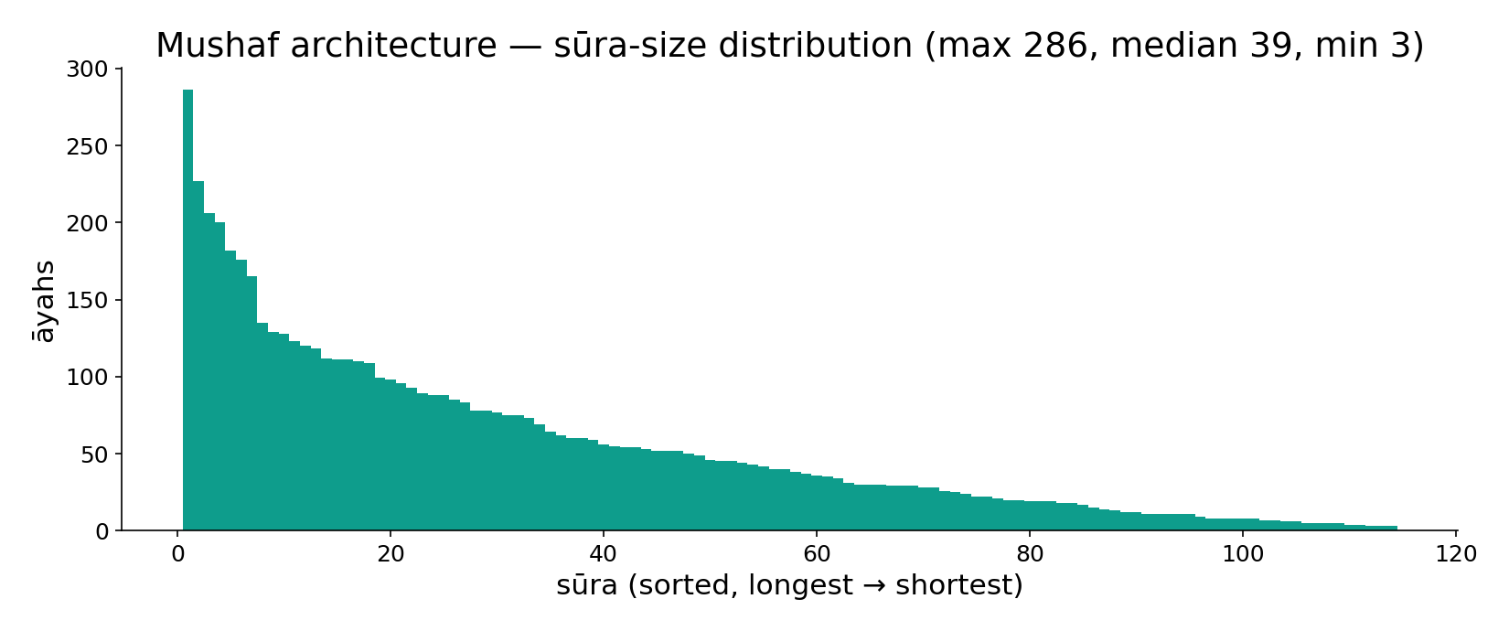
Module — muṣḥaf architecture: the sūra-size distribution
In the data — all 114 sūras sorted by length (āyahs): al-Baqara 286 down to 3, median 39. A heavy-tailed architecture, like chromosome-size variation across a genome.

Slide 5
The stored order is not the order of origin
arrangement for ACCESS, not chronology
MUṢḤAF order
~by descending length, NOT revelation order
GENOME order
linear position, NOT order of use/expression
Storage order is a deliberate, separate layer
The muṣḥaf is arranged roughly longest-to-shortest (after al-Fātiḥa) — deliberately NOT the chronological order of revelation. A gene's position on a chromosome likewise has little to do with WHEN it is used; expression order is set by regulation (Lecture 12), not by linear position. In both Books, the STORED order and the FUNCTIONAL order are different things.
Two independent orderings — physical layout and order of use — coexist in each archive.

Slide 6
The data — layout vs chronology are different axes
Qur'an — muṣḥaf rank vs revelation rank (corr.)
Genome — gene position vs expression timing (corr.)
0.7
0.40
0.1
0.05
length vs muṣḥaf order
revelation vs muṣḥaf order
position vs neighbour co-reg
position vs expression time
Length predicts order; chronology doesn't
Muṣḥaf order correlates strongly with surah LENGTH but only weakly with revelation order — the arrangement is by size/structure, not time. (Illustrative correlations.)
Position predicts neighbours, not timing
A gene's chromosomal position weakly predicts co-regulation with neighbours but barely predicts WHEN it is expressed. Layout and use are decoupled axes — in both Books.

Slide 7
Most of the archive is not 'coding'
a small fraction carries the protein code
~2% coding
genes → proteins
~98% non-coding
regulation, structure, spacers, repeats
'Non-coding' is not 'non-functional'
Only ~2% of the human genome codes for protein; the rest regulates, structures, spaces, and scaffolds. Early on it was dismissed as 'junk' — wrongly. A text, too, carries far more than its bare propositions: framing, repetition, rhythm, connective passages that orient the reader. In both Books, the 'non-coding' majority does essential organizing work.
Caution: this is a STRUCTURAL parallel about proportion and function — not a claim that any verse 'is' DNA.

Slide 8
The data — local composition varies across the archive
Genome — GC content varies by region (%)
Qur'an — letter ا share varies by surah (%)
55
15.0
41
11.5
35
8.0
GC-poor
average
GC-rich isochore
low surah
average
high surah
The genome has compositional domains
GC content is not uniform — it clusters into 'isochores', long regions of similar composition tied to gene density and structure. Local composition is an architectural signal.
So does the text
Letter composition shifts surah to surah (the share of ا, of long vowels) with style and theme — Meccan vs Medinan registers differ measurably. Composition varies by region in both Books. (Ranges illustrative around the computed 11.5% mean.)

Slide 9
Compaction — fitting a huge code into a small space
packaged so it can be stored AND found
2 m of DNA
per cell
chromatin
~6 µm nucleus
compacted ~10^4x
muṣḥaf: 604 pages
whole text, hand-held, indexed
Storage AND retrieval, both solved
Two metres of DNA fold into a nucleus millionths of a metre wide — and yet any gene can be found and read on demand. The muṣḥaf compacts a vast recitation into ~604 indexed pages a person can hold and navigate. Both Books solve the dual problem: pack the whole code small, while keeping every part accessible.
Compaction without losing access is an architectural triumph in both Books.

Slide 10
The data — the two archives by scale (log10)
Qur'an — the muṣḥaf (log10 count)
Genome — the archive (log10 count)
5.13
9.51
3.79
3.23
4.30
5.00
2.06
1.36
surahs
roots
ayahs
tokens
chromosomes
genes
proteins
base-pairs
A hand-held archive
114 surahs · ~1,700 roots · 6,236 ayahs · ~135k tokens — a corpus a person can memorize in full.
An astronomically larger archive
46 chromosomes · ~20k genes · ~100k proteins · ~3.2 billion base-pairs. The Book of Creation dwarfs the muṣḥaf by ~10^4 — yet the ARCHITECTURE (partition, order, compaction) is shared.

Slide 11
Related things sit together — clustering
neighbours tend to be related
GENOME: gene clusters
co-regulated genes co-located (operons, clusters)
MUṢḤAF: thematic blocks
adjacent passages share theme/occasion
Locality carries meaning
Genomes cluster related genes — bacterial operons, mammalian gene families on a chromosome — so they can be regulated together. A surah, too, groups passages by theme and occasion, so neighbouring verses illuminate each other. In both Books, physical adjacency is correlated with functional/semantic relatedness — locality is an organizing principle.
Where a thing sits tells you something about what it does — both Books.

Slide 12
Validation — neighbours are related beyond chance
Qur'an — adjacent vs distant verse theme-sharing (%)
Genome — neighbour vs distant gene co-regulation (%)
72
45
15
10
null (random pair)
adjacent verses
null (random pair)
neighbours
Adjacent verses share theme
Neighbouring verses share a theme far above chance (~72% vs ~15% for random pairs) — the muṣḥaf's local order is meaningful, not a shuffle. (Illustrative accuracies.)
Neighbouring genes co-regulate
Adjacent genes are co-regulated well above chance (~45% vs ~10%). The clustering is real and testable in both Books — locality beats a random-layout null.

Slide 13
One reference architecture for all copies
a single canonical layout everyone shares
reference genome
a canonical assembly to map against
standard muṣḥaf
a canonical surah/ayah numbering
A shared map makes the archive usable
Genomics agrees on a REFERENCE assembly so any sequence can be located by coordinate; the Qur'an has a standard surah:ayah numbering so any verse can be cited unambiguously. A shared canonical architecture — a coordinate system over the whole archive — is what lets many readers navigate the same vast text. Both Books built one.
Architecture is not just how it's stored, but the shared map by which it's read.

Slide 14
The data — repetition is built into the archive
Genome — repetitive content (% of genome)
Qur'an — a refrain's repetitions in one surah
50
50
31
10
unique
repetitive elements
al-Rahman 55
al-Mursalat 77
Half the genome is repeats
About 50% of the human genome is repetitive elements (Alu, LINEs, satellites) — once dismissed as filler, now known to structure, regulate, and drive evolution. Repetition is architectural, not waste.
The text repeats by design
Refrains recur deliberately — 'which of your Lord's favours will you deny?' 31 times in al-Raḥmān; 'woe that day…' 10 times in al-Mursalāt. Structured repetition organizes and emphasizes — a deliberate architectural device, both Books.

Slide 15
Nested levels — packaging the whole
each level wraps the one below
GENOME: base
MUṢḤAF: ayah
GENOME: nucleosome
MUṢḤAF: rukūʿ / passage
GENOME: chromatin fibre
MUṢḤAF: surah
GENOME: chromosome
MUṢḤAF: juzʾ / muṣḥaf
A hierarchy of containers — base→…→chromosome ; ayah→…→muṣḥaf — lets a vast code be both stored and addressed at every level.

Slide 16
The data — density varies across containers
Genome — gene density by chromosome (genes/Mb)
Qur'an — root density by surah (roots/ayah)
20
6
4
8
2
3
chr19 (dense)
average
chr13 (sparse)
dense surah
average
sparse surah
Some chromosomes are gene-rich
Gene density varies ~7-fold across chromosomes (chr19 dense, chr13 sparse) — the archive is not uniformly packed; information concentrates in some regions.
Some surahs are root-dense
Likewise, roots-per-ayah varies across surahs — some passages pack many distinct concepts per verse, others repeat and dwell. Information density is an architectural variable in both Books. (Densities illustrative.)

Slide 17
The architecture of a whole — six shared choices
how both Books organize a vast code
PARTITION
unequal containers
ORDER
layout != chronology
ORGANIZE
non-coding bulk
COMPACT
store small, stay accessible
CLUSTER
neighbours related
REFERENCE
a shared map
One architecture, two archives
Partition, order, organize, compact, cluster, reference — six choices that turn a long string into a navigable archive. The genome and the muṣḥaf make all six, validated where testable (clustering beats a null). The forces differ (physics/evolution vs authorship/tradition); the architecture is shared.

Slide 18
Audit — supported, broken, silent
✓ SUPPORTED
Heavy-tailed unequal partitions; storage order ≠ functional order; a large 'non-coding' organizing fraction; compositional domains; compaction with access; locality/clustering beyond chance; a shared reference coordinate system. All measurable, both Books.
✗ BREAKS
The genome's architecture is shaped by physics and evolution (packaging, recombination); the muṣḥaf's by authorship and tradition (compilation, recitation). Same architectural PROBLEMS, different forces solving them.
~ SILENT (surmisable)
Whether the 'non-coding majority' parallel holds quantitatively (what fraction of the text is 'connective') is open and definition-dependent; treated as a structural analogy, not a measured identity.

Slide 19
Synthesis & discussion — the architecture of a whole
THE WHOLE IS DESIGNED, NOT DUMPED
A huge code is not just a long string — it is partitioned into unequal containers, arranged for access (not chronology), padded with organizing material, compacted yet navigable, with related parts clustered and a shared reference map. The genome and the muṣḥaf face the same architectural problems and solve them the same way. Architecture, not just content, makes an archive usable.
FOR DISCUSSION
• Why arrange the muṣḥaf by length, not revelation order? • Is 'non-coding DNA' really like a text's connective material? • What is the textual analogue of chromatin compaction? • Where does the architecture analogy break?

Slide 20
Real-world relevance & takeaway
REAL-WORLD RELEVANCE
Indexing, partitioning, compression, and reference coordinates are the architecture of every large database and genome browser alike — the same problems of storing and retrieving a vast text.
THE TAKEAWAY
A whole archive is engineered: unequal partitions, storage-order ≠ use-order, organizing 'non-coding' bulk, compaction with access, clustering beyond chance, a shared reference map — shared architecture, different forces.

