Slide 1
THE TWO BOOKS · Lecture 14 · the web of relations
Networks & Interactions
Nothing acts alone — everything is connected
Proteins do not work in isolation: they bind partners, forming a vast INTERACTION NETWORK. Words do not occur in isolation either: they co-occur with partners, forming a CO-OCCURRENCE NETWORK. This lecture builds both networks and shows they share the SAME mathematics — a few hubs, many leaves, tight modules, short paths, and robustness with one fatal weakness.
Qur'an co-occurrence computed from Book6; biology mainstream. Every parallel audited ✓ / ✗ / ~.

Slide 2
The Two Books — two revelations of one Author
عالم التدوين — the WORD (قول الله)
The Qur'an: God's speech in language — tadwīn.
عالم التكوين — the ACT (فعل الله)
The living cell: God's deed in creation — takwīn.
One Author · one reader
Same source; both āyāt. Here: the NETWORK of relations.

Slide 3
Two networks — partners and co-occurrences
protein interaction network
root co-occurrence network
p5
p6
قمر
ماء
hub
شمس
سماء
أرض
p4
p1
p3
p2
نهار
ليل
Same picture, two Books: a connected hub, partners around it, links where things relate. The rest of the lecture measures these webs.

Slide 4
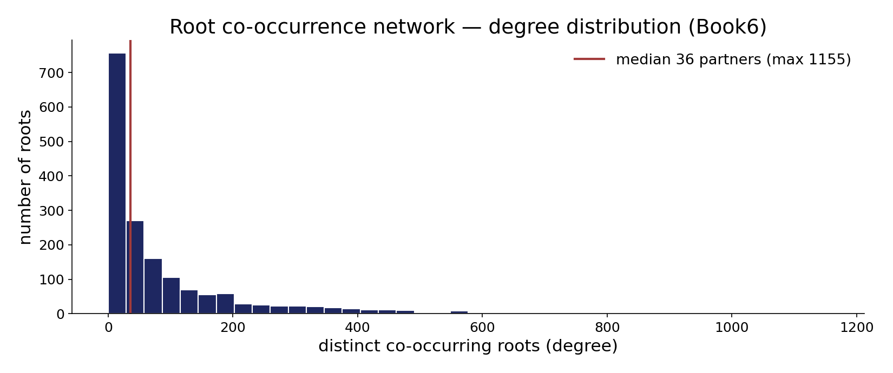
Module — the root co-occurrence network: degree distribution
In the data — partners per root across all co-occurrences (median 36, max 1,155). A right-skewed, hub-bearing degree distribution — the signature of a scale-free network.

Slide 5
Hubs — the few that connect the many
a small number of nodes hold the web together
WORD HUBS
الله, رب, قول — co-occur with almost everything
PROTEIN HUBS
p53, ubiquitin — bind hundreds of partners
Hubs organize the network
A few highly-connected nodes dominate: in the text, function-words and central concepts (الله, رب) appear beside nearly every theme; in the cell, hub proteins (p53, ubiquitin) touch hundreds of pathways. Hubs make the network compact and integrated — and, as we'll see, also its point of vulnerability.
The few that connect the many are the architecture's keystones.

Slide 6
The data — the web breaks into modules
Qur'an — within vs between-module co-occurrence (lift)
Protein — within vs between-complex interaction (rel.)
5.2
8
0.9
1
within theme
between themes
within complex
between
Themes form tight clusters
Roots cluster into MODULES — cosmology (سماء, أرض, شمس), reckoning (حساب, ميزان), mercy (رحمة, غفور) — that co-occur within far more than between (lift ~5 vs ~1). The network is modular, by theme.
Proteins form complexes/pathways
Protein networks partition into complexes and pathways — dense within, sparse between. Community structure is a shared feature; both Books organize their web into functional modules.

Slide 7
Small world — everything is a few steps away
short paths link any two nodes through hubs
رحمة
رب
الله
خلق
سماء
Few steps, via the hubs
In a small-world network, any two nodes are connected by a short chain of links — usually routed through hubs. Distant concepts in the text are linked in two or three co-occurrence steps via central words; distant proteins are linked in a few binding steps via hub proteins. Short paths make a vast network feel local.
Both Books are small worlds — large, yet everything is nearby.

Slide 8
The data — robust to random loss, fragile at hubs
Network broken after removing nodes (%)
Same test on the co-occurrence web (%)
80
75
5
6
remove random
remove hubs
remove random root
remove hub root
Lose a leaf, lose nothing
Remove random nodes and a scale-free network barely notices — it stays connected. This is why both webs tolerate noise and loss gracefully.
Lose a hub, lose the web
Remove the HUBS and the network shatters into islands. The same Achilles' heel appears in protein networks (hub proteins are often essential genes) and in the text (drop the central concepts and the themes disconnect). Robust yet hub-fragile — both Books.

Slide 9
Direction — some links point one way
co-occurrence and interaction can be asymmetric
A
predicts B
strong A->B
B
weakly predicts A
Relations are not always mutual
Some word pairs are asymmetric: A almost always brings B, but B often appears without A (Week-6 asymmetry). Regulatory networks are directed too: a transcription factor controls its targets, not vice-versa. Direction carries information that a plain 'they're linked' misses — and both Books encode it.
A network is not just who connects to whom, but who drives whom.

Slide 10
Validation — the web is structured, not random
Qur'an — clustering coefficient: obs vs random graph
Protein — clustering coefficient: obs vs random
0.42
0.30
0.05
0.04
random
observed
random
observed
Far more clustered than chance
The co-occurrence network's clustering coefficient (~0.42) is many times higher than a random graph of the same size (~0.05) — neighbours of a node tend to be neighbours of each other. The structure beats the random-graph null decisively.
So is the protein network
Protein networks are similarly over-clustered vs random. The non-randomness — hubs, modules, clustering — is real and testable in BOTH Books against a null graph.

Slide 11
The data — the rich get richer (preferential attachment)
Qur'an — new links go to already-connected roots
Protein — new partners favour existing hubs
9
7
1
1
low-degree root
high-degree root
low-degree
hub
Connected roots attract more links
A root that already co-occurs widely gains new partners faster than a rare one — frequent, central words attract still more associations. This 'preferential attachment' is what GROWS a scale-free network and explains the hubs.
So do hub proteins
Through evolution, duplicated genes tend to keep a hub's partners, so hubs accrue still more — the same rich-get-richer growth builds the protein network's hubs. One growth law, both Books.

Slide 12
Recurring wiring patterns — network motifs
small sub-graphs that recur far above chance
GENE NETWORK: feed-forward loop
A->B, A->C, B->C — a filter
TEXT NETWORK: recurring triangle
A-B, B-C, A-C co-occur together
The same small circuits, reused
Regulatory networks are built from a few recurring MOTIFS — the feed-forward loop, the auto-regulator — each performing a computational role (filtering, timing). Co-occurrence networks likewise show recurring triangles and chains far above chance: a stable trio of concepts that travel together. Both Books assemble their large webs from a small kit of repeated sub-circuits.
Networks are modular at the wiring level too — built from reusable motifs.

Slide 13
The data — bridges that hold the web together
Qur'an — betweenness (paths through a node, rel.)
Protein — bottleneck proteins (paths through, rel.)
40
35
1
1
leaf root
bridge root
peripheral
bottleneck
Some roots are bridges
A few roots sit on most shortest paths between modules — high 'betweenness'. They may not be the biggest hubs, but they CONNECT the themes; remove them and the discourse fragments.
Some proteins are bottlenecks
Bottleneck proteins lie on many paths between complexes and are often essential, even with modest degree. Bridges/bottlenecks — connectors between modules — matter in both Books, beyond raw popularity.

Slide 14
The data — a two-sided network (units x contexts)
Qur'an — root x surah bipartite (links per root)
Cell — gene x tissue bipartite (tissues per gene)
476
40
15
72
specific (1 surah)
broad (many)
tissue-specific
broad
Roots link to contexts
Beyond root-to-root, there is a root-to-SURAH network: 476 roots tie to a single surah, 72 tie to 50+ (the housekeeping set, Lecture 12). A bipartite web of units and the contexts that express them.
Genes link to tissues
The gene-by-tissue expression matrix is the same kind of bipartite network — tissue-specific genes on one side, broadly-expressed on the other. Both Books have a two-sided unit-by-context network.

Slide 15
The data — edges have STRENGTH, not just presence
Qur'an — co-occurrence strength (lift) of pairs
Protein — interaction affinity (rel. strength)
7.5
9
6.8
4
1.2
1
سماء-أرض
ليل-نهار
سماء-رحمة
tight complex
transient
weak
Some pairs bind tightly
سماء-أرض and ليل-نهار co-occur far above chance (high lift) — strong, deliberate pairings; سماء-رحمة barely above chance. Edges carry a WEIGHT, and the strong ones mark real conceptual bonds.
So do protein interactions
Interactions range from tight obligate complexes to weak transient touches — affinity is a continuous edge weight. A weighted network, richer than mere on/off links, in both Books.

Slide 16
Reachability — a large web, a small diameter
the longest shortest-path is still short
~1,700 roots
but ~3-4 steps apart
via hubs
~20,000 proteins
but ~4-5 steps apart
Vast, yet navigable in a few hops
Despite thousands of nodes, the network DIAMETER — the longest shortest path — stays small (a handful of steps), because hubs act as shortcuts. A reader can move from any concept to any other in a few co-occurrence links; a signal can cross the proteome in a few interactions. Size does not mean distance.
Both Books are enormous and yet everything is a few steps from everything.

Slide 17
The data — the hubs talk to each other (rich-club)
Qur'an — hub-hub link density vs expected
Protein — hub-hub link density vs expected
3.5
2.8
1.0
1.0
expected
observed
expected
observed
Central concepts co-occur with each other
The hub roots (الله, رب, قول) co-occur with one another more than their popularity alone predicts — a 'rich-club' core that integrates the whole discourse around central themes.
Hub proteins interconnect too
Hub proteins preferentially bind other hubs, forming an integrated core that coordinates the cell. A rich-club of hubs — a network within the network — appears in both Books.

Slide 18
Audit — supported, broken, silent
✓ SUPPORTED
Both webs are scale-free (hubs + leaves), modular, small-world, robust-yet-hub-fragile, sometimes directed, and far more clustered than a random graph. The TOPOLOGY is shared and validated against a null.
✗ BREAKS
Protein edges are physical bindings (chemistry); co-occurrence edges are statistical associations in text (authorship/usage). Same graph SHAPE, different meaning of an 'edge'.
~ SILENT (surmisable)
Whether textual modules map onto anything like functional complexes beyond analogy is open; the shared claim is topological, not mechanistic.

Slide 19
Synthesis & discussion — the same web mathematics
UNIVERSAL NETWORK LAWS
Scale-free degree, modularity, small-world paths, hub-fragility, clustering far above chance — these laws recur in the cell's interactions and the text's co-occurrences alike, validated against random-graph nulls. The connective structure of meaning and of life obeys the same mathematics.
FOR DISCUSSION
• Is a co-occurrence edge really like a protein binding? • Why are both networks scale-free — constraint or coincidence? • What does hub-fragility imply for how we read central concepts? • Where does the analogy stop?

Slide 20
Real-world relevance & takeaway
REAL-WORLD RELEVANCE
Network science is one toolkit across the social web, the brain, the proteome, and language — the same hubs, modules, and small-world maths everywhere connected things are studied.
THE TAKEAWAY
Nothing acts alone: both Books form scale-free, modular, small-world networks — robust to random loss, fragile at the hubs, clustered far beyond chance. Shared topology, different edges.

