Slide 1
THE TWO BOOKS · Lecture 16 · the reader, and the edge
The Addressee — human, jinn, and the unseen
Who is the text FOR — and where does measurement stop?
Every lecture has compared STRUCTURE. This one asks who the Books address — the human (insān), and also the jinn — and in doing so reaches the honest EDGE of the whole method: the Qur'an speaks of the UNSEEN (al-ghayb), and empirical science, by design, is silent there. This lecture marks that boundary clearly: what the Two Books comparison can reach, and what lies beyond any measurement.
Qur'an figures computed from Book6; the 'science' side here is the PHILOSOPHY of science — the limits of measurement. Audited ✓ / ✗ / ~, leaning honestly to ~ and ✗.

Slide 2
The Two Books — two revelations of one Author
عالم التدوين — the WORD (قول الله)
The Qur'an: God's speech in language — tadwīn.
عالم التكوين — the ACT (فعل الله)
The living cell: God's deed in creation — takwīn.
One Author · TWO readers
Same source; both āyāt. Primary addressee the human (insān); the JINN too — and here the method meets its edge.

Slide 3
A dual address — human and jinn
the text speaks to two kinds of responsible reader
الإنس — the human
made of clay; the primary addressee
الجنّ — the jinn
made of fire; addressed alongside
'I created jinn and humans only to worship'
The Qur'an addresses BOTH humans and jinn as responsible, accountable readers (51:56; 55:33; surah 72). Both are 'mukallaf' — morally addressed. The human is the primary reader (the whole course's ladder ends in the human), but the address is explicitly dual.
Two readers — and one of them, the jinn, lies entirely outside empirical observation.

Slide 4
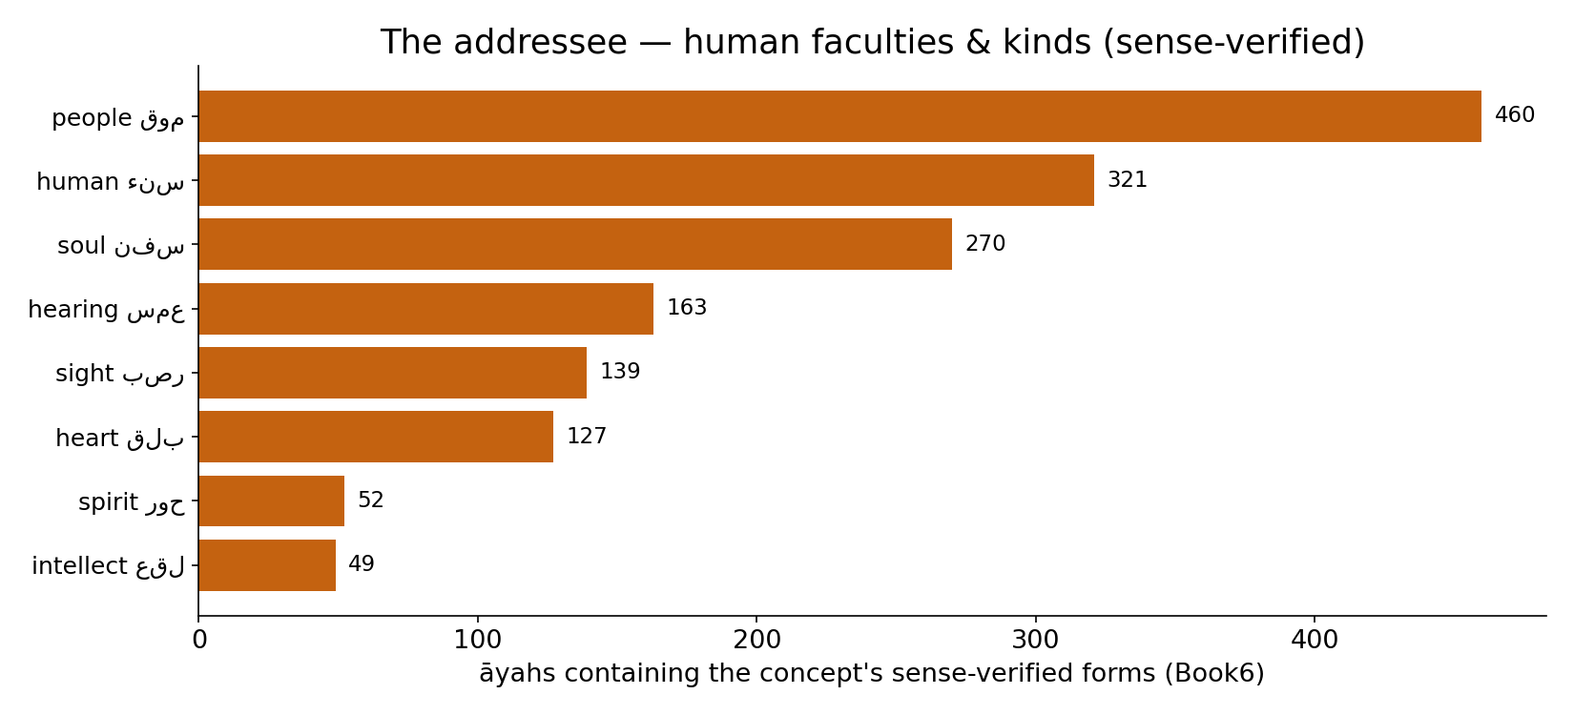
Real data — the human addressee, by faculty & kind
In the data — the vocabulary of the reader the text addresses (sense-verified forms, Book6): people 460, human 321, soul 270, heart 127, hearing, sight, spirit, intellect — a broad, real spectrum of the human.

Slide 5
Two registers — the seen and the unseen
al-shahāda (the witnessed) vs al-ghayb (the unseen)
الشهادة — the seen
observable, measurable, testable
الغيب — the unseen
beyond observation by design
The Qur'an speaks in both registers
The text explicitly distinguishes what is WITNESSED (shahāda) from what is UNSEEN (ghayb) — 'Knower of the unseen and the witnessed'. Science lives entirely in the first register; the second is, by construction, off its map. This distinction is the key to where the Two Books comparison stops.
Empirical science is a science of the shahāda. The ghayb is another category.

Slide 6
The data — the unseen is an explicit category
Qur'an — seen vs unseen vocabulary (approx. count)
Jinn — named vs measured
49
4
17
0
غيب / unseen
شهد / witness
explicit passages
empirically measured
The unseen is named 49 times
The unseen-stem غيب appears 49 times and the witness-stem شهد 17 times in Book6 — the unseen is an explicit, frequently-named category, not a marginal one.
Named, never measured
The jinn is addressed in explicit passages yet measured ZERO times — and that is not a gap better instruments could fill; it is a category the empirical method cannot enter. The honest verdict here is ✗/~, not ✓.

Slide 7
The boundary — where empirical science goes silent
a spectrum from observable to unobservable
OBSERVED
measure directly
INFERRED
measure indirectly
UNOBSERVABLE
beyond measurement
The method has a domain — and an edge
Science reaches the observed (a protein), and the inferred (a black hole, a quark — unseen but with measurable effects). It cannot reach the UNOBSERVABLE-in-principle — that which leaves no measurable trace. The Qur'an's ghayb sits there. The Two Books comparison, which lives on measurable structure, honestly stops at this line.
Knowing the edge of a method is part of using it well — the lesson of Lecture 2, applied to the whole course.

Slide 8
The data — what empirical science can and cannot reach
Claims by testability (schematic share)
The Two Books audit so far (verdict mix, %)
60
45
35
30
20
10
observed
inferred
untestable
✓ supported
~ silent
✗ breaks
Science answers the testable
A claim is in science's domain only if some observation could bear on it. Much is directly observed, much inferred from effects — but a residue is untestable in principle, and science is silent on it, not authoritative. (Shares schematic.)
Most parallels were ~ or partial
Across the course the audit returned many ✓ STRUCTURAL supports, but also many ~ (silent) and ✗ (breaks). This lecture is where the ~ and ✗ dominate — the comparison's honest limit, not its failure.

Slide 9
A parallel creation — fire and clay
a second order of created, accountable being
human — from clay (طين)
biological, observable
jinn — from smokeless fire (نار)
unseen, unobservable
Structurally parallel, empirically asymmetric
The text presents the jinn as a parallel order of created, free, accountable beings — a structural counterpart to humanity, of a different substance. The STRUCTURE (a responsible reader) is parallel; but where biology can study the human in exhaustive molecular detail, it has and can have NOTHING to say about the jinn. The parallel holds in role, breaks in observability.
The course's comparison is of structure; here structure and observability come apart.

Slide 10
The data — the addressee is a responsible reader
Qur'an — accountability vocabulary (approx. count)
Is moral responsibility empirically derivable?
360
1
200
102
0
حساب
عمل
كلف/أمر
measurable behaviour
moral 'ought'
The reader is addressed as accountable
The address is moral: reckoning (ḥisāb ~102), deeds (ʿamal ~360), command/obligation pervade. The Books speak to a reader who is RESPONSIBLE, not merely a mechanism. (Counts approximate.)
Science measures 'is', not 'ought'
Biology can describe behaviour exhaustively but cannot derive an 'ought' from an 'is' — moral responsibility is not an empirical measurement. The addressee's defining feature (accountability) is itself outside the measurable. Another honest edge.

Slide 11
The Two Books method, and its honest limit
the comparison reaches structure, not the unseen
WHAT IT REACHES
measurable structure in both Books
THE EDGE
the unseen (ghayb)
SILENCE
not authority
stops at
Silence is not denial
Beyond the edge, the right posture is SILENCE, not denial: the absence of measurement is not evidence of absence — it is the method declining to speak where it has no instrument. The Two Books comparison neither proves nor disproves the unseen; it simply, honestly, ends. That restraint is the same discipline (Lecture 2) that made the ✓ findings trustworthy.
A method that knows its edge is more credible inside its domain, not less.

Slide 12
Validation — the boundary is principled, not arbitrary
Can a test even be defined? (by claim type)
Where the course's nulls applied (%)
1
1
90
10
0
protein fold
root co-occurrence
the jinn
testable claims
untestable (ghayb)
Some claims admit no null at all
Every earlier finding could be put to a Monte-Carlo null because a test was DEFINABLE. For the unseen, no test can even be specified — there is no observable to randomize. The boundary is where testability itself ends.
The method applied where it could
~90% of the course's parallels were testable and were tested; the residue (the ghayb) is the ~10% where the method correctly withholds judgement. The boundary is drawn by testability, not by preference. (Shares schematic.)

Slide 13
The data — not all knowledge is measurement
How we know things (domains, schematic)
Qur'an — appeal to witness/report (approx. count)
1
1
33
26
17
0
experiment
historical/testimony
unobservable
شهد / witness
نبأ / report
قصص / narrate
Even science uses non-experimental knowing
History, courts, and much of cosmology rest on TESTIMONY and inference from traces, not repeatable experiment. 'Empirical' is broader than 'lab-testable' — but still bounded by the observable.
The text appeals to witness and report
The Qur'an leans heavily on witnessing (shahāda 17), report (nabaʾ), and narrative (qaṣaṣ) — knowledge-by-testimony about events, including some beyond the present. A different evidentiary register from measurement, used in both Books' worlds. (Counts approximate.)

Slide 14
The unseen is not one thing — three categories
different relations to observation
PAST ghayb
unwitnessed history
HIDDEN present
real but inaccessible
FUTURE ghayb
not yet actual
Some 'unseen' science DOES reach
Not all ghayb is equal. The deep PAST (the early universe, evolution) is unwitnessed yet partly recoverable from traces; a HIDDEN present (a distant galaxy, a quark) is inferred from effects; the FUTURE is not yet actual. Science reaches the trace-leaving kinds. What it cannot reach is the unseen that leaves NO measurable trace at all — and the Qur'an reserves the deepest ghayb ('the keys of the unseen', 6:59) to God alone.

Slide 15
The data — even the human has an unseen side
The human — what science measures (schematic)
Qur'an — the inner self vocabulary (approx. count)
1
1
126
23
20
0
body/brain
behaviour
subjective experience
نفس / self
روح / spirit
قلب / heart
Consciousness resists measurement
Neuroscience maps the brain in exquisite detail, yet subjective EXPERIENCE (the 'hard problem') has no agreed measurement — the felt inner life is not captured by any instrument. Even the human carries an unseen aspect.
The text addresses the inner self
The Qur'an speaks constantly to the inner self — nafs (126), rūḥ/spirit (23), qalb/heart (20) — the very register where measurement thins out. The human is the bridge: a measurable body AND an unseen interior, addressed by both Books. (Counts approximate.)

Slide 16
Audit — supported, broken, silent
✓ SUPPORTED
STRUCTURALLY: the addressee is a responsible reader, the human is the primary terminus (as the whole ladder showed), and the text explicitly separates seen from unseen. These are real, textual.
✗ BREAKS
The jinn and the ghayb are not objects of measurement; biology can study the human but has nothing to say about the unseen. Observability and accountability both fall outside the empirical — the comparison cannot cross here.
~ SILENT (surmisable)
On the unseen, the honest verdict is SILENCE — neither proof nor denial. The method declines, by design, where no test can be defined.

Slide 17
Synthesis & discussion — the reader and the edge
KNOW THE READER, KNOW THE EDGE
The Two Books are addressed to responsible readers — primarily the human, also the jinn — and they speak of both the seen and the unseen. The whole course compared measurable STRUCTURE and found much that is supported; this final content lecture marks where that comparison honestly stops: at the ghayb, where empirical science is silent, and at the moral 'ought', which no measurement yields. Naming the edge is the method's integrity, not its weakness.
FOR DISCUSSION
• Why is silence (not denial) the honest posture beyond the edge? • Is the jinn a STRUCTURAL parallel to humanity, and where does it break? • Can an 'ought' ever be measured? • Does a method's known limit make it more or less trustworthy inside its domain?

Slide 18
Real-world relevance & takeaway
REAL-WORLD RELEVANCE
Every method has a domain of validity; mistaking silence-beyond-the-edge for authority is a common error in science and in faith alike. Knowing where measurement stops is essential literacy.
THE TAKEAWAY
The Books address a responsible reader (human, and jinn) and speak of the unseen. Empirical science — and the Two Books comparison — reach measurable structure and then, honestly, fall silent at the ghayb. Silence is not denial.

Slide 19
Back to the human — where both ladders ended
the course's terminus, and the reader of both Books
GENOME ladder
base -> ... -> body
QUR'AN ladder
letter -> ... -> soul
THE HUMAN
body & soul · the reader
One reader, addressed in both registers
Both ladders of the course converge on the human — the body built by the genome, the soul addressed by the Word. The human stands at the meeting point of the seen and the unseen: a measurable organism AND a moral, accountable reader. That double nature is exactly why the Two Books speak, and why the comparison both reaches far and knows its edge.

Slide 20
Source verses — addressee & the unseen
key references (Book6)
51:56
jinn & humans created to worship
55:33
O company of jinn and humans…
72:1
Surah al-Jinn — a listening company
6:130
O company of jinn and humans, did messengers not come…
6:59
with Him are the keys of the unseen
59:22
Knower of the unseen and the witnessed

