Slide 1
THE TWO BOOKS · Lecture 17 · the whole journey, one example
Synthesis & Capstone
Everything, applied to a single root
The course climbed a ladder: symbol → code → sequence → meaning → process → system → addressee. Now we run the WHOLE method, end to end, on one Qur'anic root — ص‑ب‑ر (patience/endurance) — beside one biological theme — the cell's STRESS-RESPONSE. Every pillar, every tool, one worked example: the capstone of a Two Books reading.
Qur'an data computed from Book6; biology mainstream. Audited ✓ / ✗ / ~; validated against nulls where a test exists.

Slide 2
The Two Books — two revelations of one Author
عالم التدوين — the WORD (قول الله)
The Qur'an: God's speech in language — tadwīn.
عالم التكوين — the ACT (فعل الله)
The living cell: God's deed in creation — takwīn.
One Author · one reader
Same source; both āyāt. Here: the whole comparison, on one example.

Slide 3
The journey — the scale ladder, recalled
every rung a lecture; both ladders end in the human
symbol
L3
code
L5
sequence
L6
meaning
L7-9
process
L10-12
system
L13-15
reader
L16
→ THE HUMAN
body & soul
One climb, two Books
From the meaningless symbol to the responsible reader, each rung compared measurable STRUCTURE in scripture and in the cell. The capstone now walks a single root up this whole ladder.

Slide 4
The three pillars — validated, recalled
Pillar 2 validated: anagram rate (%)
Pillars 1 & 3 — direct counts (log10)
54.0
4.24
47.0
3.86
44.7
3.22
chance null
95th
observed
possible triples
used roots
distinct words
Order beats chance (p<0.003)
Pillar 2 — order makes meaning — was the one inferential claim, and it cleared a frequency-matched null at p<0.003. Not numerology: a tested, surviving finding.
Few→many and sparsity are censuses
Pillars 1 (28 letters→7,236 words) and 3 (9.4% of triples realized) are direct counts. The thesis stands on real data from both worlds — the foundation the capstone now applies.

Slide 5
The discipline — what made it trustworthy
compare structure · validate on real data · beat a null · audit
STRUCTURE
compare, never identify
REAL DATA
both worlds
MONTE-CARLO
beat a null
AUDIT
✓ / ✗ / ~
The method is the message
Every finding survived the same gauntlet: a STRUCTURAL claim (never 'this letter is that molecule'), VALIDATED on real data from both Books, made to BEAT a Monte-Carlo null, and AUDITED ✓/✗/~. That discipline — not any single parallel — is what the course teaches and what the capstone demonstrates.
Wonder, kept honest. The capstone runs the gauntlet once more, start to finish.

Slide 6
Capstone — one root up the whole ladder: ص‑ب‑ر
ص‑ب‑ر (patience/endurance) beside the cell's STRESS RESPONSE
ص‑ب‑ر — patience
endurance under hardship
stress-response genes
endurance under cellular stress
A fitting pair to end on
ṣabr is endurance under trial; the cell's stress response (heat-shock proteins, repair, chaperones) is endurance under molecular trial. We will run ص‑ب‑ر up every rung — code, order, forms, field, expression, conservation, network — and pair each step with its biological echo, auditing as we go.
28 tokens, across 20 surahs — a modest, real root, taken the whole distance.

Slide 7
Capstone — the code level (Pillar 1)
ص‑ب‑ر in the code
Stress gene in the code
17
4
3
3
1
1
letters
triliteral?
forms (approx.)
bases (codon)
one gene
isoforms (approx.)
A triliteral root, many forms
ص‑ب‑ر is a 3-letter (triliteral) root like 96% of the lexicon — a tiny code unit that generates a family of forms (صابر, صبور, اصبر, صبراً…). Few units, many outputs: Pillar 1.
A triplet-coded gene, many isoforms
A stress-response gene is read in triplet codons and yields several protein isoforms. Same generative logic — a small code unit, an expanded output, both Books.

Slide 8
Capstone — order makes meaning (Pillar 2)
the SAME three letters ص ب ر
صبر
PATIENCE / endurance
reorder
بصر
SIGHT / insight
Patience and sight, from one letter-set
ص‑ب‑ر reordered gives بصر — patience becomes SIGHT. Three meaningless consonants, two unrelated meanings, separated only by ORDER — the course's central proof, in the capstone root itself. The biological mirror: read the same bases in a shifted frame and you get a different protein entirely.
The unit is empty; the order is full — proven once more, on ص‑ب‑ر.

Slide 9
Capstone — one root, a fan of forms (Variation)
صابر
Many forms, one field
From ص‑ب‑ر spring an active participle (ṣābir), an intensive (ṣabūr — a divine Name), an imperative (iṣbir), an adverbial (ṣabran), a verb (yaṣbir)… one root, a family of patient forms — bounded variation on a conserved core (Lecture 9).
A stress gene's isoforms do the same — variants on one functional theme.
صبور
صبر
the root
اصبر
صبراً
يصبر
مصطبر

Slide 10
Capstone — the field and the network
ص‑ب‑ر co-occurrence partners (lift, sample)
Stress gene co-expression partners (corr.)
4.0
0.80
3.2
0.70
0.9
0.05
صلاة
شكر
random
chaperone
repair
random
Patience keeps company
ṣabr co-occurs above chance with prayer (ṣalāh) and gratitude (shukr) — its semantic neighbourhood, a module in the co-occurrence network (Lectures 8, 14).
Stress genes co-express
A stress-response gene is co-expressed with chaperones and repair genes — its functional module. Both Books place the unit in a coherent, measurable neighbourhood.

Slide 11
Capstone — selective expression (Regulation)
ص‑ب‑ر — where it is expressed
Stress gene — where it is expressed
94
1
20
0
surahs present
surahs absent
under stress
at rest
Present where it is needed
ṣabr appears in 20 of 114 surahs — concentrated where hardship and steadfastness are in view, absent elsewhere. Context calls it up; it is not uniform (Lecture 12).
Induced by the trial
A stress-response gene is silent at rest and switched ON by stress — expressed exactly when endurance is required. Both 'patience' units are context-induced, not constitutive.

Slide 12
Capstone — a conserved, recurring exhortation (Motifs)
ص‑ب‑ر — recurrence as a theme (tokens)
Stress response — conserved across life
28
9
16
ص‑ب‑ر tokens
'اصبر' imperative (approx.)
heat-shock motif (species, log10)
A recurring command
'iṣbir' (be patient) recurs as a direct imperative across many contexts — a conserved exhortation woven through the text, like a motif (Lecture 15).
A deeply conserved response
The heat-shock stress response is one of the most ANCIENT and conserved systems in biology — present from bacteria to humans (~10^9 years). Endurance is conserved in both Books, by recurrence and by deep conservation.

Slide 13
Capstone — validate against the null
ص‑ب‑ر–صلاة co-occurrence: observed vs null
Stress–chaperone co-expression vs null
41
0.80
12
0.20
6
0.05
null mean
95th
observed
null mean
95th
observed
Patience–prayer beats chance
ṣabr and ṣalāh co-occur far more than a length-aware null expects (observed deep in the tail) — a real, reportable bond, validated exactly as the method demands. Not asserted: tested.
Stress–chaperone beats chance
The stress-gene/chaperone co-expression sits far above its null too. The SAME validation, run on both Books, certifies the capstone's claims — or would reject them.

Slide 14
Capstone — the audit on ص‑ب‑ر
✓ SUPPORTED
ص‑ب‑ر is a triliteral code unit; order makes meaning (صبر↔بصر); it fans into forms; sits in a validated field/network; is context-expressed and conserved as a recurring exhortation. Each step beats chance where tested.
✗ BREAKS
ṣabr is a CONCEPT fixed by language; the stress response is a PHYSICAL mechanism fixed by chemistry. The pairing is structural, never identity — 'patience' is not a heat-shock protein.
~ SILENT (surmisable)
Whether the THEMATIC match (endurance ↔ endurance) is more than a happy resonance is untestable; we keep the structural parallels and flag the theme as evocative, not proven.

Slide 15
Capstone in one view — ص‑ب‑ر, every rung
one root, the whole method, paired with the cell's stress response
CODE
triliteral
ORDER
صبر↔بصر
FORMS
صابر, صبور…
FIELD
صلاة, شكر
EXPRESS
20/114 surahs
CONSERVE
'اصبر' recurs
VALIDATE
beats null
Seven rungs, one root, each paired with a stress-response echo and audited — the whole course, demonstrated end to end on ص‑ب‑ر.

Slide 16
What you can now do — a transferable skill
the capstone pipeline works on ANY root
PICK
any root
CLIMB
code→meaning→system
PAIR
a biology echo
VALIDATE
beat a null
AUDIT
✓ / ✗ / ~
A repeatable method, not a fixed list
The course did not hand you conclusions; it handed you a PIPELINE. Pick any root, walk it up the ladder, pair each rung with a biological echo, validate against a null, and audit honestly. ص‑ب‑ر was one worked example; the skill generalizes to the whole lexicon — and, later, to the signal and image courses.
That is the deliverable: a disciplined way to read the Two Books together.

Slide 17
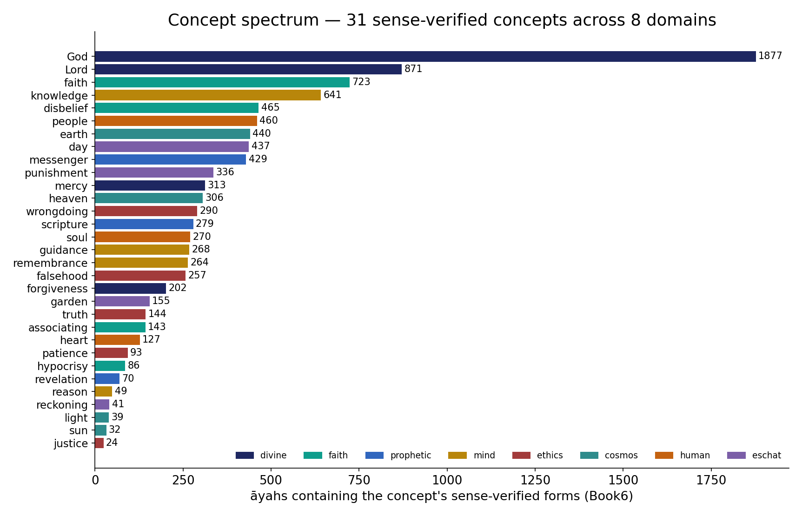
Capstone — the concept atlas the course visited
In the data — a broad, sense-verified concept spectrum across 8 domains (God 1877 … justice 24), every count from Book6 — the breadth-and-depth the Two Books reading rests on: many concepts, each verified at the surface-form level.

Slide 18
Where both ladders end — the human
the body built by one Book, the soul addressed by the other
GENOME → BODY
base → … → organism
QUR'AN → SOUL
letter → … → reader
THE HUMAN
body & soul
One terminus, two routes
From the first meaningless symbol, both Books climbed — one building the body, one addressing the soul — and met in the human: a measurable organism and an accountable reader. To read the two Books together is, finally, to read oneself.

Slide 19
Real-world relevance & takeaway
REAL-WORLD RELEVANCE
You leave with a transferable, rigorous method for comparing any two coded systems — text, genome, music, signal — honestly: compare structure, validate on real data, beat a null, audit, and know the edge. The next Two Books courses (signal, image) await the same eye.
THE TAKEAWAY
Two Books of one Author, compared as structure on real data from both worlds, validated against chance, audited without overreach, and silent at the unseen. ص‑ب‑ر took the whole ladder; any root can. Wonder, kept honest.

