Slide 1
TWO BOOKS · BIOLOGY — companion lecture deck
Reading the corpus through a genome lens
The honest spine
The genome lens (letters ≈ bases, roots ≈ codons, words ≈ proteins) is a MEASUREMENT FRAME, not a design claim. Base composition is governed by common letters and richness by length — read both against size. The genuine signal is the GRAMMAR FOOTPRINT: di-codon bias and the H₀→H₁ conditional-entropy drop. Shuffle nulls throughout; no hidden code.
Two domains, one method
Every Qur'an number is computed live from Book6. Every genomics number is mainstream, shown in round form and labelled as reference — the analogy is a lens to think with, audited stage by stage, never evidence.

Slide 2
The Two Books — two revelations of one Author
عالم التدوين (the WORD) · عالم التكوين (the ACT)
The WORD — قول الله
The Qur'an: God's speech in language. The Book of SCRIPTURE.
The ACT — فعل الله
The Universe / life: God's deed. The Book of CREATION.
This deck borrows the genome's vocabulary to MEASURE the text
Genomics reads a sequence at nested levels — base, codon, amino acid, protein, genome. We map those levels onto the text's own — letter, root, word, verse, muṣḥaf — and import the matching tools: composition profiles, codon-usage curves, adjacency bias, conditional entropy.
We import the toolkit, not a claim that scripture is DNA. Every parallel is tested against a shuffle null and audited ✓ / ✗ / ~.

Slide 3
The unit ladder — genome ↔ text, level by level
GENOME (Creation) ≈ QUR'AN (Scripture) — matched levels
base
codon
amino acid
protein
genome
≈
≈
≈
≈
≈
letter
root
word
verse
muṣḥaf
Matched levels, different substance
A clean ladder of correspondences in STRUCTURE — both build a vast lexicon from a tiny alphabet read in small groups. The deck tests each rung against a null; both ladders end in the human.

Slide 4
What this deck will — and will not — do
WILL
• Compute every Qur'an number live from Book6. • Compare each to a shuffle null. • Set it beside a mainstream genomics reference. • Read composition AGAINST length, never raw. • Audit ✓ / ✗ / ~.
WILL NOT
• Claim the text 'contains' DNA or a genetic code. • Read base composition as a hidden cipher. • Treat a length-driven richness as a choice. • Offer the analogy as proof of anything.

Slide 5
The method — composition vs the length confound
The confound
Common letters and sūra length drive most of any composition number.
The fix
Read each value against the sūra's size; test the rest against a shuffle.
Two reflexes for every number
(1) NORMALIZE: a frequent letter or a low richness is usually just length and alphabet, not meaning. (2) SHUFFLE: scramble the sequence and rebuild the statistic; if the real value sits far in the tail, the ORDER carries structure the shuffle destroyed.
The genuine signals in this deck — di-codon bias and the H₀→H₁ entropy drop — are exactly the ones that survive the shuffle. Composition and richness are the ones we must read against size.

Slide 6
Two corpora by the numbers (log₁₀)
Qur'an (log₁₀ count)
Human genome (log₁₀ count)
4.71
9.51
3.79
3.23
4.30
5.00
2.06
1.36
sūras
roots
ayahs
tokens
chromos.
genes
proteins
bases
Qur'an — finite, countable
114 sūras · 6,236 ayahs · ~51k root-tokens · 1,701 roots. A corpus a person can hold in memory.
Genome — astronomically larger
23 pairs · ~20k genes · ~3.2 billion bases. The Book of Creation dwarfs the muṣḥaf (10⁹ vs 10⁴).

Slide 7
Module 1 — Frame: the genome lens
Qur'an alphabet → lexicon
Genome alphabet → lexicon
1701
64
20
28
4
letters
roots
bases
codons
amino acids
What it is / Why
Map letter→base, root→codon, word→protein, then apply genomics' counting + shuffle machinery. Both Books build a huge lexicon from a tiny alphabet read in small groups.
In the data · Bridge
~28 letters build 1,701 roots (most exactly 3 letters); 4 bases build 64 codons → 20 amino acids. Next: how often does each 'base' (letter) appear?

Slide 8
Module 2 — Base composition: the 'bases'
Most-frequent letter — % of a sūra's letters (12 sūras, Book6)
25.5
22.5
22.7
22.4
19.2
17.8
17.6
18.1
18.4
19.0
19.1
15.2
حمد
اخلاص
ناس
فلق
کوثر
یس
الرحمن
بقره
کهف
یوسف
مریم
ق
In the data — composition is dominated by common letters
In al-Fatiha the single most frequent letter (ا) is 19.18% of its 146 letters. Across sūras the top-letter share is tightly clustered — every sūra draws on the same alphabet, so deviations from baseline are small. Read deviations, never raw counts; nothing here is a hidden code.

Slide 9
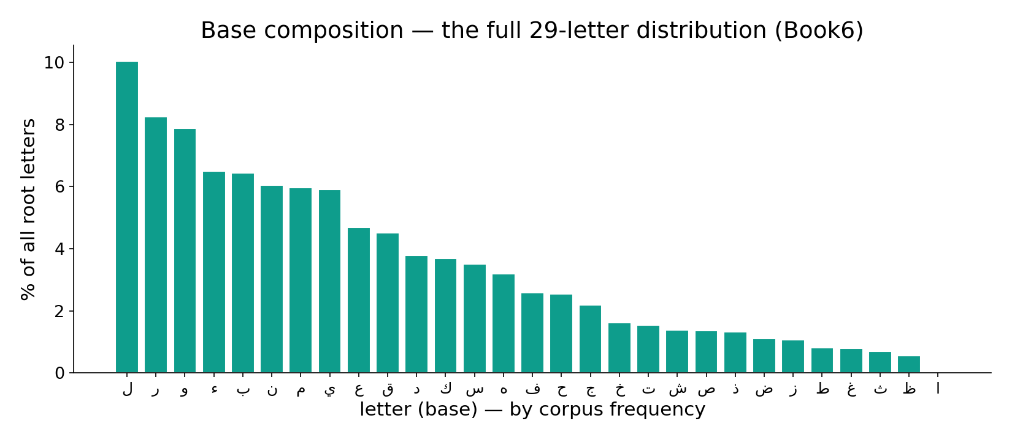
Module 2 — Base composition: the full letter distribution
In the data — every letter's share of all root-letters (Book6). A few common letters dominate and the tail is long — composition is skewed by frequency, the baseline expectation, not a code.

Slide 10
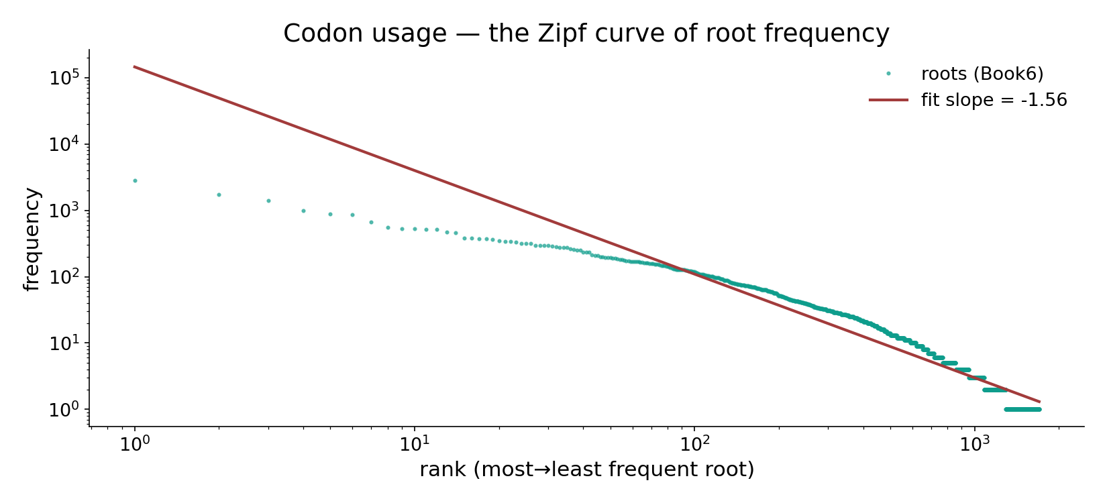
Module 3 — Codon usage: the Zipf curve
In the data — root frequency vs rank on log-log axes; the fitted slope ≈ −1.56 (steeper than ordinary word frequency ≈ −1) — a handful of roots dominate, a long tail barely appears.

Slide 11
Module 4 — Di-codon bias (adjacency structure)
Adjacent root pairs — structure test
Significance (−log₁₀ p; higher = stronger)
1.00
2.30
0.55
1.30
observed
shuffle 95%
di-codon bias
n.s. line
How / What we get
Tally observed adjacent root pairs, compare to a shuffle of the same roots, summarize the gap with a chi-square-like statistic and a permutation p.
In the data
Structure p ≈ 0.005: adjacent pairs are significantly non-random — the footprint of grammar and fixed expressions. This is a GENUINE signal, distinct from mere composition.

Slide 12
Module 5 — Sequence complexity: richness vs length
Lexical richness by sūra, ordered short → long (Book6)
1.00
0.73
0.78
0.70
0.69
0.60
0.41
0.48
0.37
0.35
0.29
0.15
کوثر
اخلاص
فلق
ناس
حمد
ق
الرحمن
یس
مریم
کهف
یوسف
بقره
In the data — richness falls as length rises
Richness = distinct roots ÷ total root-tokens. al-Fatiha (short) scores 0.783; longer sūras repeat vocabulary and score lower. Ordered short→long, the bars trend DOWN — a length effect, not a stylistic choice. Always read richness against sūra size.

Slide 13
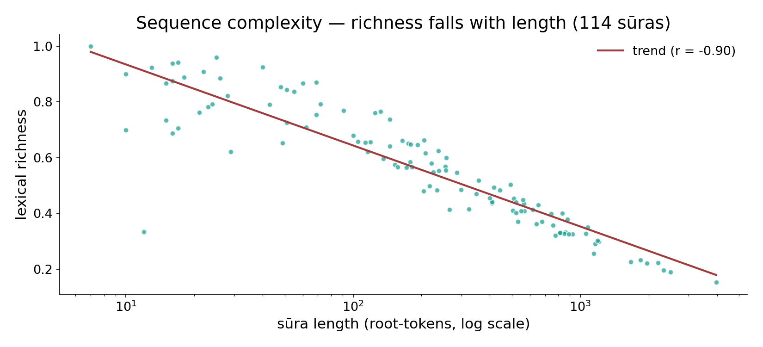
Module 5 — The length confound, in one scatter
In the data — every sūra's lexical richness vs its length (log scale), all 114 points; the trend is strongly negative (r ≈ −0.90) — richness is mostly a length artefact, not a stylistic choice.

Slide 14
Module 6 — Composition clustering (sūra as a vector)
each sūra → a vector of its top-root usage → grouped by similarity
What it is / Why it matters
Represent each sūra as its usage of the top roots, then run Ward hierarchical clustering into a dendrogram. The branches group sūras with similar composition.
In the data — the clusters largely track STYLE and LENGTH: long Medinan sūras separate from short Meccan ones. Composition similarity is not evidence of hidden thematic coding.
Takeaway — sūras cluster by the mundane drivers of composition. Bridge: zoom back to the letter stream — how predictable is the next letter?

Slide 15
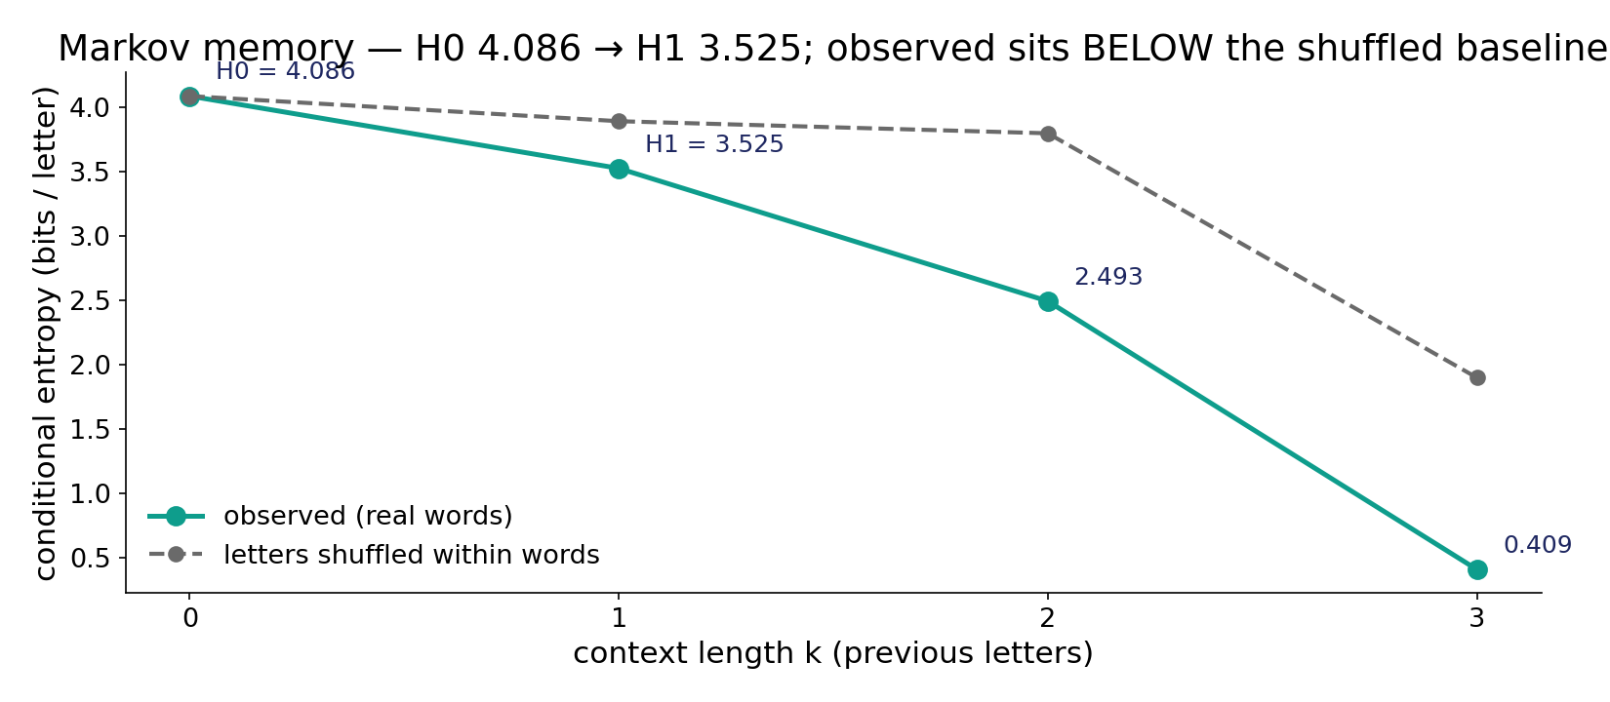
Module 7 — Markov memory: conditional-entropy decay
In the data — entropy of the next letter falls with context — H₀ 4.086 → H₁ 3.525 bits (≈ ½ bit gained). The observed curve sits BELOW the letters-shuffled baseline: real intra-word structure, the language footprint.

Slide 16
Module 8 — Synthesis: what the genome lens shows
Survives the null
Di-codon bias (p ≈ 0.005) and the H₀ 4.086 → H₁ 3.525 entropy drop — a real GRAMMAR footprint, the same any natural language shows.
Driven by confounds
Base composition (common letters), Zipf skew (−1.56), and richness (falls with length) — read these AGAINST size, not as meaning.
Honest reading
The lens reveals ordinary language structure, not a hidden biological code. Say only what the data licenses.

Slide 17
Audit — the analogy, rung by rung
~ Base ↔ letter composition
Real but dominated by common letters.
✓ Codon usage ↔ Zipf
Heavy skew, slope ≈ −1.56.
✓ Di-codon ↔ grammar
Adjacency bias survives shuffle (p ≈ 0.005).
~ Richness ↔ complexity
Mostly a length artefact; read vs size.
✓ Markov ↔ memory
H₀→H₁ drop is real language structure.
✗ Sequence ↔ genetic code
No codon table, no translation, no cipher.

Slide 18
Not a scientific miracle — and not evidence
What we are NOT claiming
The genome lens does not show that the Qur'an 'contains' DNA, encodes a genetic code, or was written biologically. letters are not bases, roots are not codons — those are LABELS on a measurement frame, not biological identities.
What the lens IS for
It is a disciplined way to MEASURE composition, adjacency, and memory, with a shuffle null behind every answer. It reveals an ordinary grammar footprint and the confounds of length and common letters — every number recomputable live in the app. The analogy is judged by clarity, never offered as proof.

Slide 19
Quick reference — terms & live numbers
Terms
Base composition — per-letter frequency. Codon usage / Zipf — root-frequency skew. Di-codon bias — adjacent-pair over/under-representation. Lexical richness — unique ÷ total roots. Conditional entropy — uncertainty of the next letter given the previous.
Live Book6 numbers
al-Fatiha top letter ا = 19.18% of 146 · Zipf slope −1.56 · di-codon p ≈ 0.005 · richness 0.783 (falls with length) · H₀ 4.086 → H₁ 3.525 bits.

Slide 20
Close — one corpus, measured honestly
The through-line
Read as a genome, the Qur'an behaves like coherent natural language: a Zipfian lexicon over a small alphabet, composition set by common letters and length, real adjacency grammar (di-codon bias), and short-range memory (H₀→H₁) — but no genetic code and no hidden cipher.
Every claim carries a shuffle null and a live Book6 number; every cross-domain parallel is a labelled lens, audited ✓ / ✗ / ~, never evidence.
Next in the series — the FDR Summary that collects every Two Books test (Disjoint Letters · Signal · Biology) into one Benjamini–Hochberg-corrected dashboard, so no single p-value is read in isolation.

