Slide 1
TWO BOOKS · DISJOINT LETTERS — companion lecture deck
al-Muqaṭṭaʿāt as a positional pointer — not a code
The honest spine
The disjoint letters mark a CONTIGUOUS block of LONGER, compositionally distinct sūras — a positional and organizational signal that survives permutation nulls and FDR. The folkloric 'code' claims (Qāf-letter saturation, thematic encoding) do NOT survive. Benjamini–Hochberg correction across the whole battery; no miracle claims.
A workbench, not an opinion
29 of 114 sūras open with disjoint letters. Each test below tags those sūras, compares to thousands of random tags of the same size, and reports an FDR-corrected verdict — every number computed live from Book6.

Slide 2
What are al-Muqaṭṭaʿāt?
الم · الر · حم · طسم — the disjoint letters opening 29 sūras
The popular view
A hidden cipher: each letter secretly encodes meaning or content.
The testable thesis
A positional / organizational POINTER to a distinct block of sūras.
We test the pointer thesis, and we test the cipher claims too
The letters open 29 sūras and are recited one by one. Rather than assume a code, we tag every sūra muqaṭṭaʿāt-bearing or not and ask whether that tag predicts measurable structure — position, size, composition — beyond chance.
Every claim faces a permutation null; the whole battery is then read AFTER Benjamini–Hochberg correction, so no single borderline p is mistaken for a miracle.

Slide 3
The workbench — three scales of question
🧭 Position
contiguity, per-family, size / geometry
🔤 Sequence
letter density & letter information
🧩 Semantic
root information, family lexis
One tag, many lenses
Position asks WHERE the marked sūras sit and how big they are; Sequence asks how their LETTERS behave; Semantic asks how their ROOTS behave. A real pointer should leave a footprint across scales — and the cipher claims should fail under the same nulls.

Slide 4
What this deck will — and will not — do
WILL
• Tag sūras and test each claim against a permutation null. • Read the battery AFTER FDR. • Keep only what survives. • Report the geometry the data licenses. • Audit each rung ✓ / ✗ / ~.
WILL NOT
• Treat the letters as a decoded cipher. • Promote a borderline uncorrected p to a finding. • Read contiguity as theology. • Offer any parallel as proof.

Slide 5
The method — permutation nulls + FDR
Permutation null
Re-tag 29 random sūras thousands of times; rebuild the statistic each time.
Benjamini–Hochberg
Correct the whole battery of p-values so chance hits don't masquerade as findings.
Why FDR is non-negotiable here
Run enough tests and some will cross p < 0.05 by chance alone — exactly how folklore manufactures a 'miracle'. Benjamini–Hochberg controls the false-discovery rate across the battery, so a borderline result like the theme test (p = 0.049) is correctly demoted once corrected.
Everything that follows is reported with its FDR-corrected status, never a lone p.

Slide 6
Module 1 — Frame: the 29-sūra tag
The corpus, split by the tag
Distinct opening families
85
4
29
muqaṭṭaʿāt sūras
other sūras
families
What it is / Why
29 of 114 sūras open with disjoint letters, in a handful of distinct families. We tag each sūra and ask whether the tag predicts structure beyond chance.
In the data · Bridge
29 marked vs 85 unmarked sūras — a clean two-group test. First and strongest question: do the marked sūras cluster contiguously?

Slide 7
Module 2 — Contiguity: do the marked sūras cluster?
Contiguity significance (−log₁₀ p) — higher = stronger; n.s. line at 1.3
3.3
3.3
1.3
muṣḥaf order
nuzūl order
n.s. line
In the data — they cluster, in BOTH orderings
The 29 muqaṭṭaʿāt sūras are significantly contiguous at p ≈ 0.0005 in the muṣḥaf order AND p ≈ 0.0005 in the revelation (nuzūl) order. A result that holds in two independent orderings is far harder to dismiss as an artefact — this is the strongest geometric signal.

Slide 8
Module 3 — Per-family contiguity
Per-family contiguity significance (−log₁₀ p) — n.s. line at 1.3
How it's done
Repeat the contiguity test WITHIN each letter-family (ḤM, ALR, ALM, ṬSM) against the same null.
3.3
3.3
2.2
1.5
1.3
ḤM
ALM
ALR
ṬSM
n.s.
In the data
Every family clusters: ḤM and ALR at p ≈ 0.0005, ALM at 0.006, ṬSM at 0.035. The geometry is family-structured, not one lucky run.

Slide 9
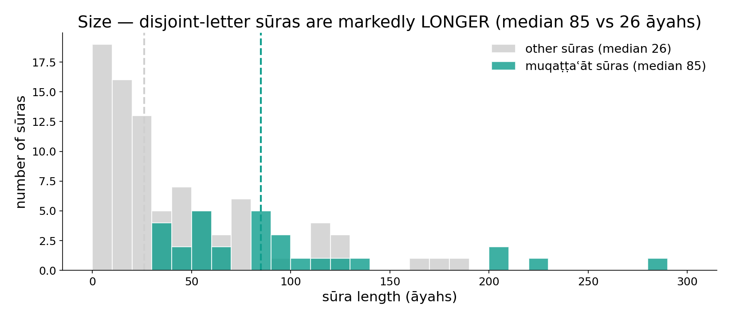
Module 4 — Size: the marked sūras are longer
In the data — the full sūra-length distribution for both groups; the muqaṭṭaʿāt sūras (teal) sit well to the right — median 85 vs 26 āyahs. A large, consistent size gap, not a handful of outliers.

Slide 10
Module 5 — What it is NOT: the code claims fail
'Code' claims — significance (−log₁₀ p); ALL below the n.s. line (1.3)
1.31
1.30
1.01
0.99
Qāf-letter (sūra 50)
theme coding
embedding similarity
n.s. line
In the data — none survive
In Sūrat Qāf the letter qāf is 3.76% of letters at p ≈ 0.10 — NOT significant. The theme test is p = 0.049 (borderline, and gone after FDR). The embedding-similarity claim is p ≈ 0.10. The famous letter-cipher claims are NOT supported.

Slide 11
Module 5 — Anatomy of a myth: Sūrat Qāf
Letter qāf density in sūra 50 (%)
Is it special? (−log₁₀ p)
3.76
3.76
1.30
1.01
sūra 50
corpus rank
observed
n.s. line
The claim
Folklore says Sūrat Qāf is saturated with the letter qāf. Its qāf density is 3.76% — and it ranks 111th of 114 sūras, not 1st.
The test
Against a permutation null the elevation is p ≈ 0.10 — not significant. An attractive story that the data simply does not support.

Slide 12
Module 6 — Letter information theory
Letter-entropy difference — significance (−log₁₀ p)
Reference — what entropy measures
2.70
1.0
0.6
1.30
observed
n.s. line
even mix
skewed mix
How / What we get
Compute the letter-entropy of each group and test the difference against a permutation null.
In the data
The difference is significant at p ≈ 0.002 — muqaṭṭaʿāt sūras are compositionally distinct at the letter scale, not only longer.

Slide 13
Module 7 — Root information theory
Root-scale differences — significance (−log₁₀ p); n.s. line at 1.3
How it's done
Compute root-entropy and lexical richness per group; test each against a permutation null.
3.3
3.3
1.3
root entropy
lexical richness
n.s. line
In the data
Root-entropy differs at p ≈ 0.0005 and lexical richness at p ≈ 0.0005 — the distinction is sharp at the root scale too. A multi-scale structural signal.

Slide 14
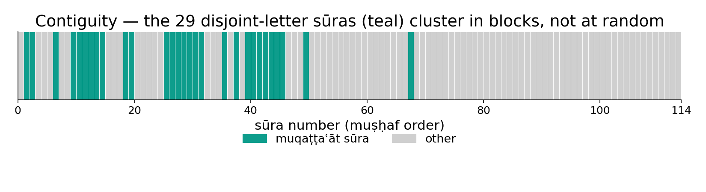
Module 8 — Contiguity you can SEE: the 114-sūra strip
In the data — each cell is one sūra in order; teal = disjoint-letter sūra. They fall in CONTIGUOUS blocks (the ḤM, ALM, ALR families), not scattered — the geometric signal at p ≈ 0.0005.

Slide 15
Synthesis — pointer, not cipher
Survives (FDR-clean)
Contiguity (0.0005, two orderings), per-family clustering, size 85 vs 26, letter-entropy 0.002, root-entropy & richness 0.0005.
Fails the null / FDR
Qāf-letter saturation (p ≈ 0.10), thematic coding (0.049, gone after FDR), embedding similarity (p ≈ 0.10).
Honest reading
A geometric and organizational signal marks these sūras as a distinct class — the data does not license a hidden cipher.

Slide 16
The whole battery at a glance
Every test — significance (−log₁₀ p). Green survives, red fails; n.s. line at 1.3
4.0
3.3
3.3
3.3
3.3
2.7
1.3
1.0
1.0
contig. muṣḥaf
contig. nuzūl
size
letter H
root H
richness
Qāf
theme
embed
Six survive, three fail
The geometric and compositional tests (green) clear the null and FDR; the three cipher claims (red) sit below the n.s. line. One picture of the honest verdict — read the battery together, never a lone p.

Slide 17
Audit — claim by claim
✓ Contiguity ↔ pointer
Significant in two orderings (p ≈ 0.0005).
✓ Per-family clustering
Every family significant (ḤM/ALR sharpest).
✓ Size ↔ architecture
Median 85 vs 26 āyahs.
✓ Composition ↔ distinct class
Letter & root entropy differ (≤ 0.002).
✗ Qāf-letter ↔ cipher
p ≈ 0.10 — not significant.
~ Theme ↔ encoding
p = 0.049, gone after FDR — not supported.

Slide 18
Not a scientific miracle — and not evidence
What we are NOT claiming
The disjoint letters are not a decoded cipher; contiguity is not theology; a borderline uncorrected p is not a finding. We do not claim to know WHY the letters are there — only what measurable structure the tag does and does not predict.
What the workbench IS for
A disciplined way to separate a real geometric/organizational signal from folklore, with a permutation null behind every answer and FDR across the battery. Every number is recomputable live in the app. The findings are judged by reproducibility, never offered as proof of intent.

Slide 19
Quick reference — terms & live numbers
Terms
Muqaṭṭaʿāt — disjoint letters opening 29 sūras. Contiguity — clustering of tagged sūras. Permutation null — re-tag random sūras to build the chance distribution. FDR (Benjamini–Hochberg) — battery-wide correction. Letter/root entropy — composition information.
Live Book6 numbers
Contiguity p ≈ 0.0005 (muṣḥaf & nuzūl) · families ḤM/ALR 0.0005, ALM 0.006, ṬSM 0.035 · median 85 vs 26 āyahs · letter-entropy 0.002 · root-entropy & richness 0.0005 · Qāf 3.76% p ≈ 0.10 (n.s.).

Slide 20
Close — the geometry the data licenses
The through-line
Tag the 29 sūras and the structure appears: they cluster contiguously in two orderings, they are markedly longer, and they are compositionally distinct at both the letter and the root scale. The attractive cipher claims — Qāf-letter saturation, thematic encoding — do not survive the nulls or FDR.
So the disjoint letters are best read as a validated positional and organizational POINTER, not a hidden code — every claim with its null, every parallel a labelled lens, never evidence.
Next in the series — Signal reads the same corpus as an ordered signal, Biology as a genome; the FDR Summary then collects every Two Books test into one corrected dashboard.

