Slide 1
TWO BOOKS · FDR SUMMARY — capstone lecture deck
One Benjamini–Hochberg correction across every domain
The honest spine
Collect one representative permutation test from each Two Books domain and correct the whole battery together. After correction the cross-domain structure is ROBUST — 6 of 8 tests survive 5% FDR — while the borderline shared-theme claim correctly drops out. Crucial caveat: FDR controls for MULTIPLICITY, not for the sūra-length confound.
Why this is the capstone
Disjoint Letters, Signal and Biology each run many tests. Read alone, the best p from a large battery is how chance masquerades as discovery. This deck reads them ALL together — every q computed live from Book6.

Slide 2
How the dashboard is built
Each page
DL · Signal · Biology
One test per domain
8 representative p's
Benjamini– Hochberg
rank & correct
Dashboard
q-values · survivors
One pipeline, one correction
Each Two Books page contributes one representative permutation test; the shared stats kernel assembles the eight p-values; a single Benjamini–Hochberg pass corrects them together; the dashboard reports q-values and survivors. No page logic is duplicated.

Slide 3
The problem — run many tests, some pass by luck
At α = 0.05
1 in 20 NULL tests 'passes' by chance alone.
Run a battery
With 8 tests, the chance of ≥1 false hit is far above 5%.
Why an uncorrected 0.05 is unsafe across a battery
Every Two Books page runs several permutation tests. Cherry-pick the smallest p and you will almost always find one under 0.05 — even if nothing real is there. That is the engine of pseudo-miracles.
The shared-theme test lands at p = 0.049 — the textbook borderline result multiplicity should make us distrust until it is corrected.

Slide 4
The fix — Benjamini–Hochberg controls the false-discovery rate
p₁
p₂
p₃
…
pₘ
How it works
Rank the m p-values ascending. The i-th passes if it is below (i ÷ m) × α. The q-value is the smallest α at which a test still passes — a number directly comparable to the 5% threshold.
FDR is the right control for an exploratory battery: less brutal than Bonferroni, yet it still guards against multiplicity. With 8 tests at α = 0.05, a raw p of 0.0005 becomes q = 0.0010, while p = 0.049 becomes q = 0.056 — now just over the line.

Slide 5
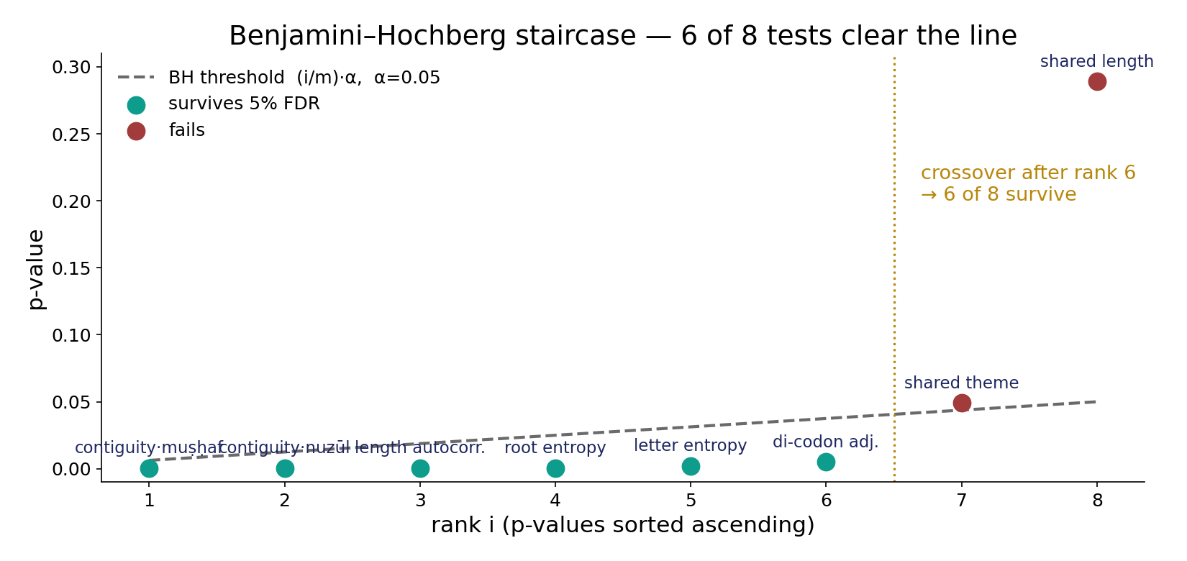
Module 3 — The ranking, made concrete
In the data — sorted p-values vs the (i/m)·α line. Ranks 1–6 sit below their thresholds and pass; rank 7 (theme, p = 0.049) crosses above and fails. Six of eight survive — exactly the q-values.

Slide 6
What this deck will — and will not — do
WILL
• Assemble one representative test per domain. • Apply ONE BH-FDR across all of them. • Read each q against 5%. • Report survivors AND casualties. • State the method's limit.
WILL NOT
• Read any single p in isolation. • Promote a borderline uncorrected result. • Claim FDR fixes the length confound. • Treat a surviving test as proof of intent.

Slide 7
Module 1 — Frame: 8 tests across 5 domains
Representative tests per domain (8 total)
What it is / Why
The capstone gathers one representative test from each Two Books domain — eight in all — so a single correction can speak for the whole project, not one page.
3
2
1
1
1
Position
Sequence
Semantic
Signal
Biology
In the data · Bridge
Position contributes three (contiguity ×2, shared length), Semantic two (theme, root-entropy), and Sequence, Signal, Biology one each. Next: the raw p's themselves.

Slide 8
Module 4 — The battery: one test per domain
Raw permutation p (−log₁₀ p) — every domain represented; n.s. line at 1.3
3.3
3.3
3.3
3.3
2.7
2.3
1.3
1.3
0.5
Contiguity · muṣḥaf
Contiguity · nuzūl
Length autocorr.
Root entropy
Letter entropy
Di-codon adj.
Shared theme
Shared length
n.s.
Eight representative tests
Contiguity in two orderings (Position), shared length & shared theme per tag, letter- and root-entropy specials (Sequence/Semantic), length autocorrelation (Signal), and di-codon adjacency (Biology) — one well-chosen test per domain, so the correction never double-counts.

Slide 9
Modules 5–6 — Raw p vs BH-FDR q across all domains
−log₁₀: light bar = raw p, coloured = BH-FDR q (green survives, red fails); 5% line ≈ 1.3
3.3
3.3
3.3
3.3
3.0
3.0
3.0
3.0
2.7
2.5
2.3
2.2
1.3
1.3
0.5
0.5
Contiguity · muṣḥaf
Contiguity · nuzūl
Length autocorr.
Root entropy
Letter entropy
Di-codon adj.
Shared theme
Shared length
The whole verdict in one picture
Green q-bars clear the 5% line; red q-bars (shared theme, shared length) fall below it. Six of eight survive after correction — the structure is robust; the borderline theme claim is not.

Slide 10
Module 5 — The survivors (6 of 8)
Survivors — BH-FDR q-value (all ≤ 0.0067)
0.0067
0.0032
0.0010
0.0010
0.0010
0.0010
Contiguity · muṣḥaf
Contiguity · nuzūl
Length autocorr.
Root entropy
Letter entropy
Di-codon adj.
In the data — one survivor from every domain
Contiguity in BOTH orderings (q 0.0010 each), length autocorrelation (q 0.0010, Signal), root-entropy (q 0.0010, Semantic), letter-entropy (q 0.0032, Sequence), and di-codon adjacency (q 0.0067, Biology). Every Two Books domain is represented among the survivors.

Slide 11
Module 6 — The casualties: what drops out
Shared theme — raw p vs BH q
Shared length — raw p
0.056
0.289
0.049
0.050
0.050
raw p
BH q
5% line
raw p
5% line
The correction works
Shared theme is the textbook case: p = 0.049 looks significant alone, but q = 0.056 — just over the line. Multiplicity correctly demotes it.
Never close
Shared length per tag is p = 0.289 — well inside the null. Both casualties drop out, exactly as a working guard should.

Slide 12
Why p = 0.049 is not a discovery
the same number, read alone vs read in a battery
Read ALONE
p = 0.049 < 0.05 → looks like a finding.
Read in the BATTERY
q = 0.056 > 0.05 → NOT a discovery.
Multiplicity changes the honest reading
A lone borderline p ignores the other seven tests. Benjamini–Hochberg asks how surprising this p is GIVEN the whole battery — and at rank 7 of 8 it is no longer surprising enough. The shared-theme claim is reported as not-supported.

Slide 13
Module 7 — Cross-domain reading
Position
contiguity ×2 (two orderings)
Sequence
letter entropy
Semantic
root entropy
Signal+Bio
autocorr + di-codon
Structure that survives independent readings
The six survivors span two INDEPENDENT orderings (muṣḥaf and nuzūl contiguity) and all three pages plus the Signal and Biology structure tests. Structure that holds across independent readings and domains is far harder to explain away than any single result.

Slide 14
The corrected dashboard at a glance
green = survives 5% FDR · red = drops out
Six green, two red
Contiguity ×2 · length autocorrelation · root-entropy · letter-entropy · di-codon — survive. Shared theme · shared length — drop out. One row, the whole Two Books verdict.
Takeaway — robust, multi-domain structure under one joint correction; the borderline claim correctly excluded. Bridge: the synthesis names the method's limit.

Slide 15
Synthesis — one corrected dashboard
Survives 5% FDR (6/8)
Contiguity ×2, length autocorrelation, root-entropy, letter-entropy, di-codon — q ≤ 0.0067, one from every domain.
Drops out
Shared theme (p 0.049 → q 0.056) and shared length (p 0.289). The correction does its job.
The limit
FDR controls MULTIPLICITY — not the sūra-length confound. A surviving test is reproducible, never a proof of intent.

Slide 16
Robustness — the contiguity signal in two orderings
Contiguity q-value — by ordering
Significance (−log₁₀ q)
0.0500
3.0
3.0
1.3
0.0010
0.0010
muṣḥaf
nuzūl
5% line
muṣḥaf
nuzūl
5% line
Why two orderings matter
The same contiguity test is run in the muṣḥaf order and the revelation (nuzūl) order — two INDEPENDENT arrangements of the same sūras.
In the data
Both survive at q = 0.0010. A signal that holds in two independent orderings is the hardest kind to dismiss as an artefact — the backbone of the survivor set.

Slide 17
Audit — the method, claim by claim
✓ Multiplicity controlled
One BH-FDR across all 8 tests.
✓ Cross-domain robustness
6/8 survive, one per domain.
✓ Borderline demoted
Theme p 0.049 → q 0.056, excluded.
✓ Reproducible
Every q re-runs live on the page.
✗ FDR ↔ confound control
FDR does NOT fix the length confound.
~ Survives ↔ proof
Reproducible ≠ proof of intent.

Slide 18
Not a scientific miracle — and not evidence
What we are NOT claiming
Surviving 5% FDR does not prove design, intent, or a miracle. FDR controls only for MULTIPLICITY — it does not correct for the sūra-length confound that several tests share, and it cannot turn a reproducible pattern into evidence of purpose.
What the dashboard IS for
A single, honest place to read the whole Two Books battery together, with multiplicity controlled and every q reproducible live from Book6. It tells us which structure is robust across domains — and which borderline claim to set aside. Judged by reproducibility, never offered as proof.

Slide 19
Quick reference — terms & live numbers
Terms
Multiplicity — many tests inflate false positives. False-discovery rate — expected fraction of 'discoveries' that are null. Benjamini–Hochberg — rank p's, compare to (i/m)·α. q-value — smallest α at which a test still passes.
Live Book6 numbers
8 tests · 6 survive 5% FDR · survivors q ≤ 0.0067 · contiguity p 0.0005 → q 0.0010 · theme p 0.049 → q 0.056 (fails) · shared length p 0.289 (fails).

Slide 20
Close — the Two Books series, corrected
The through-line
Across Disjoint Letters, Signal and Biology, the corpus shows real geometric, sequential and compositional structure. Read together under one Benjamini–Hochberg correction, six of eight representative tests survive 5% FDR — one from every domain — while the borderline shared-theme claim correctly drops out.
That is the disciplined verdict of the whole series: robust, multi-domain, reproducible structure — with multiplicity controlled, the length confound flagged, and nothing offered as proof of intent.
Every q-value on these slides re-runs live on the 📋 Two Books · Global FDR page — anyone can reproduce the dashboard from Book6.

