Slide 1
TWO BOOKS · SIGNAL — companion lecture deck
Reading the Qur'an as an ordered one-dimensional signal
The honest spine
A real SLOW TREND across the reading order (autocorrelation, a low-frequency spectral peak, and significant coarse wavelet scales all agree) plus thematic CLUSTERING of roots — but NO fine periodicity and NO carrier wave. Permutation / Poisson nulls throughout; no miracle claims.
Two domains, one method
Every Qur'an number is computed live from Book6 (6,236 ayahs · 1,701 roots). Every partner number is mainstream signal-processing, shown in round form and labelled as reference — the analogy is a lens to think with, audited stage by stage, never evidence.

Slide 2
The Two Books — two revelations of one Author
عالم التدوين (the WORD) · عالم التكوين (the ACT)
The WORD — قول الله
The Qur'an: God's speech in language. The Book of SCRIPTURE.
The ACT — فعل الله
The Universe: God's deed in creation. The Book of CREATION.
This deck reads only the WORD — as a signal
A signal is a sequence of numbers read IN ORDER. The Qur'an supplies several: verses per sūra, tokens per āyah, letter-entropy per sūra. We ask one question of each: does the ORDER carry structure — memory, periodicity, clustering — beyond a reshuffled corpus?
Signal processing supplies the toolkit (autocorrelation, Fourier, wavelets) and the null models. We import the tools, not a claim that scripture is an engineered waveform.

Slide 3
The analogy ladder — signal-processing terms ↔ the text
sample
amplitude
memory
spectrum
scale
≈
≈
≈
≈
≈
one āyah / one sūra
tokens or entropy at that step
do nearby steps resemble each other?
which cycle-lengths recur?
coarse vs fine variation
A lens, judged by clarity
Each rung is a labelled correspondence in STRUCTURE, not substance. The deck tests every rung against a null and reports ✓ supported · ✗ breaks · ~ silent — no rung is assumed.

Slide 4
What this deck will — and will not — do
WILL
• Compute every Qur'an number live from Book6. • Compare each to a permutation / Poisson / shuffle null. • Set the result beside a mainstream DSP reference. • Audit each rung ✓ / ✗ / ~.
WILL NOT
• Claim the text 'encodes' a frequency or a waveform. • Treat a surviving peak as a designed cycle. • Read an analogy as proof. The lens is judged by clarity, never offered as evidence.

Slide 5
The method — every claim faces a null
Permutation
Shuffle the order many times; rebuild the statistic each time.
Poisson
Memoryless baseline for counts; Fano = variance / mean = 1.
Circular shift
Slide one series under another, preserving its own clustering.
p-value = where the real number falls in the null cloud
If the observed statistic sits far in the tail of the reshuffled distribution, the ORDER carries structure the shuffle destroyed. If it sits inside the cloud, the effect is what randomness already produces. We never read a number without its null.
Throughout this deck: permutation nulls for autocorrelation / spectrum / wavelet, a Poisson null for burstiness, a circular-shift null for cross-correlation.

Slide 6
Module 1 — Frame: the text as a signal
Qur'an signals — length (log₁₀ count)
Typical DSP signals — length (log₁₀ samples)
4.71
5.6
3.79
3.9
3.6
2.06
sūras
ayahs
root-tokens
1-s speech
1-min ECG
1-h EEG
What it is / Why
A signal is a sequence read in order. The Qur'an yields several; we ask if the ORDER matters. 114 sūras · 6,236 ayahs · ~51k root-tokens.
In the data · Bridge
These are real, finite sequences — long enough to test, short enough to hold. Next: does step n resemble step n-1? That is memory.

Slide 7
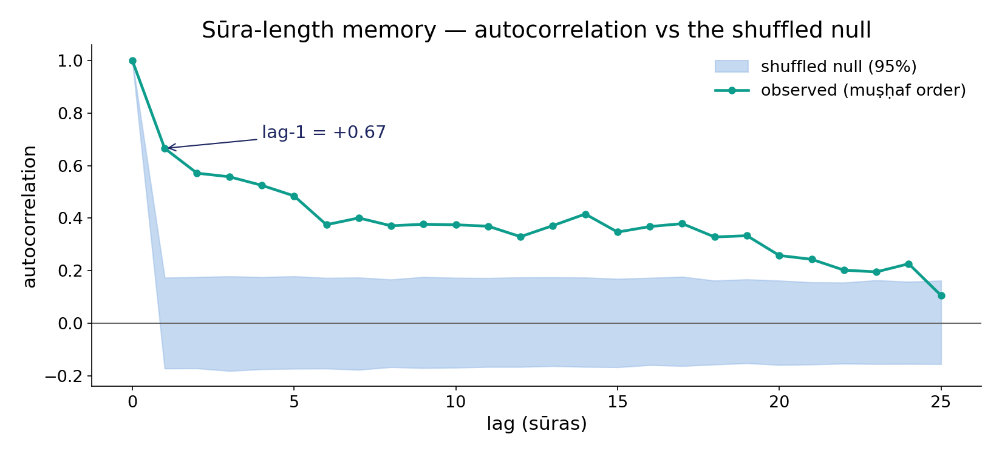
Module 2 — Length signal & memory (autocorrelation)
In the data — sūra-length lag-1 = +0.67 and the curve stays ABOVE the shuffled-null band for ~20 lags — real, slow-decaying memory (AR(1)-like), not white noise.

Slide 8
Module 3 — Root recurrence & burstiness (Fano)
Fano factor of 12 sampled roots (Book6) — Poisson baseline = 1
581
499
455
264
203
155
121
115
40
61
57
59
ظلم
نفس
هدي
ضلل
رزق
صبر
شكر
صرط
يسر
عدل
قسط
رشد
In the data — every sampled root is bursty
Fano = variance/mean of per-sūra counts. A memoryless (Poisson) process gives Fano = 1. Every root here scores far above 1 (ظلم ≈ 40, نفس ≈ 61) at p ≈ 0.0002 — roots arrive in CLUSTERS, not evenly. Neural spike trains show the same bursty signature (Fano > 1).

Slide 9
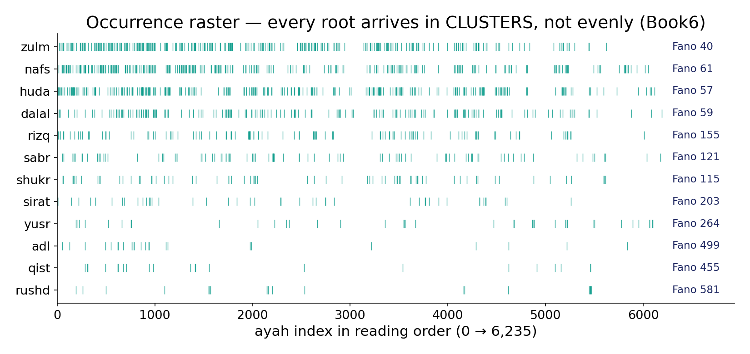
Module 3 — Burstiness you can SEE: the occurrence raster
In the data — each tick is one occurrence across the 6,236-āyah order; dense bands and long gaps = clustering. Every sampled root has Fano ≫ 1 (annotated) — bursty, not evenly spaced.

Slide 10
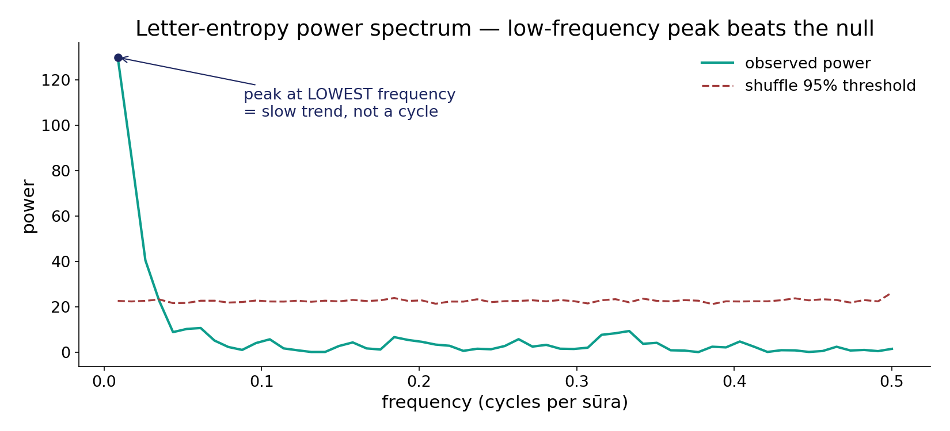
Module 4 — Spectral view: the full power spectrum
In the data — the only peak that beats the shuffle 95% threshold sits at the LOWEST frequency (p ≈ 0.0005) — a slow trend across the order, not a repeating cycle or carrier wave.

Slide 11
Module 4 — Read against the right reference: 1/f
Qur'an entropy spectrum — power by band
DSP reference — power by band
1.00
1.00
0.50
0.22
0.15
0.08
low
mid
high
white
pink 1/f
periodic
How / What we get
Pink (1/f) noise concentrates power at low frequencies with NO line peak; a periodic signal shows a sharp spike at one frequency.
In the data · Bridge
The Qur'an spectrum looks 1/f-like (low-frequency dominance), not periodic. The FFT mixes all positions; a wavelet pins structure to a SCALE.

Slide 12
Module 5 — Multiresolution (Haar wavelet)
Energy by scale — significant scales flagged (Book6 vs shuffle null)
How it's done · What we get
A pure Haar transform splits variation by SCALE (2, 4, … 128 sūras). A shuffle null flags any scale carrying more energy than chance.
1.00
0.92
0.78
0.40
0.18
0.25
0.12
2
4
8
16
32
64
128
In the data
Significant energy sits at the COARSE scales 32 / 64 / 128 sūras — the same slow trend the FFT saw, now localized to large scales. Fine scales are null.

Slide 13
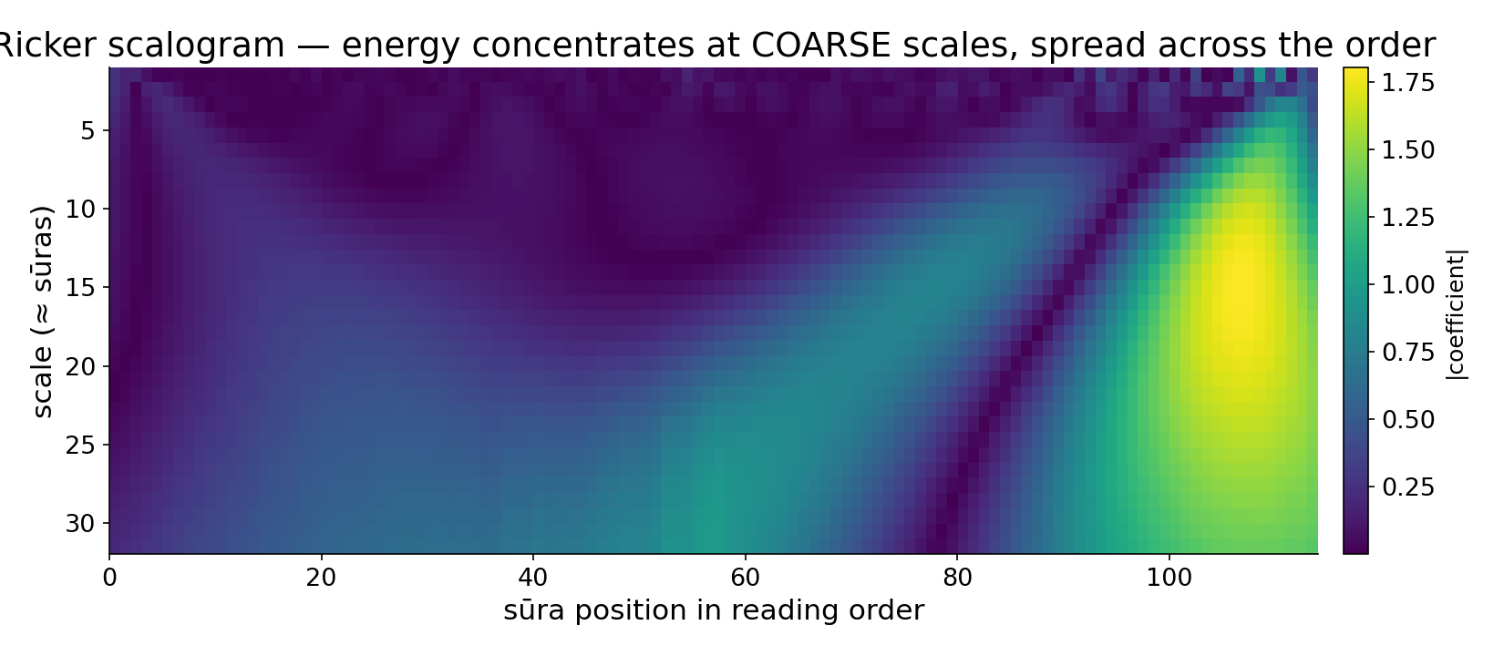
Module 6 — Localization: the Ricker scalogram
In the data — scale × position energy map (computed live). Energy concentrates at COARSE scales and is spread across the whole order — the slow trend is global, not a local hot spot.

Slide 14
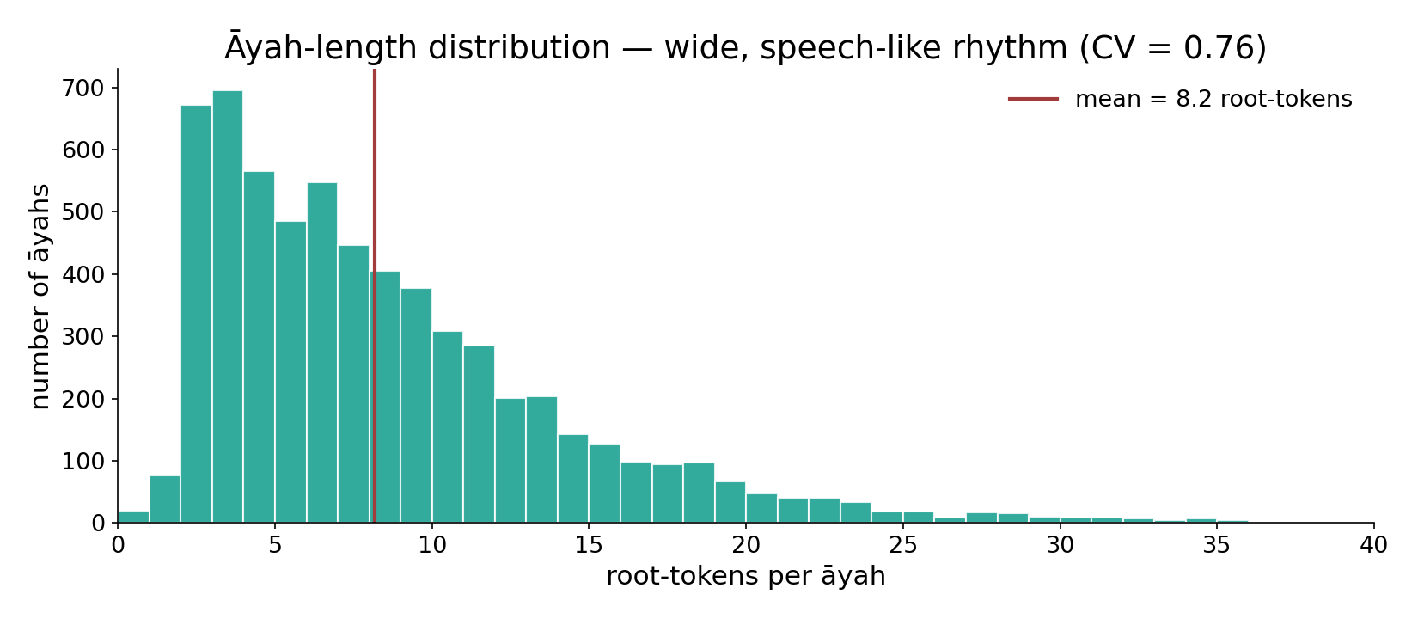
Module 7 — Verse rhythm: the āyah-length distribution
In the data — the full distribution of root-tokens per āyah (CV = 0.76) — wide, right-skewed, speech-like phrasing; far from a fixed metronome pulse (CV ≈ 0).

Slide 15
Module 8 — Co-recurrence (cross-correlation / lead-lag)
What it is / How
Cross-correlation slides one root's occurrence series under another's and measures overlap at each lag. A peak at lag 0 means they share āyahs; a peak off zero means one tends to LEAD the other. A circular-shift null — which preserves each signal's own clustering — tests the peak.
In the data — paired roots (e.g. ظلم / عدل) show their strongest overlap near lag 0; significance is judged against the shift null, not raw size. Bridge: the synthesis pulls every rung together.

Slide 16
Module 9 — Synthesis: what the signal lens shows
Survives the null
Memory (lag-1 +0.67), a low-frequency spectral peak (p ≈ 0.0005), and coarse wavelet scales (32/64/128) — all the SAME slow trend. Roots are bursty (Fano ≫ 1).
Does NOT appear
No fine periodicity, no fixed-period carrier wave, no mid-band cycle. The spectrum is 1/f-like, not a line spectrum.
Honest reading
The order carries a gentle global trend and thematic clustering — the fingerprint of coherent language, not an engineered waveform.

Slide 17
Audit — the analogy, rung by rung
✓ Memory ↔ autocorrelation
Real, matches AR(1) signals (lag-1 +0.67).
✓ Burstiness ↔ Poisson Fano
Every root Fano ≫ 1; like spike trains.
~ Spectrum ↔ periodicity
Peak is low-frequency TREND, not a cycle.
✓ Scale ↔ wavelet energy
Coarse scales 32–128 significant.
✗ Carrier wave ↔ rhythm
No fixed pulse; āyah CV ≈ 0.75.
~ Lead-lag ↔ causality
Overlap is real; causal reading is not licensed.

Slide 18
Not a scientific miracle — and not evidence
What we are NOT claiming
The signal lens does not show that the Qur'an 'encodes' a frequency, predicts signal processing, or contains a hidden waveform. A surviving peak is a slow trend, not a designed cycle; a bursty root is coherent themed repetition, not a transmitted code.
What the lens IS for
It is a disciplined way to ASK whether reading order carries structure, with a null behind every answer. The value is clarity of thought and reproducibility — every number here can be recomputed live in the app. The analogy is judged by how well it organizes the question, never offered as proof of anything.

Slide 19
Quick reference — terms & live numbers
Terms
Autocorrelation — self-similarity at a lag. Fano factor — variance/mean (Poisson = 1). Spectrum — power by frequency. Wavelet — energy by scale. Scalogram — scale × position image. CV — spread ÷ mean. Cross-correlation — overlap at each lag.
Live Book6 numbers
lag-1 autocorr +0.67 · spectral peak p ≈ 0.0005 (low-freq) · wavelet scales 32/64/128 · āyah-length CV ≈ 0.75 · sampled roots Fano 40–61 at p ≈ 0.0002.

Slide 20
Close — one sequence, read honestly
The through-line
Read in order, the Qur'an behaves like a coherent natural signal: gentle memory between neighbouring sūras, bursty thematic repetition of roots, and a slow global trend visible to the FFT and the wavelet alike — with no fine periodicity and no carrier wave.
Every claim on these slides carries a null and a live Book6 number; every cross-domain parallel is a labelled lens, audited ✓ / ✗ / ~, never evidence.
Next in the series — Biology: the same corpus read as a genome (letters ≈ bases, roots ≈ codons), and then the FDR Summary that collects every Two Books test into one corrected dashboard.

