Slide 1
A DATA-DRIVEN EXPLORATION OF QUR’ANIC ROOTS
From Frequency
to Structure
ء ل ه
Measuring how the Qur’an’s ~1,700 roots behave across all 6,236 ayahs — and reading those measurements honestly.
State a computed FACT, then a separately labeled INTERPRETATION — never blur them.

Slide 2
WEEK 1
Frequency
How often does a root appear — and how honestly can we read that?
The simplest, most objective layer. Worked roots: ظلمvs عدل.
Every value computed from Book6 (6,236 ayahs · ~1,700 roots).

Slide 3
The needle doesn’t feel the earthquake
A seismograph draws a jagged line. Hand the same paper to anyone — they read the same peaks.
But the needle never felt the fear, never saw a wall fall.
It recorded one thing only: that the ground moved — and how much.
That is all a count is.
This term we are the needle. We mark where a word shakes the page —
not what the trembling meant to those who lived it.
A reading can be wrong, so it can be re-read. A feeling can only be argued.
We hand you the reading. The meaning stays yours.

Slide 4
The frame & today's question
If I asked which idea matters most in the Qur'an, you'd answer from memory —
and we'd have no way to check each other.
So we take a smaller, humbler question we CAN settle:
not what matters most, but how often a root appears.
The course's one rule, kept all term:
state a computed FACT, then a separately labeled INTERPRETATION — never blur them.
We measure not to replace reading, but to make claims about the text AUDITABLE:
a count can be wrong, but it can be checked.
Today we claim presence only — not importance, not meaning, not relationships.

Slide 5
What frequency analysis is
Counting how often a meaning-bearing unit occurs in a text —
the word-frequency, or “bag-of-words,” tradition in corpus linguistics.
Temporarily set aside order and grammar; ask only: what is present, and how often?
Like emptying a book into a bag and counting the words —
you lose the sentences, but you can finally tally what's there.
The working assumption is modest:
how often a text names something is a SIGNAL of emphasis — a trace, not proof.
We start here because it's the most objective, reproducible layer;
everything later — distribution, partners, co-occurrence — builds on these counts.

Slide 6
From text to countable units
The same idea wears many clothes; we want to count the idea, not the spelling.
The pipeline:
• Tokenize each ayah into words.
• Reduce each word to its 3-consonant ROOT: كَتَبَ / يَكْتُبُ / كِتاب → كتب.
• Normalize letters & diacritics so the same root matches everywhere.
• Drop function words (في، من، الذي) — they carry grammar, not theme.
Count once per ayah (document frequency) — so one long verse can't dominate
by repeating a root.
The reduction is lossy ON PURPOSE — we trade nuance for comparability.
After it, the corpus holds 51,024 root-tokens.

Slide 7
Normalization to a rate – 1 Not stark
A bigger text yields bigger counts regardless of emphasis —
so raw counts can't be compared. Convert to a RATE.
• per 1,000 AYAHS = ayah-freq ÷ 6,236 × 1,000 (share of verses).
• per 1,000 ROOTS = term-freq ÷ 51,024 × 1,000 (size-true).
Why two? The denominator can flip the ranking — that's not cosmetic:
ظلم > هدي per ayah (46.5 vs 43.0), but هدي > ظلم per root (6.19 vs 6.17).
Per-1,000-roots is like deaths-per-100,000 instead of raw deaths —
the only fair way to compare populations of different sizes.
Always report both rates: presence is a RATE, not a count.

Slide 8
Normalization to a rate – 2 Per Ayah Stark
Within‑verse repetition:
وحد Oneness: 23.7 per 1,000 ayahs (the most verses) → but only 3.00 per 1,000 roots →last
قتل kill: 19.6 per 1,000 ayahs → 3.33 per 1,000 roots → first (war verses repeat it: قاتلوا… قُتِلوا
بعض some: just 14.0 per 1,000 ayahs (fewest verses) → leaps to 3.10 per 1,000 roots . repeat: 1.82 — بعضهم… بعضاً
So oneness is named in the most verses yet drops to last once you count every occurrence — a real plunge, not a hairline.
Normalize before you compare; a count is where you start, a rate is what you trust.

Slide 9
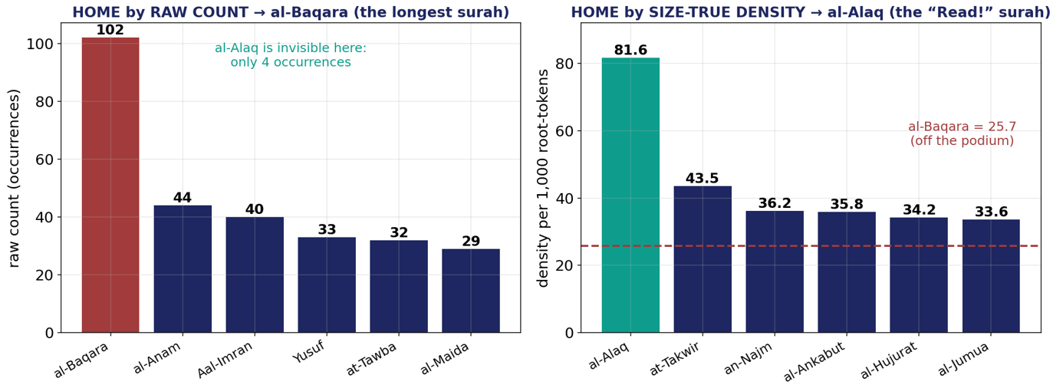
Normalization to a rate – 3 علم
LEFT - home by raw count: بقره towers at 102 occurrences, simply because it's the longest surah. علق is invisible (4 occurrences).
RIGHT - home by size‑true density (per 1,000 root‑tokens): the ranking inverts. علق leads at 81.6, and بقره — sits at 25.7, off the podium (red dashed line).

Slide 10
Normalization to a rate – 4 علم
The takeaway lands hard because it's also meaningful:
The size‑true measure crowns علق, the first revelation
"Read! … who taught by the pen" — as the true home of "knowledge,"
Exactly where a human reader would put it
The raw count just rewards the biggest surah
"presence is a rate, not a count," made stark.

Slide 11
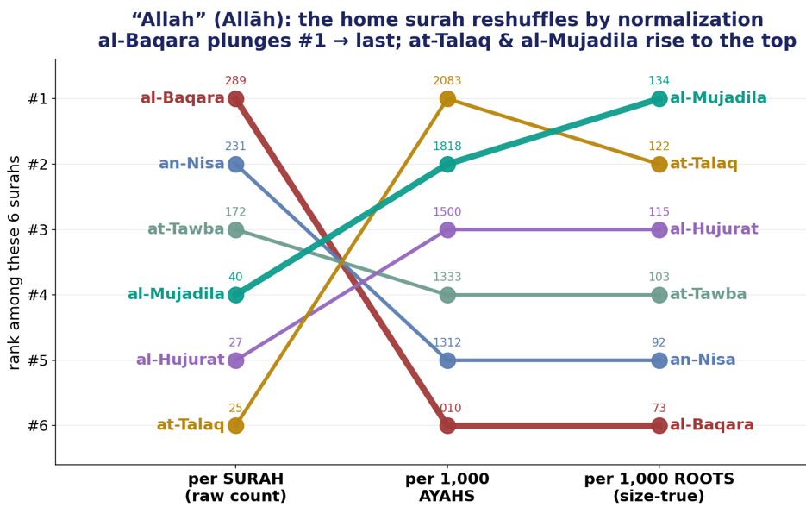
Normalization to a rate – 5 ءله

Slide 12
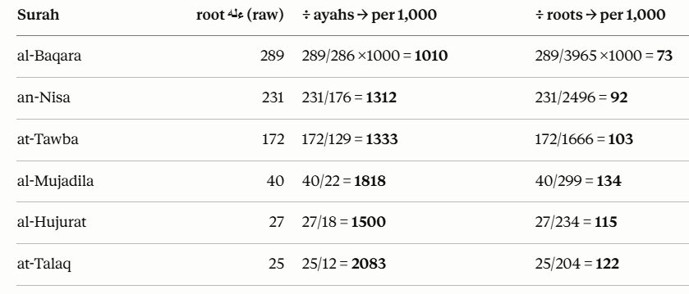
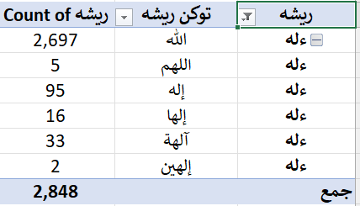
Normalization to a rate – 5a (freq=2848)ءله

Slide 13
Normalization to a rate – 6 ءله
Ranking the same 6 surahs in each column
بقره (red) plunges #1 → #6 → #6: first by raw count (289), dead last once you correct for size. The longest surah's dominance is pure container effect.
طلاق rises #6 → #1 → #2: invisible by raw count (25), but the densest per ayah.
مجادله (teal) climbs #4 → #2 → #1: the size‑true winner — the surah where "Allah" sits in every verse.
Three measures, three different #1s, and the crossing lines make the reshuffle unmistakable

Slide 14
The themed-root frequency ladder
Rank a themed set of roots by rate — the shape of the vocabulary appears.
Three descriptive bands:
• pervasive (≥25/1k): ظلم، نفس، هدي، ضلل
• mid (5–25): رزق، صبر، شكر
• rare (<5): عدل، قسط، عسر
The bands orient attention — they are not a law of the text.
Live in the app: كفر → 465 ayahs (the most-named); عسر → 12 (the rarest).
Always pair a rate with its raw count and its size-true rate.

Slide 15
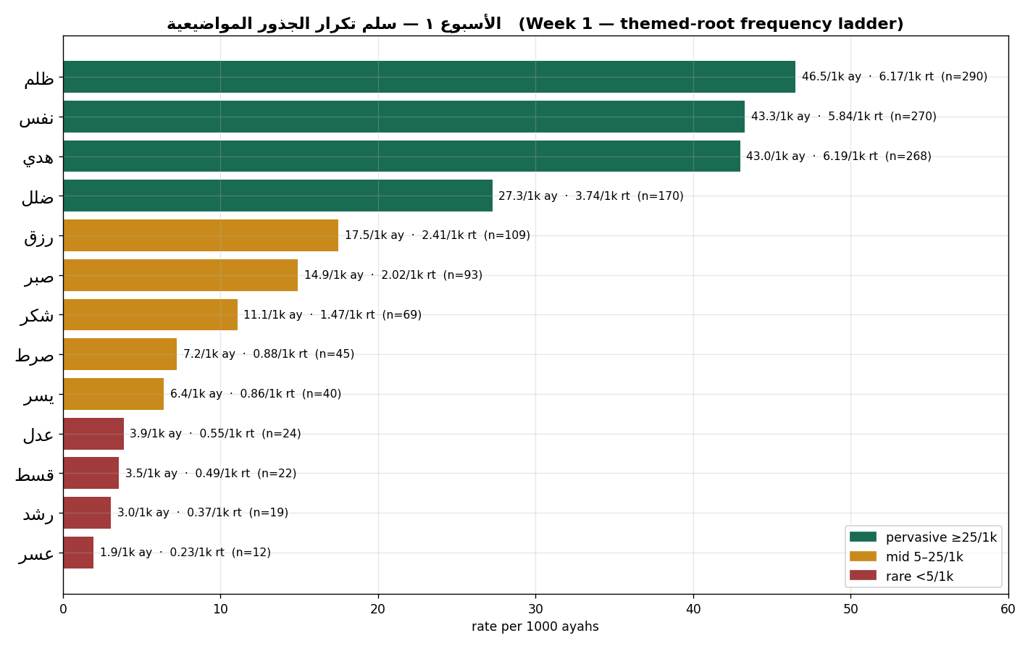
The themed-root frequency ladder

Slide 16
Predict, then check — ease vs hardship
Before we look — which is named more: ease (يسر) or hardship (عسر)?
Most rooms guess hardship.
Check it:
يسر — 40 ayahs.
عسر — 12 ayahs.
About 3.3× more “ease.”
The habit you just watched: pair the rate with the raw count BEFORE you speak.
And one number is about to unsettle a far more common assumption…

Slide 17
Live in the app — the Per-Root Profile
Type a root, press Analyze, open the Per-Root Profile. For ظلم you get:
• 290 ayahs matched, 315 total, 17 surface forms.
• 98.59th percentile — more frequent than ~98.6% of all roots.
• tier: “ubiquitous” (top 1%).
• first occurrence 2:17 (بقره); last 76:31 (الانسان).
Compute the two rates right there:
46.5 per 1,000 ayahs (share of verses) · 6.17 per 1,000 roots (size-true).
Reading habit: always pair the percentile with the raw count and BOTH rates
before you say a single word about the root.

Slide 18
The headline finding & the “unlearn”
Predict with me: which does the Qur'an name more —
عدل (justice) or ظلم (injustice)?
Most rooms say justice. The data says otherwise:
ظلم — 290 ayahs (98.6th percentile, “ubiquitous”).
عدل — 24 ayahs.
About 12× more.
A genuine unlearning: the corpus names the VIOLATION far more than the IDEAL.
But stay disciplined — this is presence, not endorsement: ظلم is named to condemn it.

Slide 19
Frequency as a vector [preview]
Here is the idea that makes today bigger than it looks.
List a root's counts across contexts — that ordered list of numbers is a VECTOR.
Do it for every root, and each root becomes a POINT in a space;
roots with similar profiles sit close together.
That is the VECTOR SPACE MODEL — the foundation of how machines “read” text.
Everything later — partners, co-occurrence, networks — is geometry on these vectors.
Nothing new is computed here: the very counts we tabulated are the coordinates.
Labeled preview — embeddings & skip-gram are further-study, never asserted against Book6.

Slide 20
What frequency gives — and what it loses
GIVES:
• objective & reproducible — anyone re-running gets the same numbers.
• scalable to all 6,236 ayahs.
• comparable, via rates.
• scoping — shows WHERE to look deeper.
LOSES — context, above all:
• stance/polarity ( كفر counted whether affirmed or refuted).
• polysemy ( ظلم = injustice AND ظلمات = darkness, as one).
• speaker, syntax, and all relationships between roots.
Frequency SCOPES inquiry; it does not SETTLE it.

Slide 21
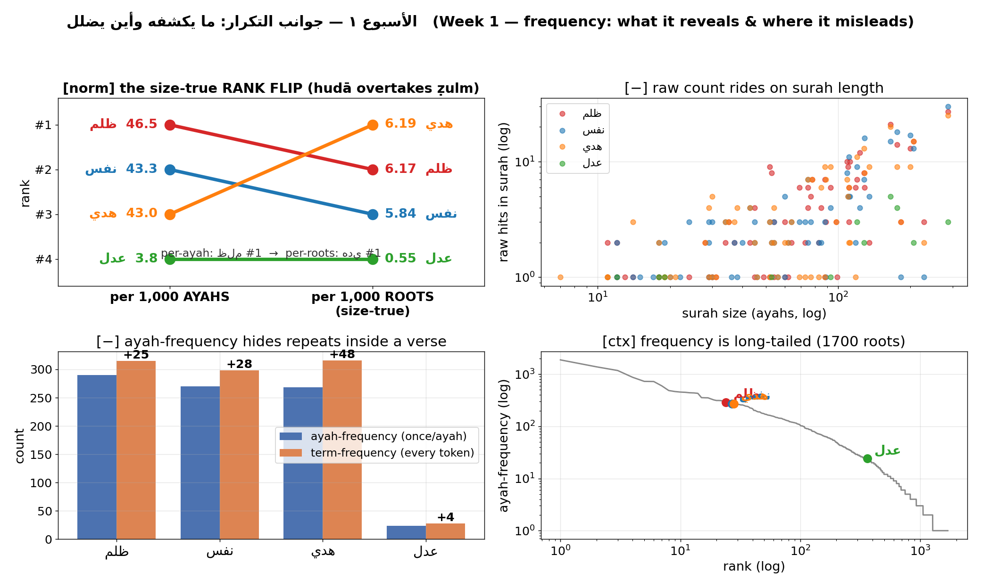
What frequency gives — and what it loses

Slide 22
What frequency gives — and what it loses
Root | Gloss | Ayahs (n) | /1k ayahs | /1k roots | Band
كفر | disbelief | 465 | 74.6 | 10.29 | pervasive
ظلم | injustice | 290 | 46.5 | 6.17 | pervasive
هدي | guidance | 268 | 43.0 | 6.19 | pervasive
ضلل | going astray | 170 | 27.3 | 3.74 | pervasive
صبر | patience | 93 | 14.9 | 2.02 | mid
شكر | gratitude | 69 | 11.1 | 1.47 | mid
يسر | ease | 40 | 6.4 | 0.86 | mid
عدل | justice | 24 | 3.8 | 0.55 | rare
عسر | hardship | 12 | 1.9 | 0.24 | rare

Slide 23
Fact vs. interpretation — the discipline
Separate the computed fact from any reading of it.
One sentence of fact (with its normalization), one labeled sentence of interpretation.
FACT
“ ظلم is named in 290 ayahs (46.5/1k ayahs, 6.17/1k roots) — about 12× عدل.”
INTERPRETATION
“I read this as the text foregrounding the diagnosis of wrong over the abstract ideal.”
Peer test: can a classmate tell which sentence is fact and which is interpretation?
If not — rewrite until they separate cleanly.

Slide 24
Worked example — al-Fatiha (by hand)
Compute frequency by hand on 7 ayahs:
tokenize → roots → count by ayah, then by token.
The teaching point — repetition:
رحم has ayah-frequency 2 but term-frequency 4 —
the only root uttered four times.
Ayah-counting hides repetition inside a verse;
term-counting catches it.
Then: one fact (“رحم, ayah-freq 2, term-freq 4”)
+ one labeled interpretation.

Slide 25
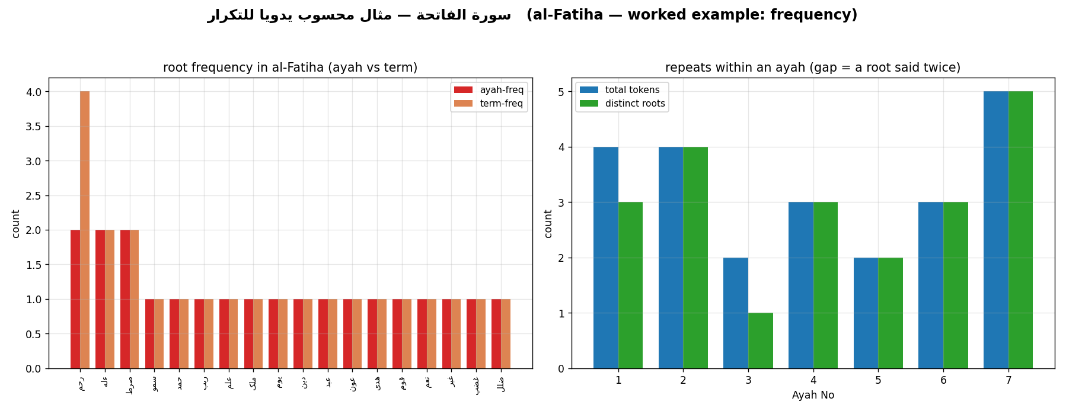
Worked example — فاتحه (by hand)

Slide 26
This week's exercise
Part 1 — by hand
• Count the roots of your assigned short surah, by ayah and by token.
• Flag any root whose term-frequency exceeds its ayah-frequency.
Part 2 — in the app
• Profile your assigned root; record BOTH rates (per 1K ayahs AND per 1K roots).
• Note percentile and tier; take one screenshot.
Submit one screenshot + two readings (one fact + one interpretation each),
the night before class — it gates the debrief.

Slide 27
Three ways to never forget: presence is a RATE, not a count
Always ask: per how much?
Salt: pot vs. cup
Stadium vs. tiny club
Textbook vs. pamphlet
• One tablespoon of salt makes a teacup undrinkable — but is barely tasted in a giant stockpot.
• al-Baqara names “Allah” 289× yet it’s a stockpot: diluted to 73 per 1,000 roots. al-Mujadila is the teacup — saturated at 134.
“It’s not how much salt — it’s how salty.”
• 500 of 50,000 sing along (1%); in a 50-person club, 40 sing (80%). The stadium has more voices, the club more devotion.
• The longest surah racks up the most mentions of everything — like the biggest crowd holds the most of every kind of person.
“The biggest crowd isn’t the most devoted — measure the %, not the headcount.”
• A word highlighted 50× across a 500-page textbook vs. 4× in a 4-page pamphlet.
• The pamphlet is the one truly about that word — why “knowledge” lives in tiny al-ʿAlaq, the “Read!” surah, not giant al-Baqara.
“Density, not tally — the small page can be the loudest.”

Slide 28
Presence is a rate, not a count — and it is context-blind
Frequency is the most objective layer — but the most context-blind.
It can defy intuition ( ظلم12 × عدل) — yet it never tells you why, who, or how.
Next week — distribution & concentration:
Frequency says HOW MUCH; next we ask WHERE a root sits and how it spreads.

