Slide 1
WEEK 1
Frequency
How often does a root appear — and how honestly can we read that?
From Frequency to Structure · every value computed from Book6 (6,236 ayahs · 1,701 roots)

Slide 2
The frame & today's question
1
The one rule state a computed fact, then a separately labeled interpretation — never blur them.
2
Today's question how often does a root appear? — the simplest, most objective layer.
3
What we claim presence only — not importance, meaning, or relationships.
4
By the end retrieve a rate, read the data honestly, write the two-sentence reading.

Slide 3
What frequency analysis is
The method
count how often a meaning-bearing unit occurs in a text — the word-frequency / “bag-of-words” tradition.
Working assumption
how often a text names something is a SIGNAL of emphasis — a measurable trace, not proof.
Why start here
it is the most objective, reproducible layer; distribution, partners, motifs all build on these counts.
A signal of emphasis is not a verdict on importance — see “what's lost.”

Slide 4
From text to countable units
Tokenize
split each ayah into word-tokens
Reduce to root
كَتَبَ · يَكْتُبُ · كِتاب → كتب (count concepts, not spellings)
Normalize
fold hamza/ya & strip diacritics so the same root matches
Content filter
keep noun/verb roots; function words (في، من، الذي، و) have no triliteral root → dropped
Count unit
once per ayah (document frequency) — long verses can't dominate

Slide 5
Two kinds of frequency
 | Ayah-frequency | Term-frequency
counts | once per ayah | every token
al-Fatiha رحم | 2 | 4
relation | the app default | ≥ ayah-freq
Lesson ayah-counting silently drops repetition inside a verse.

Slide 6
The trap of raw counts
A bigger text yields bigger counts regardless of emphasis.
ظلم looks like it lives in al-Baqara — only because al-Baqara is the longest surah.
A raw count measures length as much as emphasis.

Slide 7
Fix — normalize (ayahs are not equal-sized)
per 1,000 AYAHS
per 1,000 ROOTS (size-true)
ayah-freq ÷ 6,236 × 1000
term-freq ÷ 51,024 × 1000
290 → 46.5
315 → 6.17
share of VERSES it occurs in
share of ALL root-occurrences
Why both? ayahs vary in length. ظلم leads هدي per-ayah (46.5>43.0) — but هدي leads per-root (6.19>6.17). The ranking flips.

Slide 8
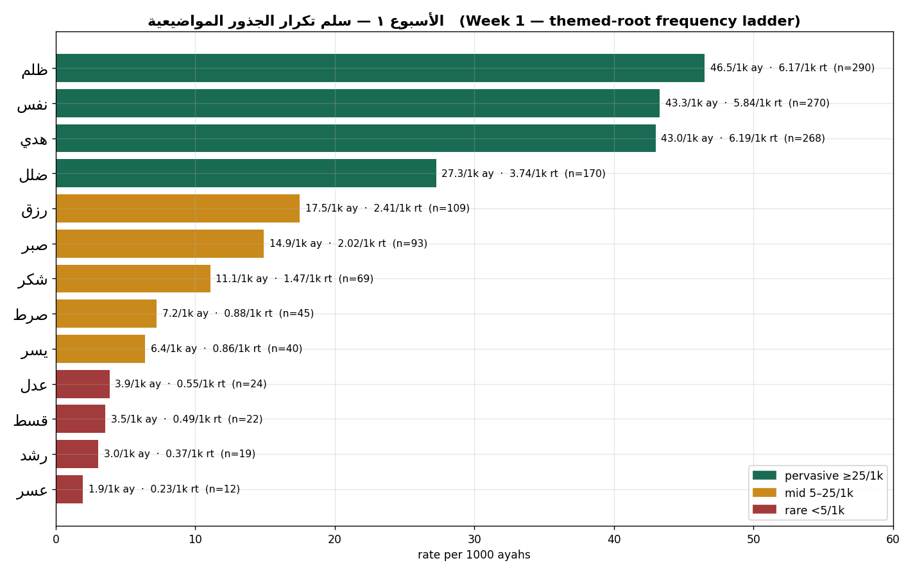
The themed-root frequency ladder
Three bands
pervasive ≥25/1k
mid 5–25/1k
rare <5/1k
descriptive, not a law of the text.

Slide 9
Predict, then check
Which is named more — عدل (justice) or ظلم (injustice)?
ظلم 290
عدل 24
≈ 12× more — the corpus names the violation far more than the ideal.
Presence, not endorsement: ظلم is named overwhelmingly to condemn it (polarity verified later).

Slide 10
Frequency as a vector [preview]
Each root’s counts form a vector; every root becomes a point in a space.
a root → a vector
→ a point in space
This is the vector space model — the foundation of how machines “read” text; later weeks are geometry on these vectors.
Preview & motivation — not tested today; embeddings and skip-gram are further-study, never asserted against Book6.

Slide 11
What counting erases
polarity / stance
speaker (God, prophet, opponents)
polysemy (ظلم = injustice & ظلمات darkness)
syntax (who does what to whom)
relationships between roots
كفر is counted whether disbelief is described or quoted-and-refuted.

Slide 12
What it gives — and what it does not
GIVES
DOES NOT GIVE
objective & reproducible
scalable to all 6,236 ayahs
comparable (via rates)
scopes where to look deeper
a reproducible baseline
meaning-in-context
polarity (affirm vs condemn)
who / why
relationships between roots
importance ≠ frequency
Rule of thumb: frequency SCOPES inquiry; it does not SETTLE it.

Slide 13
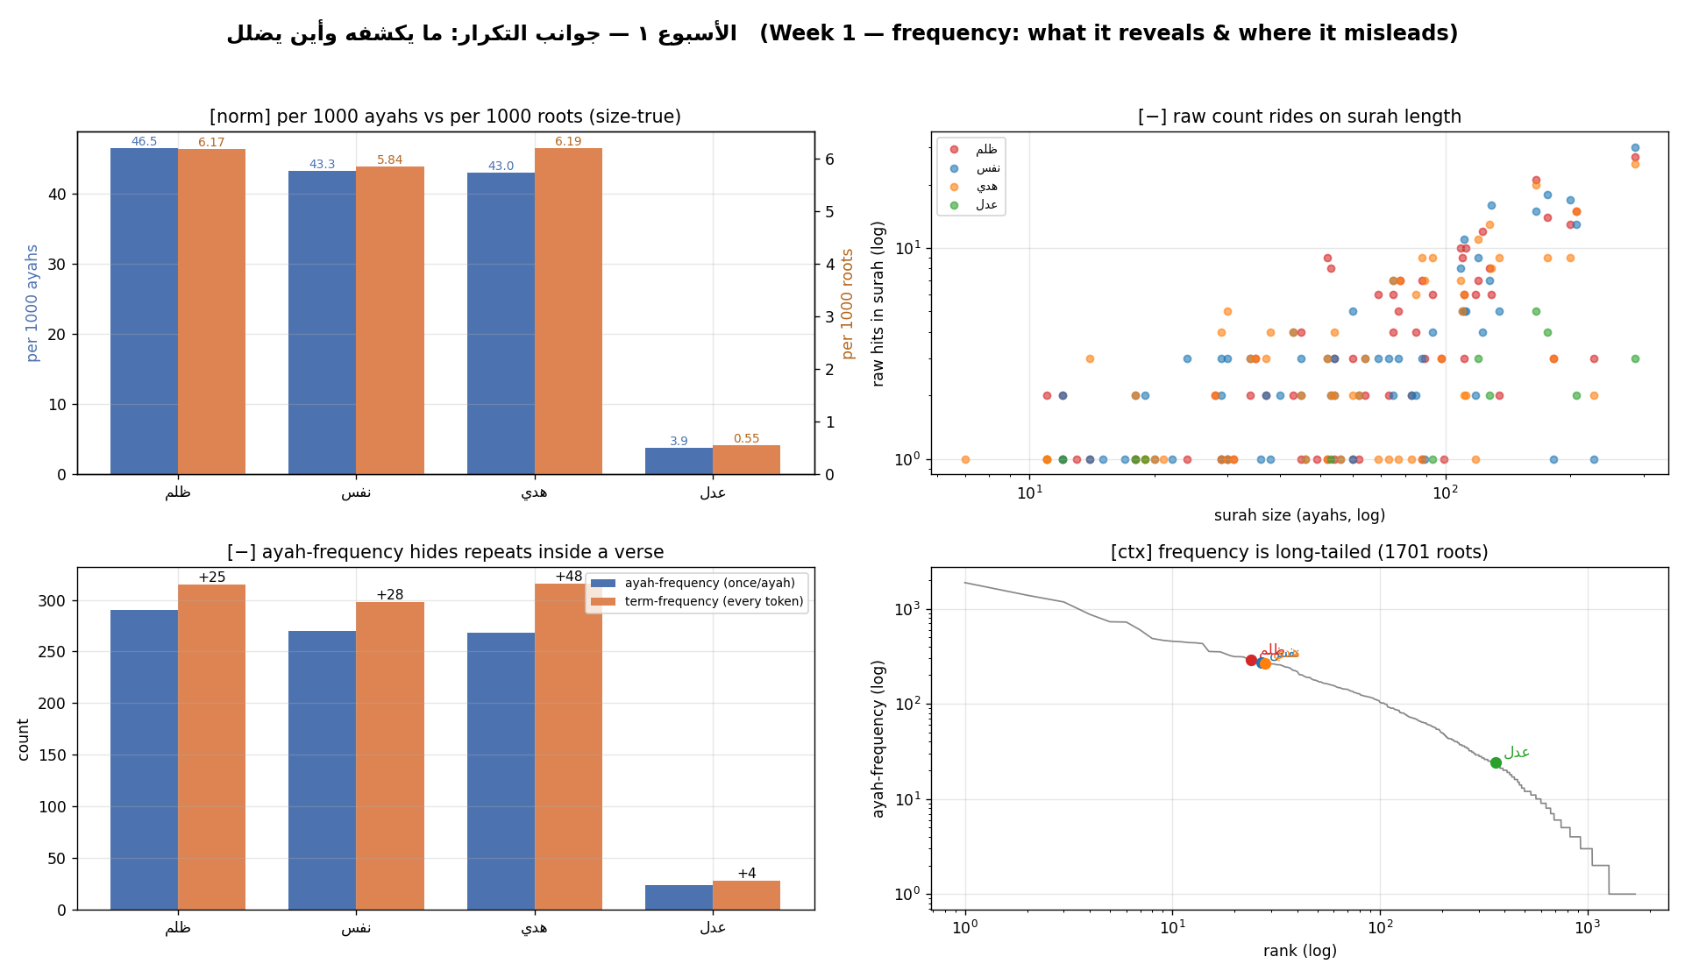
Evidence — frequency aspects

Slide 14
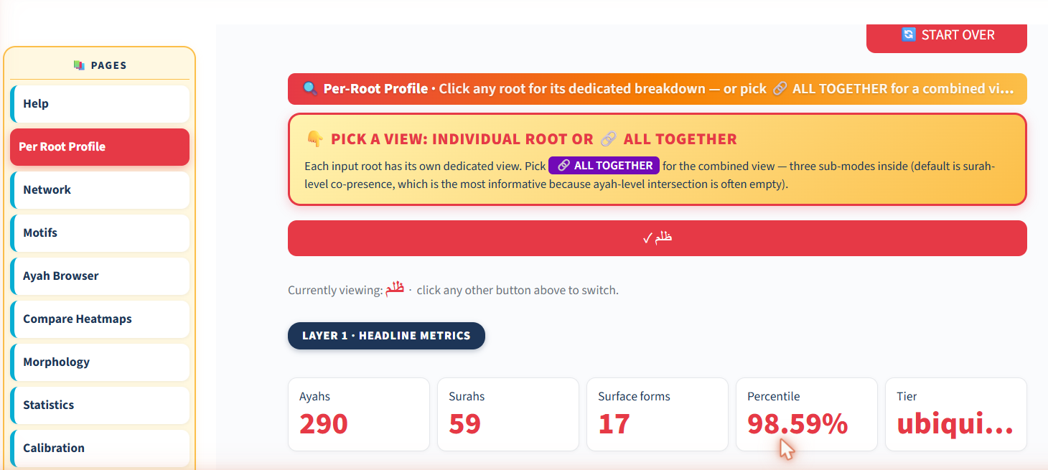
The app — Per-Root Profile (ظلم)
Type → Analyze →
Per Root Profile
290 ayahs
59 surahs
98.59th pct
ubiquitous

Slide 15
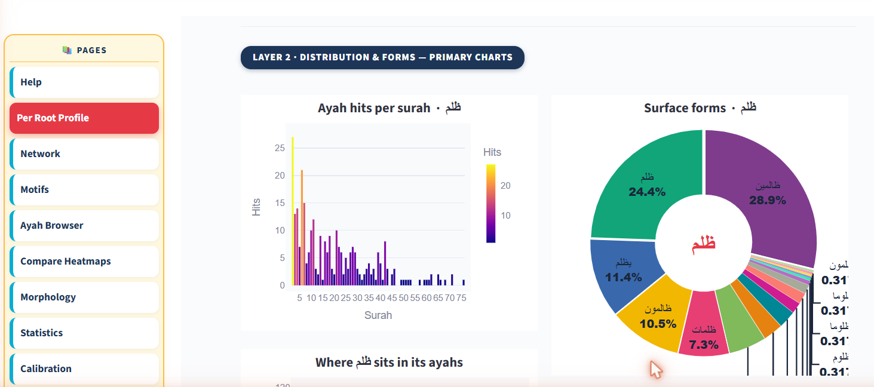
Reading the app's frequency charts
17 surface forms collapse into one root — frequency counts the root, not a spelling.

Slide 16
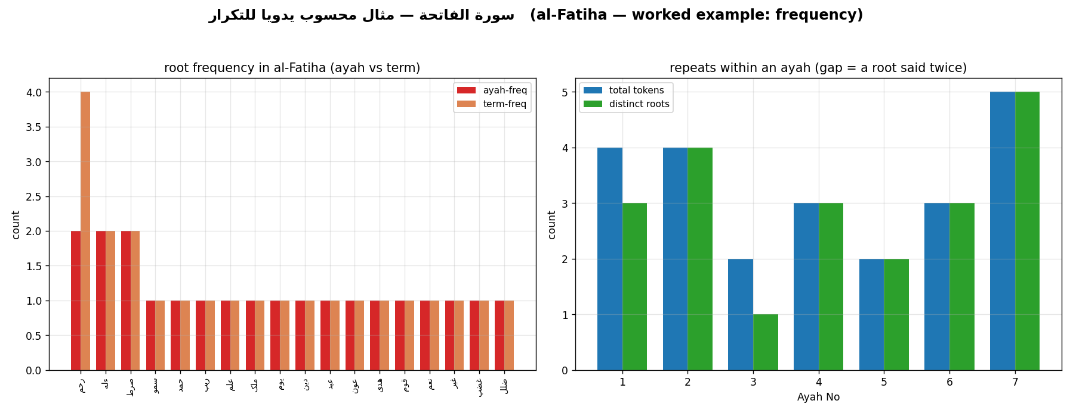
Worked example — al-Fatiha (by hand)
رحم
ayah-freq 2
term-freq 4
the only root uttered four times.

Slide 17
The two-sentence reading
FACT ظلم is named in 290 ayahs (46.5/1k ayahs, 6.17/1k roots) — ~12× عدل.
INTERPRETATION “I read this as the text foregrounding the diagnosis of wrong over the abstract ideal.”
Fact, then labeled interpretation — never blurred.

Slide 18
This week's exercise
Part 1 — by hand
frequency of your assigned short surah
Part 2 — in the app
profile your root; record BOTH rates (per 1k ayahs & roots), percentile, tier
Submit
1 screenshot + two readings (one per part), night before class
Your submission gates the live debrief.

Slide 19
Presence is a rate, not a count — and it is context-blind.
Next week — distribution & concentration: where a root sits, and how it spreads.

