Slide 1
WEEK 2
Distribution & Concentration
Where a root lives, and how unevenly — measured size-true (per 1,000 root-tokens).
Frequency told us HOW MUCH; today we ask WHERE. Worked root: ظلم.
Every value computed from Book6 (6,236 ayahs · 114 surahs).

Slide 2
Recap, and today's question
Week 1 — how MUCH a root is named (frequency).
A total, though, is silent about geography.
Two roots can have nearly the same count and live completely differently:
• one woven through the whole Qur'an,
• the other pooled in a few surahs.
Today — WHERE does a root sit, and how evenly is it spread?
Two new lenses: BREADTH (reach) and CONCENTRATION (inequality).
How much is not where — presence has a geography.
Worked root: ظلم (injustice).

Slide 3
What distribution & concentration are
DISTRIBUTION — how a root's occurrences spread across the 114 surahs.
CONCENTRATION — how unevenly they pile up.
Like a population map: is the root spread evenly across the country,
or crowded into two or three cities?
Take the per-surah counts — a vector across 114 surahs
(the same vector idea from Week 1) — and summarize its spread and inequality.
• BREADTH = reach (how many surahs).
• CONCENTRATION = inequality (how pooled).
ظلم's 290 ayahs fall across 59 surahs — and not evenly:
its three busiest surahs alone hold 21.7% of them.

Slide 4
Breadth — in how many of the 114 surahs
The crudest, most intuitive measure of reach:
how many surahs contain the root at all?
• Narrow: عسر (hardship) — 9 surahs. رشد (right guidance) — 9.
• Broad: كفر (disbelief) — 77. علم (knowledge) — 85.
Reach is NOT predicted by frequency:
a rare root can be wide; a frequent root can be narrow.
Breadth is reach, not amount.
But breadth alone can't tell an even spread from a lumpy one —
for that we need concentration.

Slide 5
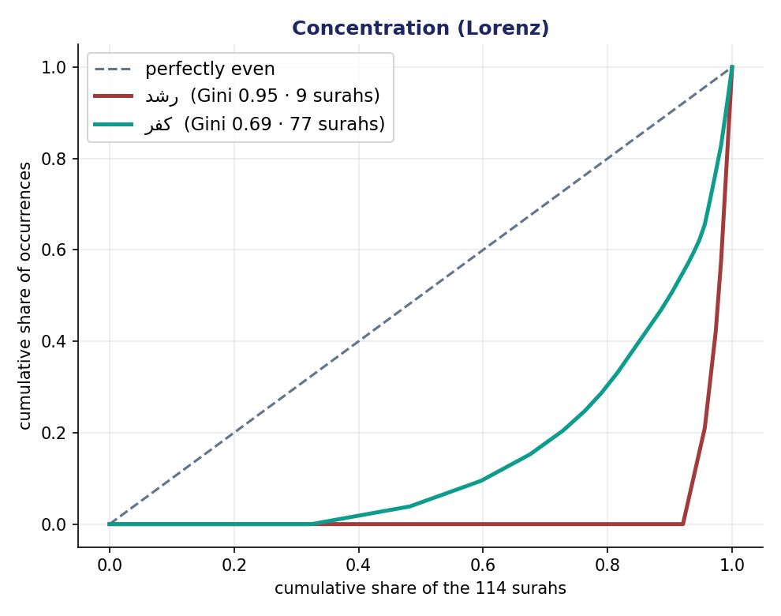
Concentration — Lorenz, Gini, top-3 share
Two roots of equal breadth can be evenly spread OR pooled in one surah.
Three ways to capture it:
• top-3 share — the intuitive one.
• the Lorenz curve — the picture; the harder it bows, the more unequal.
• the Gini — one number, 0 (even) → 1 (all in one surah).
The app computes the Gini; we read it, we don't hand-calculate it.
رشد: Gini 0.95, only 9 surahs — concentrated.
كفر: Gini 0.69, 77 surahs — spread.
Concentration is NOT importance.

Slide 6
The home surah — two traps
Which surah is a root's “home”? Two traps stack.
TRAP 1 — the surah with the most raw hits is usually just the LONGEST.
al-Baqara has 286 ayahs — the biggest store gets the most foot traffic,
regardless of how good it is. It tops nearly every root's raw count.
TRAP 2 — dividing by the surah's AYAH count is STILL wrong.
Ayahs vary in length too: a surah of long verses has more room in each.
THE FIX — normalize by ROOT-TOKENS:
the root's tokens in the surah ÷ the surah's total root-tokens × 1,000.
Measure crowd density per square metre, not per building.

Slide 7
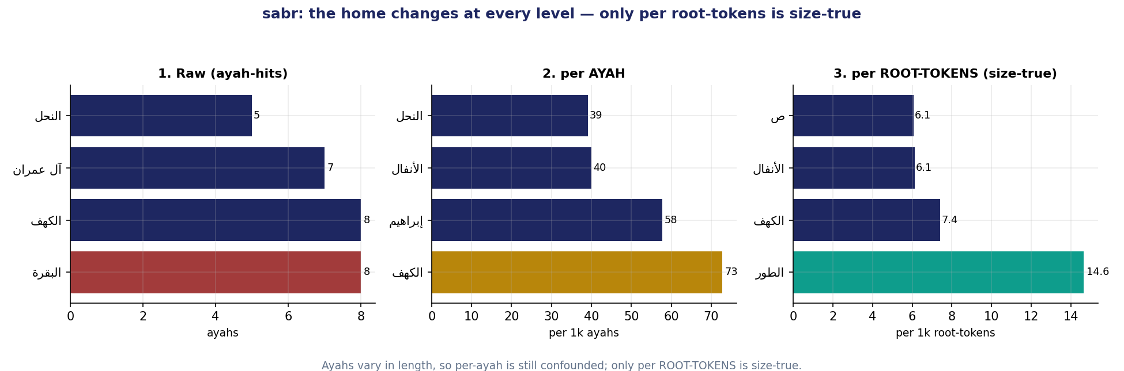
Normalize by ROOT-TOKENS, not ayahs
ṣabr (صبر): the “home” changes at EVERY level of normalization —
• RAW (ayah-hits) → al-Baqara
• per AYAH → al-Kahf
• per ROOT-TOKENS (size-true) → at-Tur
Three different surahs. Only per-root-tokens is size-true —
ayahs are no more equal than surahs.

Slide 8
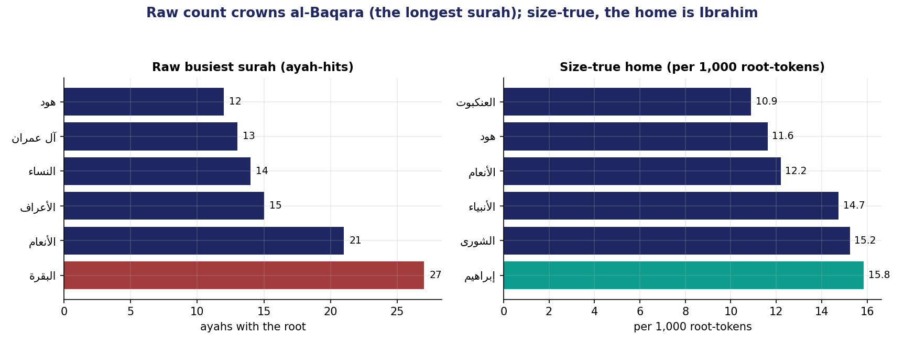
ẓulm: the home moves once you normalize
Raw busiest surah for ظلم: al-Baqara (27 hits) —
but only because al-Baqara is the longest surah in the Qur'an.
Size-true home: Ibrahim, at 15.8 per 1,000 root-tokens.
al-Baqara drops to mid-pack once you correct for size.

Slide 9
The headline — the length illusion
Take the 50 most frequent roots. Their raw busiest surah is al-Baqara for…
RAW: 30 of 50.
Size-true (per root-tokens): 0 of 50.
The single longest surah masquerades as everyone's home —
and normalizing dethrones it completely.
And per-ayah ≠ per-roots — they don't always agree (recall ṣabr).
Trust per-root-tokens.

Slide 10
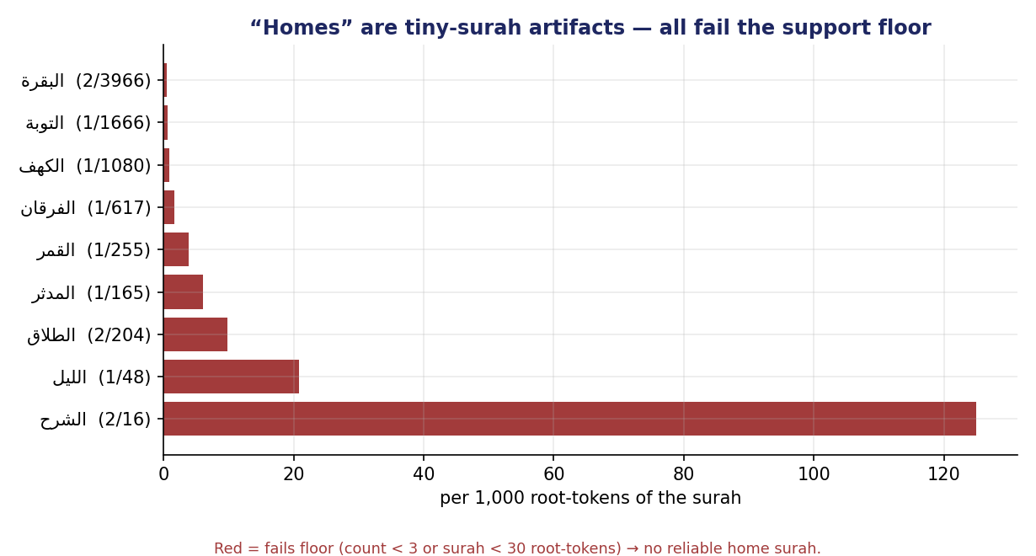
The support floor — small-sample reliability
A tiny surah can post a sky-high density off just one or two tokens.
عسر's highest prevalence is in ash-Sharh —
2 tokens in 16 = 125 per 1k — but that's noise, not a home.
THE FLOOR:
count ≥ 3 in the surah AND surah ≥ 30 root-tokens.
If no surah qualifies → report “insufficient support.”
عسر has NO reliable home surah.
A rate from too little data is a guess.

Slide 11
The size-true rule (locked)
Normalize density to per 1,000 ROOT-TOKENS — at every level.
Never by ayah-count. Never by surah-count. Never raw.
Because containers — ayahs and surahs alike — vary in size.
It is the same discipline as Week 1's per-1,000-roots rate,
now applied inside a surah.

Slide 12
What distribution does — and doesn't — tell us
GIVES:
• a root's geography — where it lives.
• size-true density (per root-tokens).
• broad vs pooled — the shape of its presence.
Does NOT give:
• importance — concentration is not centrality.
• which roots travel together — that is Weeks 3 onward.
كفر across 77 surahs is a pervasive THEME — not the most “central” root.
So pair every distribution number with a labeled reading.

Slide 13
The two-sentence reading
FACT
“ظلم spans 59 surahs (Gini 0.74); its size-true home is Ibrahim at
15.8 per 1,000 root-tokens — not al-Baqara, which leads on raw count
only because it is the longest surah.”
INTERPRETATION
“I read ظلم as a whole-Qur'an concern, not the topic of one surah.”
A classmate should tell instantly which sentence is fact and which is yours.

Slide 14
This week's exercise
Part 1 — by hand
• Take your root's raw-busiest surah and its size-true home candidate.
• Compute each one's per-1,000-root-tokens prevalence.
• Apply the support floor (count ≥ 3, surah ≥ 30 tokens); name the home.
Part 2 — in the app
• Record breadth, top-3 share, Gini; confirm your size-true home.
• One screenshot; one fact + one labeled interpretation.
Submit the night before class — it gates the debrief.

Slide 15
Where a root lives is a size-true, support-checked claim
Never its raw busiest surah.
Frequency told us how much; distribution now tells us where —
once we refuse to let the longest surah win by length alone.
Next week — partners & forms: which roots a root travels with,
and the morphological shapes it wears.

