Slide 1
WEEK 3
Partners & Forms
A root's company — its FORMS on the inside, its PARTNERS on the outside.
Arabic root-and-pattern morphology + collocation. Worked root: ءمن (believe).
Every value computed from Book6.

Slide 2
Recap, and today's two questions
Week 1 — how MUCH a root is named (frequency).
Week 2 — WHERE it sits and how it spreads (distribution).
Today — a root's COMPANY, in two directions:
• INSIDE: its surface FORMS — one root, many words (agent, act, attribute).
• OUTSIDE: its PARTNERS — the roots it travels with in the same ayah.
Both are computed; both need a labeled reading.
In Week 1 we melted every word down to its 3 consonants to COUNT it.
This week we pick the shapes back up — to read what we threw away.
Worked root: ءمن (believe).

Slide 3
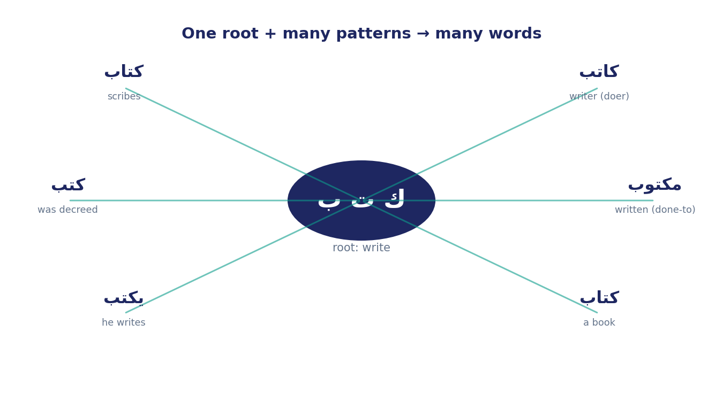
The root-and-pattern system (الجذر والوزن)
Arabic = a 3-consonant ROOT poured into a PATTERN (wazn).
Root = the raw metal; pattern = the mould you press it into.
From ك-ت-ب, “write”:
• كاتب — writer (the doer)
• مكتوب — written (the done-to)
• كِتاب — a book
• يكتب — he writes
• كُتِب — was decreed
Same metal, six jobs — the PATTERN assigns the role.
So you can't read a word's force from the bare root alone.

Slide 4
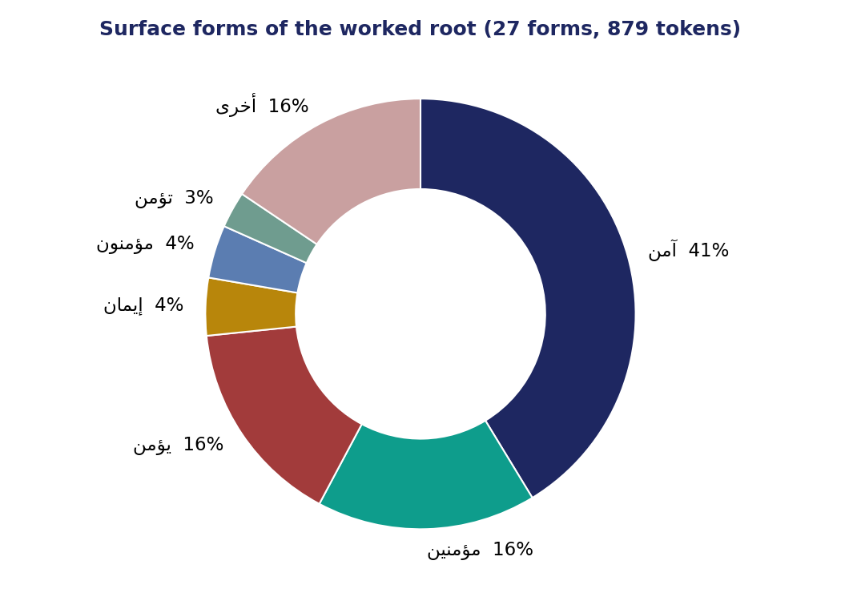
Reading a form distribution
Tally each surface form's share of the root's tokens.
ءمن: 27 forms across 879 tokens —
• آمن (verb) — 41%
• مؤمنين (participle) — 16.5%
• يؤمن (verb) — 16%
• إيمان (the noun “faith”) — only 4%
A root is not used evenly — like a coin that lands
far more often on one face than the others.
Read the dominant form BEFORE you say what a root “means.”

Slide 5
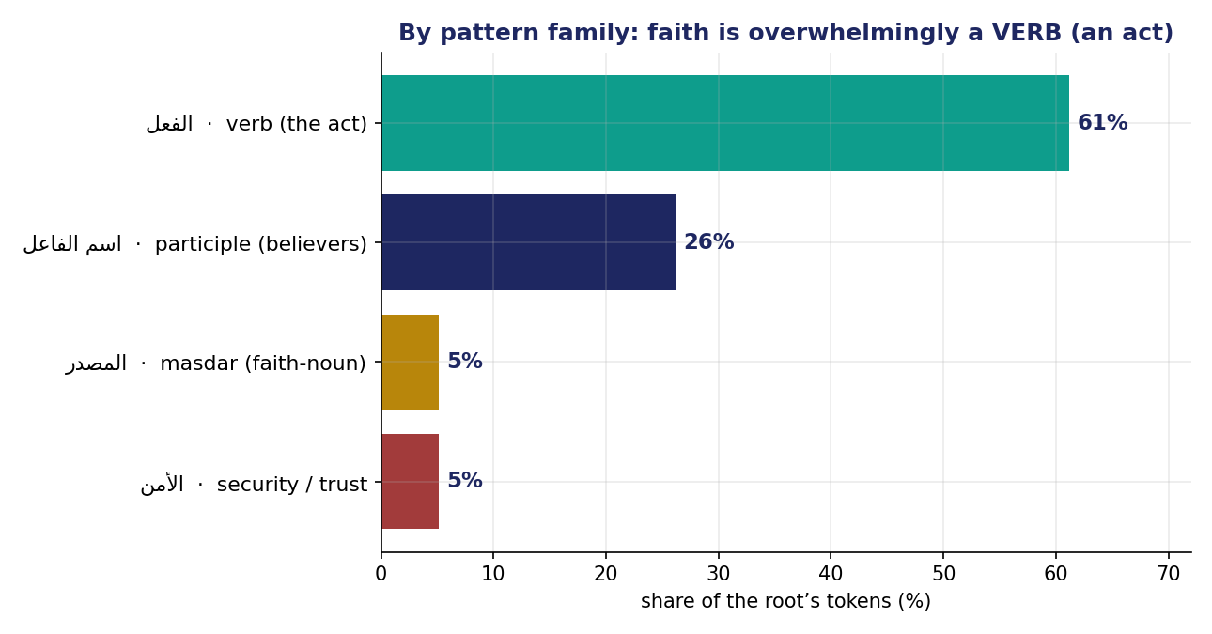
Pattern families — and the unlearn
Group forms into families — where the grammar lives:
• Verb (the act): 61%
• Participle (the believers): 26%
• Masdar (abstract faith): 5%
• Security branch: 5%
THE UNLEARN:
Faith is overwhelmingly a VERB — something DONE —
not the abstract noun إيمان.
The grammar itself encodes the theology.

Slide 6
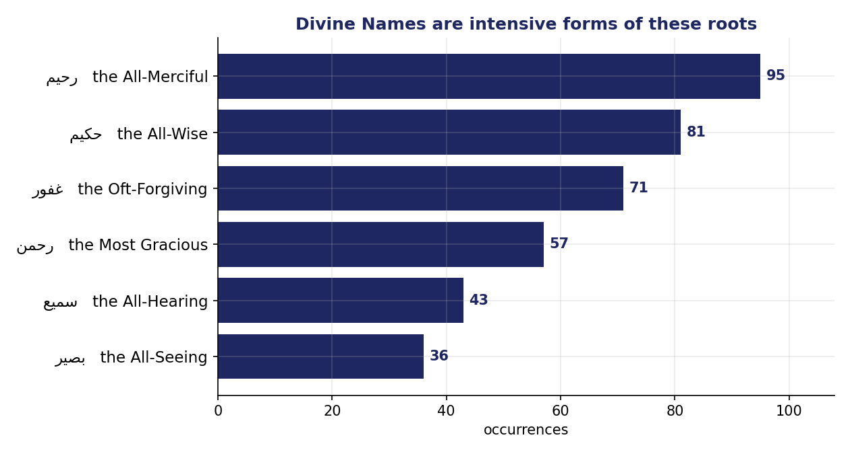
The intensive forms & the Divine Names
The intensive mould (فعيل / فعّال) turns a quality up to its maximum.
• رحم → رحيم • سمع → سميع
• بصر → بصير • غفر → غفور
• حكم → حكيم
These are Names of God.
Many Divine Names are the SAME mould pressed over different roots —
the attributes are grammatically marked as superlatives.
Learn one pattern and a whole class of the Names lines up.

Slide 7
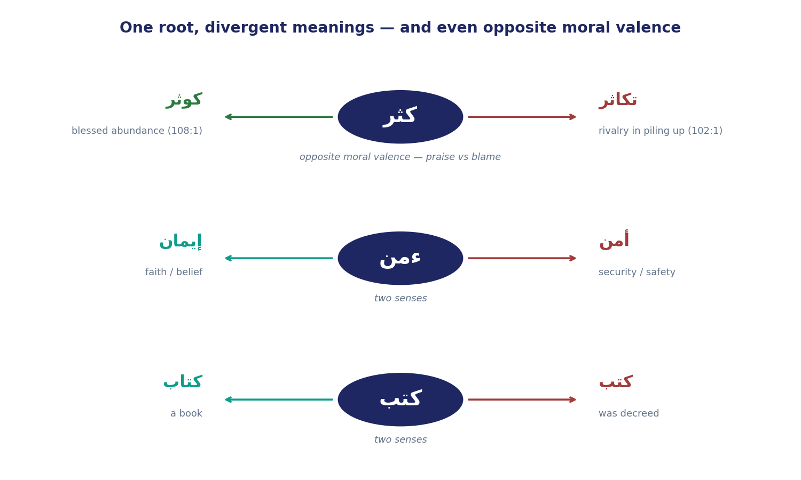
Polysemy — one root, divergent meanings
Forms split a root by SENSE — or even by moral VALENCE.
By sense:
• ءمن → إيمان (faith) / أمن (security)
• كتب → كِتاب (a book) / كُتِب (was decreed)
By valence — the deepest case:
• ك-ث-ر → كوثر (blessed abundance, 108:1)
/ تكاثر (blameworthy rivalry, 102:1)
One neutral root — “muchness” — pulled to opposite poles
by pattern and context.

Slide 8
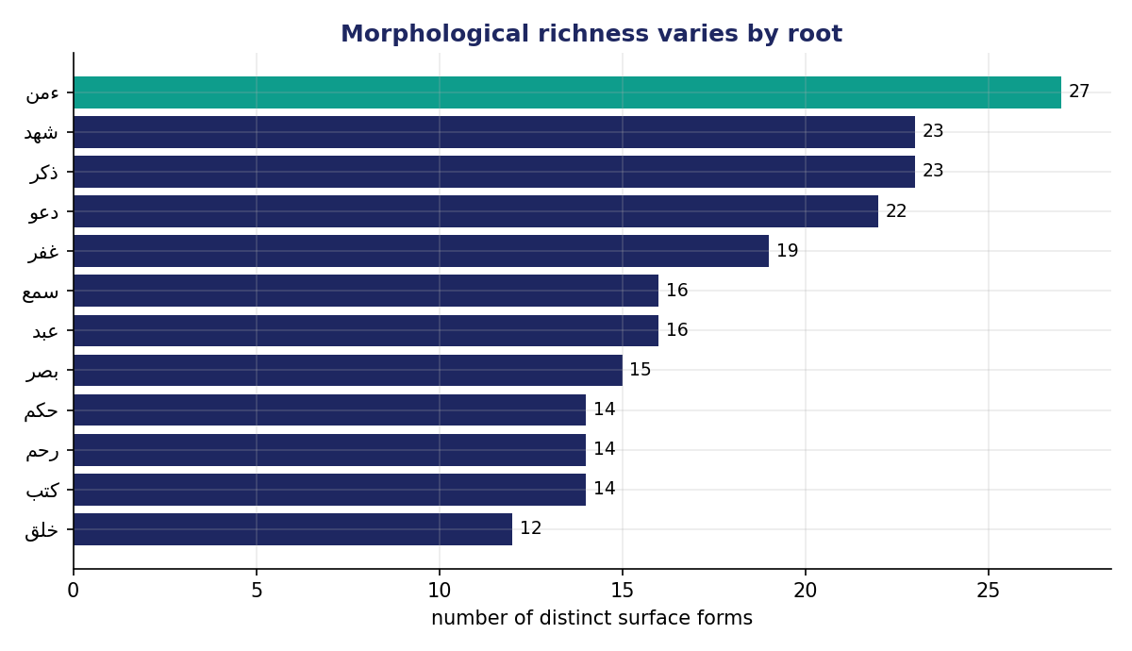
Morphological richness varies by root
How many grammatical roles does a root take on?
• Rich: ءمن 27 forms, شهد 23, ذكر 23
• Lean: خلق 12 (78% a single form)
A rich root is one the Qur'an turns over in the hand
many ways — agent, act, attribute, mood.
A lean root it uses for one tight job.
Richness is a clue to how a concept is WORKED.

Slide 9
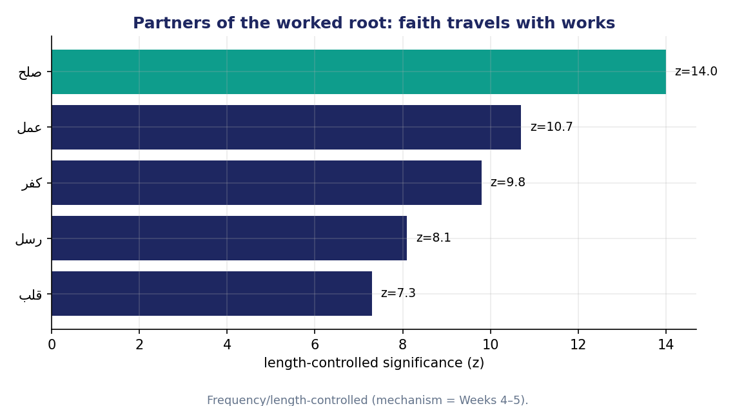
Partners — a root's external company
Partners = roots that co-occur in the same ayah more than chance.
“You shall know a word by the company it keeps.”
ءمن's specific partners:
• صلح (righteous deeds) — z 14
• عمل (works) — z 11
• رسل (messengers), قلب (heart)
Faith is almost never named alone — it walks arm in arm
with action: آمنوا وعملوا الصالحات.
(The list is already length-controlled — the how is Wk 4–5.)

Slide 10
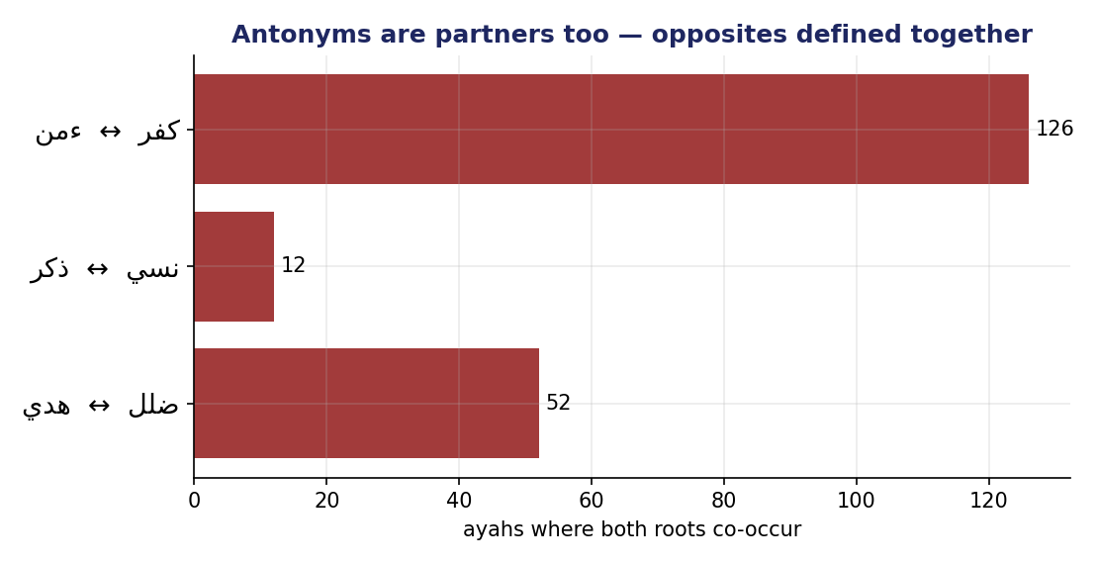
Reading partners honestly — antonyms are partners
Three cautions when reading a partner list:
1. Significant ≠ meaningful, aligned, or causal.
2. The list is length-controlled (mechanism = Wk 4–5).
3. A partner can be an ANTONYM.
Opposites are defined together — like rivals always in the same room:
• ءمن ↔ كفر (126 ayahs)
• هدي ↔ ضلل (52) · ذكر ↔ نسي (12)
A partner is a lead, not a verdict.

Slide 11
When two roots name each other
Some roots are each other's STRONGEST partner — a mutual bond:
• رحم ↔ غفر (mercy & forgiveness, z 25) — the divine pair of pardon.
• سمع ↔ بصر (hearing & seeing, z 18) — “the All-Hearing, the All-Seeing.”
• حكم ↔ عزز (wisdom & might, z 24) — “the Mighty, the Wise.”
• خلق ↔ طين / نطف (creation from clay / a drop).
When two concepts name each other, the text is telling you
they are habitually spoken in one breath.
A strong signal — but still descriptive:
the why and the direction wait for Weeks 4–6.

Slide 12
What forms & partners give — and don't
FORMS give: grammar, agency, mood, polysemy — what the root layer hid.
PARTNERS give: a concept's lived company — its collocations.
They do NOT give:
• the full meaning of a word in its ayah (forms ≠ context).
• the direction or cause of a partnership — which leads which (Week 6).
• which partner shares the MOST ayahs, or why raw counts mislead (Week 4).
So pair every forms-or-partners claim with a labeled reading.

Slide 13
The two-sentence reading
FACT
“61% of ء-م-ن's tokens are verb forms, and its strongest partner is صلح (z = 14).”
INTERPRETATION
“I read faith here as an enacted commitment bound to righteous works,
not an abstract belief.”
The peer-test:
a classmate should tell instantly which sentence the computer could check,
and which is yours. If not — the two have blurred; rewrite.

Slide 14
This week's exercise
Part 1 — by hand
• Tally your root's surface forms; record the dominant form.
• Name its pattern family: verb (act) / participle (agent) / masdar / intensive.
• Note any polysemy — does the root split by sense or by valence?
Part 2 — in the app
• Read your root's significant partners; record the top three.
• Flag any ANTONYM. Take one screenshot.
Submit one fact + one labeled interpretation per part, the night before class.

Slide 15
The root says WHAT; the pattern says HOW
Forms reveal a concept's grammar; partners reveal its company —
both computed, both needing a labeled reading.
The root tells you WHAT, the pattern HOW, the partners WHO WITH.
Next week — co-occurrence as a measure:
which root shares the MOST ayahs with a target, and why raw counts mislead.

