Slide 1



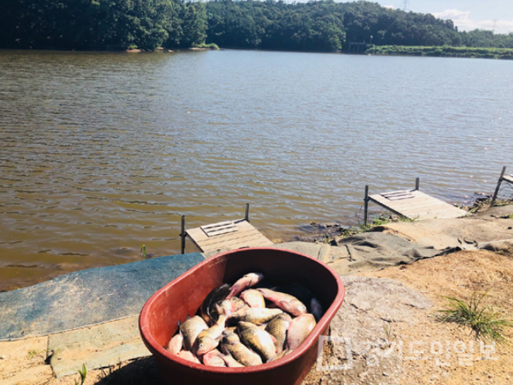
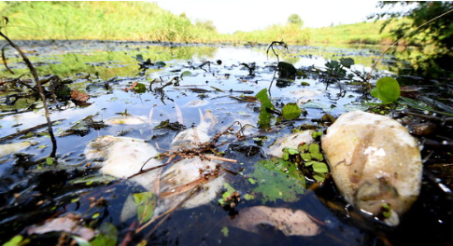
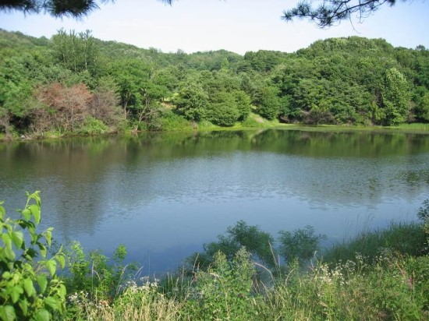
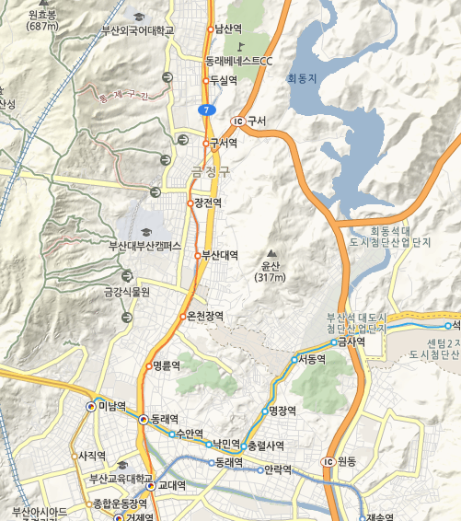
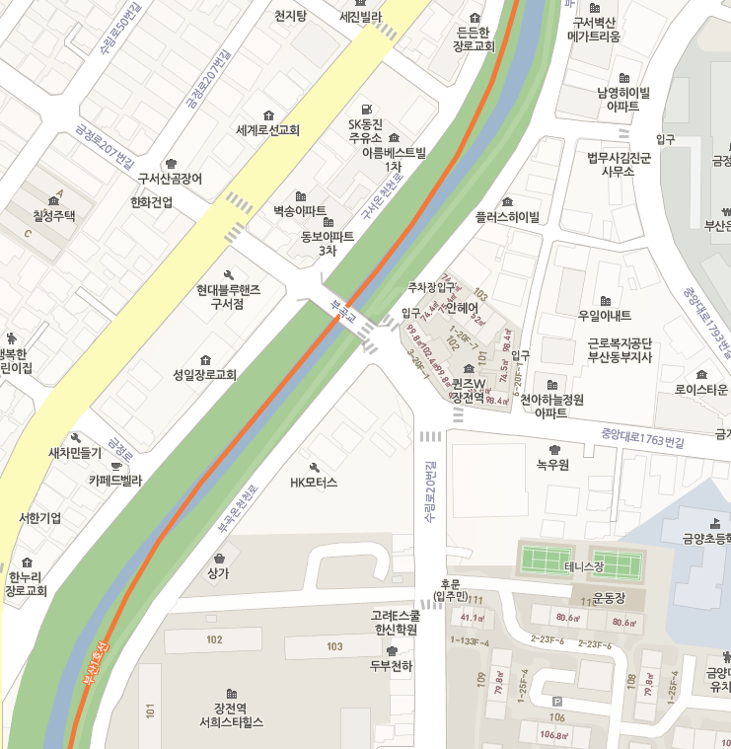
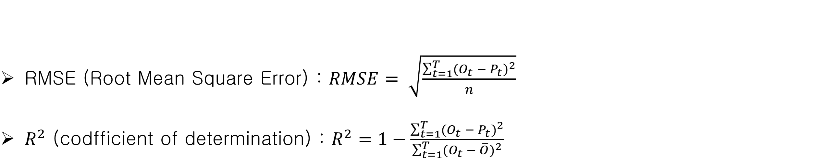
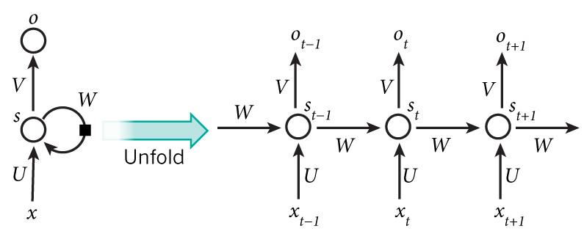
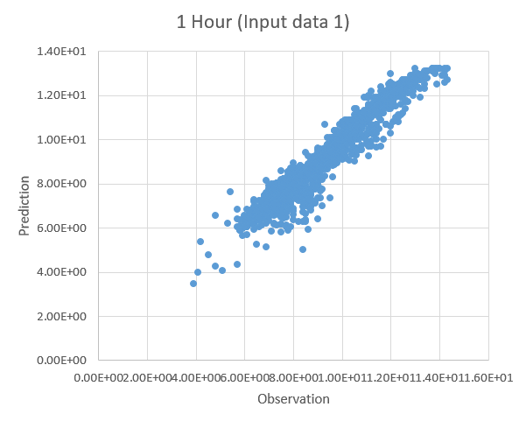
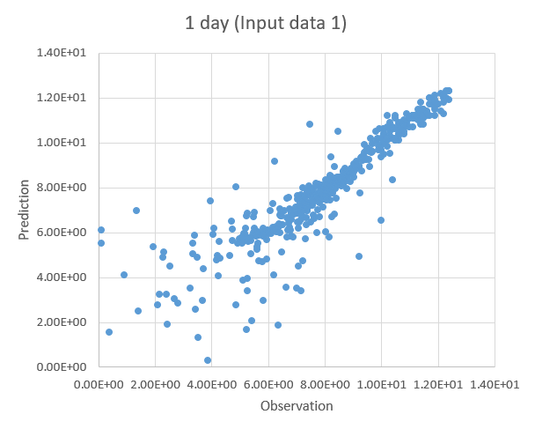
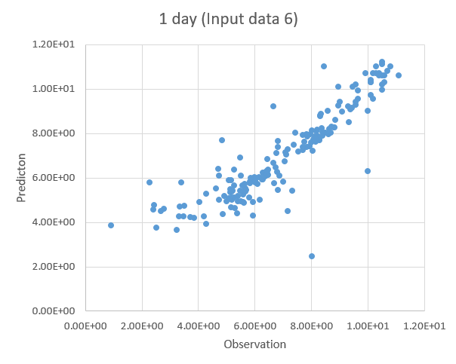
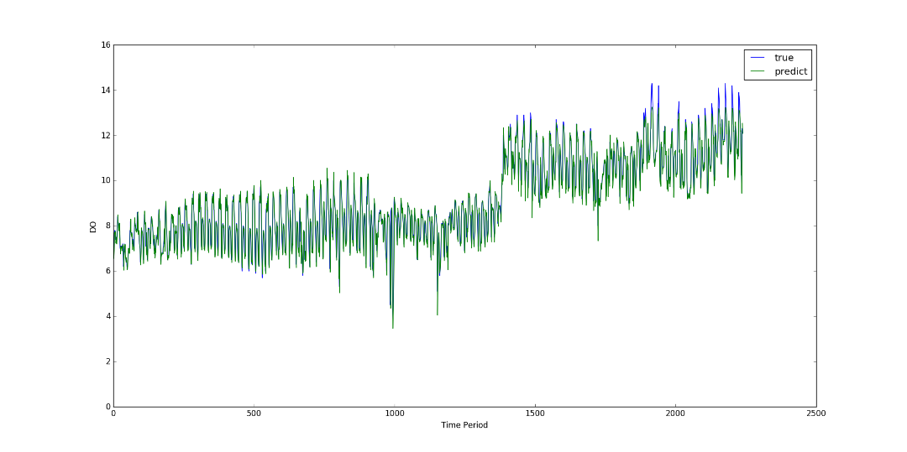
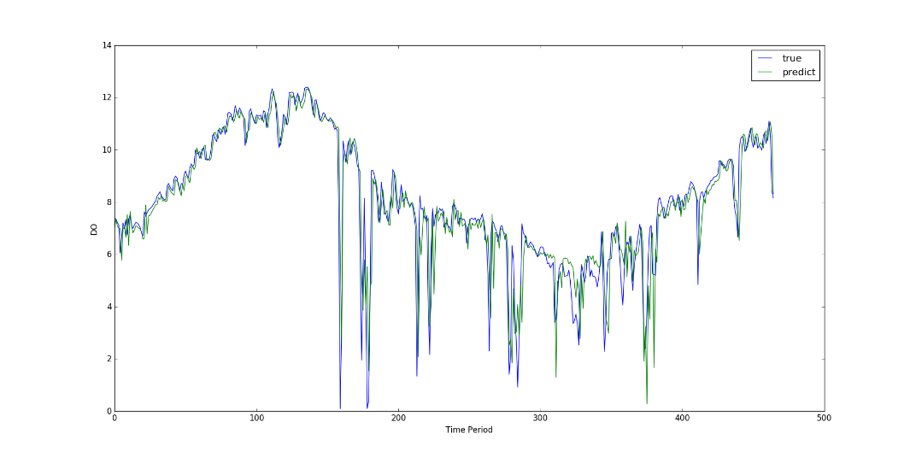
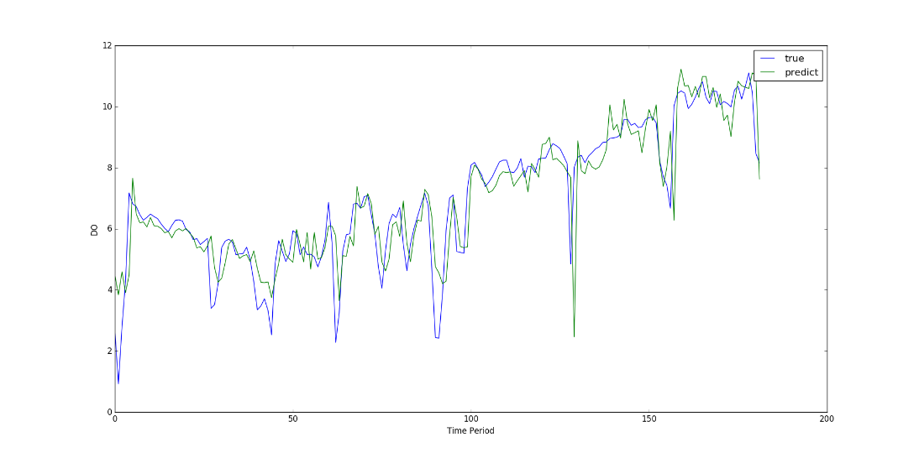
Daily and hourly prediction of DO concentration using machine learning algorithm
Lim Heesung ¹⁾, An Hyunuk¹⁾
¹⁾Chungnam National University, Department of Agricultural and Rural Engineering
(hslim1@cnu.ac.kr, hyunuk@cnu.ac.kr)
▷ Introduction
▷ Study Area
Start point
The study area is Bugok Bridge in Oncheon-stream, Busan, South Korea.
Target location collection data are Hourly-based DO(Dissolved oxygen), temperature, wind speed, relative humidity, rainfall
Over time, river pollution has been being worse, and river pollution causes uncomfortable odour.
To manage the economic and rational water quality, it is important to use a sufficient self-purification of the stream in terms of water pollution.
For the most effective utilization of the self-purification, proper countermeasures are needed by adopting water quality prediction based on water pollution data.
End point
▷ Method of Analysis
R² (coefficient of determination)
▷ Research Algorithm
RNN (Recurrent Neural Network)
The recurrent network has an input layer ‘x’, hidden layer ‘s’ and output layer ‘y’.
Input vector x(t) is formed by concatenating vector ‘w’ representing current word, and output from neurons in ‘s’ at time t − 1.
RNN is a class of artificial neural networks where connections between nodes form a directed graph along a temporal sequence.
▷ Results and Analyses
Prediction of 1 hour (2015 data)
2015. 3 ~ 9 data = Training , 2015. 10 ~ 12 data = Test
Hourly data comparison :
Input data (DO) VS Input data (Temperature, wind speed, Relative humidity, DO)
Prediction of 1 day (2014 ~ 2018 data)
2014 ~ 2017 data = Training , 2018 data = Test
1 day data comparison :
Input data (DO) VS Input data (Temperature, wind speed, Relative humidity, Rainfall, DO)
Hidden layer = 10
Prediction of 1 day (2017 ~ 2018 data)
2017 ~ 2018. 06 data = Training , 2018. 07 ~ 12 data = Test
1 day data comparison - Input data (Temperature, wind speed, Relative humidity, Rainfall, DO VS Temperature, wind speed, Relative humidity, Rainfall, DO, water level
Prediction 1 Hour |  | DO data | Temperature, wind speed, Rerative humidity, DO data
Seq. | Iter. | R square | R square
3 | 3000 | 0.9358 | 0.9345
 | 5000 | 0.9363 | 0.9234
 | 10000 | 0.9352 | 0.9382
5 | 3000 | 0.9396 | 0.9376
 | 5000 | 0.9383 | 0.9393
 | 10000 | 0.9335 | 0.9402
7 | 3000 | 0.9276 | 0.9366
 | 5000 | 0.9288 | 0.9372
 | 10000 | 0.9262 | 0.9375
Prediction 1 Day |  | DO data | Temperature, wind speed, Rerative humidity, Rainfall, DO data
Seq. | Iter. | R square | R square
3 | 3000 | 0.8284 | 0.8406
 | 5000 | 0.8171 | 0.8217
 | 10000 | 0.7532 | 0.7845
5 | 3000 | 0.8144 | 0.7295
 | 5000 | 0.7995 | 0.7129
 | 10000 | 0.7612 | 0.6989
7 | 3000 | 0.8036 | 0.7874
 | 5000 | 0.8030 | 0.7745
 | 10000 | 0.7513 | 0.7744
Prediction 1 Day |  | Water level data X | Water level data O
Seq. | Iter. | R square | R square
3 | 3000 | 0.7731 | 0.7968
 | 5000 | 0.7382 | 0.7662
 | 10000 | 0.6655 | 0.7321
5 | 3000 | 0.7540 | 0.7762
 | 5000 | 0.7173 | 0.7514
 | 10000 | 0.6405 | 0.7258
7 | 3000 | 0.6844 | 0.7542
 | 5000 | 0.6690 | 0.7316
 | 10000 | 0.5515 | 0.6925
1 day (DO data)
1 day (Temperature, wind speed, rainfall, Rerative humidity, DO, water level)
▷ Conclusion
In this study, the daily and hourly DO are predicted using the RNN-LSTM algorithm, a type of deep running algorithm, based on weather conditions and water quality data, through the use of machine learning deep running calculations.
1 hour prediction shows that there was no difference in performance between 1 input data and 4 input data and higher performance than R square 0.9.
Overall, the results comparison show that the water level data affect the water quality prediction, and the performance of prediction if the weather conditions data are available.

