Slide 1
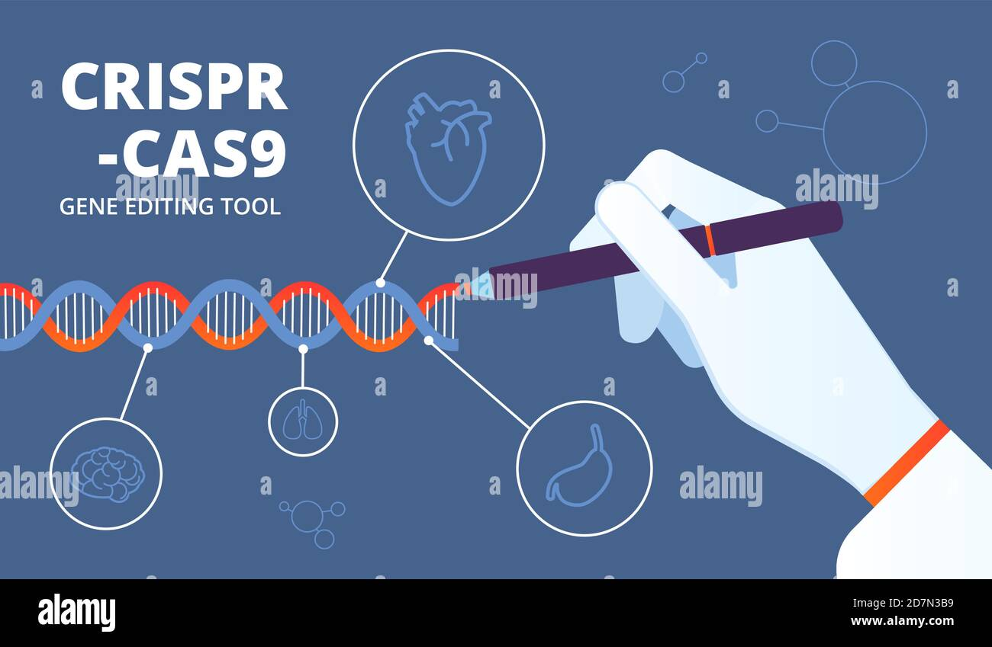
Presented by(GROUP#10):
QURAT UL AIN (2023-ag-9777) FATIMA NAVEED (2023-ag-9736)
ALIZA FATIMA (2023-ag-9712) MARYAM (2023-ag-9757)

Slide 2
Presentation Content Breakdown
25%
25%
25%
25%
Fatima Naveed Presentation
Qurat Ul Ain Presentation
Aliza Fatima Presentation
Maryam Presentation
BACKGROUND
2. INTRODUCTION
3. HISTORY & DISCOVERY
4. PRINCIPLE
5. STRUCTURE
6. MECHANISM
7. DELIVERY METHODS
8. APPLICATIONS
9. CLINICAL TRIALS
10. LIMITATIONS & CHALLENGES
11. ELSI
12. NEXT GENERATION SYSTEM
13. FUTURE ASPECTS

Slide 3
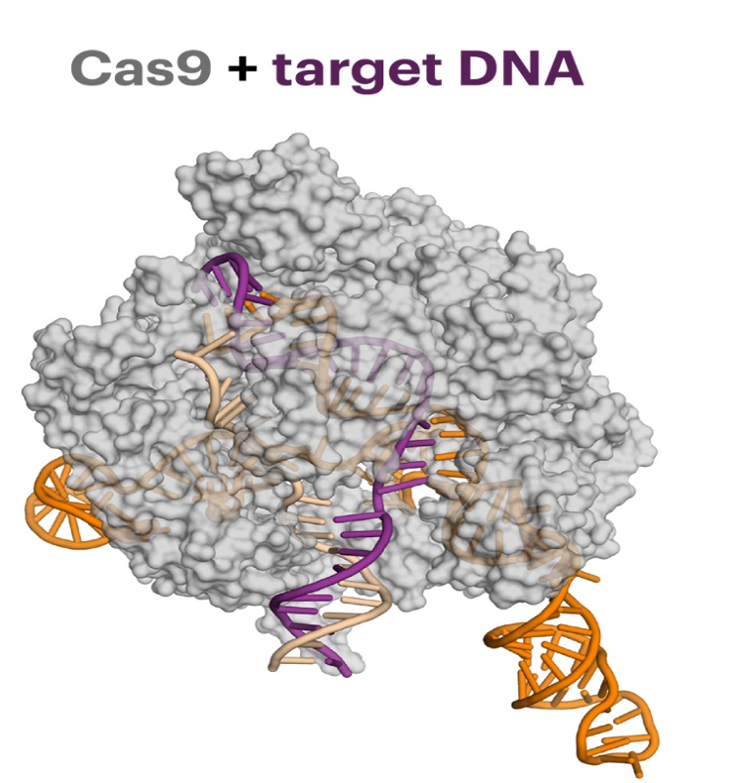
INTRODUCTION:
CRISPR (Clustered Regularly Interspaced Short Palindromic Repeats):
A gene editing tool
First identified in bacteria .
It is a type of Adaptive immune system in bacteria
CRISPR system consist of crispr locus in bacterial genome .
Cas -9 is an enzyme .

Slide 4
HISTORY & DISCOVERY
CRISPR Technology Development Timeline
First CRISPR Report
CRISPR Term Coined
Adaptive Immunity Proof
TracrRNA Identified
Genome Editing in Mammalian Cells
1987
1995
Cas12a Discovered
2002
2005
2007
2008
2010-2011
vfCRISPR Discovered
Similar Sequences in Archaea
2012
Spacers Match Viral DNA
2013
2014
crRNA Function Discovered
2015
2016
sgRNA Created
2019
2020
Genome-Wide Screening
Base Editors Invented
nCATS Development

Slide 5
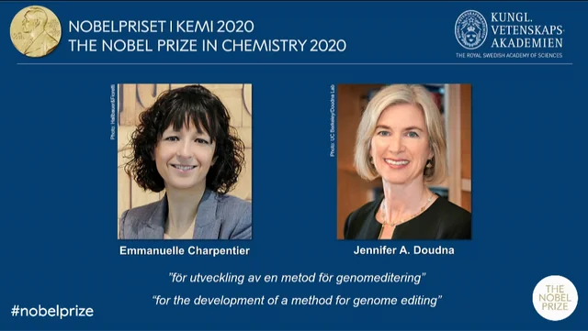

Slide 6
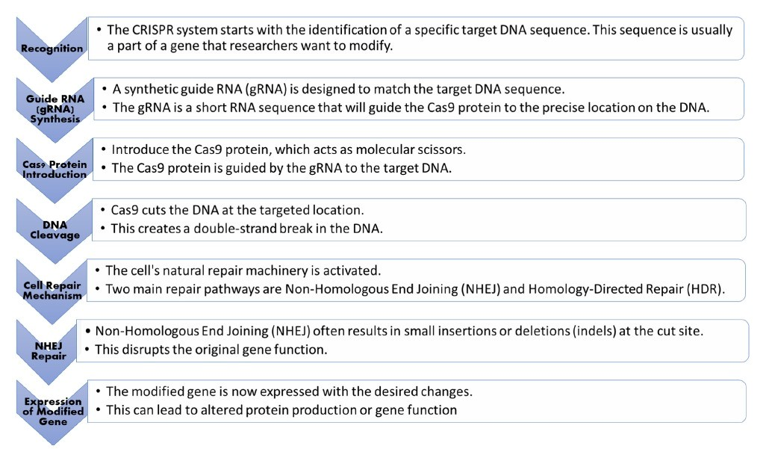
PRINCIPLE:

Slide 7
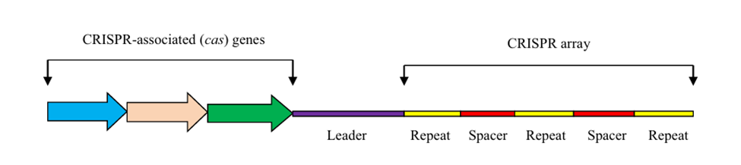
STRUCTURE
The CRISPR-Cas system consists of two main components:
CRISPR-associated (Cas) proteins → catalytic effectors
CRISPR locus → genetic memory of past foreign DNA exposure
The CRISPR locus contains:
Conserved repeat sequences (25–35 bp)
Unique spacer sequences (30–40 bp) derived from viruses, plasmids, or mobile genetic elements
An AT-rich leader sequence is located upstream of the CRISPR array and is involved in:
CRISPR transcription
Spacer acquisition
cas genes, located adjacent to the CRISPR array, encode proteins required for:
Spacer acquisition
crRNA processing
Target DNA cleavage
Notes:
CRISPR locus → pre-crRNA → crRNA(spacer region_complementary to target DNA, palindromic_just a structure)

Slide 8
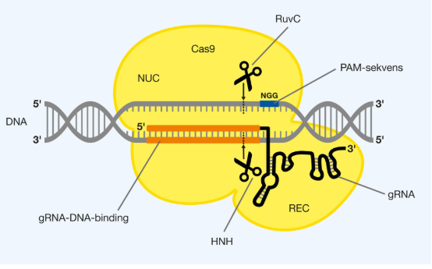
Cas9 Protein and Guide RNA Complex
Cas9 is the most widely used nuclease for genome editing
Derived from Streptococcus pyogenes (SpCas9)
Large multidomain DNA endonuclease (~1368 amino acids)
Functions as a molecular “genetic scissor”
In the native bacterial system, Cas9 associates with two RNAs:
crRNA → provides target DNA specificity
tracrRNA → essential for Cas9 activation (Type II system)
For genome editing applications:
crRNA and tracrRNA are fused into a single-guide RNA (sgRNA)
sgRNA structure:
Constant scaffold region → Cas9 binding
20-nt guide sequence (5′ end) → target DNA recognition

Slide 9
Structural Domains and Classification
Cas9 protein is organized into two major lobes:
Recognition (REC) lobe → guide RNA and target DNA binding
Nuclease (NUC) lobe → DNA cleavage
The NUC lobe contains key catalytic domains:
HNH domain → cleaves the DNA strand complementary to sgRNA
RuvC-like domain (RuvC I–III) → cleaves the non-complementary strand
PAM-interacting (PI) domain → recognizes PAM and initiates DNA binding
CRISPR-Cas systems classification:
Class 1 → multi-protein effector complexes
Class 2 → single effector protein (e.g., Cas9)
Based on Cas protein homology, systems are divided into:
Type I, Type II, and Type III
Cas9 is the signature nuclease of Type II systems

Slide 10
MECHANISM
CRISPR–Cas9 is an adaptive immune system in bacteria
Provides sequence-specific defense against viruses and plasmids
Mechanism occurs in three main stages:
Adaptation
Expression & Maturation
Interference

Slide 11
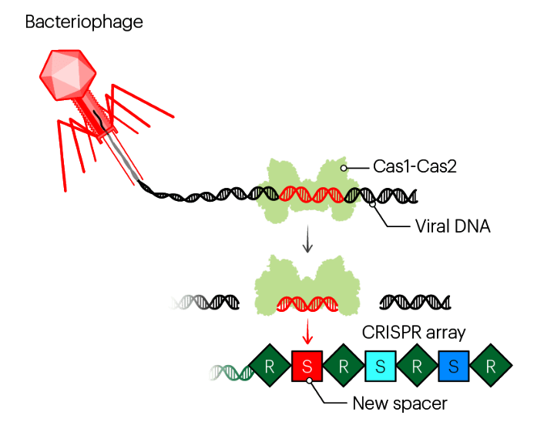
1. Adaptation (Spacer Acquisition)
Invading DNA is recognized as foreign
Cas1–Cas2 complex excises short DNA fragments (protospacers)
Protospacers are integrated into the CRISPR array as spacers
Spacer acquisition creates immune memory
PAM sequence helps distinguish self vs non-self DNA

Slide 12
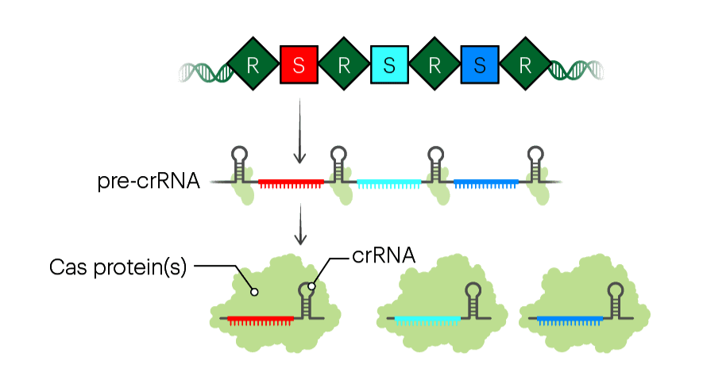
2. Expression & Maturation
CRISPR array is transcribed into pre-crRNA
The biological term for converting the CRISPR array(DNA) into RNA is known as CRISPR RNA biogenesis.
cas genes are expressed simultaneously
In type II systems:
tracrRNA binds pre-crRNA
Processed by RNase III and Cas9
Produces mature crRNA for target recognition

Slide 13
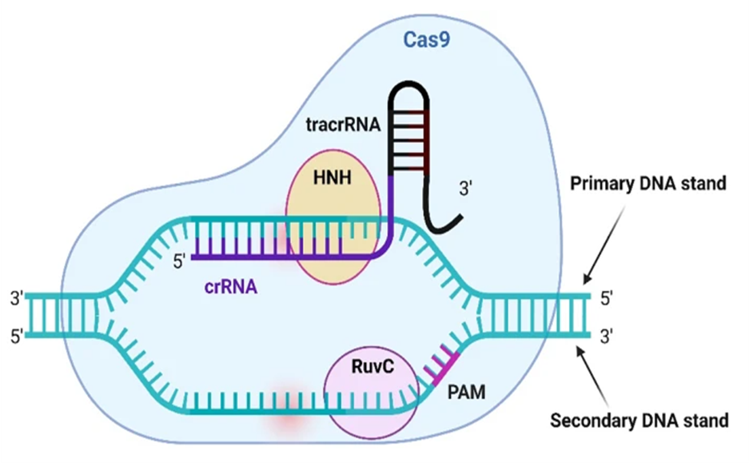
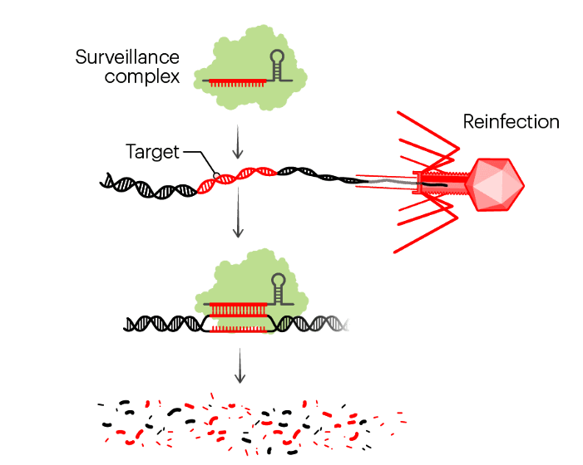
3.Interference (Target Cleavage):
crRNA–tracrRNA–Cas9 complex scans DNA
PAM recognition initiates target binding
crRNA pairs with complementary target DNA
Cas9 cleaves DNA using:
HNH domain(Cuts the target DNA strand)
RuvC domain(Cuts the non-target DNA strand)
Results in double-strand break of foreign DNA

Slide 14
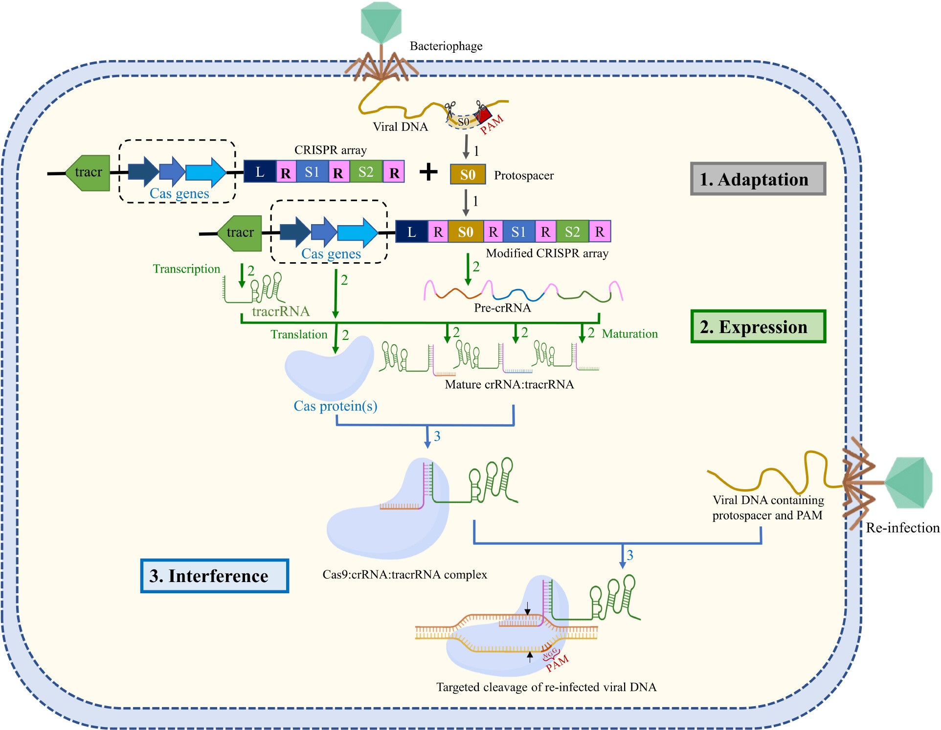

Slide 15
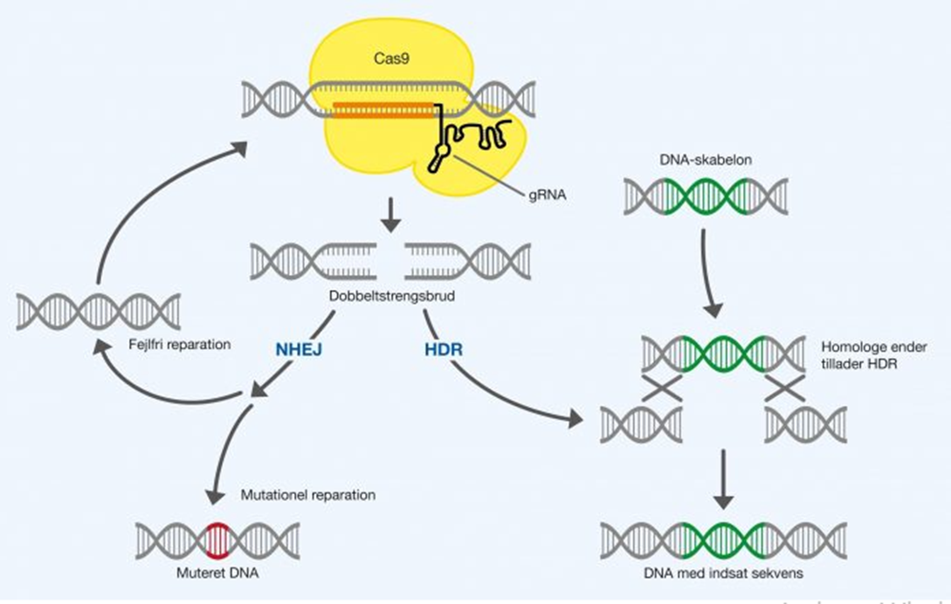
DNA Double-Strand Break (DSB) Repair in CRISPR–Cas9
CRISPR–Cas9 introduces site-specific DNA double-strand breaks (DSBs)
DSBs are repaired by endogenous cellular pathways
Two major repair mechanisms operate in eukaryotic cells:
Non-homologous end joining (NHEJ)
Homology-directed repair (HDR)

Slide 16
1. Non-Homologous End Joining (NHEJ)
Predominant and most active DSB repair pathway
Operates throughout all phases of the cell cycle
Repairs DNA by directly ligating broken ends
Error-prone; generates insertions or deletions (indels)
Indels often cause frameshift mutations → gene knockout
Widely used for loss-of-function genome editing

Slide 17
2. Homology-Directed Repair (HDR)
High-fidelity repair pathway active in late S and G2 phases
Requires a homologous DNA template (sister chromatid or donor DNA)
Enables precise gene insertion, correction, or replacement
HDR FREQUENCY:
Occurs less frequently than NHEJ (≈0.5–20% vs. 20–60% for NHEJ)
HDR efficiency influenced by cell type, cell cycle, and donor design
Strategies to enhance HDR include NHEJ inhibition and cell-cycle synchronization

Slide 18
CRISPR/CAS9 Delivery
What is CRISPR-Cas9 Delivery?
CRISPR-Cas9 delivery = the process of transporting CRISPR components (Cas9 protein + guide RNA) into target cells to edit genes.
Purpose: Gene editing in a safe, efficient, and targeted manner

Slide 19
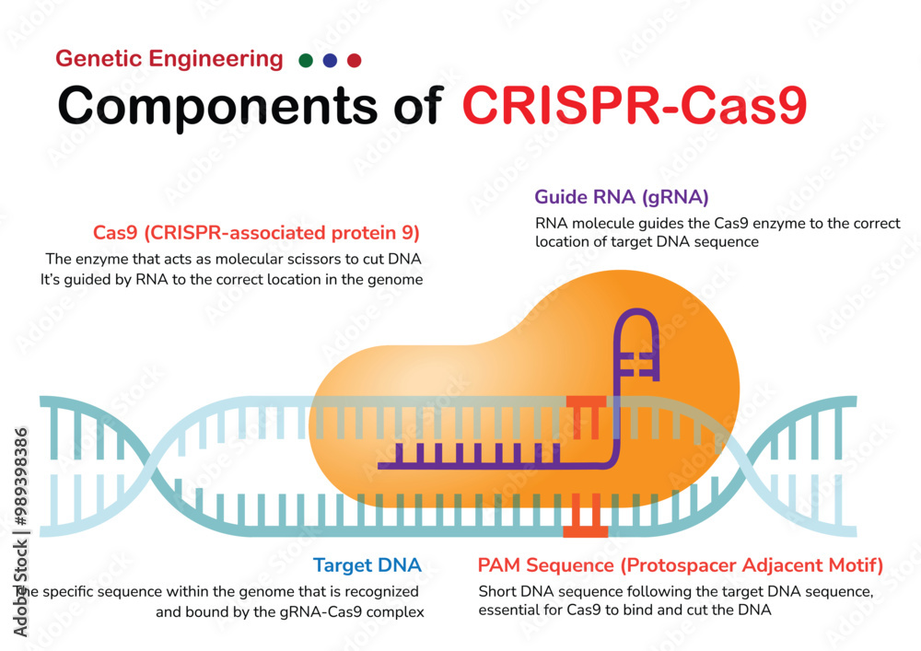
CRISPR/CAS9 Delivery Components
Cas9 protein
Guide RNA (gRNA)
Donor DNA (optional)->knockin
Knockins vs Knockouts

Slide 20
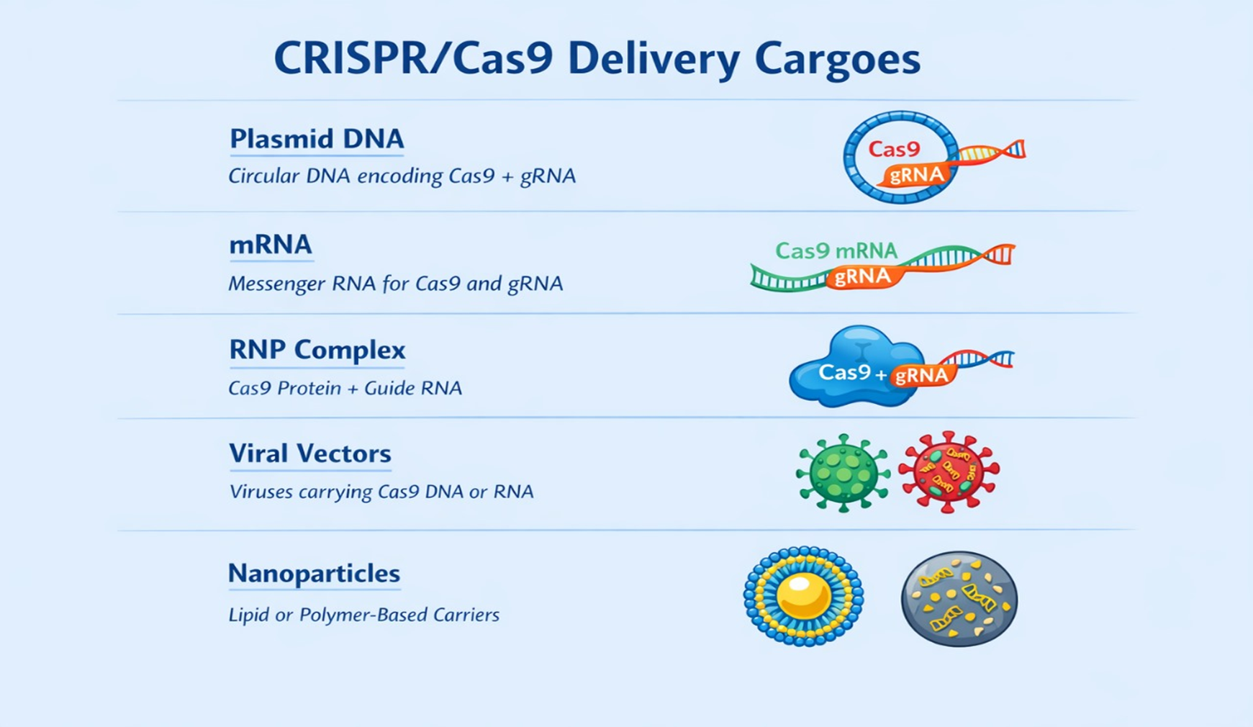
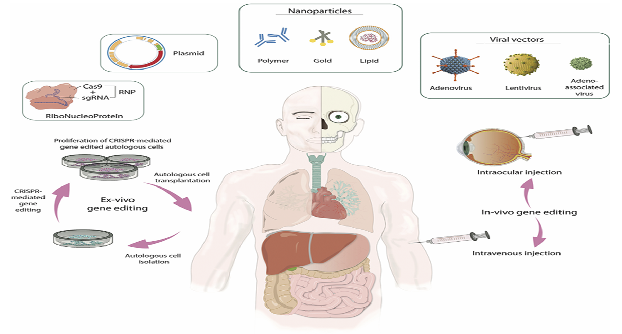

Slide 21
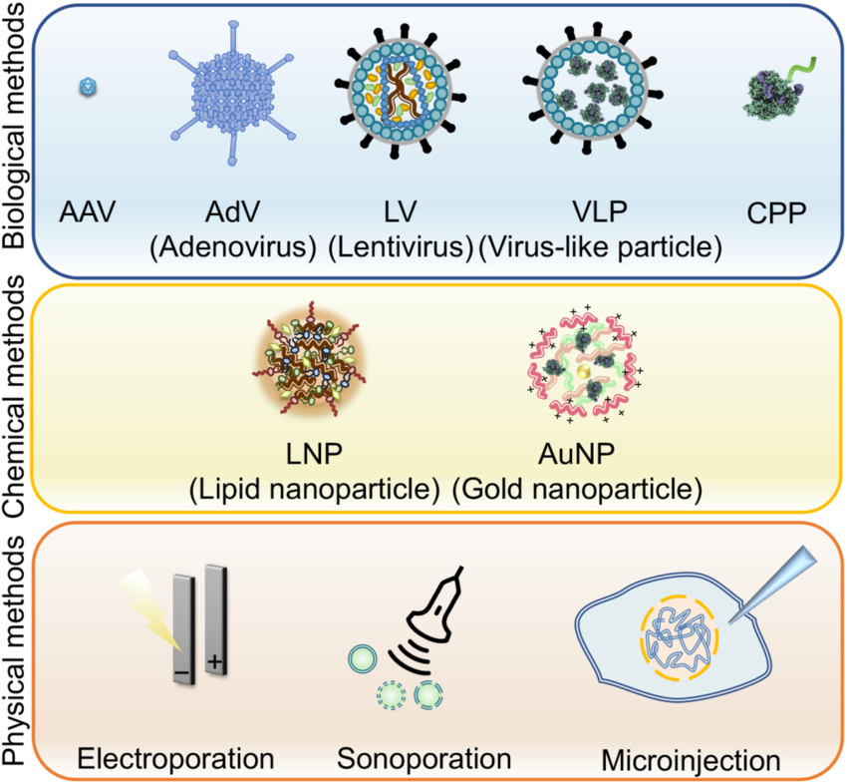
DELIVERY METHODS
Delivery is critical for gene editing success.
Influences efficiency, specificity, and therapeutic potential.
CRISPR components must reach the nucleus, overcoming:
Cell & tissue barriers
Large molecular size
Poor stability

Slide 22
CRISPR Cas9 Delivery methods
A. Viral Vectors:
AAV: Safe, transduces most cells
Lentivirus: Stable integration, ideal for ex vivo editing
B. Physical Methods:
Electroporation: Electric pulse opens cell membrane
Microinjection: Direct injection into cells
Pros/Cons: Precise but labor-intensive
C. Non-Viral Nanoparticles:
LNPs: Protect CRISPR, enhance uptake
Polymeric & Gold nanoparticles: Safe, versatile
D. Protein/RNP Delivery:
RNP complexes: Fast action, high specificity
Cons: Large protein is harder to deliver

Slide 23
CLINICAL TRIALS
Clinical trials are research studies done on humans to test whether a new treatment is safe and effective.
Why are Clinical Trials Needed?
Before any new therapy (like CRISPR/Cas9):
It is tested in cells → Then in animals → Finally in humans → this stage is called clinical trial
Purpose:
(Is it safe?, Does it work?, What are the side effects?, What is the correct dose?

Slide 24
Phases of Clinical Trials
Effectiveness Test
Post-Approval Monitoring
Larger group assesses if treatment works and monitors side effects
Long-term effects tracked after treatment is approved
1
3
Phase 1
Phase 2
Phase 3
Phase 4
Safety Test
2
Large-Scale Testing
4
Small group checks safety and side effects
Hundreds compared to standard treatment to confirm effectiveness and safety

Slide 25
CLINICAL TRIALS CASES:
Category | First Major Gene Editing | Example / Study | Purpose / Goal | Key Technology / Target | Outcome / Significance
Stem Cells [7] | 1985 — gene targeting in embryonic stem cells to make knockout mice. | Progress and Prospects of Gene Editing in Pluripotent Stem Cells (MDPI, 2023) | Research and disease modeling | CRISPR-Cas9, ESCs & iPSCs | Enables study of gene function, modeling human diseases, and regenerative medicine; foundation for future therapies
Somatic Cells [8] | 2016 — first CRISPR clinical study in human somatic cells. | CASGEVY™ for Sickle Cell Disease (FDA-approved, 2023) | Clinical treatment of patient | CRISPR-Cas9, ex vivo editing of hematopoietic stem cells, BCL11A gene | Increases fetal hemoglobin (HbF), prevents sickling; edits limited to treated individual; non-heritable
Germline Cells[9] | 2015 — CRISPR editing of human zygotes in research settings. | He Jiankui Case (2018) | Experimental/heritable modification | CRISPR-Cas9, human embryos, CCR5 gene | Genetically modified babies born; changes are heritable; global ethical and legal controversy

Slide 26
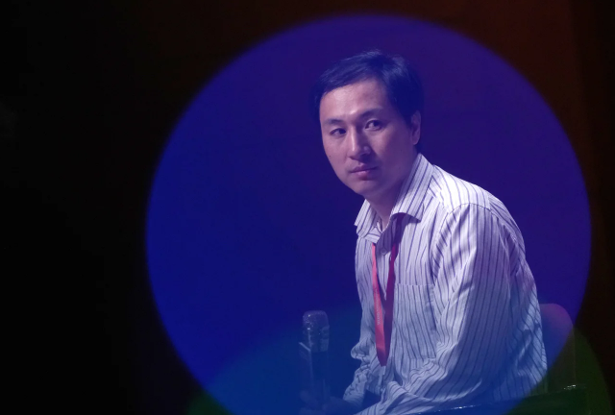
Case Study: Dr. He Jiankui and Human Germline Editing
In 2018, Chinese scientist Dr. He Jiankui reported the first case of human germline gene editing, claiming to have used CRISPR-Cas9 to modify the CCR5 gene in human embryos. The goal was to make the babies resistant to HIV infection. The edited embryos were implanted, resulting in the birth of twin girls.
This experiment involved germline editing, meaning the genetic changes were made at the embryo stage and could be passed on to future generations. While the scientific aim was disease prevention, the procedure was conducted without adequate safety validation, transparency, or ethical approval.
The case sparked global outrage within the scientific and medical communities. Major concerns included off-target mutations, unknown long-term effects, lack of informed consent, and violation of international ethical guidelines. As a result, the experiment was widely condemned, and Dr. He Jiankui was later sentenced to prison and banned from conducting scientific research.
This case highlighted the ethical risks of premature germline editing and reinforced the global consensus that CRISPR should currently be limited to somatic (non-heritable) gene editing until safety, ethical, and regulatory frameworks are firmly established.[9]

Slide 27
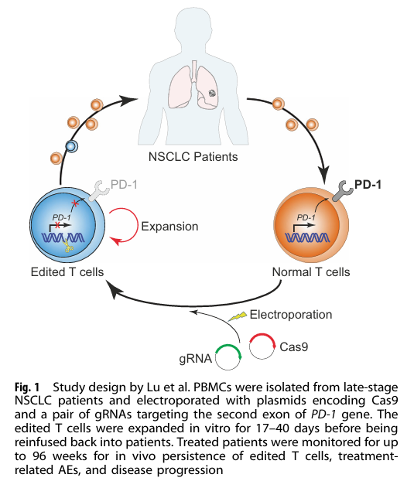
Case Study:First Human CRISPR Cell Therapy Trial for Late-Stage Lung Cancer
First Human CRISPR-Cas9 Cell Therapy Trial (China, 2016–2017)
Background:
Late-stage metastatic non-small cell lung cancer patients.
Conventional treatments (chemo & immunotherapy) failed.
Method:
T-cells extracted from patient blood.
CRISPR-Cas9 used to knock out PD-1 gene (removes “brake” on immune cells).
Edited T-cells infused back into patient.
Results:
Safe in humans, no severe side effects.
Cancer not cured but disease progression slowed.
Significance:
First real human CRISPR use.
Demonstrated feasibility & safety.
Paved way for global CRISPR trials (blood disorders, eye diseases).
Reference:
The first human trial of CRISPR-based cell therapy clears safety concerns as new treatment for late-stage lung cancer.[11][12]

Slide 28
How Many Trials Are Ongoing?
As of recent tracking:
There are ~250 clinical trials involving CRISPR or gene editors in various diseases.
Over 150 are actively recruiting or in progress worldwide. These trials span therapeutic areas like blood disorders, metabolic conditions, hereditary diseases, heart disease, and cancer.
Where Are These Trials Happening?
CRISPR clinical trials are worldwide — conducted in: 🌍 USA 🌍 Europe 🌍 China 🌍 Canada 🌍 Australia

Slide 29
Clinical Trials in Pakistan
.
Pakistan does not yet have officially registered CRISPR‑Cas9 clinical trials on humans as of 2025
Research & Pre‑Clinical CRISPR Work in Pakistan
Even though no registered clinical trials are in progress, Pakistani researchers are actively working on CRISPR at earlier research stages in areas that could lead to future therapies:
A. Pediatric Leukemia Immune Cell Editing Study
Researchers in Islamabad conducted a CRISPR‑Cas9 trial exploring editing immune cells to target tumor‑associated macrophages in pediatric leukemia. This studied safety, tolerability, and outcomes as an innovative approach in childhood leukemia.
B. Cancer Stem Cell Research
A study investigated CRISPR‑Cas9 targeting cancer stem cells in glioblastoma multiforme using patient tumor samples in Pakistan, focused on sensitizing cells to therapy — but this work is research/pre‑clinical rather than a formal clinical trial.
C. Local CRISPR Gene Editing Research Projects
Multiple Pakistani institutions (e.g., Quaid‑e‑Azam University, University of Okara, Veterinary and Agriculture universities) are publishing CRISPR research on disease models, delivery strategies, and applications — but not in registered clinical phases yet.

Slide 30
APPLICATIONS
Therapeutic Applications:
Treat genetic disorders (sickle cell, β-thalassemia)
Cancer therapy via CRISPR-engineered CAR-T cells
Retinal diseases & viral infections (e.g., HIV)
Clinical Research:
Identify disease-associated genes
Knockout/knock-in experiments
Personalized medicine & drug discovery
Agriculture:
Disease-resistant, high-yield, drought-tolerant crops
Nutritional enhancement
Biotechnology/Industry:
Engineering microbes for biofuels & enzymes
Synthetic biology and pharmaceutical production
Functional Genomics:
Genome-wide CRISPR screens
Drug target identification & pathway studies
Diagnostics:
Rapid detection of pathogens
Mutation screening & point-of-care tools

Slide 31
LIMITATIONS & CHALLENGES
Off-Target Effects Unintended DNA cuts may disrupt essential genes, activate oncogenes, or cause genomic instability — a major safety concern in clinical use.
Delivery Challenges Efficient and tissue-specific delivery of Cas9/sgRNA remains difficult. Viral vectors: immune response, limited cargo Non-viral methods: low efficiency or cell damage
DNA Repair Uncertainty CRISPR depends on cellular repair pathways: NHEJ → error-prone insertions/deletions HDR → precise but inefficient and cell-cycle dependent
Immune Response Bacterial Cas9 proteins may trigger immune reactions, reducing editing efficiency and increasing safety risks in vivo.
Mosaicism Incomplete or variable editing across cells leads to unpredictable outcomes, especially in embryos.
Notes:
Even rare off-target mutations can be unacceptable in clinical therapy.
CRISPR is powerful, but without safe delivery, it cannot reach the clinic.
CRISPR makes the cut — the cell decides the outcome.
The immune system can treat Cas9 as an infection.
Not all cells are edited equally, leading to unpredictable results.
”Understanding these limitations is essential to ensure the safe, accurate, and ethical use of CRISPR-Cas9 in research and clinical applications.”

Slide 32
ELSI(Ethical, legal & social issues)
Ethical Concerns Germline editing causes permanent, heritable changes, raising fears of designer babies and misuse for enhancement rather than therapy.
Therapy vs Enhancement ✔ Ethically acceptable: treatment of genetic diseases ✖ Ethically controversial: enhancement of normal traits (e.g., muscle strength, intelligence)
Legal Challenges Regulations vary worldwide; no unified global framework. Many countries ban human germline editing, while others allow limited therapeutic research.
Social Issues Unequal access may increase social inequality. Concerns include misuse for appearance, intelligence, or strength, public mistrust, and cultural or religious objections.
Real Case: Human Germline Editing He Jiankui (China, 2018) edited the CCR5 gene in human embryos to confer HIV resistance. → Global condemnation; highlighted ethical violations and lack of oversight
Notes:
The CRISPR debate is not about whether we can edit genes—but whether, when, and how we should.

Slide 33
NEXT GENERATION CRISPR SYSTEM
Why New Systems? Developed to improve precision, safety, and versatility beyond CRISPR-Cas9.
Cas12a (Cpf1) Uses a single RNA, produces sticky DNA ends, and has a smaller size for improved delivery. Limitation: Off-target effects still occur.
Cas13 Targets RNA instead of DNA, enabling temporary gene regulation and antiviral applications. Limitation: Effects are not permanent.
Base Editing Enables single-base substitutions without creating DNA double-strand breaks, improving safety. Limitation: Limited to specific base conversions.
Prime Editing Functions as a “search-and-replace” system for DNA, allowing precise insertions, deletions, and substitutions with minimal off-target effects. Limitation: Technically complex and currently less efficient.
Notes:
“Overall, next-generation CRISPR systems move genome editing from cutting DNA toward precise rewriting.”

Slide 34
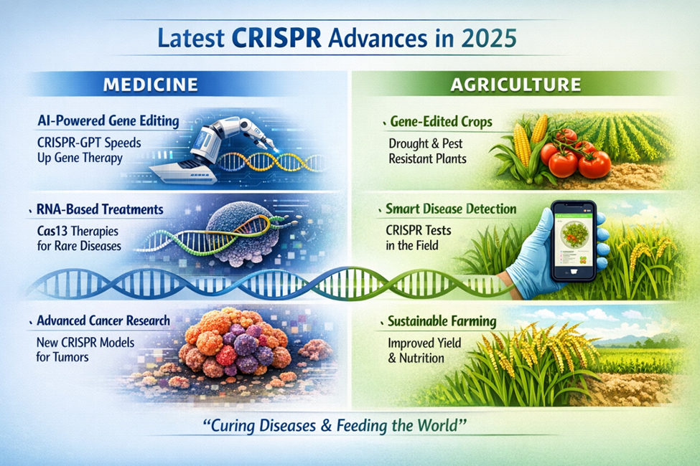
FUTURE ASPECTS
Medicine
Personalized gene therapies for cancer & genetic disorders
RNA-based therapies (Cas13)
Potential treatment of currently incurable diseases
Agriculture
Disease- and climate-resistant crops
Reduced pesticide use
Faster crop improvement than traditional breeding
Biotechnology & Research
Advanced disease models & drug discovery
Functional genomics & synthetic biology
In vivo gene-editing therapies for common diseases
Ethical & Regulatory Future
Stronger global regulations
Focus on safe somatic cell editing
Public engagement & transparency
Notes:
“CRISPR is not just a research tool anymore — it is shaping the future of medicine, agriculture, and biotechnology.”

Slide 35
Recent Real Examples in CRISPR Drug Discovery
Gene Therapy for Blood Disorders Casgevy (Exa-cel) – First approved CRISPR therapy for sickle cell disease & β-thalassemia → Edits patient blood stem cells to restore normal hemoglobin
In-Body CRISPR for Cholesterol ANGPTL3 Gene Editing (Liver) → One-time treatment reduced LDL cholesterol & triglycerides by ~50% in early trials
Other Promising Applications
Infectious Diseases: CRISPR strategies to remove viral DNA (e.g., HIV)
Cancer: CRISPR-engineered CAR-T cells & immune cell editing for enhanced tumor targeting
Notes:
Opening“CRISPR has now moved beyond the lab and into real, approved therapies.”
Closing Line “These examples show that CRISPR is no longer experimental—it is becoming a real therapeutic platform.”

Slide 36
REFERENCES
[1] Jing, X. (2024). A Review of Research on CRISPR/Cas9 Gene Editing Technology in Disease Treatment. Academic Journal of Science and Technology, 13(3), 132-134.
[2] J. Zhao, H. Fang, D. Zhang, Expanding application of CRISPR-Cas9 system in microorganisms, Synthetic and systems biotechnology, 5 (2020) 269-276.
[3] A. Barman, B. Deb, S. Chakraborty, A glance at genome editing with CRISPR–Cas9 technology, Current genetics, 66 (2020) 447-462.
[4] P. Ferreira, A.B. Choupina, CRISPR/Cas9 a simple, inexpensive and effective technique for gene editing, Molecular Biology Reports, 49 (2022) 7079-7086.
[5] E. Janik, M. Niemcewicz, M. Ceremuga, L. Krzowski, J. Saluk-Bijak, M. Bijak, Various aspects of a gene editing system—crispr–cas9, International journal of molecular sciences, 21 (2020) 9604.
[6] F. Zhang, Y. Wen, X. Guo, CRISPR/Cas9 for genome editing: progress, implications and challenges, Human molecular genetics, 23 (2014) R40-R46.
[7] S.T. Campbell, Approval of the First CRISPR-Cas9 Gene Editing Therapy for Sickle Cell Disease, Oxford University Press US, 2024.
[8] Z. Zhang, X. Bao, C.-P. Lin, Progress and prospects of gene editing in pluripotent stem cells, Biomedicines, 11 (2023) 2168.
[9] H.T. Greely, CRISPR’d babies: human germline genome editing in the ‘He Jiankui affair’, Journal of Law and the Biosciences, 6 (2019) 111-183.
[10] K. Nandal, J. Rathee, P. Dahiya, M. Kaur, Advances and applications of crispr-cas9 technology in medicine and agriculture, sciences (Wang et al., 2016; Riordan et al., 2015), 169 117.
[11]Lu, Y. et al. Safety and feasibility of CRISPR-edited T cells in patients with refractory non-small-cell lung cancer. Nat. Med. 26, 732–740 (2020)
[12] Doudna, J. A. The promise and challenge of therapeutic genome editing. Nature 578, 229–236 (2020).

Slide 37
ANY QUERIES? THANKYOU!

