Slide 1
Topic: JQuery
Presentation:
Name: Hassan khan
Name :Waleed Husnain

Slide 2

jQuery is write less do more JavaScript library designed to simplify HTML DOM (Document Object Model ,manipulation as well as event handling, CSS animation, and Ajax
Original author : John Resig
Initial release date: August 26, 2006

Slide 3
Why We Learn JQuery
Netflix ,Google ,Microsoft ,Facebook
Download And Use JQuery
Many Farmework are Available but Jquery is Most popular frame work
Short Selector
Variety of Animation functions
Easy DOM Manipulation(IT means easy to Set And Get value)
Easy CSS styling
Easy DOM Traversing(It means Target any Element)
Simple Ajex Code
How To Download Jquery
Compressed File
Google CDN link
We Will Show You This…….
Benefits Using Jquery
1) Browser Independent
2) Increase Coding Speed

Slide 4
Syntax of Jquery
$('selector').action()
There are Three Type of Main selectors
1 Element selector
2 class selector
3 id selector
Events In jquery
Any attraction user doing with your website called Event
click keypress,submit, load dblclick, keydown change resize mouseenter, keyup, focus scroll mouseleave, blur, unload
Way To Write these selector In our Code File

Slide 5
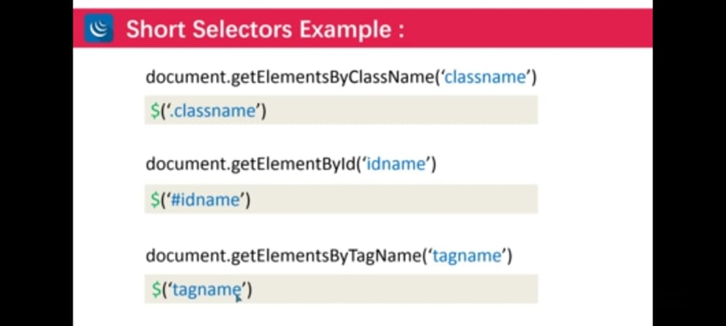

Slide 6
Slides Methods
Slideup()
slideDown()
slideToogle()
Syntax
$(‘class/id').slideUp() also write function inside
Animation Function in Jquery
Slow
Fast
Numbers like Write This 1000 =1 sec;
Height
Width
opacity
Syntax
$(‘class/id').animate({ property: value }, fast/slow/number_1000);

Slide 7
Css using Jquery
Syantax:
// $(‘#/.').css(‘property’,value');
how check value of css
$('#hk').css('background-color');
"rgb(255, 0, 0)“ //like This

Slide 8
What is Ajax
Art of Exchanging data with a server without Reloading the page and manipulate dom
google not allowed to exchange data from other origin
Method
Get
post

