Slide 1


Slide 2

Fitness Club Website/Membership Management System

Slide 3
Group Members Introduction
This is to certify that <<Hassan khan>> (<<BC190402690>>) have worked on and completed their Software Project at Software & Research Projects Section, Department of Computer Sciences, Virtual University of Pakistan in partial fulfillment of the requirement for the degree of BS in Computer Sciences under my guidance and supervision.
In our opinion, it is satisfactory and up to the mark and therefore fulfills the requirements of BS in Computer Sciences.

Slide 4

INTRODUCTION OF PROJECT
The Gym/Fitness Club Membership Management System is a web application aimed at helping gym and fitness clubs effectively manage their memberships. It offers features such as membership sign-up and renewal, fee management, personalized member dashboards, integration with RFID or biometric systems, membership analytics, member communication, automated notifications, fitness training routines, and customer diet plans. The system utilizes technologies such as PHP Laravel 9, React, and MySQL for backend, frontend, and database respectively. The project will be supervised by Abdullah Qamar, and a well-defined work plan will be followed using an appropriate methodology. The system aims to streamline administrative processes, improve member engagement, and provide a seamless and personalized experience for gym club members.

Slide 5
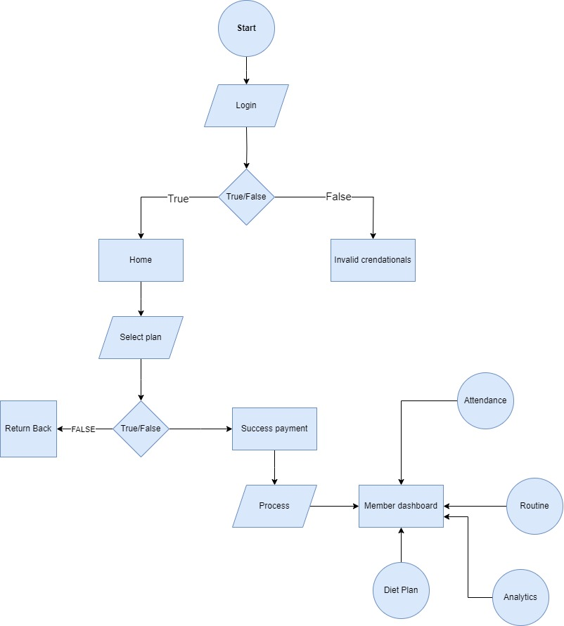
Data Flow Diagram

Slide 6
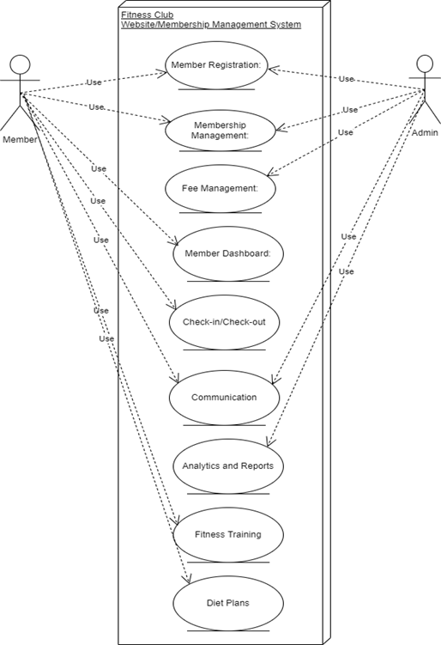
Use Case Diagram

Slide 7
Business Rules Catalog
The Fitness Club Website/Membership Management System is designed to streamline and enhance the operations of fitness clubs by providing a comprehensive platform. It facilitates membership sign-up and renewal, offering various levels and pricing options. The system empowers members with personalized dashboards to track their progress, view attendance, and manage their account details.
Integration with QR code systems ensures seamless access to the club, while robust fee management allows for discounts and flexible payment methods. Detailed analytics track member engagement and retention, aiding in informed decision-making. Automated notifications and communication tools keep members engaged and informed about classes, events, and promotions.
Moreover, the system goes beyond exercise routines, providing personalized fitness plans and dietary guidance based on individual goals and preferences. With a strong focus on security measures to safeguard member data, this system aims to revolutionize the fitness club experience, catering to both the management and the members.

Slide 8
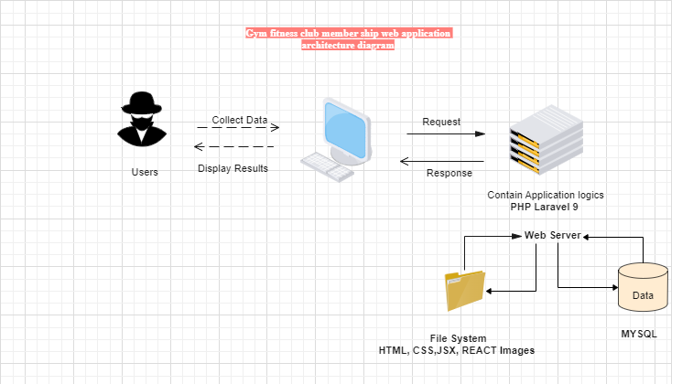
Architectural Design

Slide 9
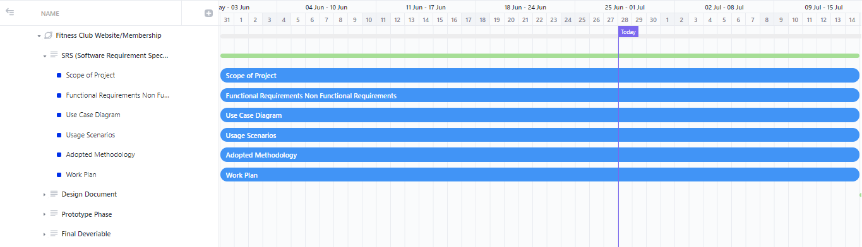
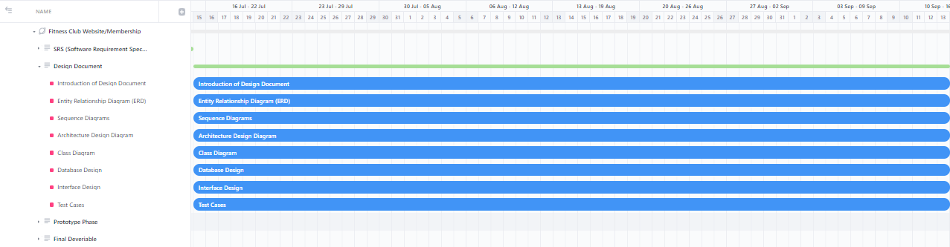
Project Schedule

Slide 10
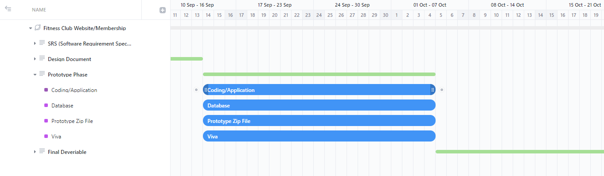
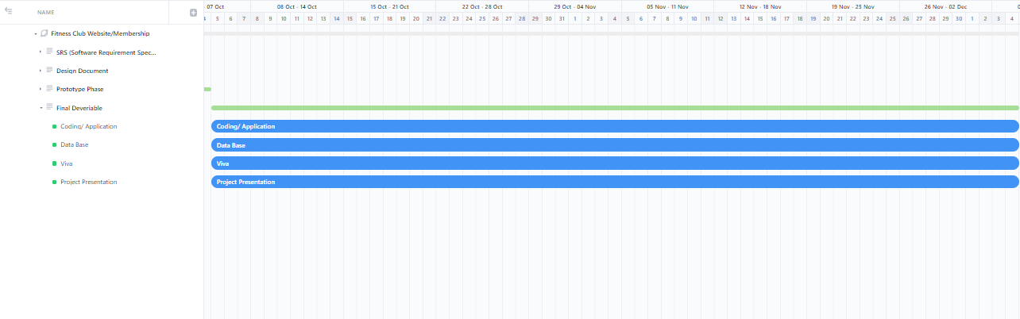
Project Schedule

Slide 11
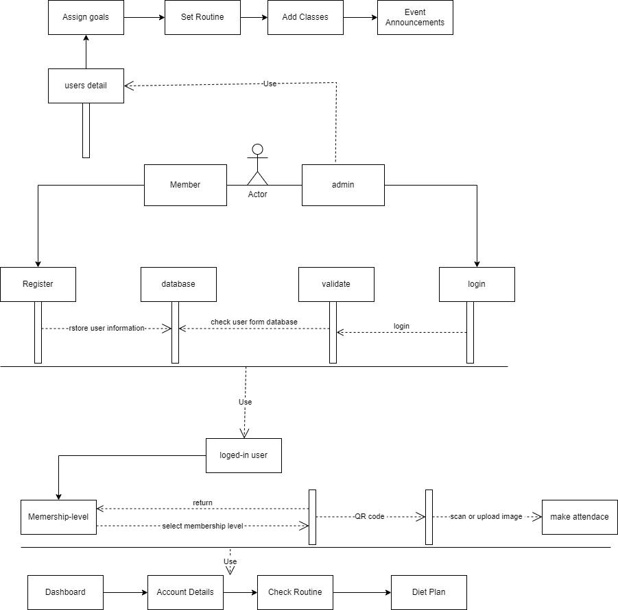
Sequence Diagrams

Slide 12
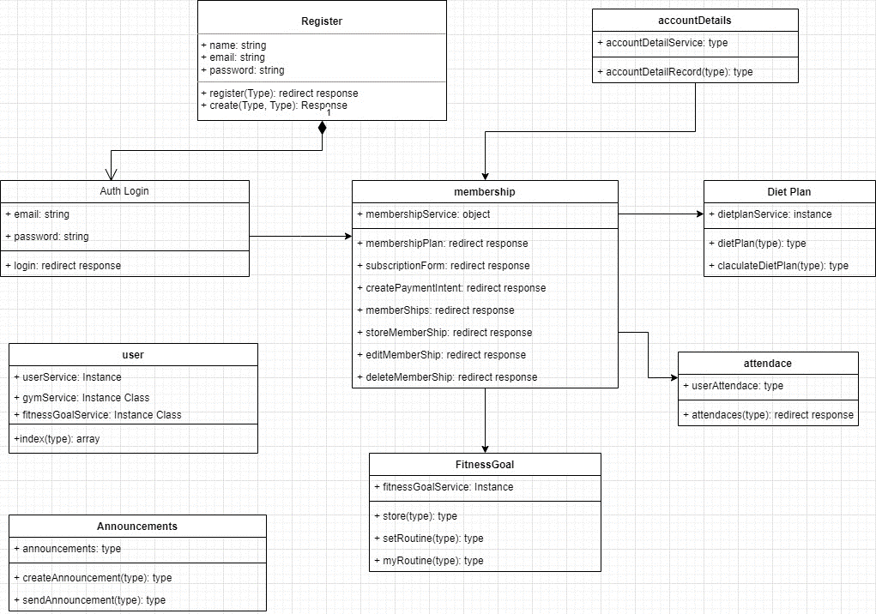
Logical Model/Class Diagram

Slide 13
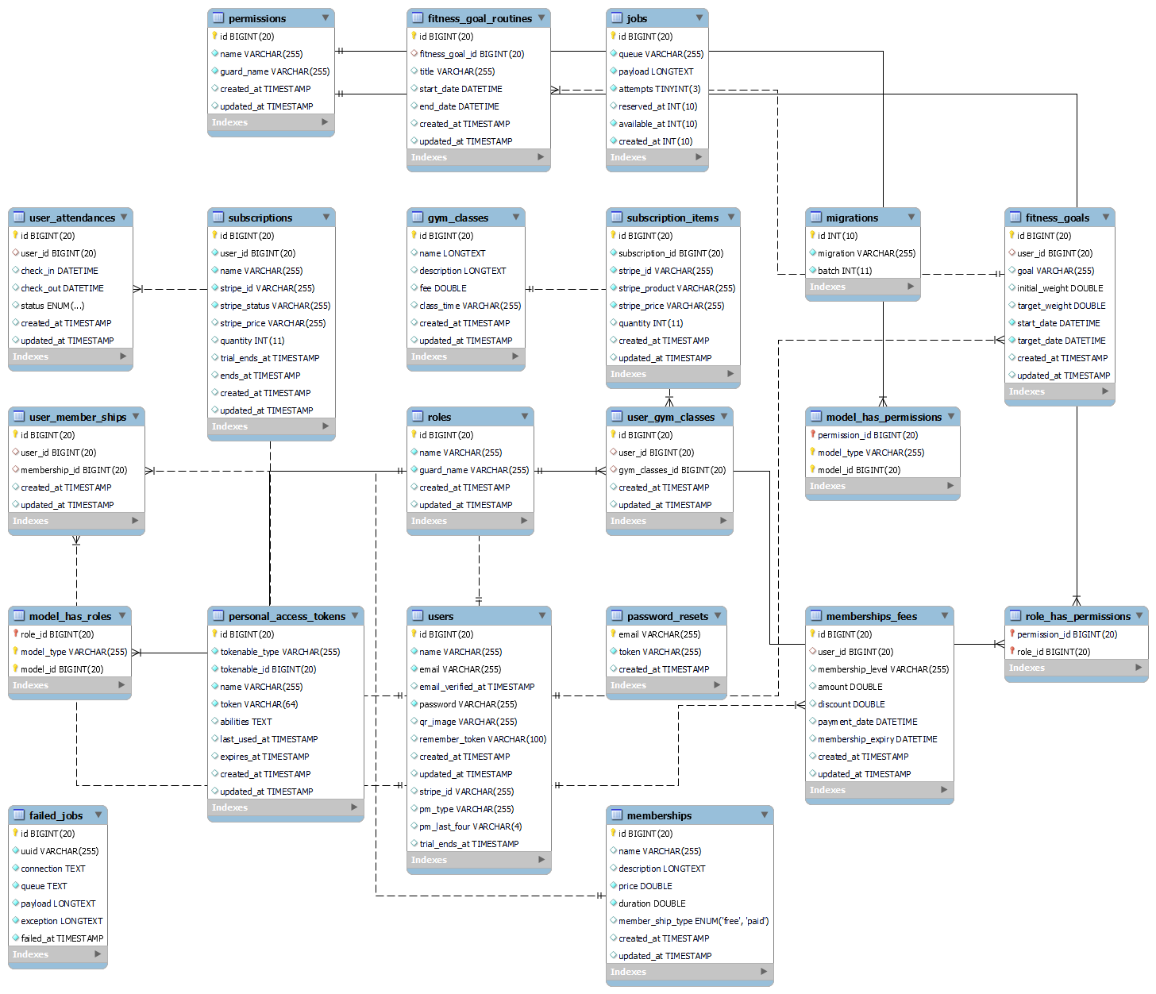
Entity-Relationship Diagram

Slide 14
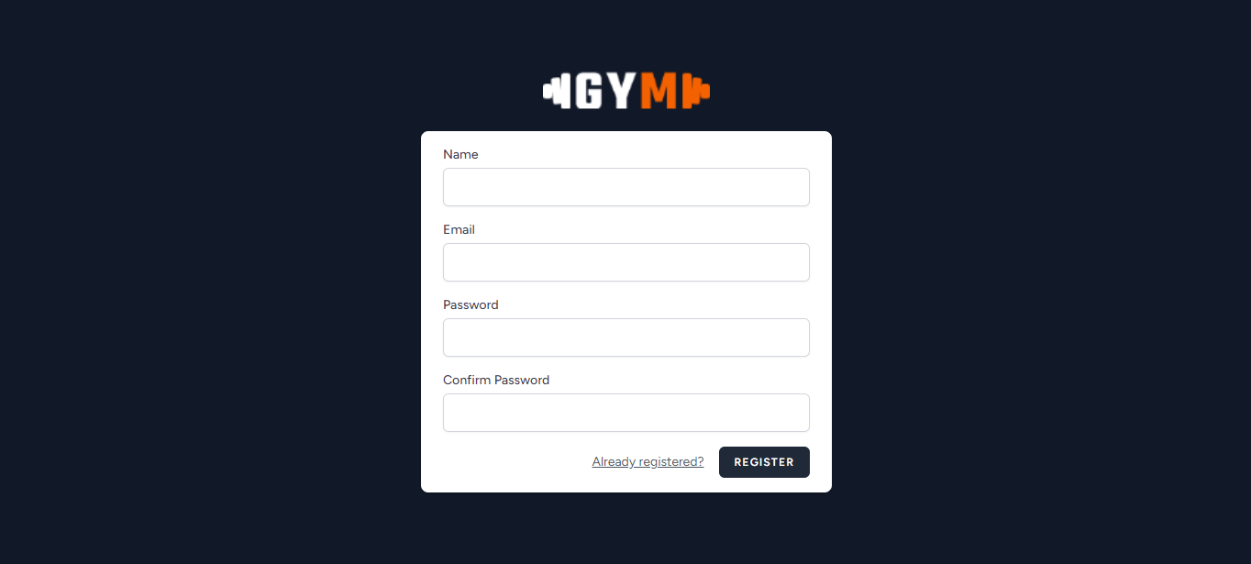
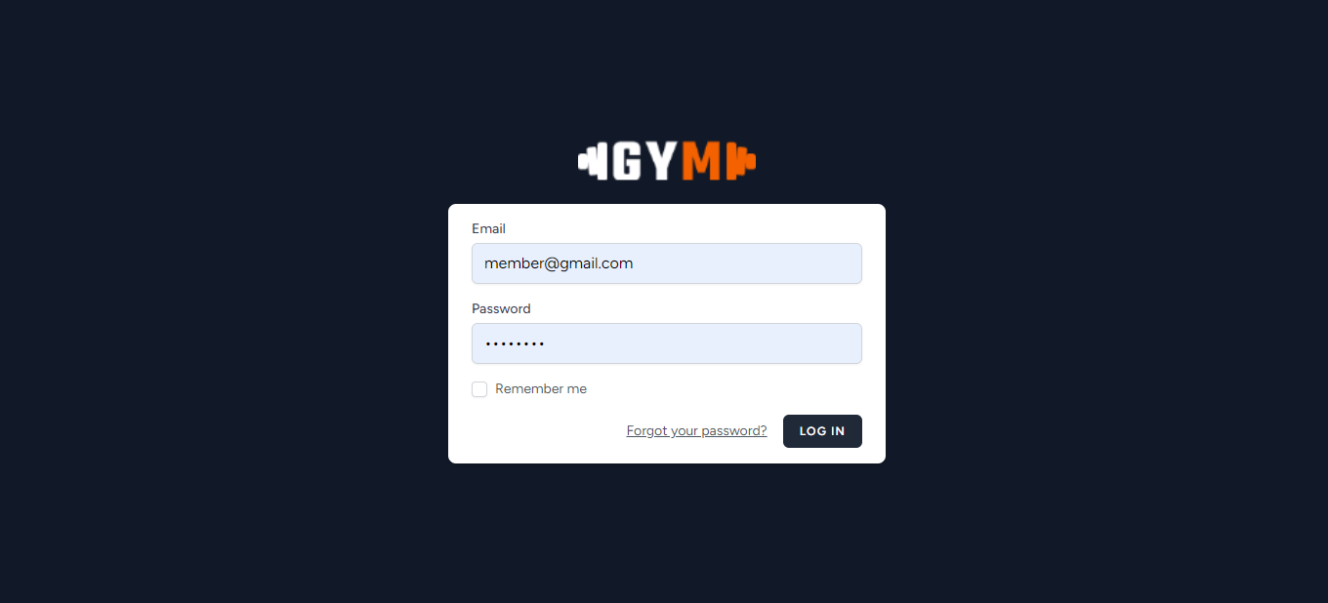
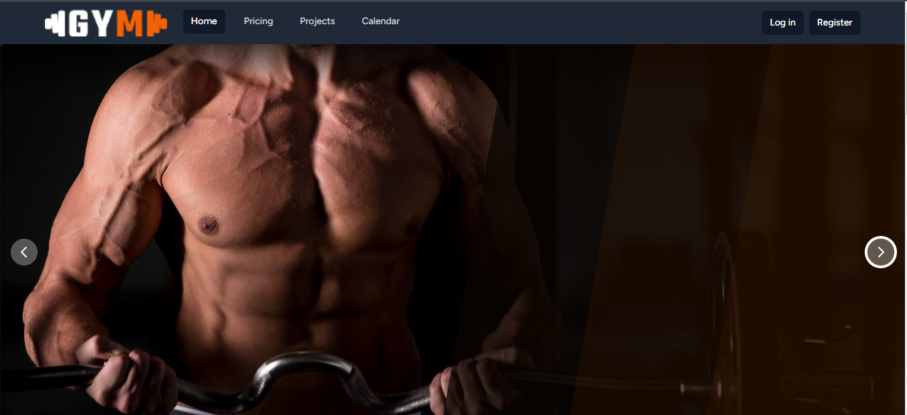
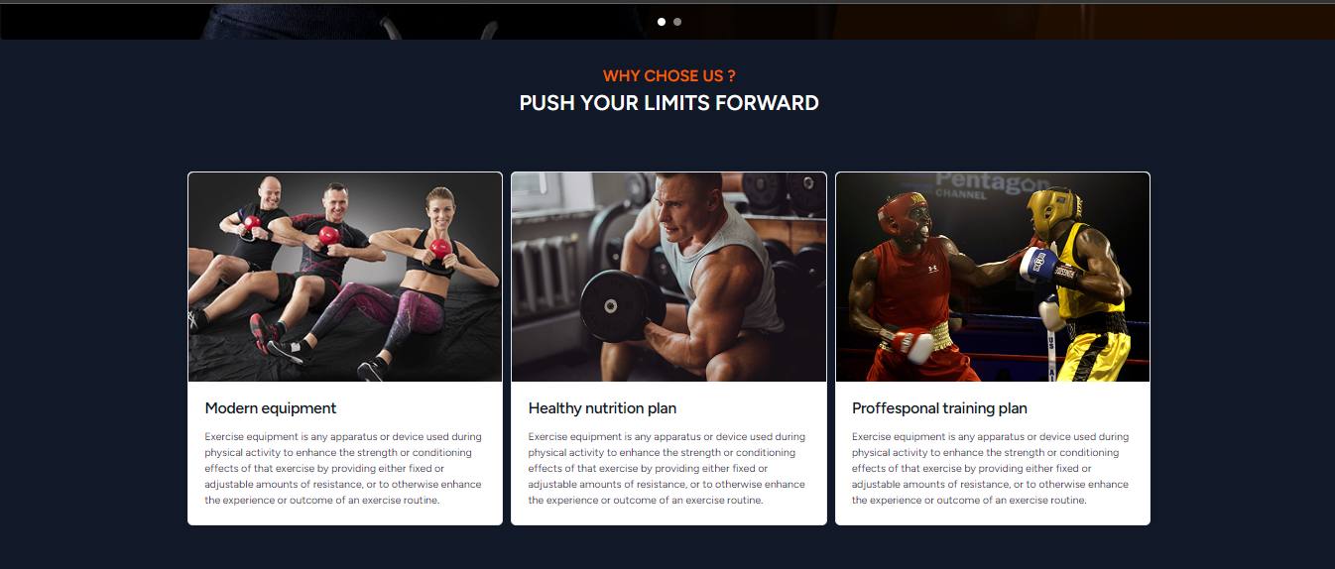
User Interfaces

Slide 15
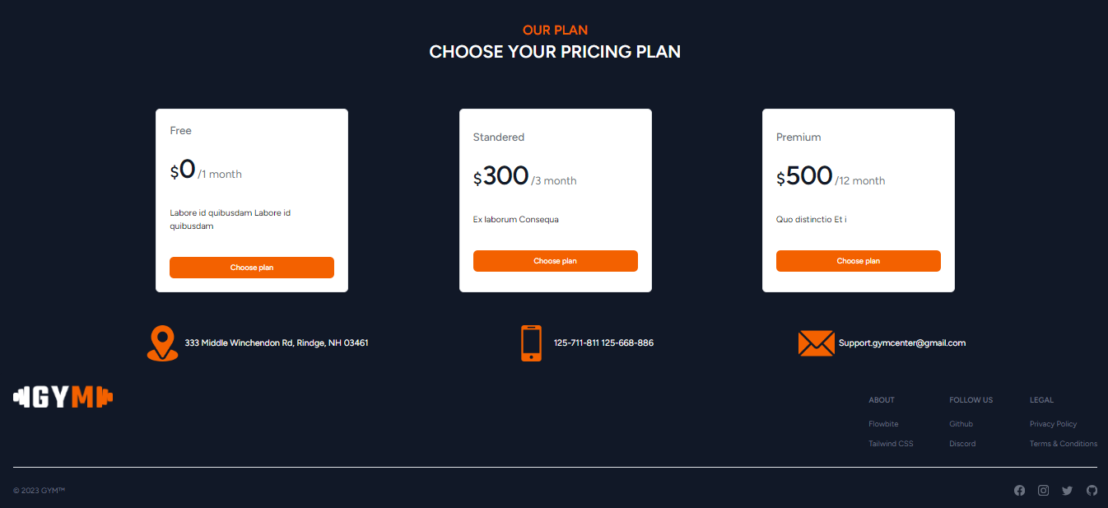
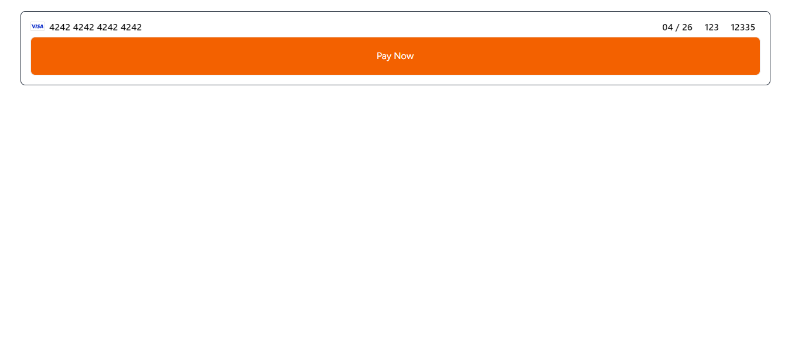
User Interfaces

Slide 16
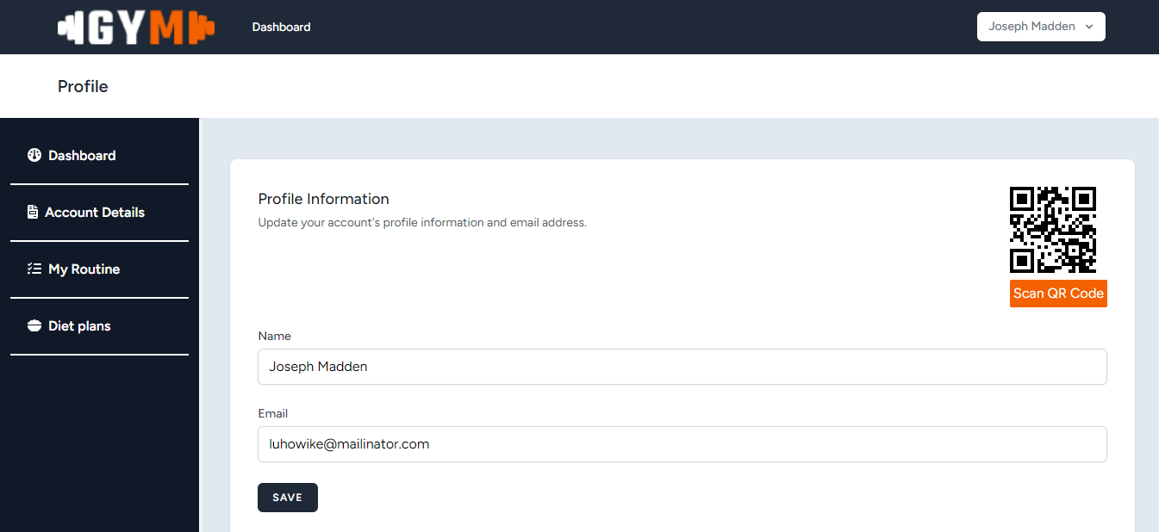
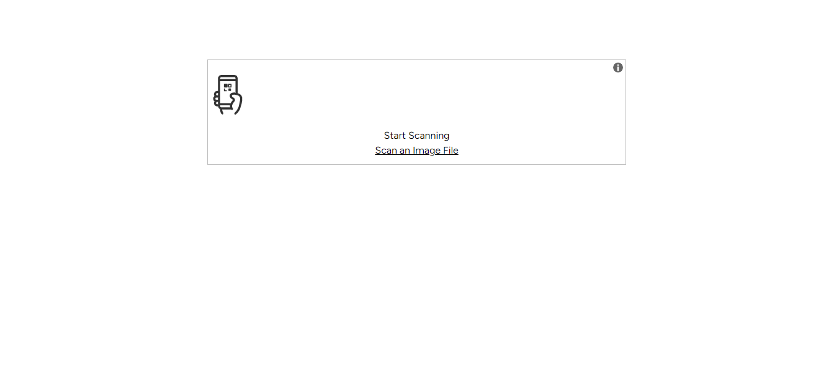
User Interfaces

Slide 17
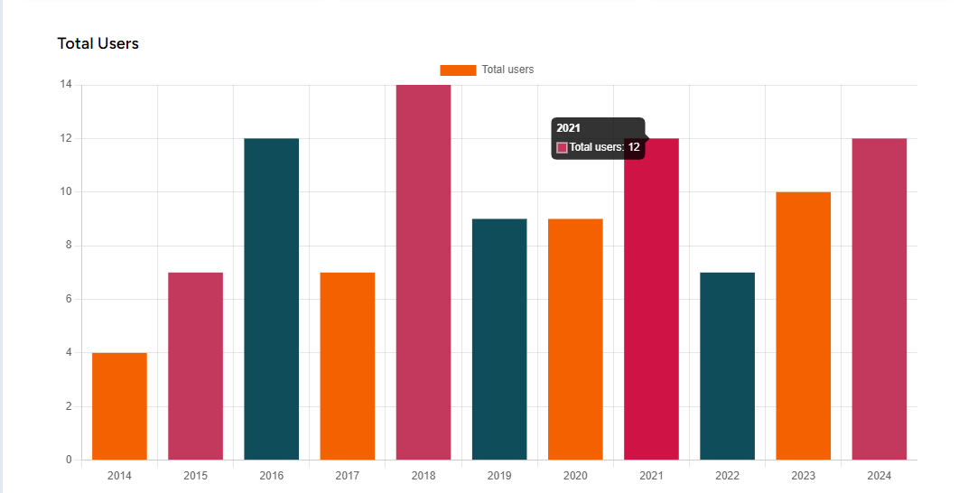
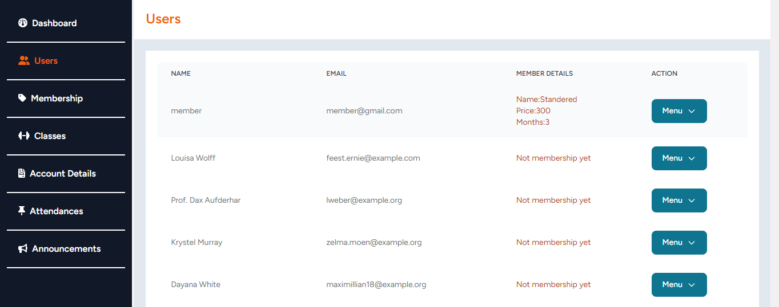
User Interfaces

Slide 18
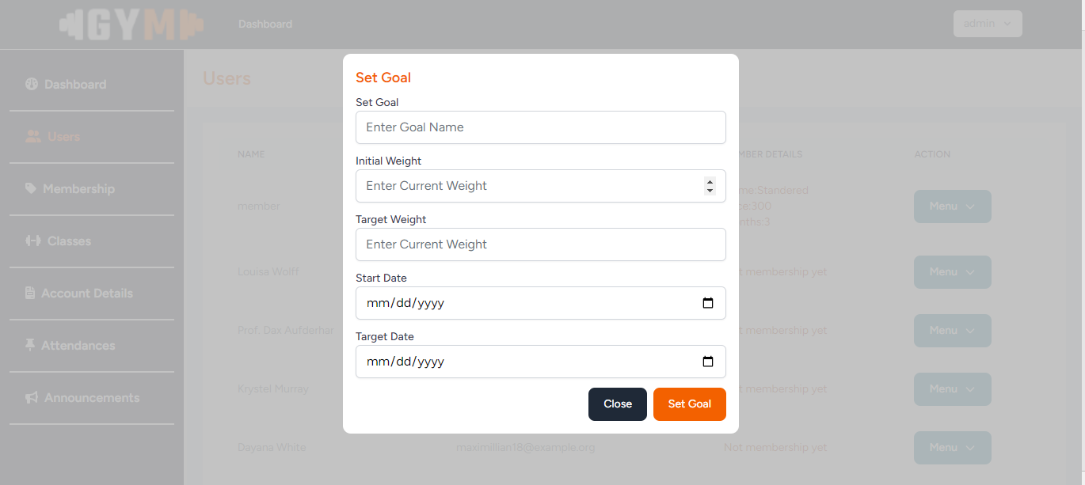
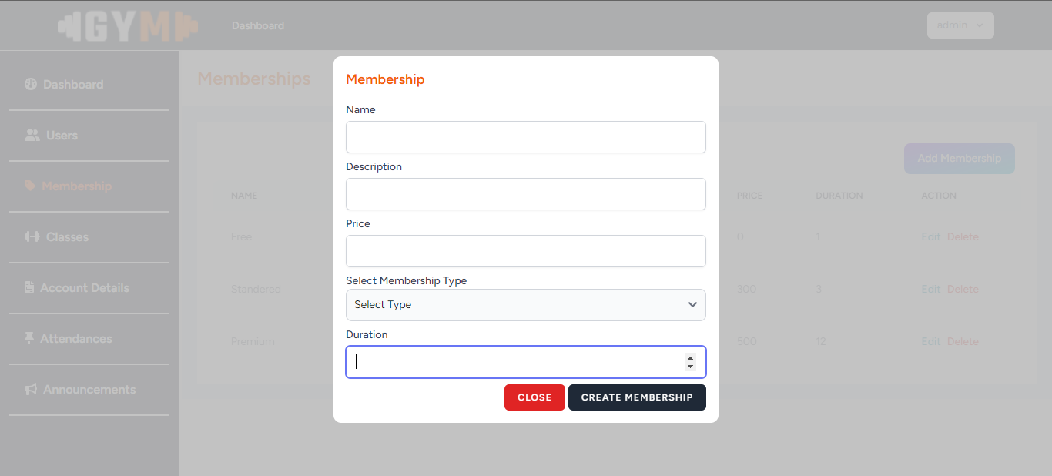
User Interfaces

Slide 19
Tools
Backend Development:
PHP Laravel 9: Framework for backend logic, routing, and database interactions.
MySQL: Database management system for storing member data, attendance records, and system configurations.
Frontend Development:
React: Frontend JavaScript library for building user interfaces and client-side functionality.
Integrated Development Environment (IDE):
Visual Studio Code: Used as the primary code editor for writing, debugging, and managing project files.
Communication and Collaboration:
SMTP: For email communication within the system.
Trello: Utilized for task management, team collaboration, and organizing project-related activities.
Version Control and Collaboration:
Git: Version control system for tracking changes in the codebase, enabling collaboration among developers.
GitHub: Platforms used for hosting repositories, managing code versions, and facilitating collaboration among team members.
Mockup and Design:

