Slide 1

Charity Organization Database Design
Presented by : Ahmad Bilal "Omari", Qurban"Sulymani" and Musawer"Rahimi"
Notes:
Welcome everyone to our presentation on Charity Organization Database Design. My name is Ahmad Bilal "Omari", and I'm joined by my colleagues Qurban "Sulymani" and Musawer "Rahimi". In this presentation, we will be discussing the key design considerations and architecture for a comprehensive charity organization database. This will cover topics such as data modeling, database schema, and system functionality to effectively manage charity operations and donor information. We hope to provide valuable insights that can help organizations streamline their data management and improve their overall efficiency.

Slide 2
Overview
This presentation provides a detailed explanation of a relational database design for a charity management system. It includes multiple entities such as donors, beneficiaries, projects, staff, volunteers, events, balances, and their inter-relationships.

Slide 3
Charity Organization Entities and Fields
Entity
Description
Fields
1. EVENT_CHARITY MAIN
MAIN
ID (PK), Name, Address, Information, Events_ID (FK), Brunch_ID (FK)
Donor(FK)
2. DONOR
Donor details
Donor_ID (PK), Name, Phone number, Information
3. BENEFICIARY
People who receive help
Beneficiaries_ID (PK), Name, Phone number, Address, Type of donation
4. EVENTS
Details of events
Event_ID (PK), Name, Type, Location, Description, Brunch_ID (FK)
5. STUFF
Staff of the organization
Stuff_ID (PK), Name, Phone number, Bio, Salary, Brunch_ID (FK)
6. BRUNCH
Branches of the organization
Brunch_ID (PK), Name, Phone number, Location
7. PROJECT
Charity projects
Project_ID (PK), Name, Description, Location, Date, Required budget, Brunch_ID (FK)
8. VOLUNTEER
Volunteers helping the organization
Volunteer_ID (PK), Name, Phone, Email, Skills, Brunch_ID (FK), Project_ID (FK)
9. STATUS
Status tracking of events and projects
Status_ID (PK), Description, Last update, Event_ID (FK), Project_ID (FK)
10. REPORTS
Reports related to events
Reports_ID (PK), Title, Date, Type
11. BALANCE
Financial tracking
Balance_ID (PK), Reference_Type, Amount, Transaction Date, Description, Recorded_By (FK to Stuff), Brunch_ID (FK)
NOTE: WE HAVE 12 TABLES AND 8 ASSOCIATIVE TABLES IN THIS DETABASE

Slide 4
Entity Relationships( Associative tables)
1. EventCH_Donor
4. Event_Report
7. Balance_Project
Fields: Event_Charity_ID (FK), Donor_ID (FK) throw associative table
Fields: Reports_ID (FK), Event_ID (FK) throw associative table
Fields: Balance_ID (FK), Project_ID (FK) throw associative table
Represents donors assigned to specific charity events
Associates reports with specific events
Tracks project-related finances
5. Stuff_Project_Rela
8. Balance_Event
2. BEN_DONA
Fields: Stuff_ID (FK), Project_ID (FK) throw associative table
Fields: Balance_ID (FK), Event_ID (FK) throw associative table
Fields: Beneficiaries_ID (FK), Donation_ID (FK) throw associative table
Associates staff with specific projects
Tracks event-related finances
Maps donations to beneficiaries
6. Donation_Balance
3. BEN_EVE
Fields: Donation_ID (FK), Balance_ID (FK) throw associative table
Fields: Event_ID (FK), Beneficiaries_ID (FK) throw associative table
Links donation transactions to financial records
Links beneficiaries to events

Slide 5
Project Management
PROJECT table stores core project data.
Each project is linked to a branch and has required budget information.
Multiple staff can be associated with a project using Stuff_Project_Rela.
Financials managed via Balance_Project.
Progress is tracked using STATUS table.
VOLUNTEER table links volunteers to the project.

Slide 6
Event Management
EVENTS and EVENT_CHARITY tables manage the planning and logistics of charity events.
Beneficiaries may attend events (BEN_EVE).
Reports for events are tracked using (Event_Report).
Event-related expenses are recorded via (Balance_Event).
Status updates are maintained in (STATUS).

Slide 7
Financial Management
BALANCE table tracks all financial transactions (donations, events, projects).
Linked with STUFF for accountability.
Separate relationship tables manage which funds belong to which projects/events/donations.

Slide 8
Reports and Monitoring
REPORTS provide documentation of activities, primarily linked to events.
STATUS table ensures each event and project is tracked through its lifecycle.
Supports transparency and organizational oversight.

Slide 9
Conclusion
This database design ensures clear data relationships for managing donors, events, staff, volunteers, projects, and finances. It provides full traceability and accountability across all charity operations, with specific emphasis on project management, financial auditing, and monitoring.

Slide 10
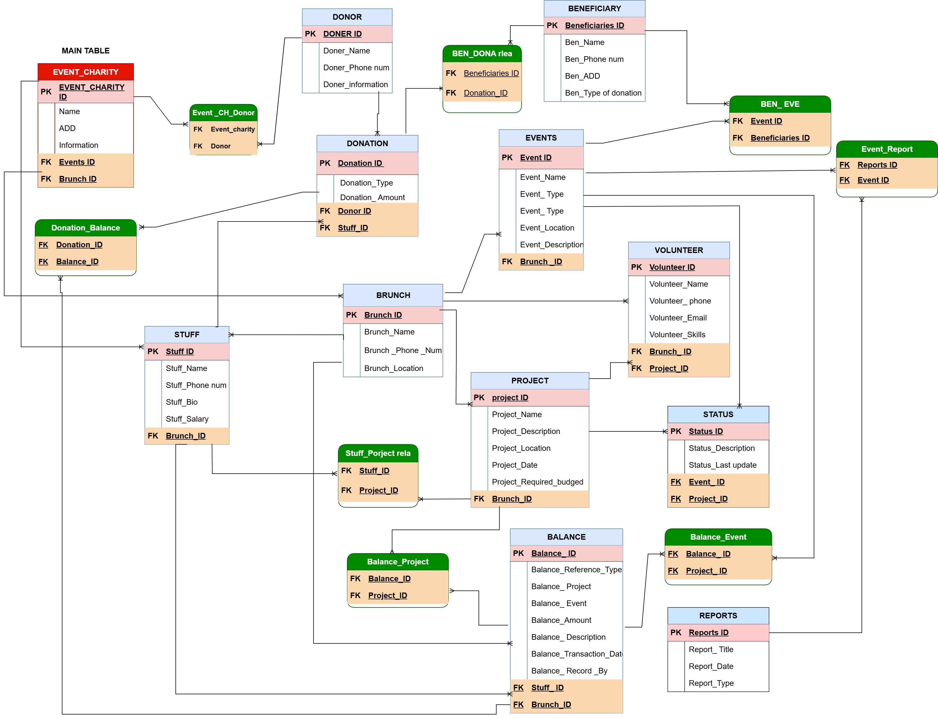

Slide 11
THANKS FROM YOUR ATTENTION

