Slide 1



Introduction to the SAGA API

Slide 2
Agenda
background recap
API structure and scope
API walkthrough
implementation details
API extensions

Slide 3
Grid APIs and Frameworks
Middleware often targets legacy applications (Unicore, Globus, Condor, ...)
some are distribution aware (MPICH-G, Ninf-G, . . . )
few APIs exist for Grid aware applications
GridFTP/GRAM
DRMAA
gLite
CoG
GAT
Cloud APIs

Slide 4
Grid APIs and Frameworks
diversity of Grid Middleware implies diversity of APIs
some APIs try to generalize Grid programming concepts
difficult to keep up with MW development, and to stay simple

Slide 5
Open Grid Forum (OGF)
The Open Grid Forum (aka GF, EGF, GGF) standardizes distributed computing infrastructures/MW
e.g. standardized job description language (JSDL)
focuses on interfaces, but also protocols, architecture, APIs

Slide 6
APIs within OGF
OGF focuses on services
some effort on higher level APIs
Distributed Resource Management Application API (DRMAA)
Remote Procedure Calls (GridRPC)
Checkpoint and Recovery (GridCPR)
Job Submission and Description Language (JSDL)
numerous ser vice interfaces, often WS-based (WSRF)

Slide 7
OGF: DRMAA
implementable on all major resource management services
simple means to define and submit jobs
basic job management features (status, kill)
job templates for bulk job management
DRMAA.v2 is expected by end of 2010 – OO, extended, SAGA aligned

Slide 8
DRMAA Example
drmaa_job_template_t * job_template;
if ( ! ( job_template = create_job_template (exe, 5, 0) ) )
{
fprintf (stderr, "create_job_template failed\n");
return 1;
}
while ( ( drmaa_errno = drmaa_run_job (job_id,
sizeof (jobid)-1,
job_template,
diagnosis,
sizeof (diagnosis)-1) )
== DRMAA_ERRNO_DRM_COMMUNICATION_FAILURE )
{
fprintf (stderr, "drmaa_run_job failed: %s\n", diagnosis);
sleep (1);
}

Slide 9
OGF: GridRPC
standardizes the three existing RPC implementations for Grids
example of ’gridified API’
simple: get function handle, call function
explicit support for async rpc calls
gridrpc.v2 adds support for remote data handles

Slide 10
OGF: GridRPC
double A[N*N], B[N*N], C[N*N];
initMatA (N, A);
initMatB (N, B);
grpc_initialize (argv[1]);
grpc_function_handle_t handle;
grpc_function_handle_default (&handle, "mat_mult");
if ( grpc_call (&handle, N, A, B, C) != GRPC_NO_ERROR )
{
exit (1);
}
grpc_function_handle_destruct (&handle);
grpc_finalize ();

Slide 11
OGF: GridCPR
Grids seem to favor application level checkpointing
GridCPR allows to manage checkpoints
defines an architecture, service interfaces, and scope of client API
a SAGA extensions exists with a matching client API

Slide 12
OGF: JSDL
extensible XML based language for describing job requirements
does not cover resource description (on purpose) does not cover workflows, or job dependencies etc (on purpose)
JSDL is extensible (ParameterSweep, SPMD, ...)

Slide 13
OGF: JSDL
<jsdl:JobDefinition>
<JobDescription>
<Application>
<jsdl-posix:POSIXApplication>
<Executable>/bin/date</Executable>
</jsdl-posix:POSIXApplication>
</Application>
<Resources ...>
<OperatingSystem>
<OperatingSystemType>
<OperatingSystemName>LINUX</OperatingSystemName>
</OperatingSystemType>
</OperatingSystem>
</Resources>
</JobDescription>
<jsdl:JobDefinition>

Slide 14
OGF: JSDL
XML: embeddable into WSRF (WS-Agreement etc.)
XML, but relatively flat
maps well to existing JDLs, but is ’more complete’
extensible (resource description, job dependencies, workflow)
top down approach!

Slide 15
OGF: Summary
some API specs exist in OGF, and are successful
OGF APIs do not cover the complete OGF scope
the various API standards are disjoint
WSDL as service interface specification cannot replace an application level API (wrong level of abstraction)
SAGA tries to address these issues

Slide 16
OGF: top-down vs. bottom-up
bottom-up often agrees on (semantic) LCD + backend specific extensions
top-down usually focuses on semantics of application requirements
bottom-up tends to be more powerful
top-down tends to be simpler and more concise
we very much prefer top-down!

Slide 17
SAGA
SAGA
Simple API for Grid Applications

Slide 18
SAGA Design Principles
SAGA: Simple API for Grid Applications
OGF approach to a uniform API layer (facade)
governing principle: 80:20 rule
simplicity versus control!
top-down approach
use case driven!
defines application level abstractions
extensible
stable look & feel
API packages
API Specification is language independent (IDL)
Renderings exist in C++, Python, Java
Examples here are in C++

Slide 19
SAGA Intro: Example 1
// SAGA: File Management example
saga::filesystem::directory dir ("any://remote.host.net//data/");
if ( dir.exists ("a") && ! dir.is_dir ("a") )
{
dir.copy ("a", "b", Overwrite);
}
list <saga::url> names = dir.find ("*-{123}.txt");
saga::filesystem::directory tmp = dir.open_dir ("tmp/", Create); saga::filesystem::file file = dir.open ("tmp/data.txt");

Slide 20
SAGA Intro: Example
API is clearly POSIX (libc + shell) inspired
where is my security??
what is ’any://’ ???

Slide 21
SAGA Intro: Example
// SAGA: Job Submission example
saga::job::description jd;
// details left out
saga::job::service js ("any://remote.host.net/");
saga::job::job j = js.create_job (jd);
j.run ();
cout << "Job State: " << j.get_state () << endl;
j.wait ();
cout << "Retval " << j.get_attribute ("ExitCode") << endl;

Slide 22
SAGA Intro: Example 2’
// SAGA: Job Submission example
saga::job::service js ("any://remote.host.net");
saga::job::job j = js.run_job ("touch /tmp/touch.me");
cout << "Job State: " << j.get_state () << endl;
j.wait ();
cout << "Retval " << j.get_attribute ("ExitCode") << endl;

Slide 23
SAGA Intro: Example 2
stateful objects!
yet another job description language? :-(
many hidden/default parameters
keeps call signatures small
’any://’ again!
TIMTOWTDI (there is more than one way to do it)

Slide 24
SAGA Intro: 10.000 feet
object oriented: inheritance, interfaces very moderate use of templates though!
functional and non-functional elements strictly separated
non-functional API:
look & feel: orthogonal to functional API
typically not mappable to remote operations
functional API:
API ’Packages’ extensible
typically mappable to remote operations
few inter-package dependencies - allows for partial implementations

Slide 25
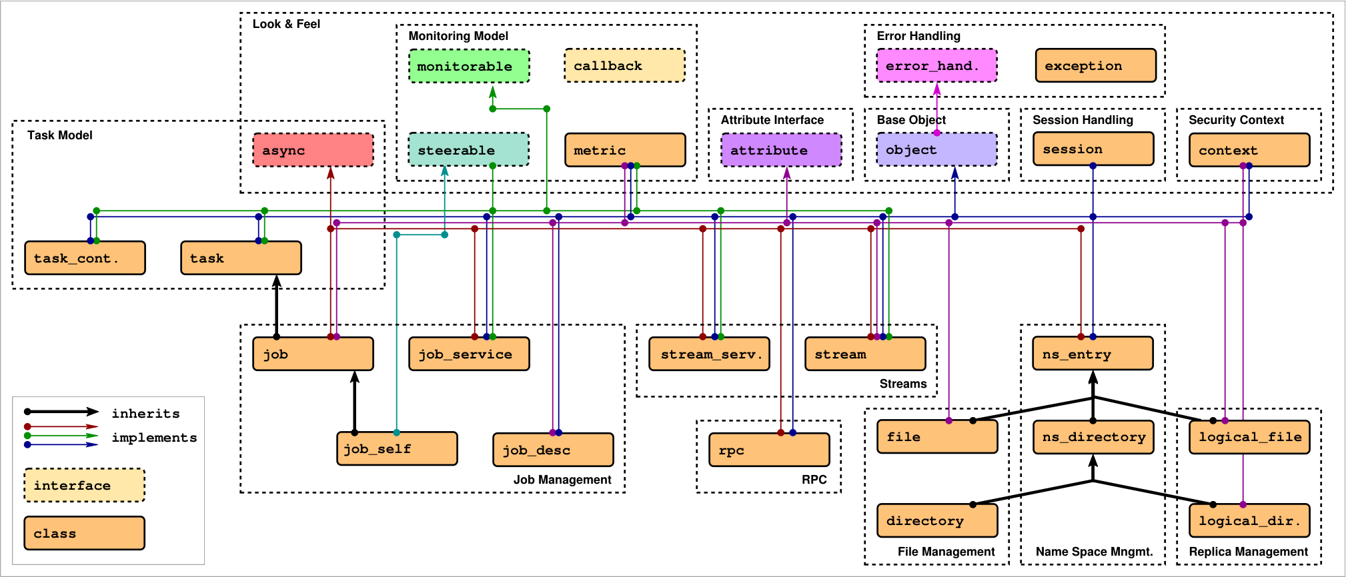
SAGA: Class hierarchy

Slide 26
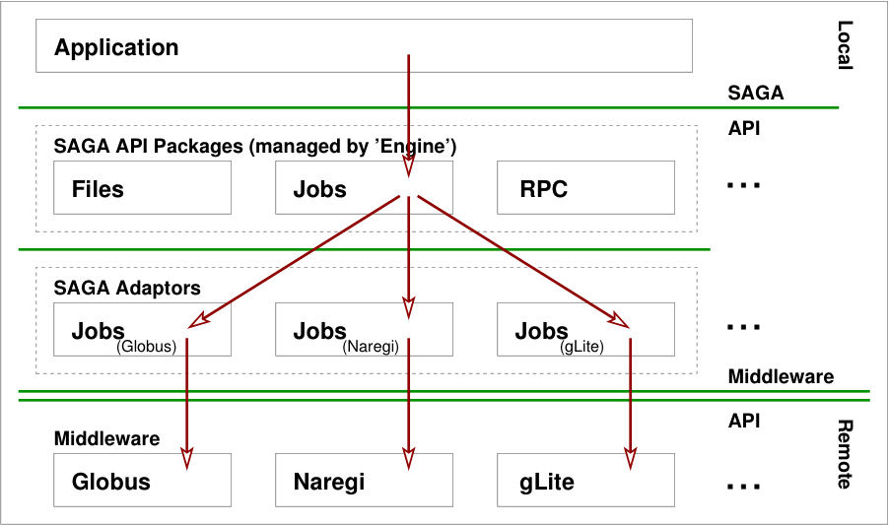
Implementation

Slide 27
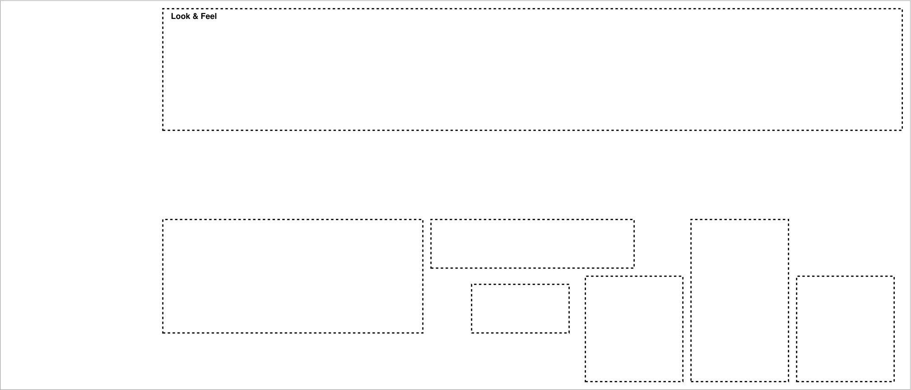
SAGA: Class hierarchy

Slide 28
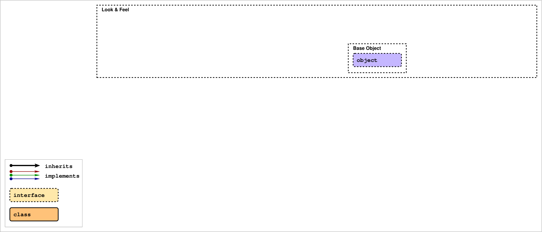
SAGA: Class hierarchy

Slide 29
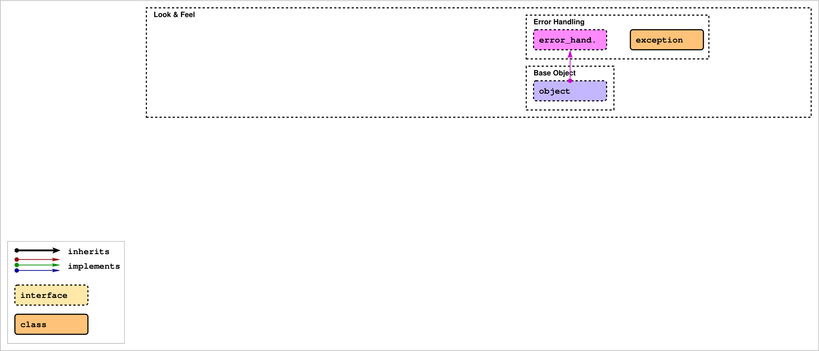
SAGA: Class hierarchy

Slide 30
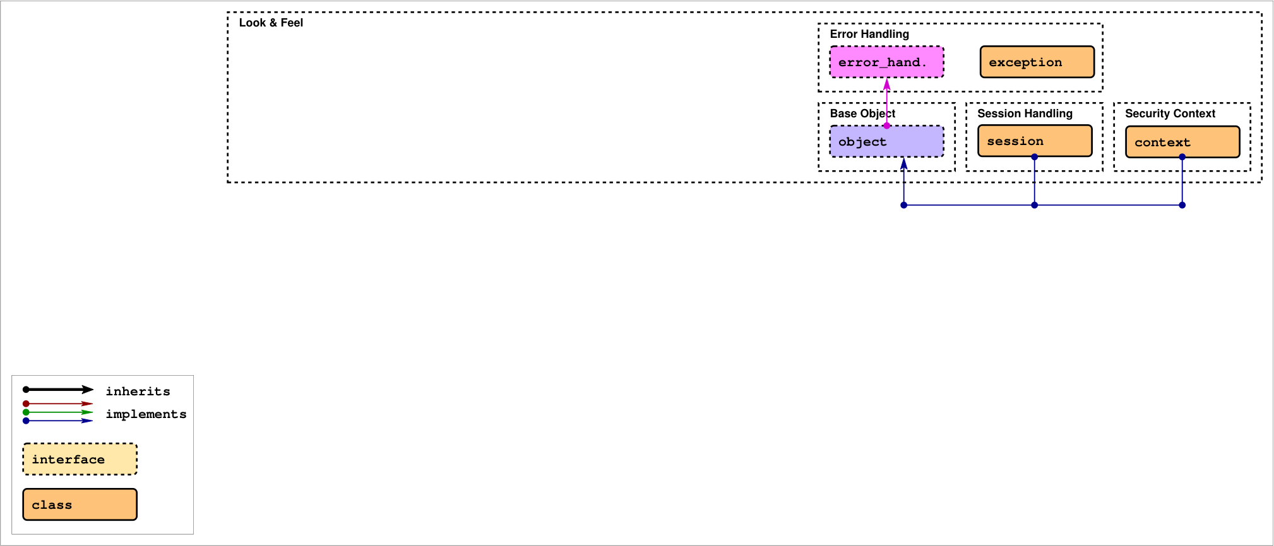
SAGA: Class hierarchy

Slide 31
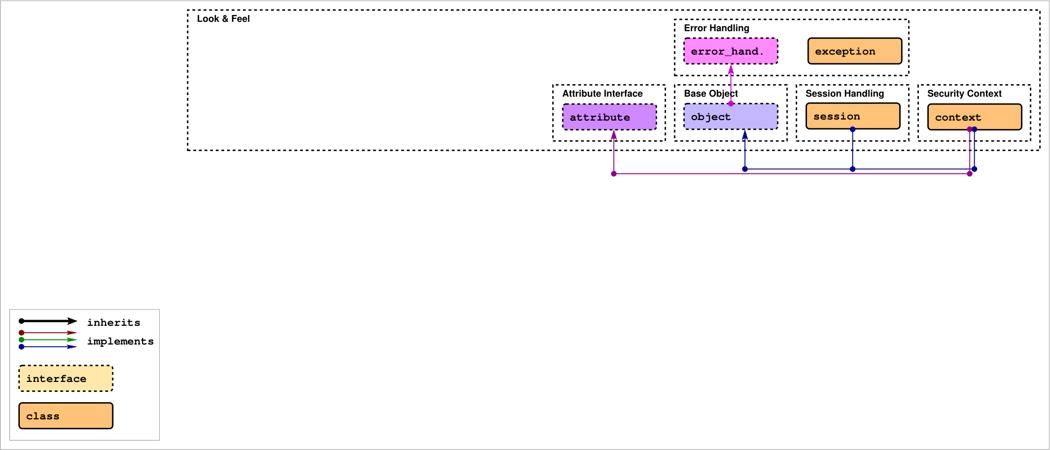
SAGA: Class hierarchy

Slide 32
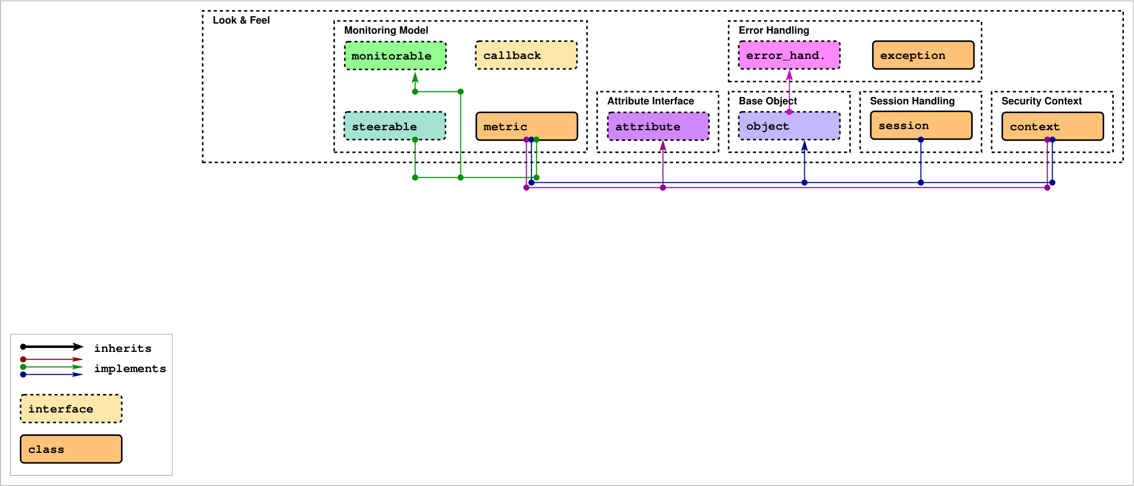
SAGA: Class hierarchy

Slide 33
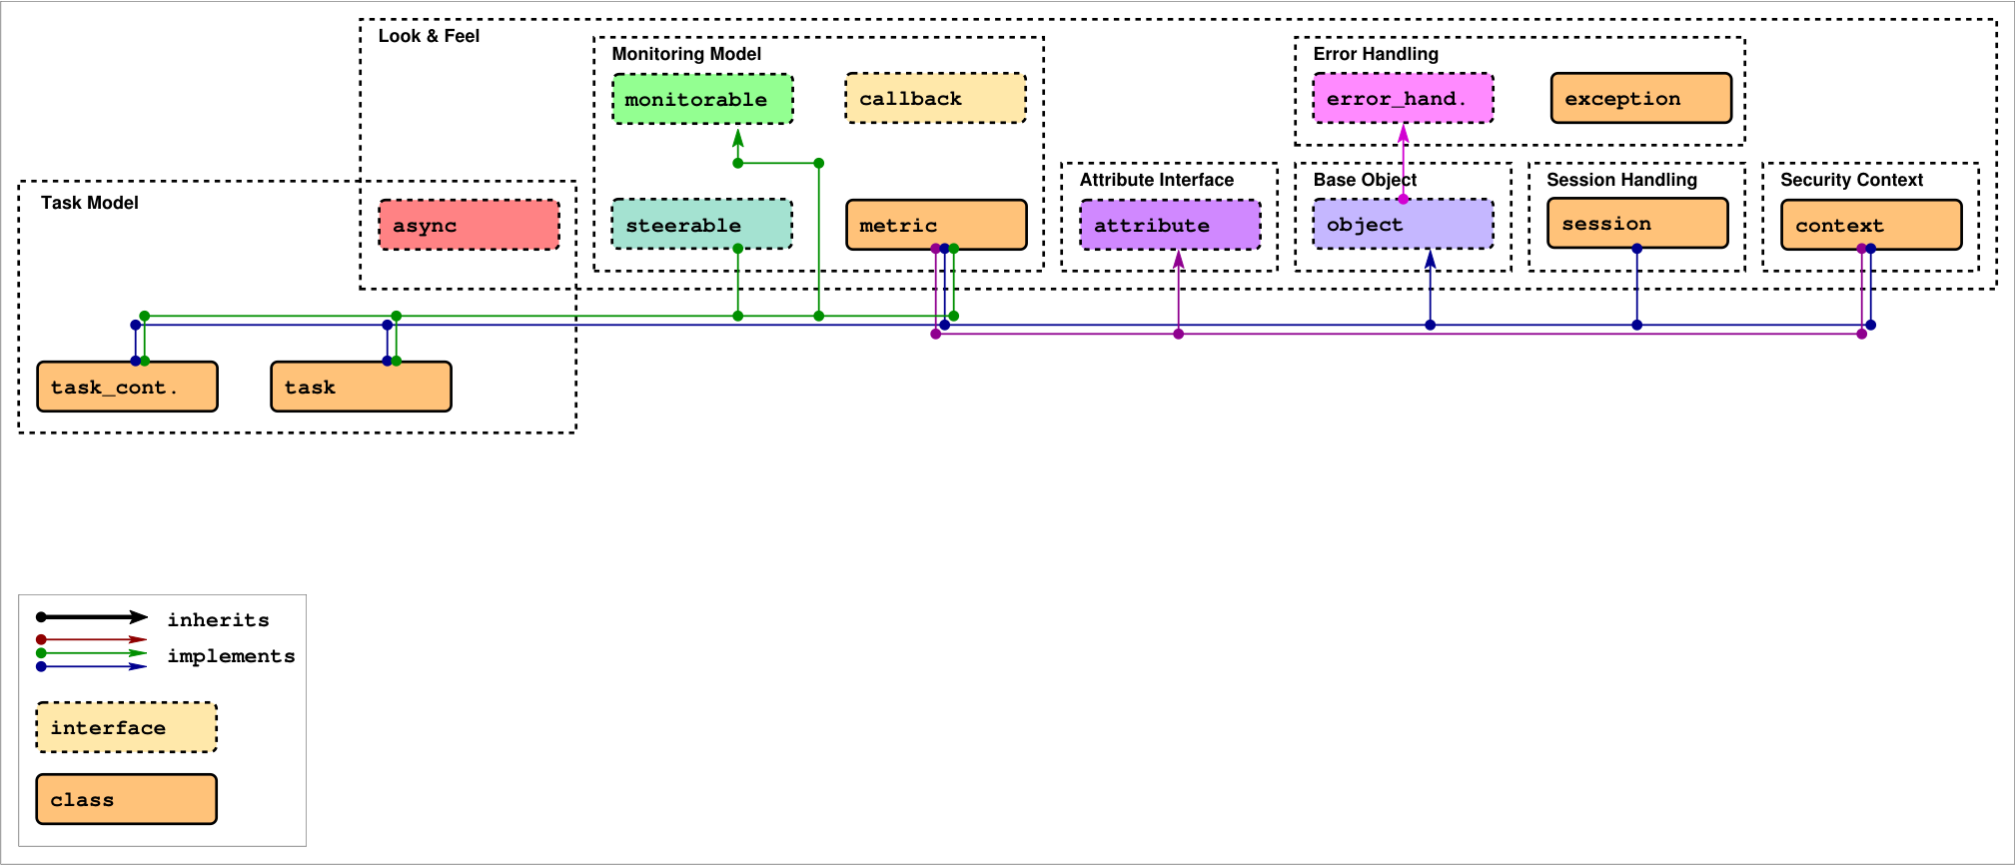
SAGA: Class hierarchy

Slide 34
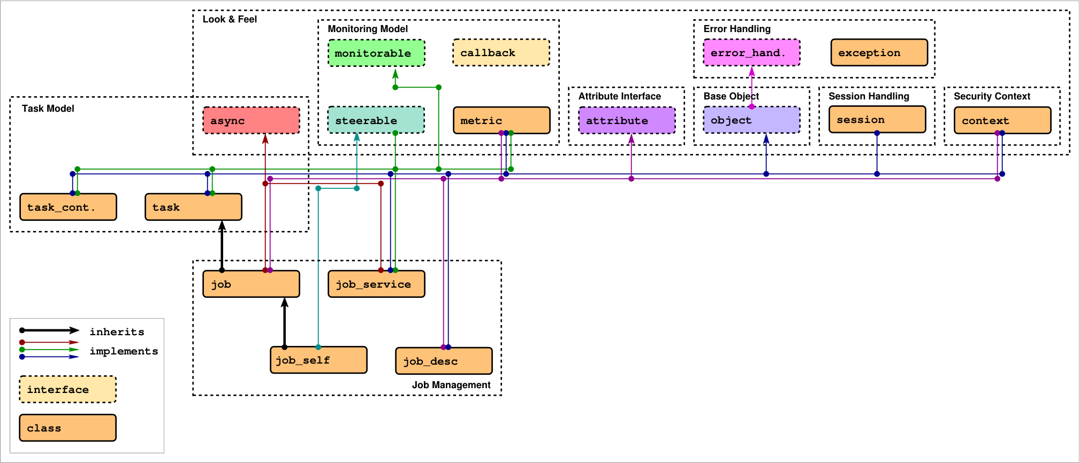
SAGA: Class hierarchy

Slide 35
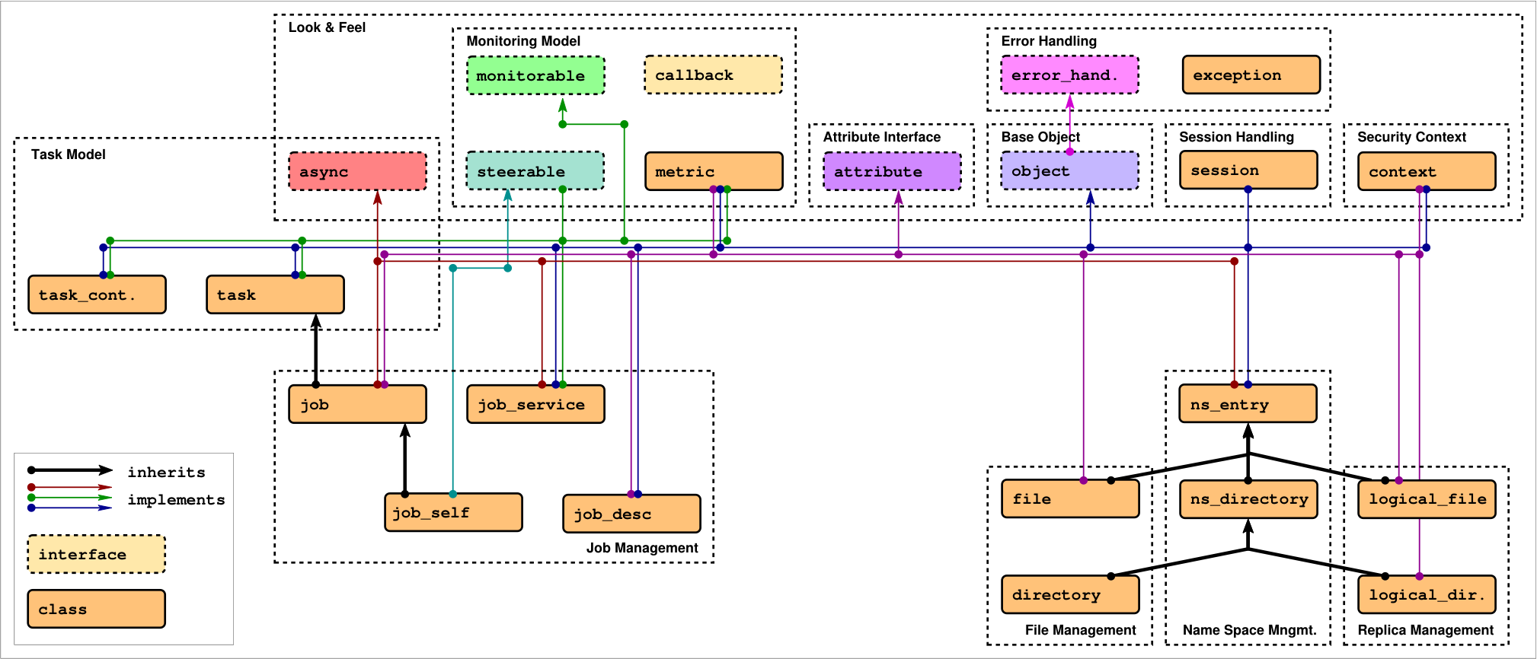
SAGA: Class hierarchy

Slide 36
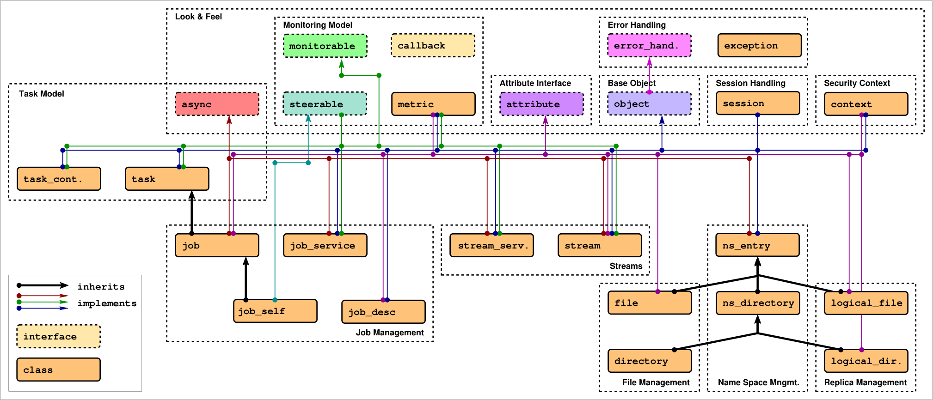
SAGA: Class hierarchy

Slide 37
SAGA: Class hierarchy

Slide 38
SAGA: Class hierarchy

Slide 39
SAGA: Class hierarchy

