Slide 1
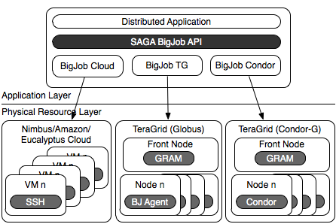



SAGA BigJob: An Extensible, Interoperable Pilot-Job Abstraction for Distributed Applications & Systems
Andre Luckow, Lukasz Lacinski and Shantenu Jha
http://saga.cct.lsu.edu/

Slide 2
Understanding Distributed Applications IDEAS: First Principles Development Objectives
Interoperability: Ability to work across multiple distributed resources
Distributed Scale-Out: The ability to utilize multiple distributed resources concurrently
Extensibility: Support new patterns/abstractions, different programming systems, functionality & Infrastructure
Adaptivity: Response to fluctuations in dynamic resource and availability of dynamic data
Simplicity: Accommodate above distributed concerns at different levels easily…
Challenge: How to develop DA effectively and efficiently with the above as first-class objectives?

Slide 3


SAGA: In a nutshell
There exists a lack of Programmatic approaches that:
Provide general-purpose, basic &common grid functionality for applications and thus hide underlying complexity, varying semantics..
The building blocks upon which to construct “consistent” higher-levels of functionality and abstractions
Meets the need for a Broad Spectrum of Application:
Simple scripts, Gateways, Smart Applications and Production Grade Tooling, Workflow…
Simple, integrated, stable, uniform and high-level interface
Simple and Stable: 80:20 restricted scope and Standard
Integrated: Similar semantics & style across
Uniform: Same interface for different distributed systems
SAGA: Provides Application* developers with units required to compose high-level functionality across (distinct) distributed systems
(*) One Person’s Application is another Person’s Tool

Slide 4
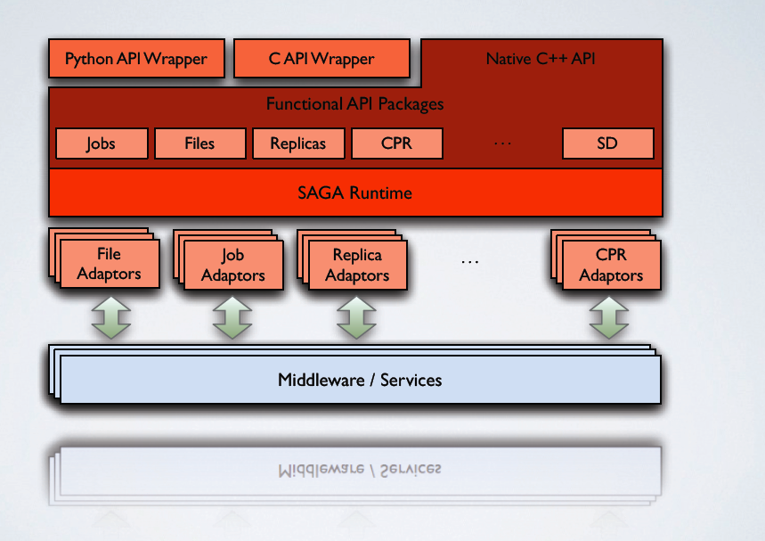
SAGA: In a thousand words..

Slide 5
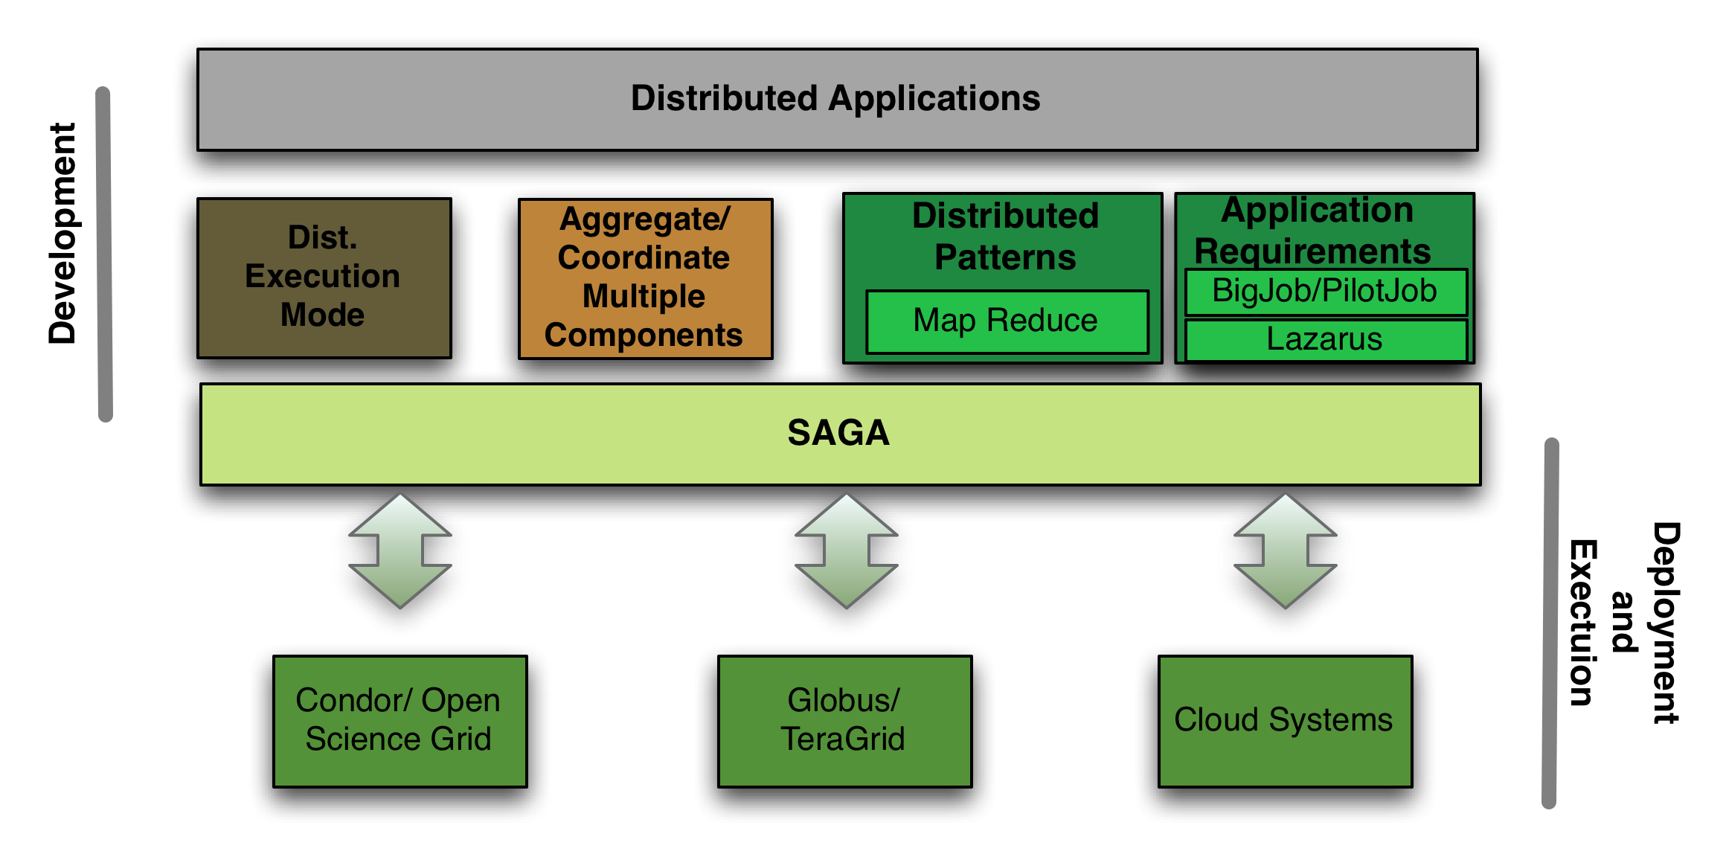
SAGA and Distributed Applications

Slide 6
Taxonomy of Distributed Application Development
Example of Distributed Execution Mode:
Implicitly Distributed
HTC of HPC: 1000 job submissions of NAMD the TG/LONI
SAGA shell example (cf DESHL)
Example of Explicit Coordination and Distribution
Explicitly Distributed
DAG-based Workflows (example of Higher-level API)
Example of SAGA-based Frameworks
Pilot-Jobs, Fault-tolerant Autonomic Framework
MapReduce, All-Pairs
Note: An application can be developed differently, and thus be in more than one category (e.g. DAG-based workflow)

Slide 7
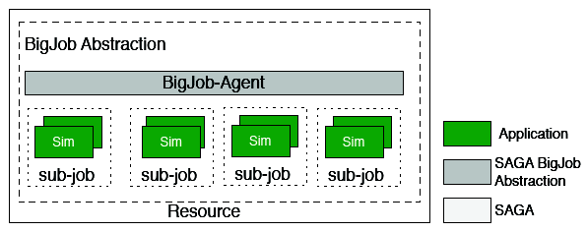
Abstractions for Dynamic Execution (1) Container Task
Adaptive:
Type A: Fix number of replicas; vary cores assigned to each replica.
Type B: Fix the size of replica; vary number of replicas (Cool Walking)
-- Same temperature range (adaptive sampling)
-- Greater temperature range (enhanced dynamics)

Slide 8
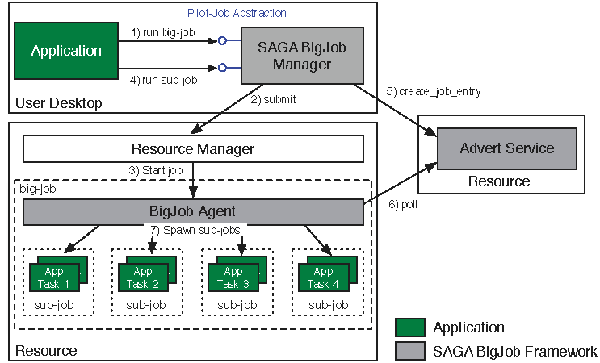
Abstractions for Dynamic Execution (2) SAGA Pilot-Job (BigJob)

Slide 9
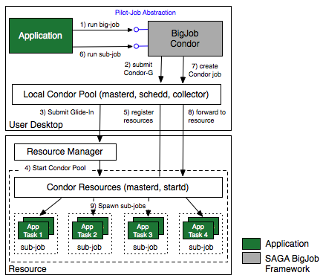
SAGA Pilot-Job: Condor

Slide 10
SAGA Pilot-Job: Condor (2)
Lukasz Please add descriptive text

Slide 11
SAGA Pilot-Job: Cloud
Please add material about SAGA-Clouds

Slide 12
Deployment & Scheduling of Multiple Infrastructure Independent Pilot-Jobs

Slide 13
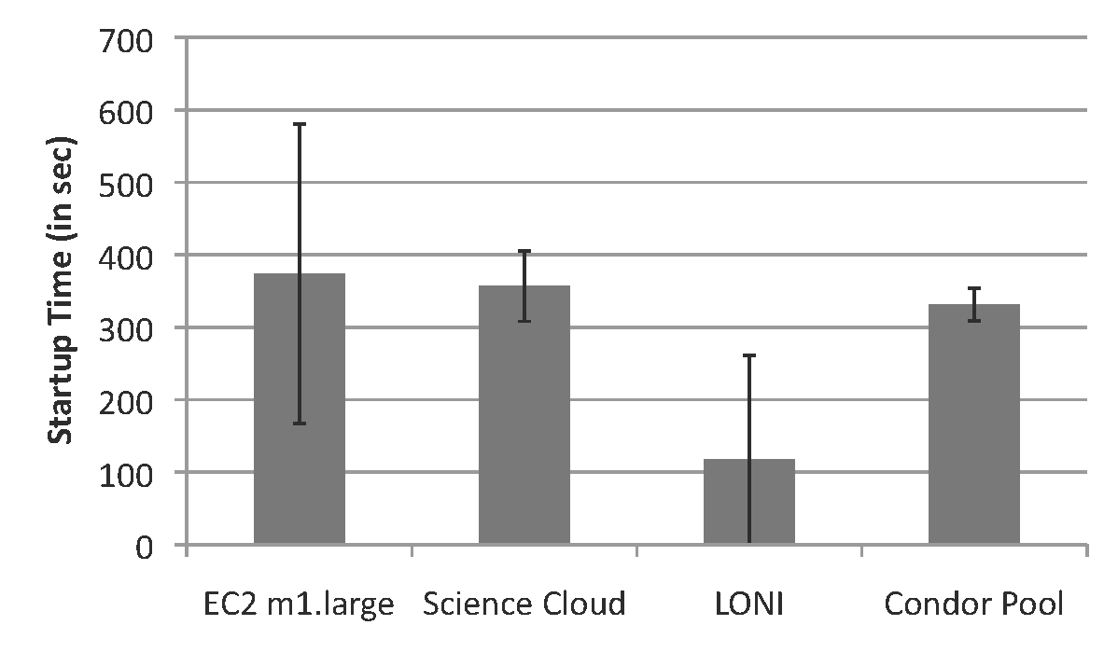
BigJob Start-up Times

Slide 14
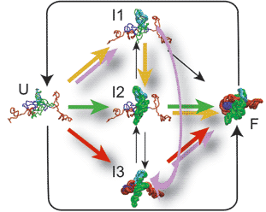
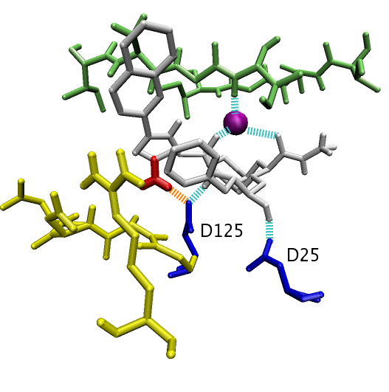
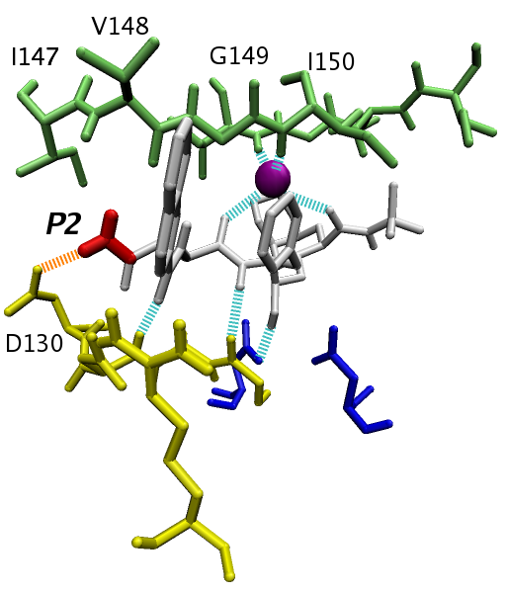
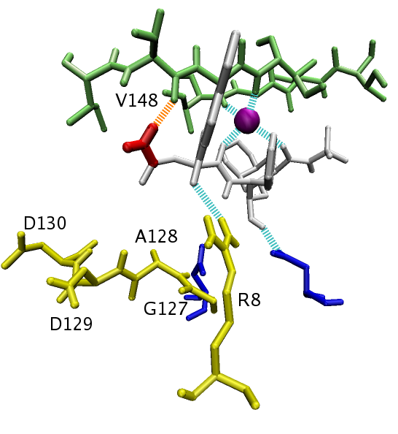
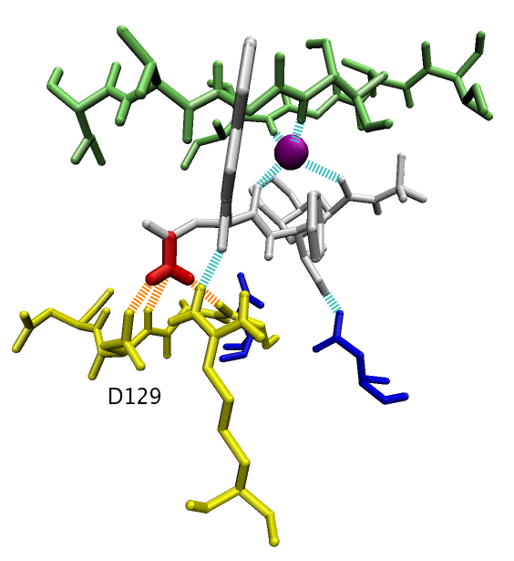
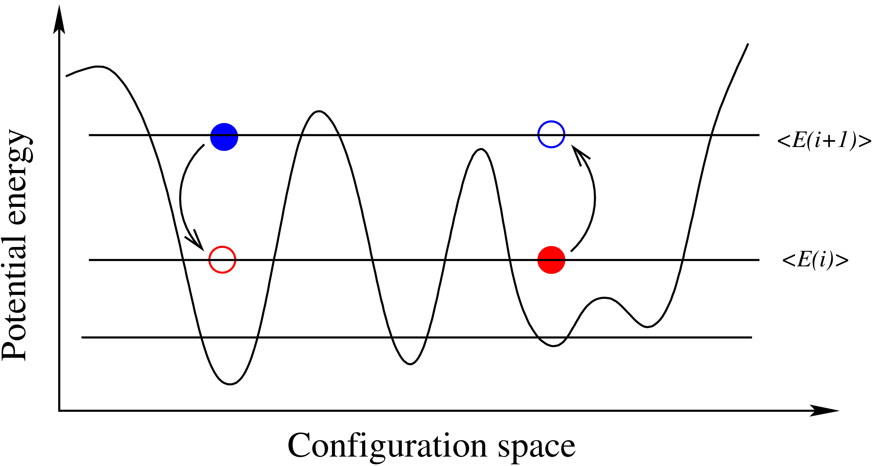
Generalized Ensemble Methods: Ensembles Can Enhance Sampling
Sampling is the challenge:
Long run vs multiple short runs?
Task Level Parallelism
Embarrassingly distributable!
Create replicas of initial configuration.
Spawn 'N' replicas over different machine
RE: Run for time t ; Attempt configuration swap. Run for further time t; Repeat till finish
We will not study Exchanges here
R₁
R₂
R₃
R_{N}
hot
T
t
300K
t
Exchange attempts

Slide 15
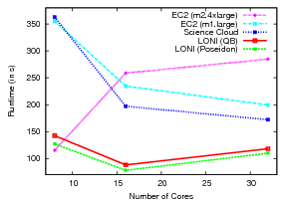
Scenario A-1: NAMD Performance for Different Resource Configurations

Slide 16
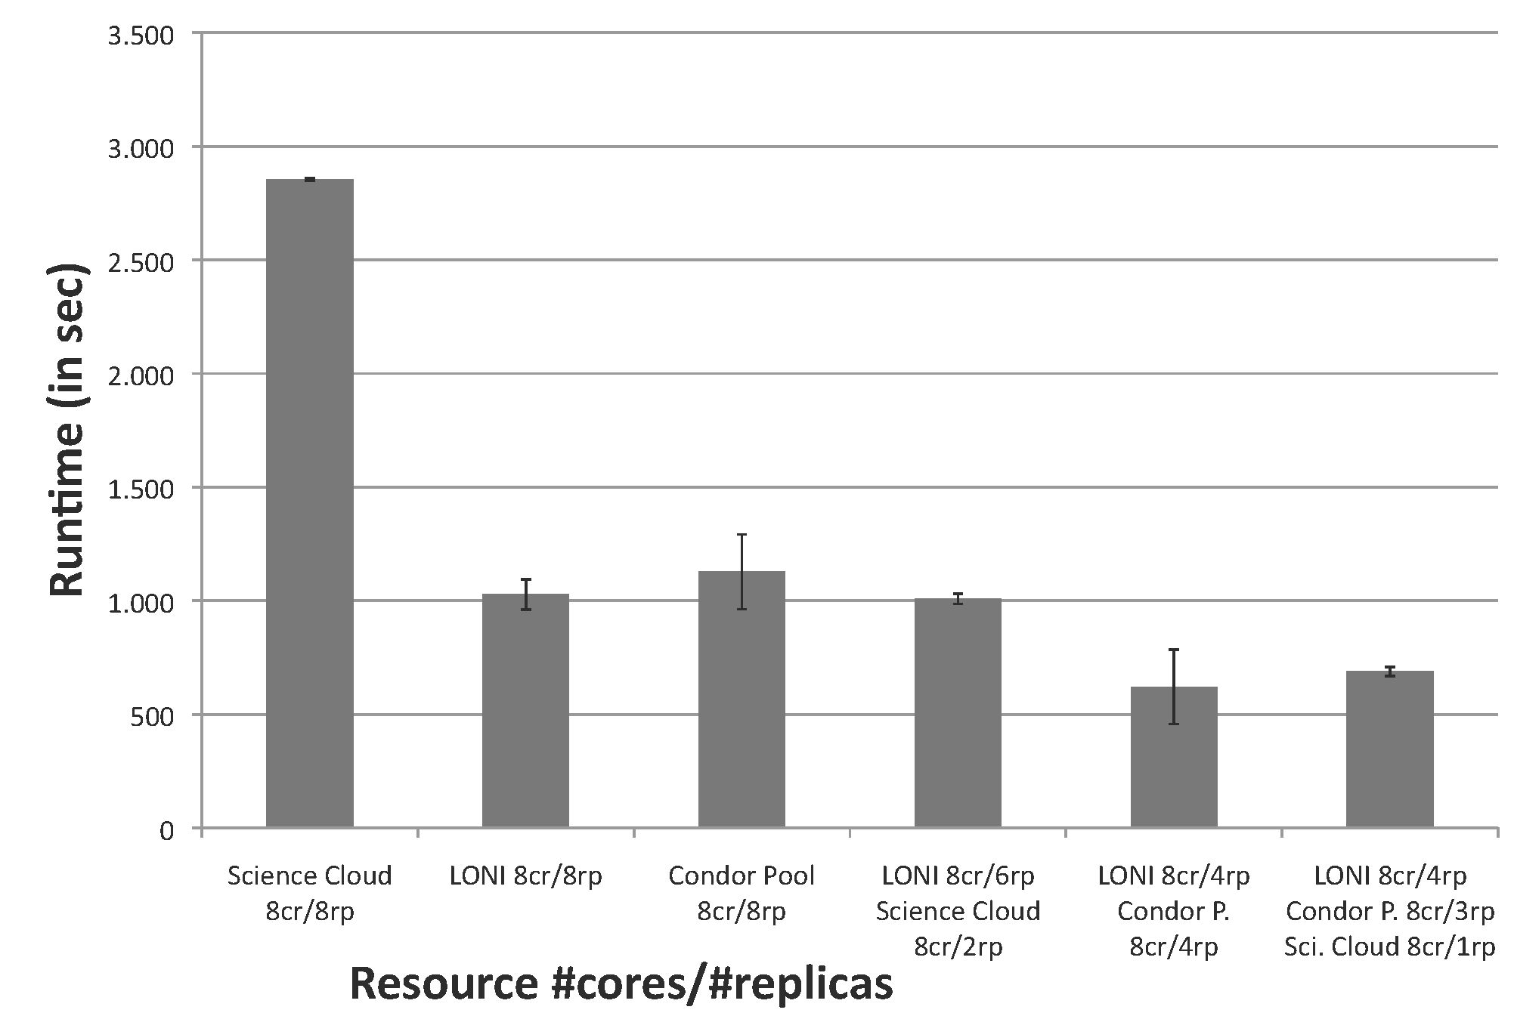
Scenario A-2: T_{c} for Different Resource Configurations
Each experiment was for 8 ensembles; repeated 4 times
More details….

Slide 17
Scenario B: Facilitating Novel Execution Modes
Interoperability and Scale-out enable new ways of resource planning and application execution
Deadline-driven scheduling: e.g., Need Workload X done before time Y
Adapt workload distribution and resource utilization to ensure completion
Develop Progress Manager; monitor’s state of completion
Based upon heuristics activates the Pilot-Jobs on Clouds
Could keep VMs cold; or hot

Slide 18

Scenario B: Experimental Results
Experiments performed 10 times; Resources used…

Slide 19
Conclusions and Future Work
IDEAS Design Objective
API for Higher-level Functionality/Abstractions built upon basic distributed API (SAGA)
ExTENCI Project – NSF Funded project wherein SAGA-based Pilot-Jobs will be used for EnKF for collective/concurrent usage of the TeraGrid and OSG

