Slide 1



SAGA Components: Installation and Deployment
Building and Installing

Slide 2
Outline
SAGA’s components
Overview, structure, dependencies
Available middleware bindings
The SAGA build system
Mephisto: a SAGA deployment/testing tool
Cyber-infrastructure deployment
LONI (Louisiana Optical Network Initiative)
TeraGrid
FutureGrid
Outlook

Slide 3
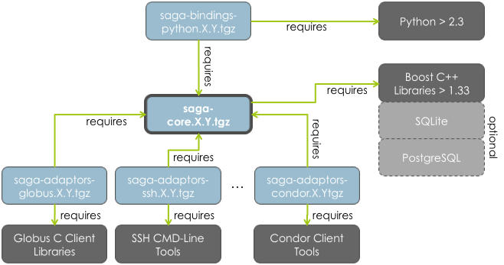
Overview | Structure | Dependencies
http://saga.cct.lsu.edu/software/cpp/download

Slide 4
Available Middleware Bindings (Adaptors)
saga-adaptors-default (fork, local fs, SQL advert & replica)
saga-adaptors-ssh (ssh job 'submission and fs ops via FUSE)
saga-adaptors-x509 (x509 security context)
saga-adaptors-globus (GRAM2/5, GridFTP, RLS)
saga-adaptors-condor Condor jobs)
saga-adaptors-lsf (Platform LSF jobs)

Slide 5
Available Adaptors (cont.)
saga-adaptors-aws (Amazon EC2, about to be released)
saga-adaptors-hdfs (Hadoop file op., about to be rel.)
saga-adaptors-glite (gLite-CREAM jobs, experimental)
saga-adaptors-pbspro (PBS Pro jobs, under review)
saga-adaptors-torque (Torque jobs, under review)
saga-adaptors-ogf (hpc-bp support, experimental)
… and: htable, kfs, naregi, ninfG, opencloud

Slide 6
SAGA’s Build System

Slide 7
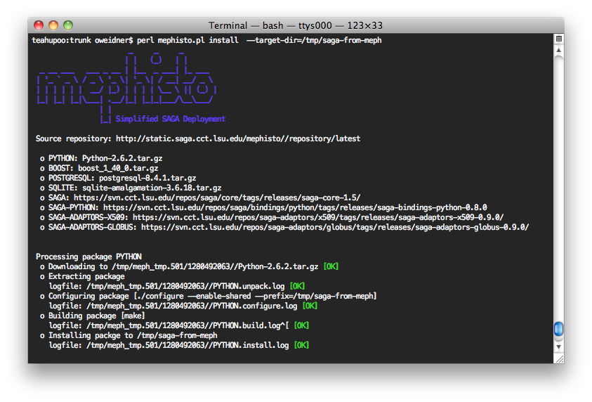
Mephisto: SAGA Deployment | Testing
http://faust.cct.lsu.edu/trac/mephisto

Slide 8
Installation
SAGA consists of several components that can be installed on demand and separately:
Core Components (required)
Also contains the default adaptors (local files, local jobs and SQL-based advert and replica adaptors)
Python Language Bindings (optional)
Adaptors (optional)
Globus, LSF, gLite, SSH, Cloud, …
The latest versions of all components can be downloaded from the SAGA website: http://saga.cct.lsu.edu/
SVN: https://svn.cct.lsu.edu/repos/saga/

Slide 9
Latest Available Components / Adaptors
Adaptor Name SAGA Package Requirements
AWS/EC2 saga::job Amazon EC2 API tools
Condor saga::job Condor cmd. line tools
Local (Fork) Exec saga::job -
Local Files saga::file -
PostgreSQL saga::advert postgresql client libraries
PostgreSQL saga::replica postgresql client libraries
SQLite3 saga::advert sqlite3 client libraries
SQLite3 saga::replica sqlite3 client libraries
gLite Cream saga::job gLite Cream client-side libraries
Globus GRAM2 / GRAM5 saga::job Globus Toolkit >= 4.x
Globus GridFTP saga::file Globus Toolkit >= 4.x
Globus RLS saga::replica Globus Toolkit >= 4.x
GridSAM saga::job OpenSSL
Platform LSF saga::job LSF cmd. line tools
NAREGI saga::job NAREGI cmd. line tools
PBS Pro saga::job PBS cmd. line tools
SSH saga::job ssh libs
SCP saga::file fuse libs
Torque saga::job torque cmd. line tools
TODO

Slide 10
Installation
SAGA is written in C++ and a little bit of Python. To build and install it, you’ll need at least:
C++ compiler and library
make tools
Python (optional)
All SAGA components require the Boost C++ libraries (>= 1.33.1). They are available as binary packages on many (Linux) systems. The source installer can be downloaded at http://www.boost.org
Adaptors require additional libraries / tools to be installed (e.g. Globus libs, PostgreSQL client libs, etc…)

Slide 11
Installation (Core Components)
Prerequisites: Boost C++ libraries and the PostgreSQL client libraries if you want to use the default advert and replica adaptors
Download and unpack the Core Components. Decide where you want to install SAGA (local/global). Run configure and make:
$> export SAGA_LOCATION=/install/location/dir/
$> ./configure --prefix=SAGA_LOCATION --with-boost= --with-postgresql=
$> make
$> make install

Slide 12
Installation (Python Bindings)
Prerequisites: SAGA Core Components and Python (>= 2.3 with shared libraries installed)
Download and unpack the Python Bindings Run configure and make:
$> export SAGA_LOCATION=/install/location/dir/
$> ./configure --with-python=
$> make
$> make install

Slide 13
Installation (Globus Adaptors)
Prerequisites: SAGA Core Components and the Globus Toolkit (available at http://www.globus.org)
Download and unpack the Globus Adaptors Run configure and make:
This works similar for all other SAGA Adaptors
$> export SAGA_LOCATION=/install/location/dir/
$> export GLOBUS_LOCATION=/path/to/your/globus/installation
$> ./configure --with-globus-location= --with-globus-flavor=
$> make
$> make install

Slide 14
Installation (Condor Adaptor)
Prerequisites: SAGA Core Components and the Condor Client Tools (available at http://www.cs.wisc.edu/condor/)
Download and unpack the Condor Adaptors Run configure and make:
$> export SAGA_LOCATION=/install/location/dir/
$> ./configure --with-condor=
$> make
$> make install

Slide 15
Installation Recap
SAGA_LOCATION must point to your Core Components installation
Different Adaptors may have different configure options. ./configure --help might help ;-)
Each adaptor comes with a file called: INSTALL Read it!

Slide 16
Configure Environment
SAGA_LOCATION is the only required environment variable. It makes sense to put it e.g. in your .bashrc
You will also have to add SAGA to your loader and Python paths if it is not installed in /usr or /usr/local
export SAGA_LOCATION=/install/location/dir/
export LD_LIBRARY_PATH=${SAGA_LOCATION}/lib:$LD_LIBRARY_PATH
export DYLD_LIBRARY_PATH=${SAGA_LOCATION}/lib:$DYLD_LIBRARY_PATH # On MacOS
export PYTHONPATH=${SAGA_LOCATION/lib/pythonX.Y/site-packages/:${PYTHONPATH}

Slide 17
Test The Installation
Use the SAGA file tool to print the contents of a file
Import the SAGA module into Python
$ SAGA_LOCATION/bin/saga-file cat file://localhost/etc/passwd
..
..
..
$ python
Python 2.6.1 (r261:67515, Feb 11 2010, 00:51:29)
[GCC 4.2.1 (Apple Inc. build 5646)] on darwin
Type "help", "copyright", "credits" or "license" for more information.
>>> import saga
>>> saga
<module 'saga' from '/opt/saga-svn/lib/python2.6.1/site-packages/saga/__init__.pyc'>

