Slide 1



Sustainability: The SAGA Experience
"Software is largely a service industry operating under the persistent but unfounded delusion that it is a manufacturing industry."
-- Eric Raymond, "The magic cauldron” (http://catb.org/~esr/writings/magic-cauldron/)
Ole Weidner, Shantenu Jha, Hartmut Kaiser, Andre Merzky
http://saga.cct.lsu.edu

Slide 2
Outline
Introduction to SAGA
Sustainability of different types, at different levels:
T-1: Production Infrastructure (Requires SAGA)
T-II: Sustainability of SAGA -- the Implementation/Software
T-III: Sustainability of SAGA -- the Community standard
“Use of standards and integration to improve use”
Four Interoperability Projects – access layers and tools
EGEE-TG[-NAREGI]
NAREGI-TG
TG-DEISA
ExTENCI [TG-OSG]
What can SSI do for SAGA?

Slide 3


SAGA: In a nutshell
There exists a lack of programmatic approaches that:
Provide general-purpose, basic &common grid functionality for applications and thus hide underlying complexity, varying semantics..
The building blocks upon which to construct “consistent” higher-levels of functionality and abstractions
Meets the need for a Broad Spectrum of Application:
Simple scripts, Gateways, Smart Applications and Production Grade Tooling, Workflow…
Simple, integrated, stable, uniform and high-level interface
Simple and Stable: 80:20 restricted scope and Standard
Integrated: Similar semantics & style across
Uniform: Same interface for different distributed systems

Slide 4
Understanding Distributed Applications IDEAS: First Principles Development Objectives
Interoperability: Ability to work across multiple distributed resources
Distributed Scale-Out: The ability to utilize multiple distributed resources concurrently
Extensibility: Support new patterns/abstractions, different programming systems, functionality & Infrastructure
Adaptivity: Response to fluctuations in dynamic resource and availability of dynamic data
Simplicity: Accommodate above distributed concerns at different levels easily…
Challenge: How to develop DA effectively and efficiently with the above as first-class objectives?

Slide 5
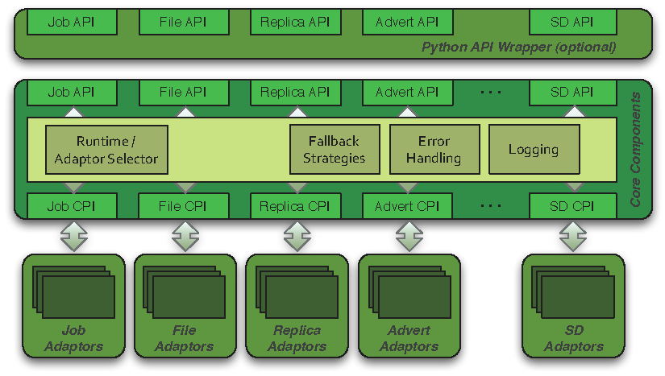
SAGA: Architecture

Slide 6
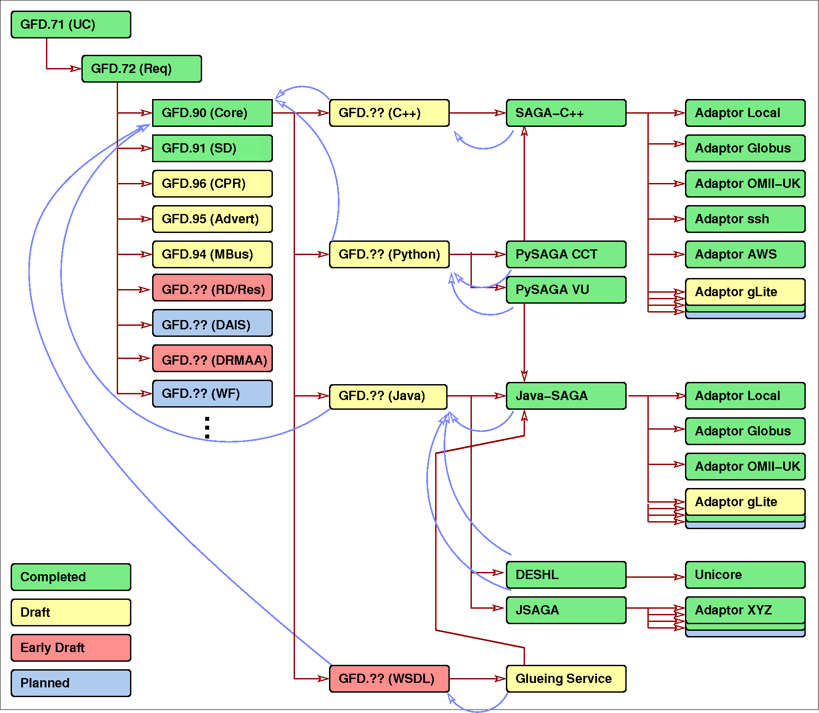
SAGA: Specification Landscape
Blue lines show
which packages
have input in the
Experience document

Slide 7
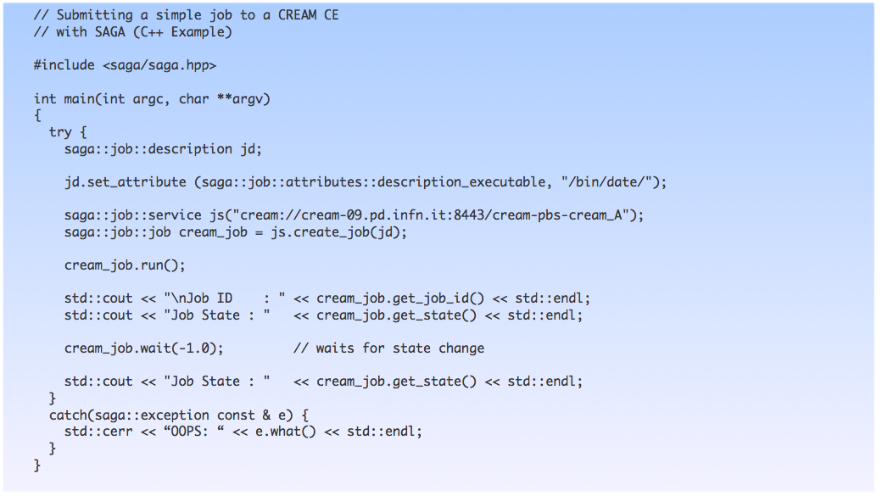
SAGA/CREAM C++ Example

Slide 8
SAGA API: Towards a Standard Standards promote Interoperability
The need for standard programming interface
Trade-off “Go it alone” versus “Community” model
Reinventing the wheel again, yet again, & then again
MPI a useful analogy of community standard
Vendors (Resource Provider), Software developers, users..
social/historic parallels also important
Time to adoption, after specification ....
OGF the natural choice (SAGA-RG, SAGA-WG)
Spin-off of the Applications Research Group
Driven by UK, EU (German/Dutch), US
Design derived from 23 Use Cases
different projects, applications and functionality
biological, coastal modelling, visualization
Will discuss the advantage of SAGA as a standard specification

Slide 9
SAGA Implementation: Extensibility
Horizontal Extensibility – API Packages
Current packages:
file management, job management, remote procedure calls, replica management, data streaming
Steering, information services, checkpoint…
Vertical Extensibility – Middleware Bindings
Different adaptors for different middleware
Set of ‘local’ adaptors
Extensibility for Optimization and Features
Bulk optimization, modular design

Slide 10
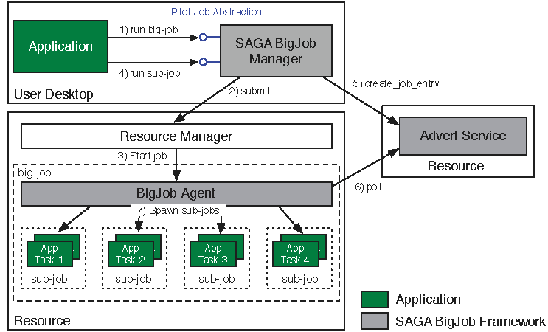
Abstractions for Dynamic Execution SAGA Pilot-Job (BigJob)

Slide 11
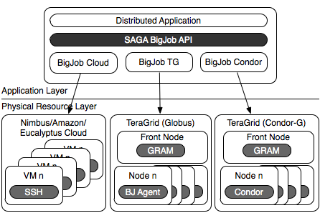
BigJob: Infrastructure Independent Pilot-Job

Slide 12
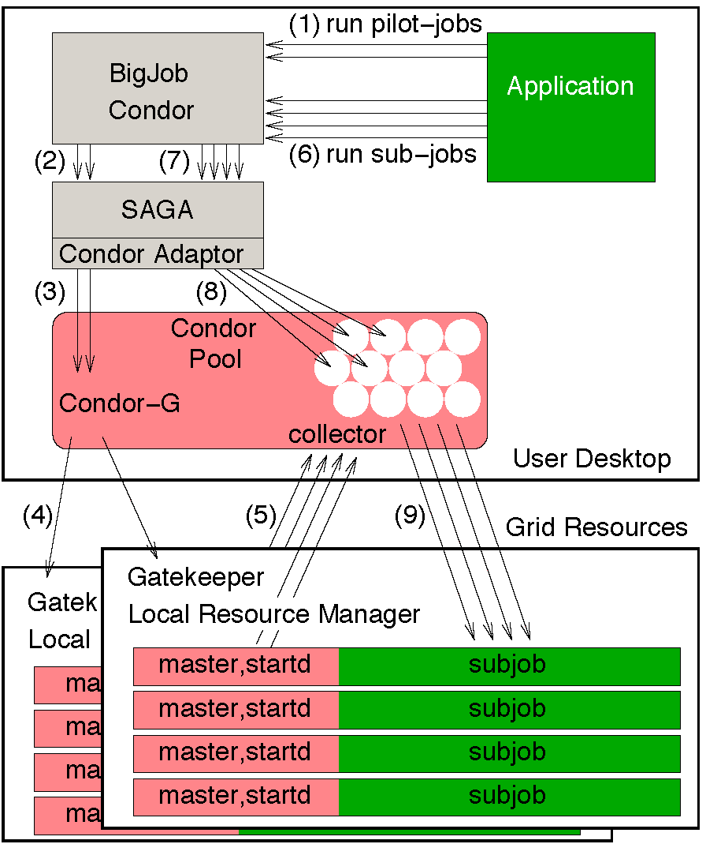
BigJob: Preserving Glide-in Semantics and Interface

Slide 13
SAGA Pilot-Jobs: What is different?
Pilot-Jobs: Decouple Resource Allocation from Resource-Workload binding
Pilot-Jobs are/have been typically used for:
Enhancing resource utilisation
Lowering wait time for multiple jobs (better predictibility)
Facilitate high-throughput simulations
Basis for Application-level Scheduling Resource binding
Two unique aspects about the SAGA-based Pilot-Job:
Pilot-Jobs have not been used for Science Driven Objectives:
First demonstration of supporting multi-physics simulations
Infrastructure Independent
Falkon, Condor Glide-in, Ganga-Diane (EGEE/EGI), DIRAC/WMS, PANDA
Frameworks based upon PJs (pull model) for specific PGI/back-end
Do not support MPI
SAGA-based Pilot-Job form the basis:
For autonomic scheduling and resource selection decisions
Advanced run-time frameworks for load-balancing and fault-tolerance

Slide 14
T-I: Sustainability Dependence on SAGA
T-I: SAGA as a standard to make DCI sustainable
T-I A : Well defined access-layer interface (For applications, tools and infrastructure)
Promotes Interoperability, Extensibility & Simplicity (of applications, tools, & infrastructure)
All three ensure sustainability.
T-1 B: Adaptor Based Development
Adaptor concept allows the adaptation to future Grid/Cloud middlewares without the need to change the application code. This can help an application to survive more than one generation of distributed/CI systems

Slide 15
SAGA: Access Layers Challenge of many Adaptors
Job Adaptors
Fork (localhost), SSH, Condor, Globus GRAM2, OMII GridSAM, Amazon EC2, Platform LSF
File Adaptors
Local FS, Globus GridFTP, Hadoop Distributed Filesystem (HDFS), CloudStore KFS, OpenCloud Sector-Sphere
Replica Adaptors
PostgreSQL/SQLite3, Globus RLS
Advert Adaptors
PostgreSQL/SQLite3, Hadoop H-Base, Hypertable
Other Adaptors
Default RPC / Stream / SD

Slide 16
T-II: SAGA Sustainability Issues
T-II: Making SAGA sustainable!
For T-I, need T-II
Outsource Development + Deployment + Maintenance
Strong community-driven standard implementation
Strategic deployment-agreements with big infrastructure providers
Support for SAGA within community tools
"Impedance matching between tools and infrastructure”
Standard + Implementation allow functional extensions (e.g. Advert, Messaging, etc.)
This allows SAGA to grow with technology and potentially prevents it from becoming 'obsolete’. (This is SAGA's horizontal extensibility).

Slide 17
T-III: Sustaining the SAGA Standaard
T-III: Keeping a standard a standard!
For T-I and T-II need T-III
General issues of the sustainability of standards apply
Should standards evolve?
“For whom the SDO toll”?
Loss of critical mass?
And then some issues about DC standards
Policy: Moral Imperative to use standards?

Slide 18
T-II SAGA Sustainability: Challenges
Engineering challenge
Syntactical translation is the easy bit. Enforcing/Engineering semantic consistency is the killer
For example: Failure models across different backends
“Everything under the hood” is now our problem
Being the top layer is not the same as being the top dog!
Unreliable Middleware
Poorly engineered, insufficiently tested
Low cost of ownership and development
Code base must be small, Number of lines of code owned must be minimum
Scalable, extensible and sustainable model for cost of testing, integrating and maintaining
Interoperability examples will serve to highlight this amongst others….

Slide 19
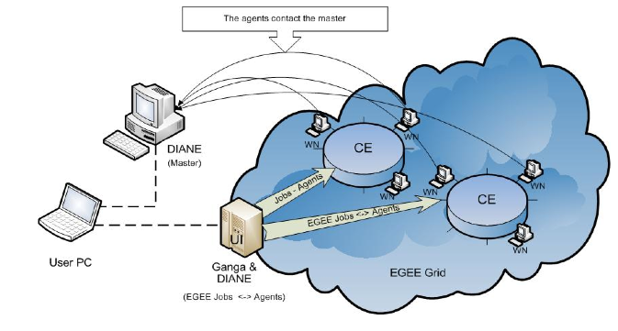
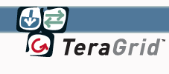

Lattice-QCD Applications on heterogeneous resources
Federating resources! EGEE Conference (Apr’10)
Payload distribution
(Not in this demo: cloud resources, additional Grid infrastructures…)
Master
Application-aware (and resource-aware) scheduling
Ganga/SAGA (to *)
Ganga/SAGA (to TeraGrid)
Ganga/gLite
Agents scheduling
Heterogeneous resources
allocation (Ganga + Ganga/SAGA)

Slide 20
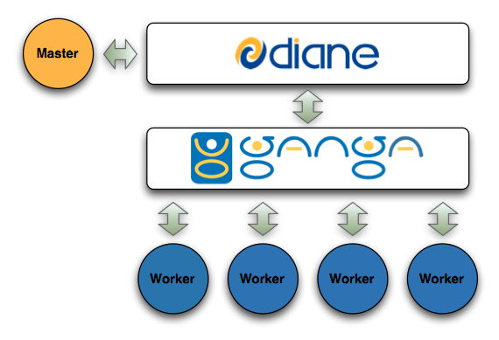
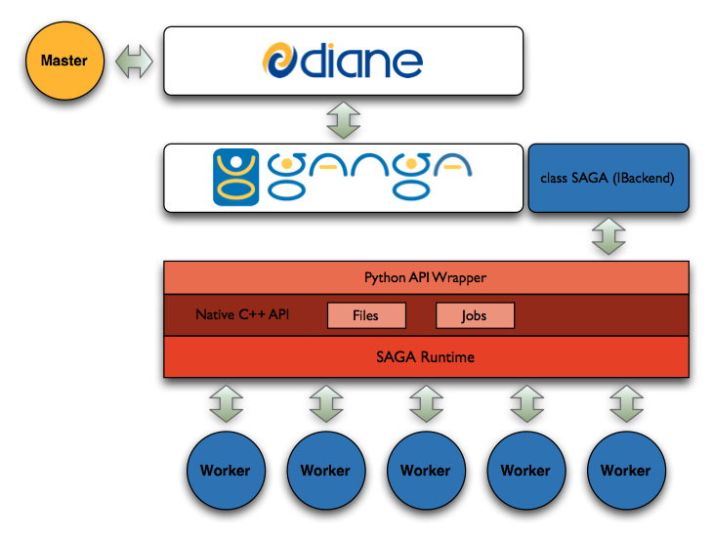
DIANE INTEGRATION
Diane without SAGA
Diane with SAGA
DIANE is an execution manager with support for pilot-jobs + worker agents
(IDEAS Redux)

Slide 21
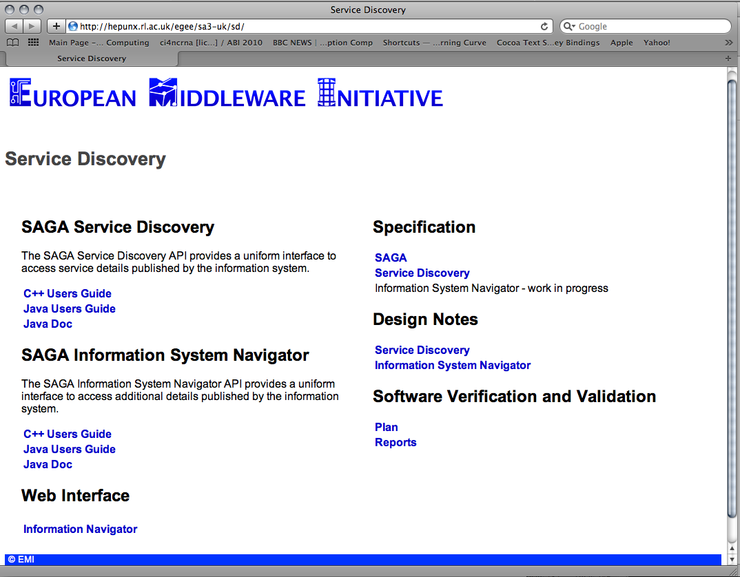

Slide 22
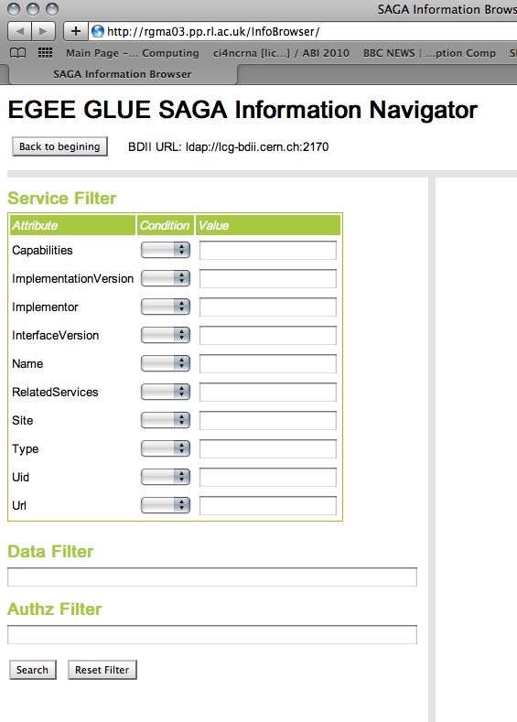

Slide 23
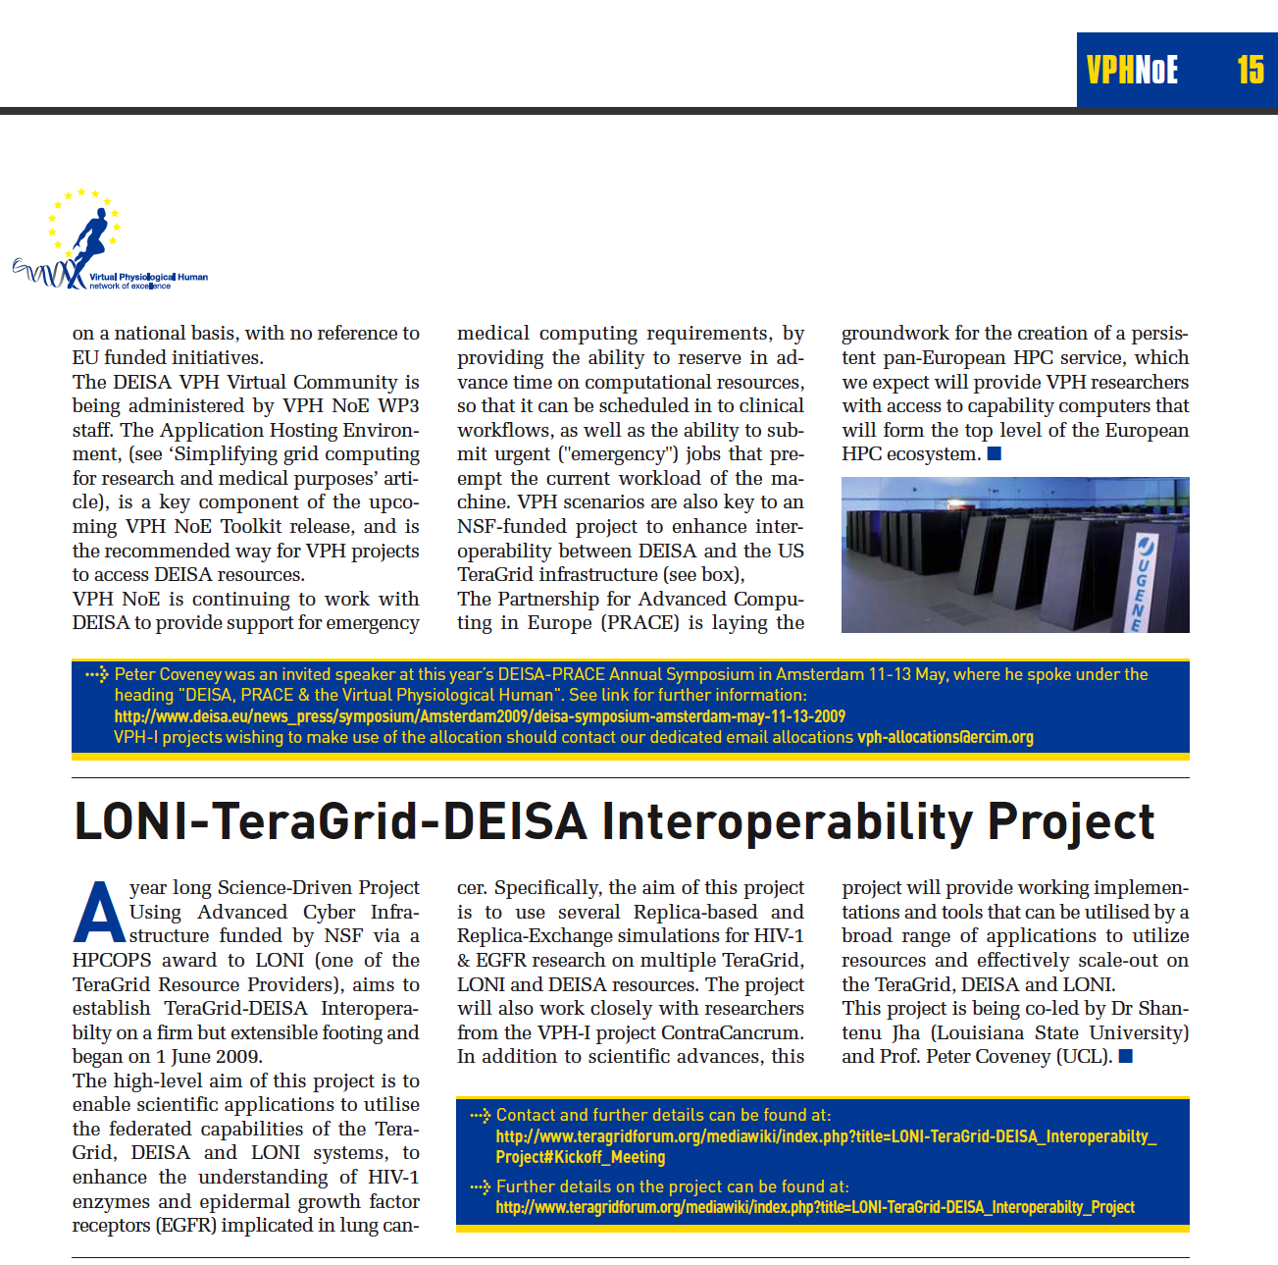

Slide 24
RENKEI Project Aims
Osaka Univ.
Tsukuba Univ.
Middleware-independent service & application
KEK
Service & Applications
Svc
Apps
Apps
SAGA
HEP
Library
RNS
Yet Another FC service based on OGF standard
Python Binding
C++ Interface
SAGA framework
SAGA-Engine
Adpt
Adpt
Adpt
SAGA adaptors
SRB
iRODS
NAREGI
gLite
Cloud
LRMS
LSF/PBS/SGE/…
This activity is funded by MEXT as a part of RENKEI project which develops seamless linkage of resources in the Grids and the local one for e-Science.
Notes:
The project “RENKEI - REsources liNKage for E-scIence” has been funded by MEXT for 3.5 years (2008-2011) and consists of 5 kinds of work groups.
KEK is developing the SAGA adaptors to bridge the NAREGI and applications
In order to demonstrate an application in multi grid infrastructure, we are developing a web application for radiotherapy simulation as practical example upon HEP library, RNS and SAGA.
RNS is being developed by another work group that consists of Osaka university and Tsukuba university
Simply, our goal is to provide middleware-independent applications and services.
A few items shown in red-line boxes are (or will be) developed by KEK members.

Slide 25
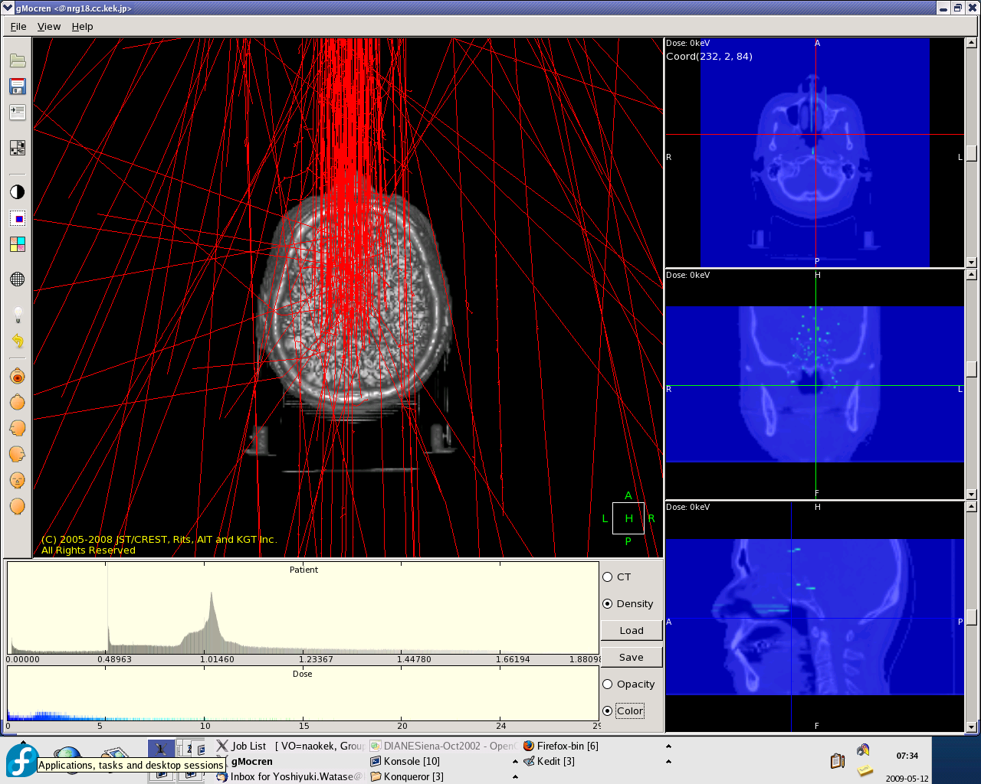
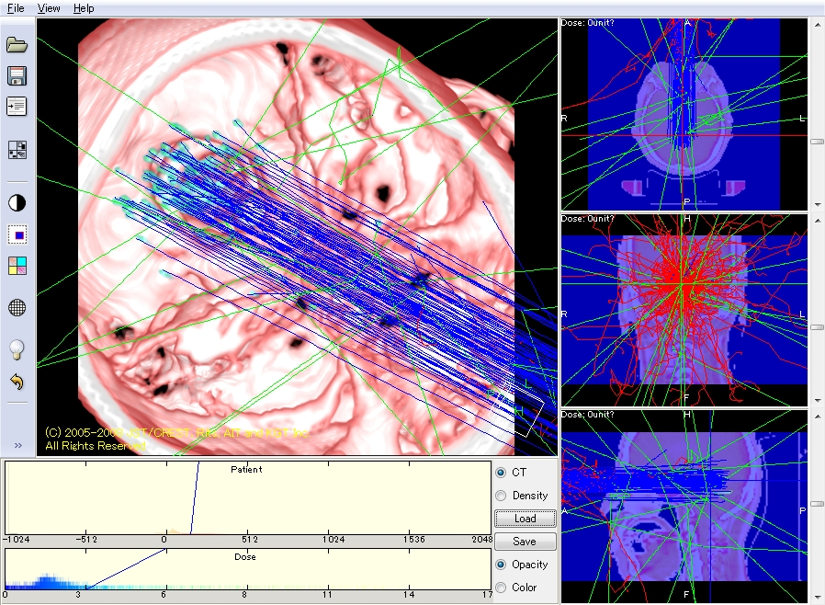
NAREGI-TG: Practical Examples
Grid environment
MW: NAREGI v1.1 released in
VO scale: KEK, NAO, HIT, and NII
SAGA adaptors:
NAREGI adaptor for job completed
Torque adaptor completed
Demonstration in testbed
Particle therapy simulation based on Geant4 as the 1st practical example
Resource scale
3 sites: KEK, NAO, HIT
CPU: 10 cores
OS: CentOS 5.2 x86_64
Memory: 2 GB each
More application-wise development in 2010
Notes:
As the first practical example, particle therapy simulation is demonstrated in testbed (NAREGI only)
We would pay efforts for more application-wise development in 2009
Geant4 is a toolkit for the simulation of the passage of particles through matter. Its areas of application include high energy, nuclear and accelerator physics, as well as studies in medical and space science.

Slide 26
ExTENCI: Cactus Application Scenarios
Problem size varies – determinant of Infrastructure used
TG, OSG or either..
MPI-based applications have a very complex SW environment that they need to worry about
Application Scenarios/Usage Modes
1. Ensemble of Cactus Simulations
NumRel, EnKF (Petroleum Eng)
2. Multiphysics Code
GR-MHD, CFD-MD
3. Spawning Simulations
Realtime ‘outsourcing’ from BlueWaters/Ranger to specialised architectures or less powerful resources

Slide 27
SAGA: Access Layers Challenge of many Adaptors
Job Adaptors
Fork (localhost), SSH, Condor, Globus GRAM2, OMII GridSAM, Amazon EC2, Platform LSF
File Adaptors
Local FS, Globus GridFTP, Hadoop Distributed Filesystem (HDFS), CloudStore KFS, OpenCloud Sector-Sphere
Replica Adaptors
PostgreSQL/SQLite3, Globus RLS
Advert Adaptors
PostgreSQL/SQLite3, Hadoop H-Base, Hypertable
Other Adaptors
Default RPC / Stream / SD

Slide 28
SAGA-based Tools and Projects Advantage of Standards
JSAGA from IN2P3 (Lyon)
http://grid.in2p3.fr/jsaga/index.html
gLite adaptors exist
JAVASAGA (Amsterdam)
Has a wide range of adaptors
JAVASAGA gets released by gLite (next few weeks)
NAREGI/KEK (Active)
http://www.ogf.org/OGF27/materials/1767/OGF27_SAGA_KEK.pdf
DEISA/DESHL
http://www.fz-juelich.de/nic-series/volume38/pringle.pdf )
http://deisa-jra7.forge.nesc.ac.uk/ and http://www.ogf.org/OGF19/materials/501/SAGA-DEISA.ppt
XtreemOS
http://saga.cct.lsu.edu/index.php?option=com_content&task=view&id=95&Itemid=174

Slide 29


JSAGA: Implementer and user of SAGA
Applications
JSAGA
JSAGA uses SAGA in a module, which hides heterogeneity of grid infrastructures
JSAGA implements SAGA to hide heterogeneity of middlewares
jobs
collection
SAGA
JSAGA
core engine
+ plug-ins
Legacy APIs

Slide 30







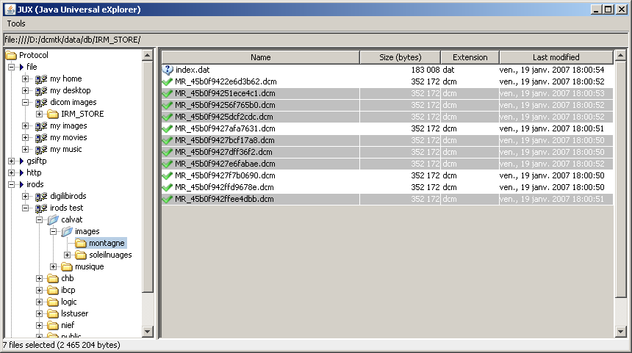
Projects using JSAGA
/
Elis@
a web portal for submitting jobs to industrial and research grid infrastructures
SimExplorer
a set of tools for managing simulation experiments
includes a workflow engine that submit jobs to heterogeneous distributed computing resources
JJS
a tool for running efficiently short-life jobs on EGEE
JUX
a multi-protocols file browser

Slide 31
