Slide 1



SAGA ALL-PAIRS
Shantenu Jha for the SAGA Team
http://saga.cct.lsu.edu

Slide 2
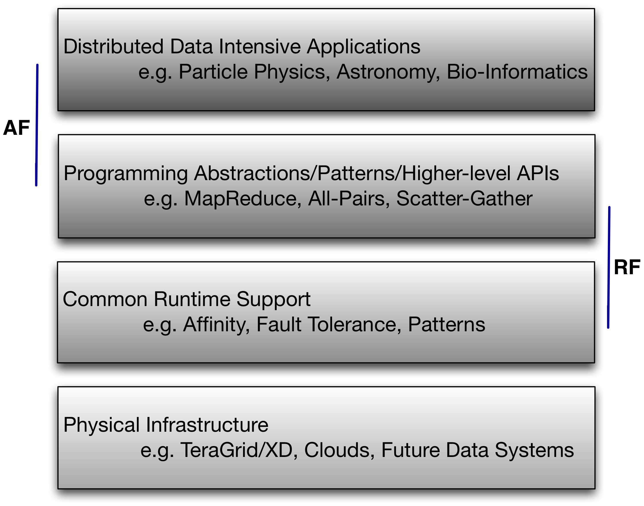
SAGA-based frameworks: Logical ordering

Slide 3
Data-Intensive Applications
There are Grids, Clouds and Cloud-like infrastructure supporting the solution of large problems
Google processes 20 petabytes of data per day
Unique performance issues arise as data sets become large
Developers should take precautions when placing, scheduling and managing such large volumes of data
Scalable placement and management techniques are required (e.g., distributed file-systems)

Slide 4
SAGA – Simple API for Grid Applications
The SAGA Philosophy
A Fresh Perspective on Distributed Applications
SAGA in a Nutshell
SAGA Landscape
Individual APIs
OGF standard
SAGA in action
Applications
Tools, Frameworks, Gateways, Access Layers.

Slide 5
All-Pair Abstraction
We want to understand
Performance tradeoffs of a DFS compared to “regular” distribution and placement techniques
How sensitive the performance is in the context of a real data-intensive distributed application.
We use a grid-enabled All-Pair abstraction
Applies an operation on the input data-set such that every possible pair in the set is input to the operation.
Our application compares ‘genome’ files that consist of random combinations of ACGT
Use a weight measure to measure to similarity of the strings

Slide 6
All-Pairs + Large Data
The application spawns distributed jobs to run sets of these pairs.
The problem becomes:
Determining which pairs to put into a set, and with which distributed resource to run that set.
Data management vs. computation
Data transfer times become important
We used CloudStore (formerly KosmosFS), an open-source high performance DFS based on Google's distributed filesystem GFS.

Slide 7
Central Model
Model traditionally used
Data at central site
Data Access
Resource requests data from central site
Compute assumed large, data I/O assumed small
Bottleneck forms when data becomes larger

Slide 8
Distributed Model
Data is spread over many machines
Data Access
Resources share data with other resources
Conventional Model
No planning when placing data
Intelligent Model
Data is dynamic
Task is mapped to a resource based on tasks’ data dependencies

Slide 9
Central vs. Distributed
Central
Ignore dependencies
Distributed
Conventional
Removes central dependency
Ignore dependencies
Intelligent
Minimize data transfer time
Utilize knowledge of network latency and data dependencies

Slide 10
Distributed Model (Conventional)
Each assignment reads 2.3 gigabytes of data
8x8 matrix. Each file 287 megabytes
Times decrease with respect to number of workers
Remote data is expensive
Minimum time required to handle requests from same server

Slide 11
Distributed Model (Intelligent)
Each assignment reads 2.3 gigabytes of data
8x8 matrix. Each file 287 megabytes
Adding workers eventually becomes ineffective
Need intelligence for speedup
Scales similarly
Overhead negligible

Slide 12
Results from Comparative Tests
Intelligence is worth the overhead
Intelligence ~1% overall time
~50% reduction in overall time!
Very simple intelligence

Slide 13
Lessons Learned
Very simple tools to measure data dependencies can be very effective. Some measurements used
Ping time
Small file transfer time
Number of hops
More complex measurements are possible
Throughput
Queue times
Ignoring data dependencies is no longer an option

Slide 14
Distributed Filesystem Model
Abstract layer between application and local filesystems
Some examples include
HDFS – Hadoop’s filesystem
GFS – Google’s filesystem
KosmosFS – open source C++ filesystem
Encapsulates Handling Data
Handles data displacement
Handles data requests

Slide 15
Distributed Filesystem
Pros
Replication
Fault tolerance
Capability to handle data dependencies
Cons
Overhead
Inability to control work placement
Is it worth it to use a distributed filesystem?
What does a distributed filesystem worry about?
Notes:
It worries about the data requests and managing them. It doesn’t look at closeness of work and decide to move the work. Maybe we can get better performance by doing this. DFS’s use replication and locality of data, but cannot move work around.

Slide 16
Results from DFS tests
Read 2.3 gigabytes
No coordination
Handled multiple requests
Some overhead for multiple dataservers in filesystem
Notes:
Some overhead for multiple dataservers in filesystem – when r = 2 it is slower than when 1 dataserver

Slide 17
Recap
AllPairs
Application framework to create an n by m comparison matrix
Data intensive
Models used today
Distributed Filesystem
Distributed
Conventional
Intelligent

Slide 18
Conclusions
Data intensive applications need overhead for efficiency
Distributed Filesystem Model
Intelligent Distributed Model
We were able to improve performance up to 50% on some cases
Distributed filesystems should also be able to move work around the data to achieve even better performance
More distribution does not always improve performance
Amdahl’s Law
Work takes a specified amount of time
Network latency and data/work transfers

Slide 19
Questions Remaining
When does intelligence overhead become too much?
What properties are important in defining dependency weight?
How does this knowledge apply differently to clusters, grids, and clouds?

