Slide 1
Abstractions for Life-Science Applications on Clouds (Past, Present and Future)
Shantenu Jha, Andre Luckow
Work in collaboration with Joohyun Kim, S Maddineni, Mark Santcroos, Ole Weidner
Microsoft Cloud Futures Workshop, Redmond, WA
Notes:
Added slide 3
I think there will not be time to focus on “assertion based” approach, i.e slides 4-7. Possibly include slide 8

Slide 2
Overview
Understanding Distributed “Dynamic” Abstractions
Unique Role for Abstractions for Distributed “Dynamic” Applications
Life Science Applications: Compute and Data Intensive, often require many (heterogeneous) ensemble based simulations
Pattern not amenable to CIRRUS; explore native abstractions that Azure
I & II: Understanding common basic computational “characteristics”
Abstractions for dynamic executions: “Intelligent” Pilot-Job
Application Exemplar I: EnMD and RE Simulations
Azure Solution: Architecture, Performance and Scalability
Azure addresses several of the distributed programming challenges
Application Exemplar II: NGS Analytics using BFAST
FutureGrid Solution: Architecture, Performance and Scalability
Lessons and Experience from TG (DARE-based Gateways) Towards a Community Cloud-based solution? NGS Analytics as a Service?

Slide 3
Overview
Understanding Distributed “Dynamic” Abstractions
Unique Role for Abstractions for Distributed “Dynamic” Applications
Life Science Applications – Data & Compute Intensive, often require many (heterogeneous) ensemble based simulations
Understanding common basic computational “characteristics”
Abstractions for dynamic executions: “Intelligent” Pilot-Job
Application Exemplar I: EnMD and RE Simulations
Pattern not amenable to CIRRUS; explore native abstractions that Azure
Azure Solution: Architecture, Performance and Scalability
Azure addresses several of the distributed programming challenges
Application Exemplar II: NGS Analytics using BFAST
DARE-based Gateways on TG and FG
Towards a Community Cloud-based solution? NGS Analytics as a Service?
Lessons and Experience from TG (DARE-based Gateways)

Slide 4
Some Primary Observations
Space of Distributed Applications (DA) Is large (and rich), but the number of effective and extensible DA small
More than just submitting jobs here and there!
Developing DA is a hard undertaking
Coordination across resources & Execution Environment
Embrace “distributedness”
Understanding distributedness -- data-centric application will be the drivers!
Heterogeneity & dynamic execution is fundamental
Points 2 & 3: Point to a unique role for Pattern-oriented and Abstractions-based Development of Distributed Applications

Slide 5
#2: Developing DA is a hard undertaking
Intrinsic reasons why developing DA is fundamentally hard:
Control & Coordination over Multiple & Distributed sites
Effective coordination in order for whole > sum of the parts
Complex design points; wide-range of models of DA
Many reasons for using DA, more than (just) peak performance
Extrinsic:
Execution environments will be dynamic, heterogeneous and varying degrees-of-control
Fundamental different variation in role of Execution Environment- distinguishing feature of DA from “regular environment” HPC
Application types strongly coupled to the infrastructure capabilities, abstractions/tools, & policy:
Often development tools assume “specific” deployment and execution environments, or don’t where needed!
Policies and tools, e.g production DCI has been missing for DDDAS

Slide 6
#3: Embrace Distribution Corollary: Clouds are not Panacea
Clouds: Novel or more of the same?
Better control over software environment via virtualization
Illusion of unlimited and immediate available resource can lead to better capacity planning and scheduling
Clouds do not remove many/all of the challenges inherent in DA
Clouds are about provisioning, grids are about federation
Fundamental challenges in distribution remain
Makes some thing worse as impose a model of strong localization
Programming models that provide dynamic execution (opposed to static), address heterogeneity etc
“The reason why we are so well prepared to handle the multi-core era, is because we took the trouble to understand and learn parallel programming” – Ken Kennedy
Clouds part of a larger distributed CI
Certain tasks better suited for Grids, others on Clouds
Notes:
“Clouds are about provisioning, grids are about federation”
“IF you can keep your head when all about you, Are losing theirs and blaming it on you..”
“The reason why we are so well prepared to handle the multi-core era, is because we took the trouble to understand parallel programming

Slide 7
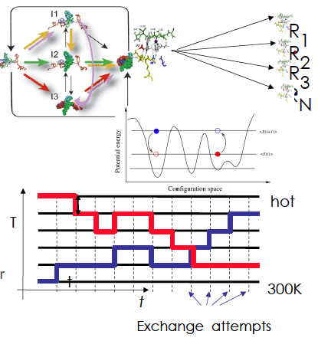
Application Exemplar I: Ensemble and Replica-Exchange Simulations
Replica-Exchange (RE) methods:
Represent a class of algorithms that involve a large number of loosely coupled ensembles.
RE simulations are used to understand a range of physical phenomena
Protein folding, unfolding etc
MC simulations
Many successful implementations
e.g. folding@home [replica based]

Slide 8
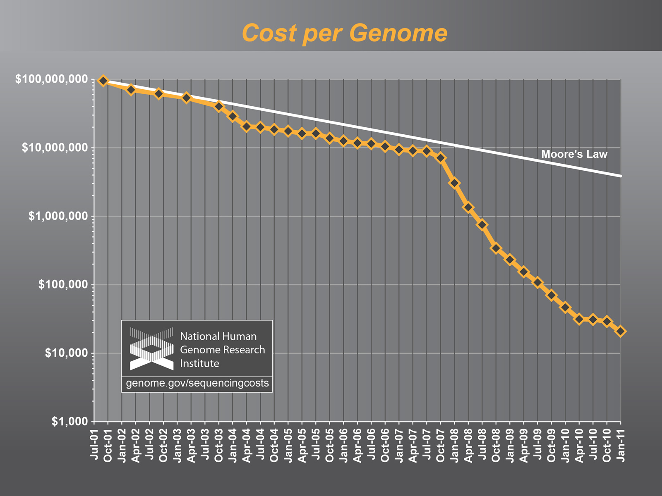
Application Exemplar II: NGS Analytics

Slide 9
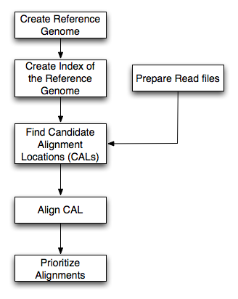
BFAST: An example of NGS Analytics
BFAST
Higher sensitivity (CAL finding and gapped Smith-Waterman alignment)
Relatively larger memory and disk space
Data types: (i) Short- Read (ii) Reference (iii) Index
Advanced features: (i) Multi-threading support (ii) Low-memory option (index file splitting)
Breaking up short-read data permits Task-Level concurrency
Each Task requires full reference genome – IO bottlneck
Time-Memory-IO tradeoff
Sensitive to specific problem/data set size
Workflow for bfast match step
Ref. Genome
Mapping
(Bfast)
SNP finding
NGS short reads

Slide 10
BFAST: File size vs Num Concurrent task
Scope for logical and physical distribution
HG18 - All

Slide 11
BFAST: An example of NGS Analytics
Human Genome (HG18) and Burkerholderia Glumae :Prokaryote vs. Eukaryote
 |  | B. Glumae | Human Genome | Human- Chr 21
Genome Size |  | 7 Mbp | 2.8Gbp (hg18) | 47 Mbp (hg18-chr21)
NGS Type |  | Whole Genome | Exome | Exome
NGS Data Size |  | 12.6 GB | 5.6 GB | 5.6 GB
Ref. Index Data | 40 index files | 40 GB | 130 GB | 70 GB
 | 10 index files
Minimum Memory | 40 index files | 9.5 MB | 3 GB | 42 MB
 | 10 index files | 38 MB | 12 GB | 164 ΜΒ

Slide 12

SAGA: In a nutshell
There exists a lack of Programmatic approaches that:
Provide general-purpose, basic & common distributed functionality for applications; hide underlying complexity, varying semantics..
The building blocks upon which to construct “consistent” higher-levels of functionality and abstractions
Meets the need for a Broad Spectrum of Application:
Simple scripts, Gateways, Tooling, Workflow…
Simple, integrated, stable, uniform and high-level interface
Simple and Stable: 80:20 restricted scope and Standard
Integrated: Similar semantics & style across
Uniform: Same interface for different distributed systems
Standards-based approach: A Technical and an Economic (Moral?) imperative & case:

Slide 13
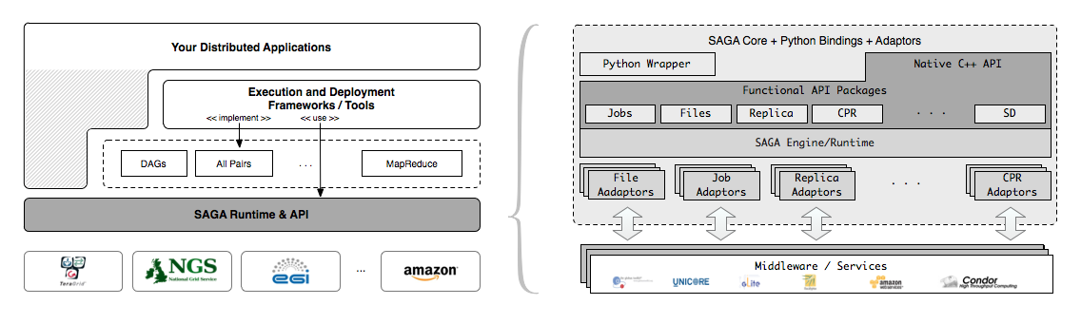
SAGA – An Overview

Slide 14
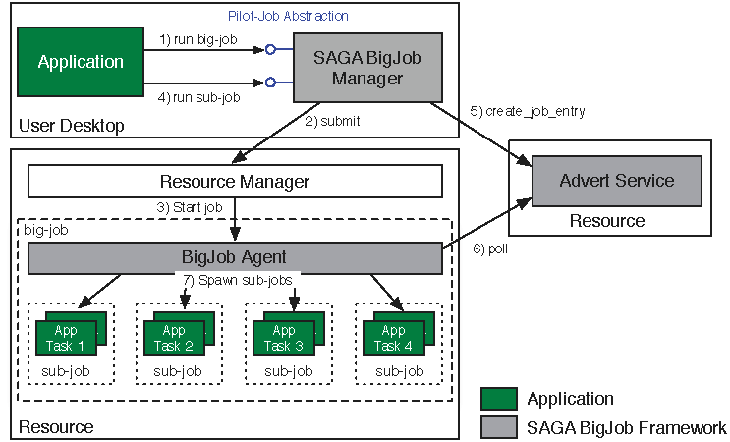
Abstractions for Dynamic Execution SAGA Pilot-Job (BigJob)

Slide 15
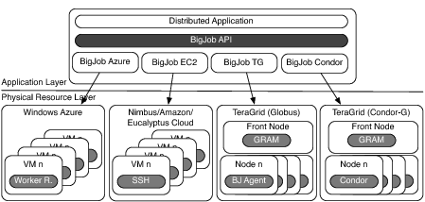
Deployment & Scheduling of Multiple Infrastructure Independent Pilot-Jobs

Slide 16
SAGA-Based Pilot-Job
Pilot-Jobs: Decouple resource allocation from resource-workload binding
Pilot-Jobs are/have been typically used for:
Enhancing resource utilization
Lowering wait time for multiple jobs (better predictability)
Facilitate high-throughput simulations
Basis for Application-level Scheduling Resource binding
Two unique aspects about the SAGA-based Pilot-Job:
Pilot-Jobs have not been used for Science Driven Objectives:
First demonstration of supporting multi-physics simulations, REMD simulations
Infrastructure Independent
Falkon, Condor Glide-in, Ganga-Diane (EGEE/EGI), DIRAC/WMS, PANDA
Frameworks based upon PJs (pull model) for specific PGI/back-end
Do not support MPI
SAGA-based Pilot-Job form the basis:
For autonomic scheduling and resource selection decisions
Advanced run-time frameworks for load-balancing and fault-tolerance

Slide 17
BigJob for Azure
Azure BigJob API calls Azure APIs directly
BigJob Manager (BM) launches requested number of worker roles using the Service Management API
Python library created for this capability
BigJob Agents run within the worker roles (C#/.Net)
Primary responsibility to execute MD code
MPI-based MD tasks confined to a single worker role (8 cores)
For each sub-job, the BM creates a work-package
Distributed to agents using AQS – reliable and scalable msgs
Agents query AQS for new work-packages
Stage data from ABS

Slide 18
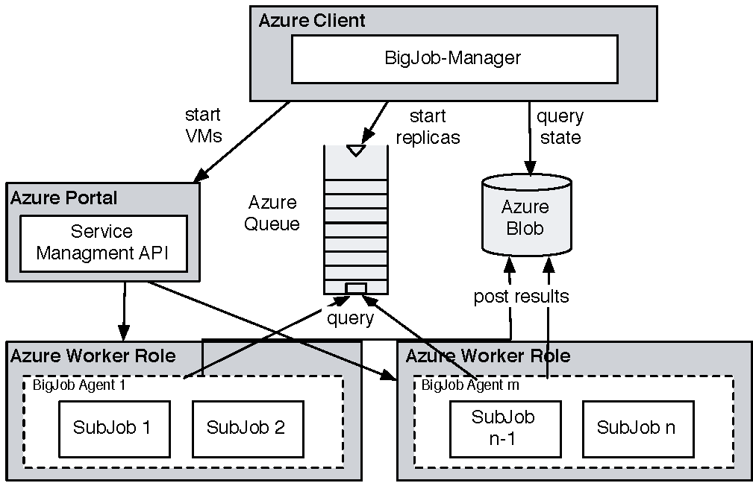
Coordinating Multiple Tasks Using BigJob for Azure
Support for Affinity Groups
Multiple Affinity Groups supported within the same BigJob for different worker-roles

Slide 19
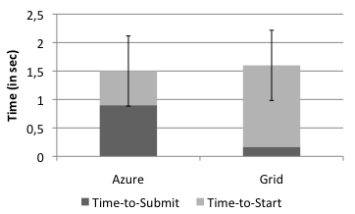
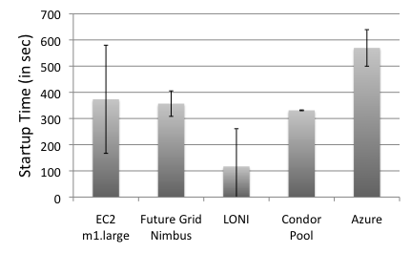
Pilot-Job for Azure: SAGA BigJob
BigJob Startup Times
In Grids the BigJob startup time depends mainly on queuing time
Azure shows a longer startup than Amazon EC2 and FutureGrid
Correlated to system load
Amazon EC2 has the highest fluctuation in the startup time (of all cloud resources)
Sub-Job submission times are comparable
BigJob Sub-Job Submission Times

Slide 20
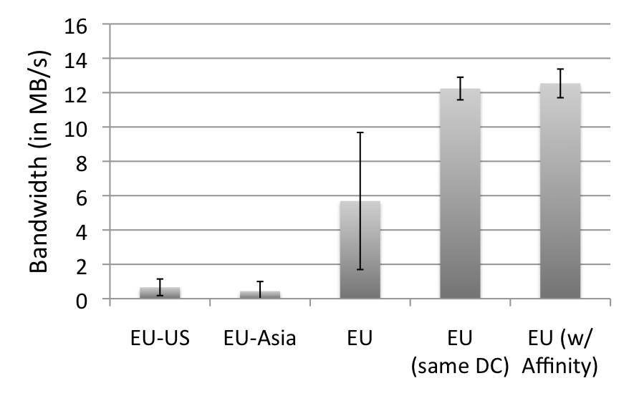
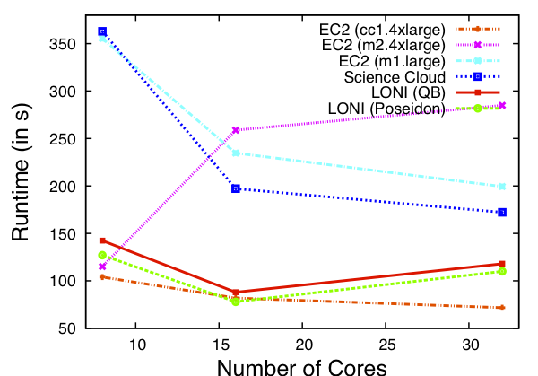
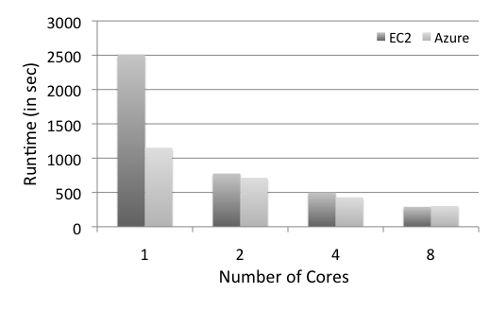
Azure: Scalability with Simplicity Providing Infra-level abstractions for DDIA
NAMD Performance on Azure
Three types of storage abstractions:
Azure Blob Service: Large amounts of raw data
Block Blob: Large chunks of 5GB
Page Blob: Mange storage as an array
Azure Table Storage: Semi-structured data
Azure Queue Storage: Message Queues
All three replicated and with strong consistency semantics
Current affinity operates at the data-center level;
Enhanced/finer-grained affinity to be made available

Slide 21
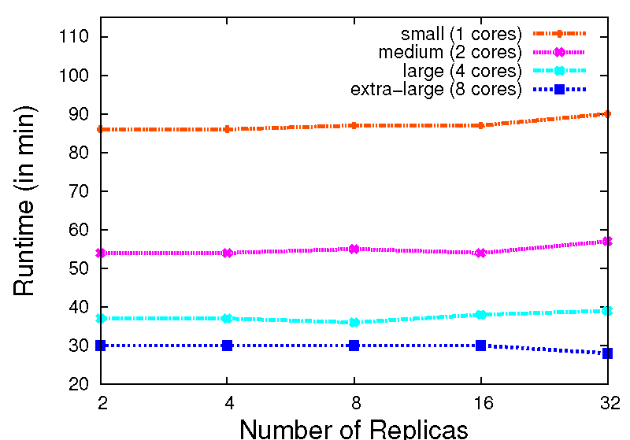
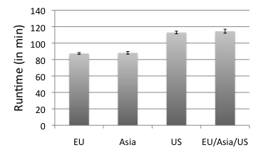
Replica-Exchange on Azure
Azure BigJob scales well with the number of replicas.
AQS proved to be effective for coordination of sub-jobs/replicas
Larger VMs have a better performance. But, efficiency drops < 0.4 for the extra-large VM
The different Azure data centers show a slight fluctuation in their performance
16 replicas, small VM

Slide 22
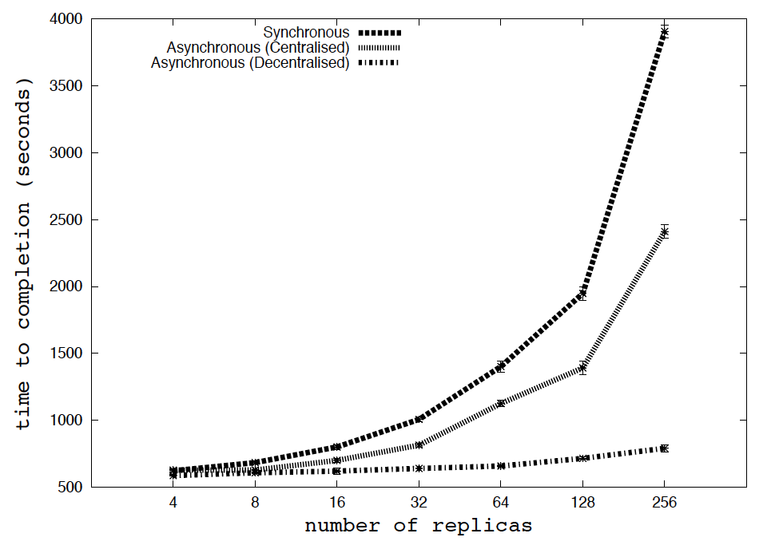
RE Algorithms at Scale (TeraGrid) Understand Algorithms at Scale on Azure?

Slide 23
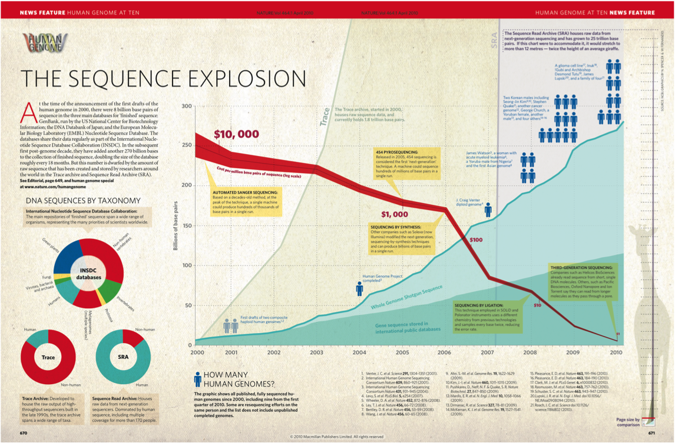
Application Exemplar II: NGS Analytics

Slide 24
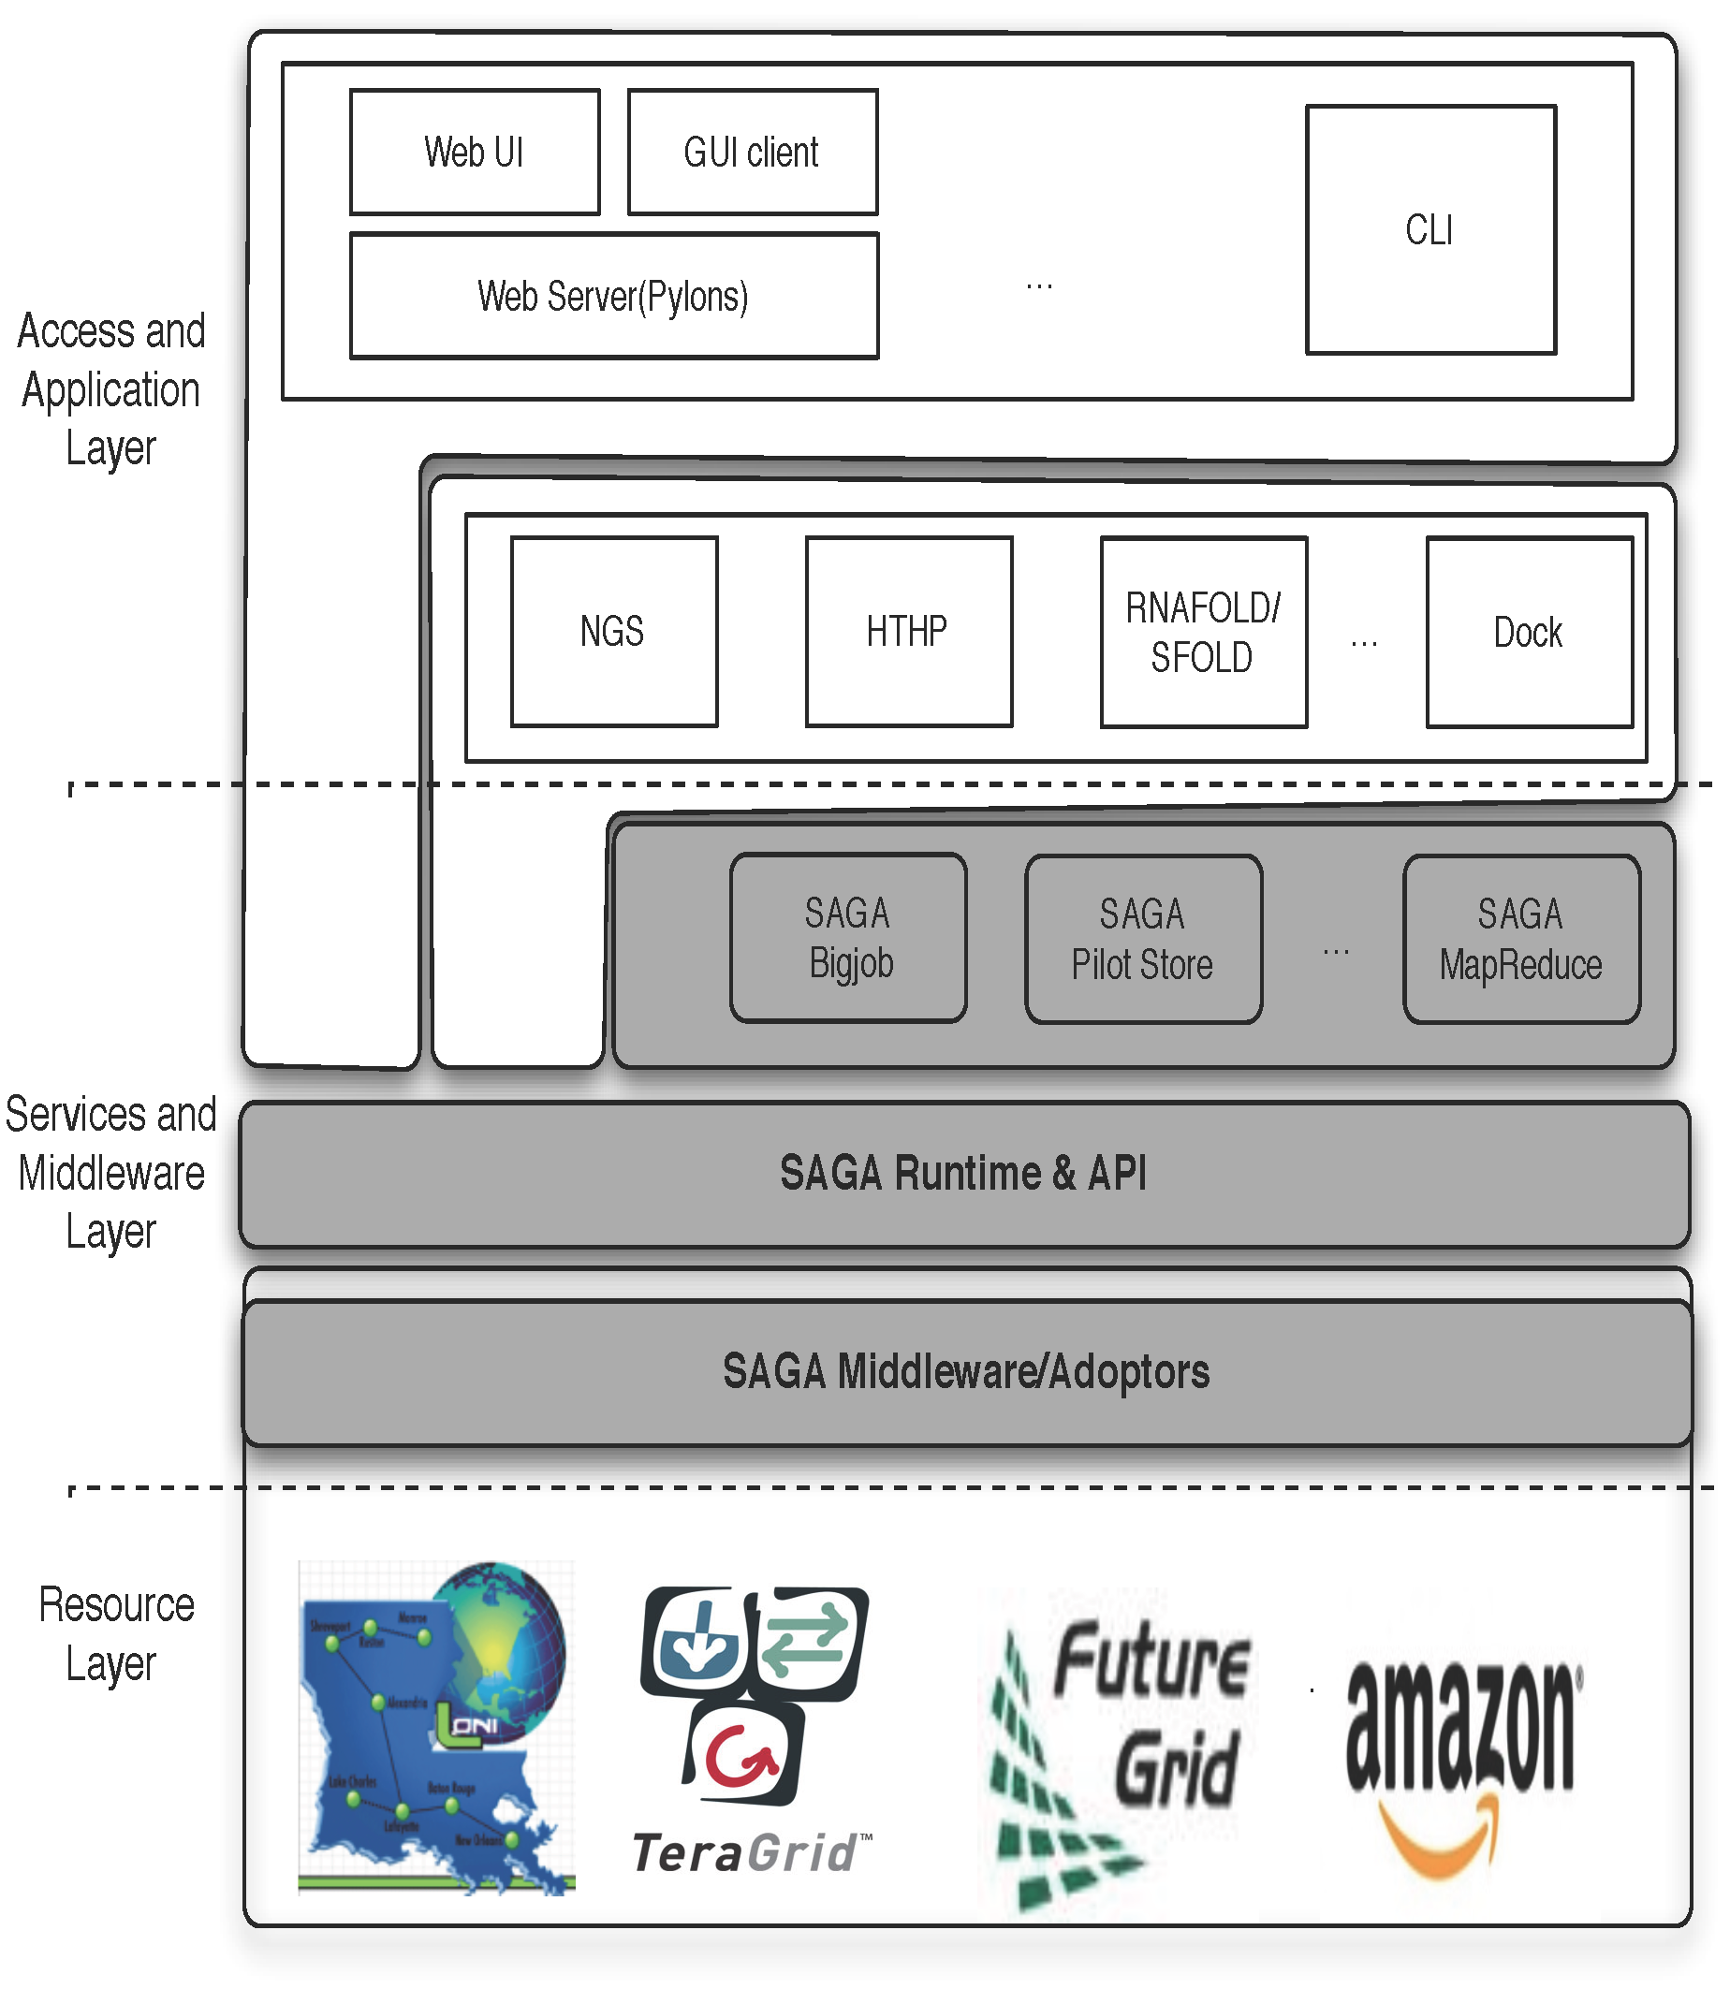

DARE
Notes:
Fixed the diagram.. Please remove next slide if you are OK with this

Slide 25
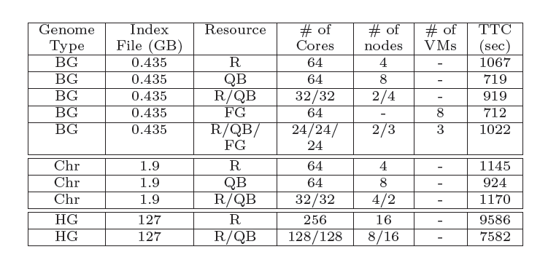
Task-level Concurrency and Scale-out
Notes:
(JK) Here, upper two tables represent the benefits of task level concurrency and scale-out strategy

Slide 26
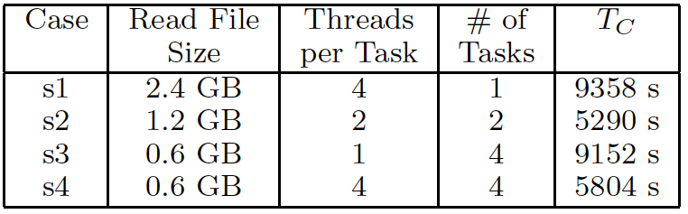
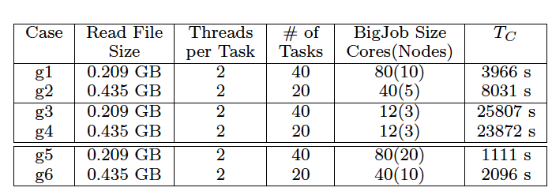
DARE-NGS : Mapping on Scalable Distributed HPC resources
Notes:
This will be very hard to read!

Slide 27
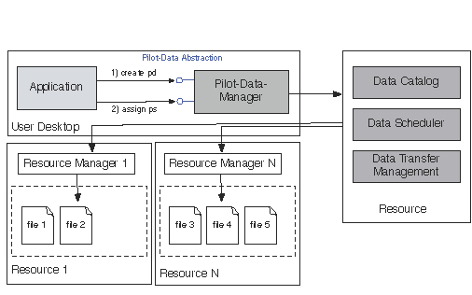
Extending the Pilot-* to Data

Slide 28
Providing NGS Analytics as a Service: Data Challenges
Challenges and Ongoing investigation
Distributed data management
Data transfer of Reference genome index files : HG18 : 130 GB, B.Glumae :447 MB
Data transfer of Short read files : e.g. 9 GB (about 2 min from local to QB using GridFTP)
Data Transfer (130 GB)
protocol | Local -> QB | Local -> Ranger | QB -> Ranger
SCP | 33 MB/s (1 h) | 1.8 MB/s (20 h) | 1 MB/s (36 h)
GridFTP | 70 MB/s (0.5 h) | 6.8 MB/s (5.3 h) | 25 MB/s (1.4 h)

Slide 29
Conclusions
Relative Ease of implementation of the R-E Pattern
Thanks to combination of appropriate system-level abstractions (AQS) and user provided abstractions (BigJob)
“Trivially use distributed resources”
Performance comparable to TG
Cost of virtualization not a first order concern
Efficient and scalable messaging
Starting point for more sophistication implementations
Affinity becomes more fine-grained, data-compute affinity
Extensions to abstractions for dynamic data
NGS Analytics present different challenges

Slide 30
Conclusions (Points to cover)
Dynamic Scalabilty:
Queuing System – no need to (Intelligent PilotJob)
Dynamic: (Resource) Elasticity/Cloudburst + (heterogeneous) task-resource mapping
Dynamic MapReduce: MR + Pilot-Job
Abstractions: Programming + System/Infrastructure
“Black Box” – something in between a black box and full-blown low-level programming: Keep the black-box model but with some-useful knobs (abstractions)
““Builiding this infrastructure is not trivial” & “TeraGrid is not used for data-intensive applications”
There are “easy” parts and “hard” parts.
SAGA handles the hard part, leaving you to do the easy part!
NGS Analytics (both Alignment + Assembly)
BigData consistent with the AMPLab definition

Slide 31
Marty Humphrey’s “List of Issues”
Data sharing/reuse policy
Task granularity/coding
Task synchronization (eg MPI) or something else?
Data storage mechanisms

Slide 32
Futuregrid Acknowledgement
This document was developed with support from the National Science Foundation (NSF) under Grant No.0910812 to Indiana University for "FutureGrid: AnExperimental, High-Performance Grid Test-bed." Any opinions, findings, and conclusions or recommendationsexpressed in this material are those of the author(s)and do not necessarily re ect the views

Slide 33
Distributed Computing: Solution or Complexity?
Task Level Concurrency and Scale-Out
Compute System | # of cores | # of tasks | Task Concurrency | Bfast (mapping)
Workstation | 4 | 8 | No | ≈18 h
Ranger | 64 | 4 | Yes | 6.5 h
Ranger | 128 | 8 | Yes | 3.4 h
Ranger | 256 | 16 | Yes | 1.95 h
Case | HPC System | # of cores | Bfast (mapping)
I | QB | 256 | 2.66 h
II | Ranger | 128 | 2.11 h
 | QB | 128
Read Data
(12 GB)
Reference Genome
I
II
Notes:
(JK) Here, upper two tables represent the benefits of task level concurrency and scale-out strategy

Slide 34
DARE-NGS : Mapping on Scalable Distributed HPC resources
The Importance of Dynamic execution utilizing the information about target species, NGS protocol, multi-core, cluster environment, disk space, memory, and available task level parallelism
Single Machine
HPC cluster with BigJob
Case | Read File Size(GB) | # of Task | Threads/task | Bfast (Mapping)
s1 | 2.4 | 1 | 4 | 2.6
s2 | 1.2 | 2 | 2 | 1.5
s3 | 0.6 | 4 | 1 | 2.5
s4 | 0.6 | 4 | 4 | 1.6
Case | Read File Size (GB) | # of Task | BigJob size | Bfast (Mapping)
g1 | 0.21 | 40 | 80 | 1.1
g2 | 0.44 | 20 | 40 | 2.2
g3 | 0.21 | 40 | 12 | 7.2
g4 | 0.44 | 20 | 12 | 6.6
Notes:
This will be very hard to read!

Slide 35
Azure: Scalability with Simplicity Providing Infra-level abstractions for DDIA
NAMD Performance on Azure
Three types of storage abstractions:
Azure Blob Service: Large amounts of raw data
Block Blob: Large chunks of 5GB
Page Blob: Mange storage as an array
Azure Table Storage: Semi-structured data
Azure Queue Storage: Message Queues
All three replicated and with strong consistency semantics
Current affinity operates at the data-center level;
Enhanced/finer-grained affinity to be made available
Azure Network Performance

Slide 36
Data -- Challenges
Challenges and Ongoing investigation
Distributed data management
Data transfer of Reference genome index files : HG18 : 130 GB, B.Glumae :447 MB
Data transfer of Short read files : e.g. 9 GB (about 2 min from local to QB using GridFTP)
Data Transfer (130 GB)
protocol | Local -> QB | Local -> Ranger | QB -> Ranger
SCP | 33 MB/s (1 h) | 1.8 MB/s (20 h) | 1 MB/s (36 h)
GridFTP | 70 MB/s (0.5 h) | 6.8 MB/s (5.3 h) | 25 MB/s (1.4 h)

