Slide 1

DARE-NGS: Scalable and Extensible NGS Analytics on High-Performance and Distributed CI
http://dare.cct.lsu.edu/ and http://saga.cct.lsu.edu
Joohyun Kim, Sharath Maddineni, Shantenu Jha
and
Christopher Gissendanner Department of Biology, University of Louisiana at Monroe
Notes:
Added slide 3
I think there will not be time to focus on “assertion based” approach, i.e slides 4-7. Possibly include slide 8

Slide 2
Overview
Introduction: DARE-based Gateways (GW)
GW: Effective integration of HPDC CI and LS
What is DARE? Global Overview
DARE-NGS GW
Scalability – Applications, People and Resources
DARE-HTHP Power of Abstractions!!
DARE-NGS: Collaborative Science-CI development [Chris[
DARE-NGS: Demo [Sharath]
Roadmap

Slide 3
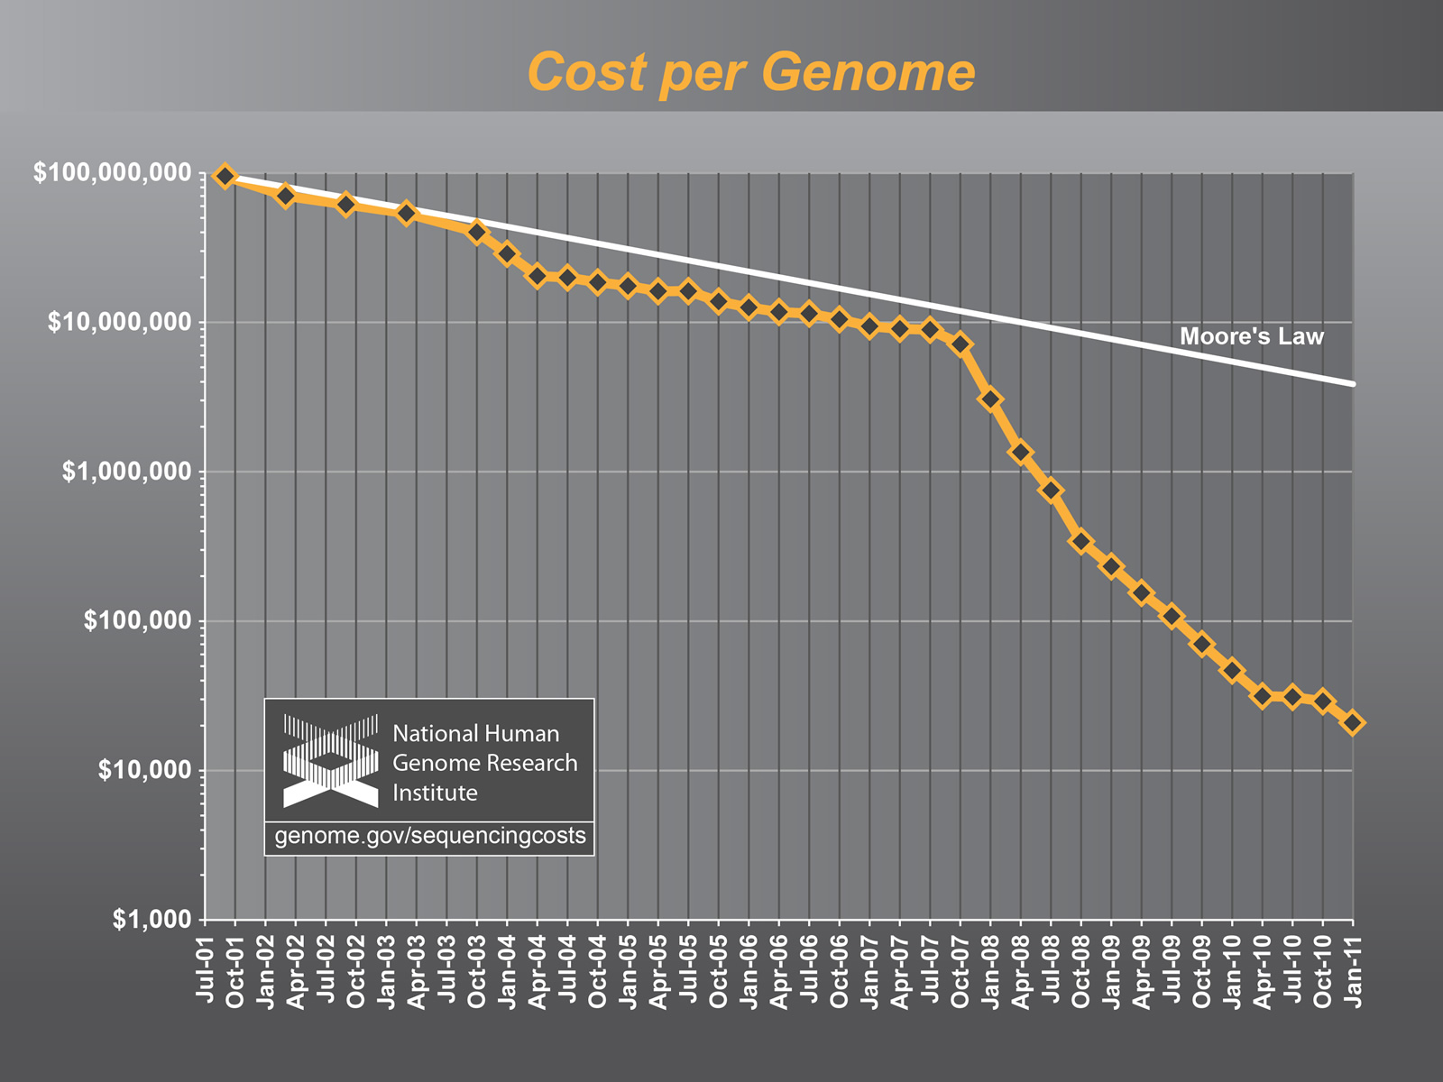
The case for Advanced, Scalable and Extensible NGS Analytics
“There is a growing gap between the generation of massively parallel
sequencing output and the ability to process and analyze the resulting data. New users are left to navigate a bewildering maze of base calling, alignment, assembly and analysis tools with often incomplete documentation and no idea how to compare and validate their outputs. Bridging this gap is essential, or the coveted $1,000
genome will come with a $20,000 analysis price tag."

Slide 4
Why do we need HPDC and Gateways?
Observation I
Using local compute resources and data storage is too limited.
Observation II
Users need a pathway from local to National CI
Need for Campus Bridging
Observation III
Using Supercomputers or HPC resources is difficult and complex
Gateways: “Community-based” Solution
“Expert” configure, optimize once: Multiple users/usage
Hiding the complexity of using distributed HPC resources and emerging cloud environment.
Gateways: fastest growing access mode/mechanism on XSEDE

Slide 5
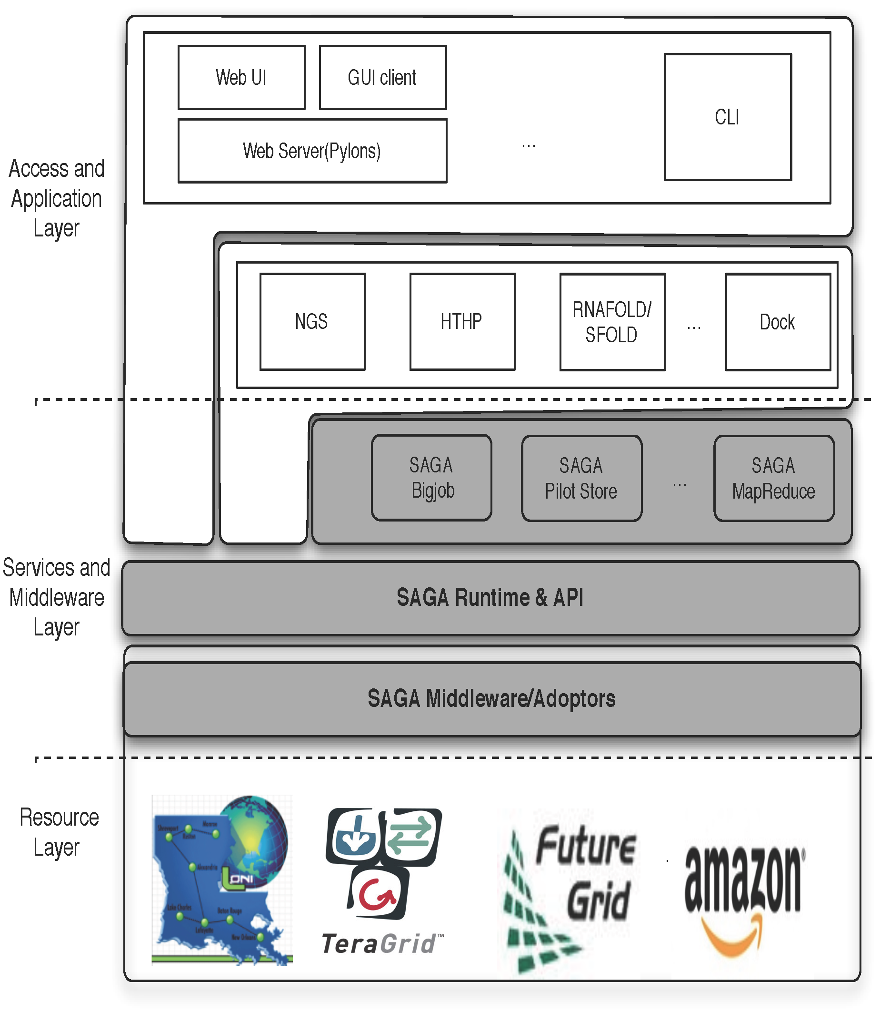
DARE-based Science Gateways (I)
Three levels:
Access/Application Layer
Services & MW Layer
Resource Layer
Application/Access Layer
Extensible and flexible
Standard-based middleware and services
OGF Standard and official access layer of NSF XSEDE
Resource Level
Horizontal Integration
Notes:
Fixed the diagram.. Please remove next slide if you are OK with this

Slide 6
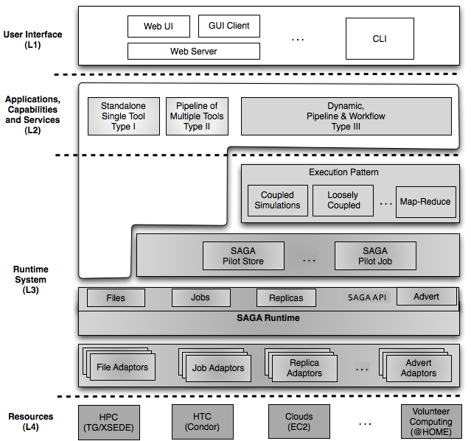
DARE-based NGS Gateways (II)
NGS is a good science application for Gateways
Plethora of tools, integration needs etc.
Complex data requirements
Integrated compute and data abstractions
Interoperable across DCI
Extensible: frameworks, abstractions and features
Notes:
Fixed the diagram.. Please remove next slide if you are OK with this

Slide 7
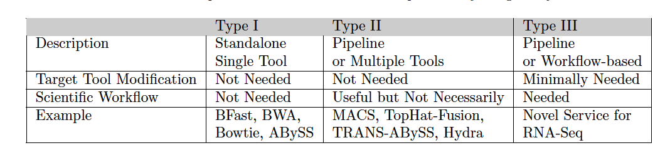
DARE-NGS : Service Types
Notes:
This will be very hard to read!

Slide 8
NGS Analytics as a Service: DARE-based Gateway on XD
Some NGS specific challenges
Efficient Algorithm/tool/code selection
Hosting pre-installed VM
Efficient task scheduling and placement
Efficient Distributed data management
Efficient Data transfer/scheduling
Transfer of Ref. genome index files:
O(hours) 130 GB,
Transfer of Short read files:
O(mins) [L to QB] 9 GB
Determine optimal point -- tradeoff
http://dare.cct.lsu.edu/gateways/ngs

Slide 9
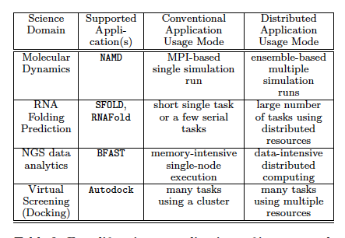
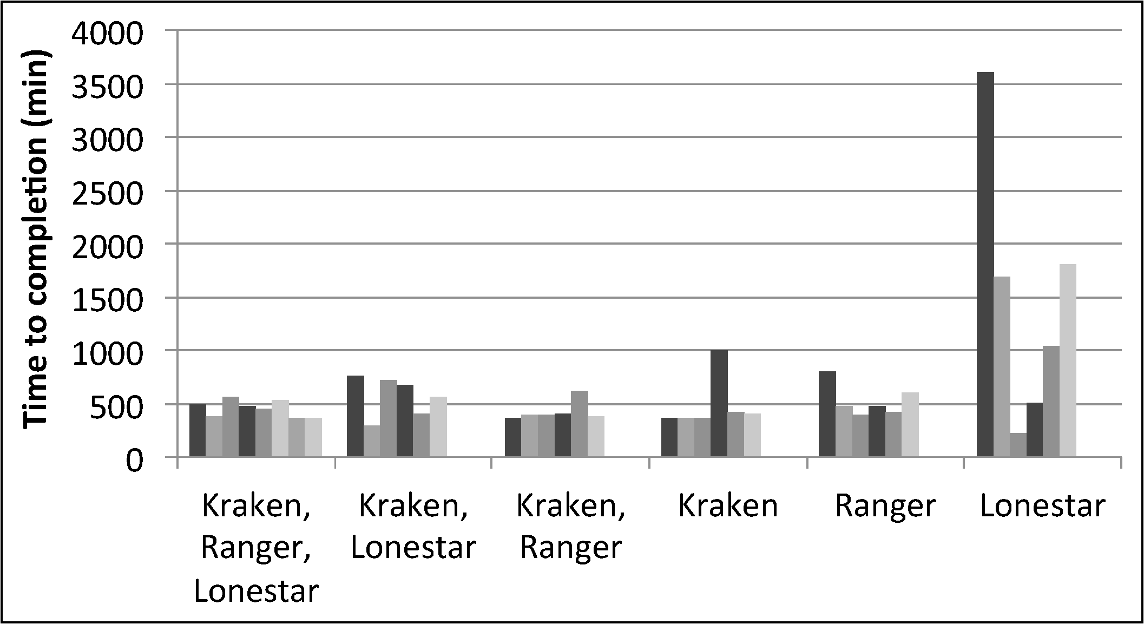
DARE-HTHP: Power of Abstractions
Work with Tom Bishop (La Tech) et al

Slide 10
DARE-NGS : NGS-Analytics and Downstream Analyses
Overview - Computational/Bioinformatics Strategies for Genomic Data Analysis
WGS, CHIP-Seq, RNA-Seq:
Billions Short Reads
Mapping
De Novo Assembly
Whole Genome Analysis (WGS)
Exome Analysis
Transcriptome Analysis
(RNA-seq)
Genome-wide DNA-protein interactions
(ChIP-seq)
Functional Genomics, Gene Regulation, Pathway Analysis – Cell Development & Differentiation, Host-Pathogen interaction, Biomedical research
Notes:
SJ: Color coding is a bit misleading. Does purple (right sight, lower level) represent analysis? If so, be sure to say so

Slide 11
DARE-NGS : Scientific Collaborative Development
RNA-Seq : Transcriptome Analysis of Burkitt’s Lymphoma cells and lincRNAs Discovery (Tulane U)
Exome : Large Scale Human Exome (PBRC)
DARE-NGS : NGS Data Analysis Gateway Development
Genome-wide Transcription Factor Binding : ULM
Host-Pathogen Interaction (Rice-B. Glumae) : LSU, AgCenter
Notes:
SJ: Something more structured than this is preferable. I still think this is getting too long. There will be other people talking about NGS and we will be the last
To talk about NGS, so a lot of this will be covered. We should give no more than 3-5min motivation.

Slide 12
DARE-NGS : Scientific Collaborative Development
Transcriptome Analysis of Burkitt’s Lymphoma cells and lincRNAs Discovery
PI : Erik Flamington (Tulane U)/Carl (Tulane GCF)
Focus : RNA-Seq using Tophat/Cufflink, Tophat-fusion
Exome Analysis
PI : Tuomo Rankinen (HGL, PBRC)/PBRC GCF
Focus : Large Scale Mapping and Genome Variation Discovery
Genome-wide (C. elegans) Transcription Factor (NHR-6) Binding
PI : Chris Gissendanner (ULM) (LBRN PI)
Focus : ChIP-seq Pipeline Development
Rice-B.Glumae (Host-Pathogen)
PI : Jong-hyun Ham (AgCener, LSU)
Focus : Host-pathogen Interaction using RNA-Seq, Integrative Infrastructure for Drug Discovery targeting Quorum-Sensing Mechanism
Notes:
SJ: Something more structured than this is preferable. I still think this is getting too long. There will be other people talking about NGS and we will be the last
To talk about NGS, so a lot of this will be covered. We should give no more than 3-5min motivation.

Slide 13
DARE-NGS:
ChIP-Seq pipeline
: Data processing
: Databases
Mapping
Peak Calling
Mapping
With BFAST &
HPC
Other Peak Caller
Mapping
Using Cloud

Slide 14
Time Line | Oct 2011 - Jan 2012 | Jan 2012 - Mar 2012 | Apr 2012 - June 2012 | July 2012 - Sep 2012
User Community | Gissendanner Lab (LBRN PI) Ham (LSU) | Flemington (Tul/LONI) Rankinen (PBRC) All LBRN-PI Other LONI-PIs | XSEDE-GW
Devel Focus | Accounting with HPC | RNA-Seq pipeline | Community Engagement More alternative tool Integratio | Type III service development XSEDE Resource Integration

Slide 15
The HPDC Challenges for NGS Analytics?
What is the physical infrastructure configuration?
No well-defined single infrastructure configuration or capabilities
Distinguish: Astronomy, HEP community
Integrated Compute and Data CI
“Building this infrastructure is not trivial”
Need both Development and System/Infrastructure level abstractions
There are “hard” parts and tractable parts
Use of standards and middleware integrated with resources handles the hard part, opening up innovation elsewhere
“Clouds are the natural CI for NGS” !?
Data localization model scalable? sustainable?
How and when to move compute to data (or vice-versa)?
What are the data transfer/access/storage mechanisms

Slide 16
Conclusions
NGS Analytics: Unique challenge and scale of compute and data intensive
DARE-based Gateway:
Need for community (provided) solution
Brings Application Scientists/UI, Middleware and HPC Resource Providers together
Scalable Solution:
Application Scenarios
NGS (Type I, II, and III) and HTHP (Molecular Dynamics)
Over Infrastructure
Campus, LONI, Clouds, XSEDE and other production DCI
Challenges remain in the scalable provisioning
What are the CI challenges of NGS Analytics?
Exploring HTC, HPC-grids and Clouds

Slide 17
Acknowledgements
LBRN NIH Grant Number P20RR016456
Sharath Maddineni and Mark Santcroos
LSU CCT
HPCOPS NSF-OCI 0710874 and Cybertools project http://cybertools .loni.org NSF/LEQSF (2007-10)-CyberRII-01
NSF Awards Grant No. 0910812, ``FutureGrid: An Experimental, High-Performance Grid Test-bed’’ (Fox, Indiana)
SAGA team – Ole Weidner and Andre Merzky and TeraGrid/XSEDE Staff for support with deployment and integration

Slide 18
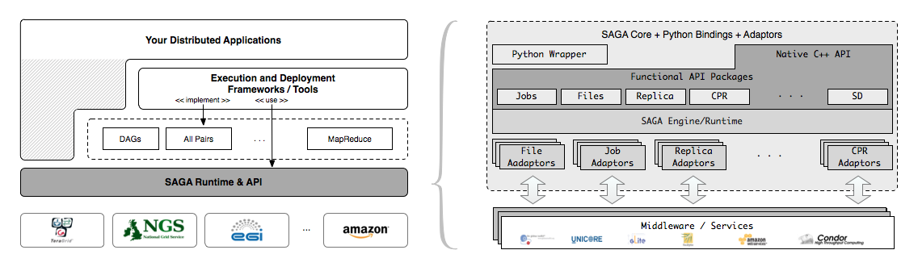
SAGA – An Overview
Simple, integrated, stable, uniform and community-standard
Simple and Stable: 80:20 restricted scope
Integrated: Similar semantics & style across primary functional areas
Uniform: Same interface for different distributed systems
The building blocks upon which to construct “consistent” higher-levels of functionality and abstractions
OGF-standard, “official” Access Layer/API of EGI, NSF-XD

Slide 19

XSEDE Technology Insertion Service

Slide 20
What is XSEDE?
XSEDE is the follow-on to TeraGrid and is the virtual organization of 17 institutions/120 FTE providing services and support for the users of NSF-OCI’s computational science resources.
CMS – coordination and management services
architecture, software integration, systems engineering, operations, allocations, project mgmt
ECSS – extended collaborative support services
TEOS – training, education, and outreach services
5-year award started July 1, 2011

