Slide 1



Introduction to the SAGA API

Slide 2
Outline
SAGA Standardization
API Structure and Scope
API Walkthrough
SAGA SoftwareComponents
C++ API bindings
Python API bindings
[ Java API bindings ]
Adaptors (backend connect)
Command Line Tools

Slide 3
SAGA: Teaser
// SAGA: File Management example
#include <saga/saga.hpp>
int main ()
{
saga::filesystem::directory dir ("any://remote.host.net//data/");
if ( dir.exists ("a") && ! dir.is_dir ("a") )
{
dir.copy ("a", "b", saga::filesystem::Overwrite);
}
list <saga::url> names = dir.find ("*-{123}.txt");
saga::filesystem::directory tmp = dir.open_dir ("tmp/", saga::fs::Create);
saga::filesystem::file file = dir.open ("tmp/data.txt");
return 0;
}

Slide 4
Grid APIs: some observations
diversity of (Grid) middleware implies diversity of APIs
middleware APIs are often a by-product
APIs are difficult to sync with middleware development, and to stay simple
successful APIs generalize programming concepts
MPI, CORBA, COM, RPC, PVM, SSH, …
no new API standards for distributed computing
!standard: Globus, gLite, Unicore, Condor, iRods, …

Slide 5
Open Grid Forum (OGF)
The Open Grid Forum (aka GF, EGF, GGF, EGA) standardizes distributed computing infrastructures/MW
e.g. gridFTP, JSDL, OCCI, …
focuses on interfaces, but also protocols, architectures, APIs
driven by academia, but some buy-in / acceptance in industry
cooperation with SDOs like SNIA, DMTF, IETF, etc.

Slide 6
APIs within OGF
OGF focuses on services
numerous service interfaces
often WS-based, but also REST, others
some effort on higher level APIs
Distributed Resource Management Application API (DRMAA)
Remote Procedure Calls (GridRPC)
Checkpoint and Recovery (GridCPR)
[ Job Submission and Description Language (JSDL) ]

Slide 7
OGF: DRMAA
implementable on all major resource management services
simple means to define and submit jobs
basic job management features (status, kill)
job templates for bulk job management
DRMAA.v2 is expected by end of 2010 (oops)
OO
extended
SAGA aligned !

Slide 8
DRMAA Example
drmaa_job_template_t * job_template;
if ( ! ( job_template = create_job_template (exe, 5, 0) ) )
{
fprintf (stderr, "create_job_template failed\n");
return 1;
}
while ( ( drmaa_errno = drmaa_run_job (job_id,
sizeof (jobid)-1,
job_template,
diagnosis,
sizeof (diagnosis)-1) )
== DRMAA_ERRNO_DRM_COMMUNICATION_FAILURE )
{
fprintf (stderr, "drmaa_run_job failed: %s\n", diagnosis);
sleep (1);
}

Slide 9
OGF: GridRPC
standardizes the three existing RPC implementations for Grids (Ninf-G, DIET)
example of ’gridified API’
simple: get function handle, call function
explicit support for asynchronous method calls
GridRPC.v2 adds support for remote persistent data handles
SAGA aligned !

Slide 10
OGF: GridRPC
double A[N*N], B[N*N], C[N*N];
initMatA (N, A);
initMatB (N, B);
grpc_initialize (argv[1]);
grpc_function_handle_t handle;
grpc_function_handle_default (&handle, "mat_mult");
if ( grpc_call (&handle, N, A, B, C) != GRPC_NO_ERROR )
{
exit (1);
}
grpc_function_handle_destruct (&handle);
grpc_finalize ();

Slide 11
OGF: GridCPR (Checkpoint & Recovery)
Grids seem to favor application level checkpointing
GridCPR
allows to manage checkpoints
defines an architecture, service interfaces, and scope of client API
SAGA aligned !
not many implementations exist, usage declining
virtualized hardware makes CPR somewhat superfluous

Slide 12
OGF: JSDL
extensible XML based language for describing job requirements
does not cover resource description (on purpose) does not cover workflows, or job dependencies etc (on purpose)
JSDL is extensible (ParameterSweep, SPMD, ...)
top-down approach
SAGA leans on JSDL for job description
future revisions of SAGA will support JSDL directly

Slide 13
OGF: JSDL
<jsdl:JobDefinition>
<JobDescription>
<Application>
<jsdl-posix:POSIXApplication>
<Executable>/bin/date</Executable>
</jsdl-posix:POSIXApplication>
</Application>
<Resources ...>
<OperatingSystem>
<OperatingSystemType>
<OperatingSystemName>LINUX</OperatingSystemName>
</OperatingSystemType>
</OperatingSystem>
</Resources>
</JobDescription>
<jsdl:JobDefinition>

Slide 14
OGF: Summary
some high-level API specs exist in OGF, and are successful
OGF APIs do not cover the complete OGF scope
the various API standards are disjoint
WSDL as service interface specification cannot replace an application level API (wrong level of abstraction)
SAGA tries to address these issues

Slide 15
SAGA Design Principles
SAGA: Simple API for Grid Applications
OGF approach to a uniform API layer (facade)
top-down approach
use case driven!
defines application level abstractions
governing principle: 80:20 rule
simplicity versus control!
extensible
stable look & feel
API packages
API Specification is language independent (IDL)
Renderings exist in C++, Python, Java
focus today on C++ or Python

Slide 16
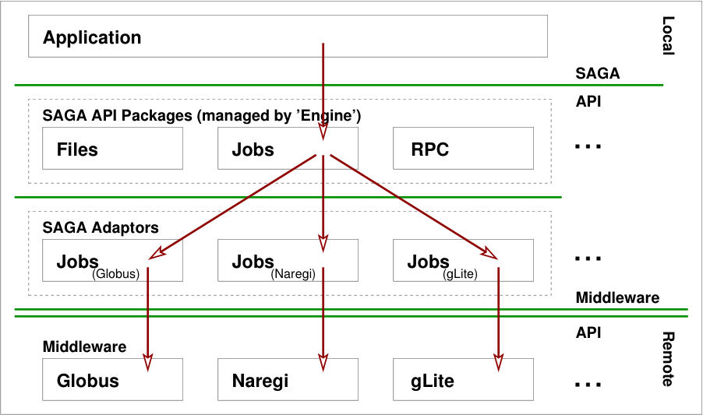
Implementation

Slide 17
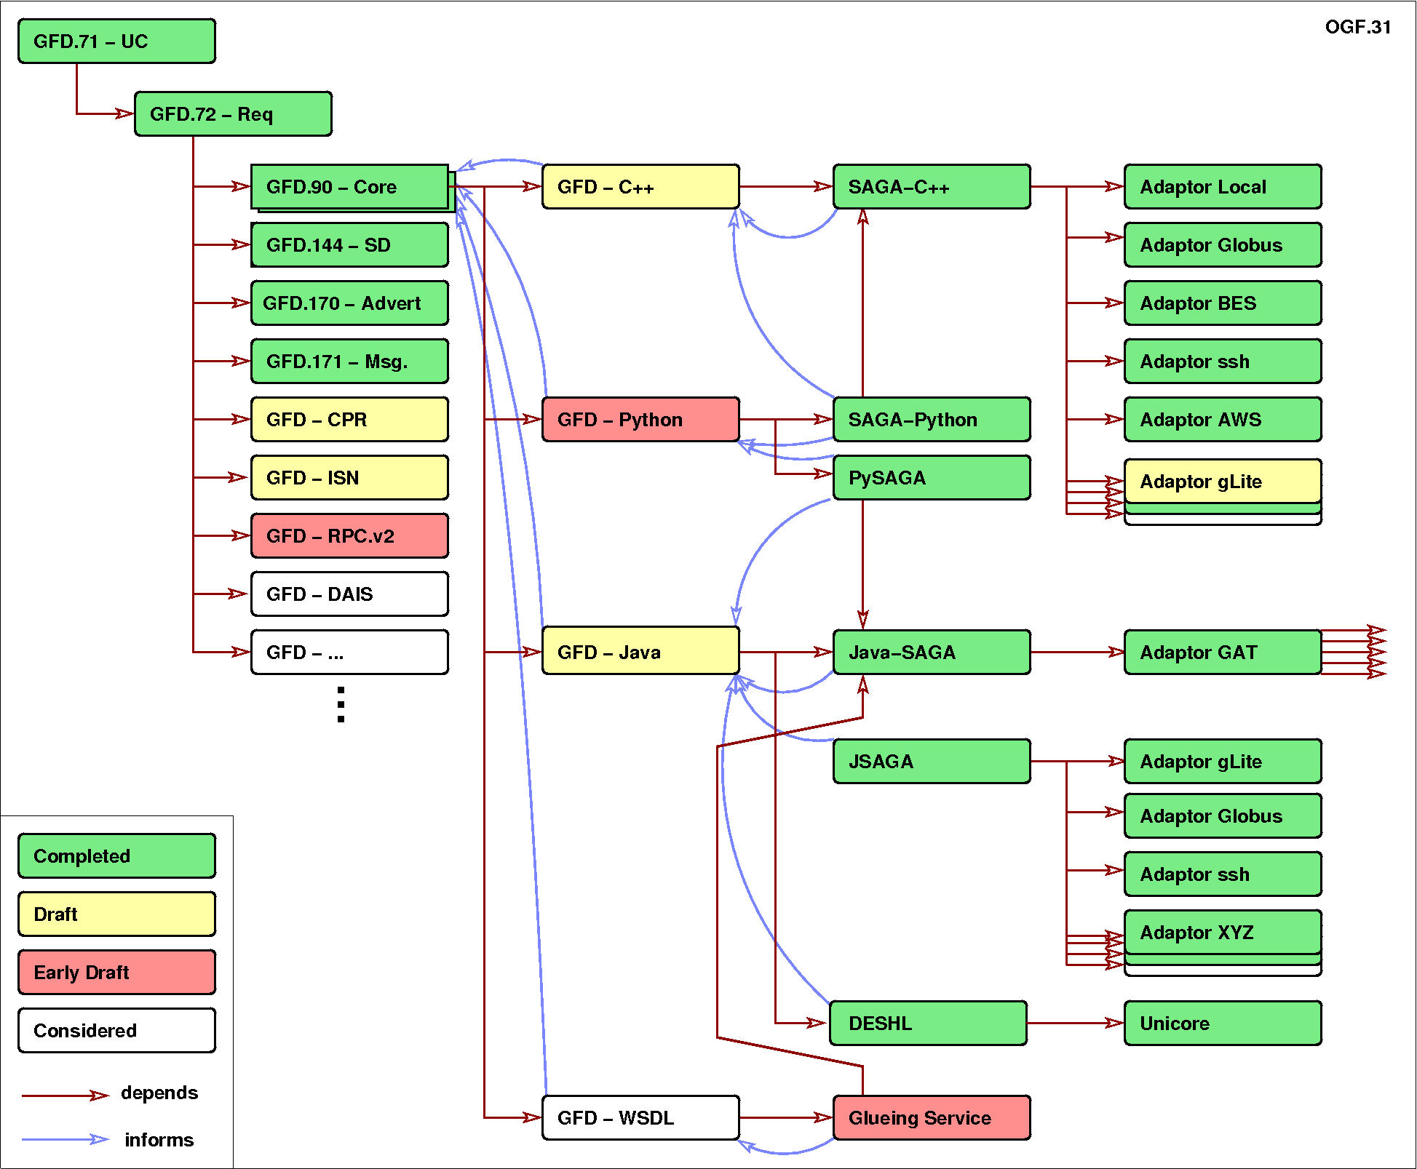
SAGA API Landscape

Slide 18
SAGA Intro: Example 1
// SAGA: File Management example
saga::filesystem::directory dir ("any://remote.host.net//data/");
if ( dir.exists ("a") && ! dir.is_dir ("a") )
{
dir.copy ("a", "b", Overwrite);
}
list <saga::url> names = dir.find ("*-{123}.txt");
saga::filesystem::directory tmp = dir.open_dir ("tmp/", Create);
saga::filesystem::file file = dir.open ("tmp/data.txt");

Slide 19
SAGA Intro: Example 1
API is clearly POSIX (libc + shell) inspired
where is my security??
what is ’any://’ ???
usage should be intuitive (hopefully)

Slide 20
SAGA Intro: Example 2
// SAGA: Job Submission example
saga::job::description jd;
// details left out
saga::job::service js ("any://remote.host.net/");
saga::job::job j = js.create_job (jd);
j.run ();
cout << "Job State: " << j.get_state () << endl;
j.wait ();
cout << "Retval " << j.get_attribute ("ExitCode") << endl;

Slide 21
SAGA Intro: Example 2’
// SAGA: Job Submission example
saga::job::service js ("any://remote.host.net");
saga::job::job j = js.run_job ("touch /tmp/touch.me");
cout << "Job State: " << j.get_state () << endl;
j.wait ();
cout << "Retval " << j.get_attribute ("ExitCode") << endl;

Slide 22
SAGA Intro: Example 2
stateful objects!
yet another job description language? :-(
many hidden/default parameters
keeps call signatures small
’any://’ again!
TIMTOWTDI (there is more than one way to do it)

Slide 23
SAGA Intro: 10.000 feet
object oriented:
uses inheritance and interfaces
very moderate use of templates though!
functional and non-functional elements strictly separated
functional API:
typically mappable to remote operations
ordered in API ’Packages’: extensible
non-functional API:
typically not mappable to explicit remote operations
“look & feel”: orthogonal to functional API
security, asynchronous ops, notifications, ...
few inter-package dependencies - allows for partial implementations

Slide 24
SAGA Class Hierarchy

Slide 25
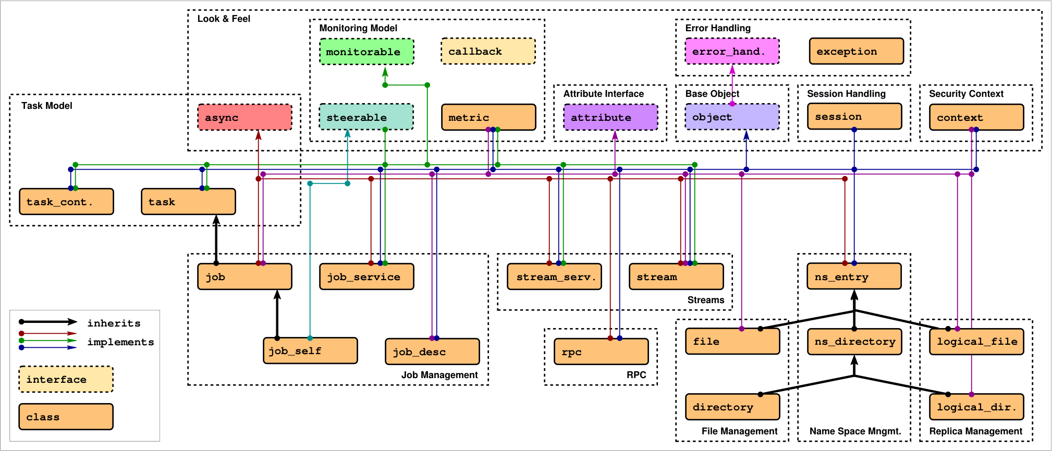
SAGA: Class hierarchy

Slide 26
SAGA: Class hierarchy
Functional API Packages

Slide 27
SAGA Job Package: Overview
running jobs is use case #1
all middlewares support it, one way or the other
well established patterns exist
job description
job state
submission endpoint
...

Slide 28
SAGA Job Package: Example 1
saga::job::description jd;
saga::job::service js ("gram://remote.host.net");
saga::job j = js.create_job (jd);
j.run ();
cout << "Job State: " << j.get_state () << endl;
j.wait ();
cout << "Retval " << j.get_attribute ("ExitCode") << endl;

Slide 29
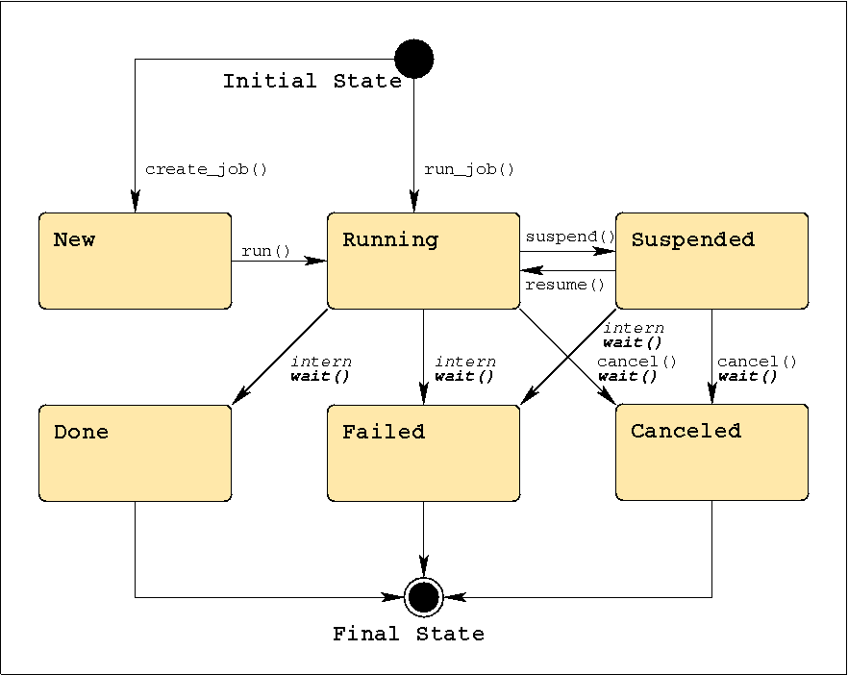
SAGA Job Package: job states

Slide 30
SAGA Job Package: job operations
j.run ();
j.wait ();
j.cancel ();
j.suspend ();
j.resume ();
j.signal (SIGUSR1);
j.checkpoint ();
j.migrate (jd);

Slide 31
SAGA Job Package: job description
saga::job::description jd;
jd.set_attribute ("Executable", "/bin/tail");
jd.set_attribute ("WorkingDirectory", "data/");
jd.set_attribute ("Cleanup", "False");
// pseudo code *blush*
jd.set_vector_attribute ("Arguments", ["-f", "my_log"]);
jd.set_vector_attribute ("Environment", ["TMPDIR=/tmp/"]);
jd.set_vector_attribute ("FileTransfer", ["my_log >> all_logs"]);

Slide 32
SAGA Job Package: job description
Executable Arguments Environment
CandidateHosts SPMDVariation TotalCPUCount
NumberOfProcesses ProcessesPerHost ThreadsPerProcess
WorkingDirectory Interactive Cleanup
Input Output Error
JobStartTime WallTimeLimit TotalCPUTime
TotalPhysicalMemory CPUArchitecture OperatingSystemType
Queue JobProject JobContact
FileTransfer

Slide 33
SAGA Job Package: job description
leaning heavily on JSDL, but flat
borrowing from DRMAA
mixes hardware, software and scheduling attributes!
cannot be extended
no support for 'native' job descriptions (RSL, JDL, ...)
only 'Executable’ is required
backend MAY ignore unsupported keys
cd /tmp/data && rm -rf *

Slide 34
SAGA Job Package: job service
saga::job::service js ("gram://remote.host.net/");
vector <string> ids = js.list (); // list known jobs
while ( ids.size () )
{
string id = ids.pop_back (); // fetch one job id
saga::job j = js.get_job (id); // reconnect to job
cout << id << " : " << j.get_state () << endl;
}

Slide 35
SAGA Job Package: job service
represents a specific job submission endpoint
job states are maintained on that endpoint (usually)
full reconnect may not be possible (I/O streaming)
lifetime of state up to backend
reconnected jobs may have different job description (lossy translation)

Slide 36
SAGA Namespace Package
interfaces for managing entities in name spaces
files, replicas, information, resources, steering parameter, checkpoints, . . .
manages hierarchy (mkdir, cd, ls, . . . )
entries are assumed to be opaque (copy, move, delete, ...)

Slide 37
SAGA Namespace Package: example
saga::name_space::directory d ("ssh://remote.host.net//data/");
if ( d.is_entry ("a") && ! d.is_dir ("a") )
{
d.copy ("a", "../b");
d.link ("../b", "a", Overwrite);
}
list <saga::url> names = d.find ("*-{123}.text.");
saga::name_space::directory tmp = d.open_dir ("tmp/data/1",
saga::name_space::CreateParents);
saga::name_space::entry data = tmp.open ("data.txt");
data.copy ("data.bak", Overwrite); // uses cwd

Slide 38
SAGA Namespace Package
name space entries are opaque: the name space package can never look inside
directories are entries (inheritance)
inspection: get_cwd(), get_url(), get_name(), exists(), is_entry(), is_dir(), is_link(), read_link()
manipulation: create(), copy(), link(), move(), remove()
permissions: permissions_allow(), permissions_deny()
wildcards are supported (POSIX influence...)

Slide 39
SAGA Filesystem Package
implements name space interface
adds access to content of namespace::entries (files)
POSIX oriented: read(), write(), seek()
optimizations: for distributed file access:
scattered I/O
pattern based I/O
extended I/O (from GridFTP)

Slide 40
SAGA Filesystem Package: Example
saga::filesystem::file f ("any://remote.host.net/data/data.bin");
char mem[1024];
saga::mutable_buffer buf (mem);
if ( f.get_size () >= 1024 )
{
buf.set_data (mem + 0, 512);
f.seek (512, saga::filesystem::Start);
f.read (buf);
}
if ( f.get_size () >= 512 )
{
buf.set_data (mem + 512, 512);
f.seek (0, saga::filesystem::Start);
f.read (buf);
}

Slide 41
SAGA Filesystem Package
provides access to the content of filesystem entries (sequence of bytes)
saga buffers are used to wrap raw memory buffers
saga buffers can be allocated/managed by the SAGA implementation
several incarnations of read/write: posix style, scattered, pattern based

Slide 42
SAGA Filesystem Package: Flags
enum flags {
None = 0,
Overwrite = 1,
Recursive = 2,
Dereference = 4,
Create = 8,
Exclusive = 16,
Lock = 32,
CreateParents = 64,
Truncate = 128, // not on name_space
Append = 256, // not on name_space
Read = 512,
Write = 1024,
ReadWrite = 1536, // Read | Write
Binary = 2048 // only on filesystem
}

Slide 43
SAGA Advert Package
persistent storage of application level information
semantics of information defined by application
allows storage of serialized SAGA objects (object persistency)
very useful for bootstrapping and coordinating distributed application components

Slide 44
SAGA Advert Package: Example
// example for browing my task adverts
saga::advert::directory todo ("any//remote.host.net/my_tasks/");
// pseudo vector code
list <saga::url> urls = todo.find ("*", ["priority=urgent"]);
while ( urls.size () )
{
saga::advert ad (urls.pop_front ());
std::cout << ad.get_attribute ("title") << std::endl;
std::cout << ad.get_attribute (« deadline") << std::endl;
std::cout << ad.get_attribute ("description") << std::endl << std::endl;
}

Slide 45
SAGA Advert Package: Example
// master side code: advertise (publish) a saga::file instance
saga::file f (url);
saga::advert ad ("any//remote.host.net/files/my_file_ad", Create);
ad.store_object (f);
// client side code: retrieve file instance
saga::advert ad ("any//remote.host.net/files/my_file_ad");
saga::file f = ad.retrieve_object ();

Slide 46
SAGA: Class hierarchy
Look & Feel Packages

Slide 47
SAGA Session: Example – default session
saga::ns_dir dir ("any://remote.host.net//data/");
if ( dir.is_entry ("a") && ! dir.is_dir ("a") )
{
dir.copy ("a", "../b");
dir.link ("../b", "a", Overwrite);
}
list <saga::url> names = dir.find ("*-{123}.text.");
saga::name_space::directory sub = dir.open_dir ("tmp/");
saga::name_space::entry entry = dir.open ("data.txt");
entry.copy ("data.bak", Overwrite);

Slide 48
SAGA Session: Properties
by default hidden (default session is used)
session is identified by lifetime of security credentials, and by objects in this session (jobs etc.)
session is used on object creation (optional)
saga::context can attach security tokens to a session
the default session has default contexts

Slide 49
SAGA Session: Example – explicit session
saga::context c1 (saga::context::X509);
saga::context c2 (saga::context::X509);
c2.set_attribute ("UserProxy", "/tmp/x509up_u123.special");
saga::session s;
s.add_context (c1);
s.add_context (c2);
saga::name_space::dir dir (s, "any://remote.host.net/data/");

Slide 50
SAGA Session: Lifetime
saga::filesystem::file f;
{
saga::context c (saga::context::X509);
c.set_attribute ("UserProxy", "/tmp/x509up_u123.special");
saga::session s; s.add_context (c);
saga::filesystem::dir d (s, "gridftp://remote.host.net/data/");
s.remove_context (c1);
f = d.open (“a");
}
f.copy ("b"); // this works – session and context are sticky!

Slide 51
SAGA Session: Lifetime
// as a rule: don’t worry about object lifetime too much...
saga::session s;
saga::context c (saga::context::X509);
c.set_attribute ("UserProxy", "/tmp/x509up_u123.special");
s.add_context (c);
saga::filesystem::dir d (s, "gridftp://remote.host.net/data/");
saga::filesystem::file f = d.open (“a");
f.copy ("b");

Slide 52
SAGA Tasks
asyncronous operations are a MUST in distributed systems
saga::task represents an asyncronous operation (e.g. file.copy ())
saga::task_container manages multiple tasks
tasks are stateful (similar to jobs)

Slide 53
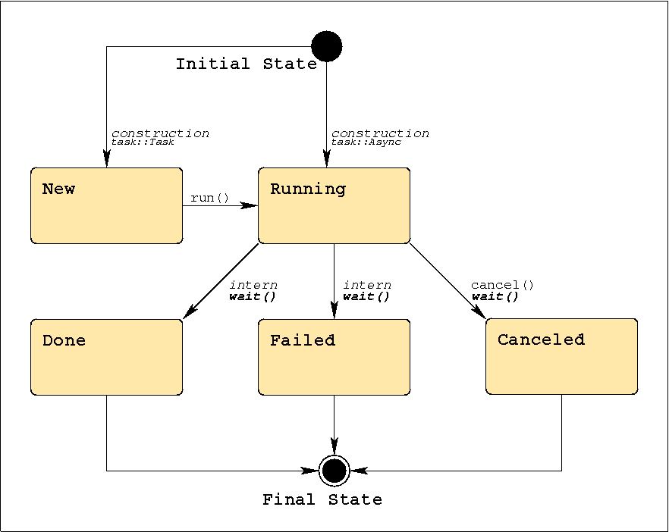
SAGA Tasks: States

Slide 54
SAGA Tasks
different versions for each method call: Sync, Async, Task
signature basically the same
differ in state of the task returned by that method
Sync: task is Done -> create () ; run () ; wait () ;
Async: task is Running -> create () ; run () ;
Task: task is New -> create () ;
delayed exception delivery
if ( saga::task::Failed == task.get_state () )
{
task.rethrow ();
}

Slide 55
SAGA Tasks
different versions for each method call: Sync, Async, Task
signature basically the same
differ in state of the task returned by that method
Sync: task is Done -> get_result ();
Async: task is Running -> wait(); get_result ();
Task: task is New -> run(); wait(); get_result ();
delayed exception delivery
if ( saga::task::Failed == task.get_state () )
{
task.rethrow ();
}

Slide 56
SAGA Task: Example
// normal method call, synchronous
/* void */ file.copy ("data.bak");
// async versions, never throw (use ’rethrow()’ on failure)
saga::task t1 = file.copy <saga::task::Sync> ("data.bak.1");
saga::task t2 = file.copy <saga::task::Async> ("data.bak.2");
saga::task t3 = file.copy <saga::task::Task> ("data.bak.3");
// t1: Done
// t2: Running
// t3: New
t3.run (); // t3 now Running, too
t2.wait ();
t3.wait ();
// t1, t2, t3 are final (Done or Failed)

Slide 57
SAGA Task: Example
// normal method call, synchronous
size_t s = file.get_size ();
// async versions, never throw (use ’rethrow()’ on failure)
saga::task t1 = file.get_size <saga::task::Sync> ();
saga::task t2 = file.get_size <saga::task::Async> ();
saga::task t3 = file.get_size <saga::task::Task> ();
// get_result: implies wait() and rethrow(), and thus can throw!
size_t s1 = t1.get_result <size_t> ();
size_t s2 = t2.get_result <size_t> ();
size_t s3 = t3.get_result <size_t> ();

Slide 58
SAGA Task Container: Example
// create task container
saga::task_container tc;
// add tasks
tc.add (t1);
tc.add (t2);
tc.add (t3);
// collective operations on all tasks in container
tc.run ();
saga::task done_task = tc.wait (saga::task::Any);
tc.wait (saga::task::All);

Slide 59
SAGA Task Container: Tasks and Jobs
// NOTE:
// class saga::job : public saga::task
// task container can thus manage tasks *and* jobs:
saga::task task = file.copy <saga::task::Async> ("b");
saga::job job = js.run_job ("remote.host.net", "/bin/date");
saga::task_container tc;
tc.add (task);
tc.add (job);
tc.wait (saga::task::All);

Slide 60
SAGA Task Container: Bulk Operations
saga::task_container tc;
tc.add (js.create_job (jd_1));
tc.add (js.create_job (jd_2));
tc.add (js.create_job (jd_3));
// ...
tc.add (js.create_job (jd_n));
tc.run ();
tc.wait (saga::task::All);

Slide 61
SAGA: also available
monitoring
notifications
attributes
exceptions

Slide 62
Questions?

Slide 63
SAGA API Examples: Shell, Python and C++
Building and Installing

Slide 64
Outline
SAGA command line tools
SAGA Python API
SAGA C++ API
Examples

Slide 65
Documentation
General information
https://svn.cct.lsu.edu/repos/saga-projects/tutorial/general_tutorial
http://saga.cct.lsu.edu/software/cpp/documentation/tutorials/loni-training-2010
API documentation
Python
http://static.saga.cct.lsu.edu/apidoc/python/latest/
C++
http://static.saga.cct.lsu.edu/apidoc/cpp/latest/
Programmers manual
http://static.saga.cct.lsu.edu/docs/programming_guide/saga_programming_guide.pdf
Example Code:
https://svn.cct.lsu.edu/repos/saga/core/trunk/examples/

Slide 66
Demo Machine
For this tutorial, we have set up a demo machine.
Accounts: {text01,…,test20}@faust.cct.lsu.edu
Passwords: test1234
Feel free to log-in an look around. SAGA is installed in /opt/saga-1.5.3-pre/ (core, python, default adaptors)
You can try to reproduce the examples if you want

Slide 67
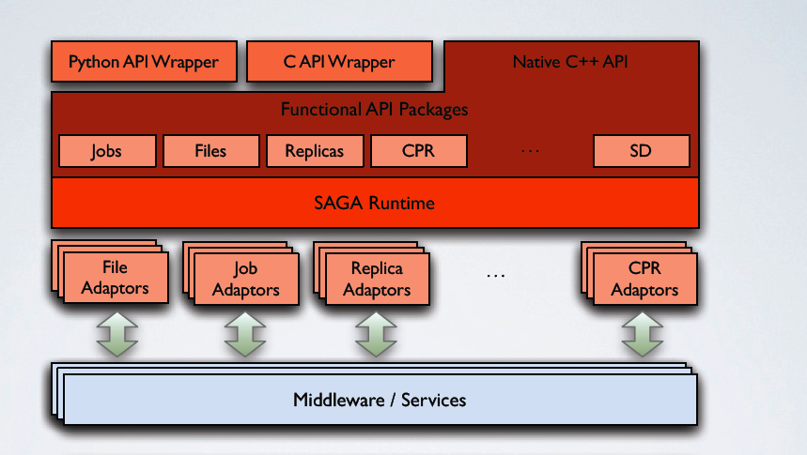
SAGA: Architecture

Slide 68
Three Ways to Use SAGA
 | Local Adaptors | Globus Adaptors | SSH Adaptors | …
 | file://localhost/... any://localhost/... | gram://remotehost/... any://remotehost/… | ssh://remotehost/… any://remotehost/…
Shell | saga-file copy src dest
 | saga-job run rm cmd
Python | import saga.filesystem dir.copy(src, dest)
 | import saga.job js.run(cmd)
C++ | using saga::filesystem::directory; dir.copy(src, dest)
 | using saga::job::job; job.run(cmd);
Notes:
Here’s the three ways how SAGA can be used:
Let’s start at the bottom with the C++ API
EPILOGUE: WE will now go briefly go through the three different Interfaces

Slide 69
Command line tools
SAGA comes with simple command line tools that allow to access basic package functionality.
The source code is very simple and a great starting point to explore the SAGA package APIs:
saga-file $SAGA_ROOT/tools/clutils/filesystem/
saga-job $SAGA_ROOT/tools/clutils/job/
saga-advert $SAGA_ROOT/tools/clutils/advert/
saga-shell $SAGA_ROOT/tools/shell/
Notes:
GIVE IT A TRY!

Slide 70
Command line tool: saga-file
Supported protocols
Depends on SAGA adaptors
Also available: Globus GridFTP, Curl (subset), KFS, Amazon EC2, Opencloud (Sector/Sphere), Hadoop (HDFS)
Supported commands:
Command | Arguments
copy | <url from> <url to>
move | <url from> <url to>
remove | <url>
cat | <url>
list_dir | <url>

Slide 71
Command line tool: saga-job
Supported protocols
Depends on SAGA adaptors
Also available: Globus Gram, Condor, OMII-GridSAM, LSF, Amazon EC2, Opencloud (Sector/Sphere)
Supported commands:
Command | Arguments
run | <rm url> <command> <arguments>
submit | <rm url> <command> <arguments>
state | <rm url> <jobid>
suspend | <rm url> <jobid>
resume | <rm url> <jobid>
cancel | <rm url> <jobid>
Notes:
Next we have

Slide 72
Command line tool: saga-advert
What is it?
Central data store with
Hierachical keys
Attributes
Filesystem like structure
Supported protocols
Depends on SAGA adaptors
Local adaptor:
Local backend: SQLite3
Remote backend: PostgreSQL
Also available: Hadoop H-Base, Hypertable

Slide 73
Command line tool: saga-advert
Supported commands:
Command | Arguments
list_directory | <advert-url> <pattern>
add_directory remove_directory | <advert-url>
add_entry remove_entry | <advert-url>
store_string | <advert-url> <string>
retrieve_string | <advert-url>
list_attributes | <advert-url>
set_attribute | <advert-url> <key> <value>
remove_attribute | <advert-url> <key>

Slide 74
Command line tool: saga-shell
All in one of all command line tools as mentioned earlier
Keeps context in between commands
Navigate (remote) filesystems (advert, replica too!)
Launch (remote) jobs, uses io redirection to access in/out
All commands are implemented using SAGA

Slide 75
Command line tool: saga-shell
Some of the supported commands
Type | Commands
File system navigation | pwd, ls, mv, cp, cd, mkdir, rmdir, touch, cat
Job package | run, suspend, resume, kill, status, ps
replica | rep_find, rep_list, rep_add, rep_remove, rep_update, rep_replicate
environment | setenv, getenv, env
permissions | add_proxy, remove_proxy

Slide 76
Python API Example: File Package
Copy a file
import saga src = saga.url("file://localhost/etc/passwd") dst = saga.url("file://localhost/tmp/passwd-copy") f = saga.filesystem.file(src, saga.filesystem.Read) f.copy(dst)
Notes:
Go ahead and try it if you want
You might end up with an “file already exists” error – that can be fixed by changing the DEST PATH

Slide 77
Python API Example: File Package
Get a directory file listing
import saga src = saga.url("file://localhost/opt/") d = saga.filesystem.directory(src) names = d.list('*') for name in names: ns = saga.name_space.entry(name) if ns.is_dir(): print 'd ', name elif ns.is_link(): print '->', ns.read_link() else: print ' ', name

Slide 78
Python API Example: Job Package #1
Submit a job
import saga
js_url = saga.url("fork://localhost/")
job_service = saga.job.service(js_url)
job_desc = saga.job.description()
job_desc.executable = "/bin/touch"
job_desc.arguments = ["-a", "touche"]
my_job = job_service.create_job(job_desc)
my_job.run()

Slide 79
Python API Example: Advert Package
Create and modify an advert entry
# host/process A import saga import time name = saga.url("advert://localhost/myentry") e = saga.advert.entry(name, saga.advert.ReadWrite|saga.advert.Create) e.set_attribute("started", time.strftime("%a, %d %b %Y %H:%M:%S +0000", time.gmtime())
# host/process B import saga name = saga.url("advert://localhost/myentry") e = saga.advert.entry(name) print "started: " + e.get_attribute("started")

Slide 80
C++ API Example: File Package
Copy a file
saga::url src (' … '); saga::url dst (' … '); saga::filesystem::file f(src, saga::filesystem::ReadWrite); f.copy(dst);

Slide 81
C++ API Example: File Package
Get a directory file listing
saga::url src (' … '); saga::filesystem::directory d (src); std::vector<std::string> names = d.list('*'); for (auto it = names.begin(); it != names.end(); ++it) { saga::name_space::entry ns (*it); if (ns.is_dir()) cout << 'd ' << *it << '\n'; else if (ns.is_link()) cout << '->' << ns.read_link() << '\n'; else: cout << ' ' << *it << '\n'; }

Slide 82
C++ API Example : Job Package #1
Submit a job
saga::url js_url("fork://localhost/");
saga::job::service js(js_url);
saga::job::description jd;
js.set_attribute("executable", "touch");
std::vector<std::string> args;
args.push_back("-a");
args.push_back("...filename…");
js.set_vector_attribute("arguments", args);
saga::job::job j = js.create_job(jd);
j.run();

Slide 83
C++ API Example : Job Package #2
Submit a job
saga::job::service js;
saga::job::ostream in;
saga::job::istream out, err;
saga::job::job j = js.run_job(
"/bin/echo -n HELLO SAGA", "fork://localhost/",
in, out, err);
std::string line;
while (std::getline(line, out))
std::cout << out << std::endl;

Slide 84
C++ API Example: Advert Package
Create and modify an advert entry
// host A saga::url name = url(' … ') saga::advert::entry e(name, advert.ReadWrite|advert.Create) e.set_attribute("started", " … " )
// host B saga::url name = url(' … ') saga::advert::entry e(name, advert.Read) std::string started = e.get_attribute("started")

Slide 85
Additional Resources: Programmers Guide
Set of very small and easy examples, one for each package/paradigm
file_copy, file_copy (async)
Error handling
Attributes
Stream (server/client)
http://static.saga.cct.lsu.edu/docs/programming_guide/saga_programming_guide.pdf

Slide 86
Example 1: hello_world
Hello world
Launch 3 jobs on different machines
Execute “/bin/echo”
No job dependency
Each job returns its passed input argument
"Hello"
"distributed"
"world!"
Jobs are launched in parallel (in separate threads)
As soon as result is collected it's printed on local console
Notes:
Here are a few practical examples, which are somewhat out of scope of this tutorial. They represent three common patterns for distributed applications:
Hello_world *uncoupled jobs”
Chaining_jobs – (“workflow”) on job’s input depends on the other’s output
Depending jobs – Centrally coordinated jobs
Feel free to check out http://saga.cct.lsu.edu/software/cpp/documentation/tutorials/loni-training-2010
There’s a document called SAGA Tutorial Exercise – it explains the following three examples in detail!

Slide 87
Example 1: hello_world
Hello world
Arbitrary sequence of results
Optimally: "Hello distributed world!"
Demonstrates
How to launch a remote job using SAGA job_service
Pass arguments using the command line
Collect result by output redirection
The source code can be found here (see ‘Example1’):
https://svn.cct.lsu.edu/repos/saga/core/trunk/examples/tutorial
The example uses localhost to spawn childs
For remote execution change HOST1, HOST2, HOST3 from "localhost" to
Notes:
Here are a few practical examples, which are somewhat out of scope of this tutorial. They represent three common patterns for distributed applications:
Hello_world *uncoupled jobs”
Chaining_jobs – (“workflow”) on job’s input depends on the other’s output
Depending jobs – Centrally coordinated jobs
Feel free to check out http://saga.cct.lsu.edu/software/cpp/documentation/tutorials/loni-training-2010

Slide 88
Example 2: chaining_jobs
Launch 3 jobs on 3 different machines
Output of previous job is needed to launch next job
Simple sequential execution, but SAGA style
Demonstrates
How to launch a job using SAGA job_service
How to feed input to launched job
How to collect output
Launched job: /usr/bin/bc
Increment the number passed as the argument
Pass returned incremented number to next job
Notes:
Here are a few practical examples, which are somewhat out of scope of this tutorial. They represent three common patterns for distributed applications:
Hello_world *uncoupled jobs”
Chaining_jobs – (“workflow”) on job’s input depends on the other’s output
Depending jobs – Centrally coordinated jobs
Feel free to check out http://saga.cct.lsu.edu/software/cpp/documentation/tutorials/loni-training-2010

Slide 89
Example 3: depending_jobs
Coordinating information from advert service
Launch a single job sequentially on a set of remote resources
Simulating checkpointing/relaunching on different resource (migration)
Maintain a single result value in advert service
Gets written by one job, and read by the next
Demonstrates
How to launch remote job using SAGA job, while maintaining environment
Assembling argument lists
Result is left in advert service, but accessed afterwards
Notes:
Here are a few practical examples, which are somewhat out of scope of this tutorial. They represent three common patterns for distributed applications:
Hello_world *uncoupled jobs”
Chaining_jobs – (“workflow”) on job’s input depends on the other’s output
Depending jobs – Centrally coordinated jobs
Feel free to check out http://saga.cct.lsu.edu/software/cpp/documentation/tutorials/loni-training-2010

Slide 90
Questions | Comments ?
We have covered:
SAGA command line tools
SAGA Python API
SAGA C++ API
Examples
Check out the tutorial website for more details and examples: http://saga.cct.lsu.edu/software/cpp/documentation/tutorials/loni-training-2010

