Slide 1
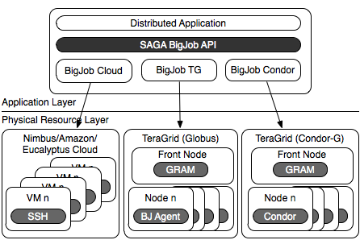



SAGA BigJob: An Extensible, Interoperable Pilot-Job Abstraction for Distributed Applications & Systems
Andre Luckow, Lukasz Lacinski and Shantenu Jha
http://saga.cct.lsu.edu/

Slide 2
Understanding Distributed Applications IDEAS: First Principles Development Objectives
Interoperability: Ability to work across multiple distributed resources
Distributed Scale-Out: The ability to utilize multiple distributed resources concurrently
Extensibility: Support new patterns/abstractions, different programming systems, functionality & Infrastructure
Adaptivity: Response to fluctuations in dynamic resource and availability of dynamic data
Simplicity: Accommodate above distributed concerns at different levels easily…
Challenge: How to develop DA effectively and efficiently with the above as first-class objectives?

Slide 3


SAGA: In a nutshell
There exists a lack of Programmatic approaches that:
Provide general-purpose, basic &common grid functionality for applications and thus hide underlying complexity, varying semantics..
The building blocks upon which to construct “consistent” higher-levels of functionality and abstractions
Meets the need for a Broad Spectrum of Application:
Simple scripts, Gateways, Smart Applications and Production Grade Tooling, Workflow…
Simple, integrated, stable, uniform and high-level interface
Simple and Stable: 80:20 restricted scope and Standard
Integrated: Similar semantics & style across
Uniform: Same interface for different distributed systems
SAGA: Provides Application* developers with units required to compose high-level functionality across (distinct) distributed systems
(*) One Person’s Application is another Person’s Tool

Slide 4
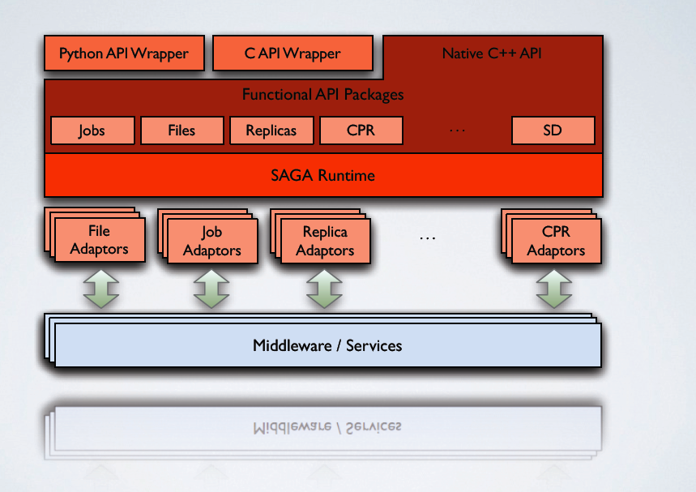
SAGA: In a thousand words..

Slide 5
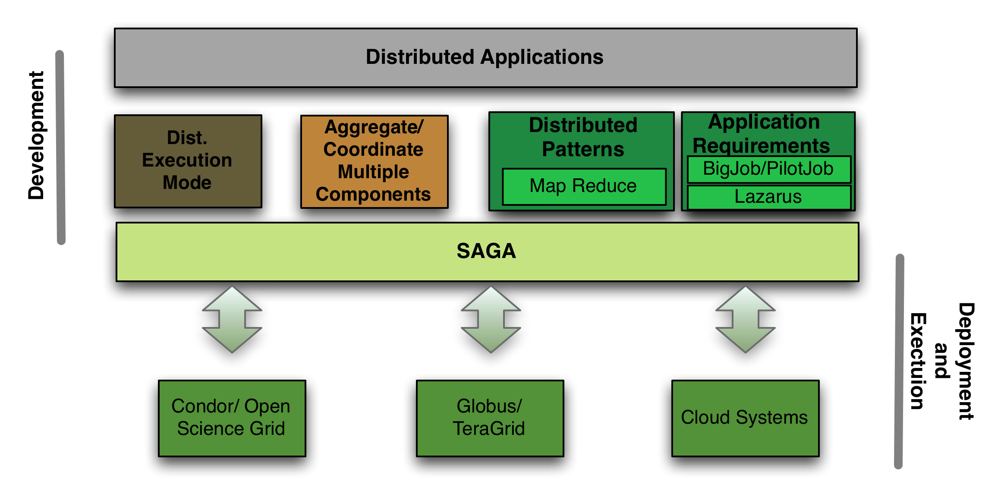
SAGA and Distributed Applications

Slide 6
Taxonomy of Distributed Application Development
Example of Distributed Execution Mode:
Implicitly Distributed
HTC of HPC: 1000 job submissions of NAMD the TG/LONI
SAGA shell example (cf DESHL)
Example of Explicit Coordination and Distribution
Explicitly Distributed
DAG-based Workflows (example of Higher-level API)
Example of SAGA-based Frameworks
Pilot-Jobs, Fault-tolerant Autonomic Framework
MapReduce, All-Pairs
Note: An application can be developed differently, and thus be in more than one category (e.g. DAG-based workflow)

Slide 7
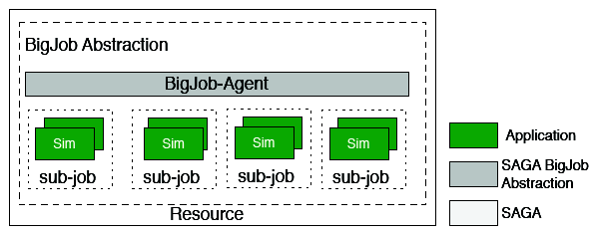
Abstractions for Dynamic Execution (1) Container Task
Adaptive:
Type A: Fix number of replicas; vary cores assigned to each replica.
Type B: Fix the size of replica; vary number of replicas (Cool Walking)
-- Same temperature range (adaptive sampling)
-- Greater temperature range (enhanced dynamics)

Slide 8
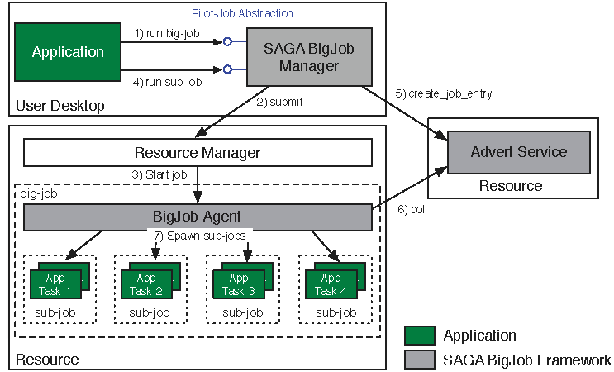
Abstractions for Dynamic Execution (2) SAGA Pilot-Job (BigJob)

Slide 9
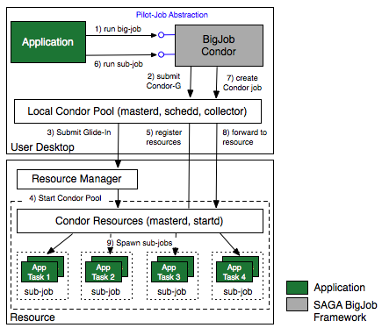
SAGA Pilot-Job: Condor

Slide 10
SAGA Pilot-Job: Condor (2)
Re-use of the Condor Glide-In native Pilot-Job functionality
To use BigJob Condor a local Condor pool is required
With the instantiation of a big-job object a Condor Glide-In (Condor-G) job is started at the remote resource via the SAGA Condor adaptor
The Condor-G job starts the master and startd daemon on the remote resource and adds these resources to the local Condor pool
Sub-jobs are dispatched to remote resources via the SAGA Condor adaptor and the local Condor pool
Advanced Condor capabilities, such as matchmaking, scheduling and automatic re-scheduling, are re-used
Notes:
Lukasz Please add descriptive text:
„A Condor Pilot-Job from an application point of view is a request for a set of resources that can later be accessed via the local Condor pool.“

Slide 11
SAGA Pilot-Job: Cloud
SAGA BigJob API provides unified abstraction to different Cloud backends. Backend specifics are encapsulated in a resource adaptor:
Amazon EC2
Eucalyptus (FutureGrid)
Nimbus (ScienceCloud)
VM images are setup during the initialization of big-job object
No agent on image necessary – sub-jobs are directly dispatched by the BigJob Manager via the SAGA SSH adaptor
Full support for MPI jobs on virtual VM clusters

Slide 12
Deployment & Scheduling of Multiple Infrastructure Independent Pilot-Jobs

Slide 13
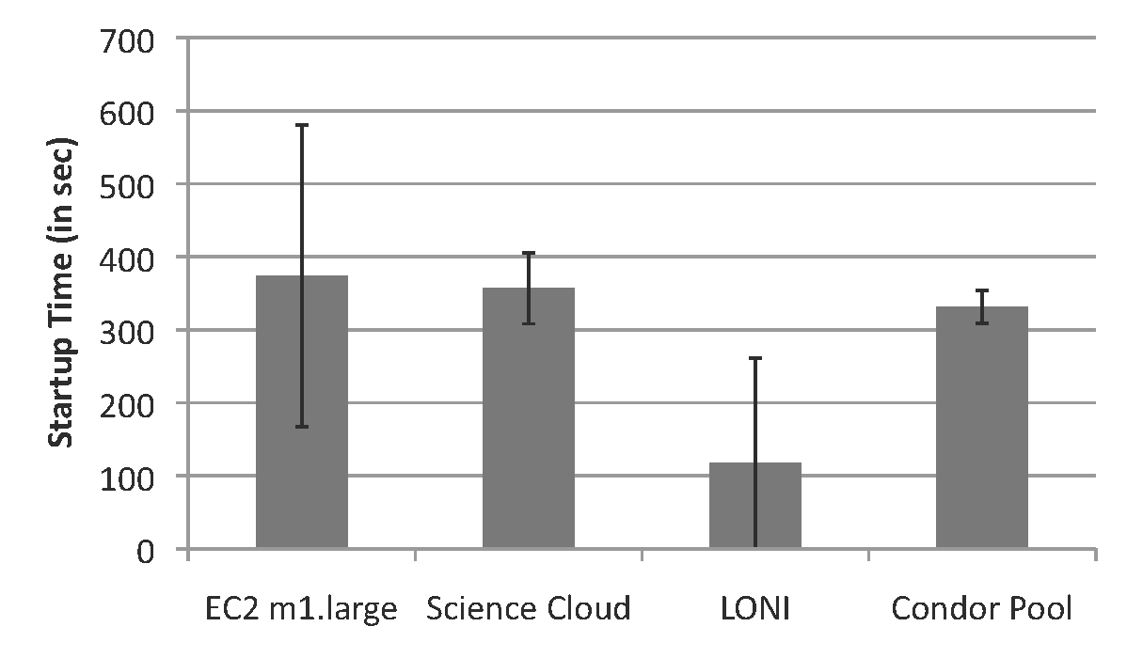
BigJob Start-up Times

Slide 14
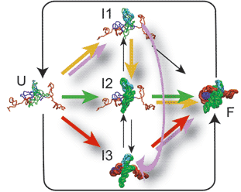
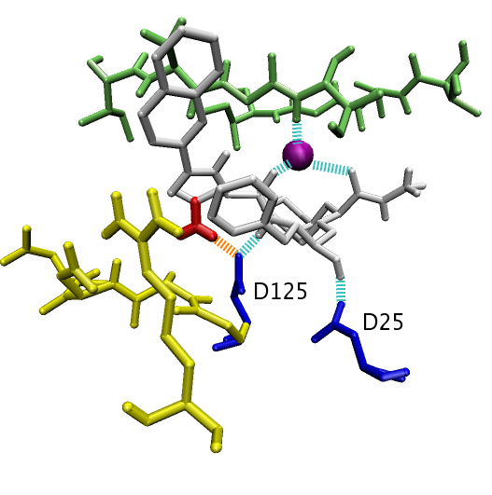
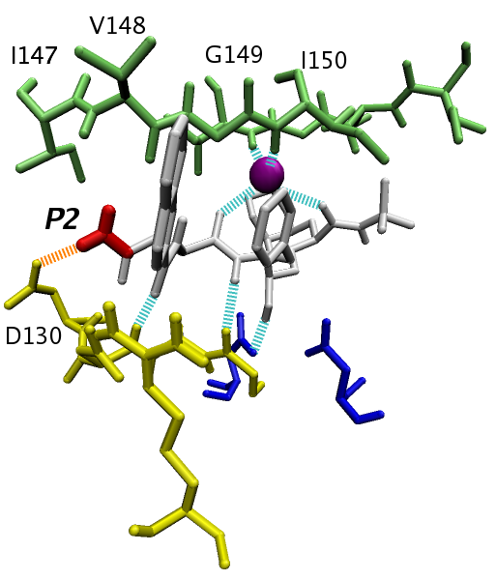
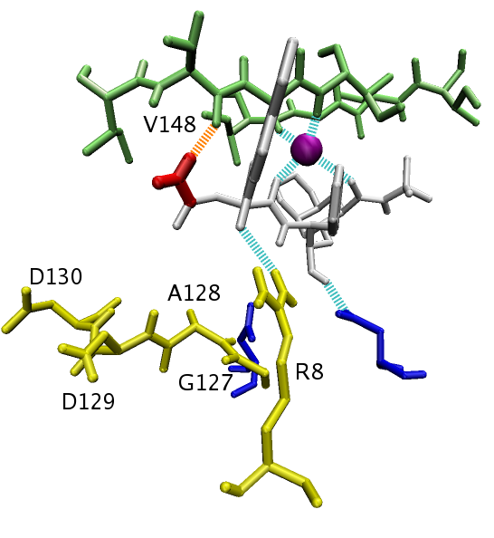
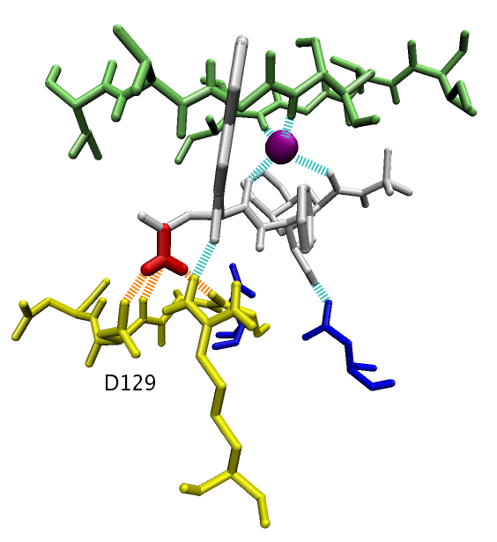
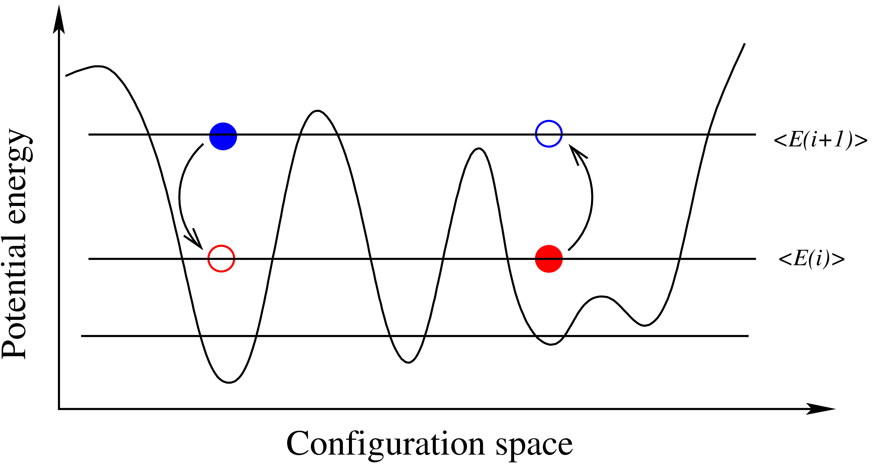
Generalized Ensemble Methods: Ensembles Can Enhance Sampling
Sampling is the challenge:
Long run vs multiple short runs?
Task Level Parallelism
Embarrassingly distributable!
Create replicas of initial configuration.
Spawn 'N' replicas over different machine
RE: Run for time t ; Attempt configuration swap. Run for further time t; Repeat till finish
We will not study Exchanges here
R₁
R₂
R₃
R_{N}
hot
T
t
300K
t
Exchange attempts

Slide 15
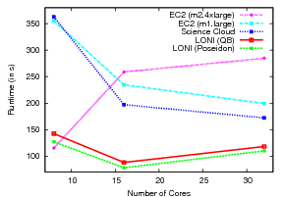
Scenario A-1: NAMD Performance for Different Resource Configurations

Slide 16
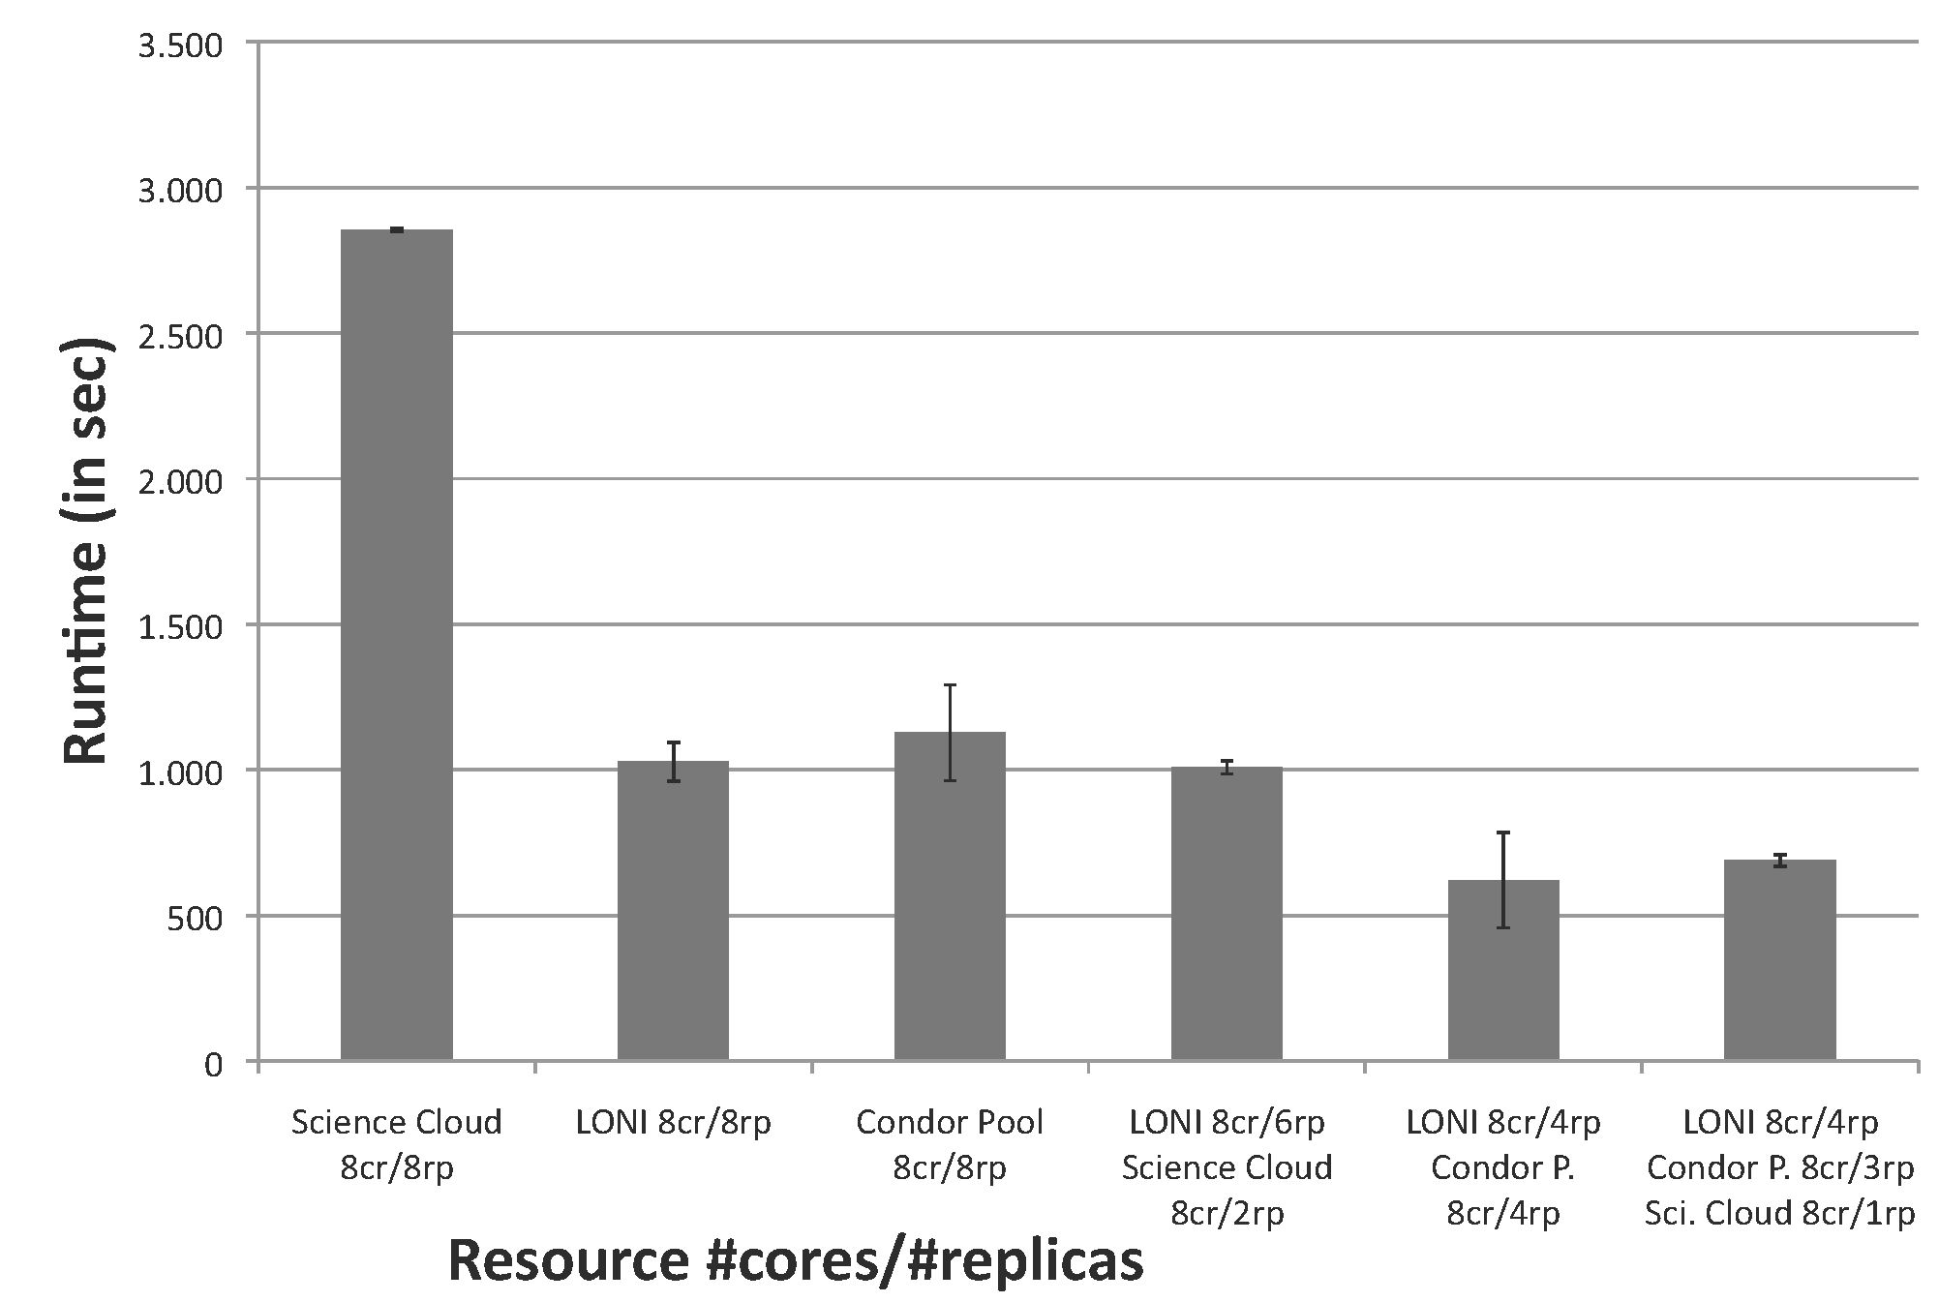
Scenario A-2: T_{c} for Different Resource Configurations
Each experiment was for 8 ensembles; repeated 4 times
Cloud resources alone less suitable for tightly coupled workloads
If Grid and Condor resources are only lightly loaded, additional Cloud resources provide no benefits
However, Cloud resources provide great benefits if on-premise resources are heavily loaded

Slide 17
Scenario B: Facilitating Novel Execution Modes
Interoperability and Scale-out enable new ways of resource planning and application execution
Deadline-driven scheduling: e.g., Need Workload X done before time Y
Adapt workload distribution and resource utilization to ensure completion
Develop Progress Manager; monitor’s state of completion
Based upon heuristics activates the Pilot-Jobs on Clouds
Could keep VMs cold; or hot

Slide 18

Scenario B: Experimental Results
Scenario: Ensuring a deadline T_{Max} for a 8 replica NAMD workload
Experiment performed 10 times; Resources used: LONI and Nimbus ScienceCloud
Progress Manager periodically monitors the progress of the computation and initiates additional big-job objects if necessary (Monitoring interval: 4 minutes)
In 60% of the cases no measures necessary. To hold the defined deadline of 45 minutes additional VMs had to be started in 40% of the cases.

Slide 19
Conclusions and Future Work
IDEAS Design Objective
API for Higher-level Functionality/Abstractions built upon basic distributed API (SAGA)
ExTENCI Project – NSF Funded project wherein SAGA-based Pilot-Jobs will be used for EnKF for collective/concurrent usage of the TeraGrid and OSG

