Slide 1

Abstractions for Loosely-Coupled and Ensemble-based Simulations on Azure
Andre Luckow and Shantenu Jha
http://saga.cct.lsu.edu
http://www.cct.lsu.edu/~sjha/
Notes:
Added slide 3
I think there will not be time to focus on “assertion based” approach, i.e slides 4-7. Possibly include slide 8

Slide 2
Overview
Introduction: Understanding Distributed Abstractions
Introduce IDEAS as minimal set of DA Design Objective
SAGA, Pilot-Jobs and SAGA BigJob
Abstractions for dynamic executions
Pilot-Job: Power of “right” Abstractions
Interoperability is the starting point
EnMD and RE Simulations
Free Energy Calculation (e.g replica-exchange) using bio-molecular simulations for range of biophysical and personalized medicine
BigJob on Azure: Architecture, Performance and Scalability
Utilizing Azure’s native abstractions

Slide 3
Some Primary Observations
Is large (and rich), but the number of effective and extensible DA small
More than just submitting jobs here and there!
Developing DA is a hard undertaking
Intrinsic and Extrinsic Factors
Unique role of the Execution Environment (Infrastructure)
Embrace “distributedness”
Understanding distributedness, heterogeneity & dynamic execution is fundamental (e.g., Exascale logically distributed prog. Models)
Data-centric application will be the drivers!
Role for Pattern-oriented and Abstractions-based Development

Slide 4
#2: Developing DA is a hard undertaking
Intrinsic reasons why developing DA is fundamentally hard:
Control & Coordination over Multiple & Distributed sites
Effective coordination in order for whole > sum of the parts
Complex design points; wide-range of models of DA
Many reasons for using DA, more than (just) peak performance
Extrinsic:
Execution environments will be dynamic, heterogeneous and varying degrees-of-control
Fundamental different variation in role of Execution Environment- distinguishing feature of DA from “regular environment” HPC
Application types strongly coupled to the infrastructure capabilities, abstractions/tools, & policy:
Often development tools assume “specific” deployment and execution environments, or don’t where needed!
Policies and tools, e.g production DCI has been missing for DDDAS

Slide 5
#3: Embrace Distribution
“History of computing like pendulum, swings from centralized to distributed”
Indications this time there is a fundamental paradigm shift due to DATA
Too much to move around; learn how to do analytics/compute in situ
Decoupling and delocalization of the producers-consumers of computation
Localized special services; people and collaborations are distributed
(Ironically) Most applications have been developed to hide from heterogeneity and dynamism; not embrace them
Programming models that provide dynamic execution (opposed to static), address heterogeneity etc
Logically vs Physically Distributed: NG programming models will need to support dynamic execution, heterogeneity at a logically-distributed level

Slide 6
#3: Embrace Distribution Corollary: Clouds are not Panacea
Clouds: Novel or more of the same?
Better control over software environment via virtualization
Illusion of unlimited and immediate available resource can lead to better capacity planning and scheduling
Partly due to underlying economic model and SLAs
Clouds do not remove many/all of the challenges inherent in DA
Clouds are about provisioning, grids are about federation
Fundamental challenges in distribution remain
Makes some thing worse as impose a model of strong localization
“The reason why we are so well prepared to handle the multi-core era, is because we took the trouble to understand and learn parallel programming” – Ken Kennedy
Clouds part of a larger distributed CI
Certain tasks better suited for Grids, others on Clouds
Notes:
“Clouds are about provisioning, grids are about federation”
“IF you can keep your head when all about you, Are losing theirs and blaming it on you..”
“The reason why we are so well prepared to handle the multi-core era, is because we took the trouble to understand parallel programming

Slide 7
#3: Embrace Distribution Corollary: Clouds are not Panacea
Clouds: Novel or more of the same?
Better control over software environment via virtualization
Illusion of unlimited and immediate available resource can lead to better capacity planning and scheduling
Partly due to underlying economic model and SLAs
Clouds do not remove many/all of the challenges inherent in DA
Clouds are about provisioning, grids are about federation
Fundamental challenges in distribution remain
Makes some thing worse as impose a model of strong localization
“The reason why we are so well prepared to handle the multi-core era, is because we took the trouble to understand and learn parallel programming” – Ken Kennedy
Clouds part of a larger distributed CI
Certain tasks better suited for Grids, others on Clouds
Notes:
“Clouds are about provisioning, grids are about federation”
“IF you can keep your head when all about you, Are losing theirs and blaming it on you..”
“The reason why we are so well prepared to handle the multi-core era, is because we took the trouble to understand parallel programming

Slide 8

SAGA: In a nutshell
There exists a lack of Programmatic approaches that:
Provide general-purpose, basic & common grid functionality for applications; hide underlying complexity, varying semantics..
The building blocks upon which to construct “consistent” higher-levels of functionality and abstractions
Meets the need for a Broad Spectrum of Application:
Simple scripts, Gateways, Tooling, Workflow…
Simple, integrated, stable, uniform and high-level interface
Simple and Stable: 80:20 restricted scope and Standard
Integrated: Similar semantics & style across
Uniform: Same interface for different distributed systems
Standards-based approach: A Technical and an Economic (Moral?) imperative & case:

Slide 9
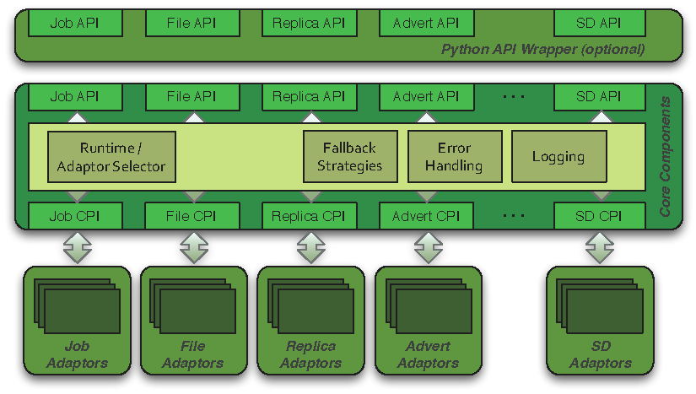
SAGA: Architecture

Slide 10
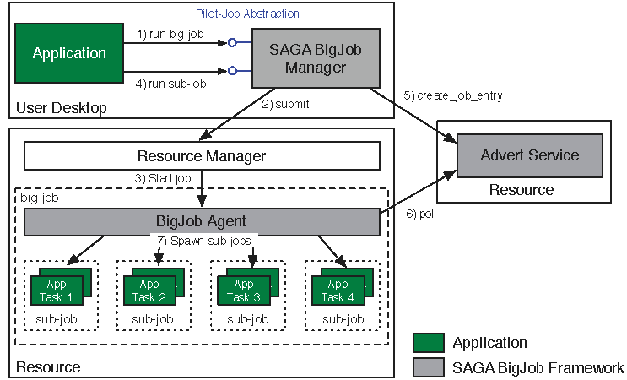
Abstractions for Dynamic Execution SAGA Pilot-Job (BigJob)

Slide 11
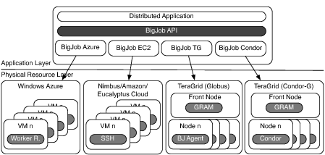
Deployment & Scheduling of Multiple Infrastructure Independent Pilot-Jobs

Slide 12
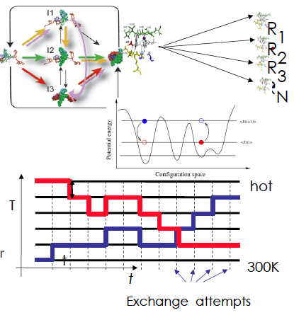
Ensemble and Replica-Exchange Simulations
Replica-Exchange (RE) methods:
Represent a class of algorithms that involve a large number of loosely coupled ensembles.
RE simulations are used to understand a range of physical phenomena
Protein folding, unfolding etc
MC simulations
Many successful implementations
e.g. folding@home [replica based]

Slide 13
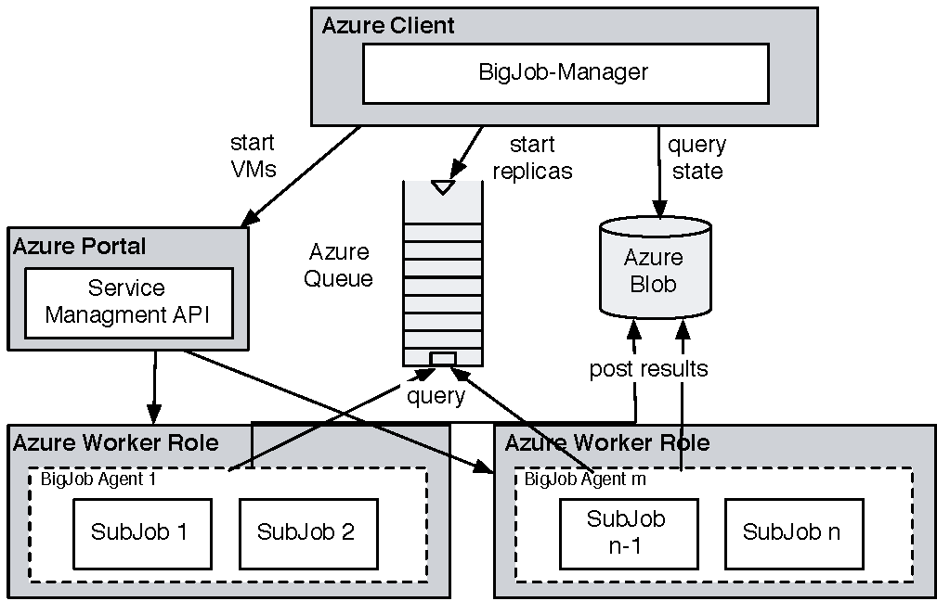
Azure: Using BigJob API and Coordinating Multiple Tasks
For Replica-Exchange application, take SAGA-BigJob and implement on Azure to test for performance
CONCLUSION: For same workload, comparable in performance to TG!
BUT SIMPLER to implement than TG!

Slide 14
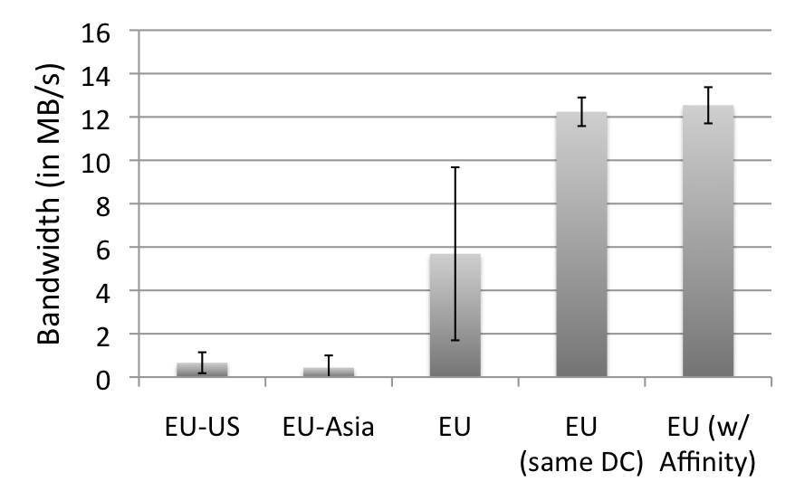
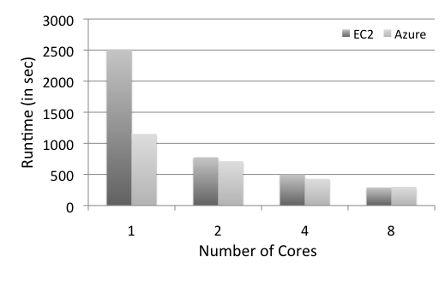
Azure: Scalability with Simplicity Providing Infra-level abstractions for DDIA
NAMD Performance on Azure
Three types of storage abstractions:
Azure Blob Service: Large amounts of raw data
Block Blob: Large chunks of 5GB
Page Blob: Mange storage as an array
Azure Table Storage: Semi-structured data
Azure Queue Storage: Message Queues
All three replicated and with strong consistency semantics
Current affinity operates at the data-center level;
Enhanced/finer-grained affinity to be made available
Azure Network Performance

Slide 15
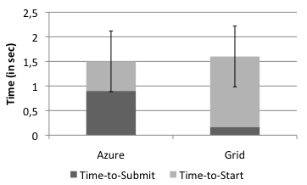
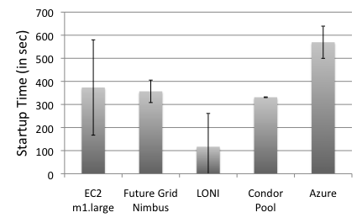
Pilot-Job for Azure: SAGA BigJob
BigJob Startup Times
In Grids the BigJob startup time depends mainly on queuing time
Azure shows a longer startup than Amazon EC2 and FutureGrid
Amazon EC2 has the highest fluctuation in the startup time (of all cloud resources)
Sub-Job submission times are comparable
BigJob Sub-Job Submission Times

Slide 16
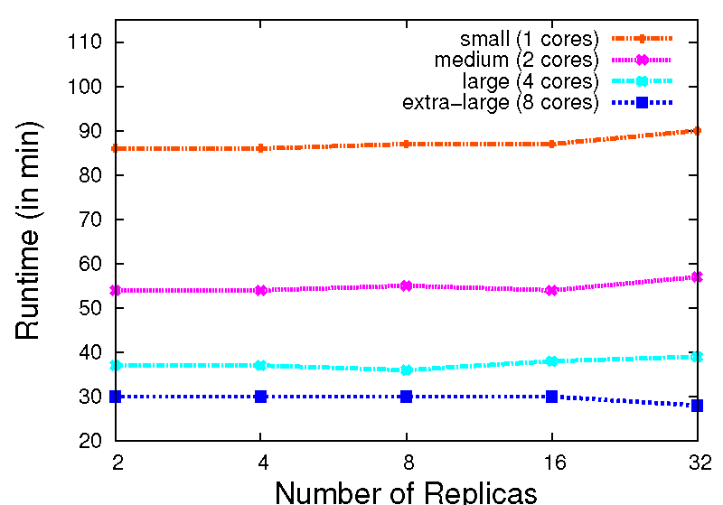
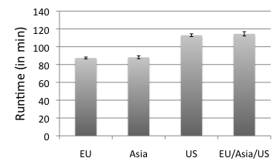
Replica-Exchange on Azure
Azure BigJob scales well with the number of replicas.
AQS proved to be effective for coordination of sub-jobs/replicas
Larger VMs have a better performance. But, efficiency drops < 0.4 for the extra-large VM
The different Azure data centers show a slight fluctuation in their performance

Slide 17
Although Clouds are not Panacea..
Nascent infrastructure do what Production DCI have not managed!
Confuse Functionality with Usability
Simplicity is the Ultimate Sophistication: “It seems that perfection is attained not when there remains nothing to add, but when there remains nothing to remove”
Community busy agenda pushing, e.g, middleware/software stacks, most innovation in DC has come from commercial sector!
“We” have lost intellectual leadership to commercial providers!
Infrastructure, Algorithmic & Development e.g., (re-discovering) MapReduce

Slide 18
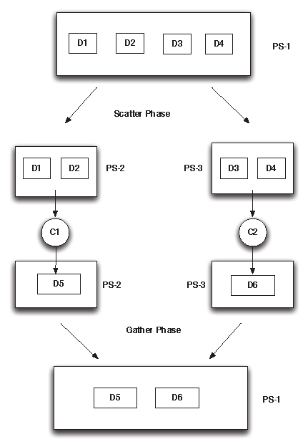
Future Work: Pilot Data
Pilot Data:
Abstraction for expressing data localities and affinities.
Pilot Data can be used to create groups of file that are always used together
Pilot Data provides a set of basic operations on top of these file groups
Pilot Store: A container that represents a logical group of physical files that share the same affinity.
Abstraction can be used to express C-C, C-D and D-D affinitities
Notes:
(D1) Data Management: This concerns all aspects associtaed with the lifecycle maintenance of data including: acquisition, access, archiving, to name a few. This includes the policies and practices that control, protect, deliver and enhance the value of data.
• (D2) Distribution: Data is either distributed or needs to be distributed. This raises the issue of efficient and reliable large-scale data transport and the association of computation to date.
• (D3) Dynamism: Data may be dynamically generated and collected (e.g. via sensors) that trigger adaptive computation and steering which may in turn impact the data collection process. This has been termed dynamic data driven application systems (DDDAS) or more recently InfoSymbiotic systems.
• (D4) Access Mechanisms: Data access includes low-level protocols that hide the distribution and heterogeneous nature of data sources via uniform interaces. This also includes access policy that govern who is allowed to access (read or write) data and under what conditions.
• (D5) Performance: Access to large-scale distributed data raises critical performance concerns with respect to scale-up and scale-out
• (D6) Data Integration : Data residing in different sources must be com- bined to provide users with a unified view. Associated issues include format conversion, the use of data shims, and semantic descriptors and ontologies to help harmonize the data.

