Slide 1





Joohyun Kim, Sharath Maddineni, Shantenu Jha, Center for Computation and Technology (CCT) Louisiana State University Christopher Gissendanner Department of Biology University of Louisiana at Monroe

Slide 2
Content
Introduction : Dynamic Application Runtime Environment (DARE) Framework and DARE-NGS Gateway Development (Shantenu Jha)
DARE-NGS : Scientific Collaborative Development Chris Gissendanner)
DARE-NGS : Demo (Sharath Maddineni)
DARE-NGS : Present and Future (Joohyun Kim and Shantenu Jha)

Slide 3
DARE-NGS
DARE-NGS : Gateway for NGS Data Analytics and Downstream Analyses on Scalable Distributed HPC and Clouds
Emerging Computational Methods in Life Sciences Workshop at HPDC11
Teragrid/Blue Waters Symposium on Data-Intensive Analysis, Analytics, and Informatics (April 2011, Pittsburgh)
Teragrid11 workshop
Submitted to Concurrency and Computation : Practice and Experience (CCPE)
dare.cct.lsu.edu : Production service
cyder.cct.lsu.edu : Development
Compute resources : QB and LONI clusters, Ranger, Futuregrid (Cloud), Amazon Cloud, and Campus Cluster
Server Deployment using virtualization

Slide 4
Next-Generation DNA Sequencing (NGS) and Its Impact on Life Sciences and Biomedical Research
Unprecedented novel opportunities for life sciences/biomedical research
High-throughput DNA sequencing
Significant roles of computation (algorithm, methods, implementation, and infrastructure)
Paradigm shift in computational biology touting the importance of the utilization of distributed High Performance Computing (HPC)
Notes:
Why is point 4 an impact? Is it not a challenge? I don’t know how we can claim point 5?

Slide 5
Do we need HPDC and Gateways?
Observation I
➔ Using local compute resources and data storage is too limited.
Observation II
➔ Using Supercomputers or HPC resources is difficult and complex.
Our Solution
➔ Hiding the complexity of using distributed HPC resources and emerging cloud environment. Therefore we propose Gateways.

Slide 6
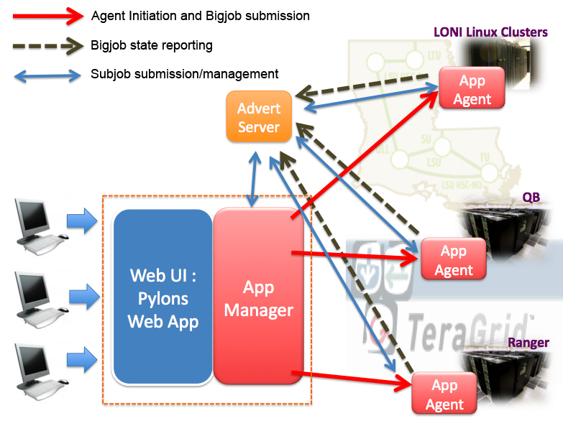
DARE-NGS : Cyberinfrastructure powered by Science-backed, Scalable Distributed Infrastructure, and Dynamic Application
LBRN Home page : lbrn.lsu.edu
Bioport : bioport.lsu.edu
Genetic/Structural Databases
DARE-NGS : http:dare.cct.lsu.edu
HPC/HTC/Clouds/Campus Clusters
Notes:
(JK) Here, upper two tables represent the benefits of task level concurrency and scale-out strategy

Slide 7
DARE-NGS : NGS-Analytics and Downstream Analyses
Overview - Computational/Bioinformatics Strategies for Genomic Data Analysis
WGS, CHIP-Seq, RNA-Seq:
Billions Short Reads
Mapping
De Novo Assembly
Whole Genome Analysis (WGS)
Exome Analysis
Transcriptome Analysis
(RNA-seq)
Genome-wide DNA-protein interactions
(ChIP-seq)
Functional Genomics, Gene Regulation, Pathway Analysis – Cell Development & Differentiation, Host-Pathogen interaction, Biomedical research
Notes:
SJ: Color coding is a bit misleading. Does purple (right sight, lower level) represent analysis? If so, be sure to say so

Slide 8
DARE-NGS : Scientific Collaborative Development
RNA-Seq : Transcriptome Analysis of Burkitt’s Lymphoma cells and lincRNAs Discovery (Tulane U)
Exome : Large Scale Human Exome (PBRC)
DARE-NGS : NGS Data Analysis Gateway Development
Genome-wide Transcription Factor Binding : ULM
Host-Pathogen Interaction (Rice-B. Glumae) : LSU, AgCenter
Notes:
SJ: Something more structured than this is preferable. I still think this is getting too long. There will be other people talking about NGS and we will be the last
To talk about NGS, so a lot of this will be covered. We should give no more than 3-5min motivation.

Slide 9
DARE-NGS : Scientific Collaborative Development
Transcriptome Analysis of Burkitt’s Lymphoma cells and lincRNAs Discovery
PI : Erik Flamington (Tulane U)/Carl (Tulane GCF)
Focus : RNA-Seq using Tophat/Cufflink, Tophat-fusion
Exome Analysis
PI : Tuomo Rankinen (HGL, PBRC)/PBRC GCF
Focus : Large Scale Mapping and Genome Variation Discovery
Genome-wide (C. elegans) Transcription Factor (NHR-6) Binding
PI : Chris Gissendanner (ULM) (LBRN PI)
Focus : ChIP-seq Pipeline Development
Rice-B.Glumae (Host-Pathogen)
PI : Jong-hyun Ham (AgCener, LSU)
Focus : Host-pathogen Interaction using RNA-Seq, Integrative Infrastructure for Drug Discovery targeting Quorum-Sensing Mechanism
Notes:
SJ: Something more structured than this is preferable. I still think this is getting too long. There will be other people talking about NGS and we will be the last
To talk about NGS, so a lot of this will be covered. We should give no more than 3-5min motivation.

Slide 10
DARE-NGS : Powered by Dynamic Application Runtime Environment on Scalable Distributed Infrastructures
ChIP-Seq pipeline
: Data processing
: Databases
Mapping
Peak Calling
Mapping
With BFAST &
HPC
Other Peak Caller
Mapping
Using Cloud

Slide 11
Time Line | Oct 2011 - Jan 2012 | Jan 2012 - Mar 2012 | Mar 2012 - June 2012 | June 2012 - Aug 2012
User Community | Gissendanner Lab (LBRN PI) | Ham (LSU) Flemington (Tulane) Rankinen (PBRC) | LBRN-Pis LONI-PIs XSEDE-GW
Development Focus | Accounting with HPC | RNA-Seq pipeline | Community Engagement More alternative tool Integratio | Type III service development XSEDE Resource Integration

Slide 12
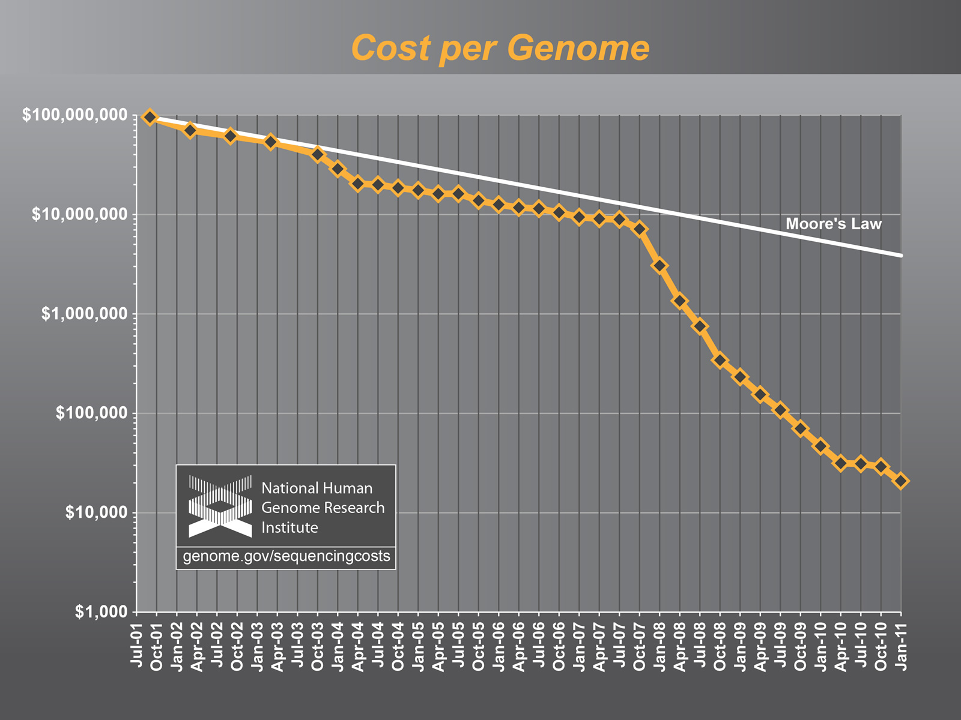
Application Exemplar II: NGS Analytics

Slide 13
What are the Challenges for LS Applications on Clouds?
Distributed Applications Revisited
Where, when, how to distribute? How to manage coordination?
What is the task decomposition granularity? Mapping to resources?
What are the data transfer/access/storage mechanisms
Need Abstractions to Support Dynamic Applications
DA challenges need to be addressed dynamically!
Resource Elasticity/Cloudburst + Heterogeneous task-resource binding and need to for application configuration trade-offs
Both Development and System/Infrastructure level abstractions

Slide 14
What are the Challenges for LS Applications on Clouds?
What is the physical infrastructure configuration?
No well-defined single infrastructure configuration or capabilities
Distinguish: Astronomy, HEP community
TG/XSEDE is not used for data-intensive application (Fox)
Must support heterogeneous, distributed, dynamic loads
“Building this infrastructure is not trivial” (Fox)
There are “hard” parts and tractable parts
SAGA handles the hard part, opening up innovation elsewhere

