Slide 1
DARE SAGA enabled Gateway
Joohyun Kim
Sharath Maddineni
Shantenu Jha

Slide 2
Contents
Introduction to DARE
Example using DARE
DARE Based Gateways
DARE-NGS
Demo

Slide 3
What is DARE?
Dynamic Application Runtime Environment
A framework to support Distributed Scientific Applications
Why?
Coordinate Compute and Data
Distributed scalable heterogeneous resources
Using the existing resource information
Build dynamic applications / workflows

Slide 4
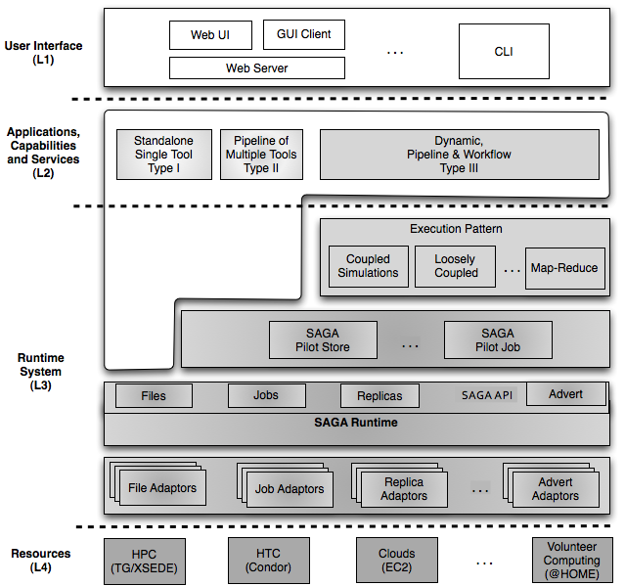
DARE

Slide 5
What is in DARE ?
Components of DARE
Compute Engine
Data Movement Engine
Configuration File parser/Writer/Validator (Data Dictionary)
Update Status to Database(Web DB)
Manager

Slide 6
DARE Architecture

Slide 7
DARE UML

Slide 8
DARE Information Management
Resource Info
https://svn.cct.lsu.edu/repos/saga-web/DARE-web/DARE/examples/chipseq/resource.cfg
Software tool Info
https://svn.cct.lsu.edu/repos/saga-web/DARE-web/DARE/examples/bfast/bfast_1_resource.cfg
Service info

Slide 9
DARE Repository
Just DARE
https://svn.cct.lsu.edu/repos/saga-web/DARE-web/DARE
DARE-NGS
https://svn.cct.lsu.edu/repos/saga-web/DARE-web/DARE-NGS/

Slide 10
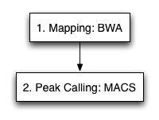
ChIP-Seq (Type II Service)
Two Stages in ChIP-Seq
Mapping and Peak Calling
Input data
Reference Genome index files
Control and Treat Short Read data(Fastq)
Tools
BWA, BFAST, BOWTIE and others (Mapping)
SAMTOOLS
MACS and others (Peak calling)
Output data
SAM files (.sam) with mapping tool
BED files (.bed, Excel, wig..) with Peak calling
Different Steps
Number of steps to generate .sam varies with Mapping tool (Bfast-3,BWA-2, BOWTIE-1 )
SAM files needs to sorted and converted into .BAM files using samtools (3)
BAM will be taken as the input to MACS (1)

Slide 11
ChIP-Seq Using DARE
Steps with DARE
Transfer Index files and fragmented fastq files for the chosen tool to the resources used.
Start performing Work Units(Tasks)
Transfer the output BED/XLS back to the Server

Slide 12
Demo
Go to
http://dare.cct.lsu.edu/gateways/ngs/users/login
Login
Email = “test@test.com”, Password= “demo” (without quotes)
Go to
http://dare.cct.lsu.edu/gateways/ngs/ngs/chipseq_form

Slide 13
Demo Cont..
Fill the form
Description = demo
CHOOSE REFERENCE GENOME = “Mouse(mm9)”(Drop Down)
CHOOSE MAPPING TOOL=‘’BWA” or “Bowtie”
COLOR SPACE= “Yes”
CHOOSE PEAK CALLING TOOL = “MACS”
CHOOSE CONTROL DATA FOR INPUT= “control.fastq”
CHOOSE TREAT DATA FOR INPUT= “treat.fastq”
EXPECTED COMPUTATION LOAD = “small”
Hit Submit
Press OK in the Popup box
It will take you to the Job Table View
http://dare.cct.lsu.edu/gateways/ngs/ngs/job_table_view

Slide 14
DARE with Gateways
Components
Pylons as the web server
Database for user info and Jobs info
A Job Monitoring thread
Application specific DARE

Slide 15
DARE-based Science Gateways
Three levels:
Access/Application Layer(L1,L2)
Services & MW Layer(L3)
Resource Layer(L4)
Abstractions for Dynamic and Adaptive Execution
Integrated compute and data
Interoperable across DCI
Extensible: frameworks, abstractions and features
Notes:
Fixed the diagram.. Please remove next slide if you are OK with this

Slide 16
NGS Analytics as a Service:
Some NGS specific challenges
Efficient Algorithm/tool/code selection
Efficient task scheduling and placement
Efficient Data transfer/scheduling
Transfer of Ref. genome index files:
O(hours) 130 GB(BFAST),
Transfer of Short read files:
O(mins) [L to QB] 10 GB

Slide 17
Conclusions & Future work
Security
Life Science Applications – compute and data intensive present broad range of challenges at scale
Using BFAST on production DCI
What are the CI challenges of NGS Analytics?
Exploring HTC, HPC-grids and Clouds
DARE-based Gateway
Extensions to abstractions for dynamic execution and data
Need for community provided solution on XD and other production DCI
Challenges remain in the scalable provisioning

