Slide 1
SAGA practical
ISSGC 2009
http://issgc-server-01.polytech.unice.fr/saga/

Slide 2
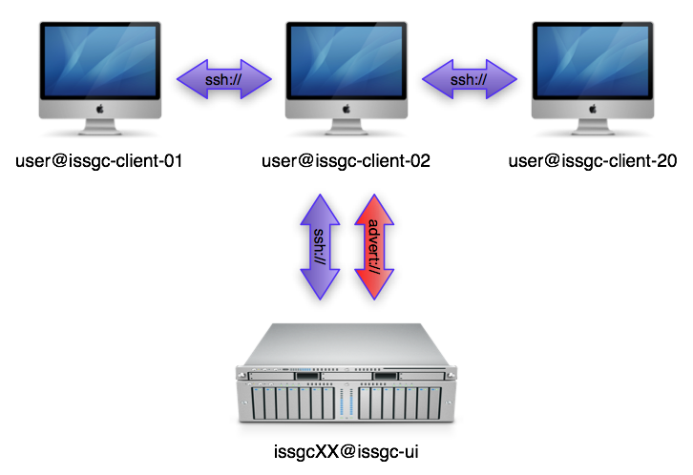
INFRASTRUCTURE

Slide 3
Login

Slide 4

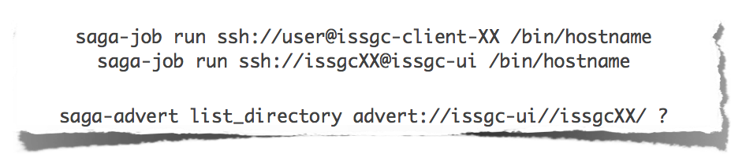
Enter the saga world
Make sure everything works:

Slide 5
command line tools
SAGA comes with simple command line tools that allow to access basic package functionality.
The source code is very simple and a great starting point to explore the SAGA package APIs:
saga-file $SAGA_ROOT/saga/cltools/file/
saga-job $SAGA_ROOT/saga/cltools/job/
saga-advert $SAGA_ROOT/saga/cltools/advert/
saga-replica $SAGA_ROOT/saga/cltools/replica/

Slide 6
Documentation
API documentation
http://issgc-server-01.polytech.unice.fr/saga/apidoc/
Programming manual
http://issgc-server-01.polytech.unice.fr/saga/manual.pdf

Slide 7
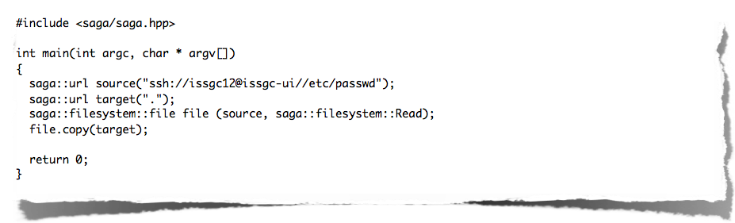
unit 1: A SIMPLE SAGA APP
Simple file copy example: copy.cpp

Slide 8
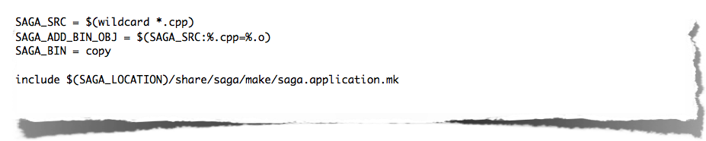
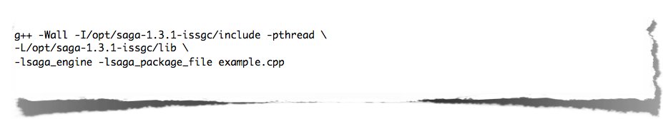
unit 2: compiling and linking
Simple file copy example: Makefile
Or do it the hard way:

Slide 9

RUNNInG A SAGA APPLICATION
Make sure that the SAGA libraries can be found by the loader. saga-env.sh takes care about that.
If something goes wrong - use SAGA_VERBOSE:

Slide 10
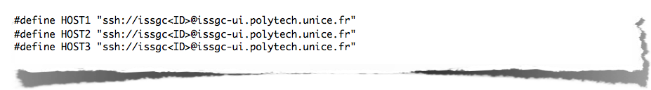
EXAMPLE 1: hello_world
The source code can be found here:
http://issgc-server-01.polytech.unice.fr/saga/examples/hello_world.cpp
Change these lines:

Slide 11
EXAMPLE 3: DEPENDING_jobs
The source code can be found here:
http://issgc-server-01.polytech.unice.fr/saga/examples/depending_jobs.cpp
Change this line:
Make sure the advert entry is empty

Slide 12
EXAMPLE 3: DEPENDING_jobs
Copy executable
Run the example:
Retrieve result from the advert service

Slide 13
Conclusion
We saw simple examples from three different API packages:
advert package
job package
file package
All the example code was rather simple, but of course it can be used to develop applications of arbitrary complexity
More packages available:
replica, service discovery, cpr, streams

Slide 14
THANKS
http://saga.cct.lsu.edu

