Slide 1



Introduction to the SAGA API

Slide 2
Outline
SAGA Standardization
API Structure and Scope
API Walkthrough
SAGA SoftwareComponents
C++ API bindings
Python API bindings
[ Java API bindings ]
Adaptors (backend bindings)
Command Line Tools

Slide 3
SAGA Design Principles
SAGA: Simple API for Grid Applications
OGF approach to a uniform API layer (facade)
governing principle: 80:20 rule
simplicity versus control!
top-down approach
use case driven!
defines application level abstractions
extensible
stable look & feel
API packages
API Specification is language independent (IDL)
Renderings exist in C++, Python, Java
Examples here are in C++

Slide 4
SAGA Intro: Example 1
// SAGA: File Management example
saga::filesystem::directory dir ("any://remote.host.net//data/");
if ( dir.exists ("a") && ! dir.is_dir ("a") )
{
dir.copy ("a", "b", Overwrite);
}
list <saga::url> names = dir.find ("*-{123}.txt");
saga::filesystem::directory tmp = dir.open_dir ("tmp/", Create);
saga::filesystem::file file = dir.open ("tmp/data.txt");

Slide 5
SAGA Intro: Example 1
API is clearly POSIX (libc + shell) inspired
where is my security??
what is ’any://’ ???
usage should be intuitive (hopefully)

Slide 6
SAGA Intro: Example 2
// SAGA: Job Submission example
saga::job::description jd;
// details left out
saga::job::service js ("any://remote.host.net/");
saga::job::job j = js.create_job (jd);
j.run ();
cout << "Job State: " << j.get_state () << endl;
j.wait ();
cout << "Retval " << j.get_attribute ("ExitCode") << endl;

Slide 7
SAGA Intro: Example 2’
// SAGA: Job Submission example
saga::job::service js ("any://remote.host.net");
saga::job::job j = js.run_job ("touch /tmp/touch.me");
cout << "Job State: " << j.get_state () << endl;
j.wait ();
cout << "Retval " << j.get_attribute ("ExitCode") << endl;

Slide 8
SAGA Intro: Example 2
stateful objects!
yet another job description language? :-(
many hidden/default parameters
keeps call signatures small
’any://’ again!
TIMTOWTDI (there is more than one way to do it)

Slide 9
SAGA Intro: 10.000 feet
object oriented:
uses inheritance and interfaces
very moderate use of templates though!
functional and non-functional elements strictly separated
functional API:
typically mappable to remote operations
ordered in API ’Packages’: extensible
non-functional API:
typically not mappable to explicit remote operations
“look & feel”: orthogonal to functional API
security, asynchronous ops, notifications, ...
few inter-package dependencies - allows for partial implementations

Slide 10
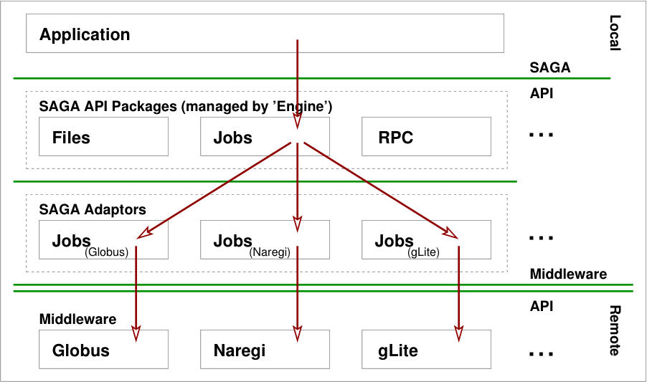
Implementation

Slide 11
SAGA Class Hierarchy

Slide 12
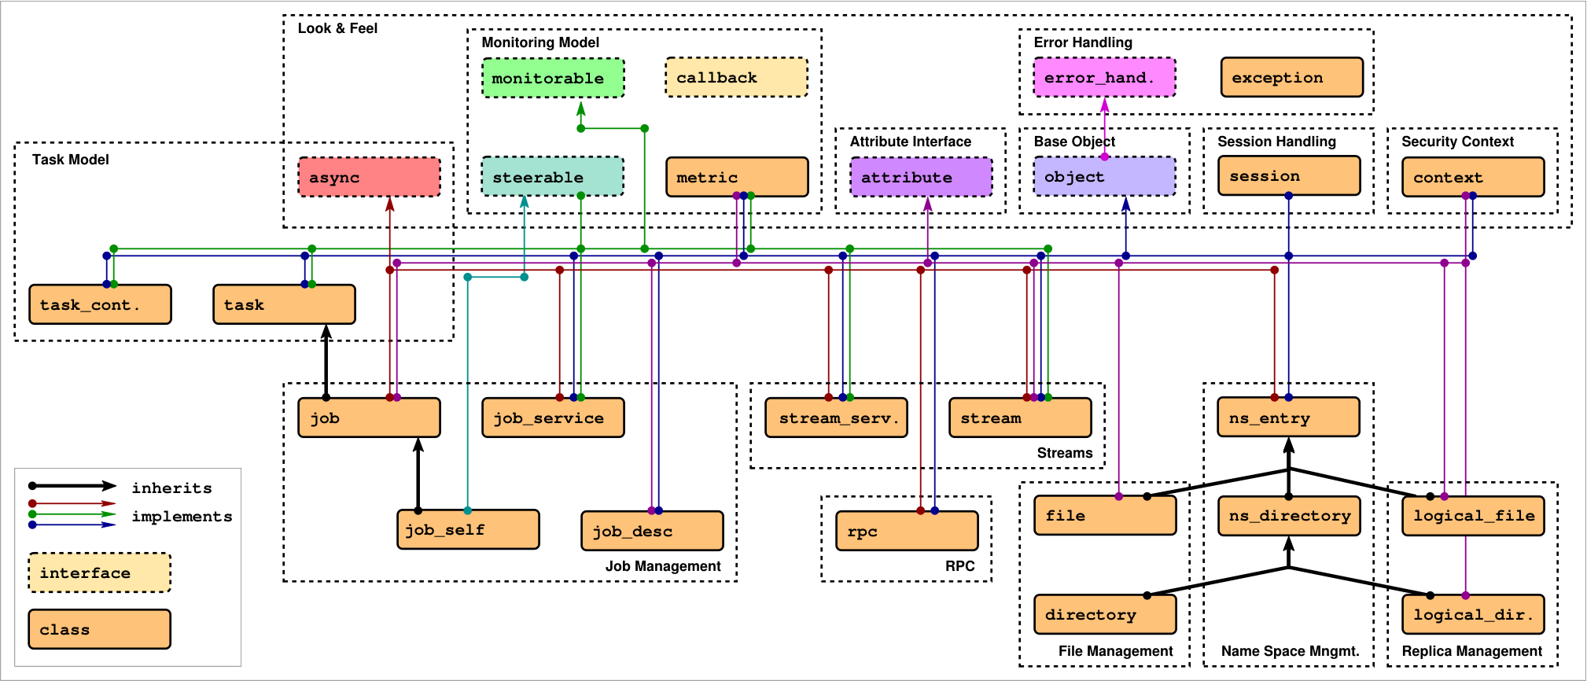
SAGA: Class hierarchy

Slide 13
SAGA: Class hierarchy
Functional API Packages

Slide 14
SAGA Job Package: Overview
running jobs is use case #1
all middlewares support it, one way or the other
well stablished patterns exist
job description
job state
submission endpoint
...

Slide 15
SAGA Job Package: Example 1
saga::job::description jd;
saga::job::service js ("gram://remote.host.net");
saga::job j = js.create_job (jd);
j.run ();
cout << "Job State: " << j.get_state () << endl;
j.wait ();
cout << "Retval " << j.get_attribute ("ExitCode") << endl;

Slide 16
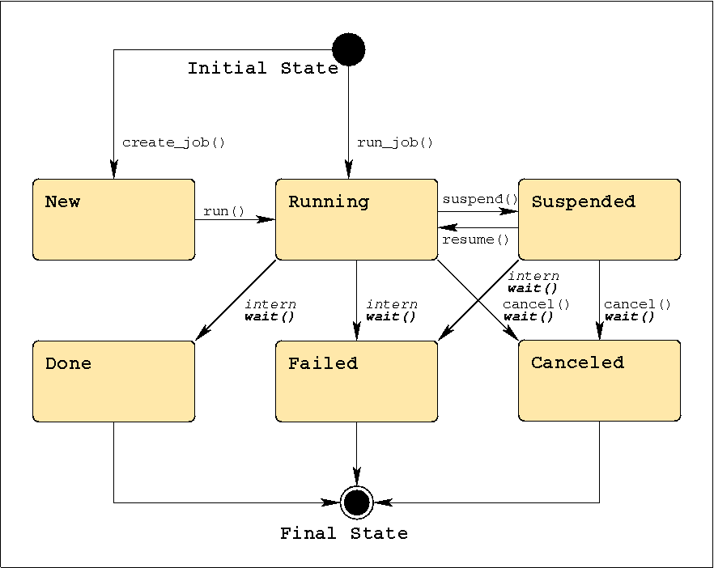
SAGA Job Package: job states

Slide 17
SAGA Job Package: job operations
j.run ();
j.wait ();
j.cancel ();
j.suspend ();
j.resume ();
j.signal (SIGUSR1);
j.checkpoint ();
j.migrate (jd);

Slide 18
SAGA Job Package: job description
saga::job::description jd;
jd.set_attribute ("Executable", "/bin/tail");
jd.set_attribute ("WorkingDirectory", "data/");
jd.set_attribute ("Cleanup", "False");
// pseudo code *blush*
jd.set_vector_attribute ("Arguments", ["-f", "my_log"]);
jd.set_vector_attribute ("Environment", ["TMPDIR=/tmp/"]);
jd.set_vector_attribute ("FileTransfer", ["my_log >> all_logs"]);

Slide 19
SAGA Job Package: job description
Executable Arguments Environment
CandidateHosts SPMDVariation TotalCPUCount
NumberOfProcesses ProcessesPerHost ThreadsPerProcess
WorkingDirectory Interactive Cleanup
Input Output Error
JobStartTime WallTimeLimit TotalCPUTime
TotalPhysicalMemory CPUArchitecture OperatingSystemType
Queue JobProject JobContact
FileTransfer

Slide 20
SAGA Job Package: job description
leaning heavily on JSDL, but flat
borrowing from DRMAA
mixes hardware, software and scheduling attributes!
cannot be extended
no support for 'native' job descriptions (RSL, JDL, ...)
only 'Executable’ is required
backend MAY ignore unsupported keys
cd /tmp/data && rm -rf *

Slide 21
SAGA Job Package: job service
saga::job::service js ("gram://remote.host.net/");
vector <string> ids = js.list (); // list known jobs
while ( ids.size () )
{
string id = ids.pop_back (); // fetch one job id
saga::job j = js.get_job (id); // reconnect to job
cout << id << " : " << j.get_state () << endl;
}

Slide 22
SAGA Job Package: job service
represents a specific job submission endpoint
job states are maintained on that endpoint (usually)
full reconnect may not be possible (I/O streaming)
lifetime of state up to backend
reconnected jobs may have different job description (lossy translation)

Slide 23
SAGA Namespace Package
interfaces for managing entities in name spaces
files, replicas, information, resources, steering parameter, checkpoints, . . .
manages hierarchy (mkdir, cd, ls, . . . )
entries are assumed to be opaque (copy, move, delete, ...)

Slide 24
SAGA Namespace Package: example
saga::name_space::directory d ("ssh://remote.host.net//data/");
if ( d.is_entry ("a") && ! d.is_dir ("a") )
{
d.copy ("a", "../b");
d.link ("../b", "a", Overwrite);
}
list <saga::url> names = d.find ("*-{123}.text.");
saga::name_space::directory tmp = d.open_dir ("tmp/data/1",
saga::name_space::CreateParents);
saga::name_space::entry data = tmp.open ("data.txt");
data.copy ("data.bak", Overwrite); // uses cwd

Slide 25
SAGA Namespace Package
name space entries are opaque: the name space package can never look inside
directories are entries (inheritance)
inspection: get_cwd(), get_url(), get_name(), exists(), is_entry(), is_dir(), is_link(), read_link()
manipulation: create(), copy(), link(), move(), remove()
permissions: permissions_allow(), permissions_deny()
wildcards are supported (POSIX influence...)

Slide 26
SAGA Filesystem Package
implements name space interface
adds access to content of namespace::entries (files)
POSIX oriented: read(), write(), seek()
optimizations: for distributed file access:
scattered I/O
pattern based I/O
extended I/O (from GridFTP)

Slide 27
SAGA Filesystem Package: Example
saga::filesystem::file f ("any://remote.host.net/data/data.bin");
char mem[1024];
saga::mutable_buffer buf (mem);
if ( f.get_size () >= 1024 )
{
buf.set_data (mem + 0, 512);
f.seek (512, saga::filesystem::Start);
f.read (buf);
}
if ( f.get_size () >= 512 )
{
buf.set_data (mem + 512, 512);
f.seek (0, saga::filesystem::Start);
f.read (buf);
}

Slide 28
SAGA Filesystem Package
provides access to the content of filesystem entries (sequence of bytes)
saga buffers are used to wrap raw memory buffers
saga buffers can be allocated/managed by the SAGA implementation
several incarnations of read/write: posix style, scattered, pattern based

Slide 29
SAGA Filesystem Package: Flags
enum flags {
None = 0,
Overwrite = 1,
Recursive = 2,
Dereference = 4,
Create = 8,
Exclusive = 16,
Lock = 32,
CreateParents = 64,
Truncate = 128, // not on name_space
Append = 256, // not on name_space
Read = 512,
Write = 1024,
ReadWrite = 1536, // Read | Write
Binary = 2048 // only on filesystem
}

Slide 30
SAGA Advert Package
persistent storage of application level information
semantics of information defined by application
allows storage of serialized SAGA objects (object persistency)
very useful for bootstrapping and coordinating distributed application components

Slide 31
SAGA Advert Package: Example
// example for browing my task adverts
saga::advert::directory todo ("any//remote.host.net/my_tasks/");
// pseudo vector code
list <saga::url> urls = todo.find ("*", ["priority=urgent"]);
while ( urls.size () )
{
saga::advert ad (urls.pop_front ());
std::cout << ad.get_attribute ("title") << std::endl;
std::cout << ad.get_attribute (« deadline") << std::endl;
std::cout << ad.get_attribute ("description") << std::endl << std::endl;
}

Slide 32
SAGA Advert Package: Example
// master side code: advertise (publish) a saga::file instance
saga::file f (url);
saga::advert ad ("any//remote.host.net/files/my_file_ad", Create);
ad.store_object (f);
// client side code: retrieve file instance
saga::advert ad ("any//remote.host.net/files/my_file_ad");
saga::file f = ad.retrieve_object ();

Slide 33
SAGA: Class hierarchy
Look & Feel Packages

Slide 34
SAGA Session: Example – default session
saga::ns_dir dir ("any://remote.host.net//data/");
if ( dir.is_entry ("a") && ! dir.is_dir ("a") )
{
dir.copy ("a", "../b");
dir.link ("../b", "a", Overwrite);
}
list <saga::url> names = dir.find ("*-{123}.text.");
saga::name_space::directory sub = dir.open_dir ("tmp/");
saga::name_space::entry entry = dir.open ("data.txt");
entry.copy ("data.bak", Overwrite);

Slide 35
SAGA Session: Properties
by default hidden (default session is used)
session is identified by lifetime of security credentials, and by objects in this session (jobs etc.)
session is used on object creation (optional)
saga::context can attach security tokens to a session
the default session has default contexts

Slide 36
SAGA Session: Example – explicit session
saga::context c1 (saga::context::X509);
saga::context c2 (saga::context::X509);
c2.set_attribute ("UserProxy", "/tmp/x509up_u123.special");
saga::session s;
s.add_context (c1);
s.add_context (c2);
saga::name_space::dir dir (s, "any://remote.host.net/data/");

Slide 37
SAGA Session: Lifetime
saga::dir dir (s, "gridftp://remote.host.net/data/");
saga::file file = dir.open ("data.bin");
s.remove_context (c1);
s.remove_context (c2);
file.copy ("data.bin.bak"); // this works – session is sticky!

Slide 38
SAGA Tasks
asyncronous operations are a MUST in distributed systems, and thus Grids
saga::task represents an asyncronous operation (e.g. file.copy ())
saga::task_container manages multiple tasks
tasks are stateful (similar to jobs)

Slide 39
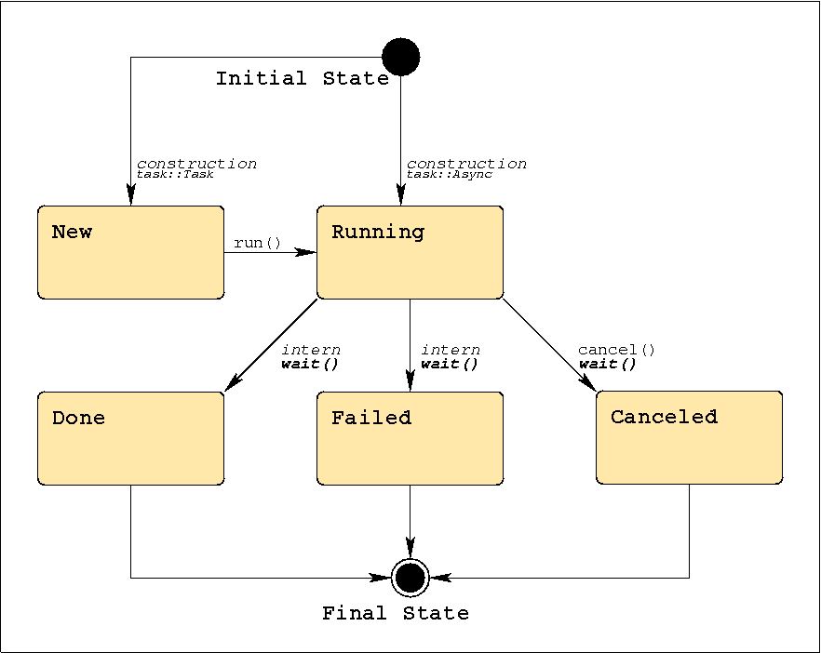
SAGA Tasks: States

Slide 40
SAGA Tasks
different versions for each method call: Sync, Async, Task
signature basically the same
differ in state of the task returned by that method
Sync: task is Done
Async: task is Running -> wait();
Task: task is New -> run(); wait();
delayed exception delivery
if ( saga::task::Failed == task.get_state () )
{
task.rethrow ();
}

Slide 41
SAGA Task: Example
// normal method call, synchronous
/* void */ file.copy ("data.bak");
// async versions, never throw (use ’rethrow()’ on failure)
saga::task t1 = file.copy <saga::task::Sync> ("data.bak.1");
saga::task t2 = file.copy <saga::task::Async> ("data.bak.2");
saga::task t3 = file.copy <saga::task::Task> ("data.bak.3");
// t1: Done
// t2: Running
// t3: New
t3.run (); // t3 now Running, too
t2.wait ();
t3.wait ();
// t1, t2, t3 are final (Done or Failed)

Slide 42
SAGA Task: Example
// normal method call, synchronous
size_t s = file.get_size ();
// async versions, never throw (use ’rethrow()’ on failure)
saga::task t1 = file.get_size <saga::task::Sync> ();
saga::task t2 = file.get_size <saga::task::Async> ();
saga::task t3 = file.get_size <saga::task::Task> ();
// get_result: implies wait() and rethrow(), and thus can throw!
size_t s1 = t1.get_result <size_t> ();
size_t s2 = t2.get_result <size_t> ();
size_t s3 = t3.get_result <size_t> ();

Slide 43
SAGA Task Container: Example
// create task container
saga::task_container tc;
// add tasks
tc.add (t1);
tc.add (t2);
tc.add (t3);
// collective operations on all tasks in container
tc.run ();
saga::task done_task = tc.wait (saga::task::Any);
tc.wait (saga::task::All);

Slide 44
SAGA Task Container: Tasks and Jobs
// NOTE:
// class saga::job : public saga::task
// task container can thus manage tasks *and* jobs:
saga::task task = file.copy <saga::task::Async> ("b");
saga::job job = js.run_job ("remote.host.net", "/bin/date");
saga::task_container tc;
tc.add (task);
tc.add (job);
tc.wait (saga::task::All);

