Slide 1
SAGA BigJob MapReduce

Slide 2
Introduction
What & Why MR programming model
Its implementation and what flexibility SAGA implementation of MR provides.
Earlier SAGA Implementation of MapReduce( Include only in Thesis documentation ) and its disadvantages.
SAGA BigJob introduction.
What is new with SAGA BigJob MR Implementation & its impact..

Slide 3
Objectives
Implement a data intensive application with SAGA BigJob MR & pilot store and experiment it on clouds & grids.

Slide 4
Infrastructure used
Futuregrid Sierra grid
Eucalyptus cloud on sierra.

Slide 5
Work Done
SAGA BigJob MR framework developed.
Ran experiments on futuregrid sierra (grid).
Comparison of these results with c++ SAGA MR and analysis of performance of both the implementation. ( Might not be useful for paper as we concentrate more on the implementation & results of BigJob MR)
Ran c++ MR using hadoop filesystem and did hadoop TestDFSIO benchmarking with. ( left in middle )
Wrote rough abstraction for MR Paper.

Slide 6
Results.
Used wordcount application
Ran experiments on sierra futuregrid machine
Varying Input Size; number of reduces, chunk size constant.
Varying chunk size, number of reduce, input size constant.
Varying number of bigjobs, number of reduces, chunk & input sizes constant.

Slide 7
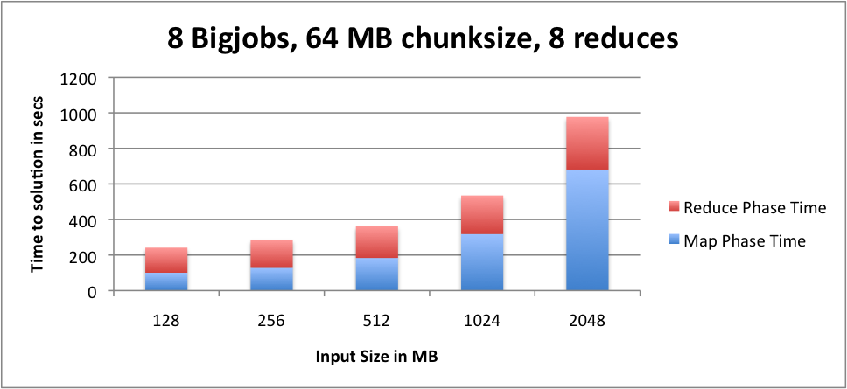
Experiment: Varying Input Size; number of reduces, chunk size constant. Type of bigjob: Used parallel version of bigjob( latest with single thread ) Distributed: logically distributed ( Used multiple bigjobs on sierra ) Number of processes for each worker : 8 BigJob size = 1 node;ppn 8

Slide 8
Inferences
Linear increase in time to solution as the input size increases. Nothing surprising..But < tts of c++ MR implementation. This is because the Data is sorted in both phases of MapReduce in C++ MR.
As the number of threads increases the time to solution decrease and results in increased performance. With one thread 9-17% performance improvement observed.
Due to latencies in accessing advert server there are some inconsistency problems.. So used only single thread..

Slide 9
scenario
The increase is due to overhead invovled in distributing jobs across mulitple bigjobs?

Slide 10
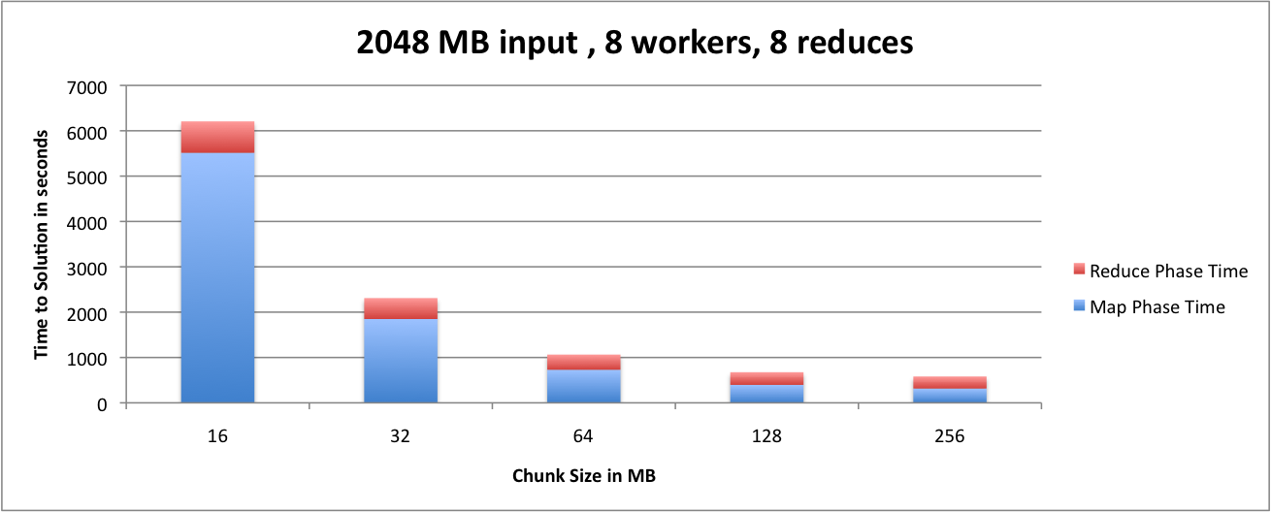
Experiment: Varying chunk Size; number of reduces, Input size constant. Type of bigjob: Used parallel version of bigjob( latest with single thread ) Distributed: logically distributed ( Used multiple bigjobs on sierra ) Number of processes for each worker : 8 BigJob size = 1 node;ppn 8

Slide 11
Inferences
Time to solution decreased as the chunk size increase.
Best chunk – 256MB ( as each bigjob will have only one task to execute and max parallelism achieved )
Problem observed : when the chunk size is small ( 16MB ) then the job is completed quickly and next job is executed on the same machine which affects the distributedness.

Slide 12
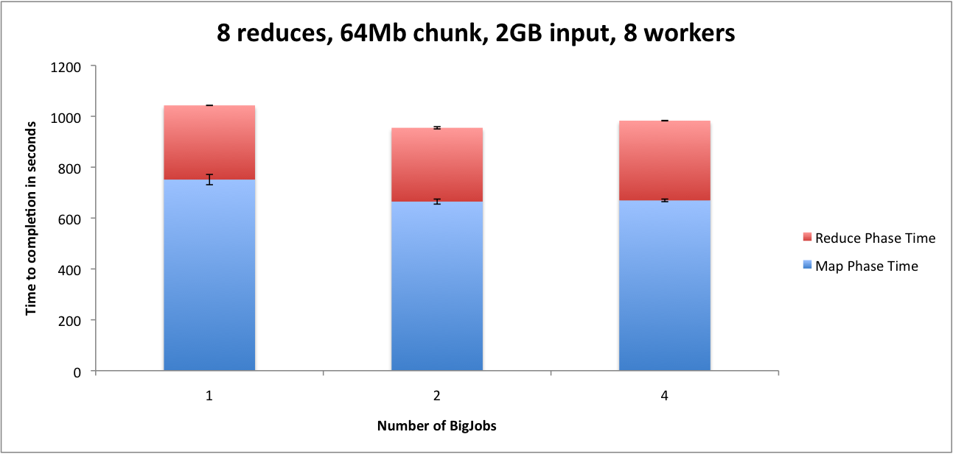
Experiment: Varying number of bigjobs ; chunk size, number of reduces, Input size constant. Type of bigjob: Used parallel version of bigjob( latest with single thread ) Distributed: logically distributed ( Used multiple bigjobs on sierra ) Number of processes for each worker : 8 BigJob size = 1 node;ppn 8

Slide 13
Road Blocks
Distributed MR is possible only if there is globus on the grid. PBSPro is available & Globus is not available on futuregrid.
Eucalyptus usage.

Slide 14
Last week changes..
Fixed problems with csa saga installation on futuregrid.
Scientific MR Applications :
Large Scale DNA Sequence Analysis
BLAST
Next generation sequencing
Rapid Parallel Genome Indexing with MapReduce
MapReducing a Genomic Sequencing Workflow
Pairwise Element Computation with MapReduce

Slide 15
TO DO
Architecture of MR.
Integrating MR with application.
Redo experiments with new application on both grid & futuregrid & cloud.
Other tasks – enhancing bigjob to be more user friendly.

