Slide 1
Characterizing Deep Sequencing Analytics Using BFAST: Towards a Scalable Distributed Architecture for Next-Generation Sequencing Data
Joohyun Kim, Sharath Maddineni, Shantenu Jha
http://saga.cct.lsu.edu and http://dare.cct.lsu.edu/
Emerging Computational Methods for Life Sciences, 2011
Notes:
Added slide 3
I think there will not be time to focus on “assertion based” approach, i.e slides 4-7. Possibly include slide 8

Slide 2
Overview
NGS Analytics
BFAST as an example of NGS alignment Analytics
BFAST computational characterization
Tradeoffs: Com. vs Mem. vs I/O vs DoD
Sensitive to specific data-set size
DARE-based Gateway
XD/FutureGrid Solution: Architecture, Performance and Scalability
Towards Lessons and Experience from DARE-based Gateway
Understand the present challenges for LS Applications on Cloud
Understanding common computational characteristics

Slide 3
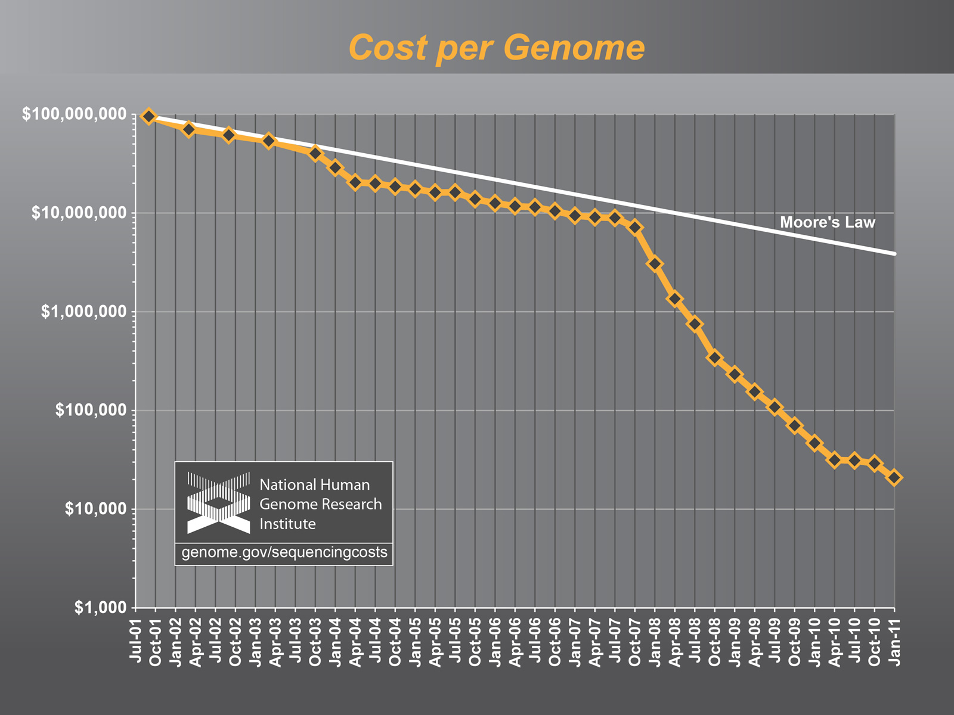
NGS Analytics

Slide 4
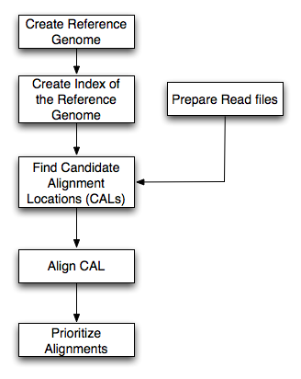
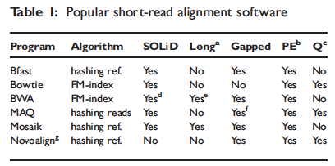
BFAST: A prototype for NGS Analytics
Most software is associated with specific sequencing instruments
Multi-stage, but focus on alignment/mapping
Classify most alignment software into categories based upon based upon indexing property
Hash-based and Tree-based
Relative to other alignments programs, BFAST has:
higher sensitivity
large memory and disk requirements
Data types:
Short read data
Reference Index data

Slide 5
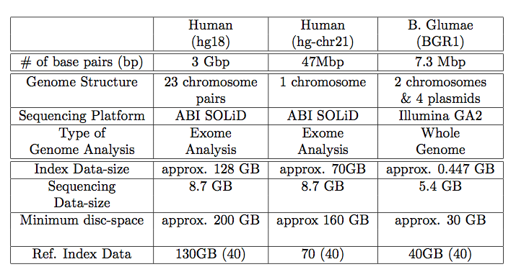
BFAST: A prototype for NGS Analytics
Supports Advanced features:
Multi-threading support
Low-memory option (index file splitting)
Breaking up short-read data permits task-level concurrency
Each task requires full reference genome possible I/O bottleneck
Distribute to overcome I/O bottleneck?
Tradeoffs:
Com. vs Mem. vs I/O vs DoD
Sensitive to specific data-set size
Ref. Genome
Mapping
(Bfast)
SNP finding
NGS short reads

Slide 6
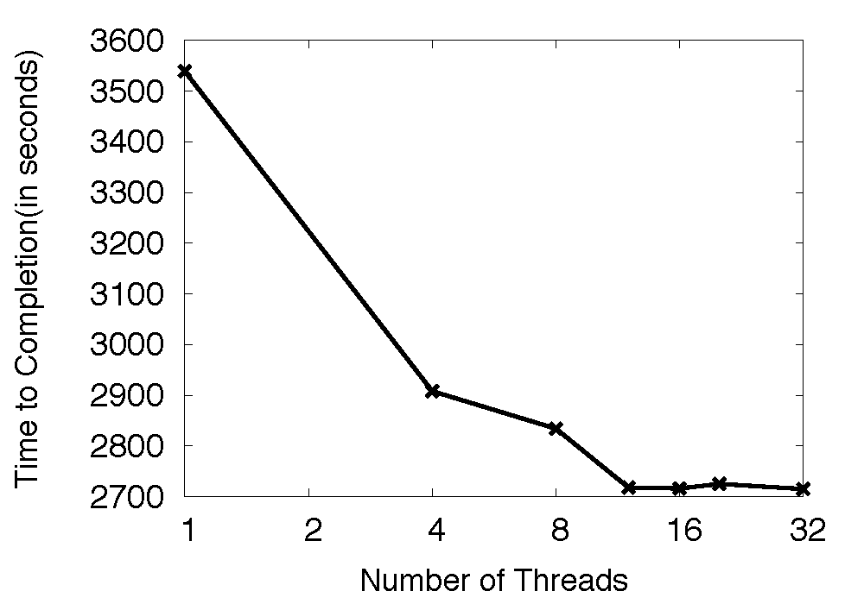
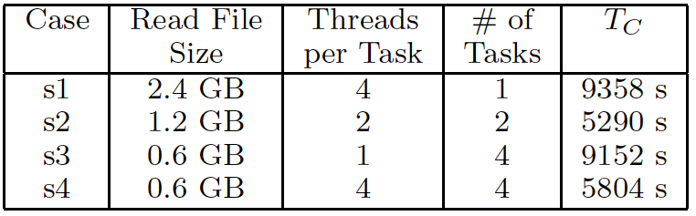
BFAST Tradeoffs: Comp. vs Mem. vs I/O vs DoD
Possible solution: Logical and then physical distribution

Slide 7
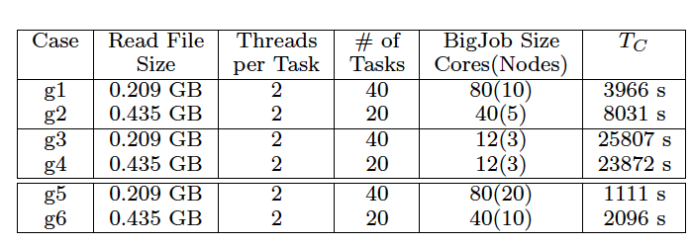
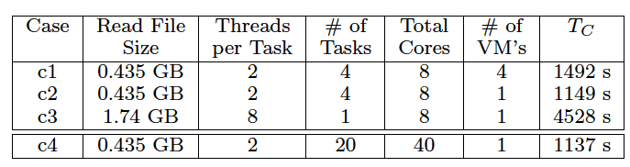
DARE-NGS : Mapping on Scalable Distributed HPC resources
Notes:
This will be very hard to read!

Slide 8
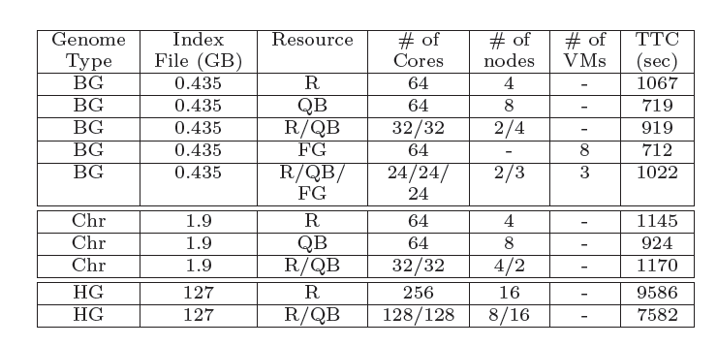
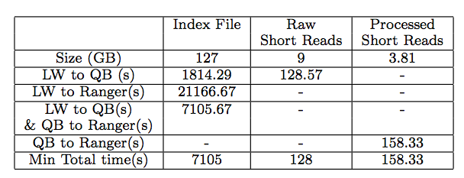
Tradeoffs: Comp. vs Mem. vs I/O vs DoD
Notes:
(JK) Here, upper two tables represent the benefits of task level concurrency and scale-out strategy

Slide 9
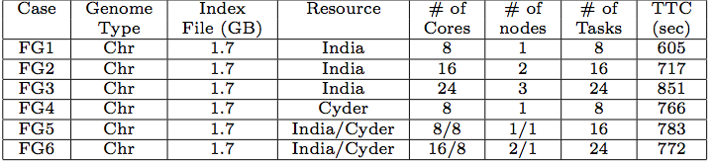
BFAST: Characterisation

Slide 10

SAGA: In a nutshell
There exists a lack of Programmatic approaches that:
Provide general-purpose, basic & common distributed functionality for applications; hide underlying complexity, varying semantics..
The building blocks upon which to construct “consistent” higher-levels of functionality and abstractions
Meets the need for a Broad Spectrum of Applications
Simple scripts, Gateways, Tooling, Workflow…
Simple, integrated, stable, uniform and community-standard
Simple and Stable: 80:20 restricted scope
Integrated: Similar semantics & style across primary functional areas
Uniform: Same interface for different distributed systems
OGF-standard, “official” Access Layer/API of EGI, NSF-XD
Standards-based approach: A Technical and an Economic (Moral?) imperative & case:

Slide 11
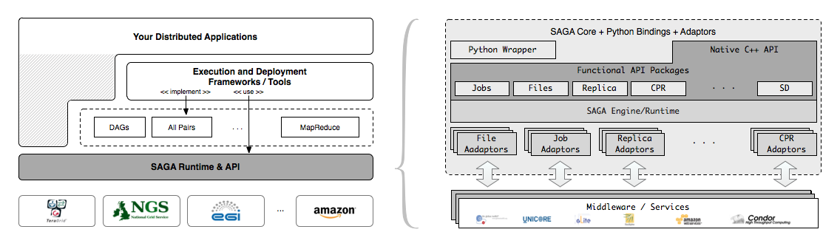
SAGA – An Overview

Slide 12
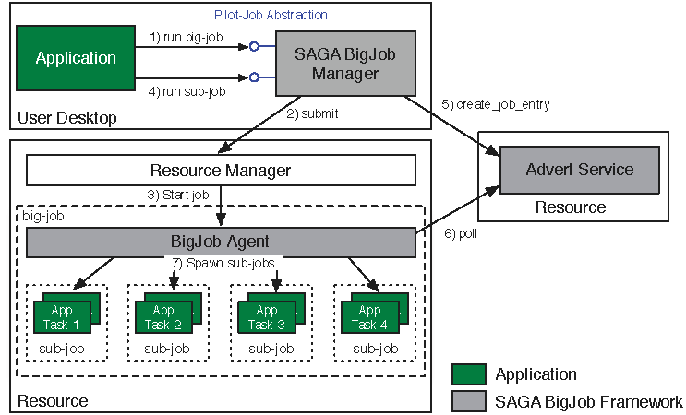
Abstractions for Dynamic Execution SAGA Pilot-Job (BigJob)

Slide 13
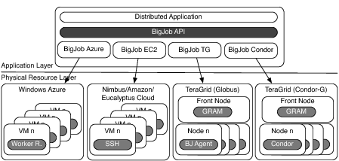
Deployment & Scheduling of Multiple Infrastructure Independent Pilot-Jobs

Slide 14
What is “unique” about Pilot-Jobs built using the right abstractions?
Pilot-Jobs: Decouple resource assignment & resource-workload binding
Pilot-Jobs are/have been typically used for:
Enhancing resource utilization; Facilitate high-throughput simulation
Lowering wait time for multiple jobs (better predictability)
Several unique aspects about the SAGA-based Pilot-Job
Pilot-Jobs have not been used for Science Driven Objectives:
First demonstration of multi-physics simulations, REMD simulations
Frameworks based upon PJs (pull model) for specific back-ends
Infrastructure Independent and “standard” PJ API to access other PJs
SAGA PJ (BigJob) API basis for inter-operable PJ (Azure, DIANE)
SAGA-based Pilot-Job form the basis for
Extension of Pilot-abstraction to other “dimensions”
For autonomic scheduling and application-level scheduling
Advanced run-time frameworks for load-balancing and FT

Slide 15
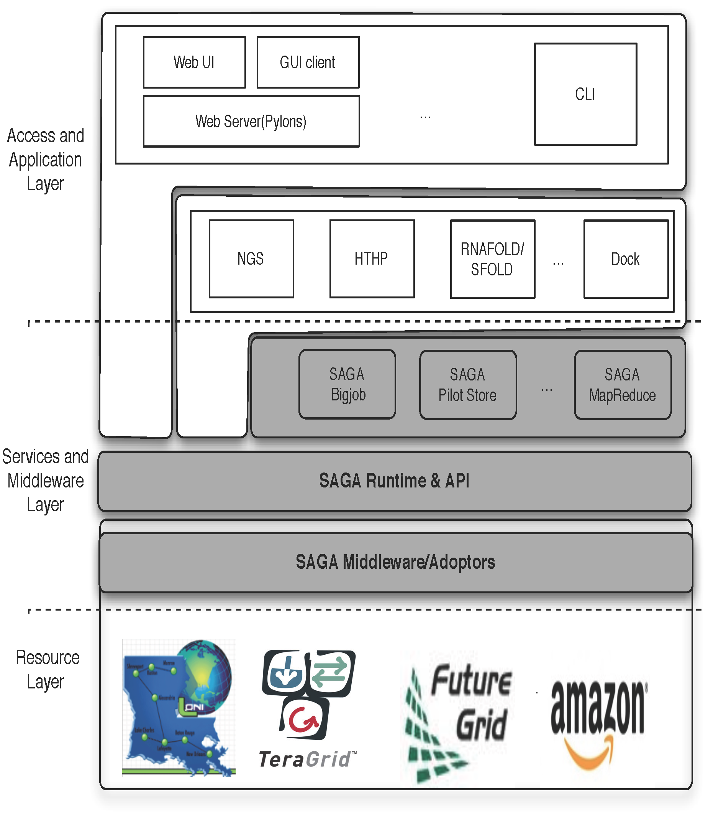
DARE-based Science Gateways
Provides fundamental abstractions for Dynamic and Adaptive Execution
Integrated compute and data
Efficient and novel runtime environments for Map-Reduce
Interoperable across DCI
Extensible: new features and abstractions
Notes:
Fixed the diagram.. Please remove next slide if you are OK with this

Slide 16
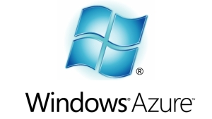
Towards NGS Analytics as a Service: DARE-based Gateway on XD
Some NGS specific challenges
Efficient Algorithm/tool/code selection
Hosting pre-installed VM
Efficient task scheduling and placement
What can we learn from HEP? WMS?
Efficient Distributed data management
Efficient Data transfer/scheduling
Transfer of Ref. genome index files:
O(hours) 130 GB,
Transfer of Short read files:
O(mins) [L to QB] 9 GB
Determine optimal point -- tradeoff
http://dare.cct.lsu.edu/gateways/ngs

Slide 17
Clouds Present: Novel or more of the same?
Clouds address several “barriers” of decade past
Better control over software environment via virtualization
Illusion of unlimited and immediate available resource can lead to better capacity planning and scheduling
Clouds do not remove many/all of the challenges inherent in DA
Clouds are about provisioning, grids are about federation
Fundamental challenges in logical and physical distribution remain
Makes some thing worse as impose a model of strong localization
If Clouds part of a larger, richer distributed CI
Certain tasks better suited for Grids, others on Clouds
Clouds represent a natural and positive evolution but will need a careful interplay of application and system-level abstractions
Notes:
“Clouds are about provisioning, grids are about federation”
“IF you can keep your head when all about you, Are losing theirs and blaming it on you..”
“The reason why we are so well prepared to handle the multi-core era, is because we took the trouble to understand parallel programming

Slide 18
What are the Challenges for LS Applications on Clouds?
Data-Intensive Distributed Applications Revisited
Where, when, how to distribute? How to manage coordination?
What is the task decomposition granularity? Mapping to resources?
What are the data transfer/access/storage mechanisms
Life-Science Applications have
Multi-parametric trade-offs exist: Mem vs I/O vs CPU vs DoD
NGS: Sequence length variation
Need to support distributed, dynamic loads
DA challenges need to be addressed dynamically!
Resource Elasticity/Cloudburst + Heterogeneous task-resource binding and need to for application configuration trade-offs
When to move data to compute, compute to data?

Slide 19
What are the Challenges for LS Applications on Clouds?
What is the Cloud infrastructure configuration?
No well-defined single infrastructure configuration or capabilities
Contrast: Astronomy, HEP - Application characteristic better defined
“Why is the TeraGrid is not used for data-intensive applications”
Is it just about storage? Or is it about data transfer?
“Building this infrastructure is not trivial” (Fox)
Need Abstractions to Support Dynamic Applications
Both Development and System/Infrastructure level abstractions
There are “hard” parts and tractable parts
SAGA handles the hard part, opening up innovation elsewhere
Moving compute to data: Is the data localization model imposed by Clouds scalable and/or sustainable" ?

Slide 20
Conclusions
LS Applications – compute and data intensive present broad range of challenges at scale
Ready/Need for community provided solution on XD
Extensions to abstractions for dynamic data

Slide 21
Acknowledgements
SAGA Team and contributors: http://saga.cct.lsu.edu
Futuregrid Acknowledgement
This document was developed with support from the National Science Foundation (NSF) under Grant No.0910812 to Indiana University for "FutureGrid: An Experimental, High-Performance Grid Test-bed." Any opinions, findings, and conclusions or recommendations expressed in this material are those of the author(s) and do not necessarily reaect the views
Also Acknowledge useful discussions:
Geoffrey Fox and Jon Weissman

Slide 22
BFAST: A prototype for NGS Analytics
Classify most alignment software into categories based upon the property of the indexing
Hash-based and Tree-based
BFAST Higher sensitivity (CAL finding and gapped Smith-Waterman alignment)
Relatively large memory and disk space
Data types: (i) Short- Read (ii) Reference (iii) Index data
Supports Advanced features: (i) Multi-threading support (ii) Low-memory option (index file splitting)
Breaking up short-read data permits task-level concurrency
Each Task requires full reference genome – possible I/O bottleneck
Distribute to over I/O bottleneck?
Tradeoffs: Comp. vs Mem. vs I/O vs DoD
Sensitive to specific data-set size

Slide 23
BFAST: Configuration values for problem sizes
 |  | B. Glumae (BG) | Human Genome (HG) | HG - Chr 21
Genome Size |  | 7 Mbp | 2.8Gbp (hg18) | 47 Mbp (hg18-chr21)
NGS Type |  | Whole Genome | Exome | Exome
NGS Data Size |  | 12.6 GB | 5.6 GB | 5.6 GB
Ref. Index Data | 40 index files | 40 GB | 130 GB | 70 GB
 | 10 index files
Minimum Memory | 40 index files | 9.5 MB | 3 GB | 42 MB
 | 10 index files | 38 MB | 12 GB | 164 ΜΒ

Slide 24
BFAST: Configuration values for problem sizes

