Slide 1



Introduction to the SAGA API

Slide 2
Agenda
background recap
API structure and scope
API walkthrough
implementation details
API extensions

Slide 3
Grid APIs and Frameworks
Middleware often targets legacy applications (Unicore, Globus, Condor, ...)
some APIs are distribution aware (MPICH-G, Ninf-G, . . . )
few APIs exist for Grid aware applications
GridFTP/GRAM
DRMAA
gLite
CoG
GAT
Cloud APIs

Slide 4
Grid APIs: some observations
diversity of (Grid) middleware implies diversity of APIs
middleware APIs are often a by-product
APIs are difficult to sync with middleware development, and to stay simple
successful APIs generalize programming concepts
MPI, CORBA, COM, RPC, PVM, SSH, …
no new API standards for distributed computing
!standard: Globus, gLite, Unicore, Condor, iRods, …

Slide 5
Open Grid Forum (OGF)
The Open Grid Forum (aka GF, EGF, GGF, EGA) standardizes distributed computing infrastructures/MW
e.g. gridFTP, JSDL, OCCI, …
focuses on interfaces, but also protocols, architectures, APIs
driven by academia, but some buy-in / acceptance in industry
cooperation with SDOs like SNIA, DMTF, IETF, etc.

Slide 6
APIs within OGF
OGF focuses on services
numerous service interfaces
often WS-based, but also REST, others
some effort on higher level APIs
Distributed Resource Management Application API (DRMAA)
Remote Procedure Calls (GridRPC)
Checkpoint and Recovery (GridCPR)
[ Job Submission and Description Language (JSDL) ]

Slide 7
OGF: DRMAA
implementable on all major resource management services
simple means to define and submit jobs
basic job management features (status, kill)
job templates for bulk job management
DRMAA.v2 is expected by end of 2010 (oops)
OO
extended
SAGA aligned !

Slide 8
DRMAA Example
drmaa_job_template_t * job_template;
if ( ! ( job_template = create_job_template (exe, 5, 0) ) )
{
fprintf (stderr, "create_job_template failed\n");
return 1;
}
while ( ( drmaa_errno = drmaa_run_job (job_id,
sizeof (jobid)-1,
job_template,
diagnosis,
sizeof (diagnosis)-1) )
== DRMAA_ERRNO_DRM_COMMUNICATION_FAILURE )
{
fprintf (stderr, "drmaa_run_job failed: %s\n", diagnosis);
sleep (1);
}

Slide 9
OGF: GridRPC
standardizes the three existing RPC implementations for Grids (Ninf-G, DIET)
example of ’gridified API’
simple: get function handle, call function
explicit support for asynchronous method calls
GridRPC.v2 adds support for remote persistent data handles
SAGA aligned !

Slide 10
OGF: GridRPC
double A[N*N], B[N*N], C[N*N];
initMatA (N, A);
initMatB (N, B);
grpc_initialize (argv[1]);
grpc_function_handle_t handle;
grpc_function_handle_default (&handle, "mat_mult");
if ( grpc_call (&handle, N, A, B, C) != GRPC_NO_ERROR )
{
exit (1);
}
grpc_function_handle_destruct (&handle);
grpc_finalize ();

Slide 11
OGF: GridCPR (Checkpoint & Recovery)
Grids seem to favor application level checkpointing
GridCPR
allows to manage checkpoints
defines an architecture, service interfaces, and scope of client API
SAGA aligned !
not many implementations exist, usage declining
virtualized hardware makes CPR somewhat superfluous

Slide 12
OGF: JSDL
extensible XML based language for describing job requirements
does not cover resource description (on purpose) does not cover workflows, or job dependencies etc (on purpose)
JSDL is extensible (ParameterSweep, SPMD, ...)
top-down approach
SAGA leans on JSDL for job description
future revisions of SAGA will support JSDL directly

Slide 13
OGF: JSDL
<jsdl:JobDefinition>
<JobDescription>
<Application>
<jsdl-posix:POSIXApplication>
<Executable>/bin/date</Executable>
</jsdl-posix:POSIXApplication>
</Application>
<Resources ...>
<OperatingSystem>
<OperatingSystemType>
<OperatingSystemName>LINUX</OperatingSystemName>
</OperatingSystemType>
</OperatingSystem>
</Resources>
</JobDescription>
<jsdl:JobDefinition>

Slide 14
OGF: Summary
some high-level API specs exist in OGF, and are successful
OGF APIs do not cover the complete OGF scope
the various API standards are disjoint
WSDL as service interface specification cannot replace an application level API (wrong level of abstraction)
SAGA tries to address these issues

Slide 15
OGF: top-down vs. bottom-up
bottom-up often agrees on (semantic) LCD + backend specific extensions
top-down usually focuses on semantics of application requirements
bottom-up tends to be more powerful
top-down tends to be simpler and more concise
we very much prefer top-down!

Slide 16
SAGA
SAGA
Simple API for Grid Applications

Slide 17
SAGA Design Principles
SAGA: Simple API for Grid Applications
OGF approach to a uniform API layer (facade)
governing principle: 80:20 rule
simplicity versus control!
top-down approach
use case driven!
defines application level abstractions
extensible
stable look & feel
API packages
API Specification is language independent (IDL)
Renderings exist in C++, Python, Java
Examples here are in C++

Slide 18
SAGA Intro: Example 1
// SAGA: File Management example
saga::filesystem::directory dir ("any://remote.host.net//data/");
if ( dir.exists ("a") && ! dir.is_dir ("a") )
{
dir.copy ("a", "b", Overwrite);
}
list <saga::url> names = dir.find ("*-{123}.txt");
saga::filesystem::directory tmp = dir.open_dir ("tmp/", Create);
saga::filesystem::file file = dir.open ("tmp/data.txt");

Slide 19
SAGA Intro: Example 1
API is clearly POSIX (libc + shell) inspired
where is my security??
what is ’any://’ ???

Slide 20
SAGA Intro: Example 2
// SAGA: Job Submission example
saga::job::description jd;
// details left out
saga::job::service js ("any://remote.host.net/");
saga::job::job j = js.create_job (jd);
j.run ();
cout << "Job State: " << j.get_state () << endl;
j.wait ();
cout << "Retval " << j.get_attribute ("ExitCode") << endl;

Slide 21
SAGA Intro: Example 2’
// SAGA: Job Submission example
saga::job::service js ("any://remote.host.net");
saga::job::job j = js.run_job ("touch /tmp/touch.me");
cout << "Job State: " << j.get_state () << endl;
j.wait ();
cout << "Retval " << j.get_attribute ("ExitCode") << endl;

Slide 22
SAGA Intro: Example 2
stateful objects!
yet another job description language? :-(
many hidden/default parameters
keeps call signatures small
’any://’ again!
TIMTOWTDI (there is more than one way to do it)

Slide 23
SAGA Intro: 10.000 feet
object oriented: inheritance, interfaces very moderate use of templates though!
functional and non-functional elements strictly separated
non-functional API:
look & feel: orthogonal to functional API
typically not mappable to remote operations
functional API:
API ’Packages’ extensible
typically mappable to remote operations
few inter-package dependencies - allows for partial implementations

Slide 24
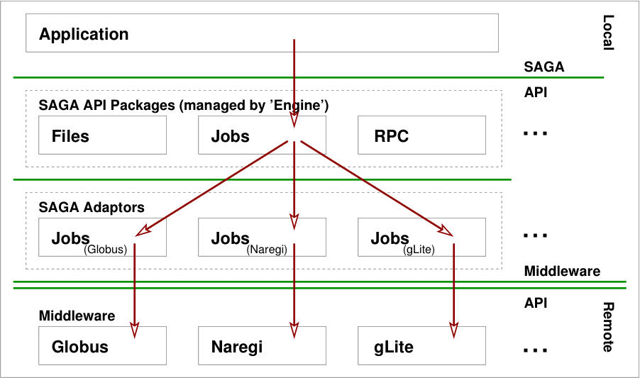
Implementation

Slide 25
SAGA Class Hierarchy

Slide 26
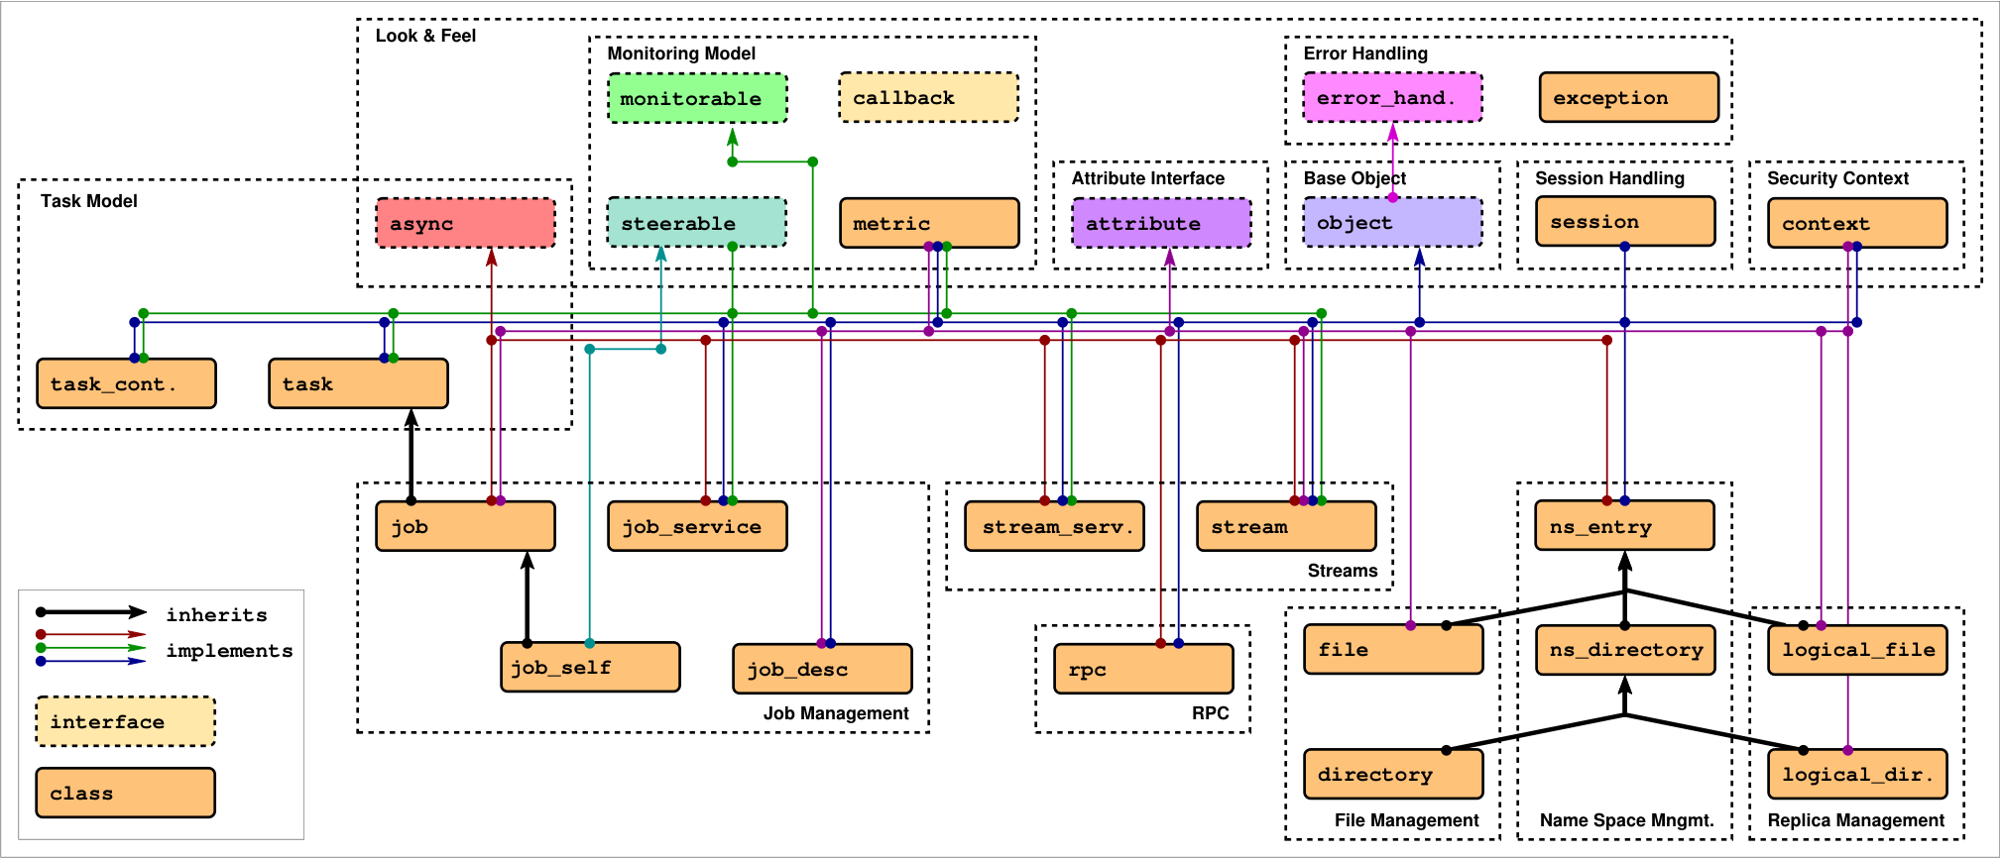
SAGA: Class hierarchy

Slide 27
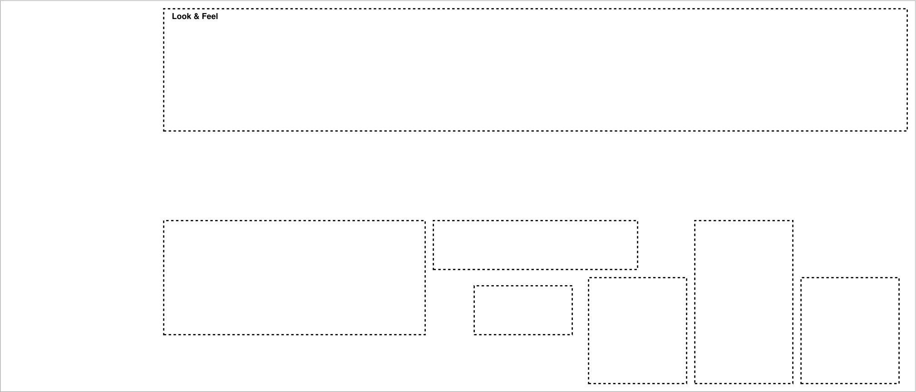
SAGA Class hierarchy

Slide 28
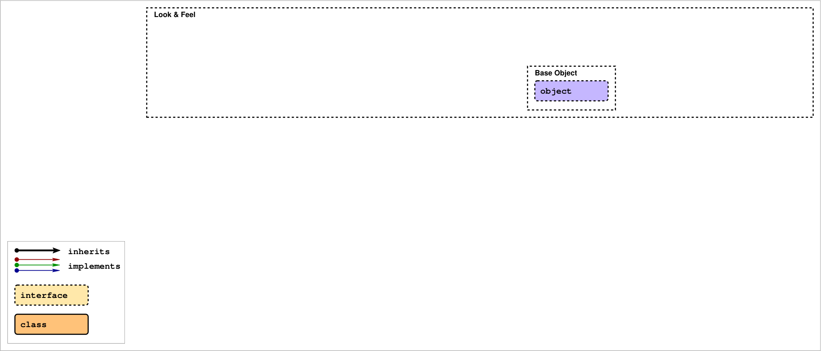
SAGA Class hierarchy
SAGA Look & Feel:
saga::object allows for object uuids, clone() etc.

Slide 29
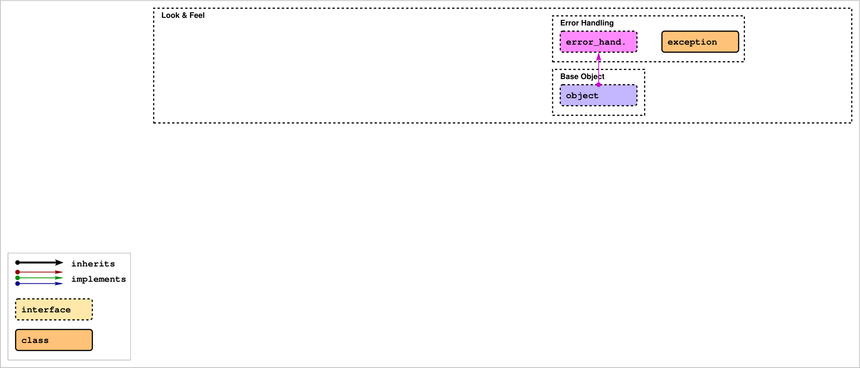
SAGA Class hierarchy
SAGA Look & Feel:
Errors are based on exceptions or error codes.

Slide 30
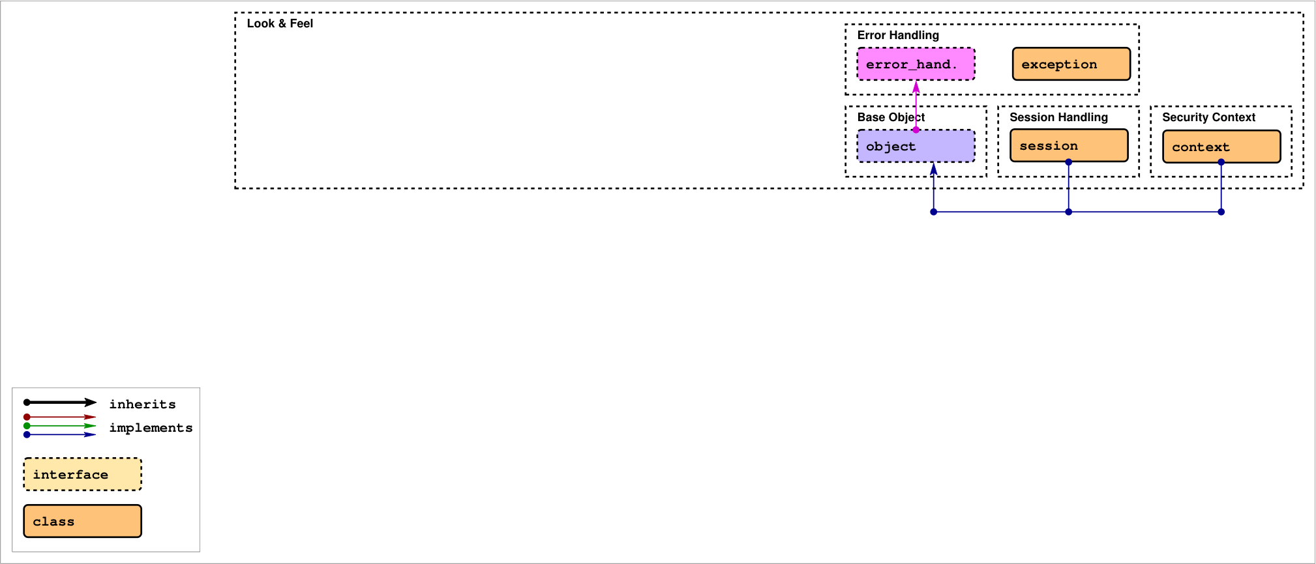
SAGA Class hierarchy
SAGA Look & Feel:
Session and credential management is hidden.

Slide 31
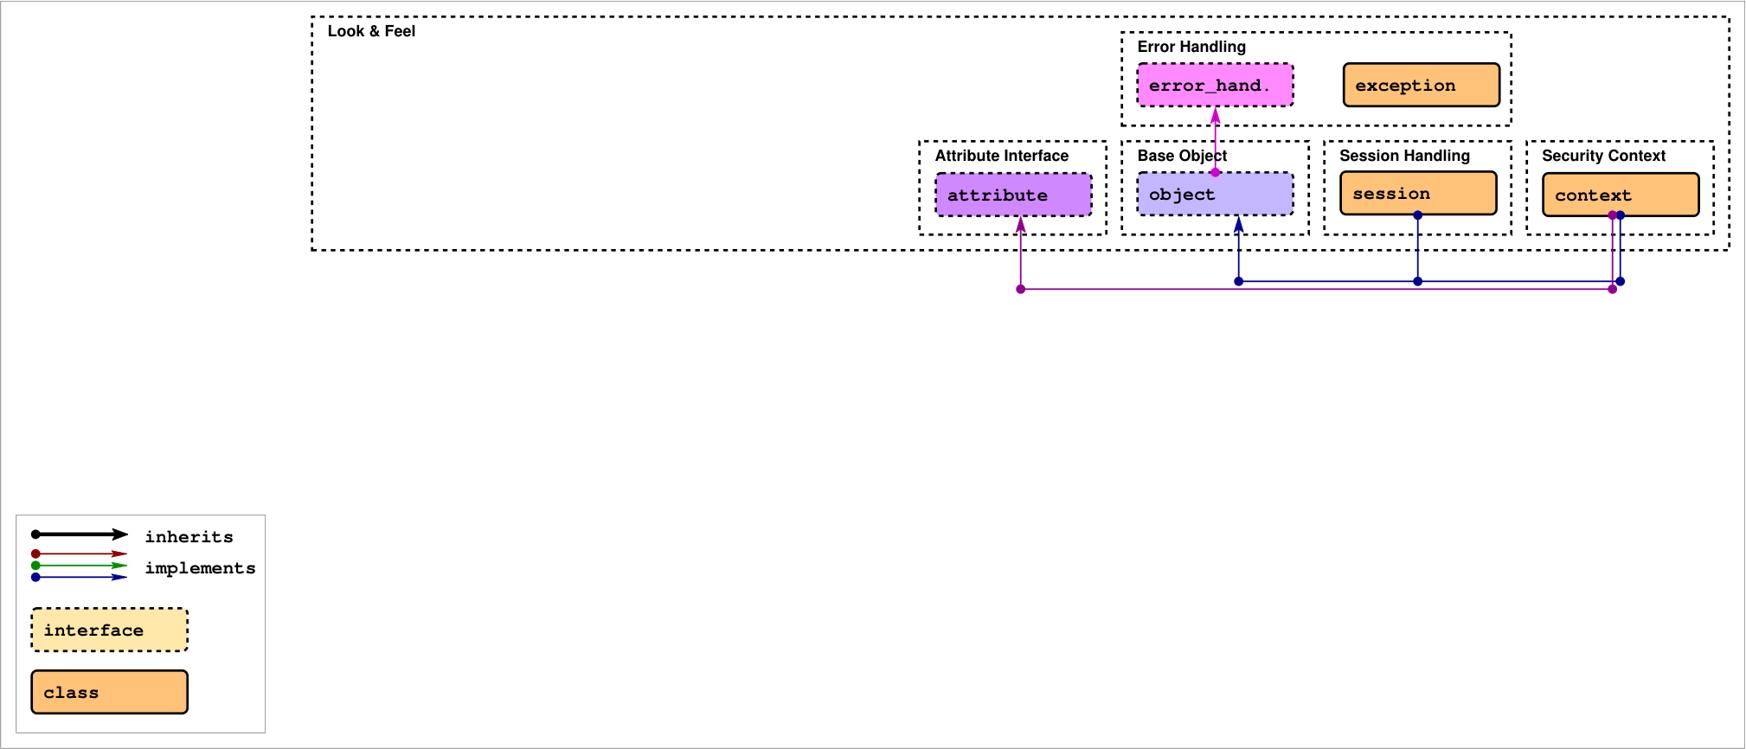
SAGA Class hierarchy
SAGA Look & Feel:
Attribute interface for meta data.

Slide 32
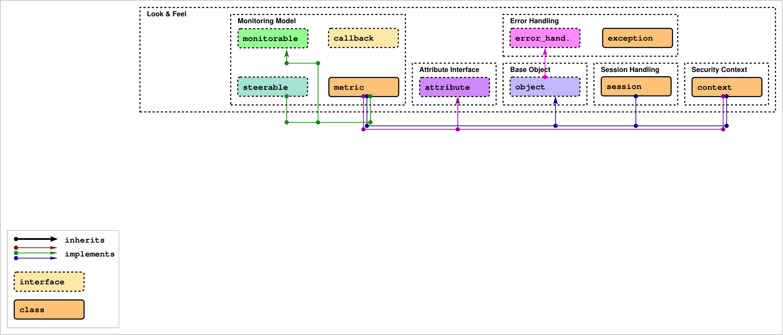
SAGA Class hierarchy
SAGA Look & Feel:
Monitoring includes asynchronous notifications.

Slide 33
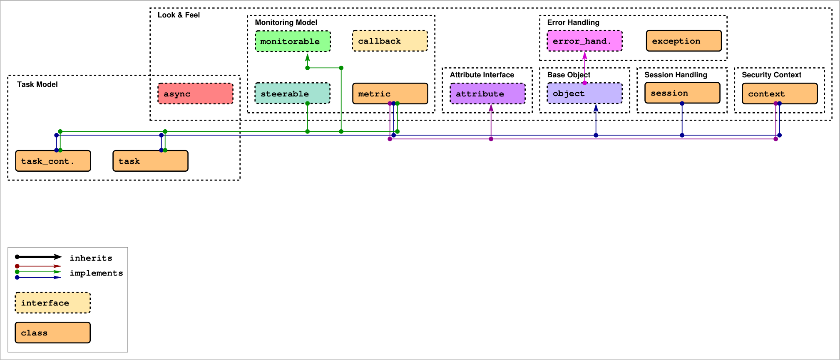
SAGA Class hierarchy
SAGA Look & Feel:
The task model adds asynchronous operations.

Slide 34
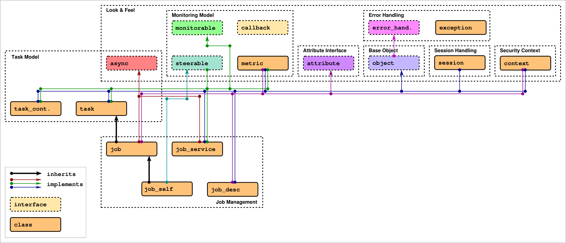
SAGA Class hierarchy
SAGA API Package 'job':
Create and manage remote processes.

Slide 35
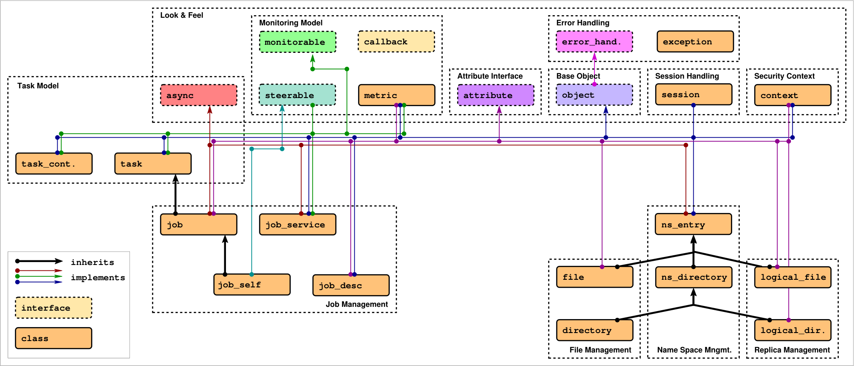
SAGA Class hierarchy
SAGA API Package ‘name_spaces':
Manage files, replicas, etc.

Slide 36
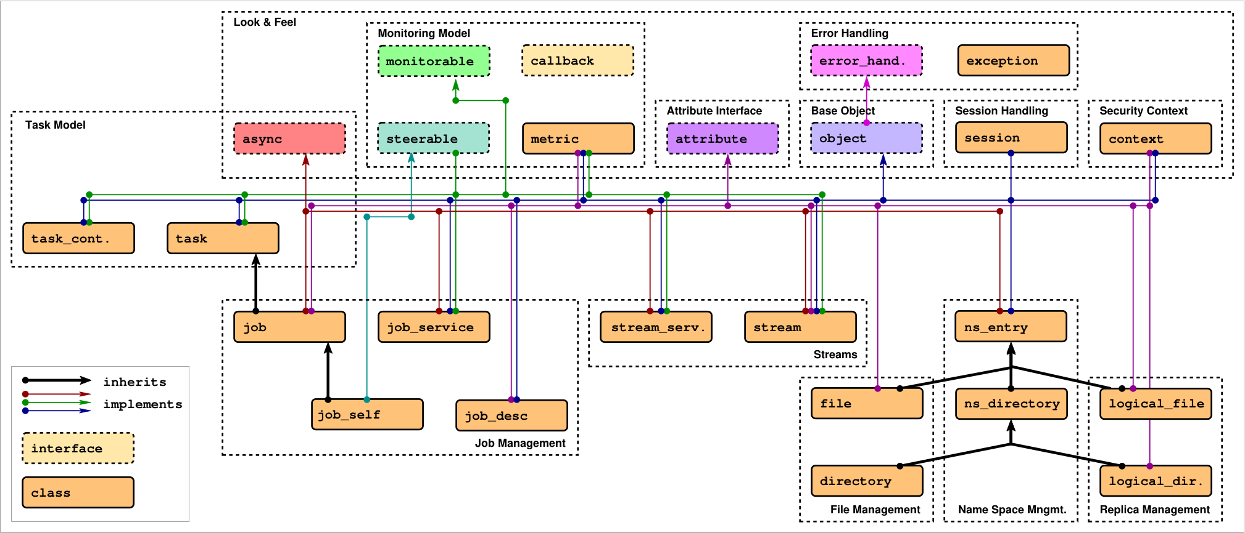
SAGA Class hierarchy
SAGA API Package ‘stream':
SAGA rendering of BSD streams.

Slide 37
SAGA Class hierarchy
SAGA API Package ‘rpc':
Remote procedure calls.

Slide 38
SAGA: Class hierarchy
Functional API Packages

Slide 39
SAGA Job Package: Example 1
saga::job::description jd;
saga::job::service js ("gram://remote.host.net");
saga::job j = js.create_job (jd);
j.run ();
cout << "Job State: " << j.get_state () << endl;
j.wait ();
cout << "Retval " << j.get_attribute ("ExitCode") << endl;

Slide 40
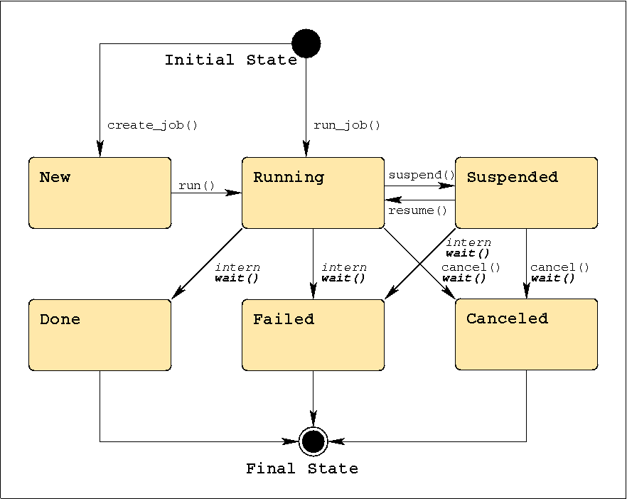
SAGA Job Package: job states

Slide 41
SAGA Job Package: job operations
j.run ();
j.wait ();
j.cancel ();
j.suspend ();
j.resume ();
j.signal (SIGUSR1);
j.checkpoint ();
j.migrate (jd);

Slide 42
SAGA Job Package: job description
saga::job::description jd;
jd.set_attribute ("Executable", "/bin/tail");
jd.set_attribute ("WorkingDirectory", "data/");
jd.set_attribute ("Cleanup", "False");
// pseudo code *blush*
jd.set_vector_attribute ("Arguments", ["-f", "my_log"]);
jd.set_vector_attribute ("Environment", ["TMPDIR=/tmp/"]);
jd.set_vector_attribute ("FileTransfer", ["my_log >> all_logs"]);

Slide 43
SAGA Job Package: job description
Executable Arguments Environment
CandidateHosts SPMDVariation TotalCPUCount
NumberOfProcesses ProcessesPerHost ThreadsPerProcess
WorkingDirectory Interactive Cleanup
Input Output Error
JobStartTime WallTimeLimit TotalCPUTime
TotalPhysicalMemory CPUArchitecture OperatingSystemType
Queue JobProject JobContact
FileTransfer

Slide 44
SAGA Job Package: job description
leaning heavily on JSDL, but flat
borrowing from DRMAA
mixes hardware, software and scheduling attributes!
cannot be extended
no support for 'native' job descriptions (RSL, JDL, ...)
only 'Executable’ is required
backend MAY ignore unsupported keys
cd /tmp/data && rm -rf *

Slide 45
SAGA Job Package: job service
saga::job::service js ("gram://remote.host.net/");
vector <string> ids = js.list (); // list known jobs
while ( ids.size () )
{
string id = ids.pop_back (); // fetch one job id
saga::job j = js.get_job (id); // reconnect to job
cout << id << " : " << j.get_state () << endl;
}

Slide 46
SAGA Job Package: job service
represents a specific job submission endpoint
job states are maintained on that endpoint (usually)
full reconnect may not be possible (I/O streaming)
lifetime of state up to backend
reconnected jobs may have different job description (lossy translation)

Slide 47
SAGA Job Package: job::self
saga::job::service js;
saga::job::self self = js.get_self ();
// self represenst *this* SAGA application
self.signal (SIGUSR1);
self.checkpoint ();
self.migrate (jd);
self.wait (); // blocks forever :-P
self.cancel ();

Slide 48
SAGA Job Package: job::self
represents the calling application instance
self.signal (SIGUSR1); goes via the job manager, unlike ::kill (::getpid (), SIGUSR1);
as it goes over the job manager (accounting, logging, cleanup...)
job::self is the only SAGA object to which metrics can be added

Slide 49
SAGA Namespace Package
interfaces for managing entities in name spaces
files, replicas, information, resources, steering parameter, checkpoints, . . .
manages hierarchy (mkdir, cd, ls, . . . )
entries are assume opaque (copy, move, delete, ...)

Slide 50
SAGA Namespace Package: example
saga::name_space::directory d ("ssh://remote.host.net//data/");
if ( d.is_entry ("a") && ! d.is_dir ("a") )
{
d.copy ("a", "../b");
d.link ("../b", "a", Overwrite);
}
list <saga::url> names = d.find ("*-{123}.text.");
saga::name_space::directory tmp = d.open_dir ("tmp/data/1",
saga::name_space::CreateParents);
saga::name_space::entry data = tmp.open ("data.txt");
data.copy ("data.bak", Overwrite); // uses cwd

Slide 51
SAGA Namespace Package
name space entries are opaque: the name space package can never look inside
directories are entries (inheritance)
inspection: get_cwd(), get_url(), get_name(), exists(), is_entry(), is_dir(), is_link(), read_link()
manipulation: create(), copy(), link(), move(), remove()
permissions: permissions_allow(), permissions_deny()
wildcards are supported (POSIX influence...)

Slide 52
SAGA Filesystem Package
implements name space interface
adds access to content of namespace::entries (files)
POSIX oriented: read(), write(), seek()
optimizations: for distributed file access:
scattered I/O
pattern based I/O
extended I/O (from GridFTP)

Slide 53
SAGA Filesystem Package: Example
saga::filesystem::file f ("any://remote.host.net/data/data.bin");
char mem[1024];
saga::mutable_buffer buf (mem);
if ( f.get_size () >= 1024 )
{
buf.set_data (mem + 0, 512);
f.seek (512, saga::filesystem::Start);
f.read (buf);
}
if ( f.get_size () >= 512 )
{
buf.set_data (mem + 512, 512);
f.seek (0, saga::filesystem::Start);
f.read (buf);
}

Slide 54
SAGA Filesystem Package
provides access to the content of filesystem entries (sequence of bytes)
saga buffers are used to wrap raw memory buffers
saga buffers can be allocated/managed by the SAGA implementation
several incarnations of read/write: posix style, scattered, pattern based

Slide 55
SAGA Filesystem Package: Flags
enum flags {
None = 0,
Overwrite = 1,
Recursive = 2,
Dereference = 4,
Create = 8,
Exclusive = 16,
Lock = 32,
CreateParents = 64,
Truncate = 128, // not on name_space
Append = 256, // not on name_space
Read = 512,
Write = 1024,
ReadWrite = 1536, // Read | Write
Binary = 2048 // only on filesystem
}

Slide 56
SAGA Advert Package
persistent storage of application level information
semantics of information defined by application
allows storage of serialized SAGA objects (object persistency)
very useful for bootstrapping and coordinating distributed application components

Slide 57
SAGA Advert Package: Example
// example for browing my task adverts
saga::advert::directory todo ("any//remote.host.net/my_tasks/");
// pseudo vector code
list <saga::url> urls = todo.find ("*", ["priority=urgent"]);
while ( urls.size () )
{
saga::advert ad (urls.pop_front ());
std::cout << ad.get_attribute ("title") << std::endl;
std::cout << ad.get_attribute (« deadline") << std::endl;
std::cout << ad.get_attribute ("description") << std::endl << std::endl;
}

Slide 58
SAGA Advert Package: Example
// master side code: advertise (publish) a saga::file instance
saga::file f (url);
saga::advert ad ("any//remote.host.net/files/my_file_ad", Create);
ad.store_object (f);
// client side code: retrieve file instance
saga::advert ad ("any//remote.host.net/files/my_file_ad");
saga::file f = ad.retrieve_object ();

Slide 59
SAGA: Class hierarchy
Look & Feel Packages

Slide 60
SAGA Session: Example – default session
saga::ns_dir dir ("any://remote.host.net//data/");
if ( dir.is_entry ("a") && ! dir.is_dir ("a") )
{
dir.copy ("a", "../b");
dir.link ("../b", "a", Overwrite);
}
list <saga::url> names = dir.find ("*-{123}.text.");
saga::name_space::directory sub = dir.open_dir ("tmp/");
saga::name_space::entry entry = dir.open ("data.txt");
entry.copy ("data.bak", Overwrite);

Slide 61
SAGA Session: Example – explicit session
saga::context c1 (saga::context::X509);
saga::context c2 (saga::context::X509);
c2.set_attribute ("UserProxy", "/tmp/x509up_u123.special");
saga::session s;
s.add_context (c1);
s.add_context (c2);
saga::name_space::dir dir (s, "any://remote.host.net/data/");

Slide 62
SAGA Session: Properties
by default hidden (default session is used)
session is identified by lifetime of security credentials, and by objects in this session (jobs etc.)
session is used on object creation (optional)
saga::context can attach security tokens to a session
the default session has default contexts

Slide 63
SAGA Session: Lifetime
saga::dir dir (s, "gridftp://remote.host.net/data/");
saga::file file = dir.open ("data.bin");
s.remove_context (c1);
s.remove_context (c2);
file.copy ("data.bin.bak"); // this works – session is sticky!

Slide 64
SAGA Tasks
asyncronous operations are a MUST in distributed systems, and thus Grids
saga::task represents an asyncronous operation (e.g. file.copy ())
saga::task_container manages multiple tasks
tasks are stateful (similar to jobs)

Slide 65
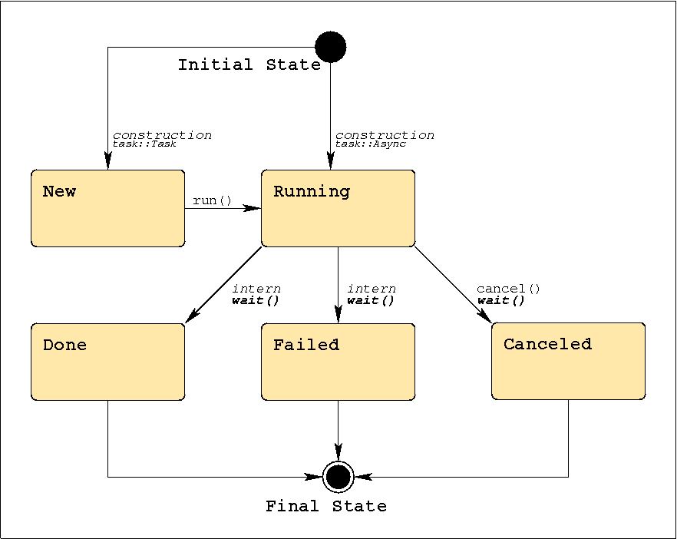
SAGA Tasks: States

Slide 66
SAGA Tasks
different versions for each method call: Sync, Async, Task
signature basically the same
differ in state of the task returned by that method
Sync: task is Done
Async: task is Running -> wait();
Task: task is New -> run(); wait();
delayed exception delivery
if ( saga::task::Failed == task.get_state () )
{
task.rethrow ();
}

Slide 67
SAGA Task: Example
// normal method call, synchronous
/* void */ file.copy ("data.bak");
// async versions, never throw (use ’rethrow()’ on failure)
saga::task t1 = file.copy <saga::task::Sync> ("data.bak.1");
saga::task t2 = file.copy <saga::task::Async> ("data.bak.2");
saga::task t3 = file.copy <saga::task::Task> ("data.bak.3");
// t1: Done
// t2: Running
// t3: New
t3.run (); // t3 now Running, too
t2.wait ();
t3.wait ();
// t1, t2, t3 are final (Done or Failed)

Slide 68
SAGA Task: Example
// normal method call, synchronous
size_t s = file.get_size ();
// async versions, never throw (use ’rethrow()’ on failure)
saga::task t1 = file.get_size <saga::task::Sync> ();
saga::task t2 = file.get_size <saga::task::Async> ();
saga::task t3 = file.get_size <saga::task::Task> ();
// get_result: implies wait() and rethrow(), and thus can throw!
size_t s1 = t1.get_result <size_t> ();
size_t s2 = t2.get_result <size_t> ();
size_t s3 = t3.get_result <size_t> ();

Slide 69
SAGA Task Container: Example
// create task container
saga::task_container tc;
// add tasks
tc.add (t1);
tc.add (t2);
tc.add (t3);
// collective operations on all tasks in container
tc.run ();
saga::task done_task = tc.wait (saga::task::Any);
tc.wait (saga::task::All);

Slide 70
SAGA Task Container: Tasks and Jobs
// NOTE:
// class saga::job : public saga::task
// task container can thus manage tasks *and* jobs:
saga::task task = file.copy <saga::task::Async> ("b");
saga::job job = js.run_job ("remote.host.net", "/bin/date");
saga::task_container tc;
tc.add (task);
tc.add (job);
tc.wait (saga::task::All);

