Slide 1



Pilot-Store
An Abstraction for Data-Intensive Computing

Slide 2
Pilot-Store Abstractions
Pilot Data:
Abstraction for expressing data localities and affinities.
Pilot Data can be used to create groups of file that are always used together (Filecule, Iamnitchi 2008)
Pilot Data provides a set of basic operations on top of these file groups
Pilot Store: A container that represents a logical group of physical files that share the same affinity.
Notes:
(D1) Data Management: This concerns all aspects associtaed with the lifecycle maintenance of data including: acquisition, access, archiving, to name a few. This includes the policies and practices that control, protect, deliver and enhance the value of data.
• (D2) Distribution: Data is either distributed or needs to be distributed. This raises the issue of efficient and reliable large-scale data transport and the association of computation to date.
• (D3) Dynamism: Data may be dynamically generated and collected (e.g. via sensors) that trigger adaptive computation and steering which may in turn impact the data collection process. This has been termed dynamic data driven application systems (DDDAS) or more recently InfoSymbiotic systems.
• (D4) Access Mechanisms: Data access includes low-level protocols that hide the distribution and heterogeneous nature of data sources via uniform interaces. This also includes access policy that govern who is allowed to access (read or write) data and under what conditions.
• (D5) Performance: Access to large-scale distributed data raises critical performance concerns with respect to scale-up and scale-out
• (D6) Data Integration : Data residing in different sources must be com- bined to provide users with a unified view. Associated issues include format conversion, the use of data shims, and semantic descriptors and ontologies to help harmonize the data.

Slide 3
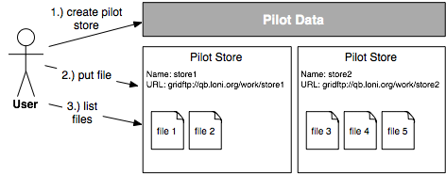
Pilot-Store Overview
Pilot Store Containers can be used to express data-data abstractions.
Abstraction supports basic management tasks (create, delete, update,
move, list).

Slide 4
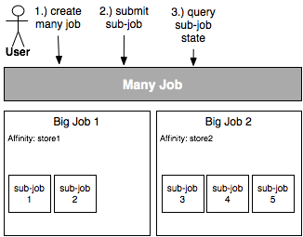
Pilot-Store and Many Job
The ManyJob abstraction allows the management of multiple BigJobs. Sub-Jobs will be transparently distributed across all BigJobs according to a defined scheduling policy.
Each BigJob in a ManyJob can be tagged with a certain affinity. The ManyJob abstraction will ensure that only sub-jobs with the right affinity will be allocated to this BigJob.

Slide 5
Pilot-Store Limitations and Challenges
The current framework provides building blocks for expressing data localities and operation on file groups (DPA book: filecule).
Limitations:
No active agent that monitors state of files
No placement policy support or autonomic behavior
Infrastructures generally expose insufficient locality/topology information
Compute – Data Affinity
ManyJob only provides a very coarse-grained affinity
No policy for what’s happening if data is not available in right location:
Run anyways – affinity is just an hint
When to move pilot stores? Move or copy?
Move data to compute or visa versa?
Data Replication:
Identification of the same file: logical filename -> physical files
Manage replication process (consistency!)

Slide 6
Pilot-Store Limitations and Challenges
Access to files:
Assume if it is in the right affinity group, processing task (i.e. sub-job) can access it
Copy file to local node vs. stream data?
Block-based access like HDFS?

