Slide 1



Efficient Replica-Exchange Simulations on Large-Scale Production Infrastructure
Abhinav Thota, Andre Luckow, Shantenu Jha
[Student Paper: This work is part of Thota’s Master’s Thesis]

Slide 2
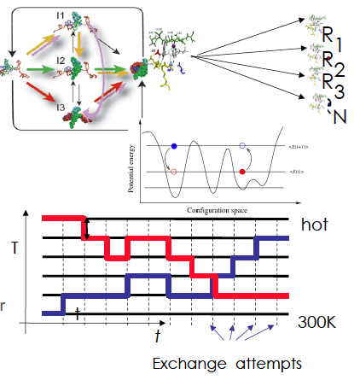
Replica-Exchange Simulations
Replica-Exchange (RE) methods:
Represent a class of algorithms that involve a large number of loosely coupled ensembles.
RE simulations are used to understand a range of physical phenomena
Protein folding, unfolding etc
MC simulations
Many successful implementations
Eg folding@home [replica based]

Slide 3
RE: Limitations
Simulations and Methodology have been tied to specific implementations and infrastructure
Break the coupling between the development and the underlying infrastructure:
Interoperable: Usage across multiple infrastructure
Extensible -- to new methods of communication and coordination
Scalable
Whither New Distributed Algorithms?
Infrastructure doesn’t support implementation/testing, hence no attempts at algorithmic innovation; hence no pressure on infrastructure!
Challenges at Multiple-Levels
Heterogeneity of environments – coordination and execution
Distributed Coordination Problem: Developing applications that are able to orchestrate heterogeneous resources RE simulations involve a large number of loosely coupled ensembles

Slide 4
Overcoming RE Limitations
Using abstractions for distributed computing, implement a flexible, extensible and scalable RE capabilty
Utilises a range of infrastructure concurrently
Supports different replica pairing/exchanging mechanisms:
Synchronous versus asynchronous and thereby different variants of the RE algorithm
Supports different coordination mechanisms
Implement (i) Synchronous Exchange (ii) Two type of Asynchronous Exchange types
Performance Advantages arise
Logical and physically distributed applications

Slide 5
Synchronous (Traditional) RE
For the traditional implementation of RE and number of replicas (N), create a fixed set of N/2 pairs of replicas.
When all the replicas reach a pre-determined state, the exchanges are attempted (the exchange step).
If yes, (i.e. exchange is successful), parameters such as the temperature are swapped and replicas are re-started
If not, continue till next exchange
Limitations:
Exchanges can only take place between fixed paired replicas; inhibits exchanges between replicas with non-nearest temperatures.
Synchronized exchange steps: Inefficient for heterogeneous infrastructure (i.e., different running times for each replica).
Synchronized exchange step means concurrent (bursty) communication and coordination; does not scale for large N

Slide 6
Asynchronous RE
Implement Asynchronous version of the RE algorithm to overcome the limitations.
Asynchronous RE, replicas can perform exchanges with any other available replica, whenever possible – instead of waiting for all the replicas to finish for a synchronized exchange step
This does not limit exchanges to fixed pairs of replicas. Any two replicas can attempt to exchange.
Experiment with two different async implementations:
Centralized point of decision making & coordination(cent)
A master co-ordinates and manages all the replicas and exchanges [Classical M-W Paradigm]
Decentralized coordination (De-cent)
Each replica is handled independently [akin to P2P..w/ M]
Does this prevent central manager/master from becoming a bottleneck, with large N?
Notes:
What do you mean asynchronously? Elaborate please? How does it eliminate the need to pair replicas?
We do not propose it. It has been already been proposed/implemented. We are trying to implement it using SAGA, which gives us the ability to test/implement on large-scale production infrastructure

Slide 7
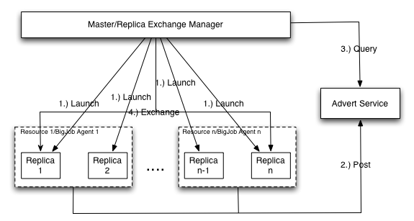
Control Flow – Asynchronous RE Centralized
Notes:
Control flow of what?

Slide 8
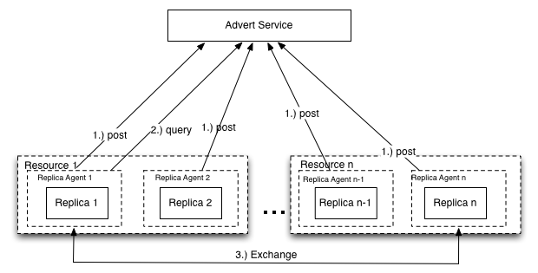
Control Flow – Asynchronous RE Decentralized

Slide 9
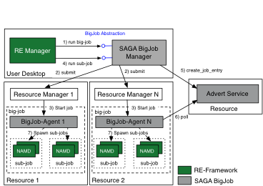
SAGA BigJob: General purpose Pilot-Job
We use the SAGA BigJob (the SAGA Pilot-Job framework) to run RE simulations across multiple, heterogeneous distributed Grid infrastructures. Supports both pull and push-based.
(Application)

Slide 10
Advantages and Limitations
This is an improvement over the Synchronous RE algorithm.
Scales better with more replicas and distributed resources.
But with large number of replicas, the centralized implementation becomes a bottleneck.

Slide 11
Experiments
We have implemented the following:
Synchronous RE
Case I: Synchronous (traditional) RE
Asynchronous RE
Case II: Asynchronous RE (centralized)
Case III: Asynchronous RE (decentralized)
Compare the three cases for:
Scalabiltiy/Performance with increasing N
On a single resource
Distributed Performance
Relative performance with increasing number of resources (R)

Slide 12
Experiment Configurations
All cases use a parallel NAMD simulation with 4, 8, 16, 32 and 64 replicas sampling a temperature between 300 K and 1000 K on QueenBee, a LONI/Teragrid machine
The ratio between the number of replicas and the number of exchanges is kept constant, for the purpose of comparison.
Each replica uses 16 MPI processes and runs 500 time steps between exchange attempts. Single BigJob is launched with sufficient number of cores
The metric used is the time to complete a particular number of exchanges. Ignore wait times!
Each experiment has been repeated at least 10 times

Slide 13
Notes:
Plots/Results are not readable. Maybe pairwise compairision? Eg Sync vs Centralized, then Centralized vs Decentralised?

Slide 14
Analysis
The ratio between the number of replicas and the number of exchanges is kept constant
Ideally the runtime would be constant too
As N increases performance variation for 3 cases
Asynchronous RE scales better with a large number of replicas and resources. The decentralized asynchronous RE beats the centralized version.
In synchronous RE, the overhead of managing a large group of replicas at each exchange step causes the degradation
Notes:
It is possible to design a decentralized synchronous RE mechanism.
But then, with a heterogeneous infrastructure, each replica could have different run times.
The asynchronous RE mechanism eliminates the synchronization delays caused due to a heterogeneous infrastructure.
A decentralized implementation adds to the efficiency of the asynchronous RE method.

Slide 15
Experiment Configurations
All cases use a parallel NAMD simulation with 4, 8, 16, 32 and 64 replicas sampling a temperature between 300 K and 450K on QueenBee and Ranger
The ratio between the number of replicas and the number of exchanges is kept constant, for the purpose of comparison.
Each replica uses 16 MPI processes and runs 500 time steps between exchange attempts
Three scenarios:
(i) Two bigjobs (64) on 2 machines (ii) 1 Bigjob (64) on 1 machine, (iii) 1 Bigjob (128) on 1 machine
The metric used is the time to complete a particular number of exchanges. Cannot Ignore wait time of 2nd Bigjob now..
Each experiment has been repeated at least 10 times

Slide 16
Notes:
Use this or 20 or 18.

Slide 17
Analysis – More resources, faster time to completion
From the graph, it can be seen that the distributed runs take longer than the local run. There are two reasons:
The co-ordination and communication across two machines takes longer
The waiting time of the second machine.
The runtime is calculated as the time it takes to complete the required number of exchanges once a job request on one of the machines becomes active.
Comparing 1B and 2 in the graph, we can see that, more often than not, it is beneficial to request more cores for more machines and use more replicas to make more exchanges.

Slide 18
Analysis – Asynchronous RE scales better with distributed resources
In the best case scenario, where both job requests on both machines become available instantaneously, asynchronous-centralized and asynchronous-decentralized equal their respective performances on a single machine.
Even in the best case scenario, the synchronous RE underperforms when compared to its performance on a single machine.
The reasons are:
Heterogeneous infrastructure (Ranger and QueenBee)
Coordinating the exchange step across two machines takes longer, hence adding to the overhead at each exchange step

Slide 19
Questions/Comments

