Slide 1
Building Gateways for Life-Science Buildin Building Gateways for Life-Science Applications using the Dynamic Application Runtime Environment (DARE) Framework
Joohyun Kim, Sharath Maddineni, Shantenu Jha
http://saga.cct.lsu.edu and http://dare.cct.lsu.edu/
Teragrid 2011
Notes:
Added slide 3
I think there will not be time to focus on “assertion based” approach, i.e slides 4-7. Possibly include slide 8

Slide 2
Overview
DARE-based Gateways for Life Science Applications
Importance of Life Science < == > Role of Gateways
Different computational characteristics
DARE for HT-HPC and NGS
Architecture, Performance and Scalability
DARE based Gateway for NGS Analytics
Perform alignment for “real” NGS problems on production DCI
Empirical understanding of using prod DCI for DI applications
BFAST computational characterization
Tradeoffs: Com. vs Mem. vs I/O vs DoD
Towards Production DCI for NGS Analytics
DARE-based Gateway: Lessons and Experienc

Slide 3
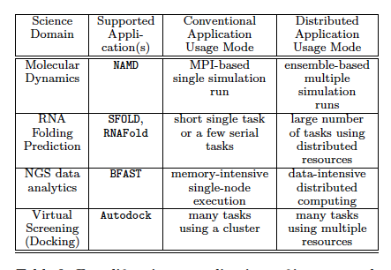
Four Life-Science Applications

Slide 4
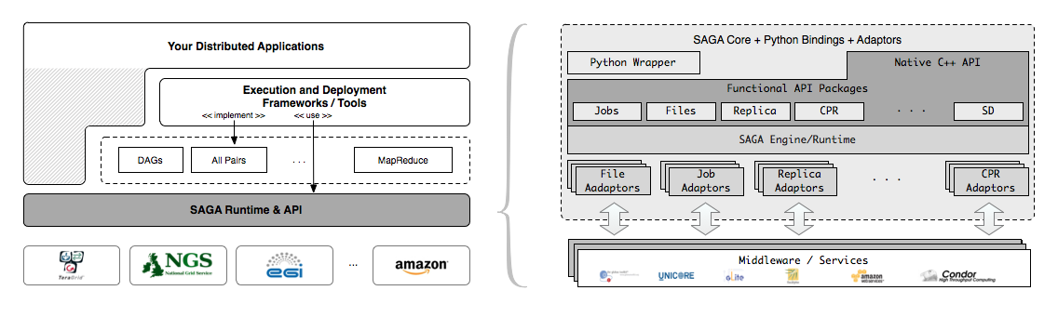
SAGA – An Overview
Simple, integrated, stable, uniform and community-standard
Simple and Stable: 80:20 restricted scope
Integrated: Similar semantics & style across primary functional areas
Uniform: Same interface for different distributed systems
The building blocks upon which to construct “consistent” higher-levels of functionality and abstractions
OGF-standard, “official” Access Layer/API of EGI, NSF-XD

Slide 5
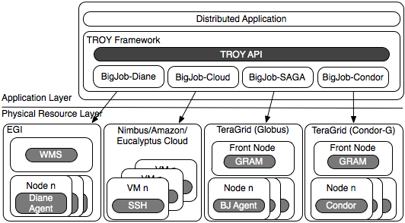
Deployment & Scheduling of Multiple Infrastructure Independent Pilot-Jobs

Slide 6
What is “unique” about Pilot-Jobs built using the right abstractions?
Pilot-Jobs: Decouple resource assignment & resource-workload binding
Pilot-Jobs are/have been typically used for:
Enhancing resource utilization; Facilitate high-throughput simulation
Lowering wait time for multiple jobs (better predictability)
Several unique aspects about the SAGA-based Pilot-Job
Pilot-Jobs have not been used for Science Driven Objectives:
First demonstration of multi-physics simulations, REMD simulations
Frameworks based upon PJs (pull model) for specific back-ends
Infrastructure Independent and “standard” PJ API to access other PJs
SAGA PJ (BigJob) API basis for inter-operable PJ (Azure, DIANE)
SAGA-based Pilot-Job form the basis for
Extension of Pilot-abstraction to other “dimensions”
For autonomic scheduling and application-level scheduling
Advanced run-time frameworks for load-balancing and FT

Slide 7
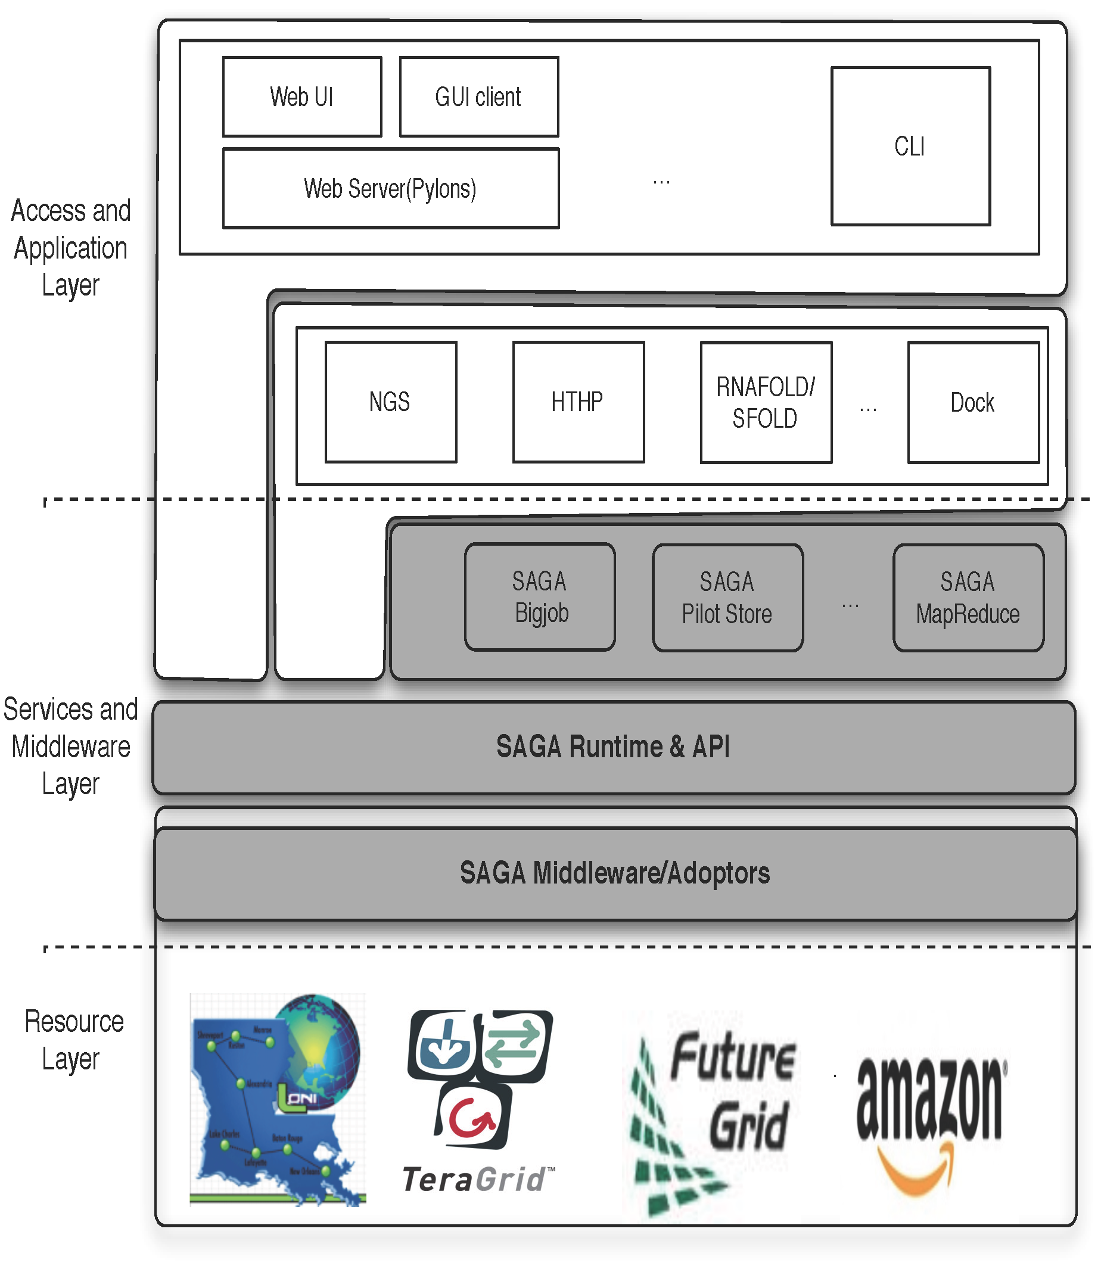
DARE-based Science Gateways
Three levels:
Access/Application Layer
Services & MW Layer
Resource Layer
Abstractions for Dynamic and Adaptive Execution
Integrated compute and data
Interoperable across DCI
Extensible: frameworks, abstractions and features
Notes:
Fixed the diagram.. Please remove next slide if you are OK with this

Slide 8
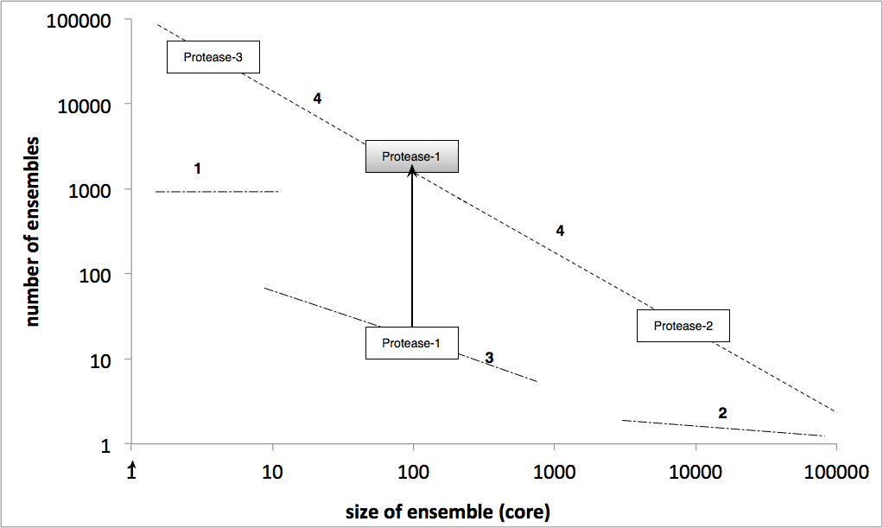
DARE – HT-HPC

Slide 9
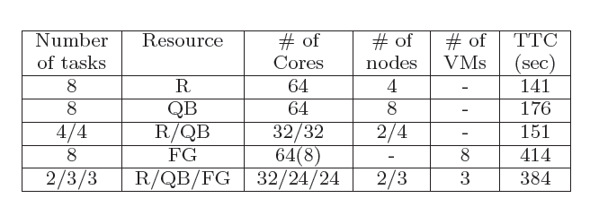
DARE HT-HPC

Slide 10
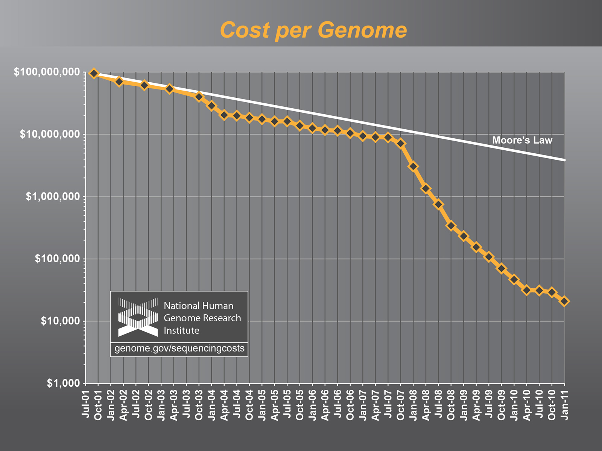
The case for advanced NGS Analytics

Slide 11
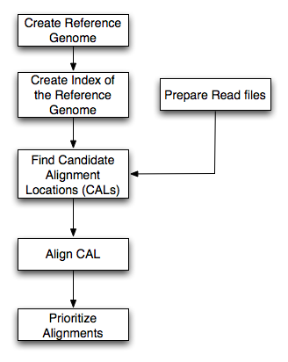
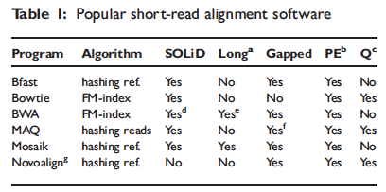
BFAST: A prototype for NGS Analytics
Most software is associated with specific sequencing instruments
Multi-stage, but focus on alignment/mapping
Data types:
Short read data
Reference Index data
Classify most alignment software into categories based upon based upon indexing property
Hash-based and Tree-based
Relative to other alignments programs, BFAST has:
higher sensitivity
large memory and disk requirements

Slide 12
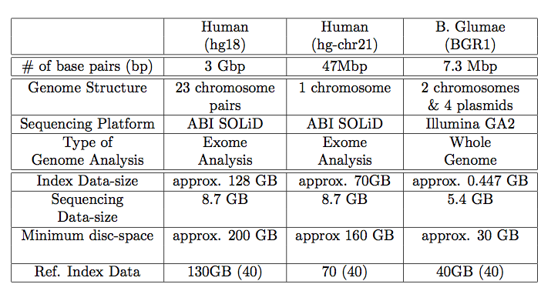
BFAST: A prototype for NGS Analytics
Supports Advanced features:
Multi-threading support
Low-memory option
index file splitting
Breaking up short-read data permits task-level concurrency
Each task requires full reference index, possible I/O bottleneck
Distribute to overcome I/O bottleneck?
Tradeoffs:
Com. vs Mem. vs I/O vs DoD
Sensitive to specific data-set size
Ref. Genome
Mapping
(Bfast)
SNP finding
NGS short reads

Slide 13
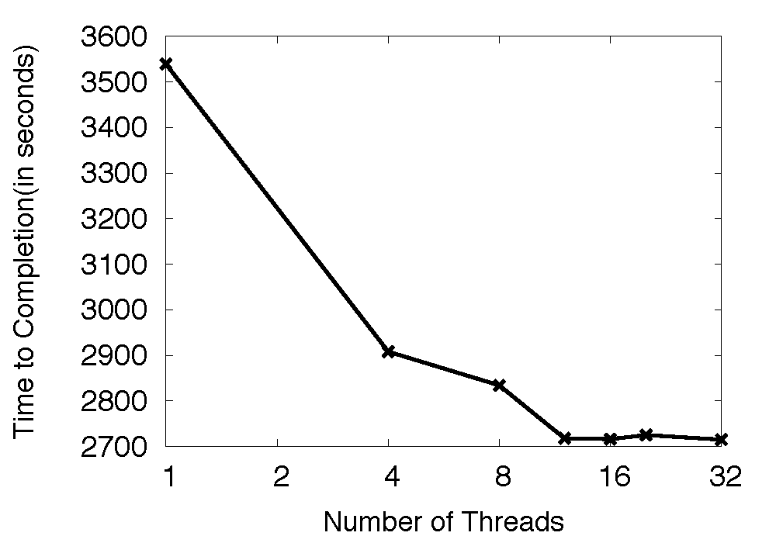
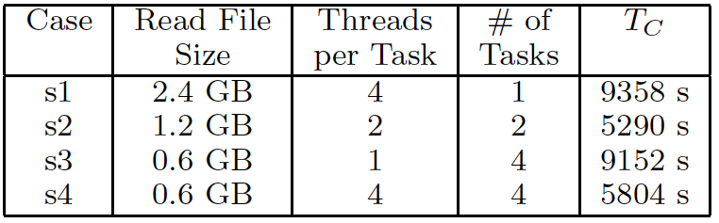
BFAST Tradeoffs: Comp. vs Mem. vs I/O vs DoD [Single Cluster]
Possible solution: Logical and then physical distribution

Slide 14
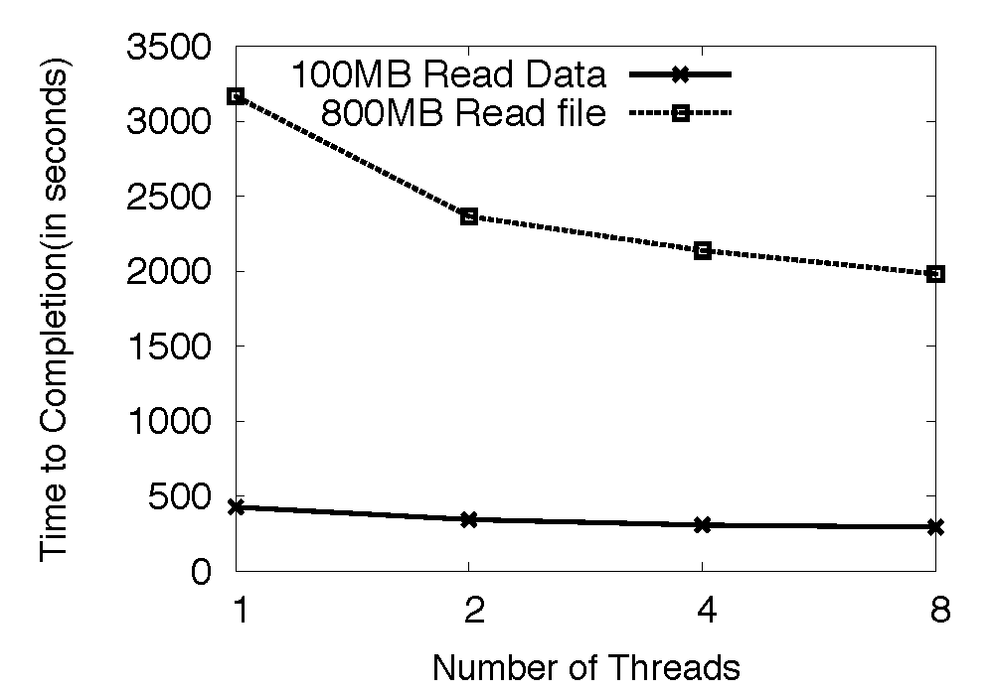
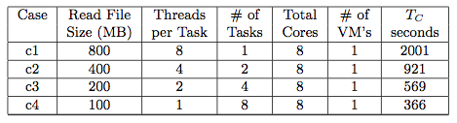
BFAST Tradeoffs: Comp. vs Mem. vs I/O vs DoD [Single Cloud]

Slide 15
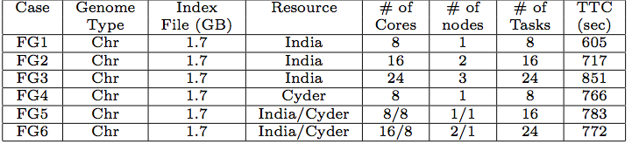
BFAST Characterization: I/O Bottleneck
FG1-FG3: Number of tasks varies, but each task has constant read-file size
Note increase in going from FG1, FG2 and FG3
Note Cyder is slower than India
Compare FG5 and FG2: coordination cost
Compare FG6 and FG3: FG6 I/O bottleneck reduced by distributing tasks

Slide 16
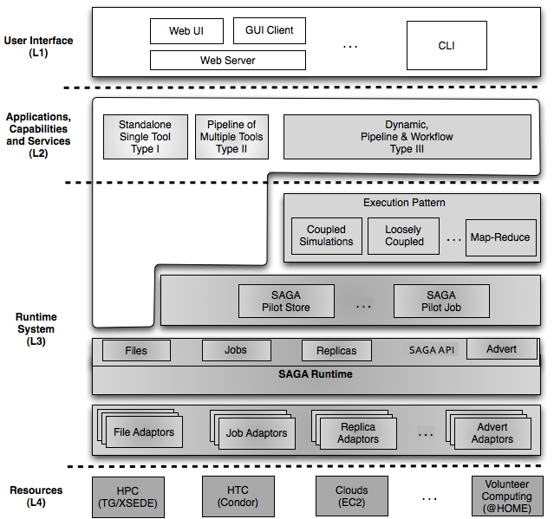
DARE-based Science Gateways
Three levels:
Access/Application Layer
Services & MW Layer
Resource Layer
Abstractions for Dynamic and Adaptive Execution
Integrated compute and data
Interoperable across DCI
Extensible: frameworks, abstractions and features
Notes:
Fixed the diagram.. Please remove next slide if you are OK with this

Slide 17
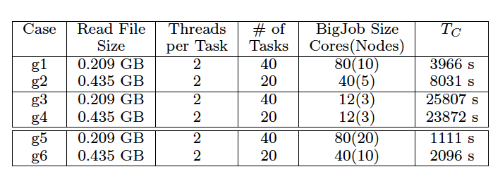
DARE-NGS : Mapping on Scalable Distributed HPC resources
g1-g4: each task requires 2 cores (40 index files)
g1, g2: Scalable task concurrency
Be sure this is not IO bound
g3, g4: multiple generations of tasks (and concurrency)
Basis for dynamic
g5, g6: Different number of index files (10)
Notes:
This will be very hard to read!

Slide 18
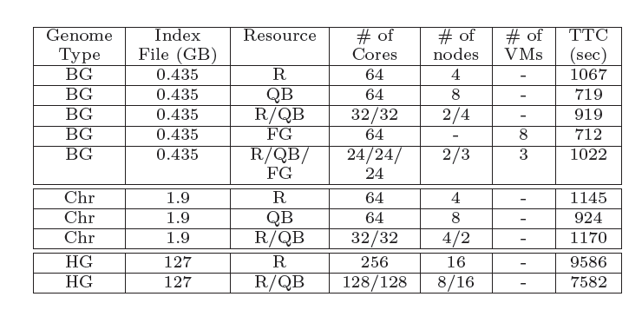
Tradeoffs: Comp. vs Mem. vs I/O vs DoD
R3 – average of R1 and R2
Not including Transfer time
Coordination time quite small, including R/QB/FG
Similar characteristics for different physical systems
Notes:
(JK) Here, upper two tables represent the benefits of task level concurrency and scale-out strategy

Slide 19
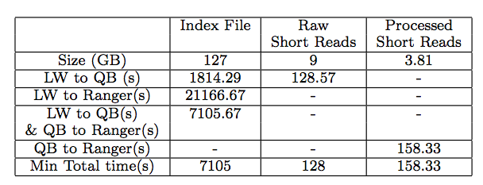
Tradeoffs: Comp. vs Mem. vs I/O vs DoD
Notes:
(JK) Here, upper two tables represent the benefits of task level concurrency and scale-out strategy

Slide 20
Towards Production DCI for NGS Analytics
“Why is the TeraGrid not used for data-intensive applications” (Fox)
Is it just about storage? Or is it about data transfer? High Amdahls?
What is the “optimal” CI/Cloud configuration? No well-defined single infrastructure configuration or capabilities
Astronomy, HEP - Application characteristic better defined
What can LS community learn from them?
“Building this infrastructure is not trivial” (Fox)
Need Abstractions to Support Dynamic Applications
Both Development and System/Infrastructure level abstractions
There are “hard” parts and tractable parts
SAGA handles the hard part, opening up innovation elsewhere

Slide 21
NGS Analytics as a Service: DARE-based Gateway on XD
Some NGS specific challenges
Efficient Algorithm/tool/code selection
Hosting pre-installed VM
Efficient task scheduling and placement
Efficient Distributed data management
Efficient Data transfer/scheduling
Transfer of Ref. genome index files:
O(hours) 130 GB,
Transfer of Short read files:
O(mins) [L to QB] 9 GB
Determine optimal point -- tradeoff
http://dare.cct.lsu.edu/gateways/ngs

Slide 22
What are the Challenges for LS Applications on Clouds?
Clouds address several “barriers” of decade past
Better control over software environment via virtualization
Illusion of unlimited and immediate available resource can lead to better capacity planning and scheduling
Clouds do not remove many/all of the challenges inherent in DA
Coordination, decomposition, granularity, distribution:
Where, when, how to distribute? How to manage coordination?
What is the task decomposition granularity? Mapping to resources?
What are the data transfer/access/storage mechanisms
Clouds represent a natural and positive evolution but will need a careful interplay of application and system-level abstractions
If clouds part of a larger, richer distributed CI
Are certain tasks better suited for Grids, others on Cloud? When?
Notes:
“Clouds are about provisioning, grids are about federation”
“IF you can keep your head when all about you, Are losing theirs and blaming it on you..”
“The reason why we are so well prepared to handle the multi-core era, is because we took the trouble to understand parallel programming

Slide 23
What are the Challenges for LS Applications on Clouds?
Clouds as the natural CI for DI computing?
Need to support distributed, dynamic loads
Multi-parametric trade-offs exist: Mem vs I/O vs CPU vs DoD
Sequence length variation
DA challenges need to be addressed dynamically!
Resource Elasticity/Cloudburst + Heterogeneous task-resource binding and need for application configuration trade-offs
Is the Cloud data localization model scalable and/or sustainable?
Must address: How and when to move compute to data (or vice-versa) in scalable fashion?

Slide 24
Conclusions
DARE-based Gateway
Extensions to abstractions for dynamic execution and data
Need for community provided solution on XD and other production DCI
Challenges remain in the scalable provisioning
LS Applications – compute and data intensive present broad range of challenges at scale
Have characterized BFAST as an example of alignment that can be used in production DCI
What are the CI challenges of NGS Analytics?
Exploring HTC, HPC-grids and Clouds

Slide 25
Acknowledgements
SAGA Team and contributors: http://saga.cct.lsu.edu
Futuregrid Acknowledgement
This document was developed with support from the National Science Foundation (NSF) under Grant No.0910812 to Indiana University for "FutureGrid: An Experimental, High-Performance Grid Test-bed." Any opinions, findings, and conclusions or recommendations expressed in this material are those of the author(s) and do not necessarily reaect the views
Also Acknowledge useful discussions:
Geoffrey Fox and Jon Weissman

