Slide 1



A Brief Introduction to SAGA
Building and Installing

Slide 2
All material from this tutorial can be found at: http://saga.cct.lsu.edu/software/cpp/documentation/tutorials/loni-training-2010 And at: https://svn.cct.lsu.edu/repos/saga-projects/tutorial/general_tutorial

Slide 3
General Information and Documentation
General information
http://saga. cct.lsu.edu/
Documentation:
http://saga.cct.lsu.edu/software/cpp/documentation
API documentation
Python
http://static.saga.cct.lsu.edu/apidoc/python/latest/
C++
http://static.saga.cct.lsu.edu/apidoc/cpp/latest/
Programmers Guide:
https://svn.cct.lsu.edu/repos/saga/core/trunk/docs/manuals/programming_guide/tex/saga-programming-guide.pdf

Slide 4
Distributed Applications Development Challenges
Ability to develop simple or effective distributed applications
Distributed CI: Is the whole > than the sum of the parts?
App. that utilize resources sequentially, concurrently or asynchronously is low
Developing Distributed Applications is fundamentally hard:
Intrinsic:
Control/Coordination & execution over Heterogeneous sites
Complex Design point/Models of Distributed Applications,
Reasons for using distributed CI -- more than (peak) performance result
Extrinsic:
(Complex) Underlying infrastructure & its provisioning
Deployment and Exec. environment dependent on development tools
Large number Programming systems, tools and environments
Lack of well-defined interfaces & abstractions
Interoperability and extensibility become difficult
See: DPA Survey Paper:
http://www.cct.lsu.edu/~sjha/dpa_publications/dpa_surveypaper.pdf

Slide 5
SAGA: In a nutshell
There exists a lack of Programmatic approaches that:
Provide general-purpose, basic &common grid functionality for applications and thus hide underlying complexity, varying semantics..
The building blocks upon which to construct “consistent” higher-levels of functionality and abstractions
Meets the need for a Broad Spectrum of Application:
Simple scripts, Gateways, Smart Applications and Production Grade Tooling, Workflow…
Simple, integrated, stable, uniform and high-level interface
Simple and Stable: 80:20 restricted scope and Standard
Integrated: Similar semantics & style across
Uniform: Same interface for different distributed systems
SAGA: Provides Application* developers with units required to compose high-level functionality across (distinct) distributed systems
(*) One Person’s Application is another Person’s Tool

Slide 6
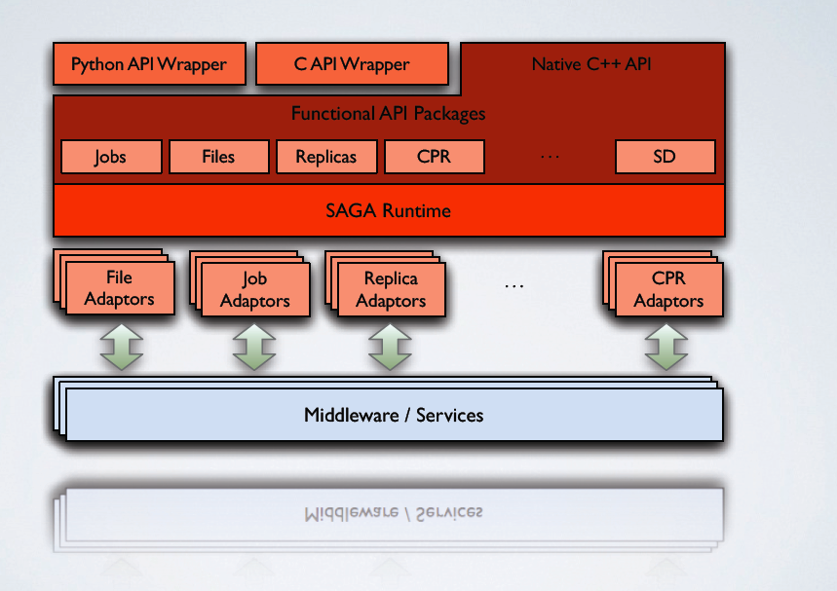
SAGA: In a thousand words

Slide 7
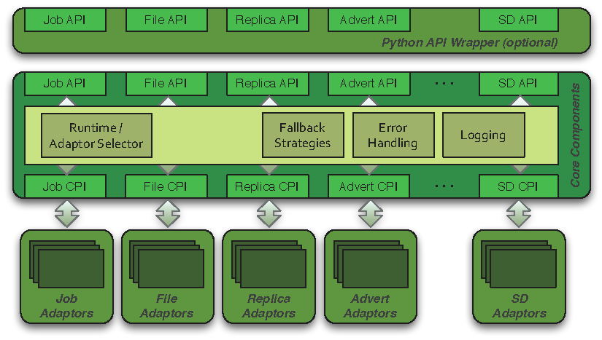
SAGA: Architecture

Slide 8
How is SAGA Used?
SAGA is used to develop applications that are distributed by definition:
Simple extensions of “localized applications” (eg scripting)
Novel Distributed Programming Models (eg Rep-Exch)
SAGA: Build tools and implement abstractions that enable the execution of applications over distributed resources, without modifying the applications
Eg. Infrastructure Independent Pilot-Jobs
SAGA: To provide uniform access layers to heter. CI
Uniform access to EGI (ARC, gLite, Globus and Unicore/BES)
Simplify the building of tools and Gateways or MW applications, workers submitted to >8 back-ends

Slide 9
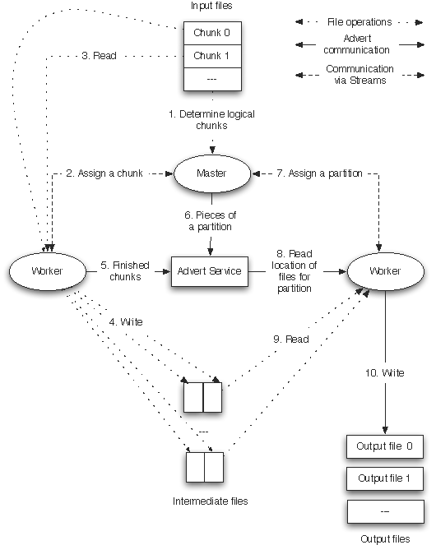
SAGA: Develop applications that are distributed by definition
How to develop a simple MR that is interoperable across infrastructure concurrently?
Same application, same programming model:
Very different performance dependence
Same application, different programming models
Very different performance dependence

Slide 10
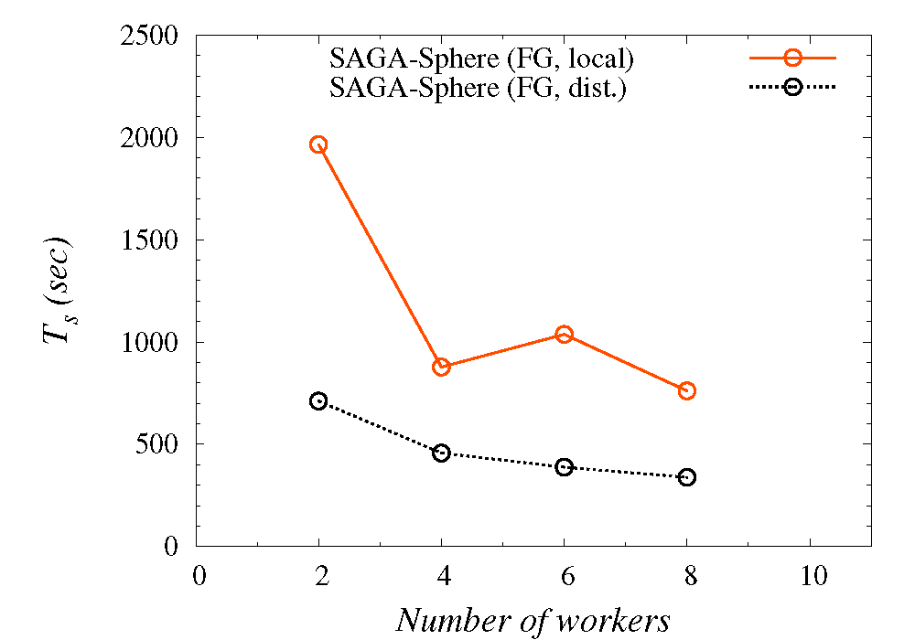
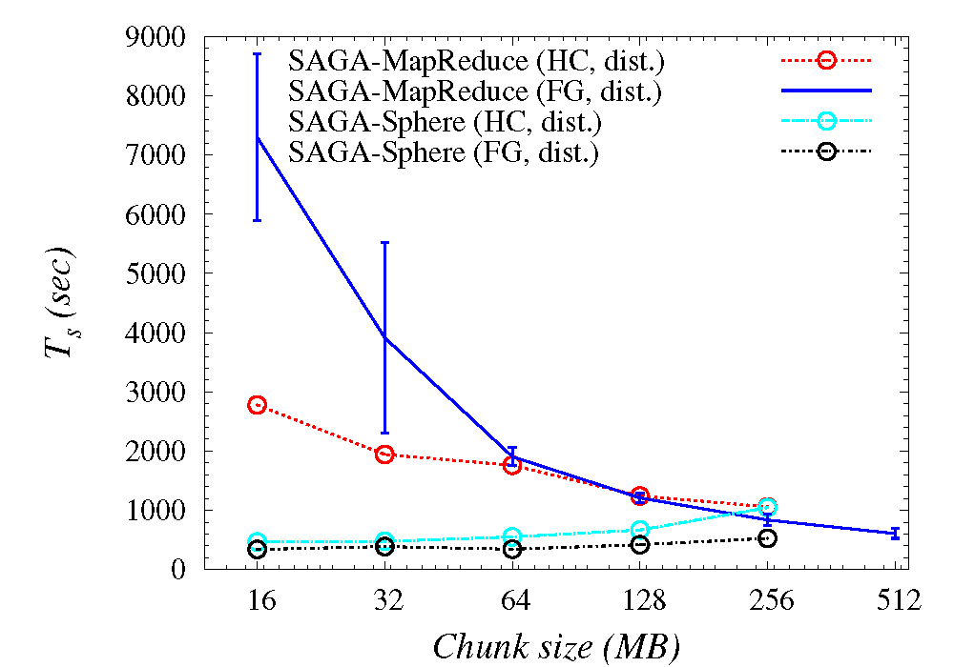
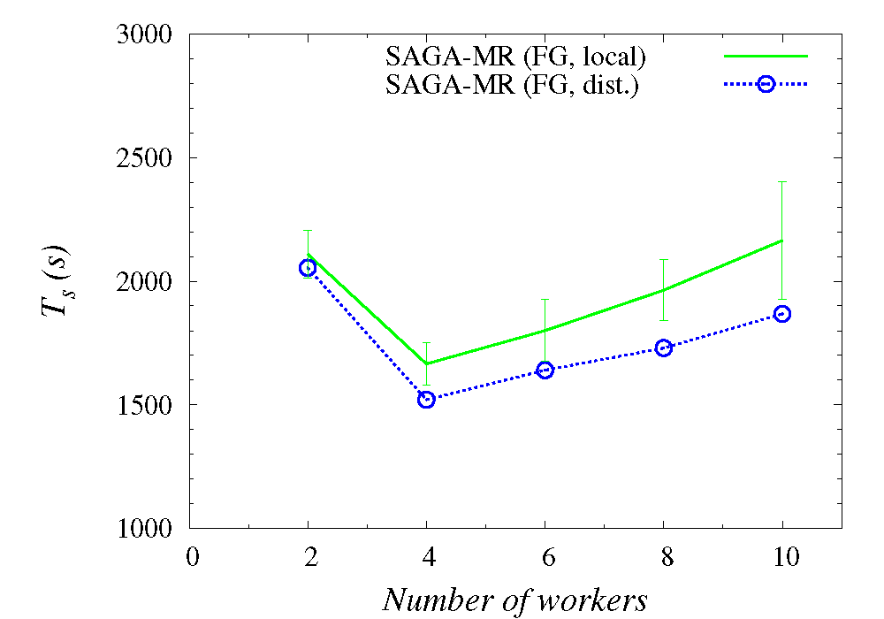
Understanding Distributed Programming Models

Slide 11
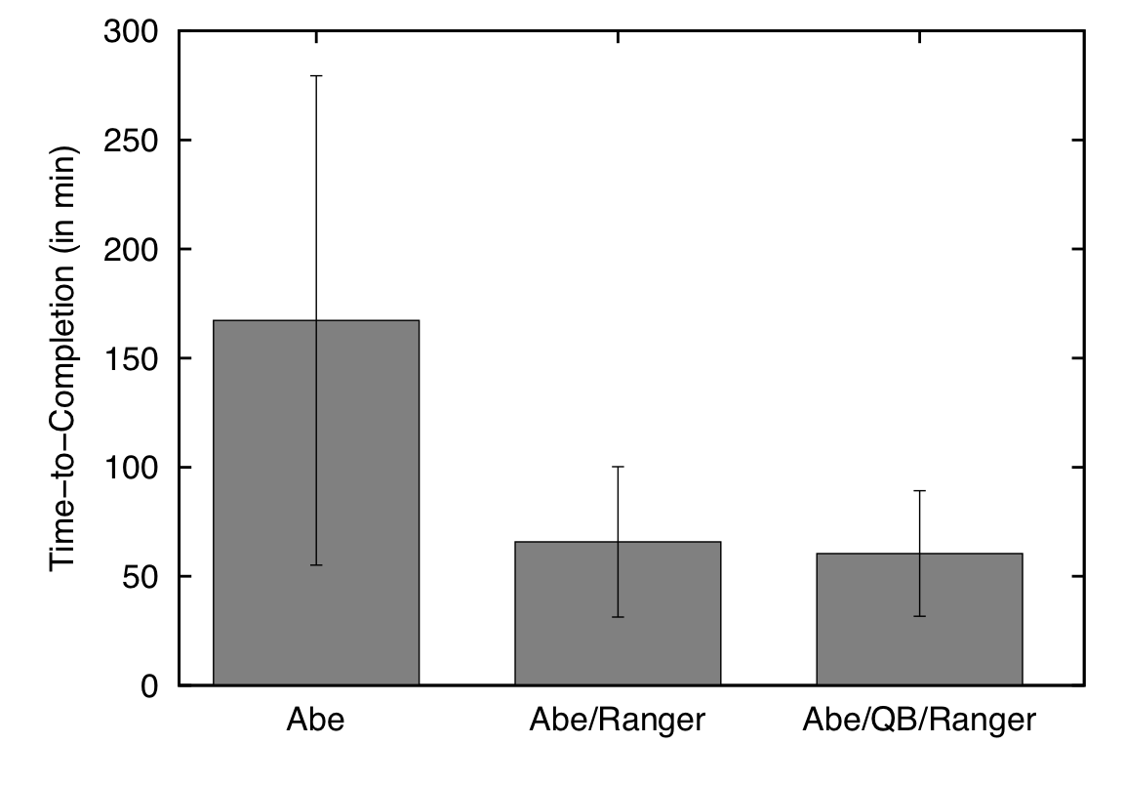
Distributed Adaptive Replica Exchange (DARE) Multiple Pilot-Jobs on the “Distributed” TeraGrid
Ability to dynamically add HPC resources. On TG:
Innovations in Distributed Algorithms:
Variants of RE: Sync (local) vs async (distr.)

Slide 12
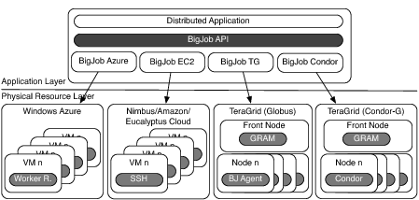
SAGA: Tools for Effective Distributed Execution

Slide 13
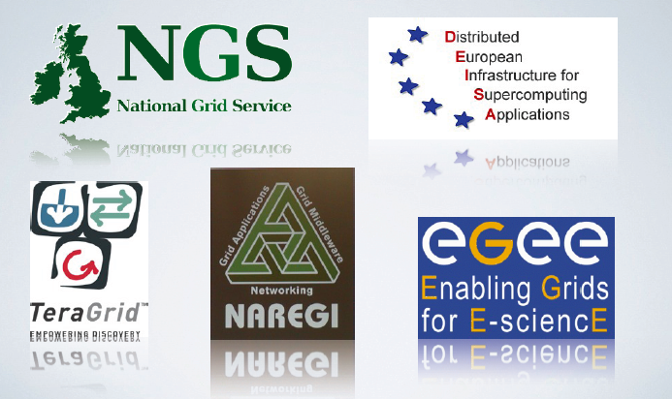
SAGA: Provides uniform access layers to heterogenous CI

Slide 14
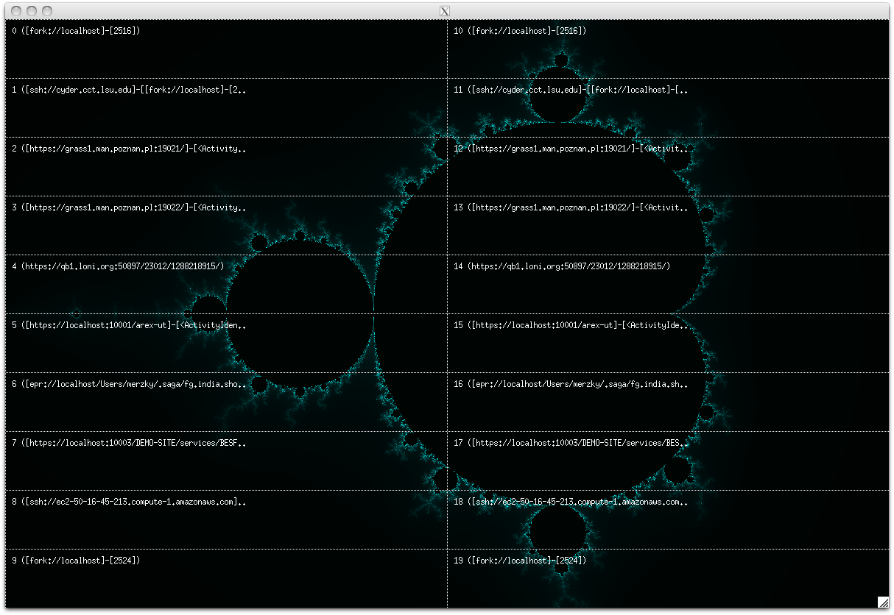
SAGA: To provide uniform access layers to heterogeneous CI

Slide 15
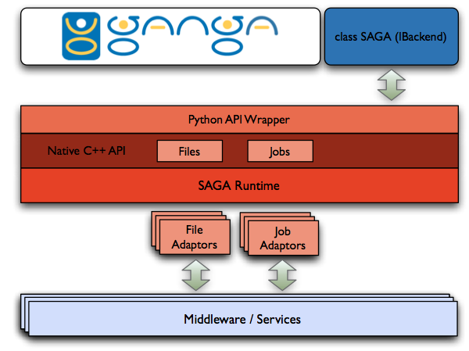
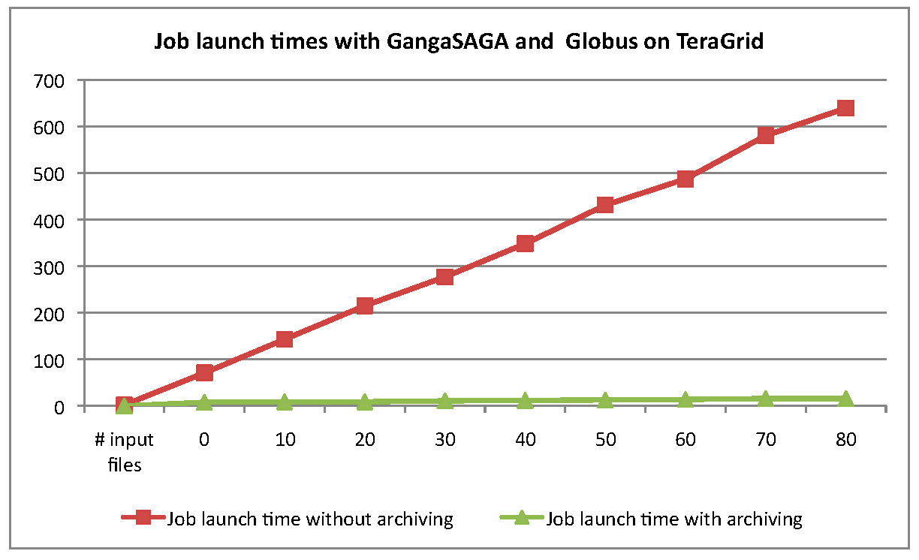
SAGA-GANGA Integration

Slide 16
Java-based Python SAGA wrapper
C Python
Jython
a user application
a user application
Python Bindings for SAGA
SAGA-C++Py
?
JPySAGA
JySAGA
legacy python bind.
Boost wrapper
C++ Bindings for SAGA
Java Bindings for SAGA
SAGA-C++
JSAGA
Java SAGA
Java GAT

Slide 17
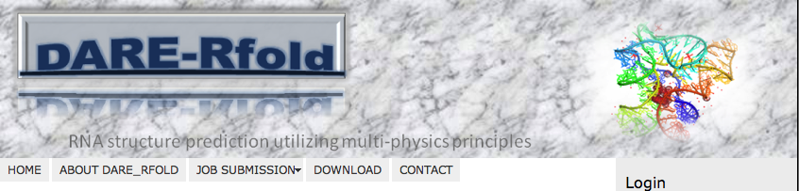
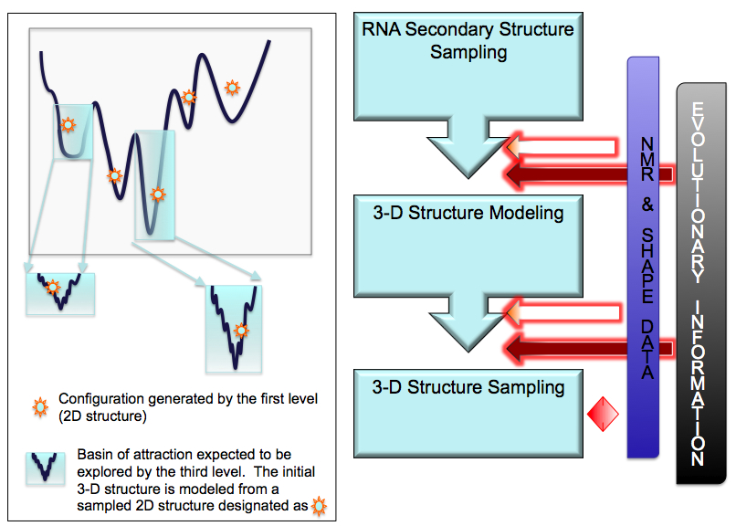
DARE – Gateway for RNA-folding (Joohyun Kim, CyD)
DARE-Gateway:
Integrated, Extensible
Balanced: Scale-Up and Scale-out to

