Slide 1
DARE SAGA enabled Gateway
Joohyun Kim
Sharath Maddineni
Shantenu Jha

Slide 2
What is DARE?
A framework to support Distributed Scientific Applications
Why?
Co-ordinate Compute and Data
Support for Pipelines/Workflows
Using the resource database
Build dynamic applications / workflows

Slide 3
What is DARE ?
Components of DARE
Compute
DATA
Configuration File parser/Writer/Validator (Data Dictionary)
Update Status to Database(Web DB)
Manager

Slide 4
Overview
DARE-based Gateways for Life Science Applications
Importance of Life Science < == > Role of Gateways
Different computational characteristics
DARE for HT-HPC and NGS
Architecture, Performance and Scalability
DARE based Gateway for NGS Analytics
Perform alignment for “real” NGS problems on production DCI
Empirical understanding of using prod DCI for DI applications
BFAST computational characterization
Tradeoffs: Com. vs Mem. vs I/O vs DoD
Towards Production DCI for NGS Analytics
DARE-based Gateway: Lessons and Experienc

Slide 7
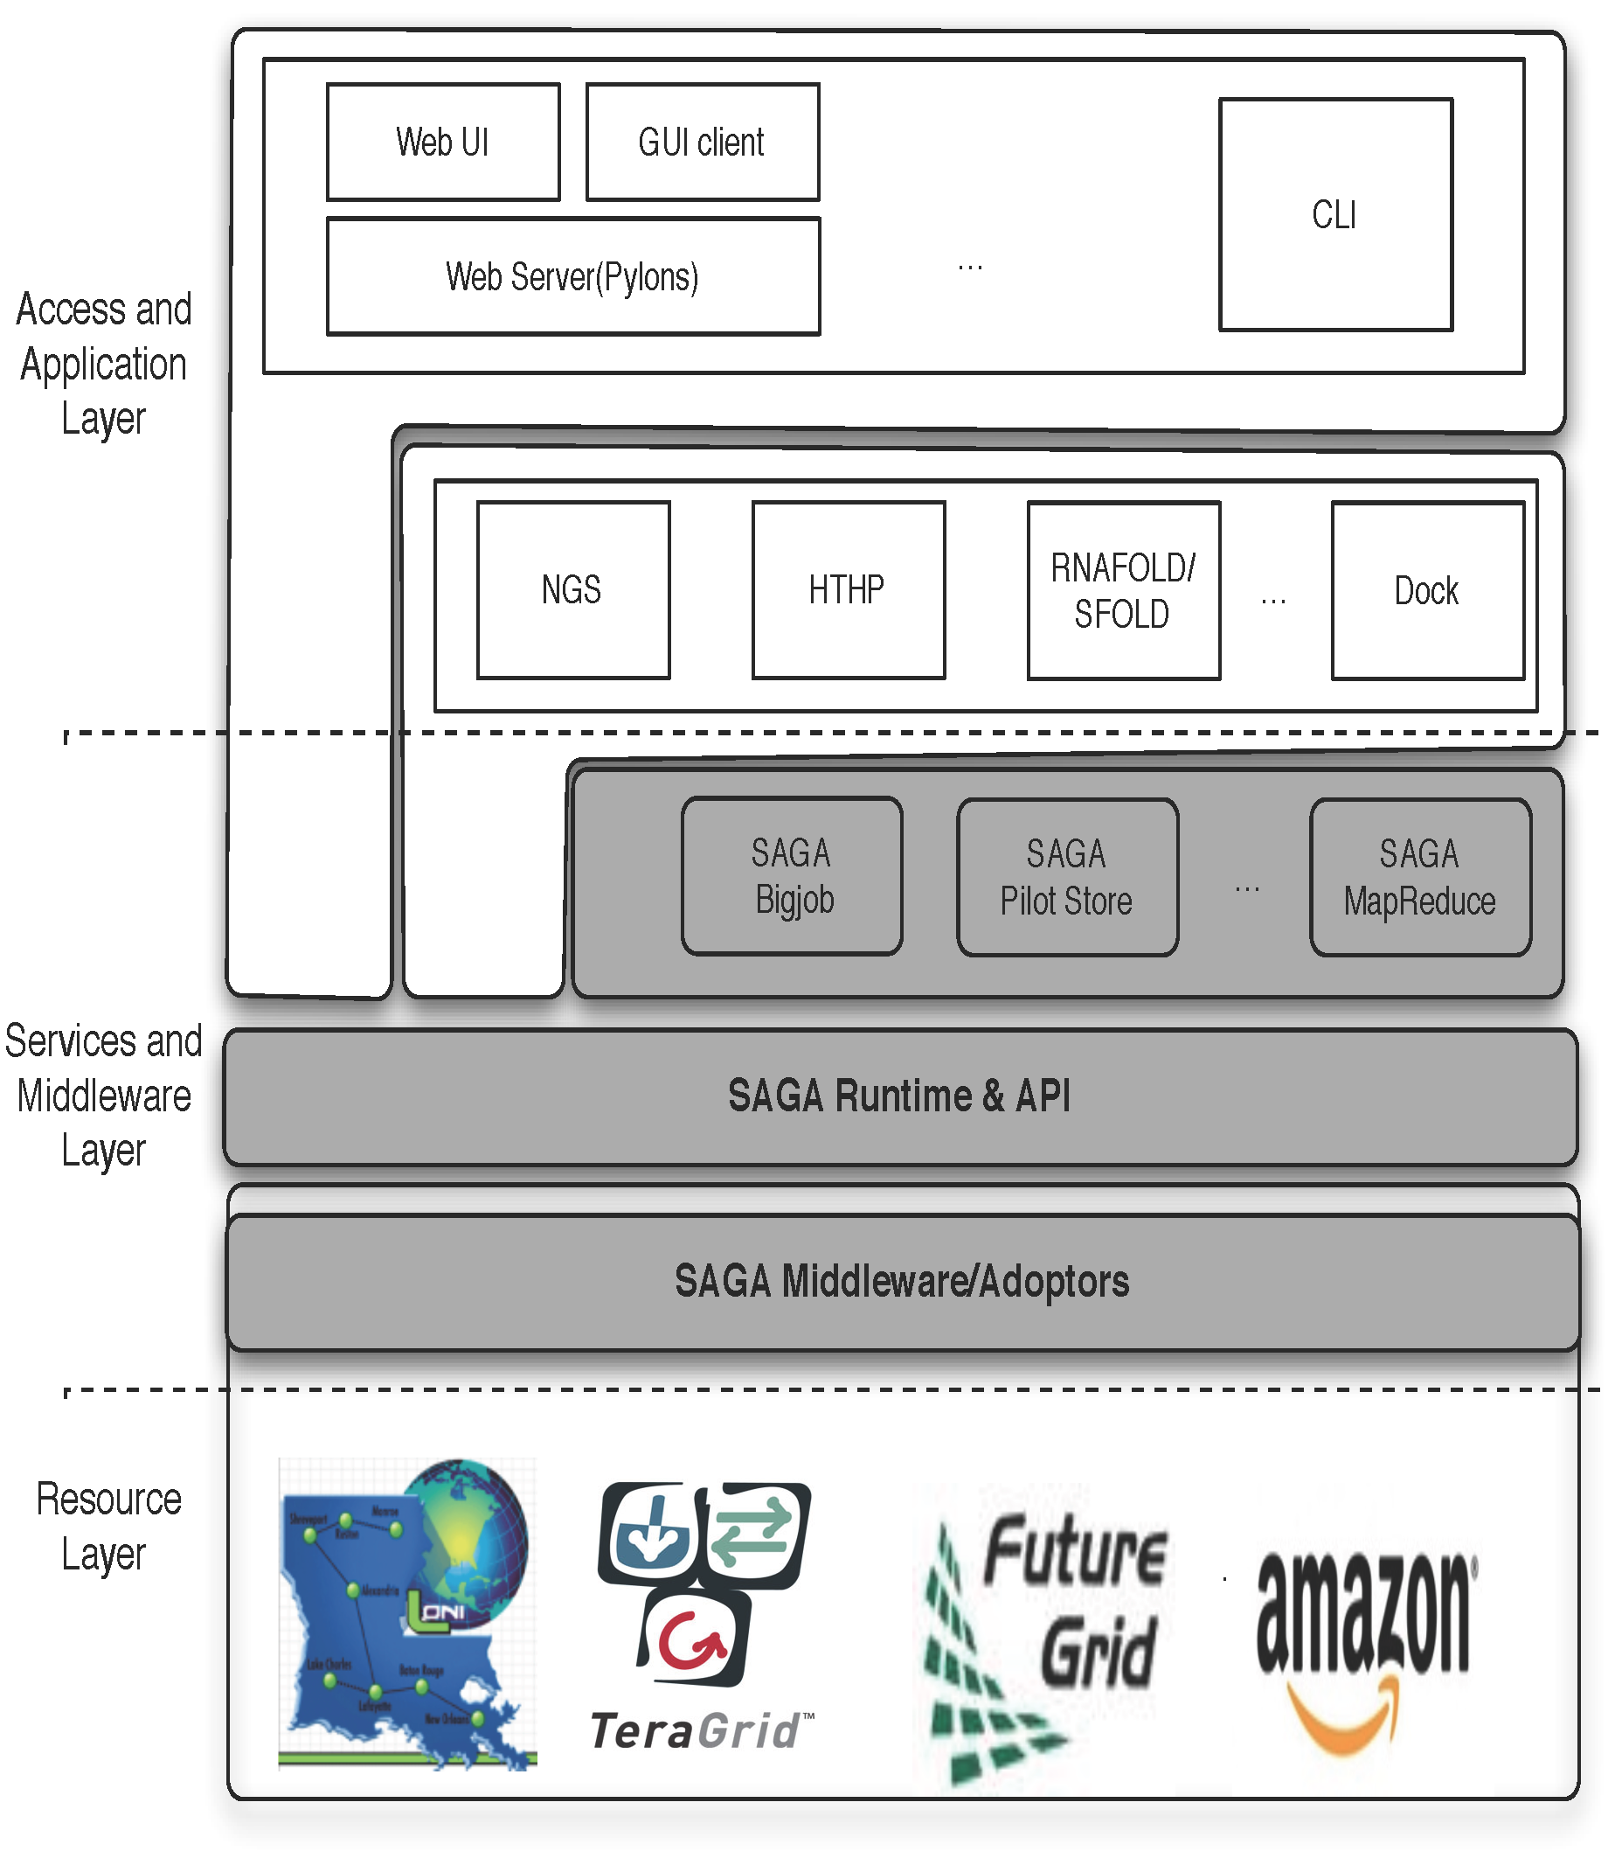
DARE-based Science Gateways
Three levels:
Access/Application Layer
Services & MW Layer
Resource Layer
Abstractions for Dynamic and Adaptive Execution
Integrated compute and data
Interoperable across DCI
Extensible: frameworks, abstractions and features
Notes:
Fixed the diagram.. Please remove next slide if you are OK with this

Slide 8
NGS Analytics as a Service: DARE-based Gateway on XD
Some NGS specific challenges
Efficient Algorithm/tool/code selection
Hosting pre-installed VM
Efficient task scheduling and placement
Efficient Distributed data management
Efficient Data transfer/scheduling
Transfer of Ref. genome index files:
O(hours) 130 GB,
Transfer of Short read files:
O(mins) [L to QB] 9 GB
Determine optimal point -- tradeoff
http://dare.cct.lsu.edu/gateways/ngs

Slide 9
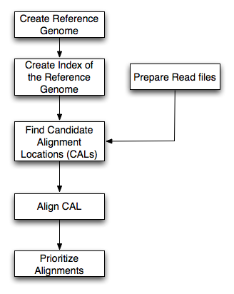
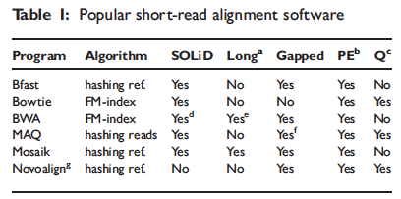
BFAST: A prototype for NGS Analytics
Most software is associated with specific sequencing instruments
Multi-stage, but focus on alignment/mapping
Data types:
Short read data
Reference Index data
Classify most alignment software into categories based upon based upon indexing property
Hash-based and Tree-based
Relative to other alignments programs, BFAST has:
higher sensitivity
large memory and disk requirements

Slide 10
Conclusions
LS Applications – compute and data intensive present broad range of challenges at scale
Have characterized BFAST as an example of alignment that can be used in production DCI
What are the CI challenges of NGS Analytics?
Exploring HTC, HPC-grids and Clouds
DARE-based Gateway
Extensions to abstractions for dynamic execution and data
Need for community provided solution on XD and other production DCI
Challenges remain in the scalable provisioning

