Slide 1



A Brief Introduction to SAGA
Building and Installing

Slide 2
All material from this tutorial can be found at: http://saga.cct.lsu.edu/software/cpp/documentation/tutorials/loni-training-2010 And at: https://svn.cct.lsu.edu/repos/saga-projects/tutorial/general_tutorial

Slide 3
General Information and Documentation
General information
http://saga. cct.lsu.edu/
Documentation:
http://saga.cct.lsu.edu/software/cpp/documentation
API documentation
Python
http://static.saga.cct.lsu.edu/apidoc/python/latest/
C++
http://static.saga.cct.lsu.edu/apidoc/cpp/latest/
Programmers Guide:
https://svn.cct.lsu.edu/repos/saga/core/trunk/docs/manuals/programming_guide/tex/saga-programming-guide.pdf

Slide 4
Distributed Applications Development Challenges
Ability to develop simple or effective distributed applications
Distributed CI: Is the whole > than the sum of the parts?
App. that utilize resources sequentially, concurrently or asynchronously is low
Developing Distributed Applications is fundamentally hard:
Intrinsic:
Control/Coordination & execution over Heterogeneous sites
Complex Design point/Models of Distributed Applications,
Reasons for using distributed CI -- more than (peak) performance result
Extrinsic:
(Complex) Underlying infrastructure & its provisioning
Deployment and Exec. environment dependent on development tools
Large number Programming systems, tools and environments
Lack of well-defined interfaces & abstractions
Interoperability and extensibility become difficult
See: DPA Survey Paper:
http://www.cct.lsu.edu/~sjha/dpa_publications/dpa_surveypaper.pdf

Slide 5
SAGA: In a nutshell
There exists a lack of Programmatic approaches that:
Provide general-purpose, basic &common grid functionality for applications and thus hide underlying complexity, varying semantics..
The building blocks upon which to construct “consistent” higher-levels of functionality and abstractions
Meets the need for a Broad Spectrum of Application:
Simple scripts, Gateways, Smart Applications and Production Grade Tooling, Workflow…
Simple, integrated, stable, uniform and high-level interface
Simple and Stable: 80:20 restricted scope and Standard
Integrated: Similar semantics & style across
Uniform: Same interface for different distributed systems
SAGA: Provides Application* developers with units required to compose high-level functionality across (distinct) distributed systems
(*) One Person’s Application is another Person’s Tool

Slide 6
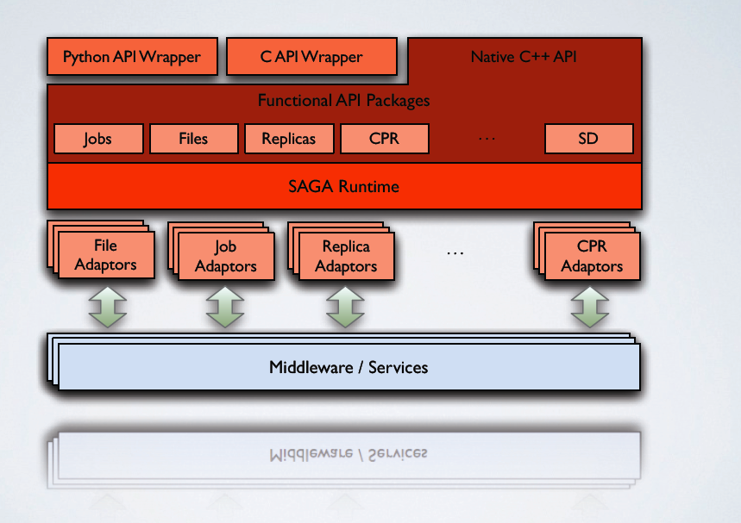
SAGA: In a thousand words

Slide 7
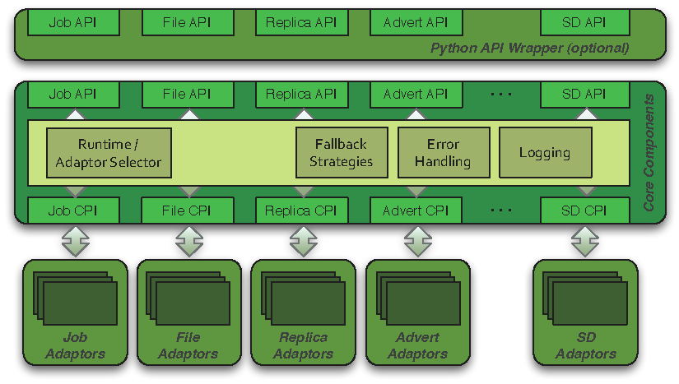
SAGA: Architecture

Slide 8
How is SAGA Used?
SAGA is used to develop applications that are distributed by definition:
Simple extensions of “localized applications” (eg scripting)
MW applications, workers submitted to >8 back-ends
Novel Distributed Programming Models (eg Rep-Exch)
SAGA: Build tools and implement abstractions that enable the execution of applications over distributed resources, without modifying the applications
Eg. Infrastructure Independent Pilot-Jobs
SAGA: To provide uniform access layers to heterogeneous CI
Uniform access to EGI (ARC, gLite, Globus and Unicore/BES)
Simplify the building of tools and Gateways

Slide 9
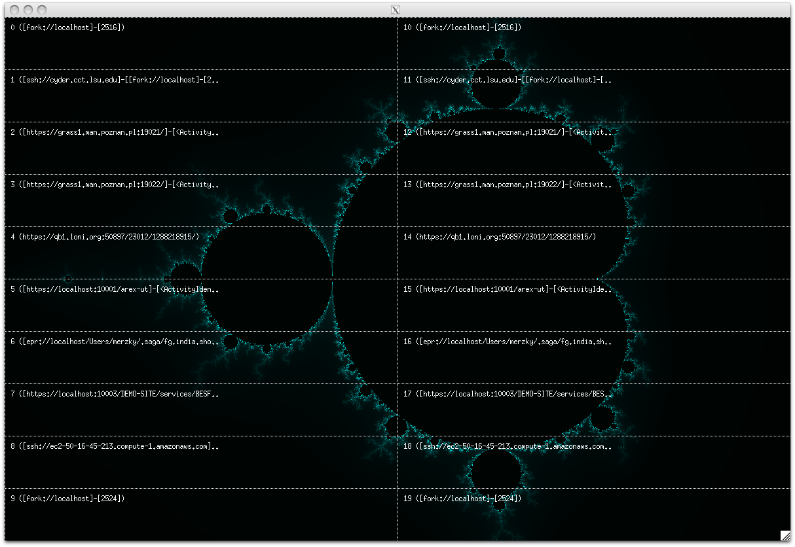
1. Develop applications that are distributed by definition

Slide 10
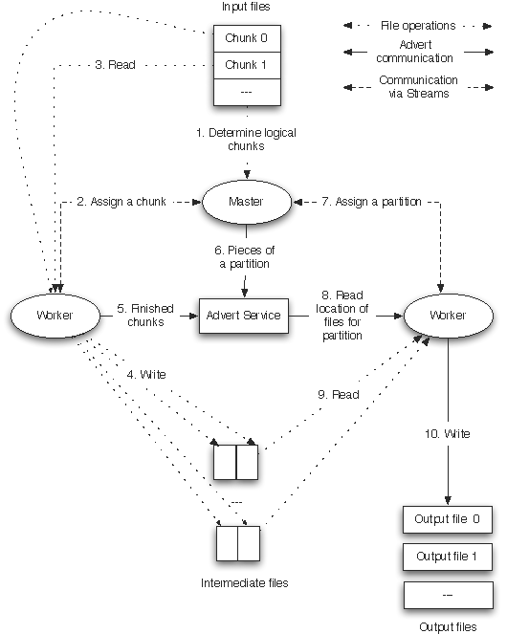
SAGA: Develop applications that are distributed by definition
How to develop a simple MR that is interoperable across infrastructure concurrently?
Same application, same programming model:
Very different performance dependence
Same application, different programming models
Very different performance dependence

Slide 11
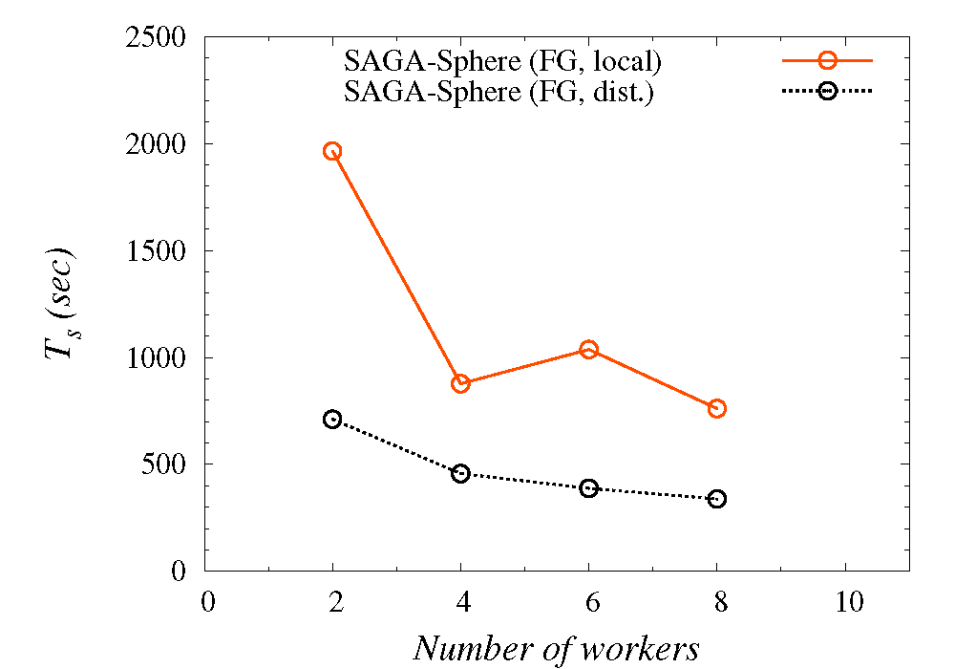
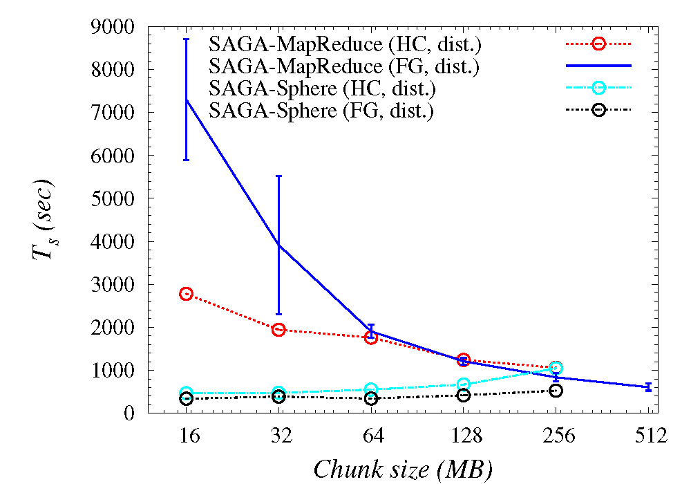
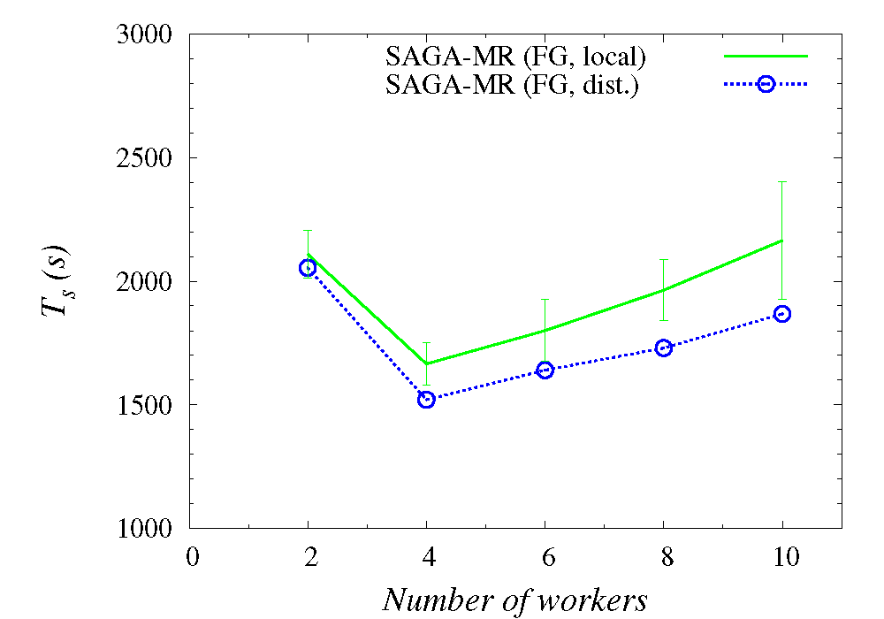
Understanding Distributed Programming Models

Slide 12
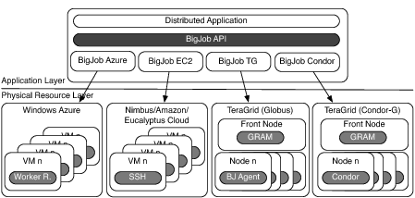
2. Tools for Effective Distributed Execution

Slide 13
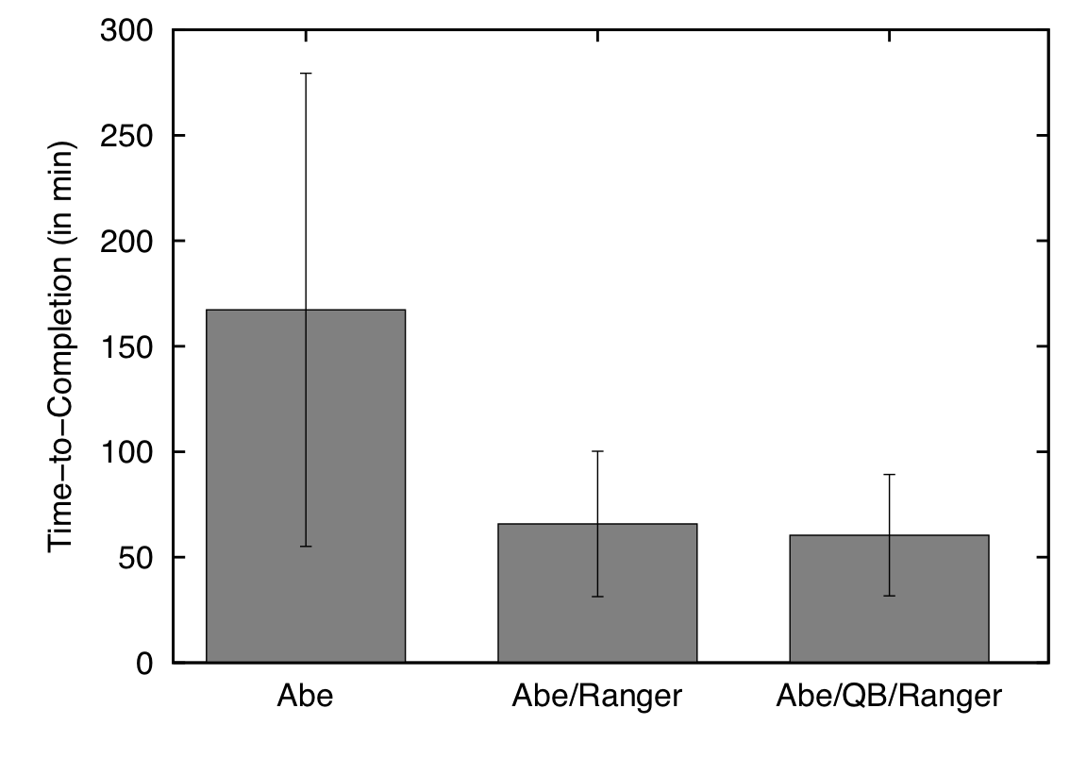
Distributed Adaptive Replica Exchange (DARE) Multiple Pilot-Jobs on the “Distributed” TeraGrid
Ability to dynamically add HPC resources. On TG:
Innovations in Distributed Algorithms:
Variants of RE: Sync (local) vs async (distr.)

Slide 14
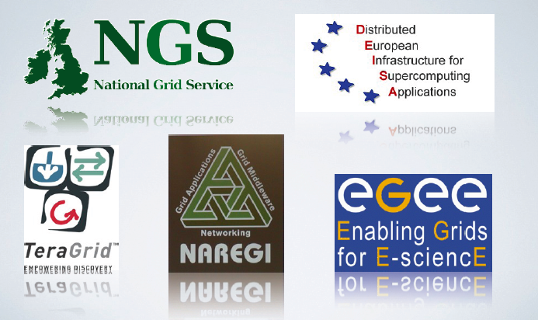
3. Provides uniform access layers to heterogenous CI

Slide 15
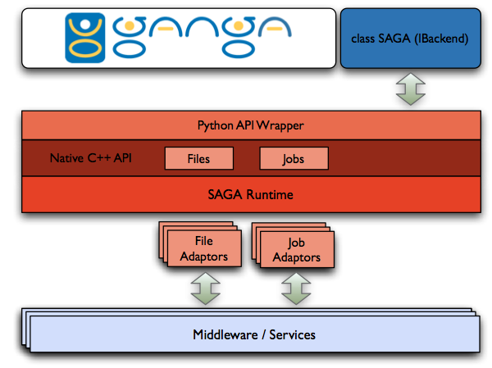
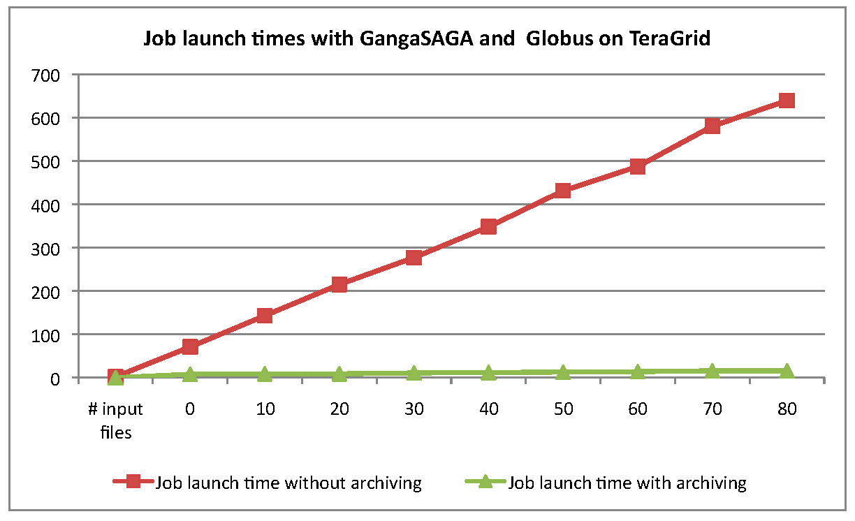
SAGA-GANGA Integration

Slide 16
Java-based Python SAGA wrapper
C Python
Jython
a user application
a user application
Python Bindings for SAGA
SAGA-C++Py
?
JPySAGA
JySAGA
legacy python bind.
Boost wrapper
C++ Bindings for SAGA
Java Bindings for SAGA
SAGA-C++
JSAGA
Java SAGA
Java GAT

Slide 17
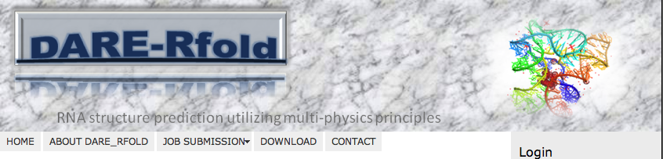
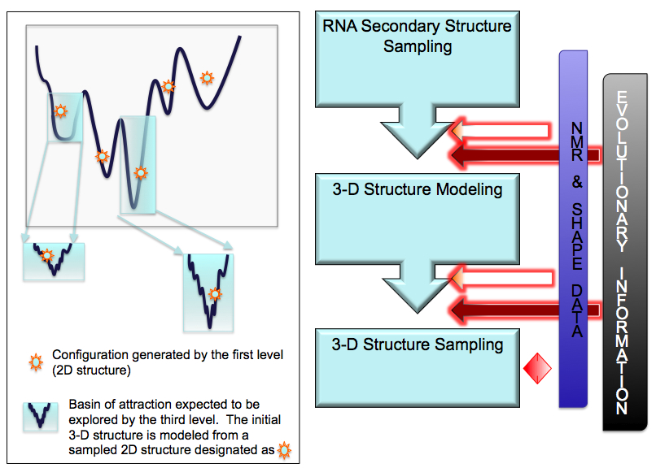
DARE – Gateway for RNA-folding (Joohyun Kim, CyD)
DARE-Gateway:
Integrated, Extensible
Balanced: Scale-Up and Scale-out to
DARE-RFOLD, DOCK, Bioscope (NG Sequence Data), STMD (Molecular Dynamics)

